Slide 1
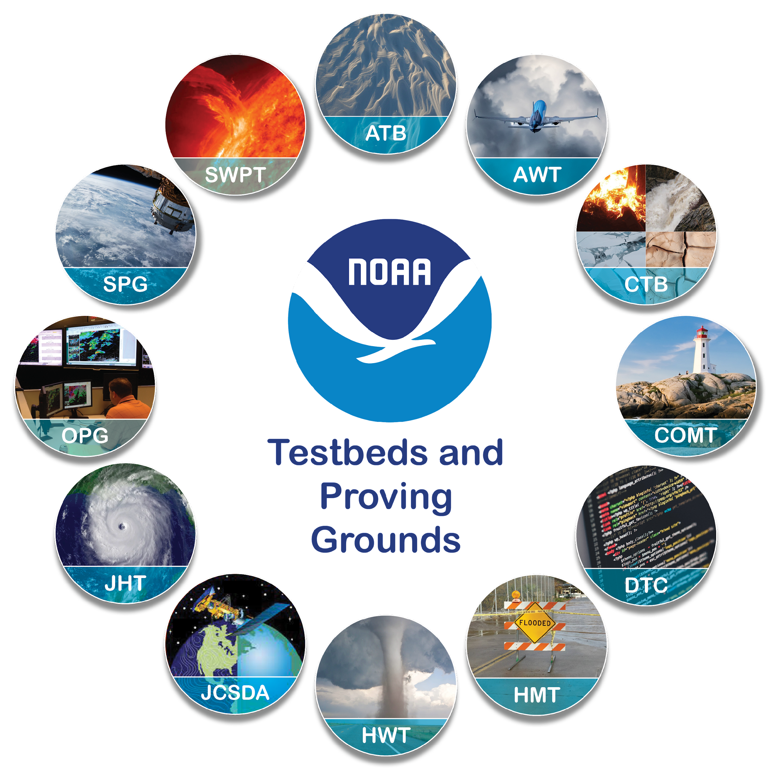
The NOAA Testbeds & Proving Grounds: A Crucible for Transitions between
Research & Operations
Andrea Ray, Chair, TBPG Coordinating Committee (OAR/PSL & HMT)
J.J. Brost, Vice-Chair (NWS/STI/OPG)
Arctic Testbed, Aviation Weather Testbed
Climate Testbed, Coastal & Ocean Modeling Testbed, Developmental Testbed Center
Hazardous Weather Testbed, Hydrometeorology Testbed, Joint Center for Satellite Data Assimilation, Joint Hurricane Testbed/Hurricane Ocean Testbed, Operations Proving Ground
Satellite Proving Ground, Space Weather Testbed
UICFW, July 17, 2023
Notes:
Presentation for the NOAA Booth at AMS, Jan 11,, 2023

Slide 2
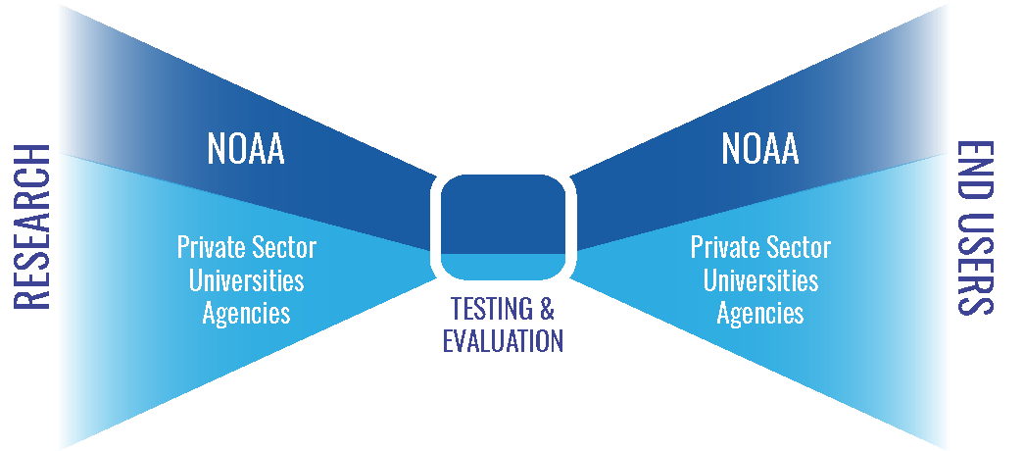
12 Testbeds & Proving Grounds sit at a
critical node in NOAA Research to Operations (R2O)
as well as iteration with research (O2R)
T&E
Notes:
After slide from Readiness Levels workshop, May 2020, presentation by Dr. Gary Matlock; graphic from that presentation
NOAA’s mission: science, service, and stewardship
1. To understand and predict changes in climate, weather, oceans and coasts
2. To share that knowledge and information with others
3. To conserve and manage coastal and marine ecosystems

Slide 3
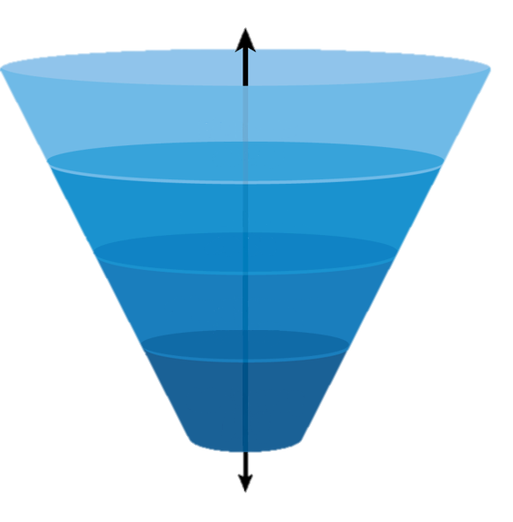
What are NOAA’s Testbeds & Proving Grounds?
TB & PG words are used in other contexts, these are:
Multi-project efforts that are ongoing partnerships between research & operations, aimed at improving or creating new operations & operational products
in NWS, NOS and NESDIS
TBPG’s facilitate the orderly transition of research capabilities to operational implementation through testing and evaluation (T&E)
They are a major facilitator of R2O, moving through “funnel” – and of O2R, operations informing research
Online Portal: Charters & links to the 12 NOAA TB & PGs www.testbeds.noaa.gov
Research
(RL 1-2)
Development
(RL 3-5)
Demonstration
(RL 6-8)
Deployment
(RL 9)
Notes:
https://www.testbeds.noaa.gov/ Most conduct experiments to test
HMT Winter Weather and Flash Flood & Intense Rainfall Expts

Slide 4
What else are they?
Interactive- Crucible - Facilitator
Developers
Forecasters (National center)
Public(s)
Forecasters (WFO)
and like a road trip together, the or carpool lane, there are often discoveries along the way
Notes:
Thanks to J. Correia for the upper left graphic, originally for HMT

Slide 5
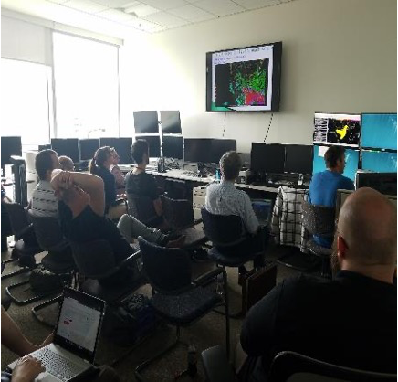
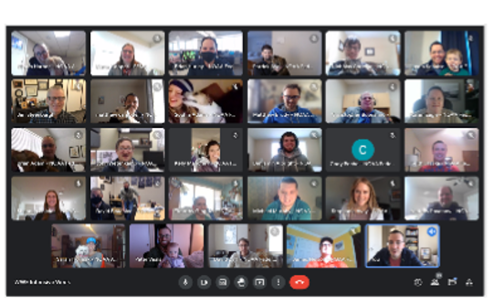
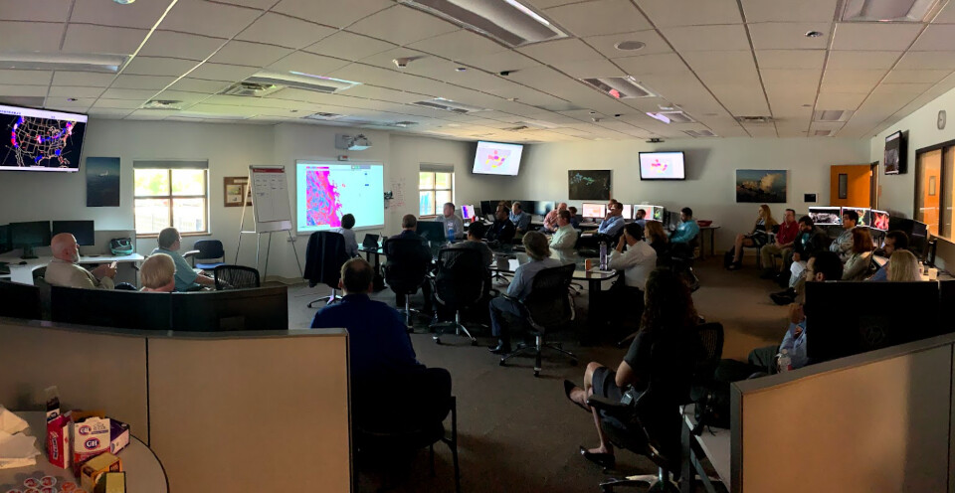
How do they do this?
Most conduct experiments for T&E, e.g.
HMT Winter Weather and Flash Flood & Intense Rainfall Expts
HWT Experimental Forecast & Experimental Warning Programs
Aviation weather experiments with airlines
Operations PG: conducts readiness evaluations of innovations in a realistic environment mirroring WFOs, before formal deployment
and/or extended retrospective tests focused on robust sample sizes and objective verification metrics
A lot of collaboration between TBPGs in particular OPG and SPG with others
Hands-on, even while virtual: WFO & forecasters often involved; and forecast-users like emergency managers, media
Many have training component
Notes:
https://www.testbeds.noaa.gov/ ; develops new Collaborative Forecast ProcessesMany have or developing social science components Most conduct experiments to test
HMT Winter Weather and Flash Flood & Intense Rainfall Expts
others: Arctic TB & PG > NWS Alaska Region
Coastal & Ocean Modeling TB > NOS coastal forecasting
Operations Proving Ground > WFO’s

Slide 6
However, no two are alike
Two are Multi-agency partnerships:
JCSDA: NOAA, NASA, Navy and US Air Force
DTC: NOAA, NCAR and US Air Force
COMT is National Ocean Service, SPG and JCSDA NESDIS
The OAR Weather Program Office runs competitions aimed at four: CTB, HWT, HMT and HOT (formerly JHT); JTTI also funds projects at TBPGs
NWS/STI funds some NWS personnel and specific projects
Most are - the weather TBs in particular - operate on ~<$1M & 1-3 FTEs & soft-funded contractors, including some in-kind from OAR lab & NWS/NCEP center base
Most have SBES (social-behavioral-economic science) aspects, varying ways, e.g.
HWT and HMT have embedded social science staff
AWT works closely with FAA’s Aviation Weather Demonstration & Evaluation Services (AWDE) - Social sciences - user aspect.
Most are using the findings of social science funded separately
Both engaging in and using SBES
Notes:
https://www.testbeds.noaa.gov/ ; develops new Collaborative Forecast ProcessesMany have or developing social science components Most conduct experiments to test
HMT Winter Weather and Flash Flood & Intense Rainfall Expts
others: Arctic TB & PG > NWS Alaska Region
Coastal & Ocean Modeling TB > NOS coastal forecasting
Operations Proving Ground > WFO’s

Slide 7
T&E goes beyond quantitative
Often includes forecasters at National and WFO levels
Increasingly, bringing in external end users, e.g. emergency
managers, broadcasters, transportation managers
Integrating Social, Behavioral and Economic Sciences
results of these inform product development
and qualitative or subjective evaluation methods
Some findings of HWT on benefits of bringing end users in (from Kodi Berry, HWT)
Realism in testing helps identify, address, & mitigate factors that create the “valley of death” in transitioning R2O (Karstens et al. 2018)
Interaction between NWS forecasters and end users enables the generation of useful, usable, and understandable information (Karstens et al. 2018)
End-user engagement to the level of co-production results in a parallel increase in the use of products developed in those projects (Nygren et al. 2018)
Notes:
Thank you Kodi Berry for the findings on benefits; and to Wallace Hoggsett for the photo of HOT

Slide 8
Subjective & qualitative evaluation of RRFS: comments from Hydromet TB 2022 experiment participants
“The RRFSs generally performed similar to the NAM. They both had pros and cons. One thing that stuck out for me was that while the NAM has high rain rates, the RRFSs have even higher rain rates.”
“One bias I generally noticed from the RRFSp1 and p2 was the tendency to over forecast coverage and rainfall maxima pockets for the pulse thunderstorm convection over the Texas/Louisiana/Arkansas Gulf Coast area. Otherwise it handled the northeast CONUS convection and southwest convection fairly well.”
“RRFS seemed to really overdo precip accums, especially in moist air masses like with the tropical system or the southeast.”
“Overall, I thought it was too popcorny and wasn't showing enough more organized thunderstorm clusters.”
“Toward the end of the week, I gained some confidence in relying more on them (RRFSp#s) for guidance in my forecasting.”
“Most of the time the smaller clusters of convection were drier/smaller in area than the MRMS verification, but the overall max on the grid seemed high/wetter.”
“The RRFS models tended to show heavy precipitation totals over a larger areal extent than was observed.”
“I am a bit sketchy on my memory, but I seem to recall being impressed by all of the RRFS runs.”
Another role & benefit: Introduce innovations to forecasters at national & WFO levels
Notes:
From Trojniak 2022 AMS talk
General feedback - wet biased, storms seem to be more isolated than clustered, but overall impressed with the RRFSp’s
differing from other years we are seeing the potential in the RRFS but still seeing some issues

Slide 9
Recent examples of R2O related to UFS
Hurricane and Ocean TB (HOT)
Coastal and Ocean Modeling TB (COMT)
Developmental Testbed Center (DTC)
Satellite Proving Ground (SPG)
Hydrometeorological TB (HMT)
Climate TB (CTB)
…and their NOAA and external collaborators

Slide 10
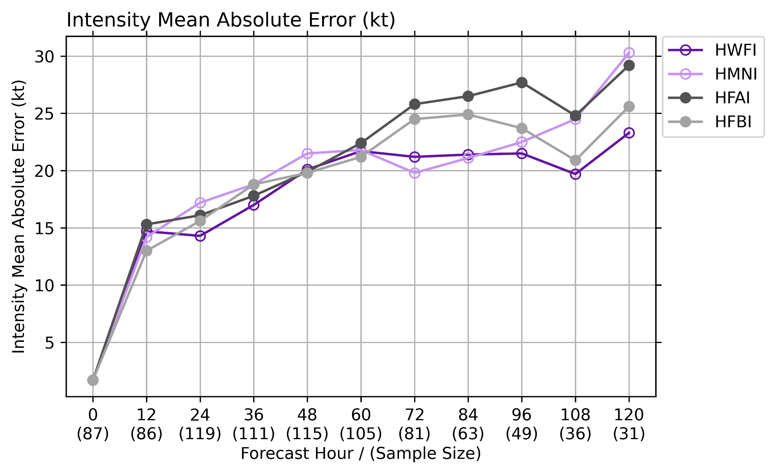
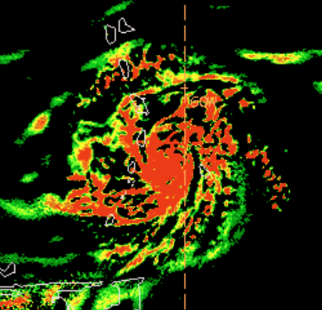
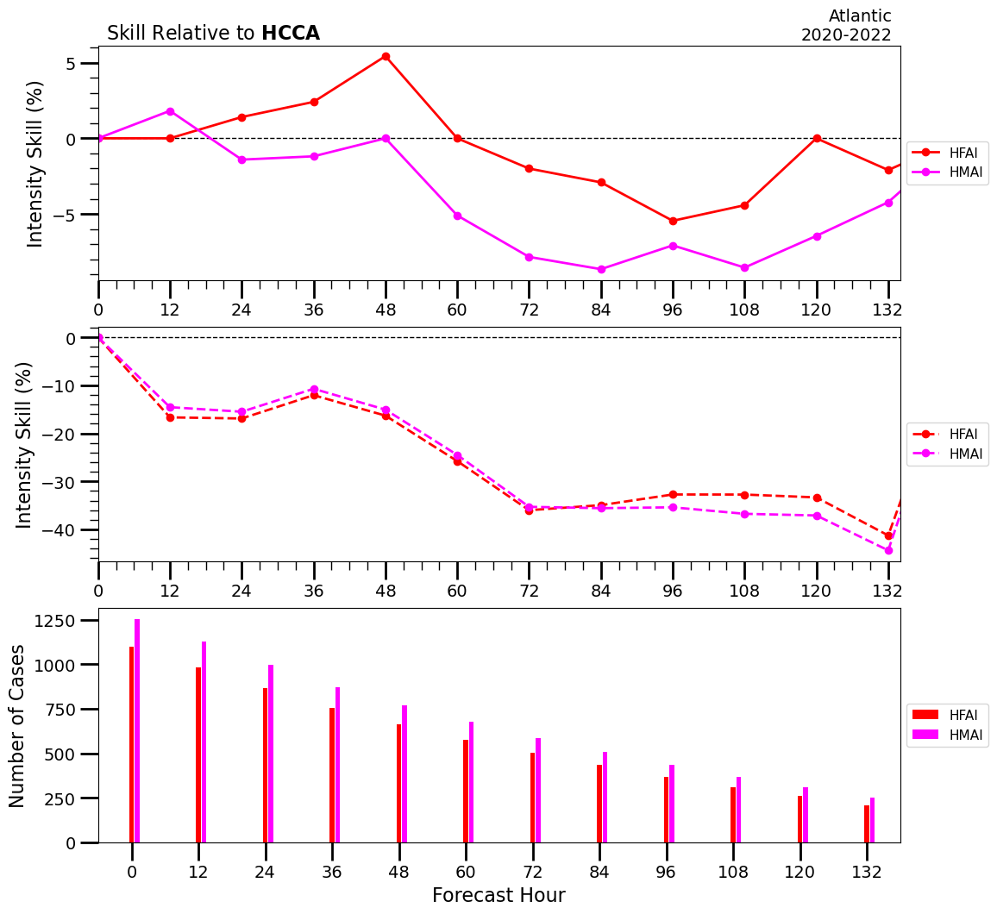
Hurricane & Ocean Testbed (HOT):
Role in the Operational HAFS Evaluation
In advance of the operational HAFS implementation, the HOT team worked with Natl Hurricane Ctr staff and the NOAA Environmental Modeling Center (EMC) to:
Acquire a 3-year sample of retrospective forecasts
Gather critical metrics from operational forecasters
Track, intensity, structure, rapid intensification, etc.
Perform thorough verification and assess the impact of HAFS on downstream multi-model statistical guidance
Implement upgrades to the NHC model suite on WCOSS
Test the ingest and configuration of HAFS data in Cloud AWIPS system to prepare for operational transition
**Jon Martinez’ talk Tuesday of UIFCW23 described this process!

Slide 11
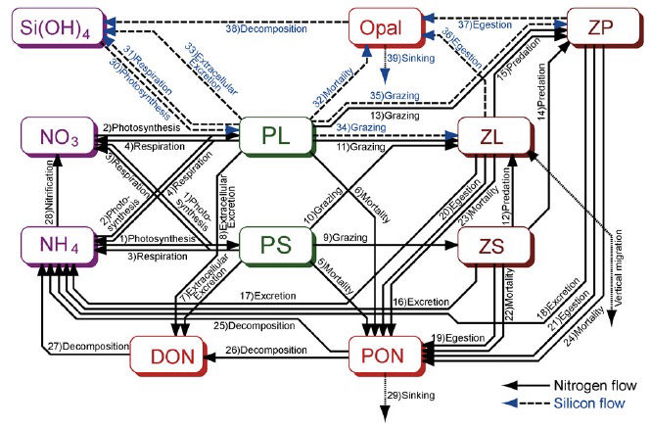
COMT: Improving DA algorithms for U.S. West & East coastal ocean forecast systems
Multi-resolution and mixed precision ROMS 4D-Var
• faster … more resolution - down to 4km
Time- and space-averaged observation operators- maximize information content
• represent time-average data (e.g., low-passed HF-radar) and conventional altimetry with geophysical corrections (de-tide and DAC) to emphasize ocean mesoscalef
Ecosystem/BGC modeling with WCOFS
• better physics … better bio: UCSantaCruz version of ROMS-NEMURO coupled BioGeoChem model
ROMS 4D-Var sandbox
• community crowd sourced development
Transition activities (make it relevant)
• e.g. Stakeholder workshop – prioritize opportunities for follow-on products & capacity building and training on use of ROMS 4D-Var using Cloud Sandbox
Biogeochemical model run in WCOFS domain w/
initial/boundary conditions from operational WCOFS
Notes:
Motivated by attributes of the JPSS VIIRS fire radiative power (FRP) product and NWS recognized the FRP could improve smoke forecasts with higher spatial resolution to address smoke forecast deficiencies in complex terrains.
Stakeholders include US Forest Service National Interagency Fire Center, WFO IMETs

Slide 12
Developmental Testbed Center:
Supporting R2O in UFS
Software framework
Developed community workflow for SRW App
Transitioned to EPIC
Continuing to contribute verification aspects
Develop/support Common Community Physics Package (CCPP)
Adopted by UFS
Flexibility supported operational implementation of 2 HAFS configurations in 2023
Develop/support advanced Model Evaluation Tools (METplus)
Selected as verification system for UFS
Testing and Evaluation
RRFS
Critical feedback to the development team through an agile testing framework
Tests informing ensemble design
HAFS
Integral part of testing team focused on v1 implementation
Physics
Support UFS R2O physics team by applying aspects of Hierarchical System Development approach
Feedback to developers on issues with schemes
Support decisions to include innovations in GFS proto-types

Slide 13
Satellite Proving Ground & NWS transition major innovation: HRRR-Smoke
Societal impacts of smoke include:
Human health – both near fire and distant; Aircraft operations; Fire Operations; Transportation – Amtrak & highways; Recreational & school sports; Visual
“Users overwhelmingly need higher resolution meteorological model fields in complex terrain and the tools and input data to understand fire behavior and smoke dispersion.” (2011 OFCM, 4.1.a.)
Motivated by new parameters available from JPSS VIIRS, SPG organized a Fire and Smoke Initiative to address this need, including NWS scientists and forecasters, OAR Global Systems Lab, NESDIS and key stakeholders
“Orange sky” smoke event, San Francisco Bay area, September 9, 2020
Notes:
Motivated by attributes of the JPSS VIIRS fire radiative power (FRP) product and NWS recognized the FRP could improve smoke forecasts with higher spatial resolution to address smoke forecast deficiencies in complex terrains.
Stakeholders include US Forest Service National Interagency Fire Center, WFO IMETs

Slide 14
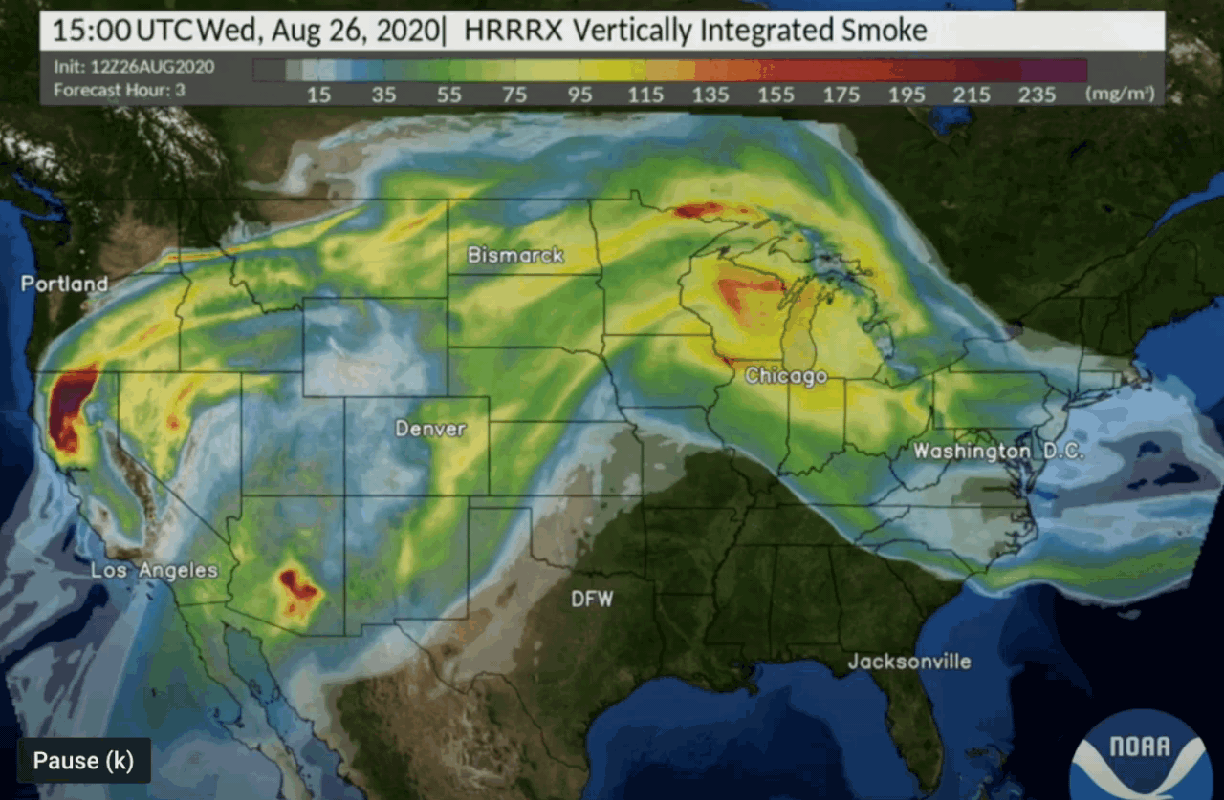
NOAA HRRR-Smoke Nowcasting/Forecasting
SPG worked with NOAA/NWS and NOAA Research Global Systems Lab to develop and test a HRRR-Smoke Model in which smoke and weather are fully interactive
HRRR Smoke is a combo of HRRR model upgraded with aerosols and improved Fire Radiative Power (FRP) capability from JPSS VIIRS
Uses high resolution satellite obs of fires (location & intensity)
WFO and Public acceptance very high - animations are a huge selling point!
36 hour 3km animations
HRRR-Smoke Forecast
https://rapidrefresh.noaa.gov/hrrr/HRRRsmoke
Notes:
Good example of the value of sat obs based on their impact on modeling/forecasting
JPSS VIIRS = Visible Infrared Imaging Radiometer Suite (VIIRS)

Slide 15
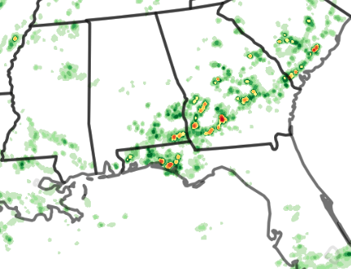
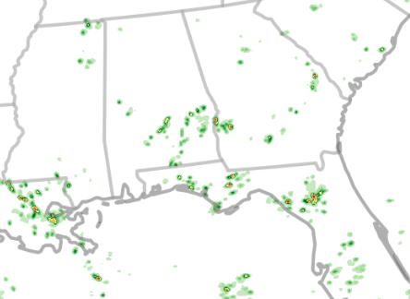
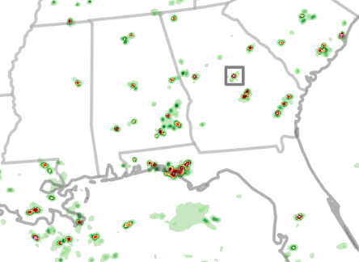
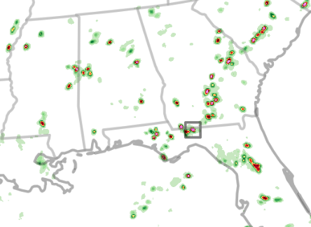
HMT eval of storms in the RRFSp#
MRMS
1h QPE
HRRR
1h QPF
Popcorn observed, but not >5”/hr
LAM
1h QPF
RRFS1
1h QPF
6.01”
9.14”
21z 15 July 2021
Thanks to S.Trojniak, AMS 2023 presentation
Notes:
Thanks to Sarah Trojniak, AMS 2023 presentation
MRMS max is in convective cell in AZ - 4.2
HRRR max in northeastern KS as part of heavy rain event in KS/MO developing - 3.52
LAM - nearly every cell has >1.75”
RRFS1 - nearly every cell has >3”

Slide 16
Changes in UFS inspired by HMT
Flash Flood & Intense Rainfall Expt
Recommended UFS modifications to alleviate the precip rates:
Microphysics adjustments
Divergence damping nord2 -> nord3 (ramifications on MCSs?)
Energy conservation
We requested to add hourly max precip rate to understand this further
Situation has improved (Still seeing sporadic HM rates up to 130”/hr)
Hourly maximum has proven to be a decent diagnostic for detection of subhourly issues.
Thanks to J. Correia, HMT EPIC presentation
Notes:
Also – from HWT Accomplishment of UFS R2O project: “HWT + FFaIR testbeds & feedback for RRFS and 3DRTMA”

Slide 17
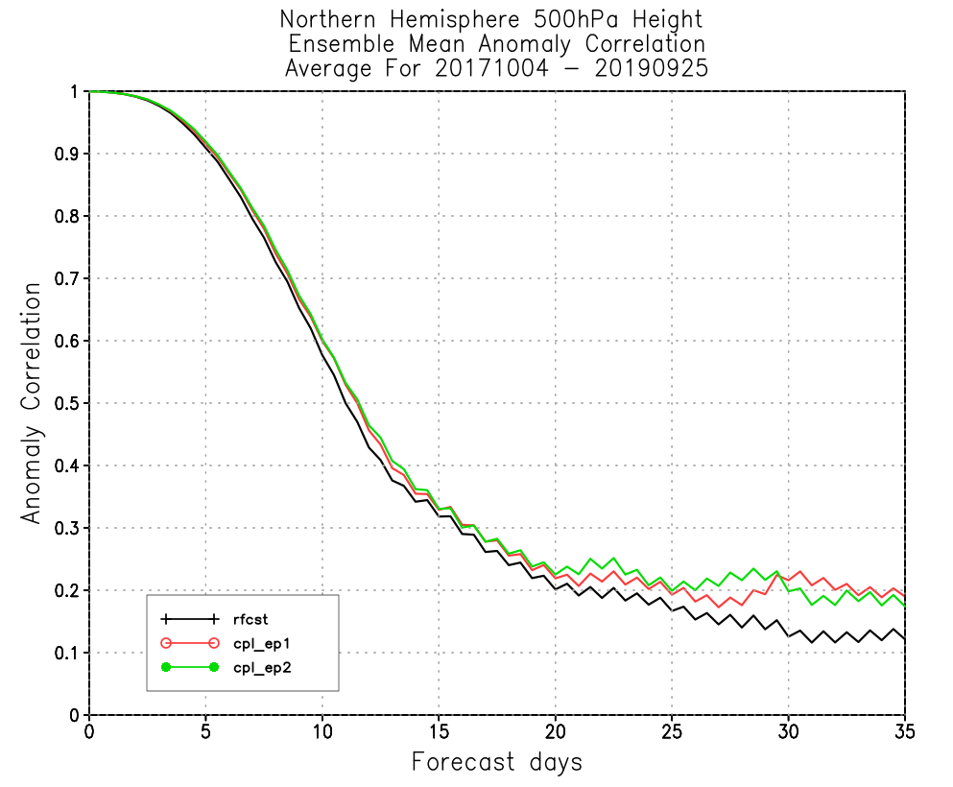
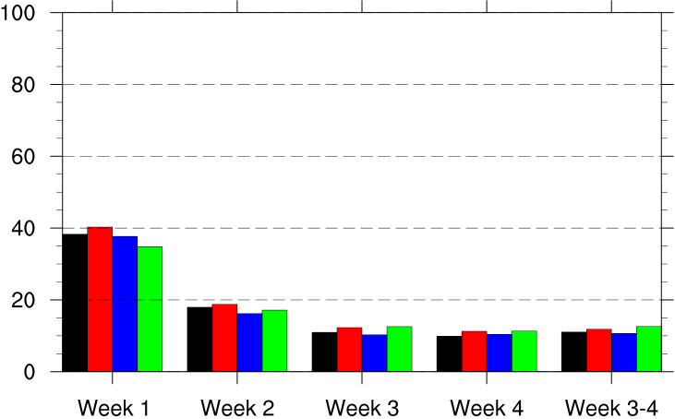
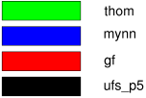
Climate TB Supporting UFS Development
OAR/WPO funded projects with development directly targeting UFS improvements
Swapping out physics schemes in UFS prototypes. Thompson was tested, evaluated well, and is being implemented in NCEPs GEFSv13/GFSv17 (left)
Making the prototypes into Ensembles (EP1, EP2, EP3). Ensembling strategy worked out by CTB is being used for GEFSv13 (right)
Thanks to M. Rosencranz, CTB
Notes:
The two projects:
Ben Green (PI) and Vijay Tallapragada - Swapping out physics schemes in UFS prototypes (most work done with P3 and P5, some with P7, then contractor turnover and funding lapse hit before P8 was finalized. Thompson was tested, evaluated well, and is being implemented in NCEPs GEFSv13/GFSv17.
Xin-Zhong Liand (PI) and Yuejian Zhu - Making the prototypes into Ensembles (EP1, EP2, EP3). Ensembling strategy worked out in this project is being used for GEFSv13.

Slide 18
NOAA TBPG Coordinating Committee
A venue for coordination, collaboration, synergies &
learning among individual TB/PGs
Identify opportunities for collaboration
Network for addressing common issues and opportunities
Annual & monthly meetings
Subcommittee of the NOAA Line Office Transition
Manager Committee (LOTMC)
Online Portal includes Charters & links to the TB & PGs https://www.testbeds.noaa.gov/
Notes:
https://www.testbeds.noaa.gov/

Slide 19
Funding opportunities for engaging in R2O2R
NOAA Weather Program Office
JTTI (POC: Chandra Kondragunta - chandra.kondragunta@noaa.gov): Next NOAA Internal competition in FY25 and Notice of Funding Opportunity (external) in FY26.
Testbeds (POC: Jordan Dale - jordan.dale@noaa.gov):
NOFO expected in August for Climate Testbed and Fire Weather
FY25 competition anticipated, will include priorities for FWT, HMT, HOT, HWT
EPIC (POC: Maoyi Huang - maoyi.huang@noaa.gov)
NWS OSTI
CSTAR (POC: Christopher Hedge - christopher.hedge@noaa.gov)
HFIP/NGGPS (POC: Kevin Garrett - kevin.garrett@noaa.gov): Expecting Notice of Funding Opportunity (external) in FY24. Information to be posted on the OSTI-Modeling site.
COMET Partners (POC: Peter Roohr - peter.roohr@noaa.gov
Testbed programs
DTC Visitor Program (POC: Eric Gilleland - ericg@ucar.edu)
Offer opportunities for both PIs and graduate students
See https://dtcenter.org/visitor-program for more information
Coastal & Ocean Modeling TB (COMT) - NOFO tracey.fanara@noaa.gov

Slide 20
In closing
Most TBPGs already have activities supporting UFS development or UFS-based products & are willing partners
Only a few examples here
Have capabilities that can directly support/benefit UFS
Robust T&E processes already being used for UFS
Access to forecasters and other users who can provide meaningful feedback to UFS development at different stages for different hazard scenarios
Engaged with SBES - both implementing findings and generating SBES science
Probabilistic products are a major focus
Work with us - start talking to us early so we know your schedule for innovations needing T&E, so we can get activities on calendars, and talk with our funders about your priorities

Slide 21
Thank you
https://testbeds.noaa.gov
Andrea Ray (Chair, OAR/PSL & HMT)
J.J. Brost (Vice-Chair, NWS/STI/OPG)
For the TBPG community: Kodi Berry (OAR/NSSL & HWT), Michele Cash (NWS/SWPC & SWTB), Jordan Dale (OAR/WPO), Tracy Fanara (NOS/IOOS & COMT), Mitch Goldberg (NESDIS & SPG), Satya Kalluri (NESDIS), Patrick Marsh (NWS/SPC & HMT), Gene Petrescu & Rebecca Mazur (NWS/Alaska Region & ATB),
Louisa Nance (NCAR/RAL & DTC), Jim Nelson (NWS/WPC), Matt Rosencrans, (NWS/CPC & CTB), Joshua Scheck (NWS/AWC & AWT), Peter Stone (NOS), Jim Yoe (NCEP & JCSDA), Wallace Hogsett (NWS/NHC, JHT/HOP), & our support staff: Abby Arnold (Exec. Sec, FedWriters, Inc. & Katie Geddes, Groundswell, both supporting OAR/ORTA)
Presentation at the UICFW, July 17, 2023

Slide 22
EXTRAS and other examples
Notes:
this prompted an idea that TBPGs are more a carpool lane than an express lane – with all the collaboration and interaction of a getting in a car for a road trip!

Slide 23
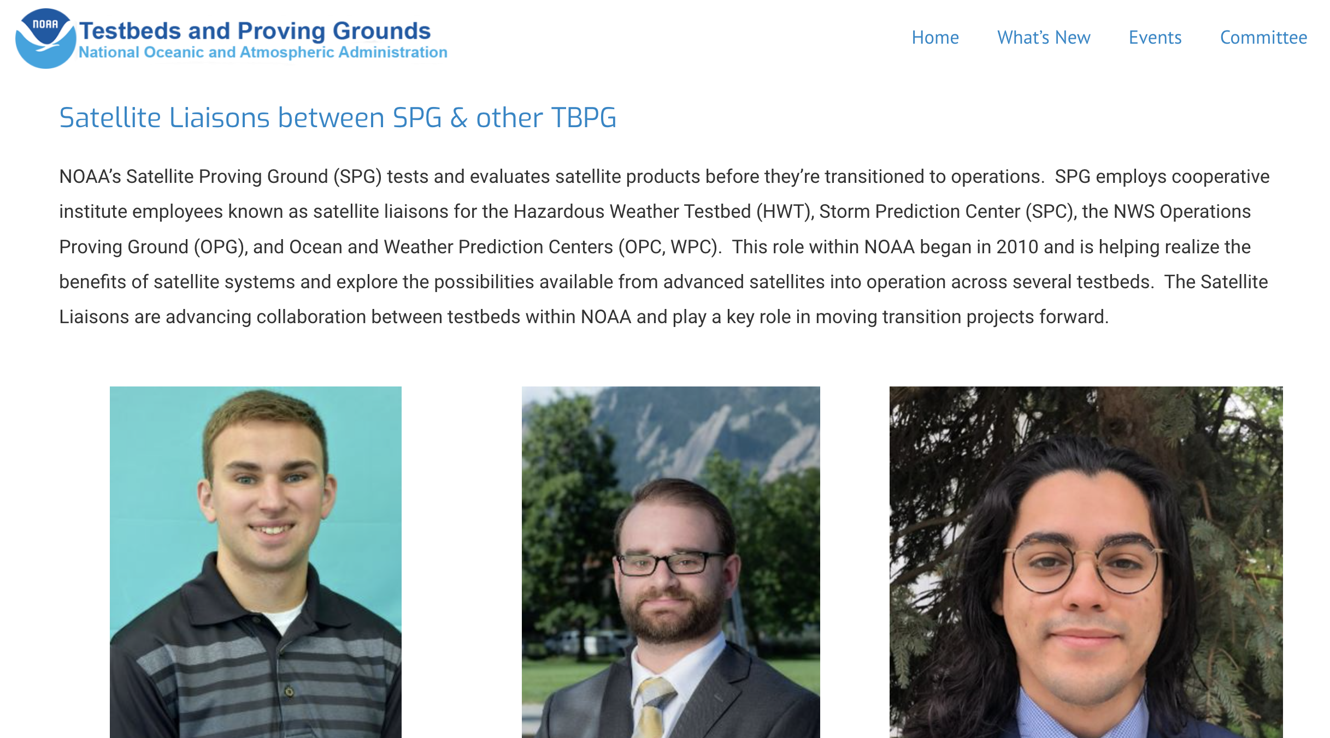
Website: testbeds.noaa.gov
News stories
Notes:
https://www.testbeds.noaa.gov/ Most conduct experiments to test
HMT Winter Weather and Flash Flood & Intense Rainfall Expts
Comment on “user needs” –most are working with already determined needs; although many are refining those through work with WFO’s and EM’s

Slide 24
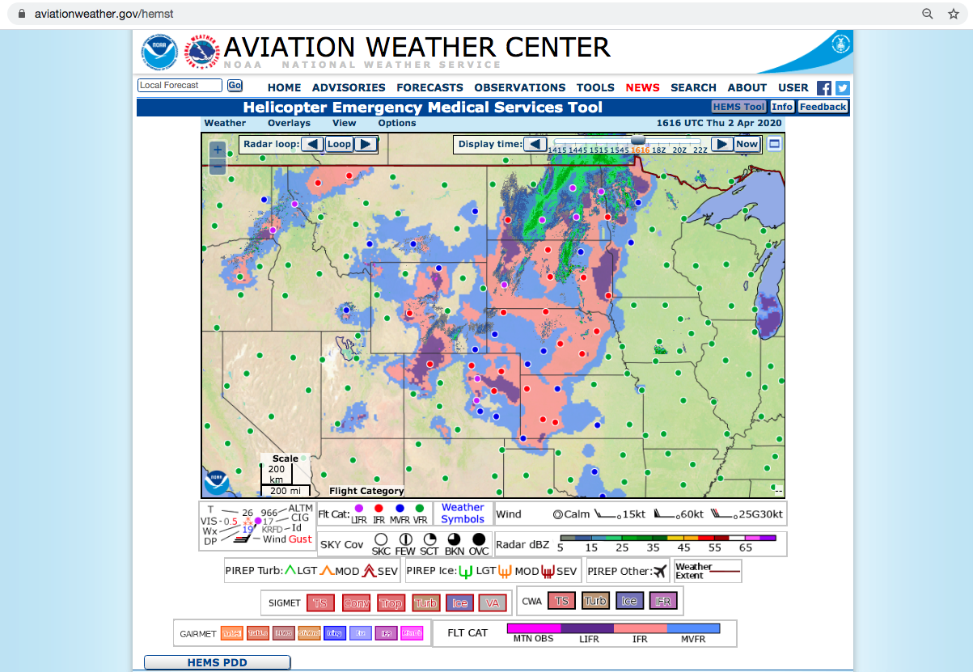
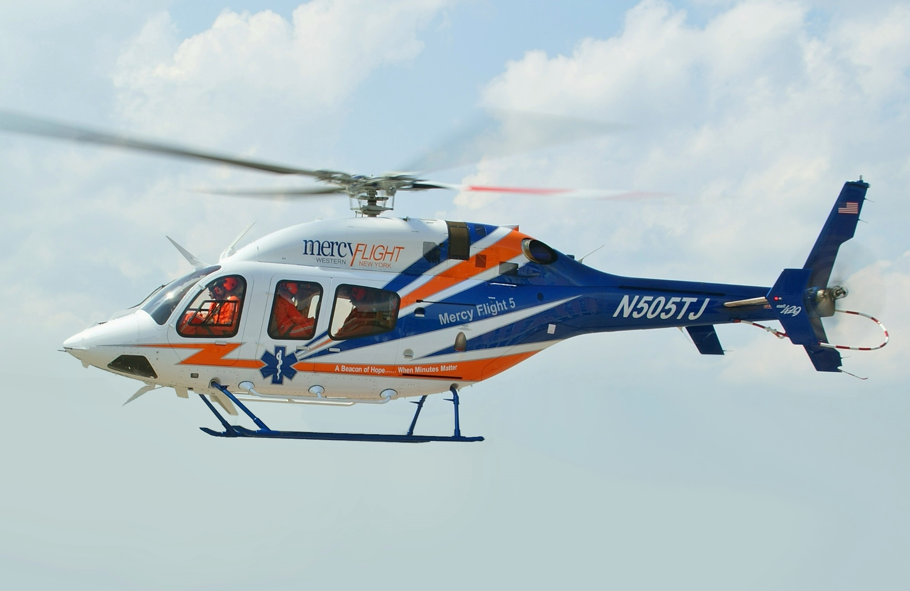
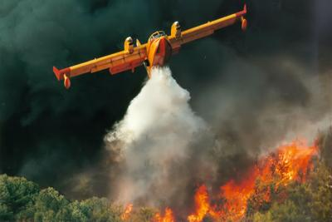
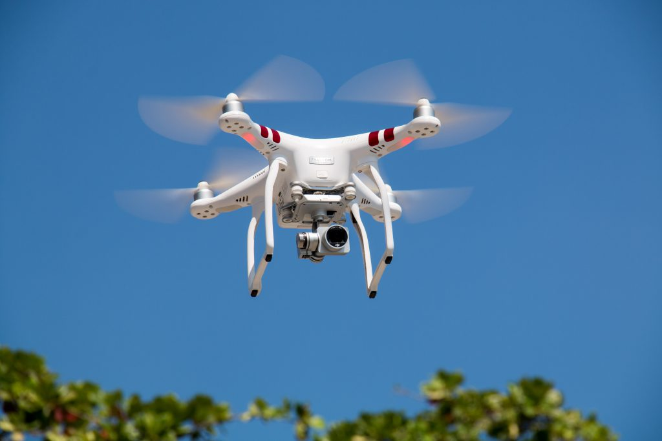
Aviation Weather Testbed: Evolving the Helicopter Emergency Medical Services Tool
HEMS is a web interface that shows weather conditions for short-distance & low-altitude flights that are common for the Helicopter Emergency Medical Services (HEMS) community. Also supports other low level fliers: airtankers for firefighting, cropdusters, balloons, drones
Cloud ceiling and surface visibility (C&V) and other parameters presented for non-weather experts quickly and effectively
Existing one-off product was going out of service, needed new 24-7 product in WCOSS framework, reduced O&M costs
Federal Aviation Administration requirement
AviationWeather.gov/hemst
Notes:
WCOSS is composed of primary and backup operational supercomputing systems, storage resources, wide area network, support services, and developmental computing systems.
earlier system “being antiquated” — HEMS operators are extremely sensitive to changing and/or adverse weather conditions and need weather information presented for non-weather experts quickly and effectively. To meet this need, the interactive tools were adapted to display high resolution grids of critical weather parameters, particularly cloud ceiling and surface visibility. Using a highly interactive and intuitive tool that focuses on small, localized regions, HEMS operators gain critical weather awareness to make all their flights safe for crews and patients.

Slide 25
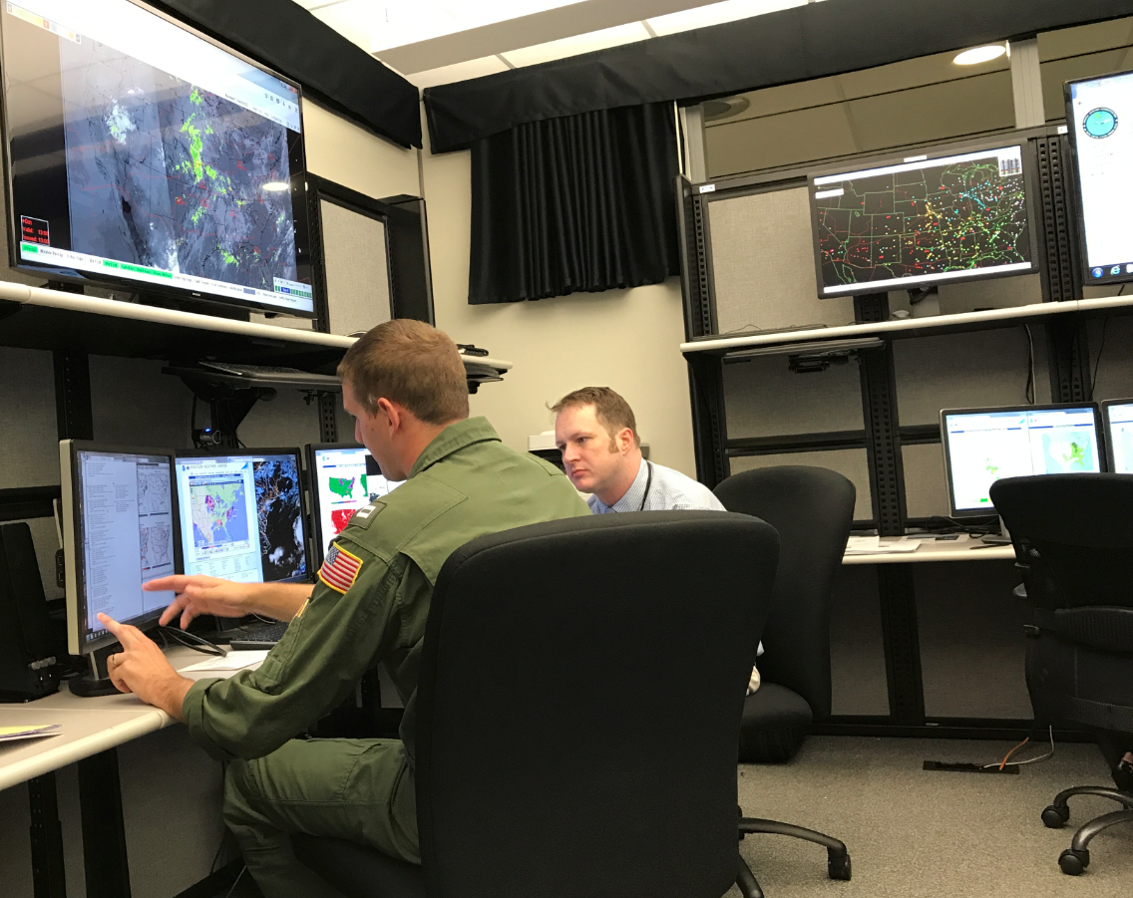
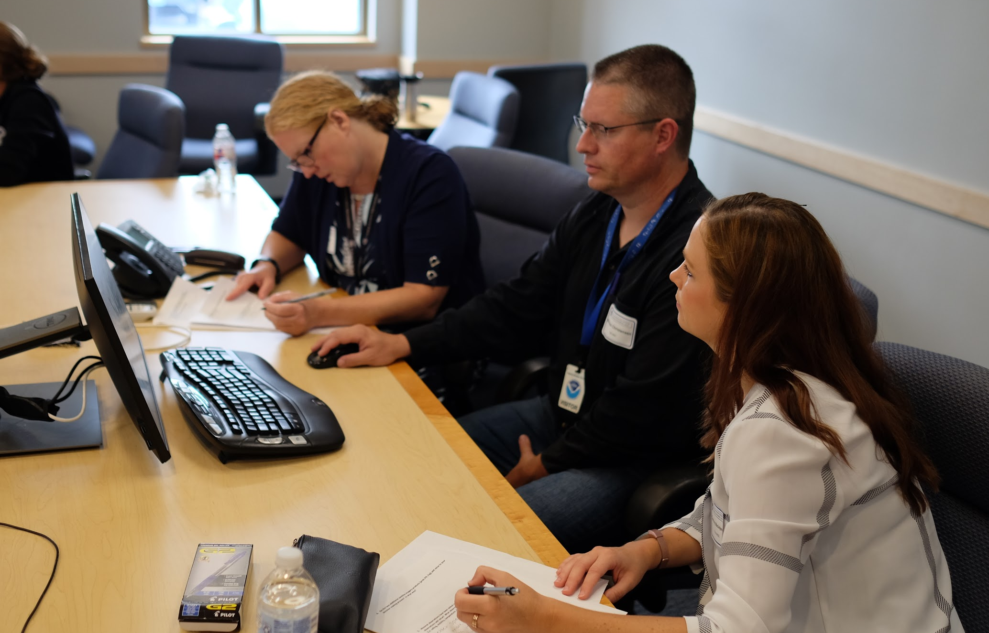
AWT & Helicopter Emergency Service (HEMS) Tool Improvements
NOAA’s Environmental Modeling Center (EMC) & Model Development Laboratory (MDL) developed experimental analyses for evaluation as replacement
AWT worked with OAR/Global Systems Lab (GSL) to do quantitative assessment of Ceiling & Visibility analysis
FAA’s Aviation Weather Research Program (AWRP) funded assessment & some development work
FAA’s Aviation Weather Demonstration and Evaluation Services (AWDE) - Social sciences - user aspect.
Improved user interface features include a Time slider & Configurations menu
New product had to pass FAA’s Safety Risk Management Panel - it did! Risk of misinterpretation of the tool was actually downgraded from previous version
AWDE held interviews with pilots and key users of the HEMS tool to gain feedback both
in the testbed and in their research lab
Notes:
Risk was downgraded from “3C” - Remote Likelihood and Major Severity to “3D” - Extremely Remote Likelihood and Major Severity
OAR/Global Systems Lab (GSL) Quality Assessment Team

Slide 26
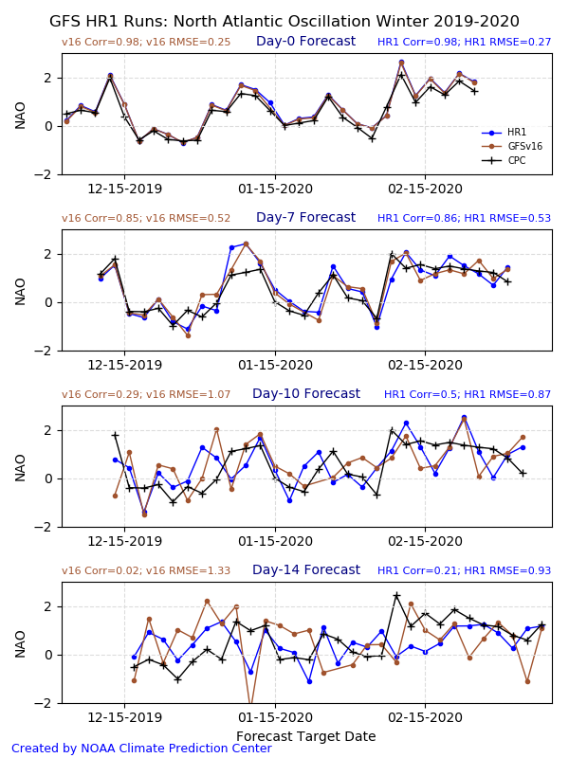
CPC Supporting UFS
Development (draft slide)
CPC is involved in the development of UFS-MRW/S2S
Evaluation of prototypes
Evaluation of retrospectives
Structure of reforecast/real-time delivery
Evaluation of reforecasts for final science review/approval at NCEP.
Notes:
Our eval of the HR1 retrospectives.
I have other figures if you want.

Slide 27
Focus Groups with forecasters: an HMT WWE Activity
Development of a DSS tool that provides a 0 - 100% probability that roads are subfreezing. (ProbSR; Reeves et al. JTTI)
Development of a Travel Component to WSSI
Based on 1h HRRR data
3 WSSI components
Snow amount (since initialization)
Snow rate (hourly)
Ice accumulation (since initialization)
Feedback on ensemble visualization & tools (Radford & Lackman; Paper in preparation)
Notes:
Feedback on ensemble visualization & tools (Radford & Lackman; Paper in preparation)

Slide 28
Funding
From a number of sources varies among TBPG
NWS Science and Technology Integration Office (STI) and NOAA/OAR Weather Program Office (WPO)
Competitive grants/Coop agreements support PIs on projects to be evaluated in TBs
STI – funds some NWS personnel and TB Milestones for ATPG, AWT, JHT, OPG, HWT, HMT, FWTB
WPO funds infrastructure for their
NESDIS GOES-R and POES satellite programs
also funds satellite liaison positions at HWT, JHT/HOT, WPC
COMT, Space Wx TB and some others run their own competitions.

Slide 29
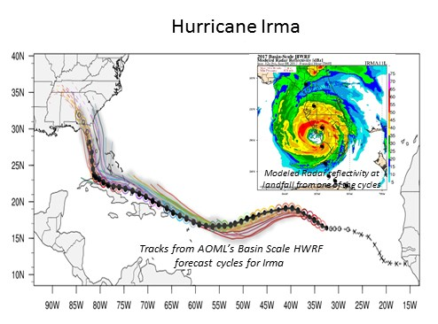
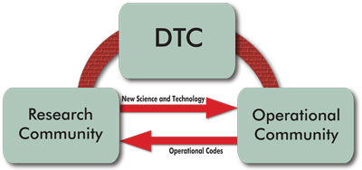
Developmental Testbed Center & Innovations to HWRF
The Hurricane Weather Research & Forecast system (HWRF) is NOAA’s operational hurricane forecasting model. It continues to be refined and improved in collaboration with agency and university researchers.
The Developmental Testbed Center has facilitated the transition of innovations into the HWRF through sustained focus over a number of years.
HWRF forecast plume 3-km resolution regional model
Iterative testing & evaluation of innovations by DTC staff in collaboration with researchers external innovations on one side, and by NOAA EMC which implements HWRF – example of bundling innovations on next slide
Notes:
Say this: HWRF Originally developed by NWS Environmental Modeling Center (EMC), in collaboration with NOAA GFDL, NOAA AOML, and the University of Rhode Island,
Nance: experience has shown us that sometimes innovations need to be bundled to produce improvement - so instead of including Iacono/Henderson in this block - perhaps the RRTMG and partial cloudiness bundle would make more sense to call out since RRTMG by itself did not do the trick
Nance: Fovell performed diagnostics that brought to light a problem with current scheme and some case studies using RRTMG showed that it would fix the deficiency - RRTMG was already available in the WRF framework, which enabled the testing. But more robust testing showed that simply replacing the operational radiation scheme with RRTMG led to degradations in track and intensity skill - more diagnostics demonstrated need for partial cloudiness scheme which then the DTC engaged a model developer at NCAR to implement - bundle of RRTMG and partial cloudiness led to improvements in track and intensity forecasts.
“One way of bringing in innovations into HWRF is the DTC, is a visitor program….”

Slide 30
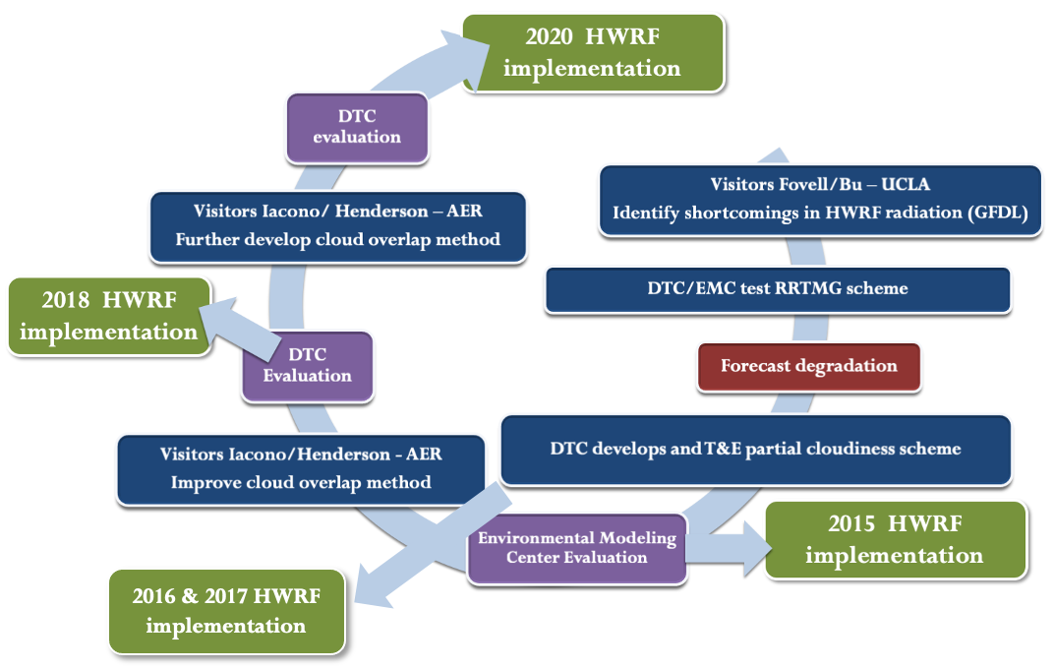
DTC’s iterative testing & evaluation led to
solving radiation code issue in HWRF
Problem identified at DTC with radiation in the operational HWRF,
Case studies using RRTMG showed that it would fix the deficiency
However - replacing with RRTMG led to degradations in track and intensity skill
DTC engaged a model developer at NCAR to implement a bundle of RRTMG and partial cloudiness that led to improvements in track and intensity
DTC efforts have contributed to steady improvement of hurricane forecasting. Success strategies:
Dedicated funding to support R2O & sustained focus through multi-year efforts of iterative diagnostics and evaluation
Engagement with model developers from universities, NOAA & the private sector
Communicating timelines to meet annual implementation cycle at EMC
Notes:
I’m going to walk you thru this graphic to illustrate how DTC facilitates innovations . SAY: HWRF is updated annually, on a timeline established to implement accepted innovations ahead of the hurricane season
Rapid Radiative Transfer Model for GCMs (RRTMG) scheme

Slide 31
from JJ Brost
We exist - and we have capabilities that can directly support/benefit UFS 2. We have access to a lot of forecasters (users) who can provide meaningful feedback to the UFS group at different stages of development for different hazard scenarios (often times leveraging cloud technology to increase sample size) 3. You really should be using us more formally. Start talking to us early so we can get projects set on calendars.

