Slide 1

Welcome to the
Unifying Innovations in Forecasting Capabilities Workshop
September 8, 2025
A Unified Forecast System (UFS) Collaboration Powered by the Earth Prediction Innovation Center (EPIC)
Center Green Auditorium, Boulder, CO

Slide 2
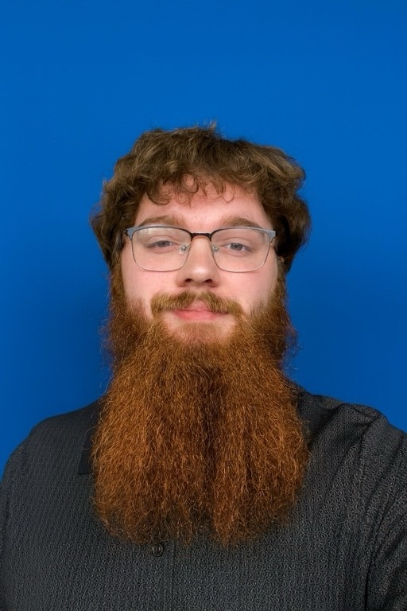
Today’s Master of Ceremonies
Joshua Kublnick
EPIC User Support Scrum Master
NOAA/OAR/WPO/EPIC

Slide 3
Live Streaming Announcement
The UIFCW is an open event that will be live-streamed online and recorded. By staying in the room (and online), you understand that your image, in video or still, and any sound recorded alongside it, will live-streamed over social media and recorded. The videos will be submitted to NOAA for review before sharing publicly. The information that you provide will be used for websites, agenda's, and event descriptions.
For more information on NOAA's Privacy policy: https://www.noaa.gov/sites/default/files/legacy/document/2021/Mar/NOAAPrivacyPolicy_Final_May2017.pdf

Slide 4
Monday, September 8th
11:00 AM – 12:30 PM – Virtual Poster Session
01:00 PM – 04:00 PM – Training #1: Using Container (Singularity Image File) to
Compile and Run UFS Global-Workflow on Variety of
Platforms (Rm 2126)
Training #2: Artificial Intelligence in Weather Modeling
Training (North Bay Auditorium)
04:00 PM – Adjourn
05:00 PM – Hike with Alison Gregory

Slide 5
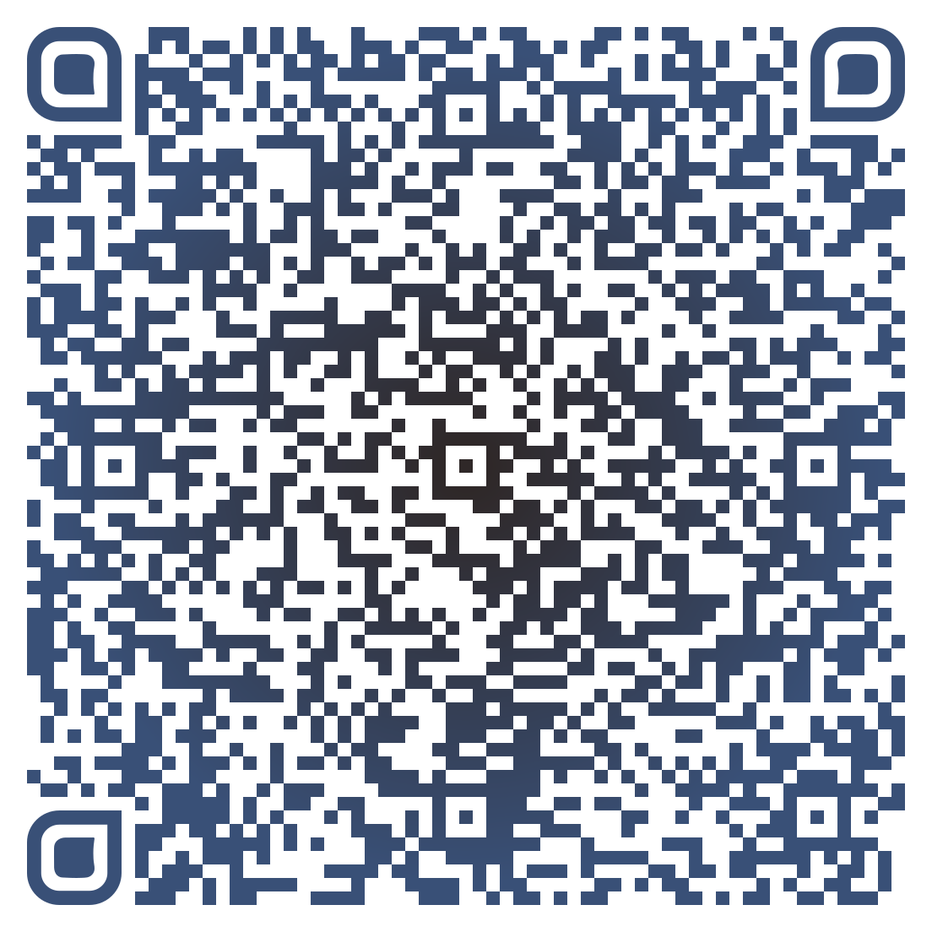



Connect With Us!
Participant Guide
Connect with us on Slido, X, and Instagram
Access Slido & the Livestream from the UIFCW Event Page:
@NOAAEPIC
#UIFCW25
Wi-Fi: UCAR Visitor
No password is required.

