Slide 1
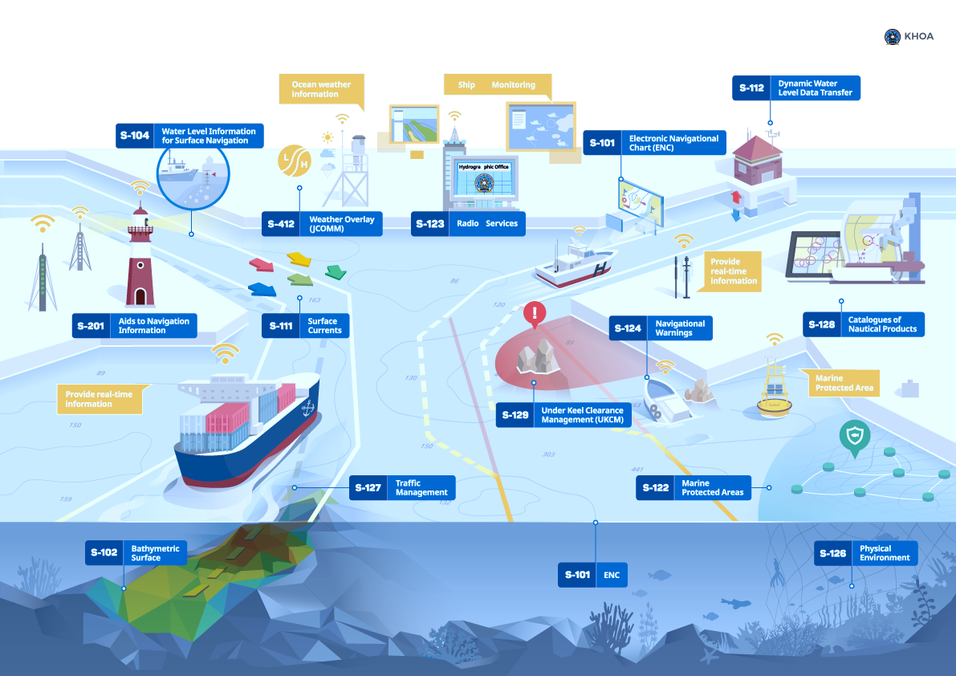
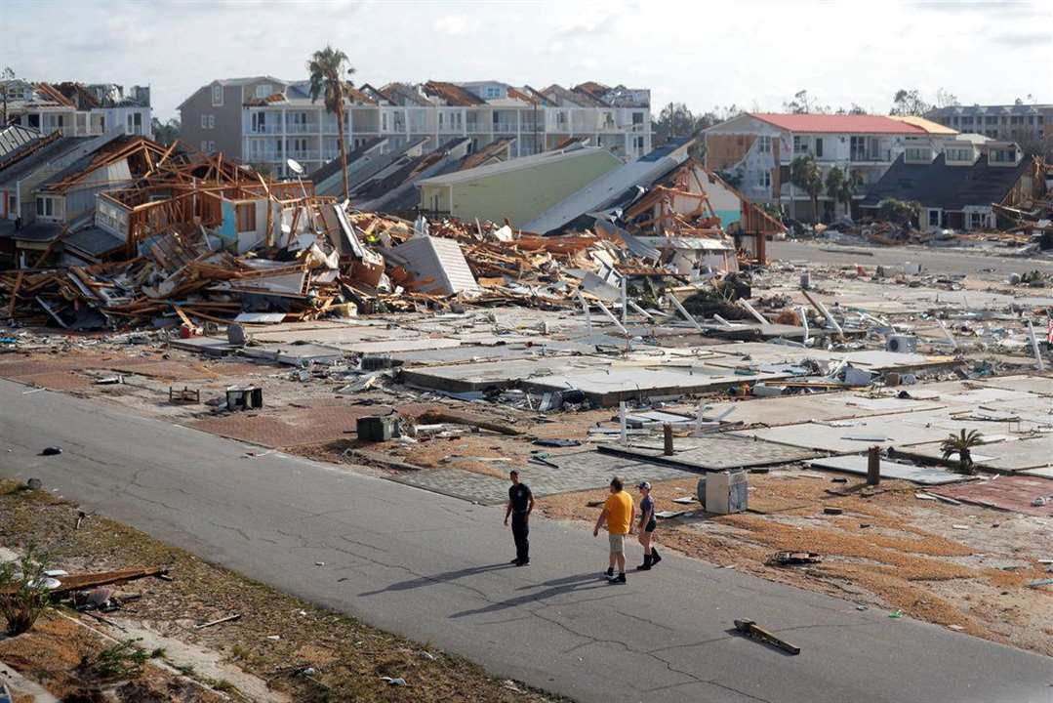
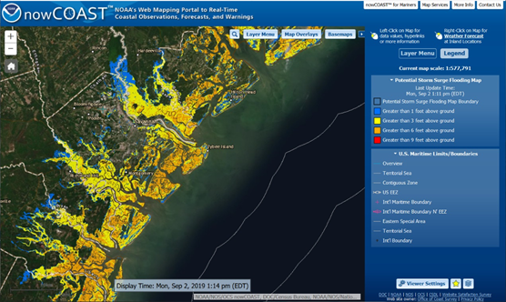
NOAA Unified Forecast System Coastal Applications Team (UFS CAT) Model Evaluation
Marine Navigation
Risk Reduction
Total Water Level
Schematic illustration of S-1XX and S-4XX layers (IHO.int)
Aftermath of Hurricane Michael in Mexico Beach, FL. (AP Photo/Gerald Herbert)
NWS Potential Storm Surge Flooding Map for Hurricane Dorian (NowCOAST - 9/2/2019)
Presenter: Ayumi Fujisaki-Manome, CIGLR at University of Michigan

Slide 2
Team Members
Academia
Ayumi Fujisaki-Manome (U. of Mich./CIGLR)
John Kelley (U. New Hampshire, formally NOAA/NOS)
Olivia Doty (U. of Mich./CIGLR)
Kayo Ide (University of Maryland, College Park)
Brendan Gramp (University of Maryland, College Park)
Eric Anderson (Colorado School of Mines)
Kaitlin Huelse (Colorado School of Mines)
Yonggang Liu (University of South Florida)
Sebin John (University of South Florida)
Emanuele Di Lorenzo (Brown University)
Kyungmin Park (Georgia Tech University)
Spenser Wipperfurth (Georgia Tech University)
Natalia Sannikova (University of Hawaii)
Cigdem Akan (University of North Florida)
Timothy Cockerill (NSF/TACC)
Andres Tejada (University of South Florida)
Cuong Sieu San (University of South Florida)
Saeed Memari (Colorado School of Mines)
Haibo Xu (University of South Florida)
Federal
Greg Seroka (NOAA/NOS/OCS)
Fred Ogden (NOAA/NWS/OWP)
Tracy Fanara (formally at NOAA/NOS/IOOS)
Edward Myers (NOAA/NOS/OCS)
Saeed Moghimi (NOAA/NOS/OCS)
Vasily Titov (NOAA/OAR/PMEL)
Yong Wei (NOAA/OAR/PMEL)
Wei Wu (NOAA/NOS/OCS)
Carolyn Lindley (NOAA/NOS/CO-OPS)
Cristina Forbes (USCG-SAR)
Jesse Feyen (NOAA/OAR/GLERL)
Joe Sienkiewicz (formally at NOAA/NWS/NCEP/OPC)
Shachak Pe’eri (NOAA/NOS/NGS)
(Bold: WG Co-Lead. Italic Bold: CAT Co-Lead)
We sincerely thank ….
The NOAA NOS Water Team for funding support .
Dr. Changsheng Chen from University of Massachusetts – Dartmouth
Dr. Joseph Zhang from Virginia Institute of Marine Sciences (William and Mary)
Texas Advanced Computing Center (TACC) for support for computational resources

Slide 3
UFS Coastal Applications Team - Background
The Unified Forecast System (UFS) Coastal Applications Team (CAT) is part of a larger development within NOAA that includes federal and academic partners to review NOAA needs and consolidate them into individual modeling systems (i.e., global and regional atmosphere, ocean, land, etc.) using a smaller set of coupled Earth System models that would continue to serve its various stakeholders.
Marine Navigation
Risk Reduction
Total Water Level
Schematic illustration of S-1XX and S-4XX layers (IHO.int)
Aftermath of Hurricane Michael in Mexico Beach, FL. (AP Photo/Gerald Herbert)
NWS Potential Storm Surge Flooding Map for Hurricane Dorian (NowCOAST - 9/2019)

Slide 4
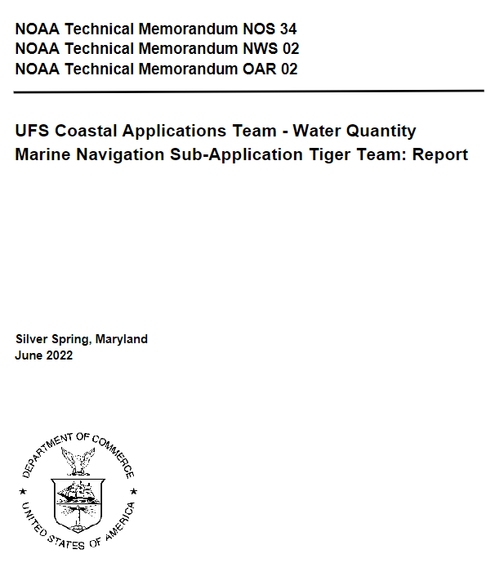
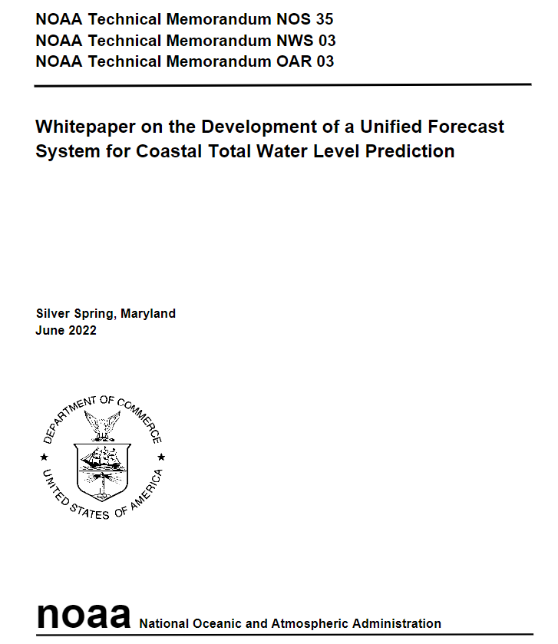
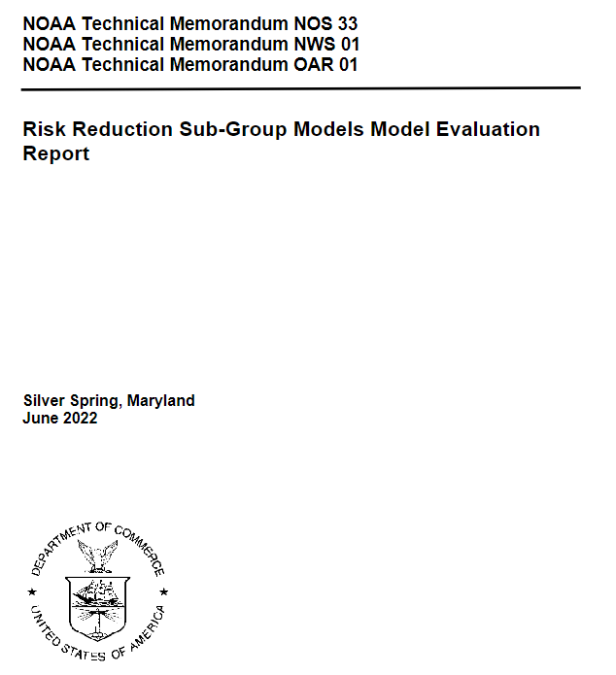
Phase 1 - Gathering Requirements (early in 2022)
The UFS Coastal Applications Team (CAT) requested all three working groups (sub-application teams) to generate consensus guidelines (i.e., metrics, criteria, and competing numerical oceanographic models) for a model evaluation.
Marine Navigation
Total Water Level
Risk Reduction

Slide 5
Phase 2 - Model Evaluation (October 2022 - ongoing)
The team decided to further pursue the Marine Navigation sub-application and conduct a model evaluation. Based on Phase 1 outcomes, two ocean models were selected for Phase 2 evaluation: FVCOM and SCHISM (two unstructured hydrodynamic models).
9 tester groups from academia & government.
Hindcast Periods: Three months, not including warm-up period.
July 1 - September 30, 2021: includes hurricanes (Elsa, Henri, Ida)
January 1 - March 31, 2022: includes Nor’easters (Jan 14-17; Jan 28-29)
Round 1: Evaluation in the 2D tide only mode (Depth averaged). Only tidal components were evaluated.
Round 2: Evaluation in the 3D mode (vertically layered), and models are coupled (one-way forcing) with atmospheric models (GFS/HRRR).
Round 3: Same as Round 2, and include wave processes (WAVEWATCH III). Use UFS-Coastal Infrastructure
Round 4: Same as Round 3, and include National Water Model outputs.

Slide 6
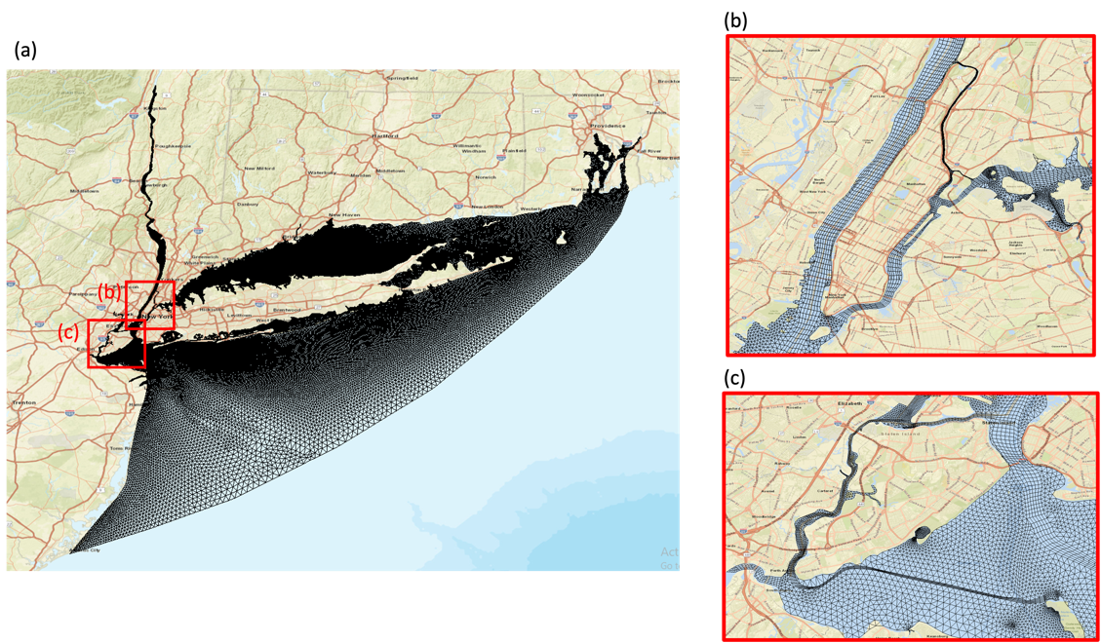
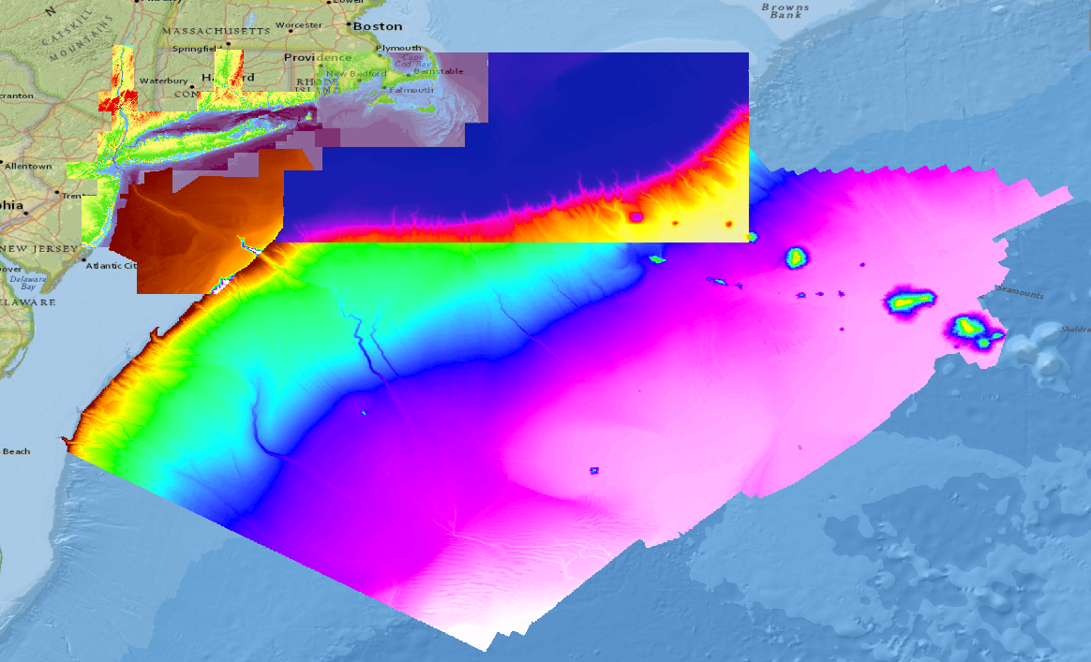
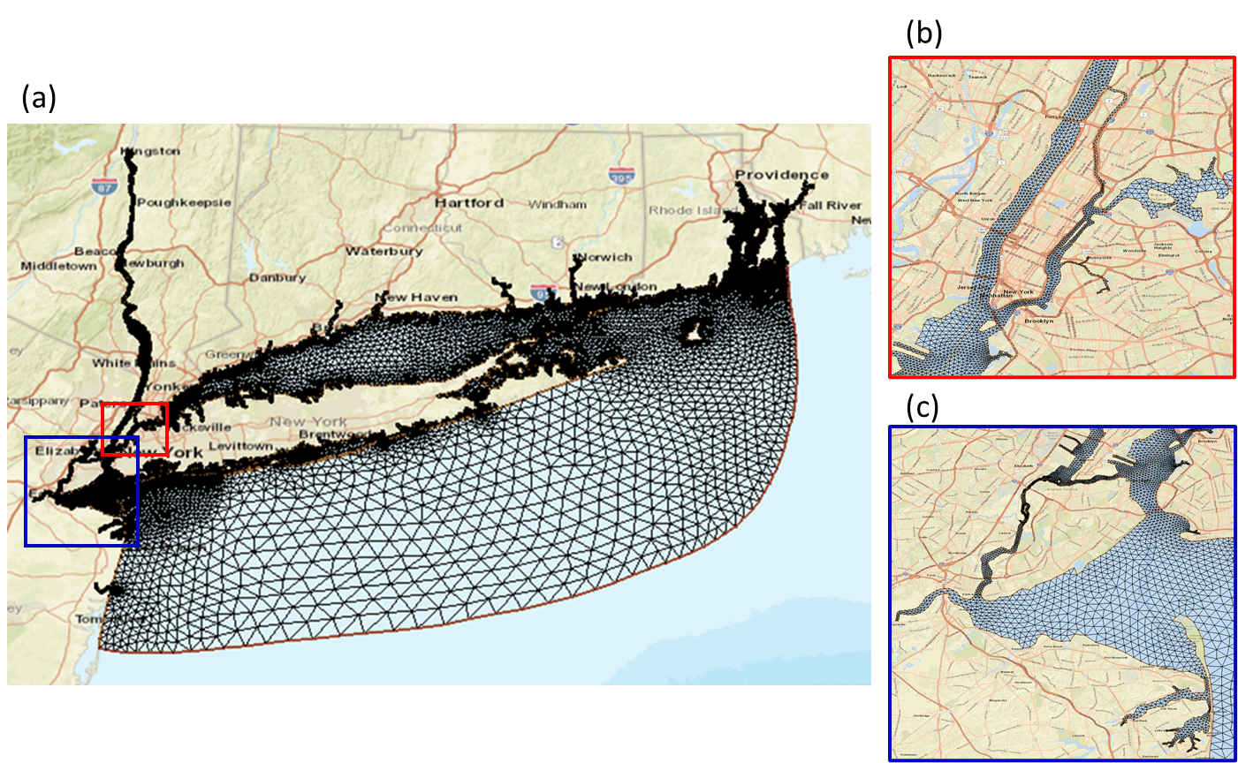
Study Site (New York Harbor)
Mesh generation: Use provided bathymetry, geographic polygon for mesh generation. Resolve small riverine areas at ~10 m horizontal resolution.
8 m
SCHISM Mesh
4 m
16 m
32 m
100 m
Available bathymetry datasets at the study site (NY Harbor/Raritan Bay) and offshore for model evaluation
FVCOM Mesh

Slide 7
Outcomes - Training the Next Gen Coastal Ocean Modelers
Successes
  “Grad Student Test”: Total of 9 postdocs and graduate students and their advisors were exposed to 1) coastal circulation models used by NOS; 2) NOAA’s operational and marine navigation user requirements; 3) NOS’ model development and implementation approach; and 4) various observational platforms and skill assessment approaches.
Lessons learned
  Sustained collaboration and regular communications.
  Each tester had own ‘baseline’ as a starting point for running other model configurations, allowing flexibility and learning by the trial and error method.
  All information in NOS National Bathymetric Source, not just depths but also source and uncertainties, should be used.
Challenges
  The baseline approach made it difficult for a tester to discuss their particular model issue(s) and to obtain troubleshooting help from other testers. Testers were encouraged to follow guidelines to allow for sharing knowledge and lessons learned among the testers while still providing flexibility and trial and error learning.
Notes:
One lesson was that sustained collaboration and regular communications among the testers and with model developers and NOAA development and operations teams led to more rapid progress for each tester than working in isolation.
A second lesson was having each tester configure their own ‘baseline’ mesh and simulation to serve as a starting point for running other model configurations (i.e. different atmospheric forcing, air-sea flux formulations, etc.). This approach provided flexibility to the testers and allowed testers to learn by the trial and error method (i.e. learning by making mistakes until a successful solution is found).
A third lesson was that all information in NOS National Bathymetric Source (NBS, Rice et al., 2023), not just depths but also source and uncertainties, should be used in preparing models’ bathymetry. The NOS NBS Team has implemented a validated process to generate the best available Digital Elevation Model (DEM) which should reduce uncertainties in the entire DEM and ocean modeling development and testing process.

Slide 8
Outcomes - Evaluation of Potential Coastal Ocean Models
Successes
  Performance assessed for the two ocean models as potential candidates for the coastal ocean model component of the UFS.
  Testers evaluated the ability of the two models to predict the conditions according to NOS standards, for the two hindcast periods.
Lessons learned
  Need to balance the requirement to generate accurate high resolution hindcasts vs. practical computational constraints (e.g., NOAA’s operational HPC environment).
  Advanced testers contributed code to the UFS-Coastal coupled infrastructure, expanding the number of atmospheric variables in coupling NUOPC caps and merging code into the UFS-Coastal git repository.
  Need for NOS to continue its development of open source skill assessment software not only for surface ocean but also for subsurface and spatially.
  Need for local knowledge to understand model vs. observation differences and digitized bathymetry vs. bathymetry collected by an acoustic system.
Notes:
One lesson was that sustained collaboration and regular communications among the testers and with model developers and NOAA development and operations teams led to more rapid progress for each tester than working in isolation.
A second lesson was having each tester configure their own ‘baseline’ mesh and simulation to serve as a starting point for running other model configurations (i.e. different atmospheric forcing, air-sea flux formulations, etc.). This approach provided flexibility to the testers and allowed testers to learn by the trial and error method (i.e. learning by making mistakes until a successful solution is found).
A third lesson was that all information in NOS National Bathymetric Source (NBS, Rice et al., 2023), not just depths but also source and uncertainties, should be used in preparing models’ bathymetry. The NOS NBS Team has implemented a validated process to generate the best available Digital Elevation Model (DEM) which should reduce uncertainties in the entire DEM and ocean modeling development and testing process.

Slide 9
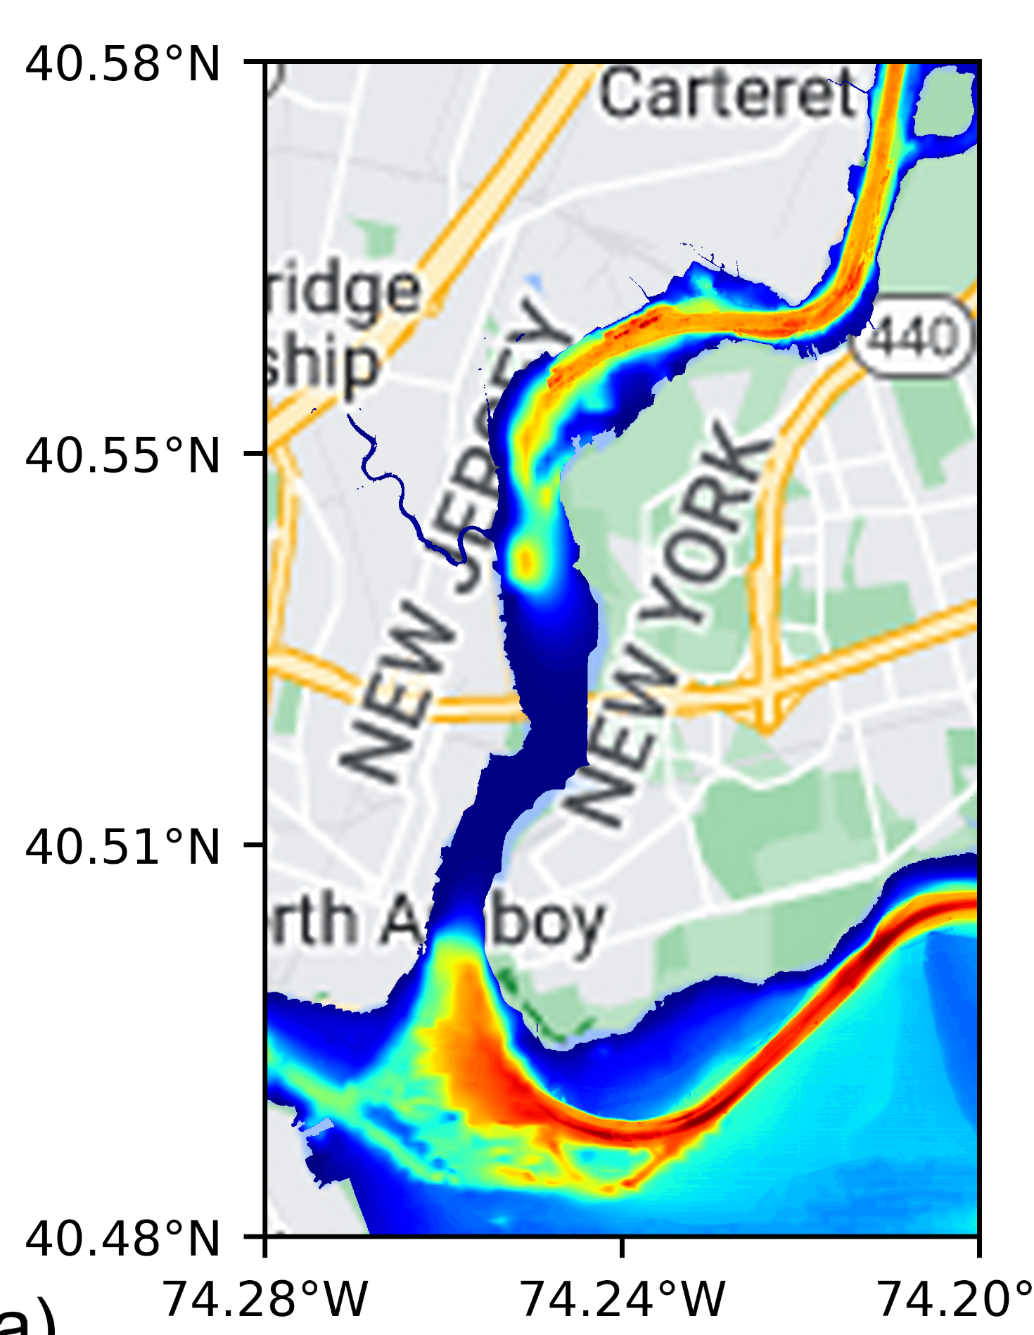
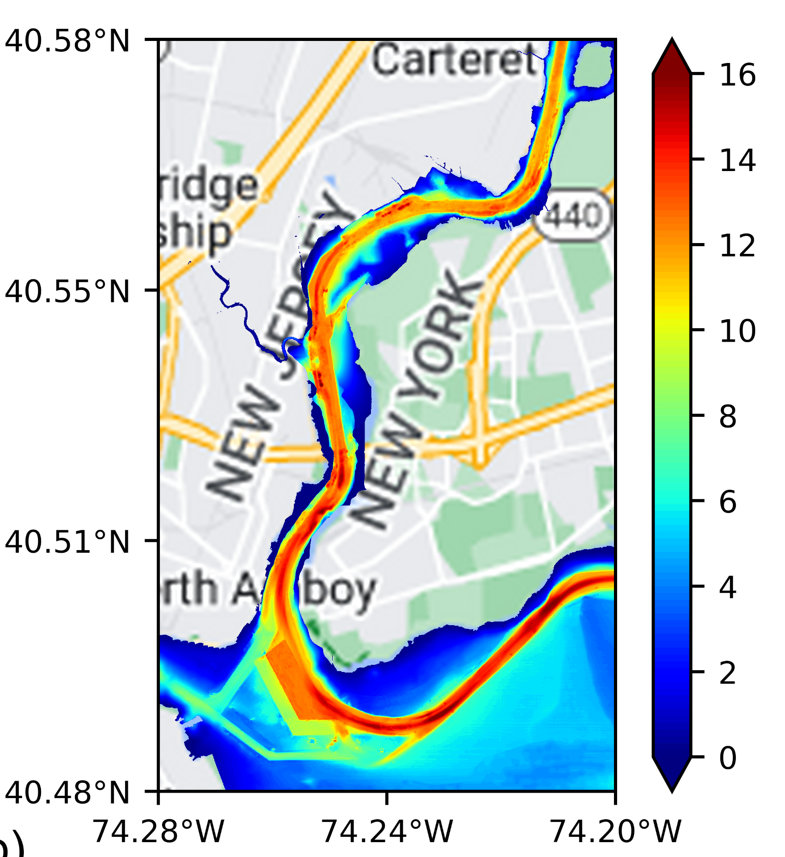
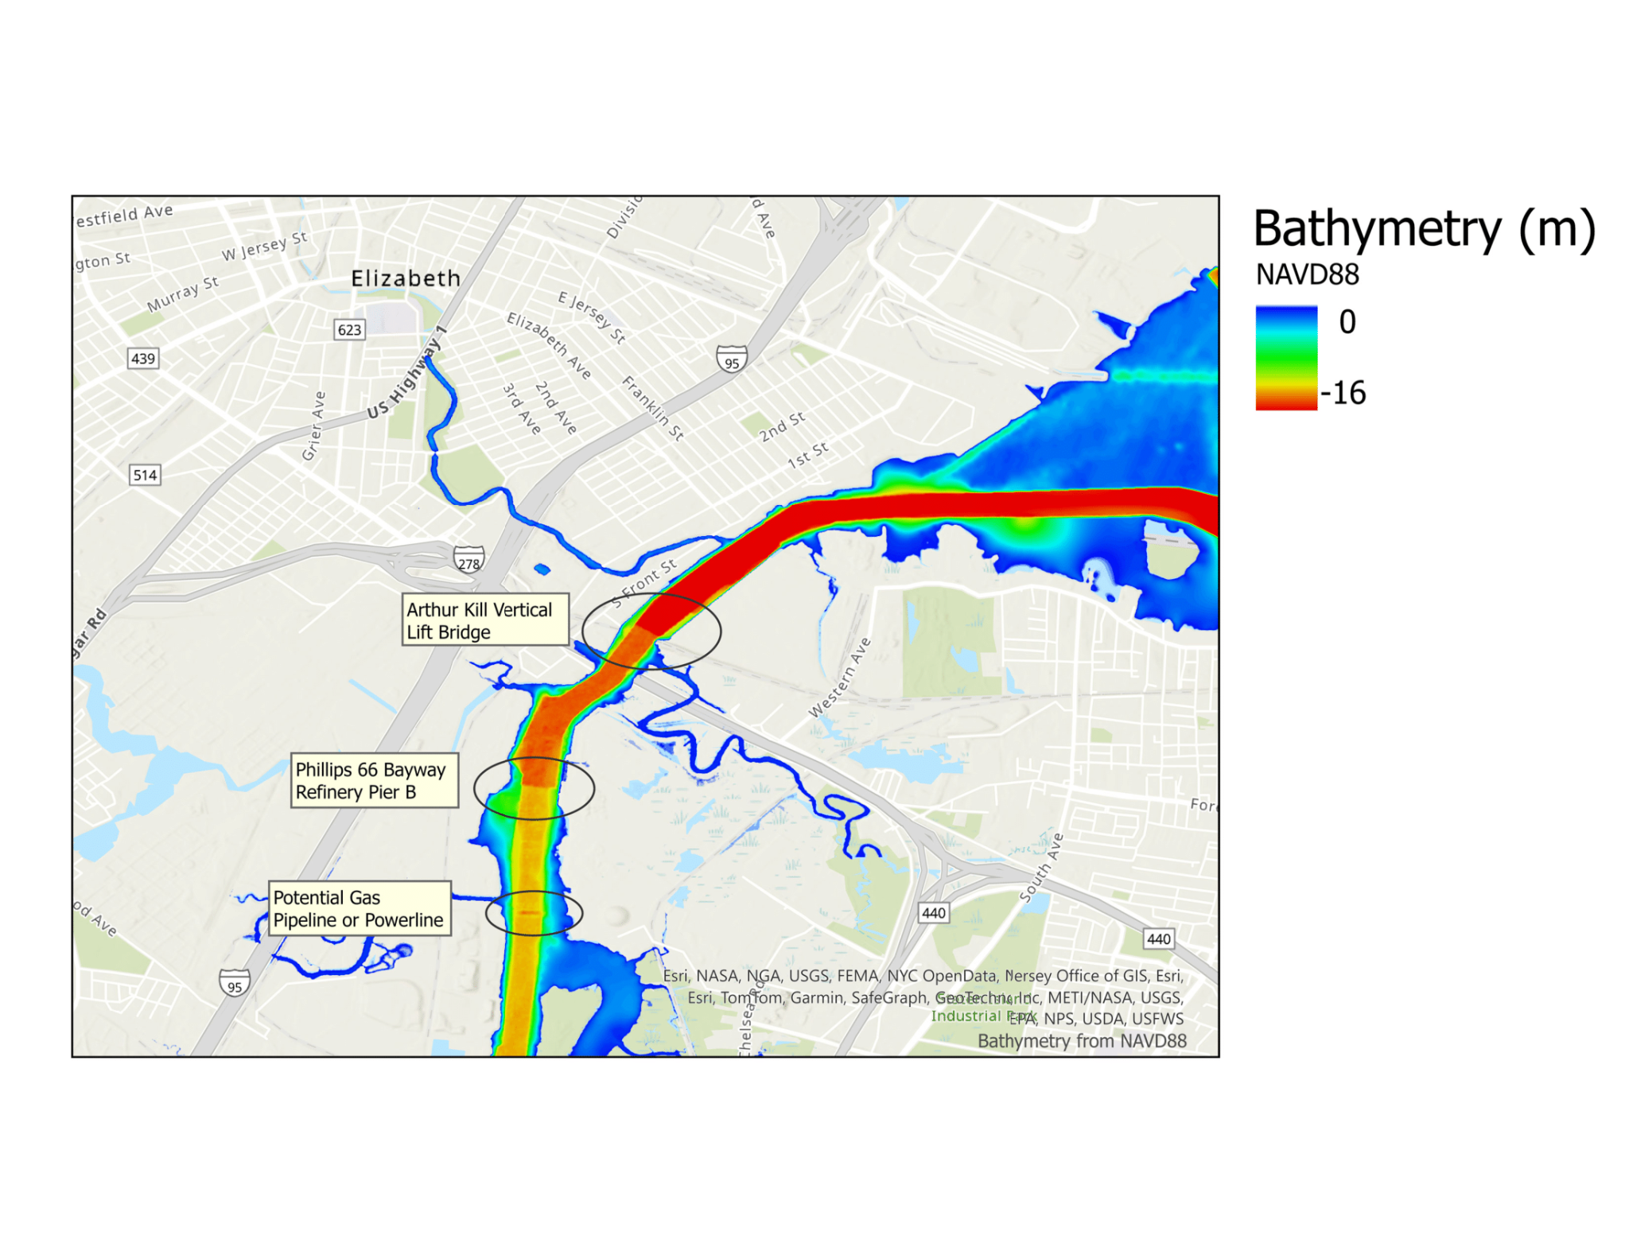
Lessons Learned:
Need for local knowledge
↓ Suspicious jumps in bathymetry, which were actually deemed as real based on inputs from a local expert.
↑ (left) Disconnected River over the Arthur Kill, (right) Fixed bathymetry data.
Local knowledge of physical oceanography and bathymetry was critical in properly configuring and evaluating the forcing used by the two models.
Notes:
For example, cold bias in models’ water temperature simulations was identified in the Raritan Bay NJ/NY Harbor region which a local expert said was likely due to missing representation of warm water point sources of local power plants and/or sea/river ice. Local knowledge led to the discovery of a bathymetry gap in the dredged channel in Arthur Kill which was corrected for the testers (Figure 3). Local knowledge was also able to state that a few suspicious jumps in the provided bathymetry in Arthur Kill were actually real (Figure 4). Local knowledge of physical oceanography and bathymetry for the test region was critical in properly configuring and evaluating the forcing used by the two models.

Slide 10



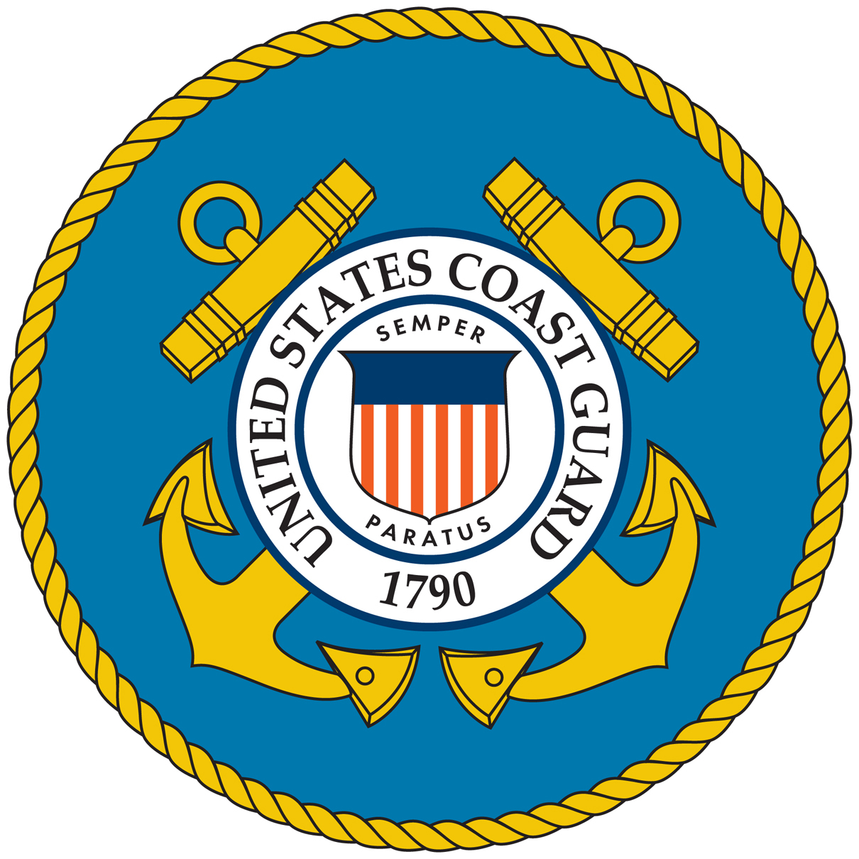








Summary and Next Steps
The team is currently in Round 4, which will run through the end of Sep 2025.
The evaluation indicates that both models are viable candidates to be coastal ocean components of the UFS to support the marine navigation application
Trained next generation of ocean modelers (9 postdocs & students)
2+ publications, 10+conference presentations so far
NOAA Tech Reports published (Round 1, Round 2, a Round 3+4 report in prep)
An overview manuscript in prep for submission to Bulletin of the AMS.
The NOAA emblem is a registered trademark of the U.S. Department of Commerce, used with permission. The use of the NOAA emblem recognizes the collaborative research partnership between the Institute and NOAA and does not constitute endorsement by the Department of Commerce/National Oceanic and Atmospheric Administration of the information products or services contained therein that were not developed in partnership with NOAA.

