Slide 1



Fire Aerosol Prediction in NOAA’s Global Aerosol Systems and Its Impact on Subseasonal to Seasonal (S2S) Forecasting
Li (Kate) Zhang^{1,2}, Georg A. Grell², Gonzalo Ferrada^{1,2}, Shan Sun², Partha S. Bhattacharjee³, Ben Green^{1,2}, Haiqin Li^{1,2}, Jordan Schnell^{1,2}, Anders A. Jensen², Ravan Ahmadov², Ligia Bernardet², Ziheng Sun⁴, Yunyao Li^{4,5}, Daniel Tong⁴, Li Pan³, Barry Baker⁵, Bing Fu⁶, Fanglin Yang⁶, Raffaele Montuoro⁶
¹CIRES, University of Colorado, Boulder, CO, US;
²Global Systems Laboratory, Earth System Research Laboratories, NOAA, Boulder, CO, US;
³SAIC/Lynker at NCEP/NWS/EMC, College Park, MD, US;
⁴George Mason University, Fairfax, VA, US;
⁵University of Texas at Arlington, Arlington, TX, US;
⁶NOAA Air Resources Laboratory, College Park, MD, US;
⁶Environmental Modeling Center (EMC), NCEP, National Weather Service, College Park, MD, US;
Center Green Auditorium, Boulder, CO. September 8-12, 2025
Kate.Zhang@noaa.gov

Slide 2
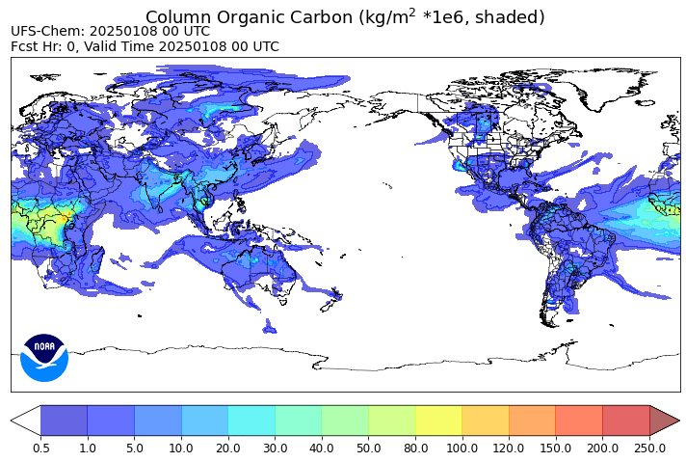
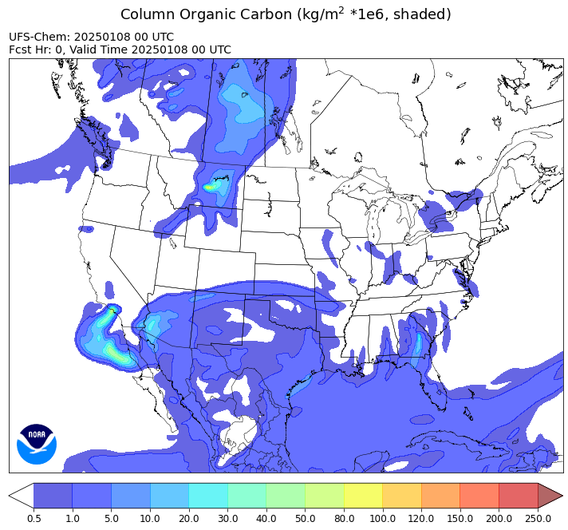
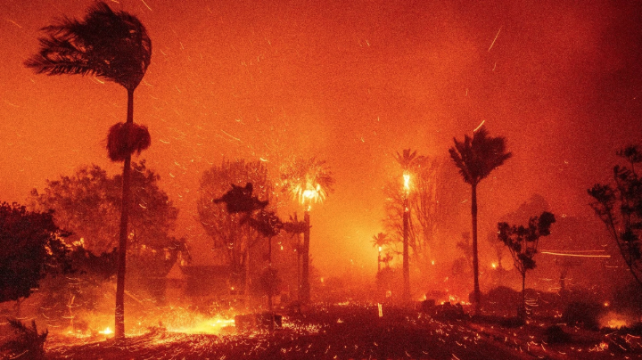
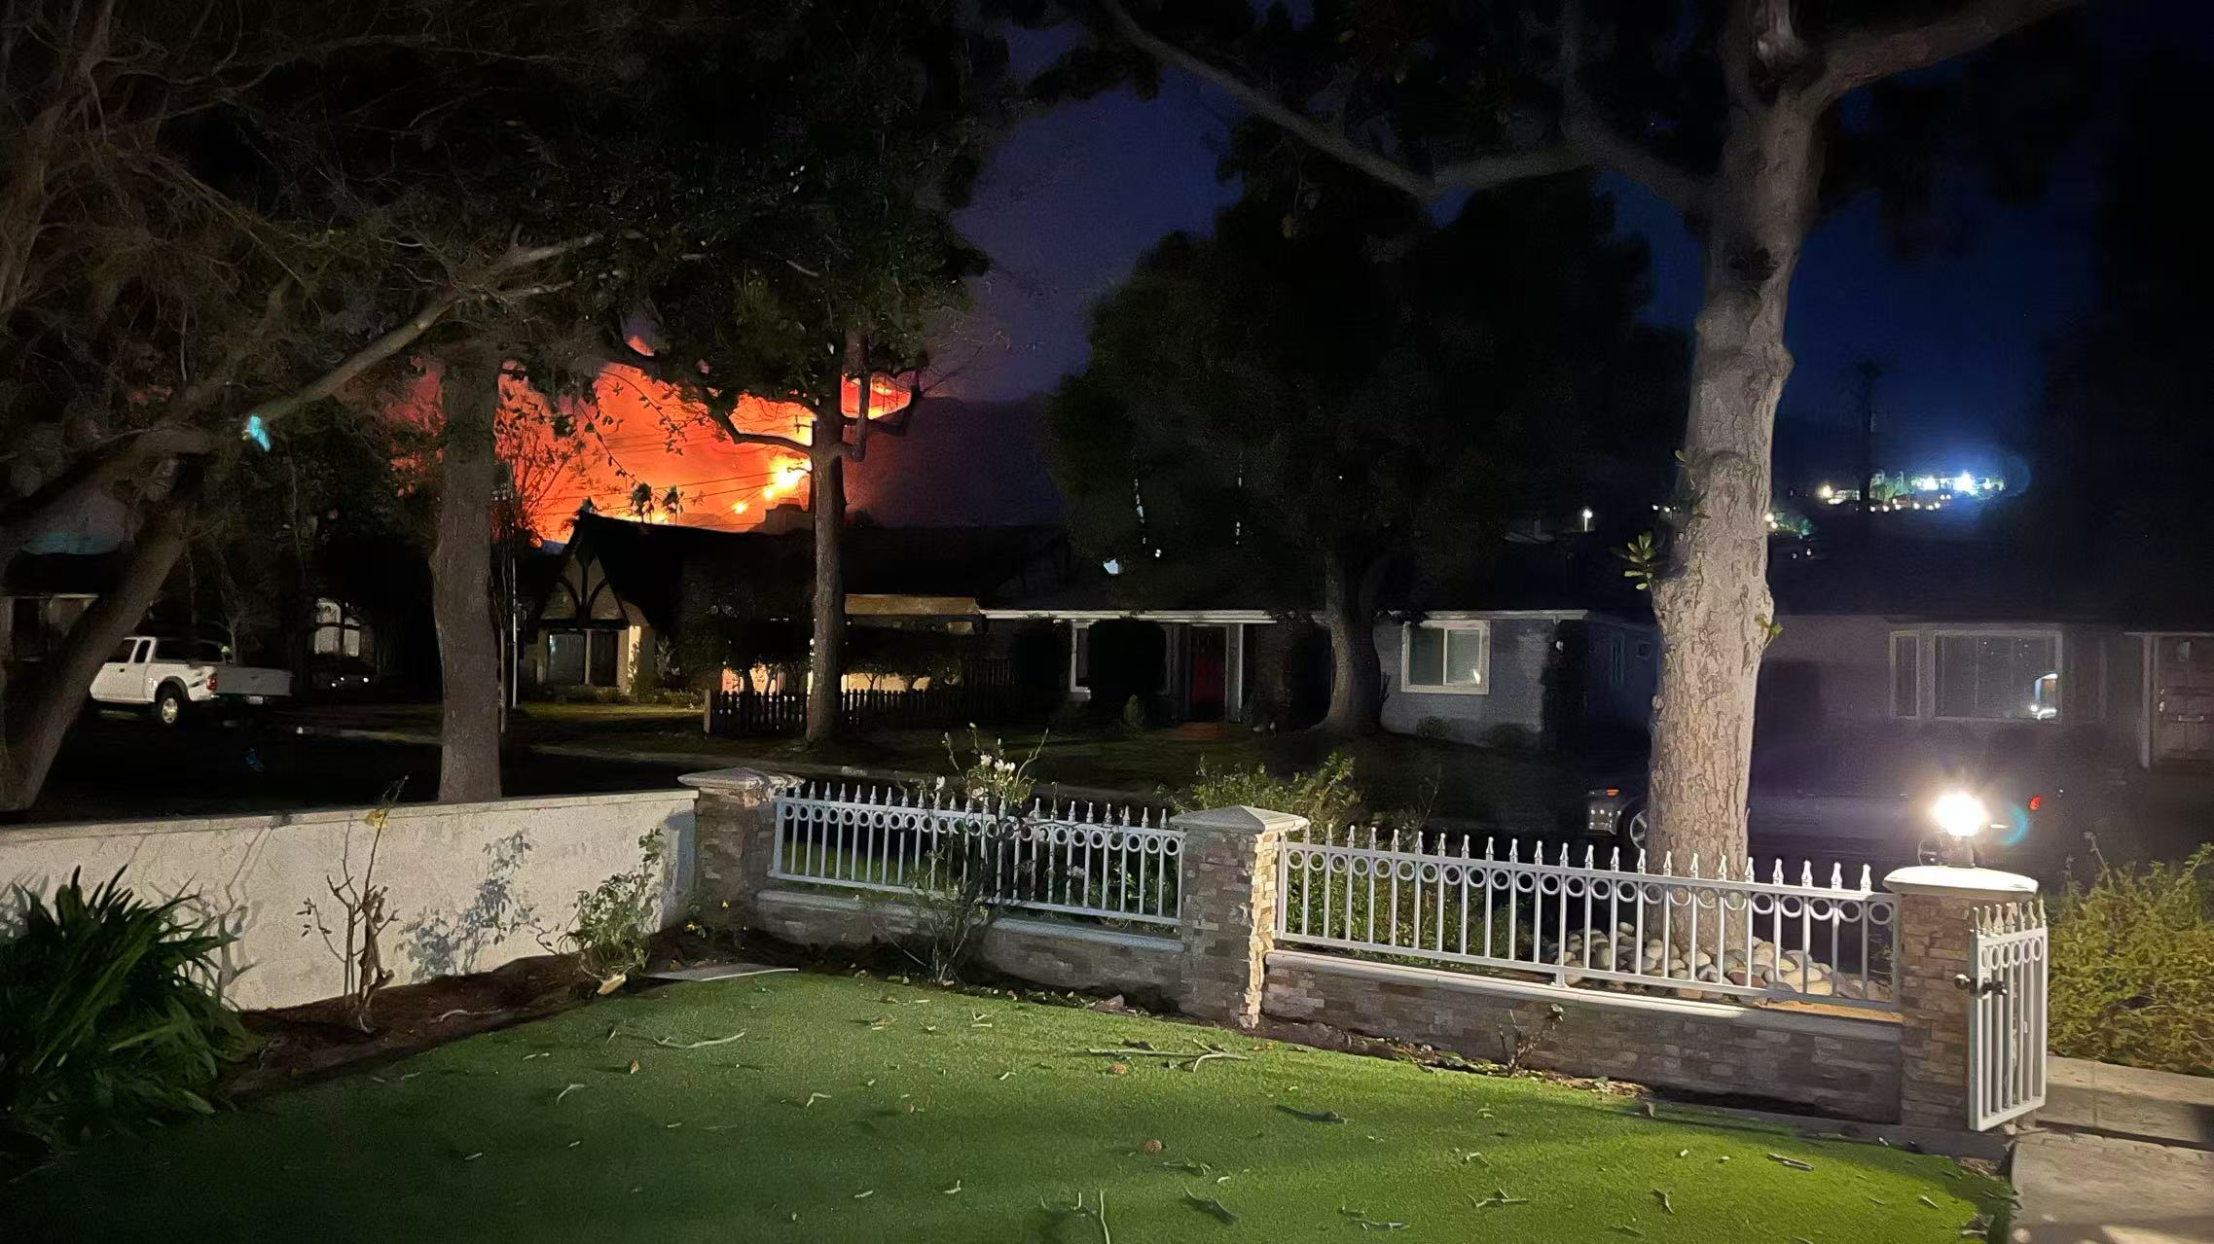
Motivation
Real-time global fire aerosol prediction in GSL
2025 Los Angeles Fire
As of August 30, 2025, 46,503 wildfires have burned over 4.1 million acres in the United States, representing one of the most extensive fire seasons in recent years.
(https://www.nifc.gov/fire-information/nfn)
UFS-Chem
Palisades Fire (Jan 7, 2025)
With wildfire activity projected to increase in the United States and globally, concerns are growing about the impacts of fire aerosols on weather forecasts, subseasonal to seasonal (S2S) predictions and and seasonal outlooks.
Eaton Fire (Jan 7, 2025)
During January 7–31, 2025, fourteen destructive wildfires affected the Los Angeles metropolitan area and San Diego County in Southern California.
(https://en.wikipedia.org/wiki/January_2025_Southern_California_wildfires).
Advancing fire weather prediction and improving our understanding of fire aerosol impacts will strengthen NOAA’s air quality forecasts, providing more accurate and timely early warning guidance to support effective management strategies.

Slide 3
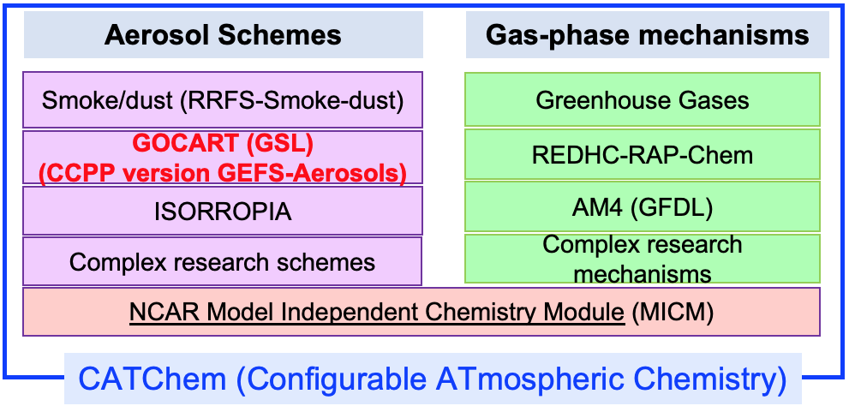
NOAA’s Global Chemistry/Aerosol Forecast Systems
V12 Sep. 2020
V12.3 Jan. 2023
Research version
2026
Operational
date
GEFS-Aerosols
GEFS v12 & v12.3
UFS-Chem
GCAFS v1
ATM model
FV3
FV3/UFS
Aerosols: sulfate, 5-bin sea salt and dust, hydrophobic and hydrophilic BC and OC. Online aerosol prediction for direct and semidirect radiative feedback
FV3/UFS
Physics
GFSv15
GFSv17
GFSv17
Horizontal Res.
~25km
CCPP version of GEFS-Aerosols
~25km
~25km
Vertical Res.
65 layers
127 layers
127 layers
Infrastructure
NUOPC
CCPP
NUOPC
Aerosol/Chem
Components
GSL GOCART (based on WRF-Chem)
2nd NASA GOCART
FENGSHA dust scheme
Atmospheric model only, direct radiative feedback is coming from climatological aerosol reanalysis data
JEDI based aerosol data assimilation capability has been implemented
S2S: Fully coupled with ocean, sea ice and wave components
Global data assimilation (DA) for atmospheric composition will be implemented

Slide 4
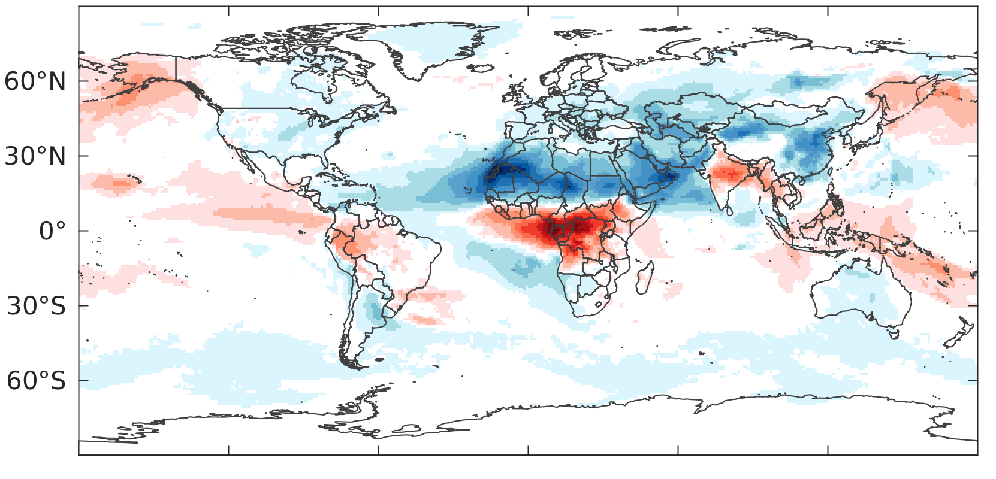
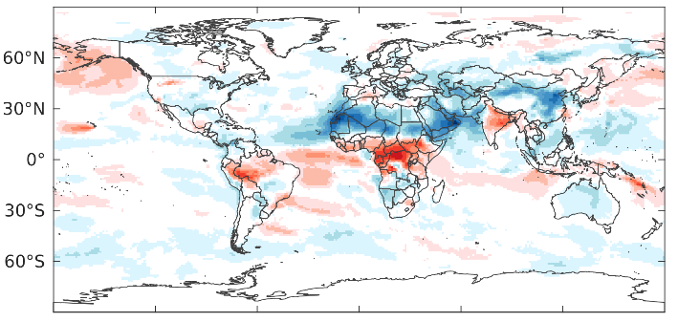
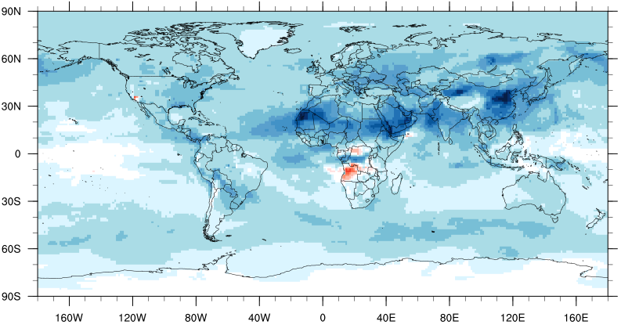
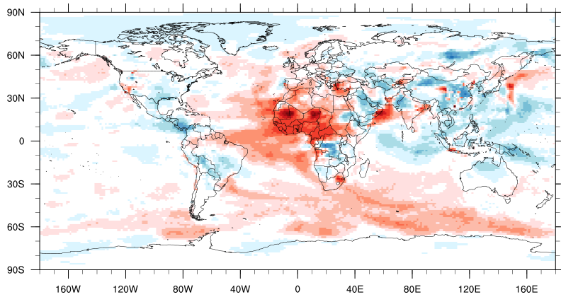
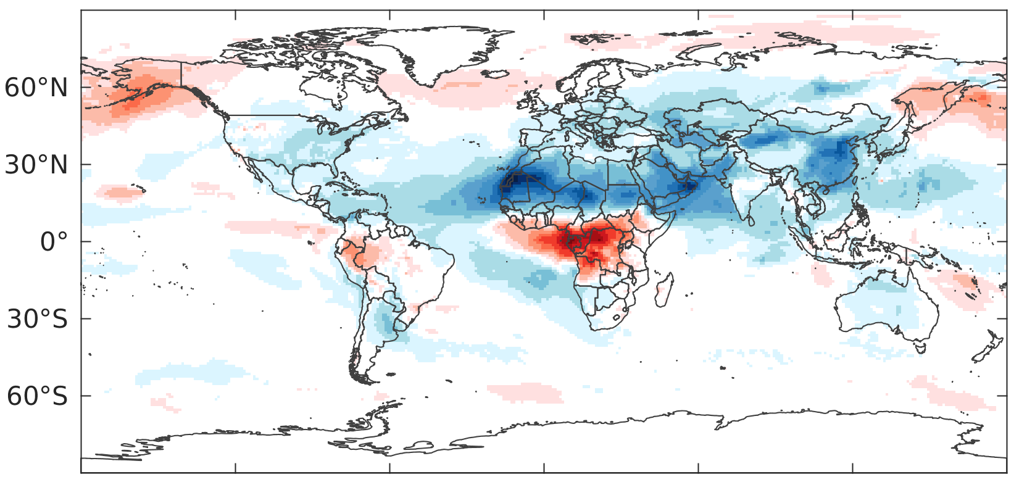
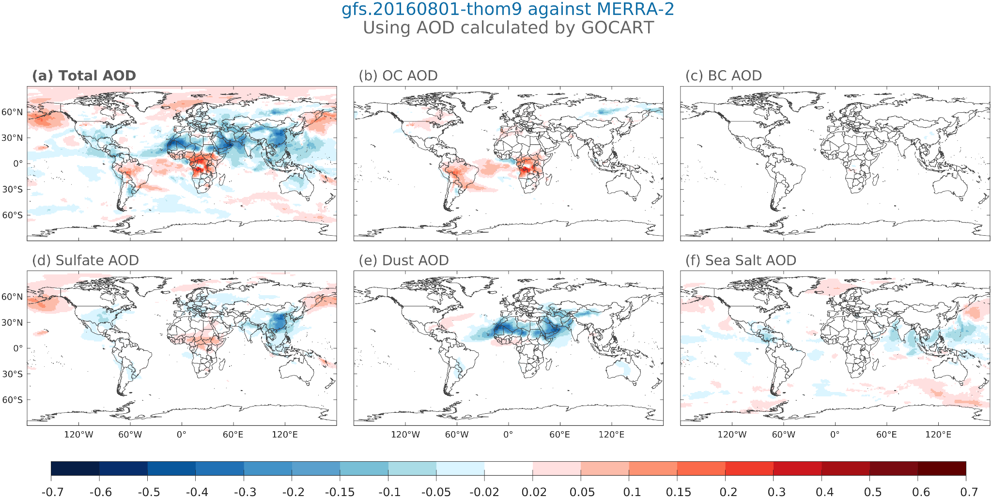
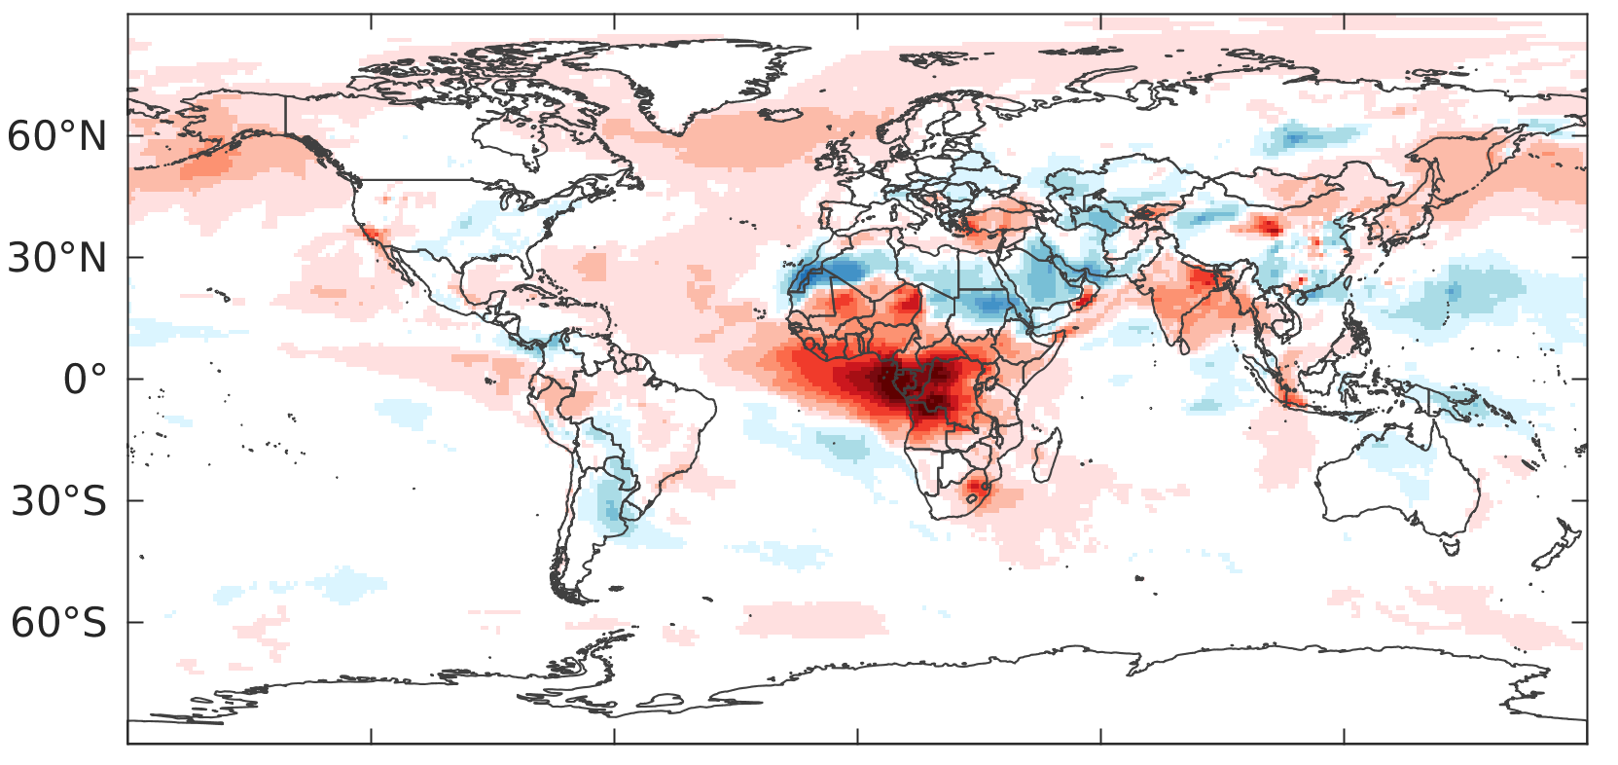
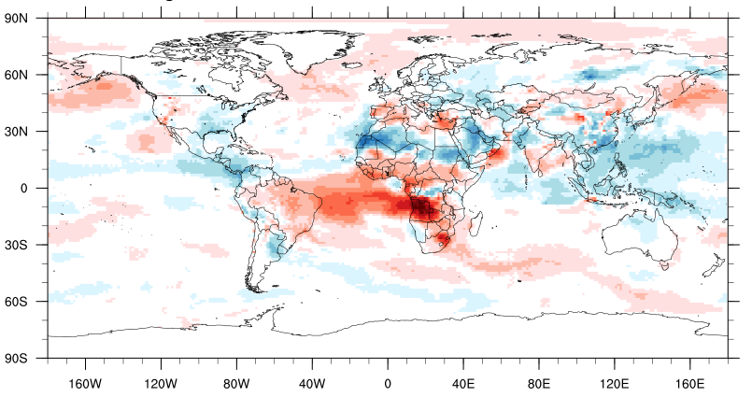
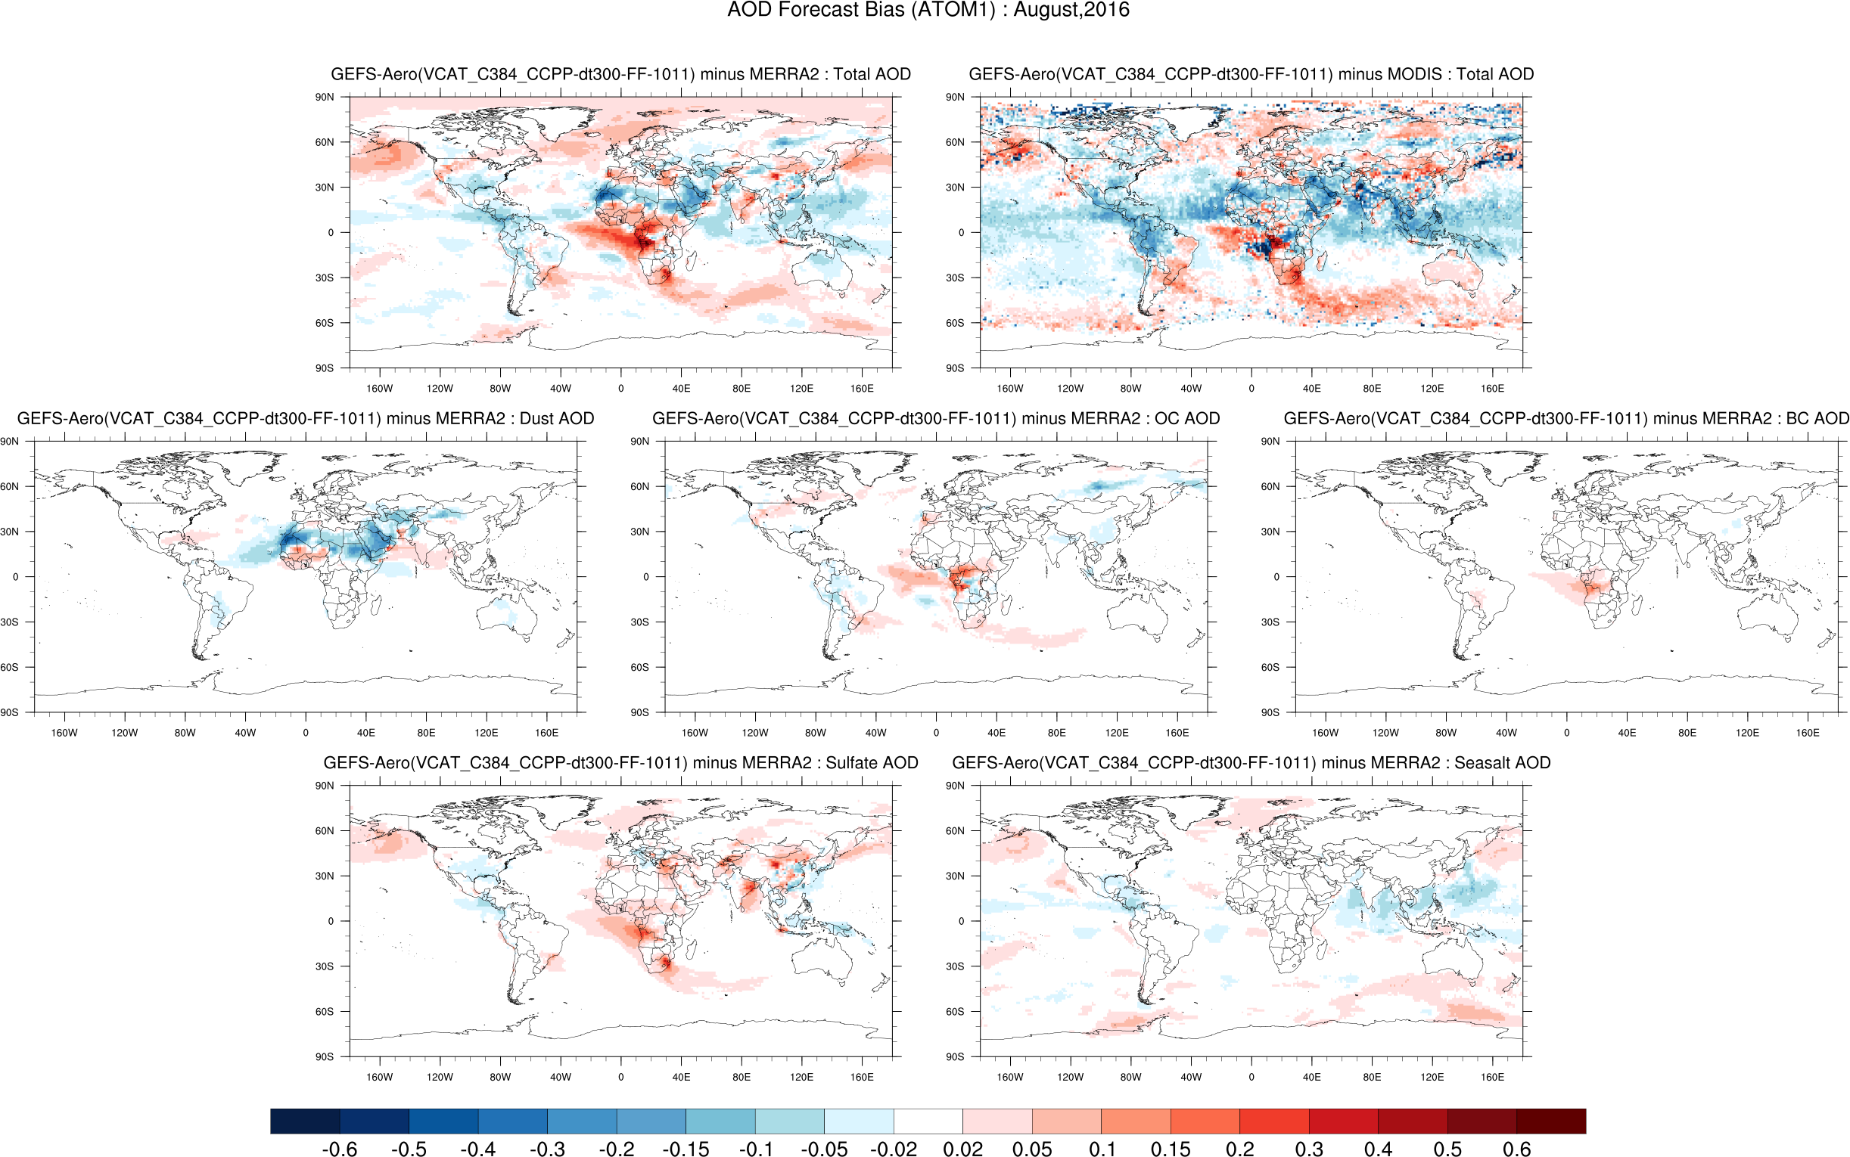
Implementation of inline large-scale wet removal and aerosol-aware indirect effect into Thomson MP for GOCART aerosol
ATM Model
Convective transport & wet dep.
PBL mixing
Aerosol optical calculation
CHEM/AERO Model
Emission
Dry deposition
Chemistry
Large-scale wet dep.
Thompson MP
Rain, snow, graupel
IFA
WFA
Ensures that aerosol removal is physically consistent with the model’s cloud and precipitation processes
Introduce discrepancies when using different chemistry/aerosol schemes
GCAFSv1 model
UFS-Chem model
Offline large-scale wet removal in Aerosol Model
24-hr cycling ATM
S2S fully couple
24-hr cycling ATM
S2S fully couple
Inline large-scale wet removal in TH-MP
AOD biases with respect to MERRA-2, Aug. 2016
Notes:
After implementing the inline large-scale wet removal calculation into Thompson MP scheme, AOD biases shows greater consistency between the cycling and the S2S fully coupled experiment compared to the offline wet removal scheme

Slide 5
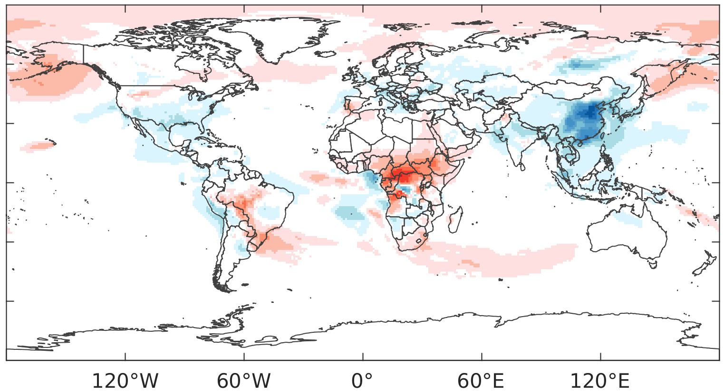
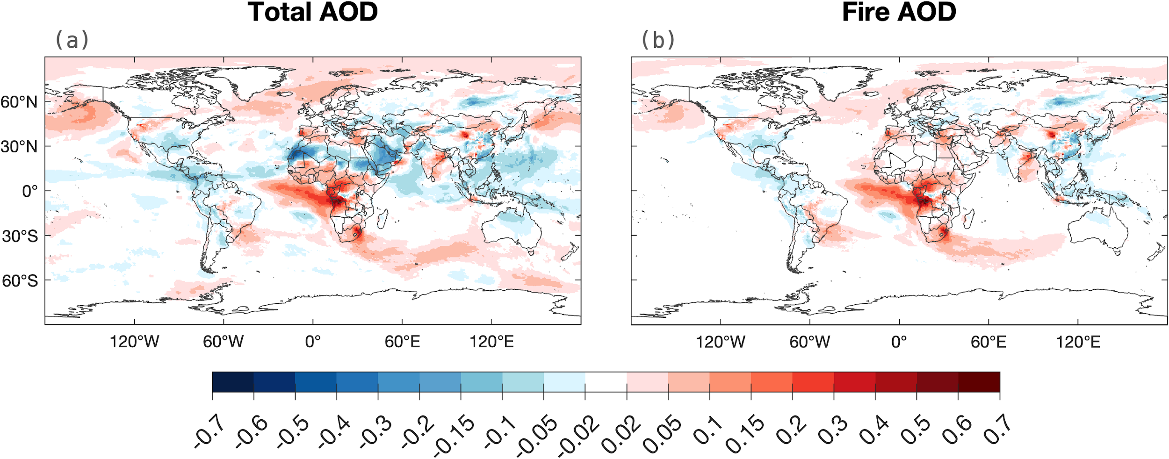
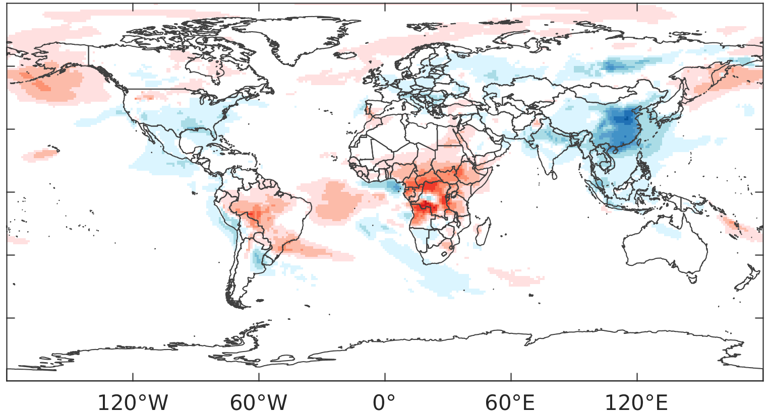
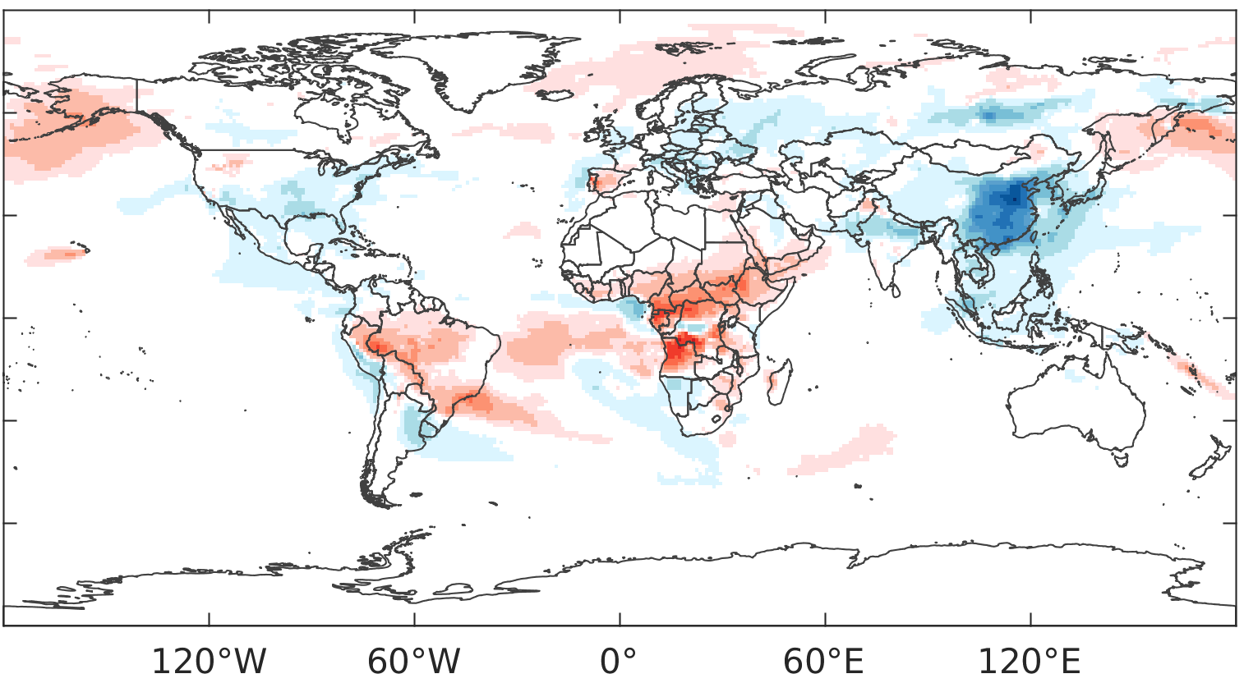
Impact of aerosol feedback on fire (OC+BC+Sulfate) AOD biases in GCAFS v1
Direct + semi-direct feedback from MERRA-2 Climate
Inclusion of online-predicted aerosols for direct and semi-direct feedback reduces fire AOD biases over high latitudes in the Northern Hemisphere.
For fire-contributed aerosols (OC, BC, and sulfate), the inclusion of indirect feedback leads to increased removal to reduce positive biases and relatively lower AOD over most areas.
No radiative feedback from coupled aerosol model
Fire AOD biases with respect to MERRA-2, Aug. 2016
Direct + semi-direct feedback from NASA-GOCART
Direct + semi-direct + indirect feedback from NASA-GOCART

Slide 6
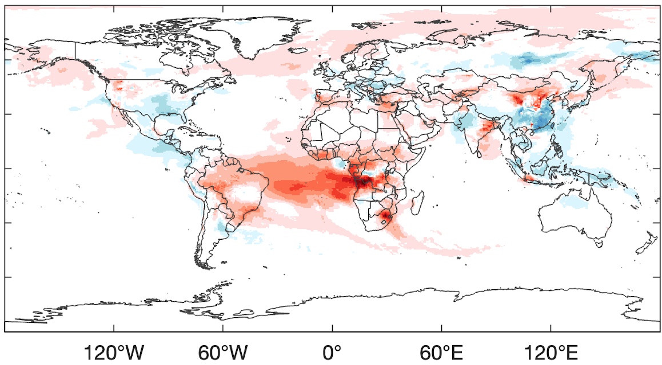
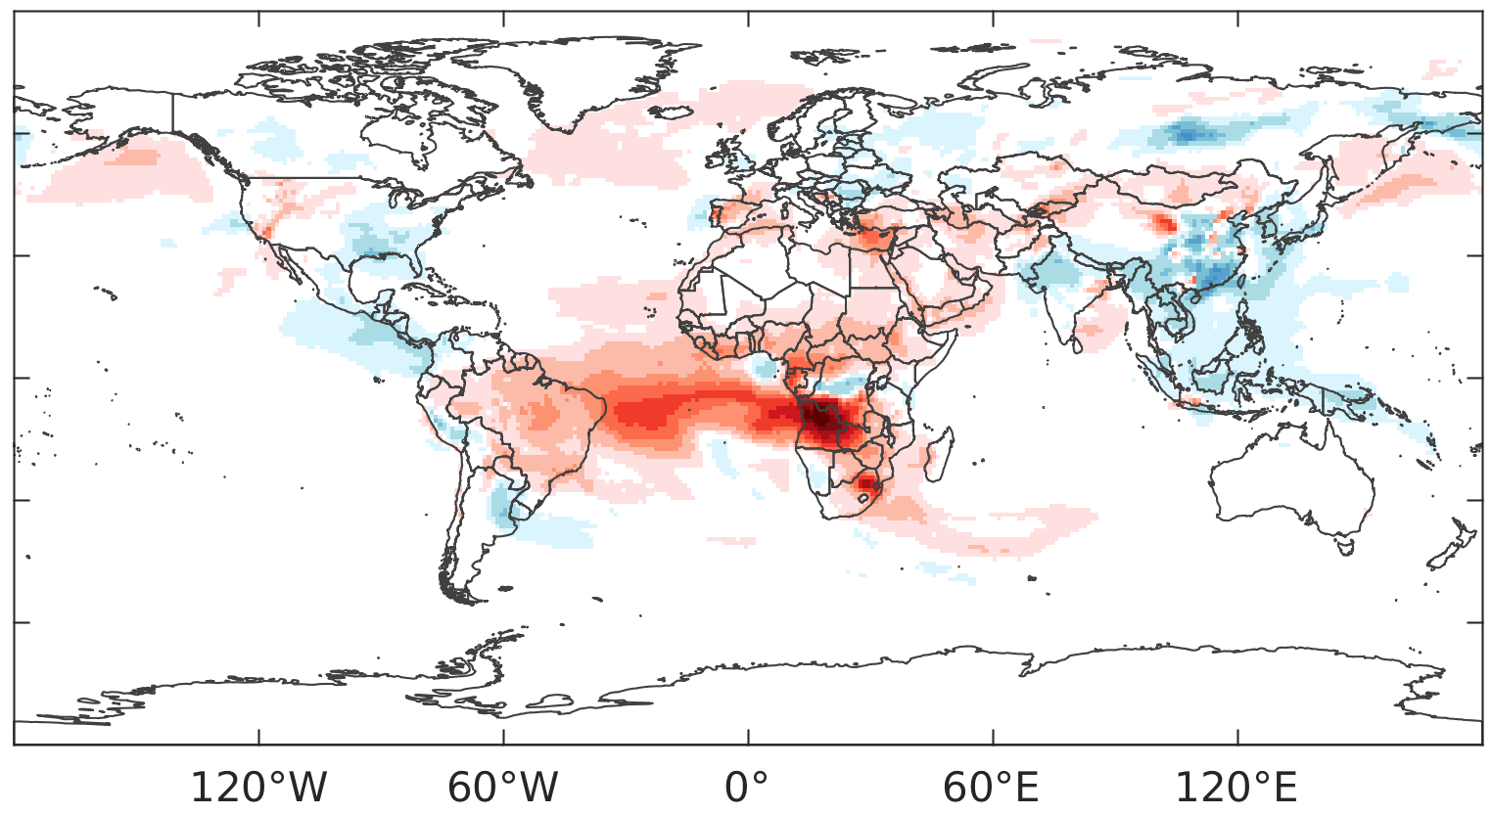
Impact of aerosol feedback on fire (OC+BC+Sulfate) AOD biases in UFS-Chem
Direct + semi-direct feedback from MERRA-2 Climate
Adding online-predicted aerosol indirect feedback further reduces AOD biases at high latitudes but increases biases over the tropical Atlantic compared with using only direct and semi-direct feedback.
Both GCAFS and UFS-Chem shows consistent impact of aerosol feedbacks of direct, semi-direct, and indirect effects.
No radiative feedback from coupled aerosol model
Fire AOD biases with respect to MERRA-2, Aug. 2016
Direct + semi-direct feedback from GSL-GOCART
Direct + semi-direct + indirect feedback from GSL-GOCART
AOD biases with respective to MERRA-2, Aug. 2016

Slide 7
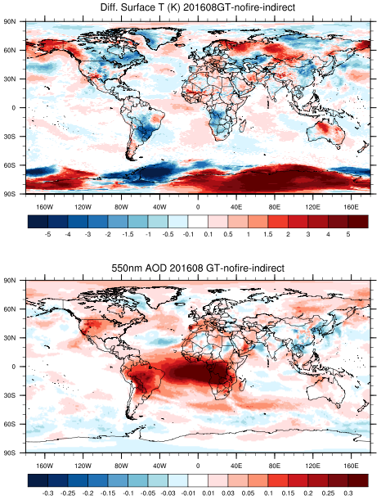
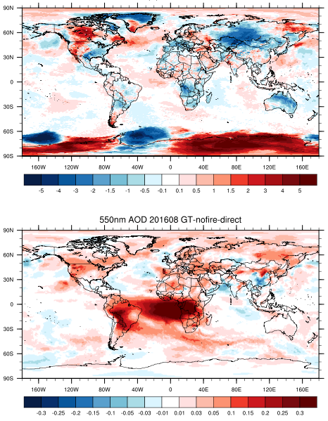
Evaluate the impacts of fire aerosols on S2S predictions in UFS-Chem
Sensitivity experiment: with fire emission run minus no fire emission run (August 2016)
Direct + semi-direct feedback
Direct + semi-direct + indirect feedback
Differences of
surface T (K)
Differences of
550 nm AOD
When only direct and semi-direct feedback are included, fire aerosols exhibit a cooling effect across central Russia and Asia, while causing a warming effect over the western US and central Canada.
Enabling aerosol-aware indirect feedback shifts fire aerosol impacts from cooling to warming over Alaska and central Russia, and from warming to cooling over eastern North America.

Slide 8
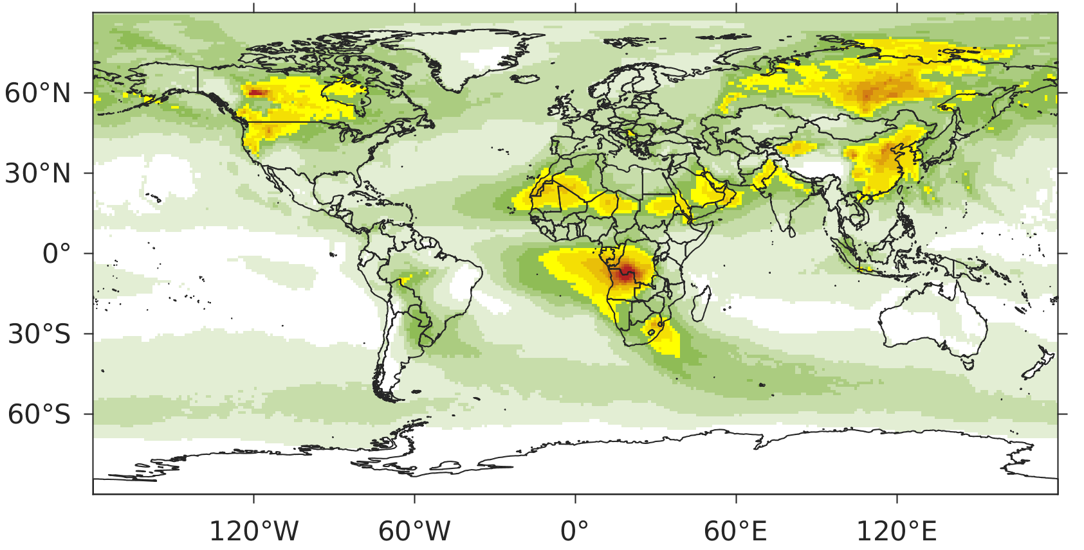
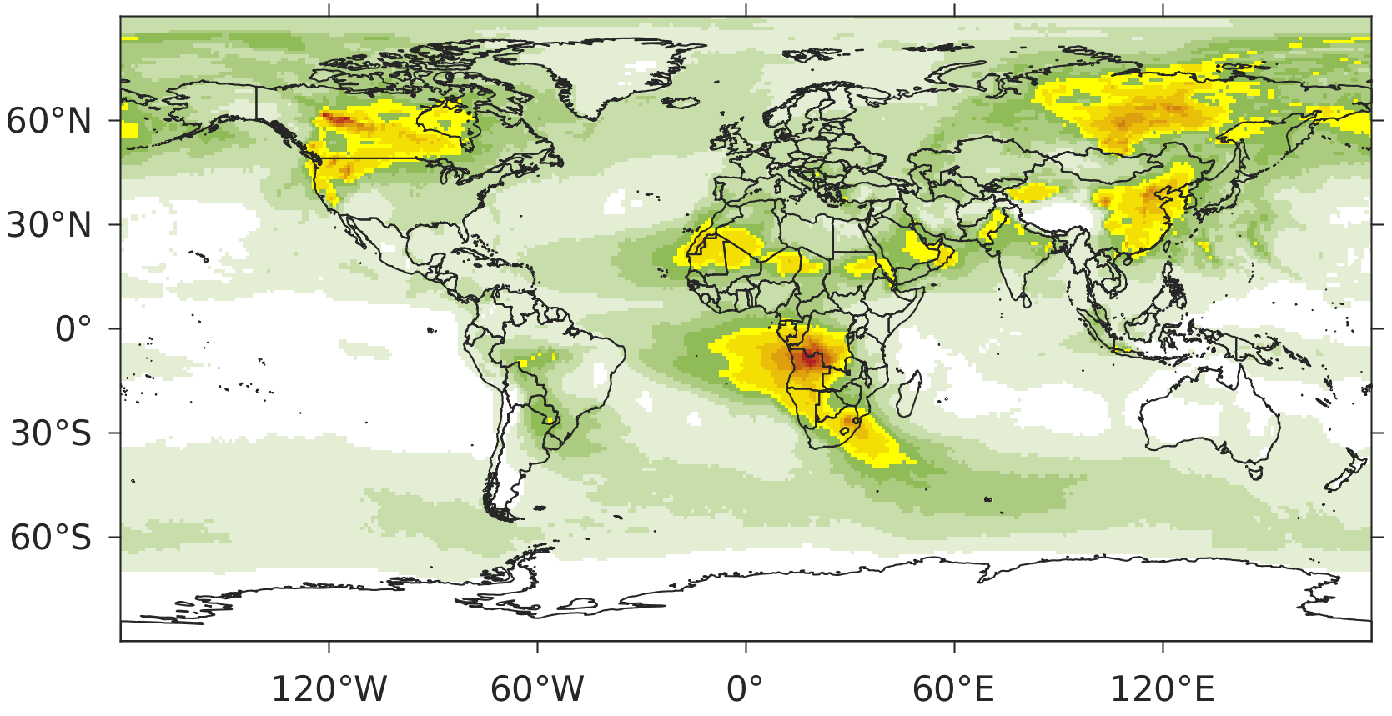
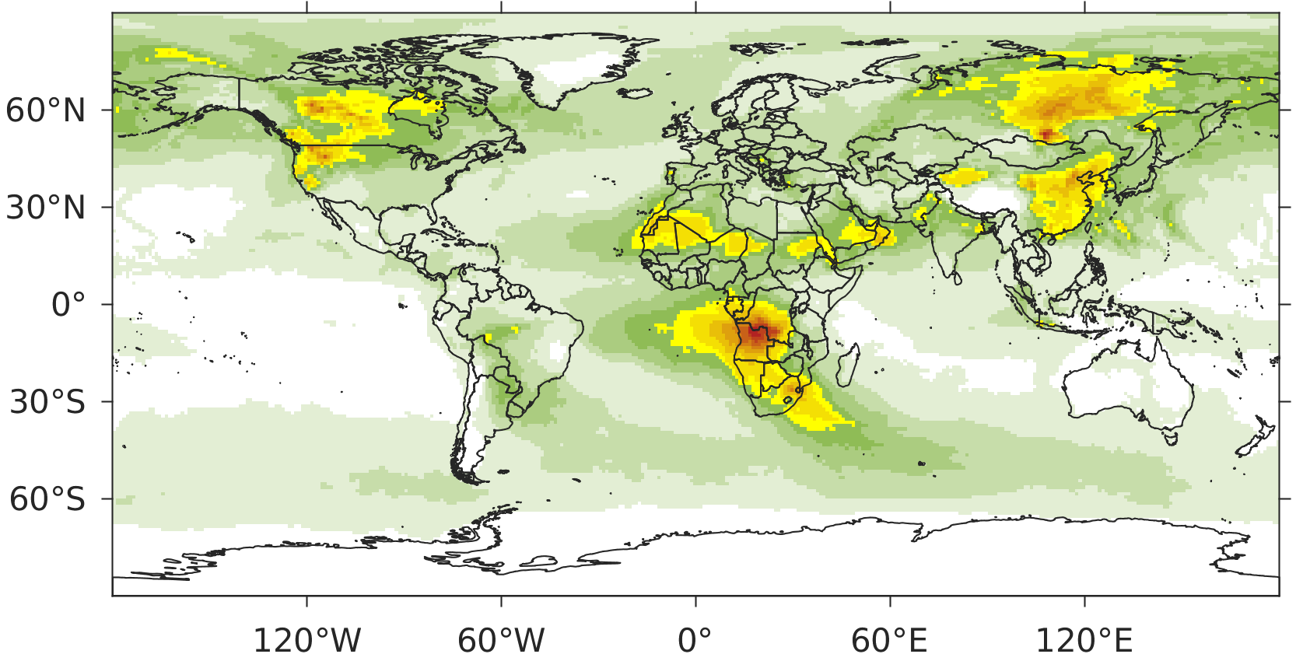
Impact of aerosol feedbacks on AOD prediction for 2012-2017
AOD RMSE with respect to MERRA-2 in UFS-Chem, August of 6-yr average
MERRA2 Direct + semi-direct feedback
Mean: 0.108
Inclusion of online-predicted aerosols for direct and semi-direct feedback from GOCART reduce AOD RMSE over eastern Europe.
Inclusion of online-predicted aerosols into the Thompson MP aerosol-aware scheme (indirect feedback) reduces AOD RMSE over North America compared to the inclusion of only direct and semi-direct feedback.
No radiative feedback from coupled aerosol model
GSL-GOCART Direct + semi-direct feedback
GSL-GOCART Direct + semi-direct + indirect feedback
Mean: 0.106
Mean:0.105

Slide 9
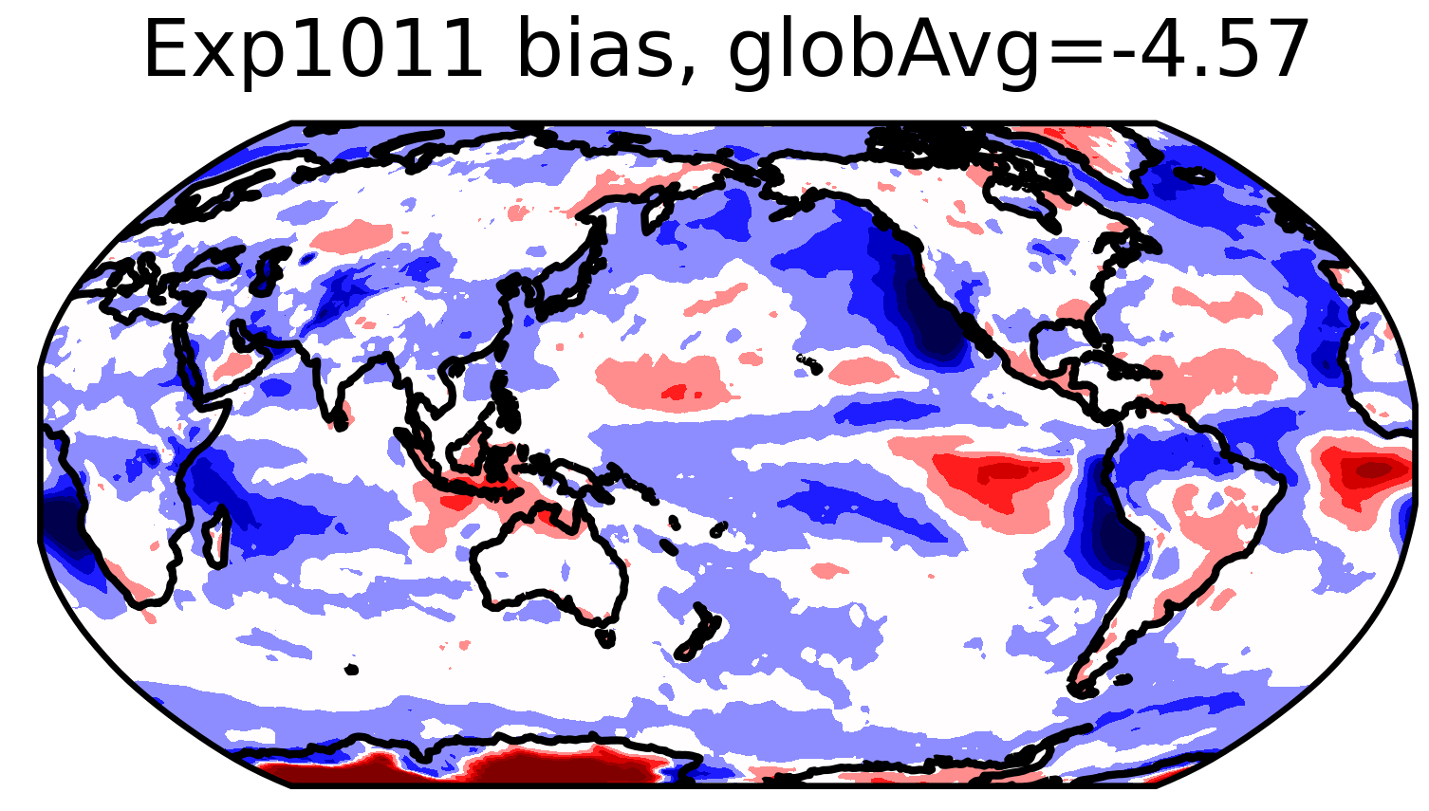
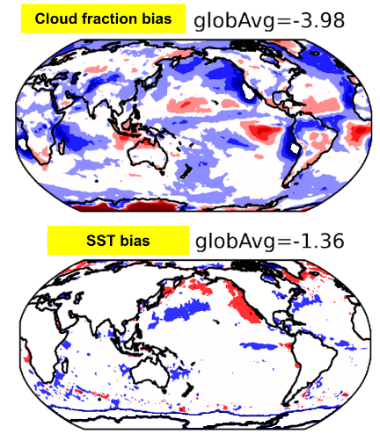
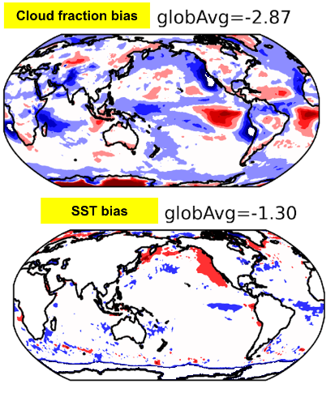
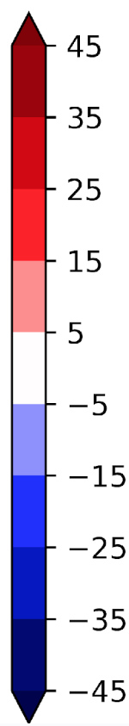
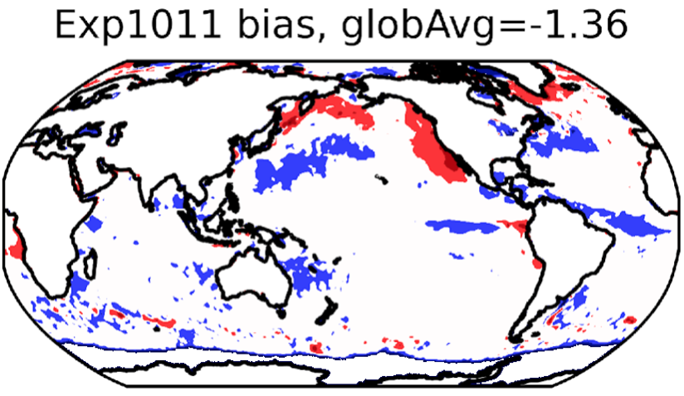
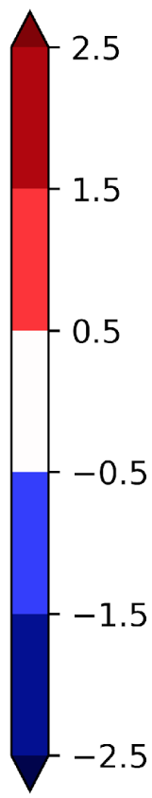
Impact of aerosol feedbacks on S2S forecasting in UFS-Chem for 2012-2017
Aerosol direct, semi-direct, and indirect feedbacks on cloud fraction and SST for S2S prediction (August of 6-yr average)
Direct and semi-direct feedback reduce global cloud fraction bias by ~13%, while adding indirect feedback achieves a further 28% reduction, most notably over the North Atlantic.
Aerosol indirect feedback contributes to warming over the North Pacific Ocean and helps reduce global sea surface temperature (SST) biases.
MERRA2 Direct + semi-direct feedback
GSL-GOCART Direct + semi-direct feedback
GSL-GOCART Direct + semi-direct + indirect feedback
Cloud fraction bias
SST bias
No radiative feedback from coupled aerosol model
Notes:
UFS-Chem Experiments
Performed sensitivity experiments isolating the effects of aerosol direct + semi-direct feedback and indirect feedback for multiple years (2012–2017) of S2S simulations in August.
Quantification of the impacts of aerosol direct + semi-direct and indirect feedback on key meteorological fields based on the experimental analysis.
The Thompson MP scheme handles large-scale removal internally, ensuring consistency, unlike most chemical models that apply it offline using separate precipitation-driven schemes.

Slide 10
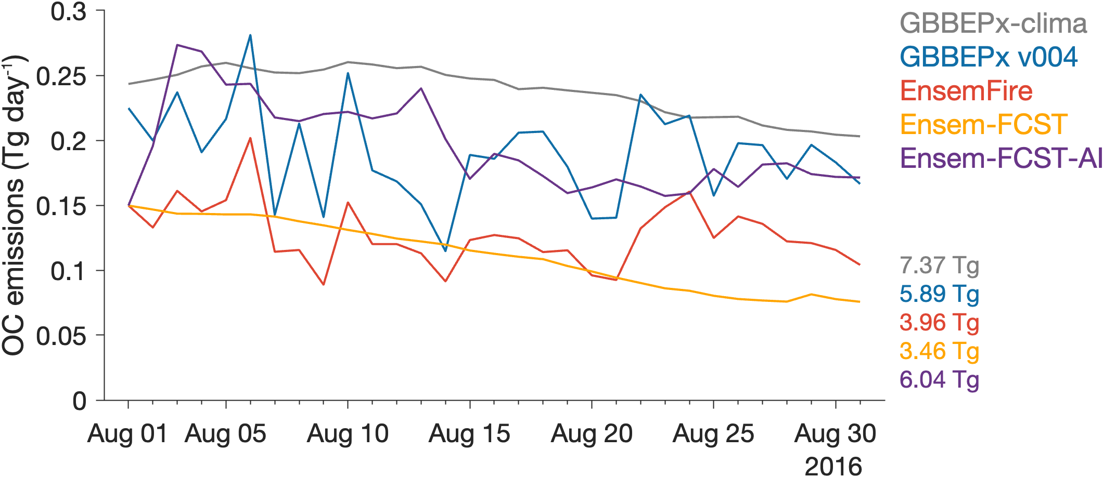
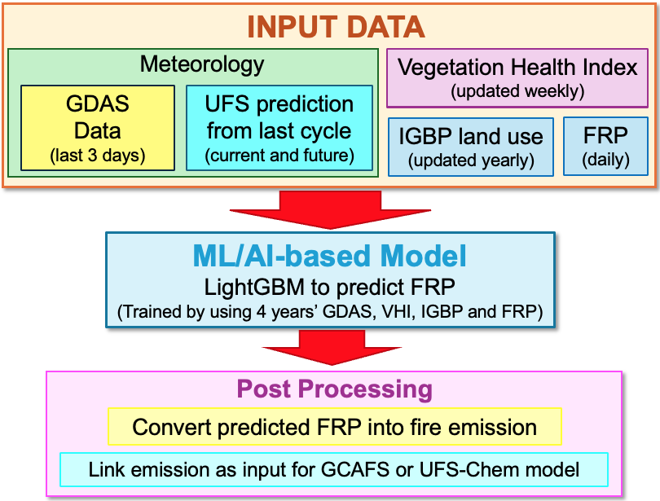
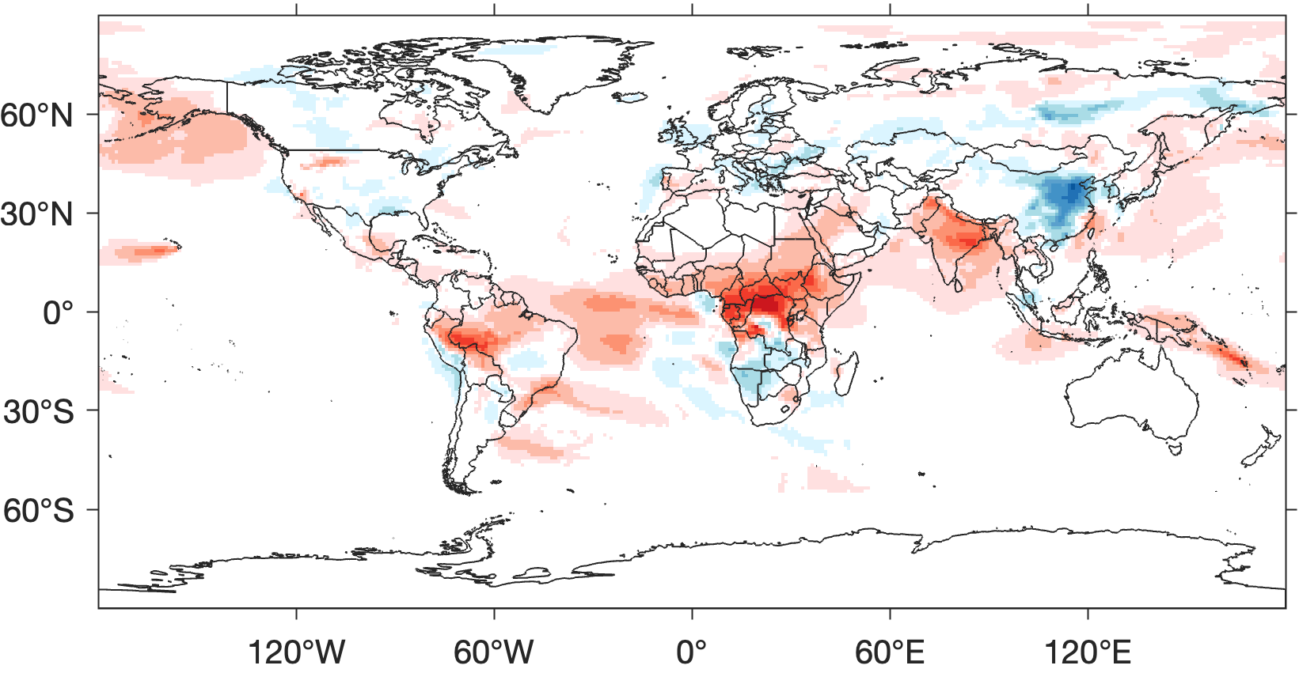
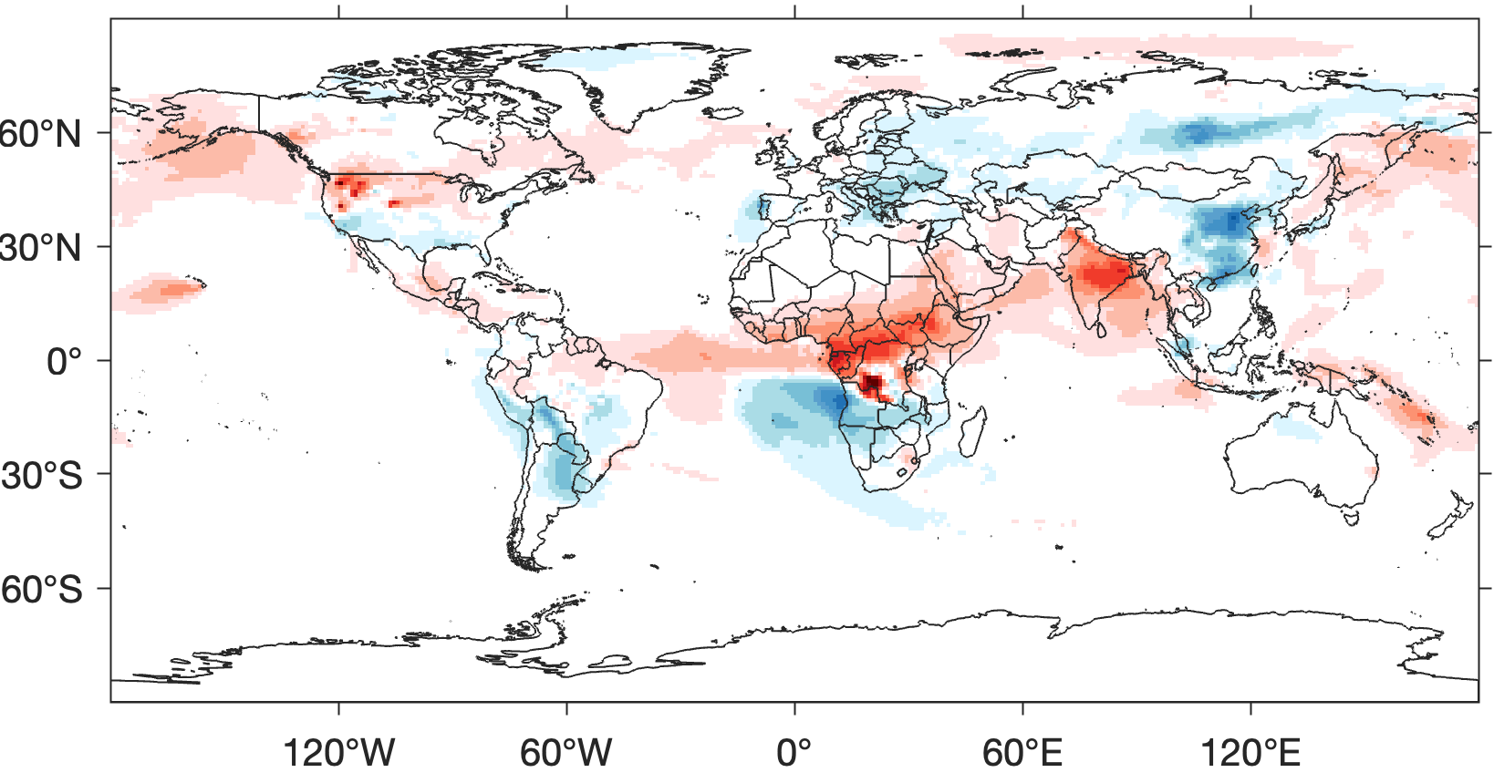
ML/AL-Based Fire Emission Prediction and its Application for S2S Forecasting
Challenges in S2S Prediction
Fire Emission Estimate
Global OC fire emission 2016
Flowchart of the ML/AI based fire emission prediction system
Fire AOD biases with respect to MERRA-2, Aug. 2016
GBBEPx v004 Fire Emission
ML/AI predicted Fire Emission
Mean bias:+0.006
Mean bias:+0.003
More details in poster section: Ferrada et al.,
Thursday at 11:15 am

Slide 11
Summary
Inline aerosol large-scale wet removal has been implemented in the Thompson MP, resulting in significant improvements in S2S aerosol predictions in UFS-Chem, that the AOD biases shows greater consistency between the cycling and the S2S fully coupled experiment compared to the offline wet removal scheme.
We have initiated the implementation of indirect feedback for online predicted GOCART aerosols in the Thompson aerosol-aware microphysics scheme for both GCAFSv1 and UFS-Chem. This further reduces AOD biases over high latitudes compared to including only direct and semi-direct feedback.
With the inclusion of aerosol direct and semi-direct feedback, enabling the aerosol-aware (indirect feedback) causes fire aerosols (WFA) to shift wildfire aerosol impacts from cooling to warming over Alaska and central Russia, and from warming to cooling over eastern North America.
Direct and semi-direct feedback reduce global cloud fraction bias by ~13%, while adding indirect feedback achieves a further 28% reduction, most notably over the North Atlantic.
The MERRA-2 and CAMS AOD data exhibit substantially different magnitudes, resulting in different criteria for AOD bias validation. Consequently, AOD biases appear smaller when evaluated against CAMS than when compared with MERRA-2.
We have initiated further studies to enhance fire emission estimates for S2S predictions by developing (ML/AI) based model to predict fire emissions for the next 35–45 days.

Slide 12

Thank you!

Slide 13
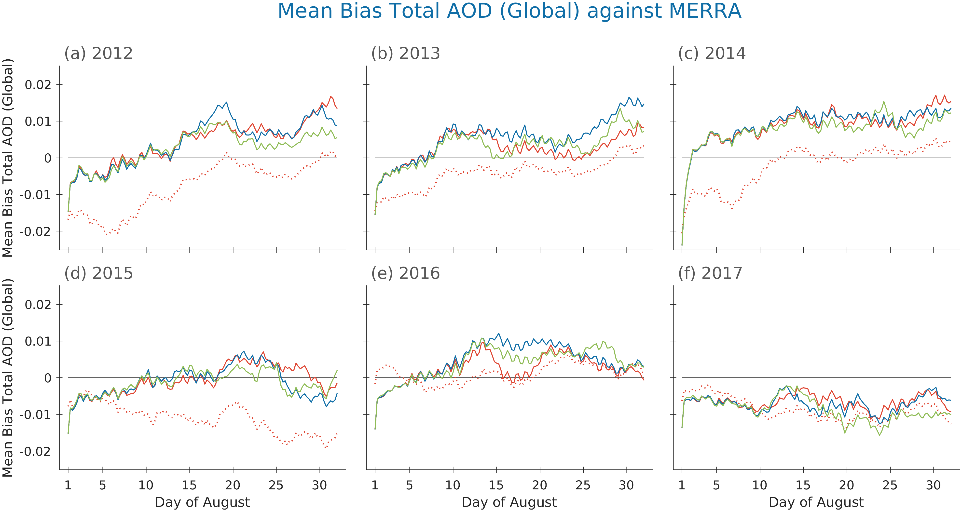
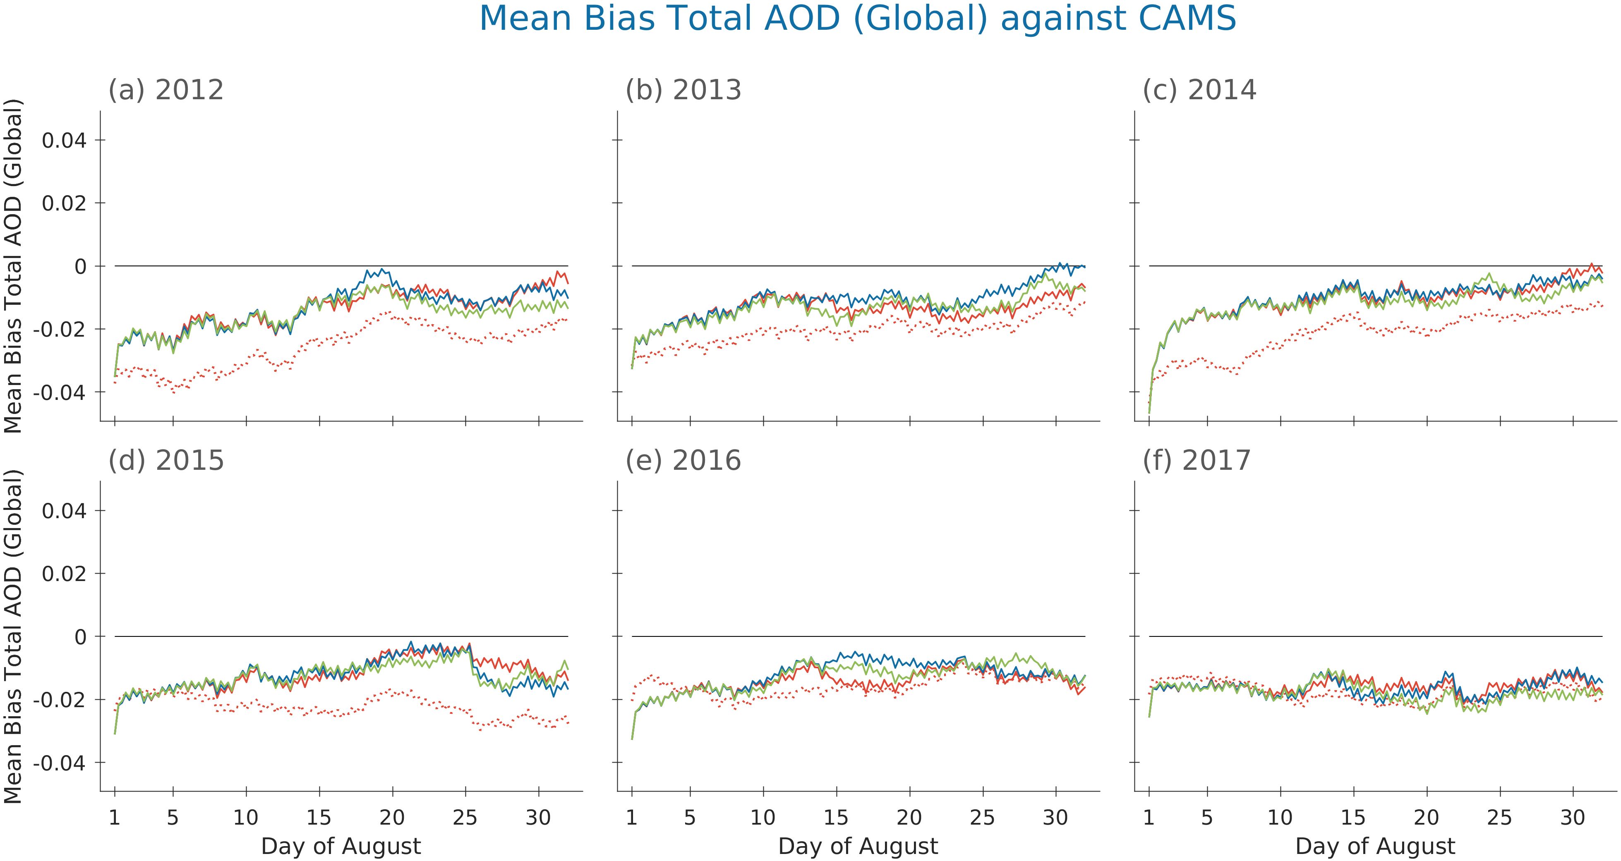
Impact of aerosol feedbacks on AOD prediction for 2012-2017
The MERRA-2 and CAMS AOD data exhibit substantially different magnitudes, resulting in different criteria for AOD bias validation. Consequently, AOD biases appear smaller when evaluated against CAMS than when compared with MERRA-2.
Aerosol feedbacks begin to show noticeable impacts on AOD after 10–15 days of simulation (spin-up time), while the differences remain relatively small in the global average when including radiative and indirect feedbacks from GOCART aerosols.
AOD biases with respect to MERRA-2 and CAMS in UFS-Chem August
Global mean bias of AOD against MERRA-2
Global mean bias of AOD against CAMS
MERRA-2 climatological AOD
GOCART Direct + semi-direct feedback
MERRA-2 Direct + semi-direct feedback
GOCART Direct + semi-direct + indirect feedback feedback

Slide 14
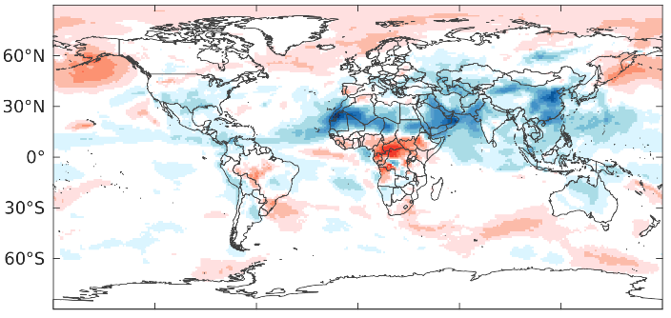
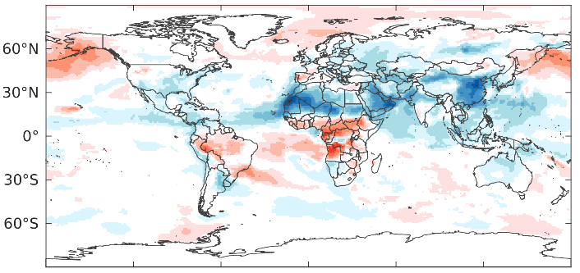
Impact of aerosol feedback on AOD biases in GCAFSv1
Direct + semi-direct feedback from MERRA-2 Climate
The implementation of online-predicted aerosols into the Thompson MP aerosol-aware scheme (indirect feedback) further reduces AOD biases over high latitudes compared to the inclusion of only direct and semi-direct feedback.
Inclusion of online-predicted aerosols for direct and semi-direct feedback reduces AOD biases over high latitudes in the Northern Hemisphere.
AOD biases with respect to MERRA-2, Aug. 2016
Direct + semi-direct feedback from NASA-GOCART
Direct + semi-direct + indirect feedback from NASA-GOCART

Slide 15
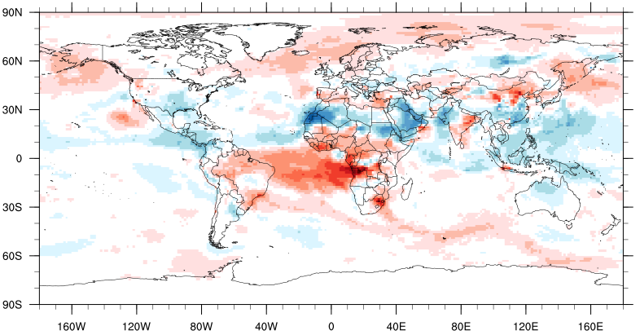
Impact of aerosol feedback on AOD biases in UFS-Chem
Direct + semi-direct feedback from MERRA-2 Climate
Both GCAFS and UFS-Chem shows consistent impact of aerosol feedbacks of direct, semi-direct: Including online-predicted aerosols for direct and semi-direct feedback reduces AOD biases over Northern Hemisphere high latitudes.
Adding online-predicted aerosol indirect feedback further reduces AOD biases at high latitudes but increases biases over the tropical Atlantic compared with using only direct and semi-direct feedback.
AOD biases with respect to MERRA-2, Aug. 2016
Direct + semi-direct feedback from GSL-GOCART
Direct + semi-direct + indirect feedback from GSL-GOCART

Slide 16
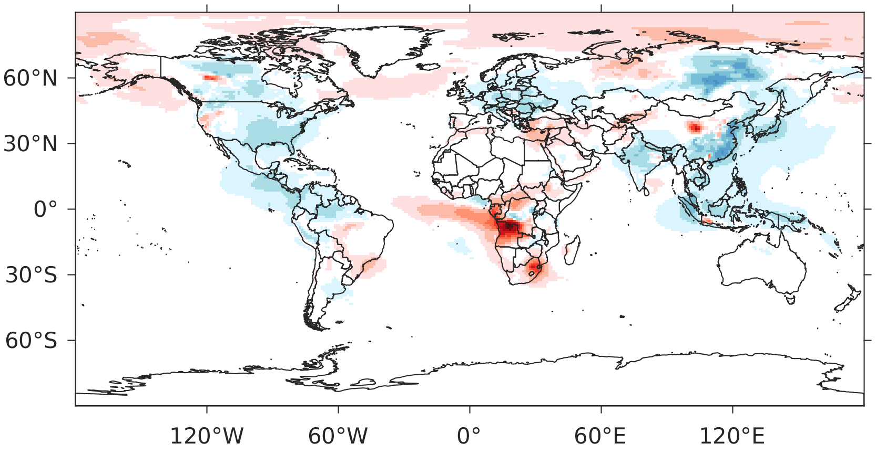
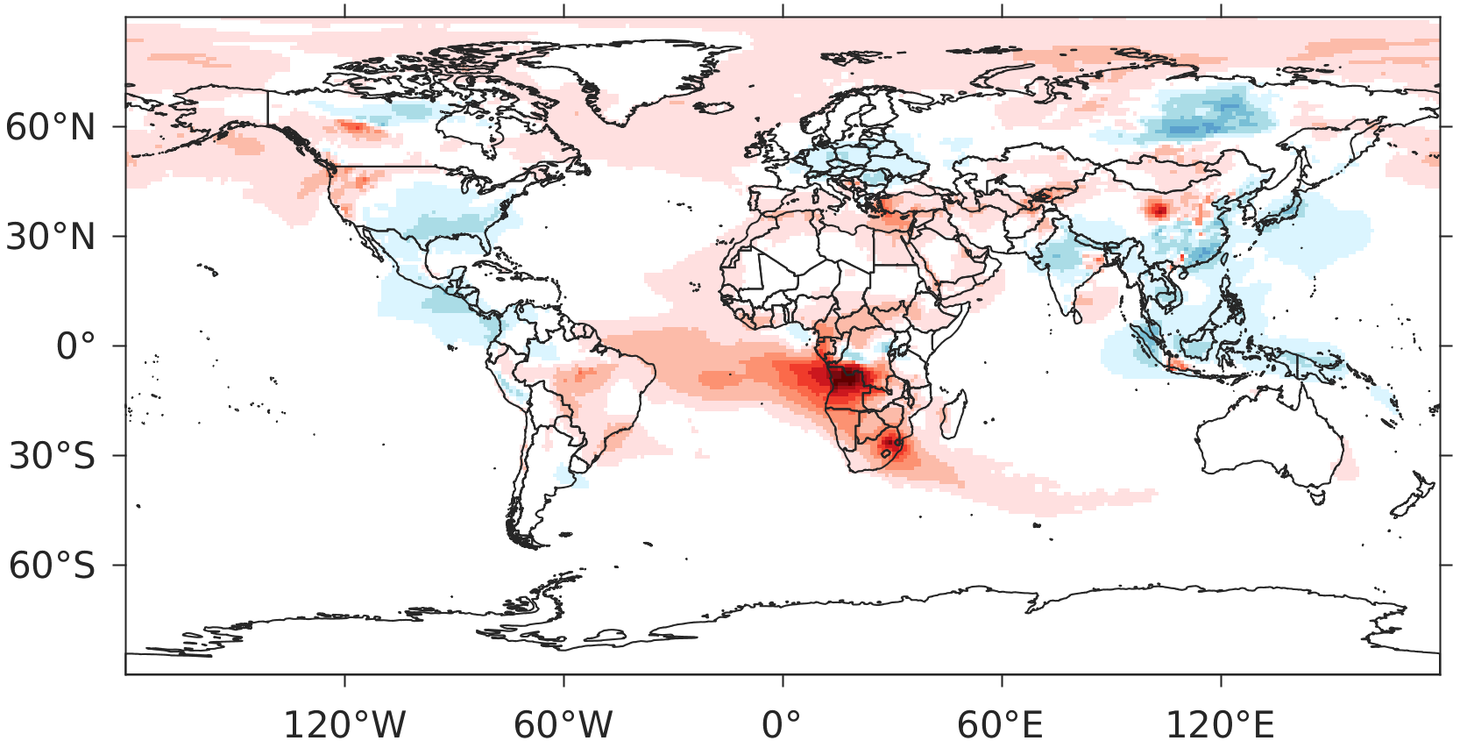
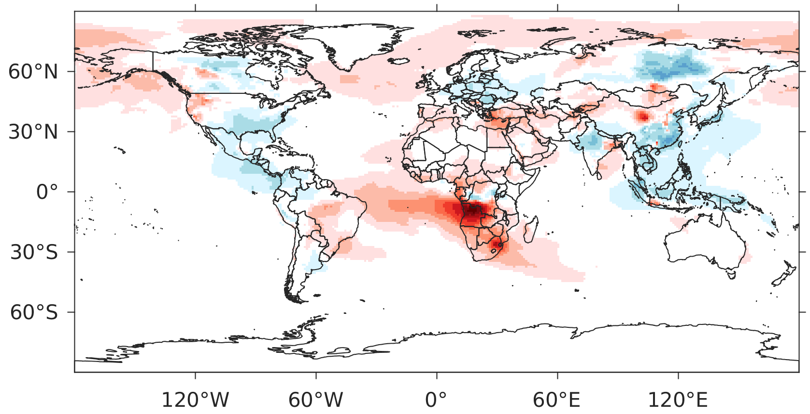
Impact of aerosol feedbacks on fire AOD prediction for 2012-2017
Fire (OC+BC+SO₄) AOD biases with respect to MERRA-2 in UFS-Chem, August of 6-yr average
MERRA2 Direct + semi-direct feedback
Mean bias:-0.003
Inclusion of online-predicted aerosols into the Thompson MP aerosol-aware scheme (indirect feedback) reduces fire AOD biases over high latitudes and North America compared to the inclusion of only direct and semi-direct feedback.
Inclusion of online-predicted aerosols for direct and semi-direct feedback from GOCART increase positive biases while improve negative biases of fire AOD.
No radiative feedback from coupled aerosol model
GSL-GOCART Direct + semi-direct feedback
GSL-GOCART Direct + semi-direct + indirect feedback
Mean bias:+0.005
Mean bias:+0.003

