Slide 1
Obstacles for High-Resolution HAFS over the Entire Atlantic Basin
Joseph Knisely
University of Maryland
WPO Innovation for Next Generation Scientists (WINGS) Fellow
Co-Author:
Dr. Jonathan Poterjoy, University of Maryland

Slide 2
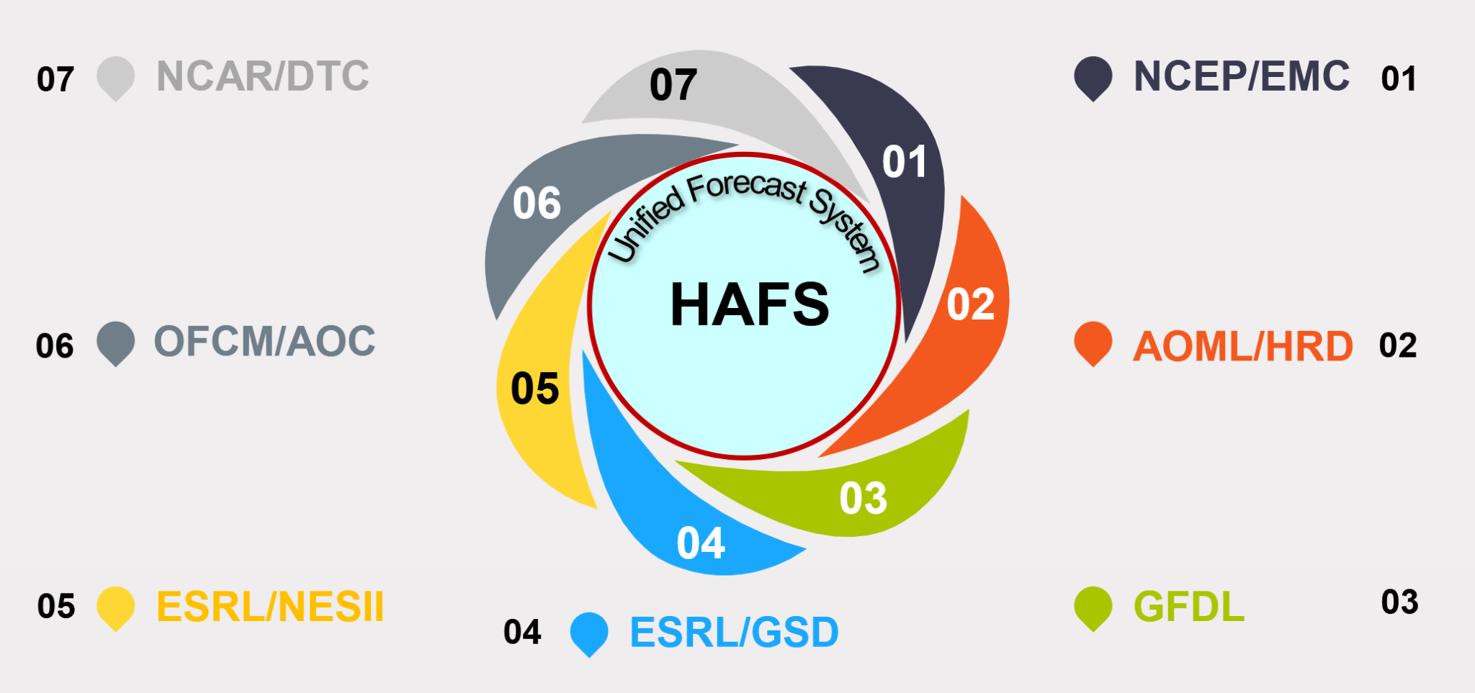
Introduction
Operational HAFS performs well, but relies heavily on GFS and features limited DA over a small nest, which constrains capabilities
We operate HAFS with a static, basin-wide analysis domain with uninterrupted assimilation of measurements domain-wide
Such a configuration would allow for a variety of probabilistic DA methodologies (e.g. high-res ensemble DA & forecasts, online radiance bias correction, etc.)
However, model physics parameters are carefully tuned to the TC application, and may struggle to characterize broader environmental conditions
Expanding analysis domain size while maintaining high resolution requires careful consideration of model physics
Notes:
We’re expanding this convective permitting domain without modifying physics. First of all because its expensive to test such things, and second because we’re not physics people. It goes beyond the scope of our work

Slide 3
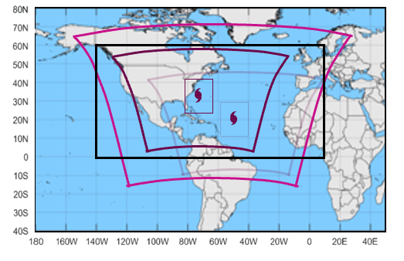
Goals
We operate HAFS with a static high-res analysis & forecast domain that covers the entire Atlantic basin, CONUS, and more
Config. includes continuous domain-wide DA and uses ensemble methodologies to produce probabilistic analyses
From these analyses we initialize an ensemble of storm-centric forecasts which resemble operational domain config.
We explore and compare two static analysis/forecast domain resolutions: 3 and 6 km
We examine how high-res. IC & ensemble data affect TC forecasts, including track & intensity, and compare vs. operational HAFS
We explore potential deficiencies with regards to model physics, but highlight the potential for probabilistic TC forecasting
Pink: Basin-wide 3/6 km analysis/forecast
Outer Purple: Storm-centric 6 km forecast
Inner Purple: Moving 2 km nest
Black: NHC “Area of Responsibility”
Notes:
Replace domain figure when you get a chance We in the HAFS community discussed domain rez and we decided in the long run we’d shoot for 3 km

Slide 4
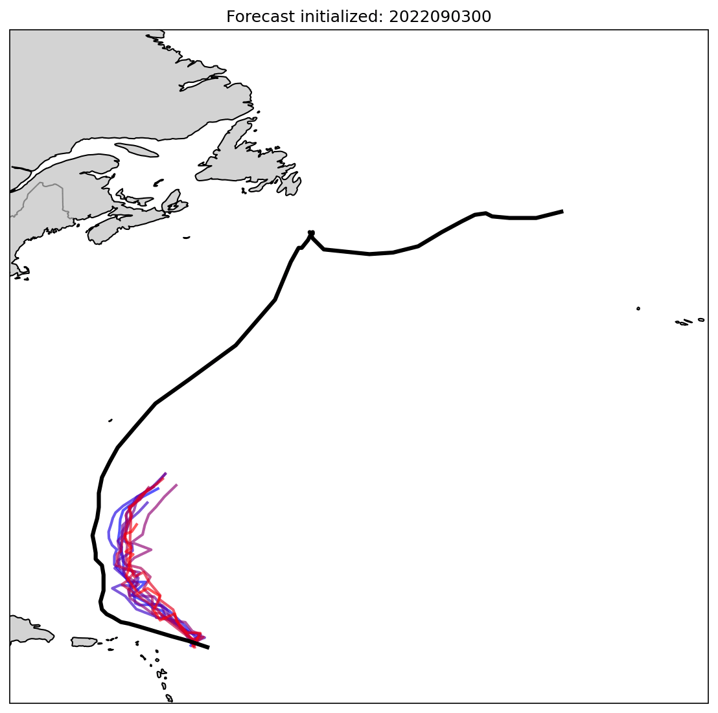
Model Details
3D-EnVar deterministic analysis w/ flow-dependent error covariances
40 member HAFS ens. augmented w/ 80 member GDAS ens. (Kurosawa and Poterjoy 2025)
Online radiance bias correction (Knisely and Poterjoy 2023)
Basin-wide analyses provides IC for 10 member ens. of long storm-centric forecasts
Storm-centric forecasts resemble operational HAFS: 6 km parent domain w/ moving 2 km nest
HAFS-B physics schemes
HYCOM ocean coupling
Experiments cover 20 days during 2022 season, include 2 named storms (Danielle & Earl)
Progression of 10 member forecast ens. along the lifecycle of Hurricane Earl. Each member is a different color, and best track is in black
Notes:
Ensemble of forecasts lets us cut down on sampling error/noisiness when verifying forecasts
Skip augmented ensembles but mention online radiace BC

Slide 5
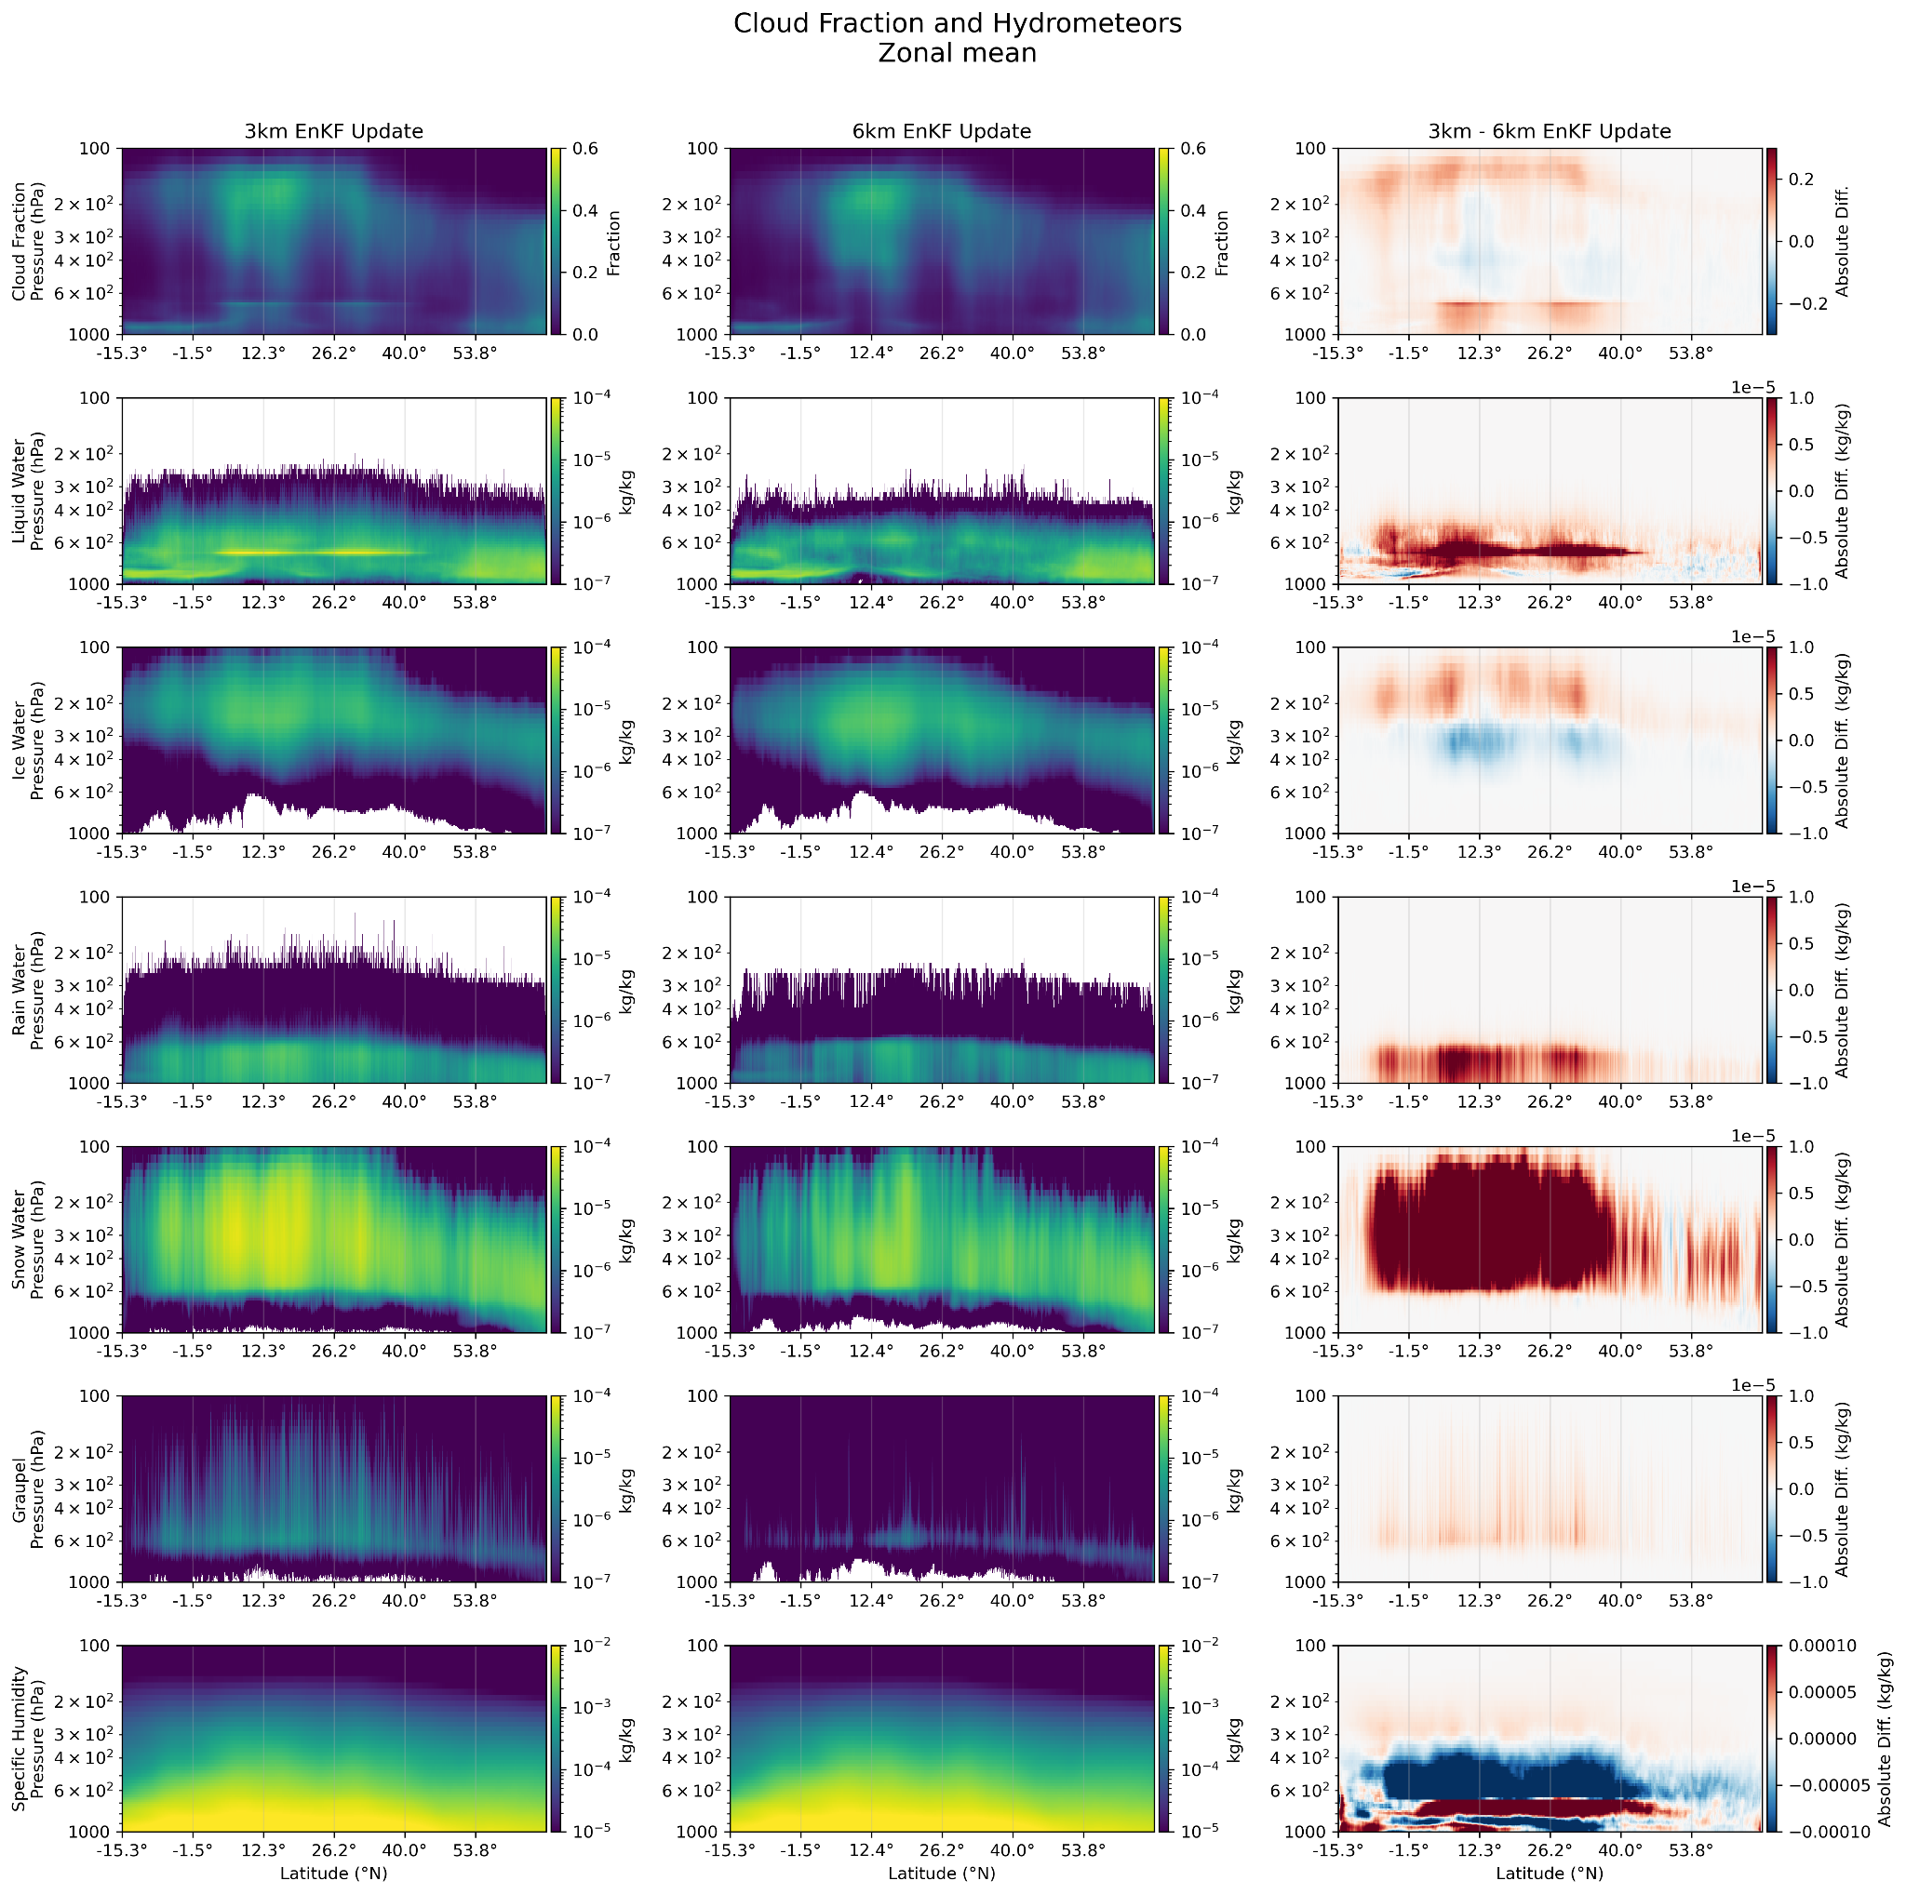
3 km
6 km
Diff
Changes in forecast resolution result in notable differences in the placement and concentration hydrometeors (water, ice, rain, snow, graupel)
We notice…
A prominent band of liquid water at 700 mb in 3 km
Ice water clouds biased to higher altitudes in 3 km
More snow & graupel throughout in 3 km
Liquid Water
Pressure (hPa)
Ice Water
Pressure (hPa)
Rain Water
Pressure (hPa)
Snow Water
Pressure (hPa)
for Diff plots:
Red —> 3 km higher
Blue —> 6 km higher
Graupel Water
Pressure (hPa)
Notes:
Changes in forecast resolution result in notable differences in the placement and concentration of humidity and hydrometeors

Slide 6
3 km
6 km
Diff
Cloud Fraction
Pressure (hPa)
Sp. Humidity
Pressure (hPa)
Changes in forecast resolution result in notable differences in the placement and concentration of cloud fraction & specific humidity
We see…
More humidity & stratus/nimbostratus clouds around 700 hPA in 3km
More humidity & cumulonimbus clouds throughout mid trop. in 6 km
Higher cloud fraction at high altitudes in 3 km (cold cloud bias)
for Diff plots:
Red —> 3 km higher
Blue —> 6 km higher
Notes:
Changes in forecast resolution result in notable differences in the placement and concentration of humidity and hydrometeors

Slide 7
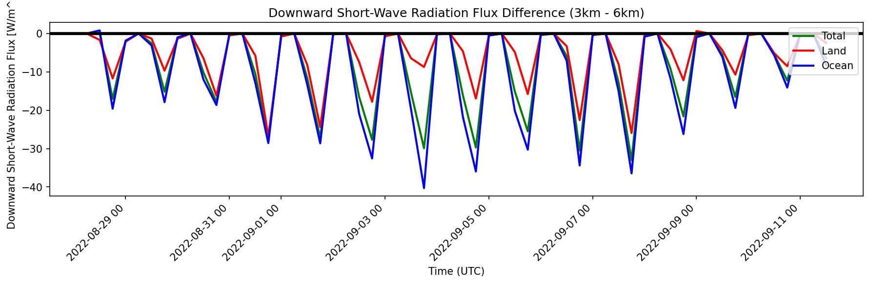
Positive Values: 3 km > 6 km
Negative Values: 6 km > 3 km
3 km results in significantly less downward shortwave radiation flux
Notes:
“The previous two slides showed how these different configs changed cloud coverage/location. We find that these differences in cloud coverage lead to notable differences in incoming rad. flux. and consequently surface temperature”

Slide 8
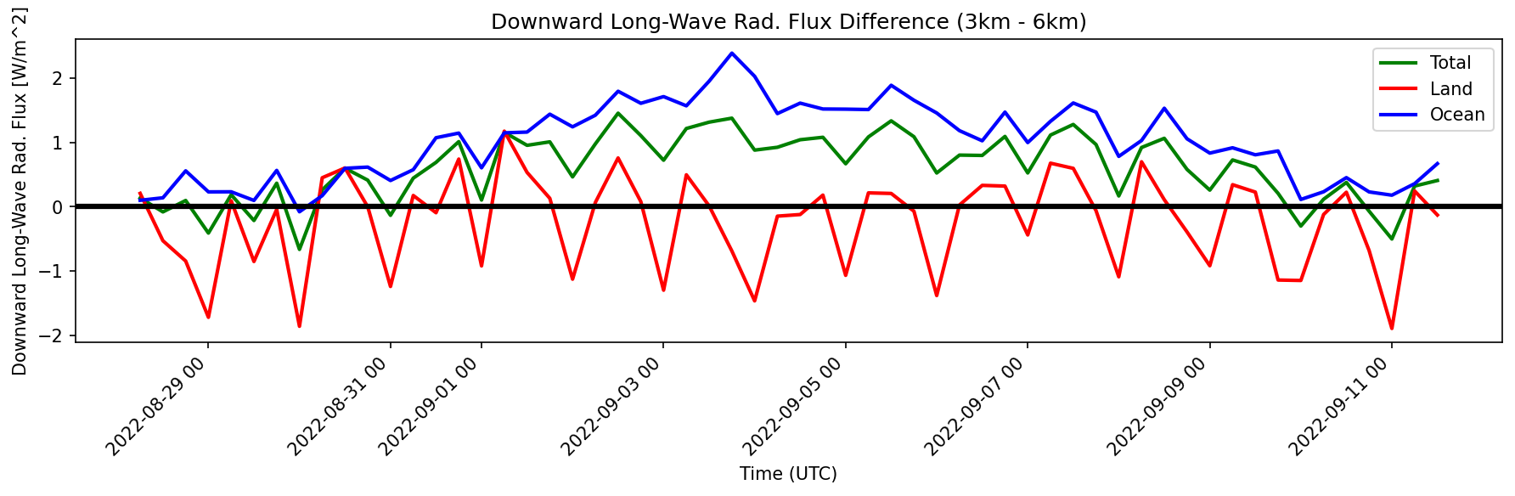
Positive Values: 3 km > 6 km
Negative Values: 6 km > 3 km
Notice that relative downward longwave rad. flux increases while Earl and Danielle are active
Notes:
“The previous two slides showed how these different configs changed cloud coverage/location. We find that these differences in cloud coverage lead to notable differences in incoming rad. flux. and consequently surface temperature”

Slide 9
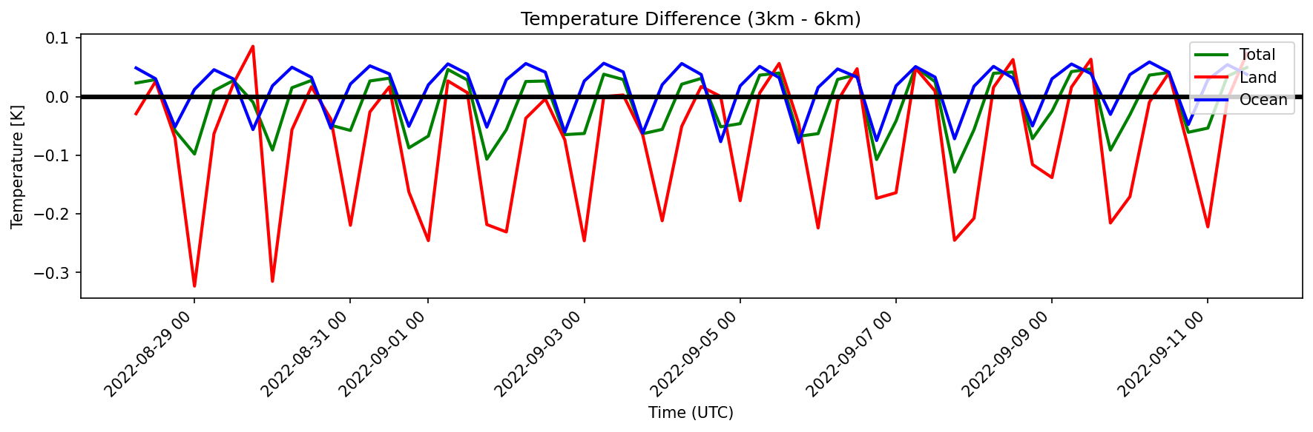
Positive Values: 3 km > 6 km
Negative Values: 6 km > 3 km
Differences in incoming rad. flux. correspond to differences in surface temperature
Notes:
“The previous two slides showed how these different configs changed cloud coverage/location. We find that these differences in cloud coverage lead to notable differences in incoming rad. flux. and consequently surface temperature”

Slide 10
Positive Values:
3 km > 6 km
Negative Values:
6 km > 3 km
Notes:
“The previous two slides showed how these different configs changed cloud coverage/location. We find that these differences in cloud coverage lead to notable differences in incoming rad. flux. and consequently surface temperature”
Notice how these rad fluxes over ocean are larger from 9/2 to 9/8. This coincides with two major weather systems (Earl & Danielle) over the basin.

Slide 11
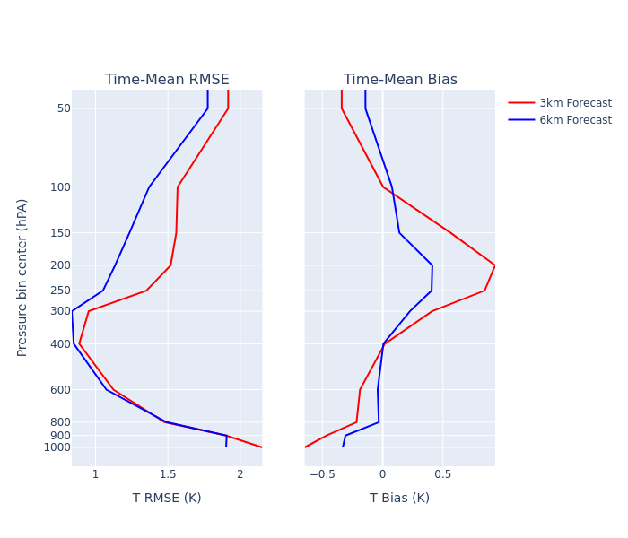
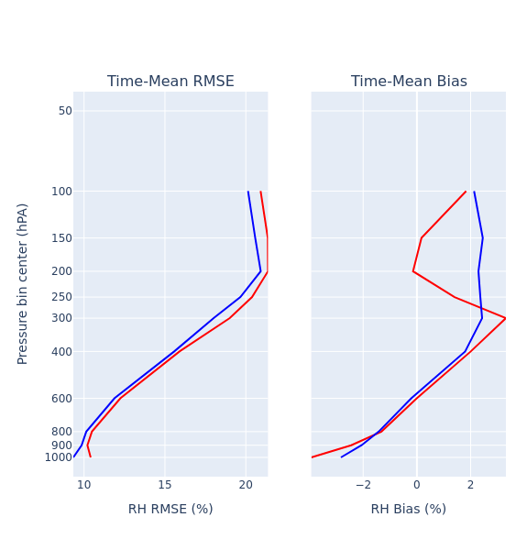
Domain-wide time-average observation minus forecast (O-B) verification
Temp
RH
Notes:
“The rad flux and temperature differences from the previous slide result in significantly different air mass biases throughout the entire atmospheric column”

Slide 12
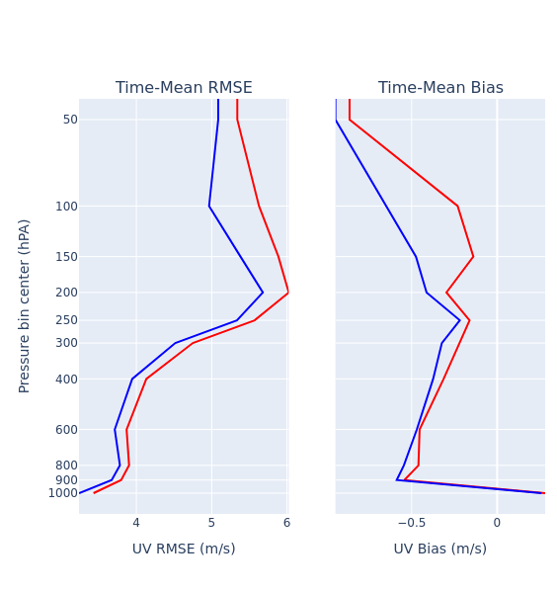
Domain-wide time-average observation minus forecast (O-B) verification
Temp
UV Wind
Notes:
“The rad flux and temperature differences from the previous slide result in significantly different air mass biases throughout the entire atmospheric column”

Slide 13
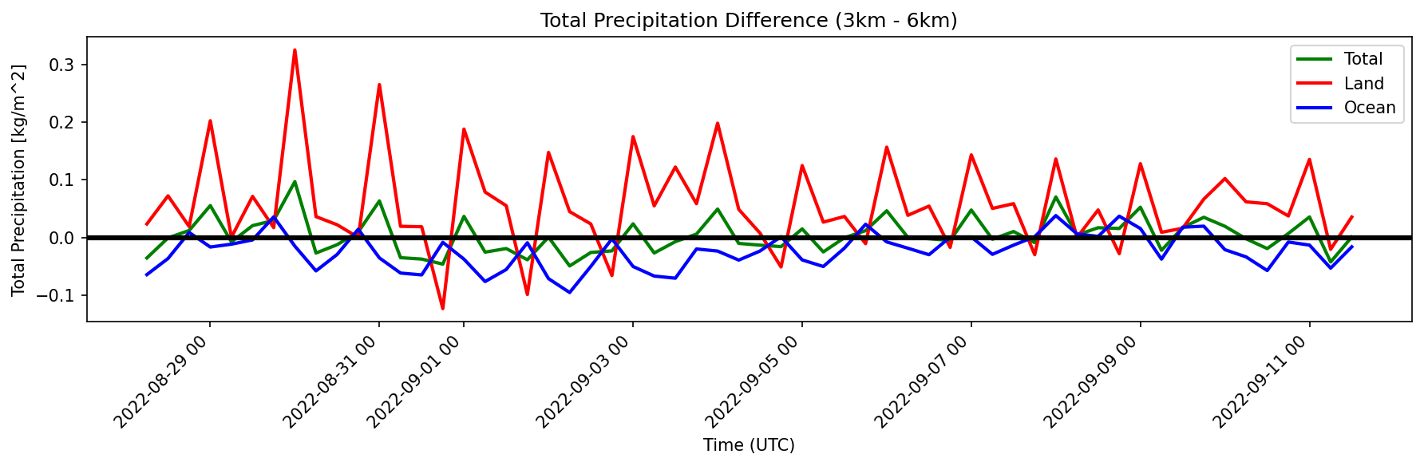
Total Precipitation Diff (3 km -6 km)
Positive Values: 3 km > 6 km
Negative Values: 6 km > 3 km
Notes:
“These rad flux and air mass bias differences also potentially feed back into cloud processes. We notice that while overall precip rates are similar, the 6km resolution results in greater convective precip and CAPE while the 3km results in greater non-convective precip.”

Slide 14
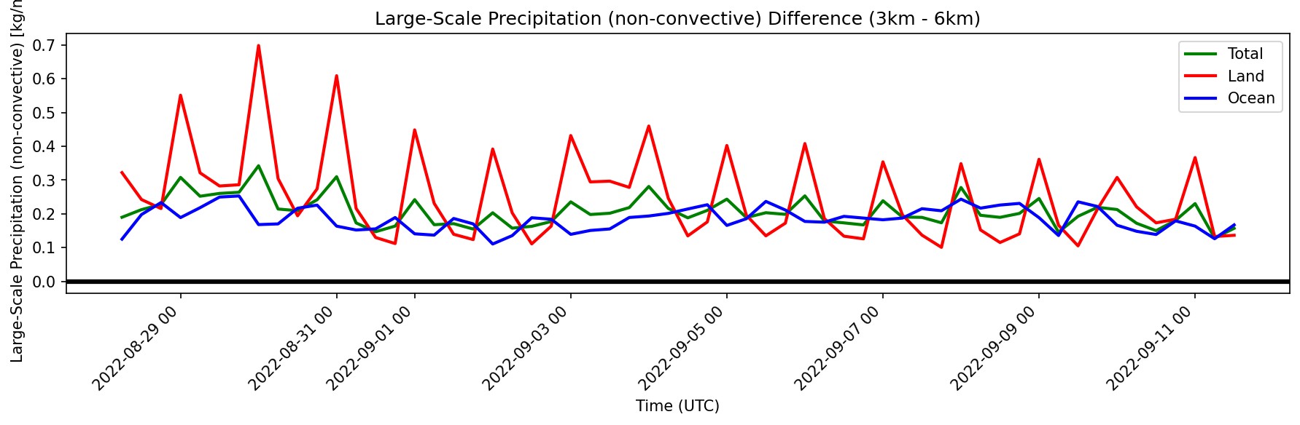
Total Precipitation Diff (3 km -6 km)
Large-Scale Precipitation (non-convective) Diff (3 km -6 km)
Positive Values: 3 km > 6 km
Negative Values: 6 km > 3 km
Notes:
“These rad flux and air mass bias differences also potentially feed back into cloud processes. We notice that while overall precip rates are similar, the 6km resolution results in greater convective precip and CAPE while the 3km results in greater non-convective precip.”

Slide 15
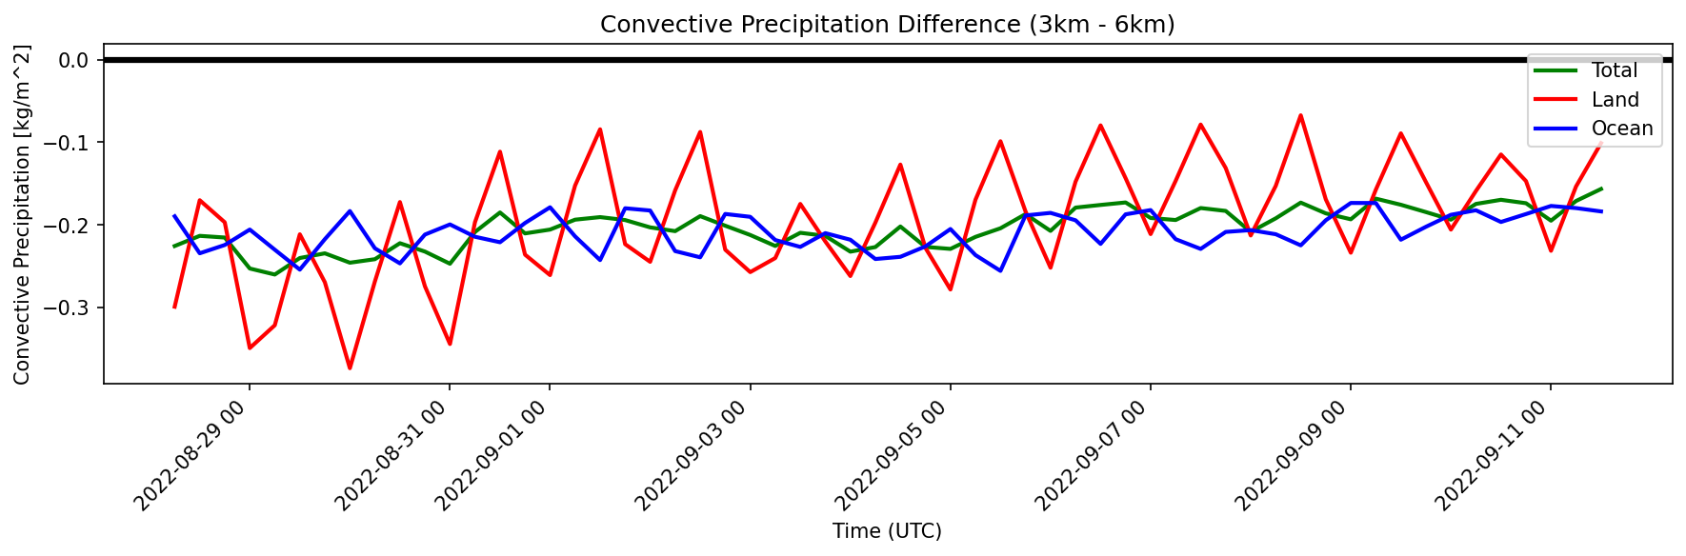
Total Precipitation Diff (3 km -6 km)
Convective Precipitation Diff (3 km -6 km)
Large-Scale Precipitation (non-convective) Diff (3 km -6 km)
Positive Values: 3 km > 6 km
Negative Values: 6 km > 3 km
Notes:
“These rad flux and air mass bias differences also potentially feed back into cloud processes. We notice that while overall precip rates are similar, the 6km resolution results in greater convective precip and CAPE while the 3km results in greater non-convective precip.”

Slide 16
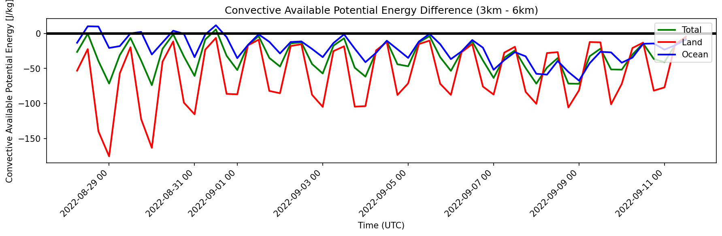
Total Precipitation Diff (3 km -6 km)
Convective Precipitation Diff (3 km -6 km)
Large-Scale Precipitation (non-convective) Diff (3 km -6 km)
CAPE Diff (3 km -6 km)
Positive Values: 3 km > 6 km
Negative Values: 6 km > 3 km
Notes:
“These rad flux and air mass bias differences also potentially feed back into cloud processes. We notice that while overall precip rates are similar, the 6km resolution results in greater convective precip and CAPE while the 3km results in greater non-convective precip.”

Slide 17
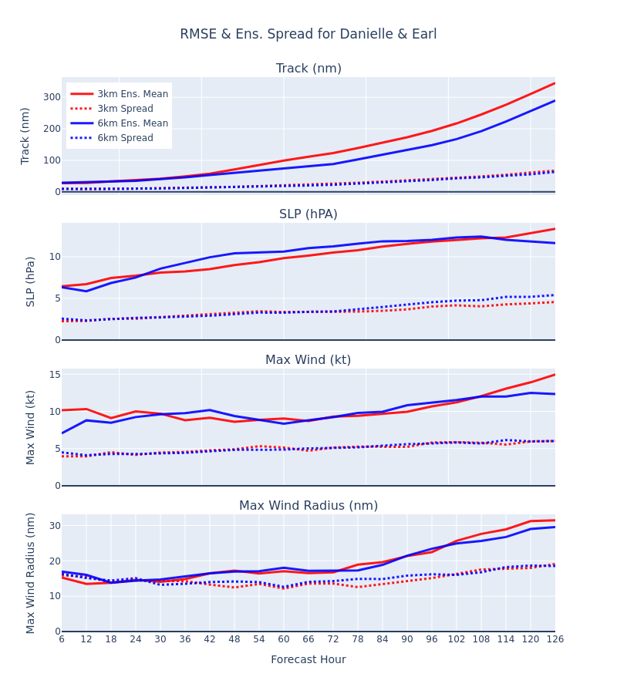
RMSE & Ens. Spread (Danielle and Earl)
TC-specific error metrics for 10 mem. ens. mean
6 km results in noticeably better track forecasts
Intensity results are more mixed
Underdispersed spread
Notes:
Given all the errors we showed in the last slide, it makes sense that 3km is giving us a bad track. Intensity is more mixed. SLP bias is almost zero at 6 hr

Slide 18
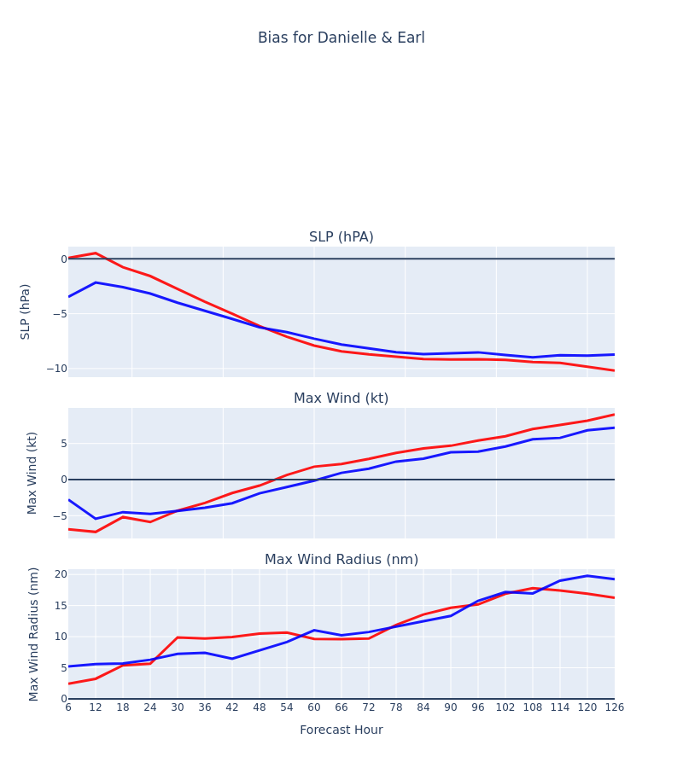
RMSE & Ens. Spread (Danielle and Earl)
TC-specific error metrics for 10 mem. ens. mean
6 km results in noticeably better track forecasts
Intensity results are more mixed
Underdispersed spread
Bias (Danielle and Earl)
Notes:
Given all the errors we showed in the last slide, it makes sense that 3km is giving us a bad track. Intensity is more mixed. SLP bias is almost zero at 6 hr

Slide 19
Summary
HAFS can benefit from a self-contained basin-wide analysis configuration featuring high-resolution ensembles
However, challenges remain in regards to expanding the analysis domain to the entire basin, particularly for model physics
Changes in resolution result in notable differences in the placement and concentration of humidity and hydrometeors
These differences in cloud coverage/composition result in significant air mass biases, which in turn feedback into cloud physical processes
Altogether, these changes result in non-trivial differences in error profiles for TC-specific metrics
These results should inform how we design and tune future HAFS model configurations

