Slide 1
JEDI-Based Data Assimilation for the NOAA Global Chemistry and Aerosol Forecast System (GCAFS)
Yaping Wang^{1,2}, Andrew Tangborn^{1,2}, Cory Martin², Li Pan^{1,2}, Partha S. Bhattacharjee^{1,2}, Barry Baker³, Fanglin Yang², Youhua Tang^{3.4}, Bing Fu², Raffaele Montuoro², Li (Kate) Zhang^{5,6}, Bo Huang^{5,8}, Jerome Barre⁷
¹Lynker/SAIC at NCEP/NWS/EMC/NOAA;
²Environmental Modeling Center, NCEP/NWS/NOAA;
³Air Resources Laboratory, NOAA; ⁴George Mason University; ⁵CIRES, University of Colorado;
⁶Global Systems Laboratory, NOAA; ⁷JCSDA/UCAR; ⁸Physical Sciences Laboratory, NOAA;
September 8-12, 2025

Slide 2

GCAFS - Global Chemistry and Aerosol Forecast System
The NOAA Global Chemistry and Aerosol Forecast System (GCAFS) is expected to begin operations in 2026.
GCAFS aerosol modules incorporate NASA's GOCART model.
15 aerosol species: dust, sea salt, black carbon, organic carbon and sulfate.
GCAFS include a Global Chemistry and Aerosol Data Assimilation System (GCDAS) for the first time and will use the Joint Effort for Data assimilation Integration (JEDI).

Slide 3
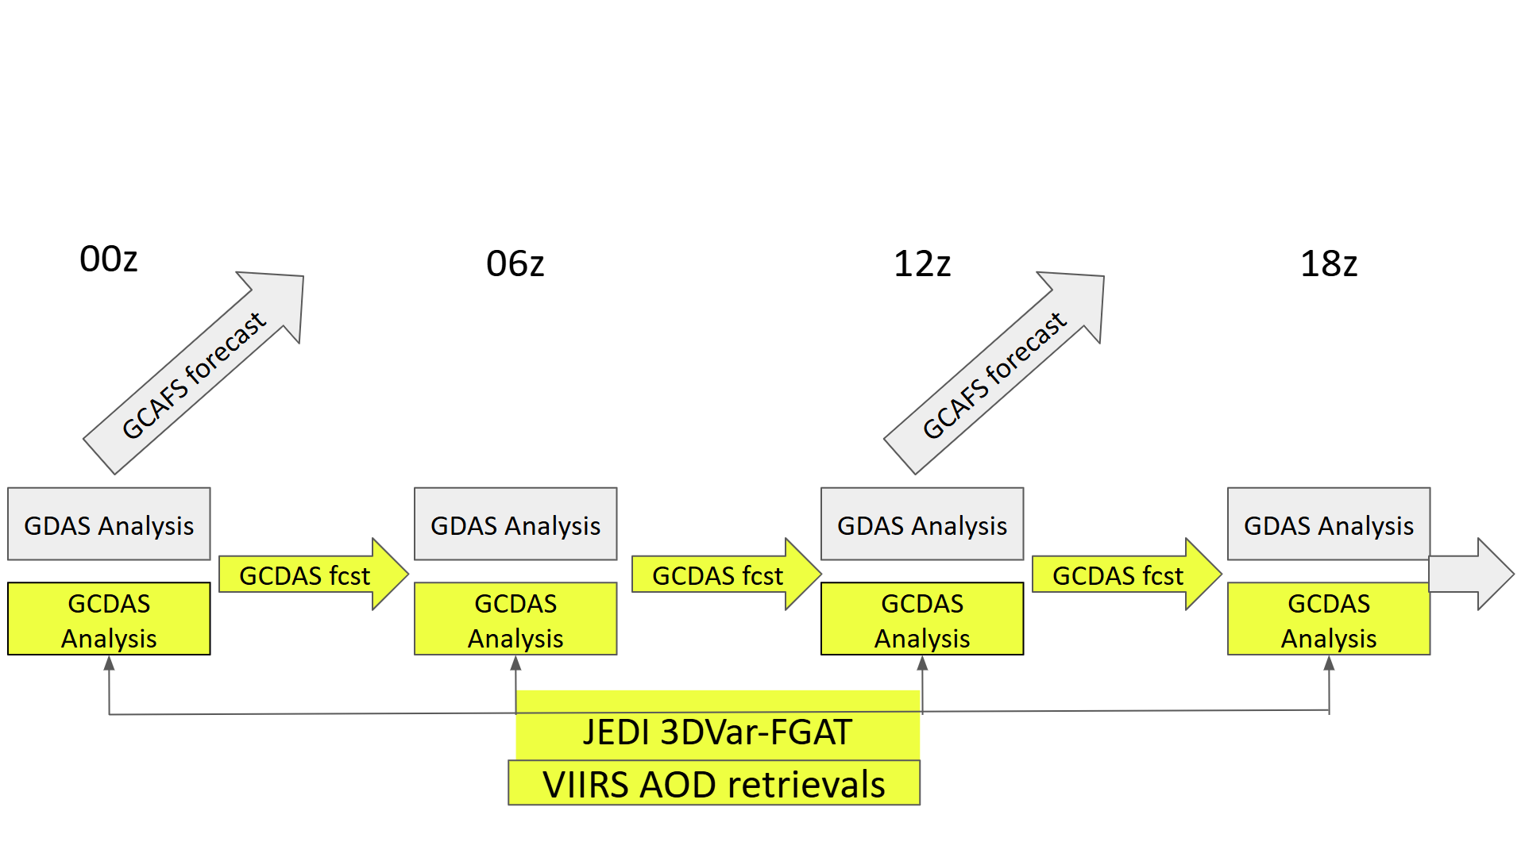
GCAFS Analysis Configuration
Atmospheric analysis from GDAS GSI in Global Forecast System (GFS) regridded to GCAFS resolution
Provides highest quality meteorology ICs
Aerosol Analysis from GCDAS using JEDI-based 3-dimensional variational-First Guess at Assimilation Time (3DVar-FGAT)
C384 analysis resolution (~25 km)
Update 14 tracer species
AOD CRTM operator
VIIRS Aerosol Optical Depth (AOD) products from S-NPP, NOAA-20, NOAA-21 satellites
GCAFS Cycling Workflow (Courtesy of Cory Martin)

Slide 4
GCDAS - Obs Quality Control
Observation Quality Control
High-quality obs within [-3h, +3h ] time window thinned or superobbed approximately to C384 resolution.
Domain check: Limit obs to 60°S–60°N latitude range.
Bounds Checks: obs values are within [0, 5].
Background Checks: Inflate observation error by 3 times if the departure between obs and background guess is larger than 3 times of observation error.
Variational Bias Correction (VarBC)
Bias correction applied to VIIRS NPP AOD
No VarBC to VIIRS N20 and N21 AOD (work as anchor)
Wind speed and Constant Predictors applied separately over land and sea

Slide 5
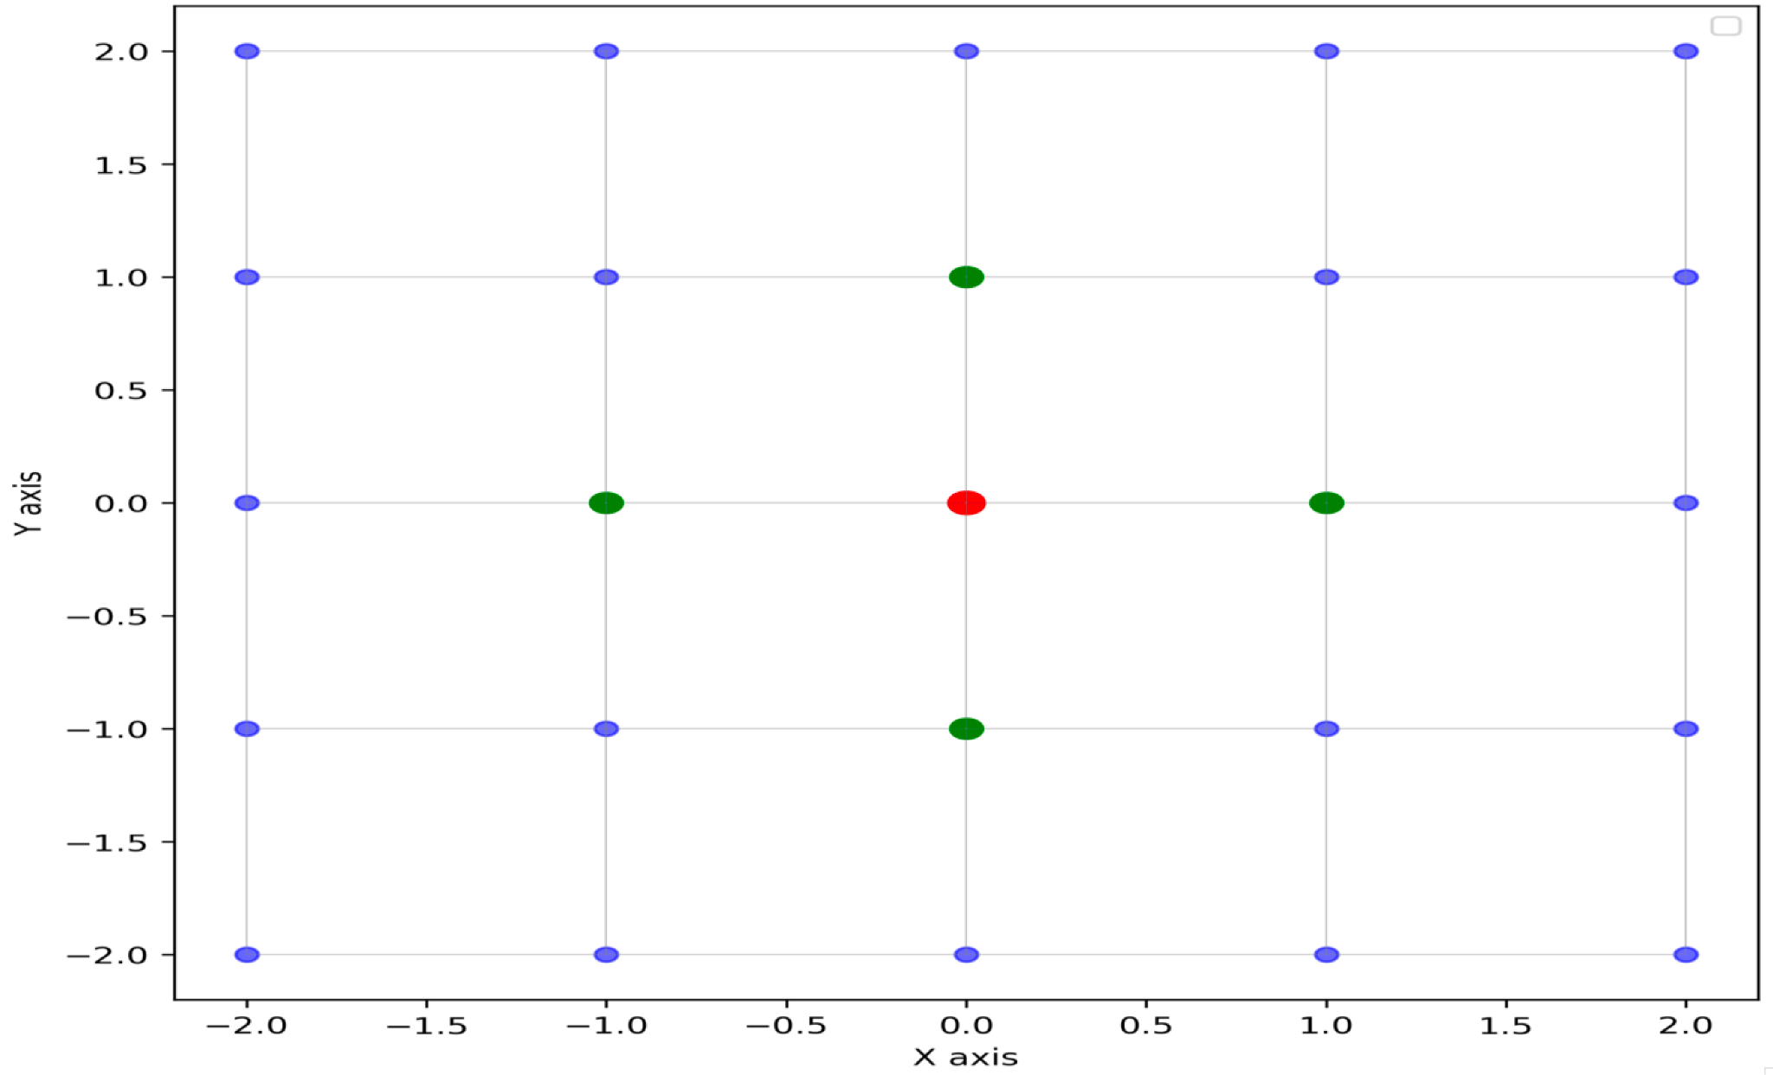
GCDAS - 3DVar Background Error Covariance (B)
Flow-dependent B matrix
The diagonal of the B are estimated based on background.
Tuning is done using rescaling factors that vary with aerosol species, land/ocean and latitude.
Spatial correlations length in B
300 km in horizontal, and 20 levels in vertical
B matrix is applied by the SABER model in JEDI.
Neighboring gridpoints are used to compute the aerosol variance around each gridpoint as a proxy for uncertainty at that gridpoint

Slide 6
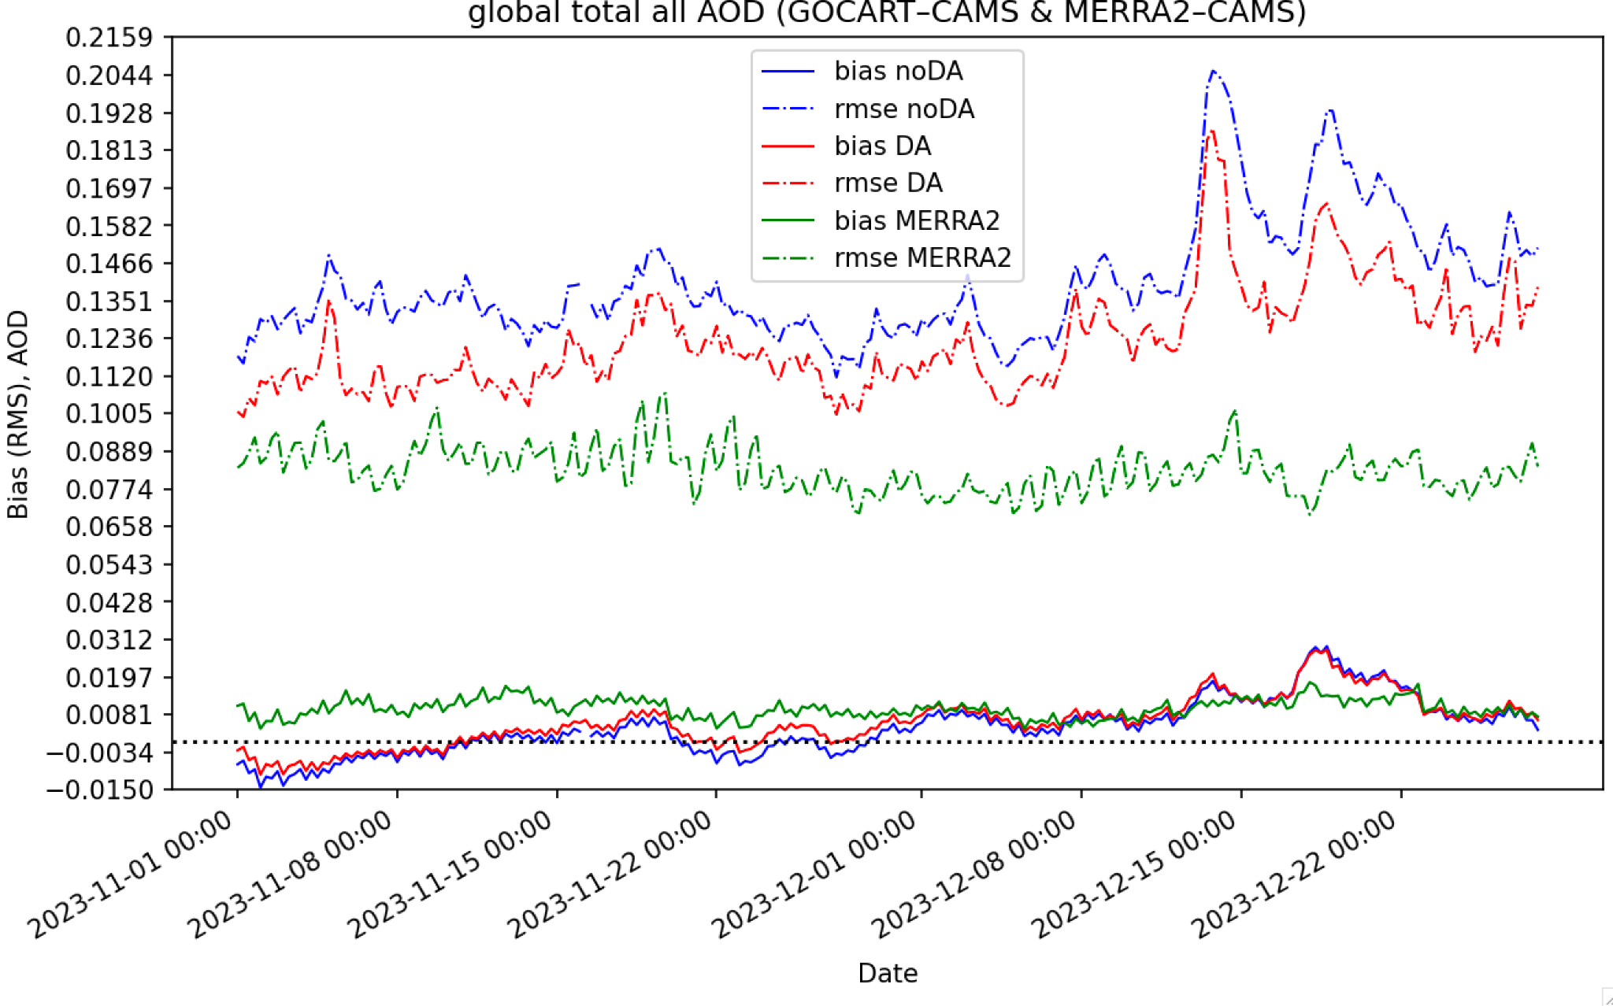
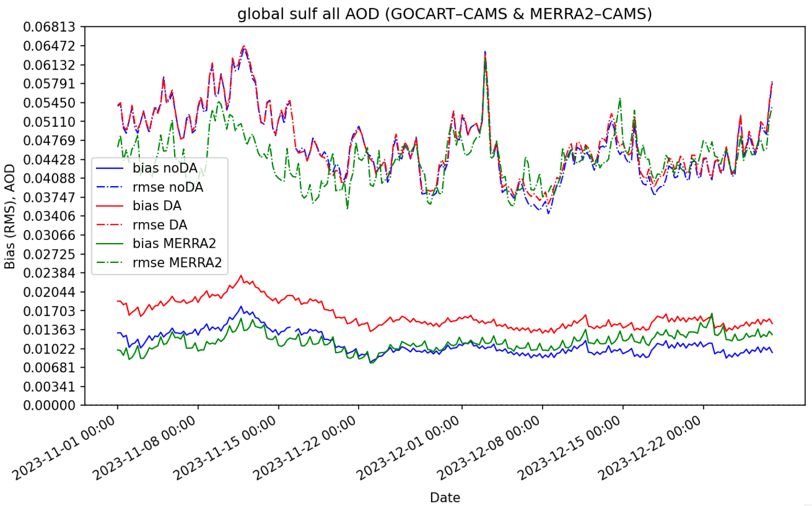
GCDAS Background Error Tuning Results
Cycling experiments started at Sep 30 2023 from a 15 day spinup.
GCDAS 6-h AOD forecast verification against CAMS (GCDAS - CAMS) starting after 1 month of cycling spin up.
MERRA2 against CAMS (MERRA2 - CAMS).
Blue - noDA
Red - DA
Green - MERRA2 reanalysis !!
Total AOD
Sulf AOD
noDA
DA
Nearly as good as MERRA2
MERRA2
(Courtesy of Andrew Tangborn)

Slide 7
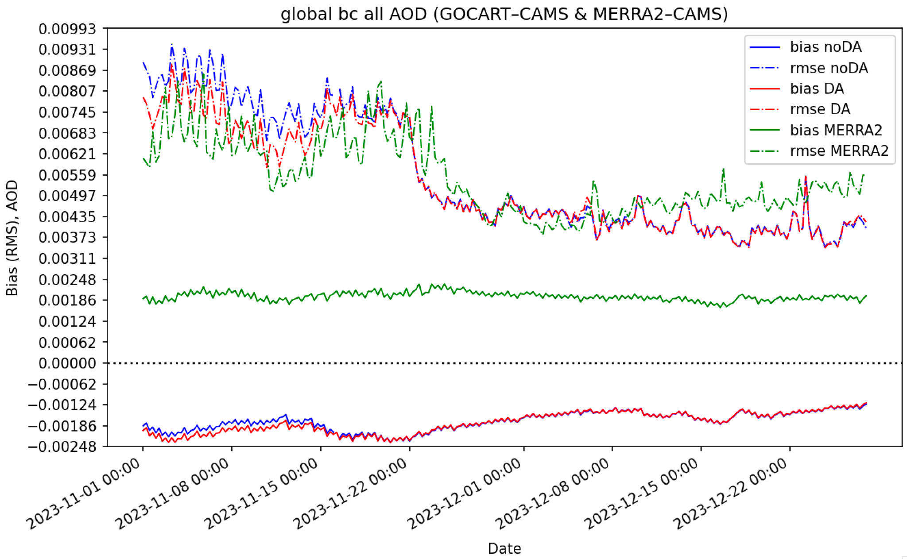
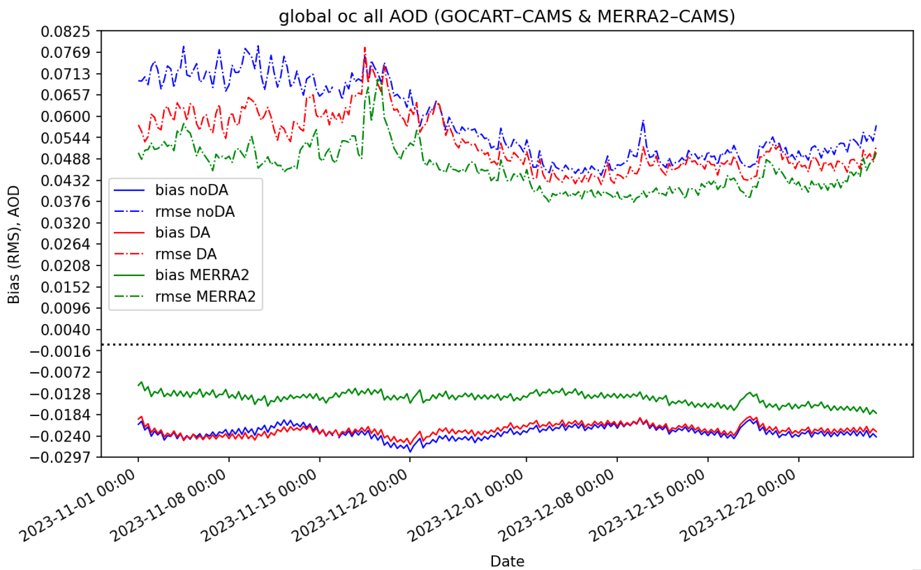
Blue - noDA
Red - DA
Green - MERRA2 reanalysis
BC AOD
OC AOD
Small quantities
(Courtesy of Andrew Tangborn)

Slide 8
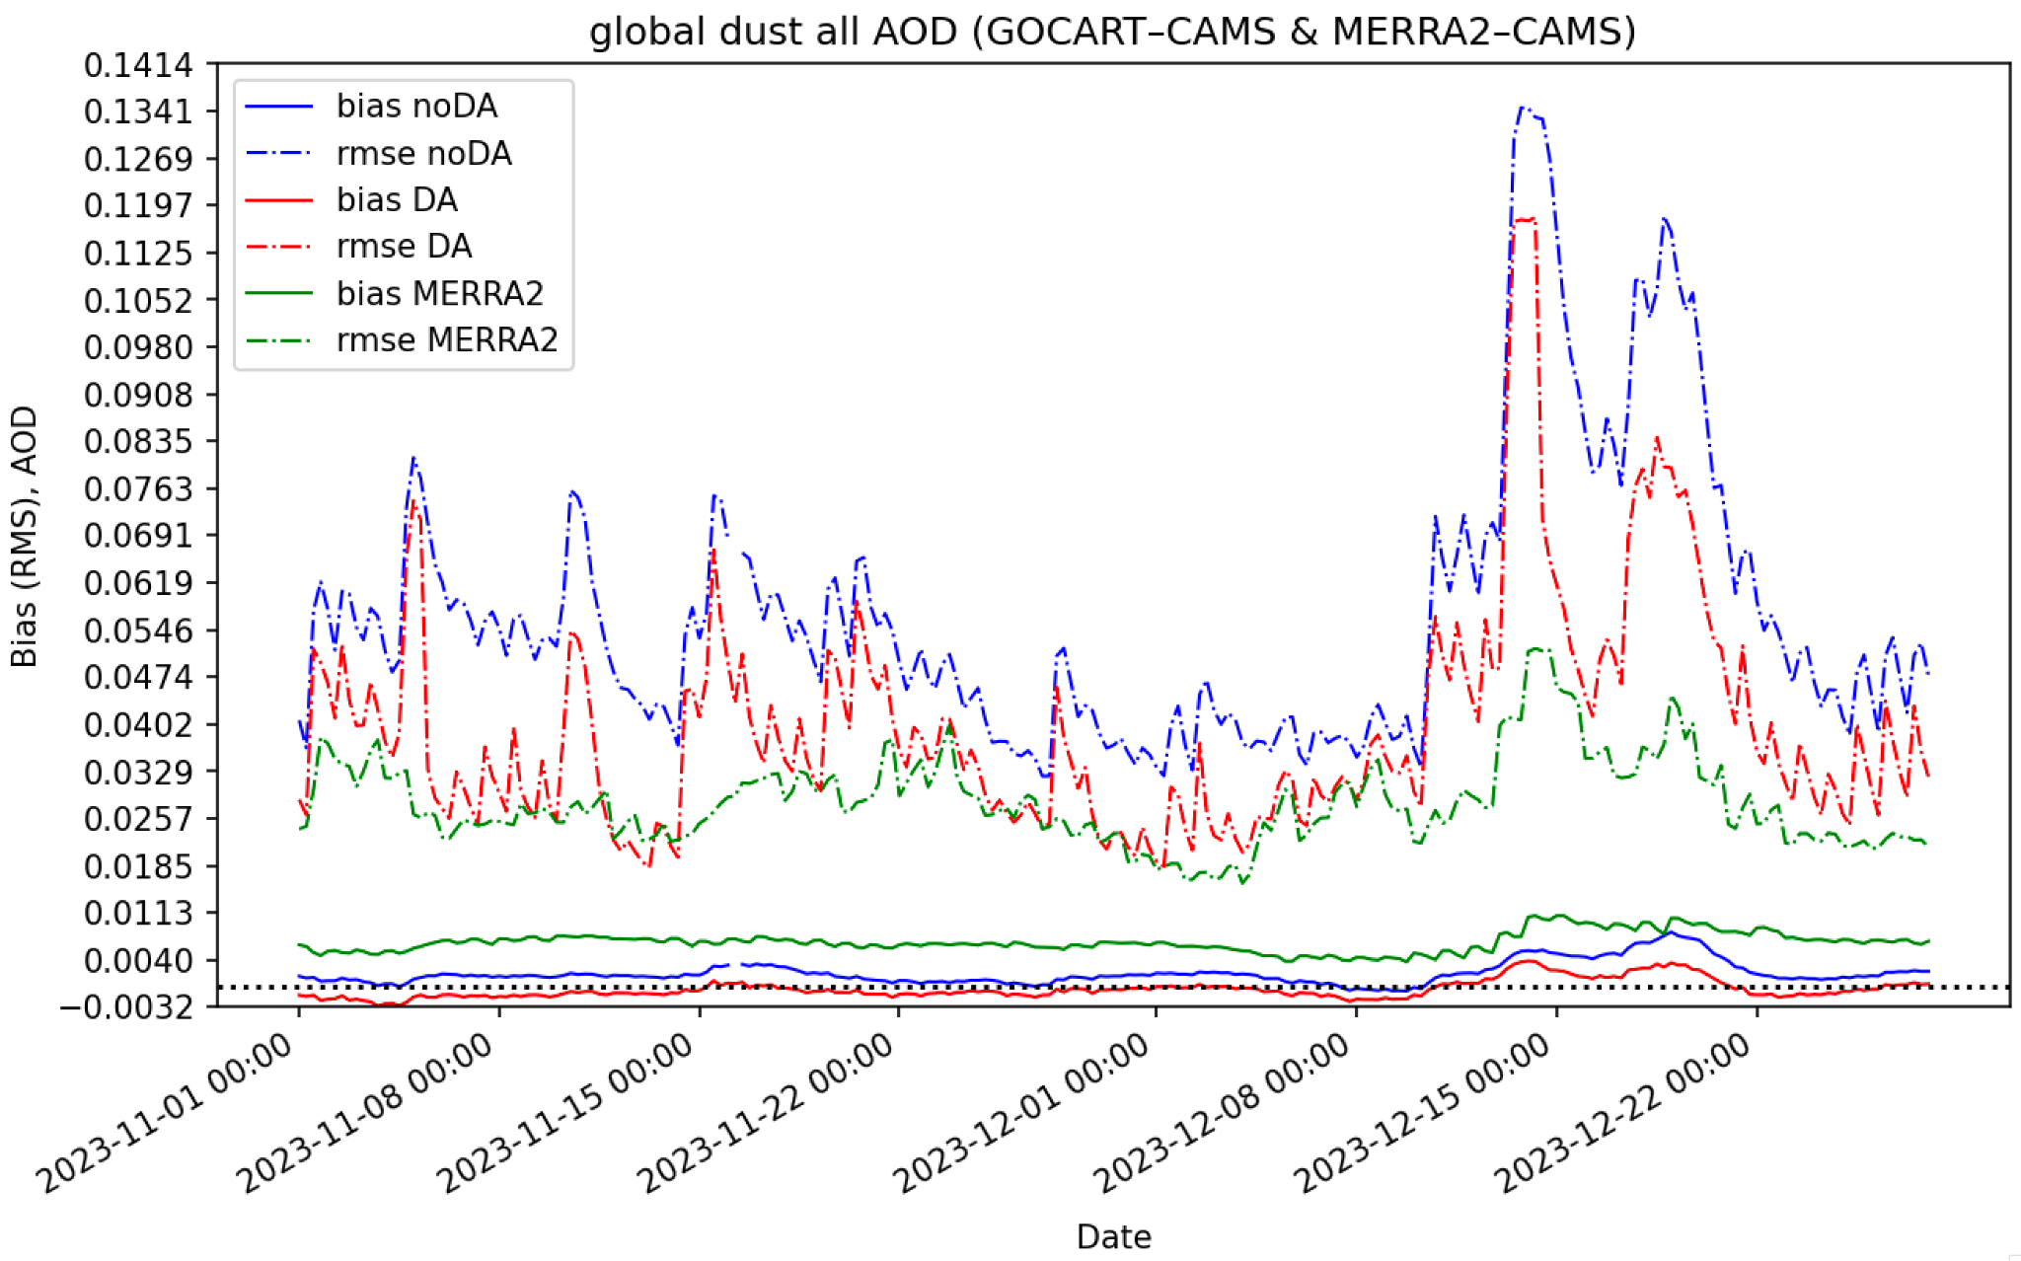
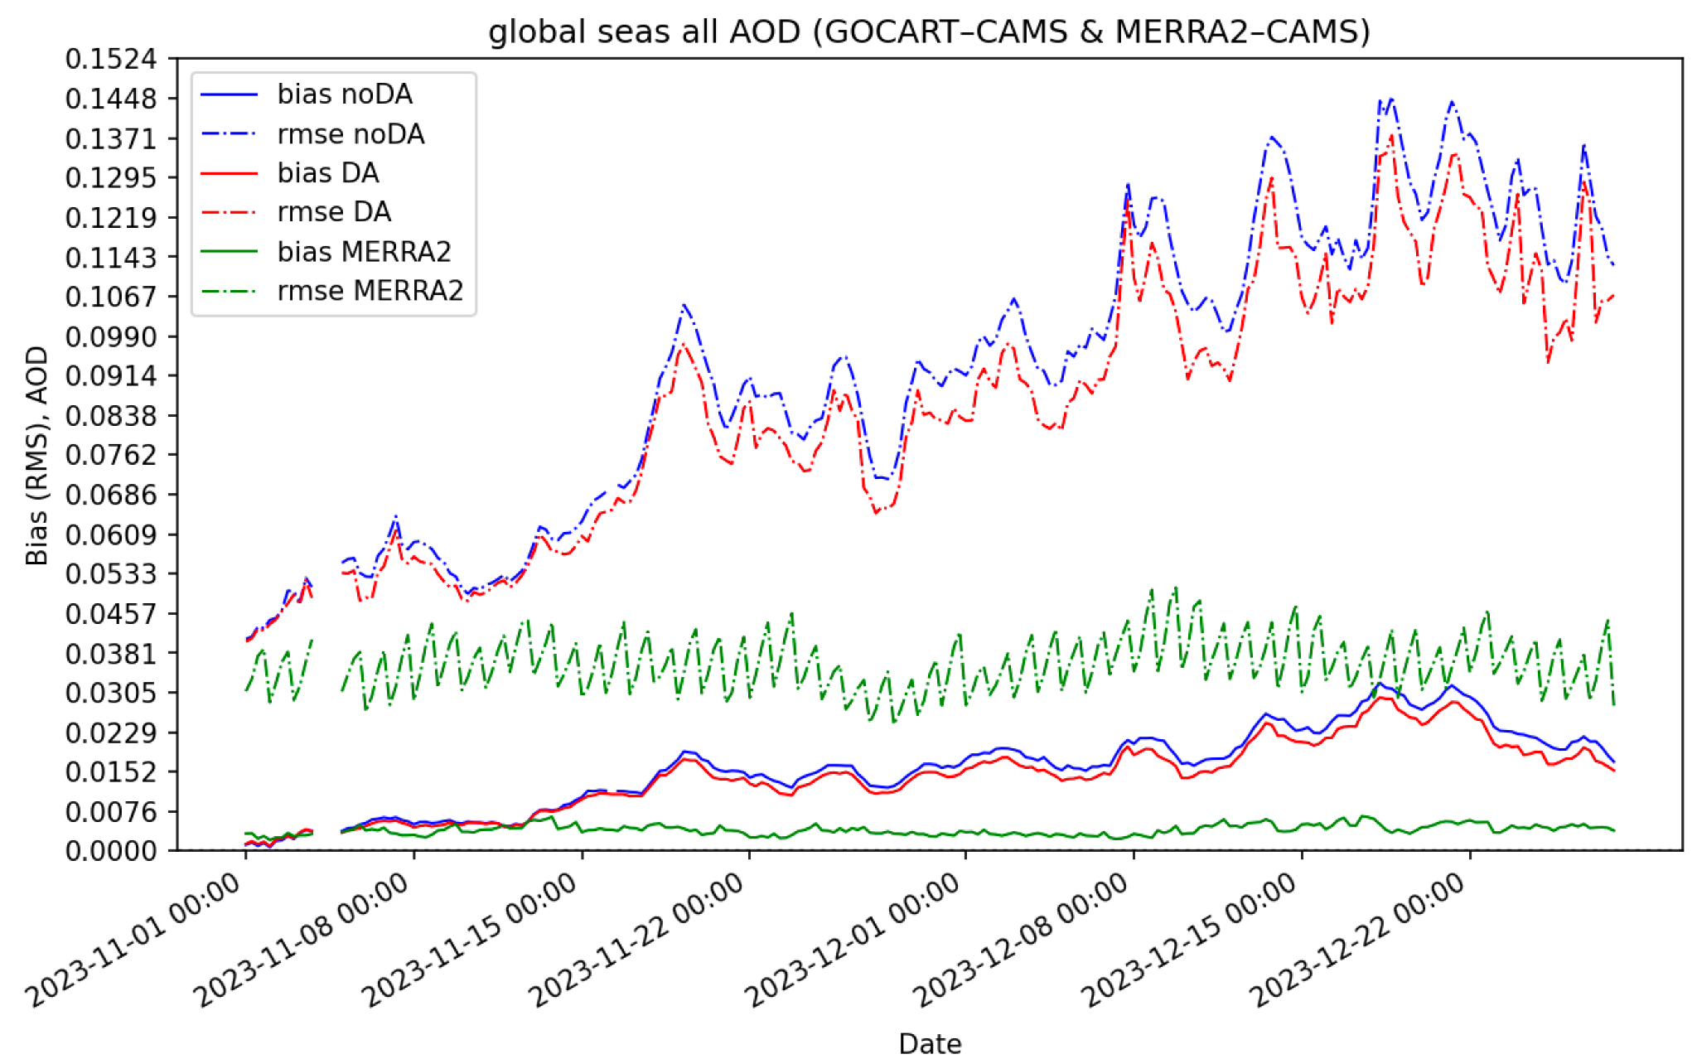
Blue - noDA
Red - no rescaling
Green - MERRA2 reanalysis
Dust AOD
Seasalt AOD
(Courtesy of Andrew Tangborn)

Slide 9
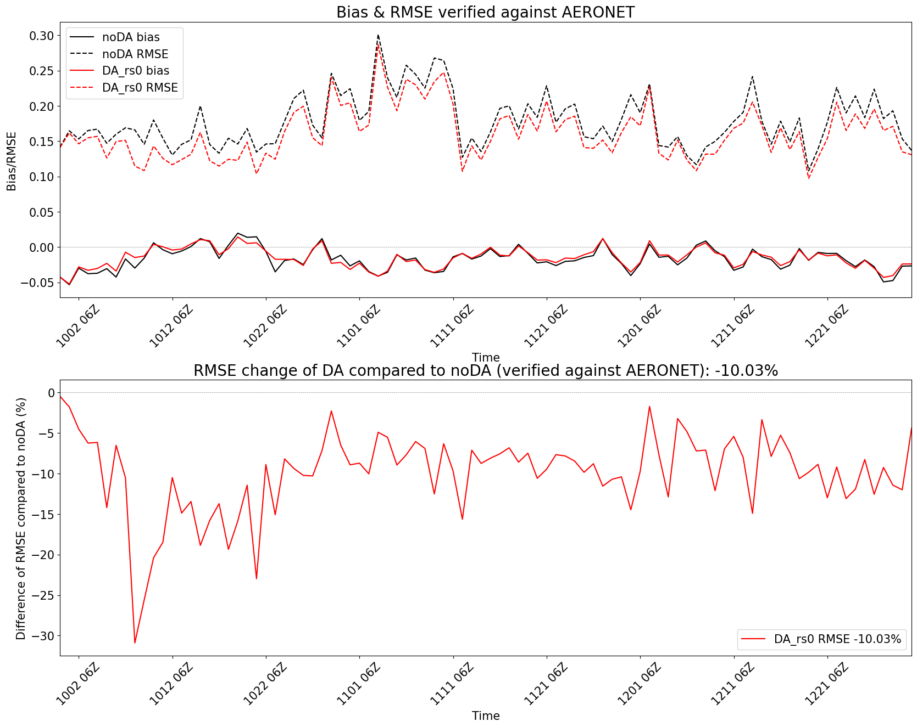
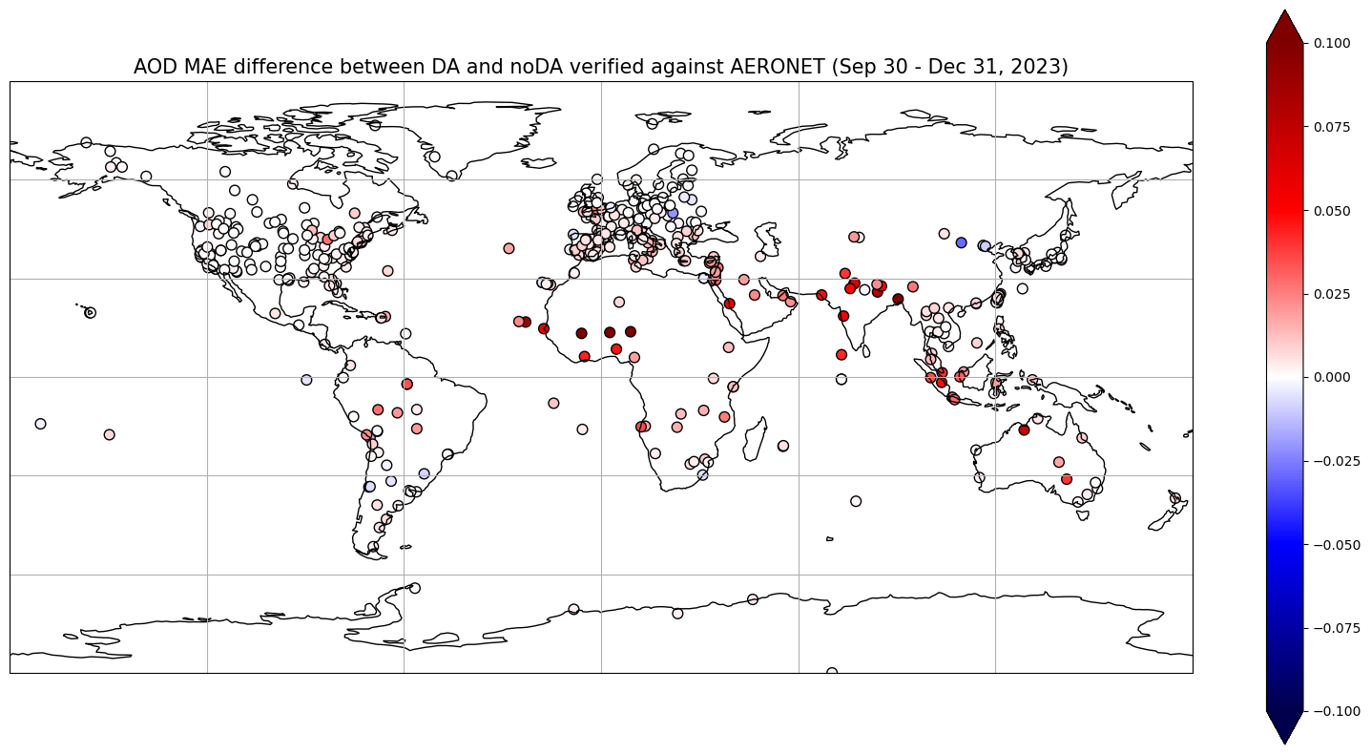
GCDAS 6-h AOD Verification against AERONET
The RMSE of total AOD verified against AERONET is reduced ~10% globally by DA.
Abs. Error difference (noDA - DA)
Better
10% lower
Wrose

Slide 10
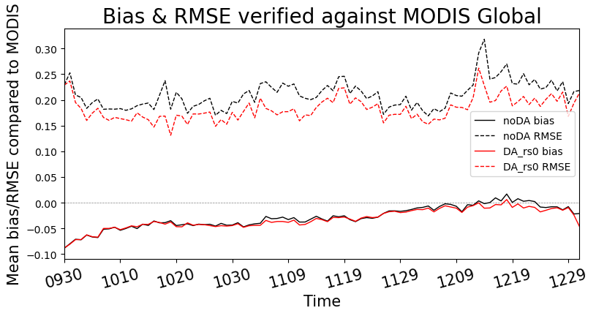
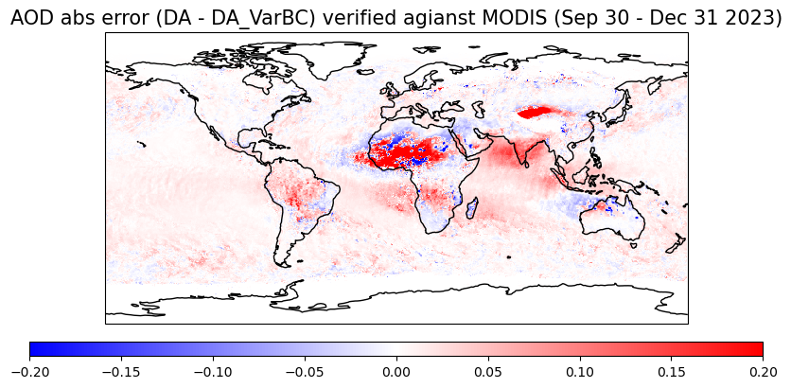
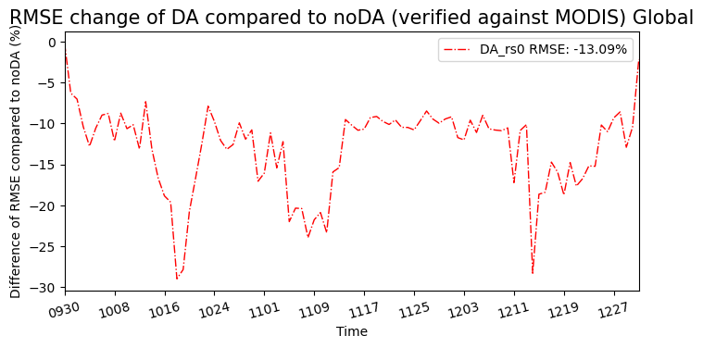
GCDAS 6-h AOD Verification against MODIS
The RMSE of AOD is reduced 13% globally by DA.
Most significant improvements are over dust areas and over ocean.
Worse
Better
13% lower

Slide 11
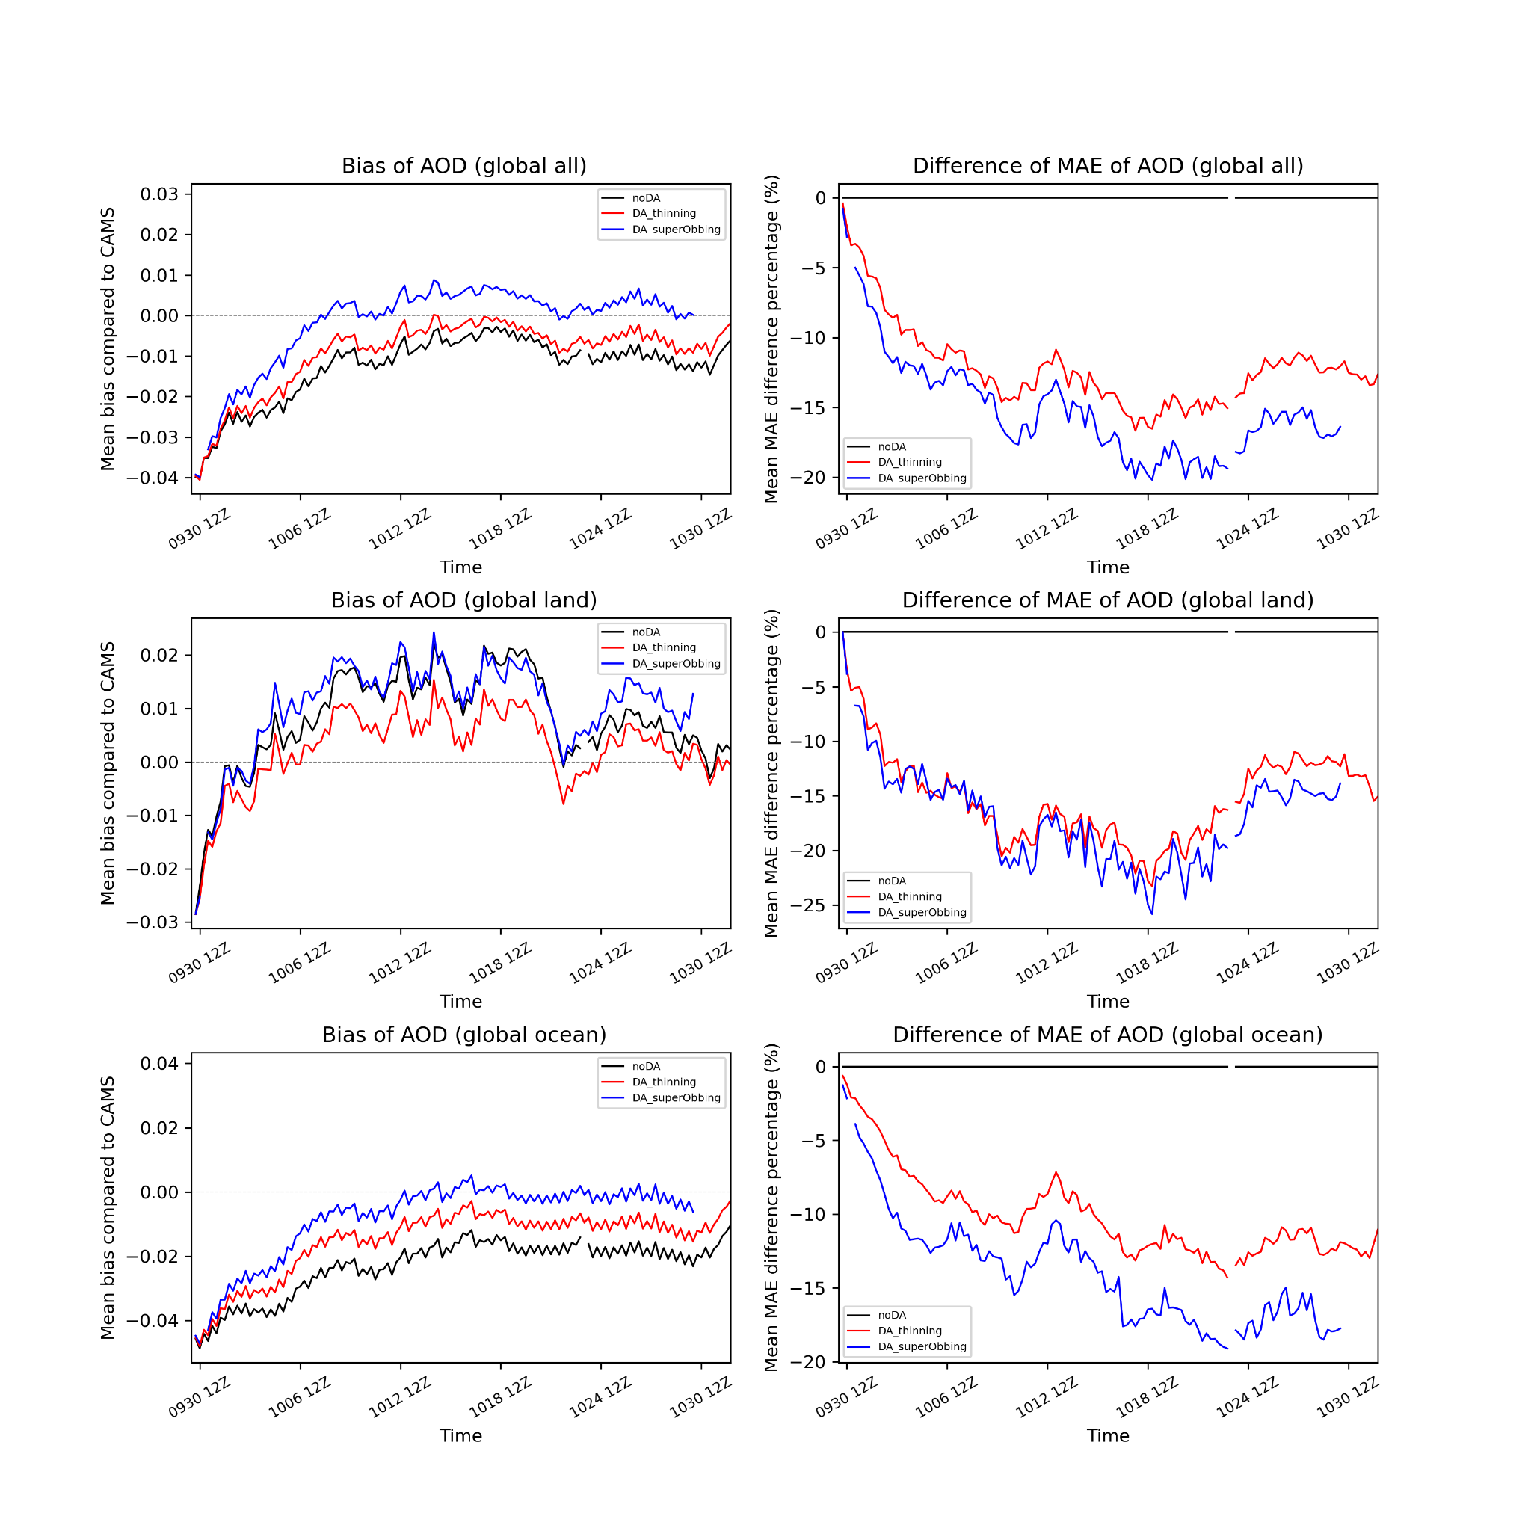
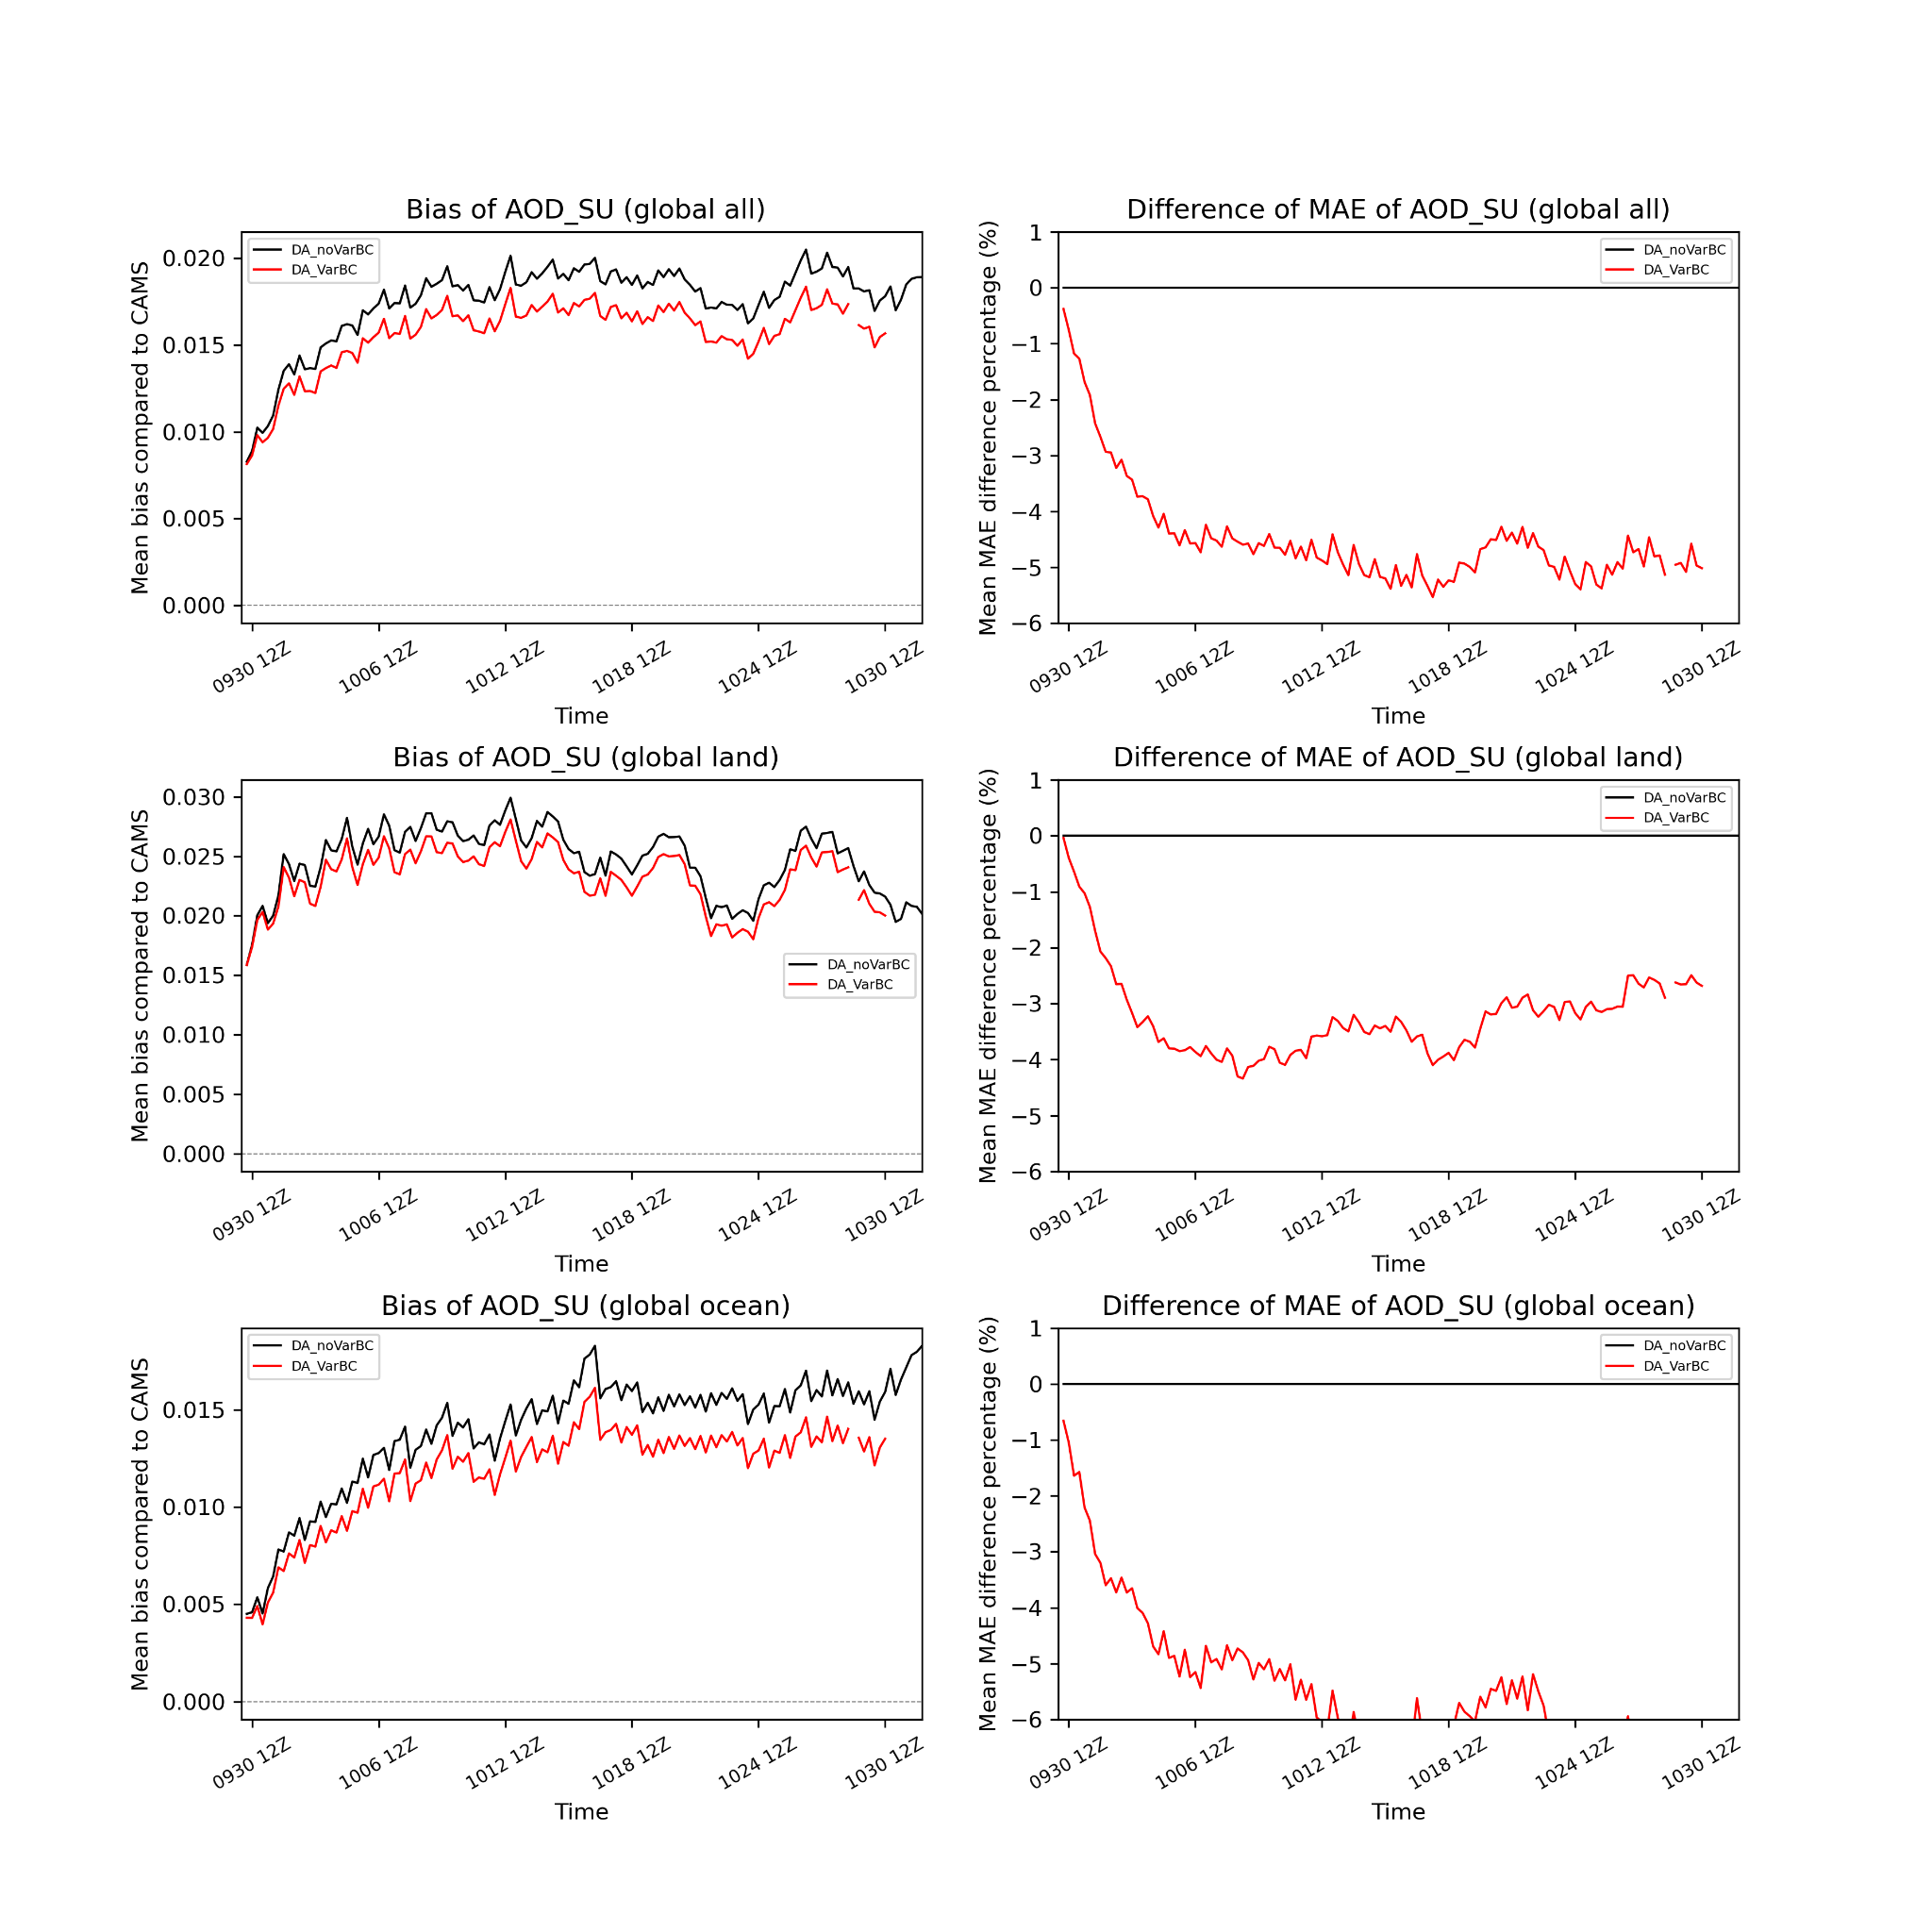
Quality Control Experiments Compared with CAMS
Total AOD
Thinning vs. Superobbing
Superobbing further reduces MAE.
No VarBC vs. VarBC
Bias correction applied to VIIRS NPP AOD
Wind speed and Constant Predictors
VarBC reduces MAE of Sulfate by ~5%.
SU AOD

Slide 12
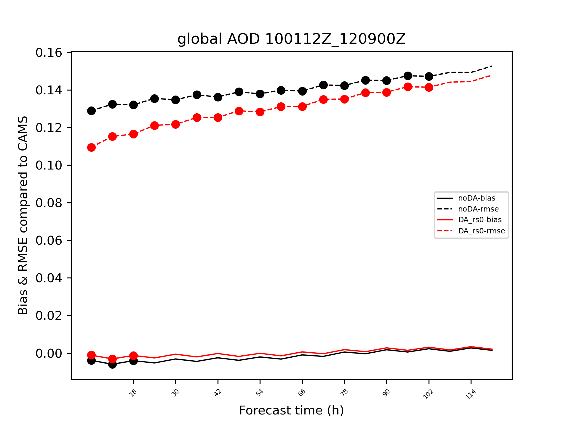
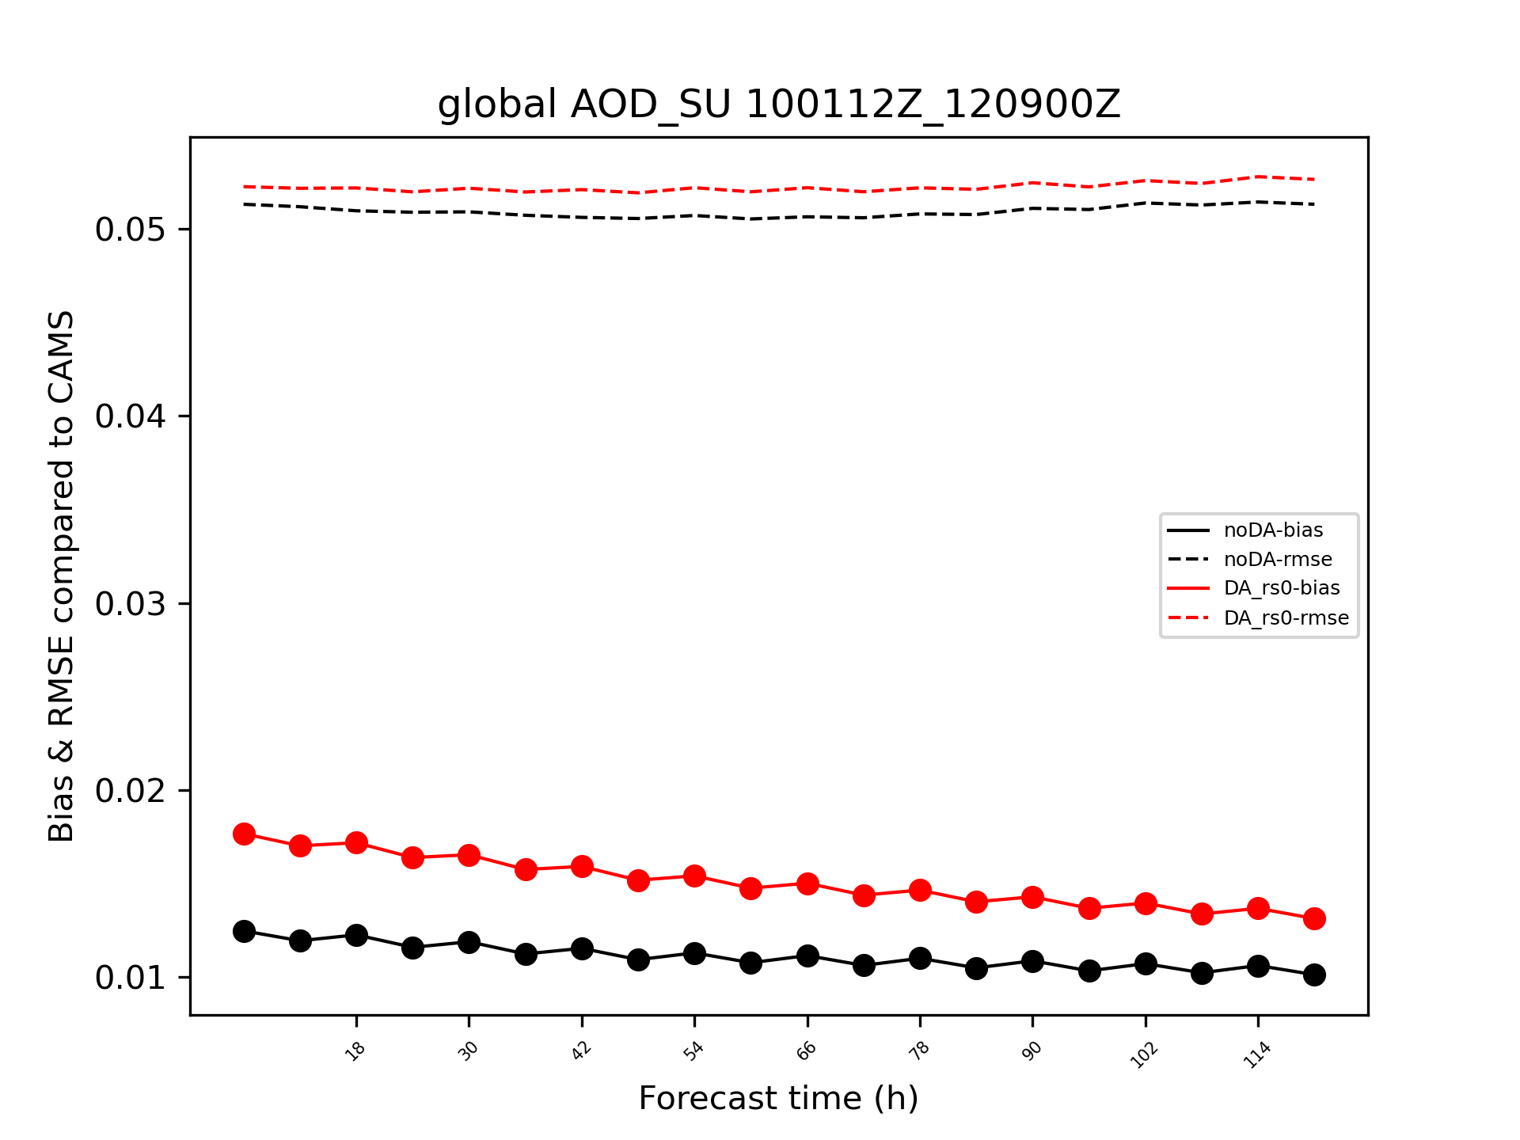
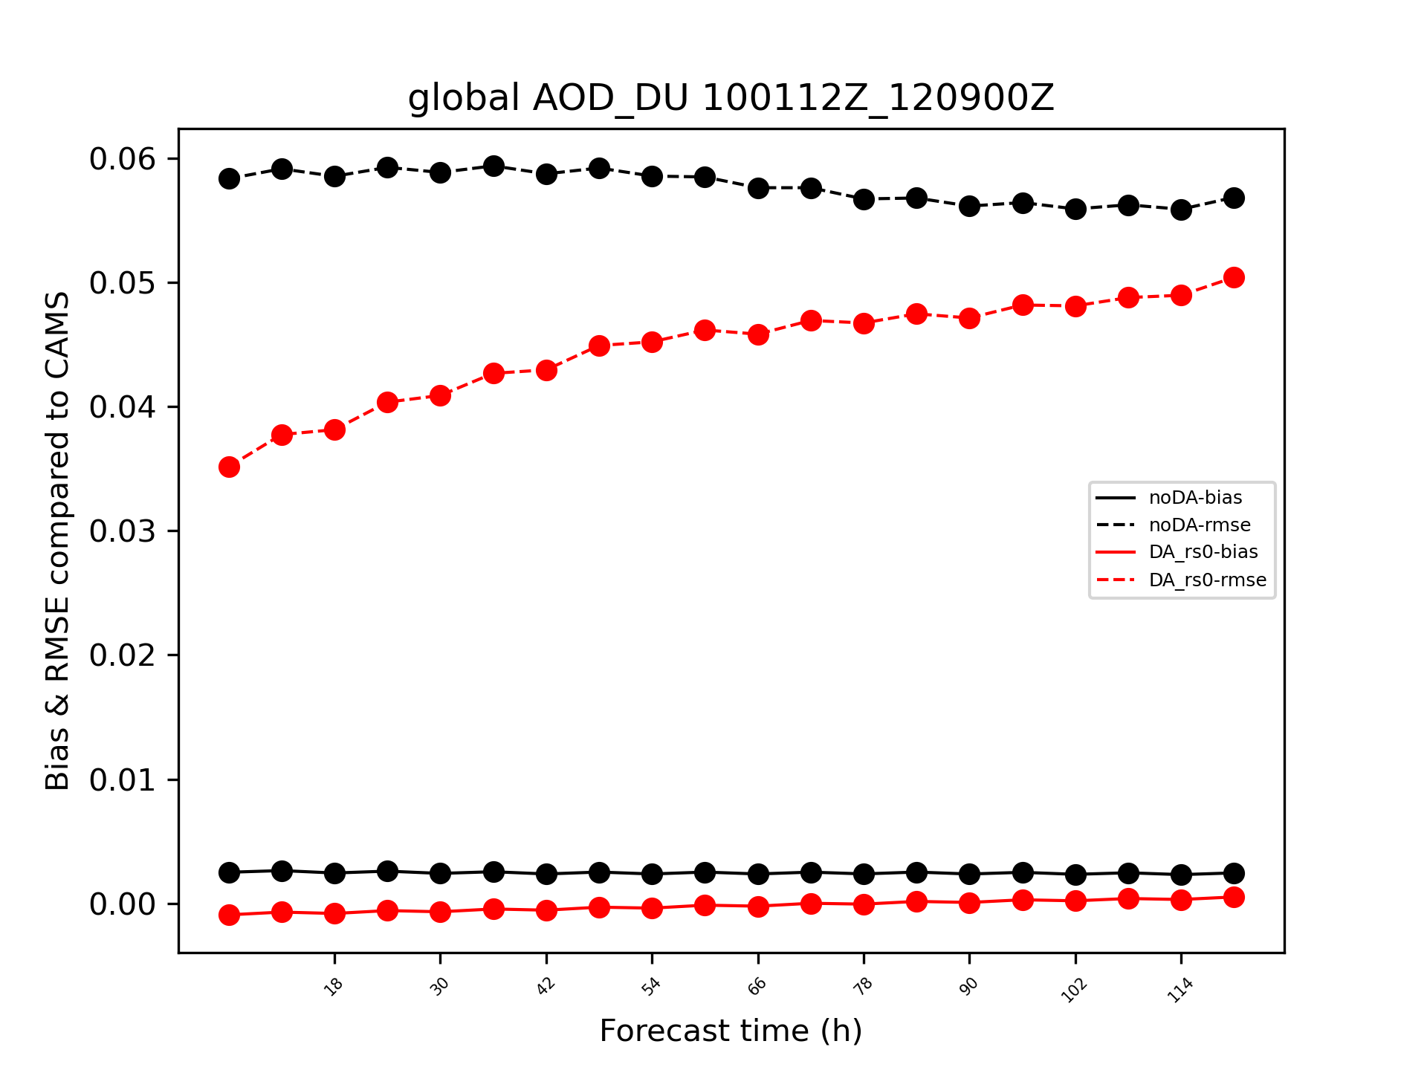
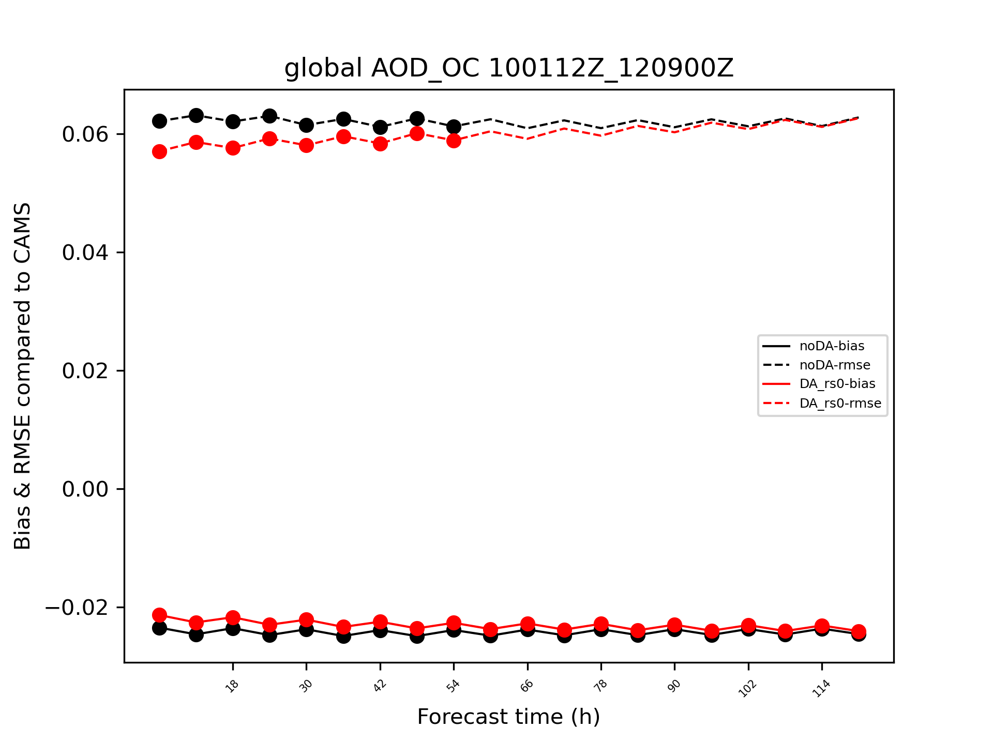
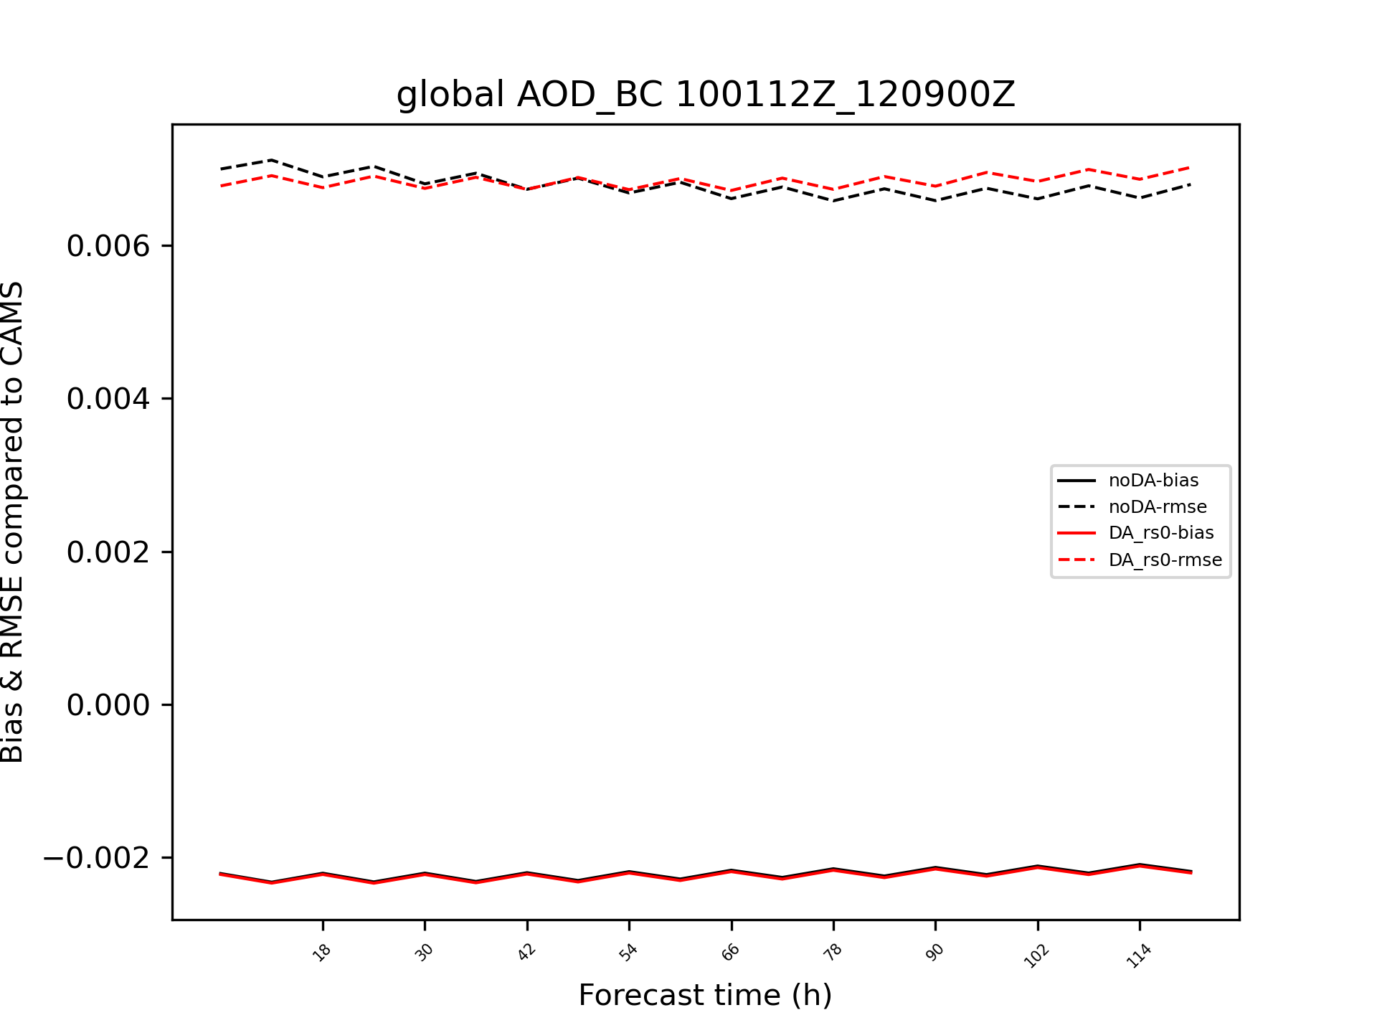
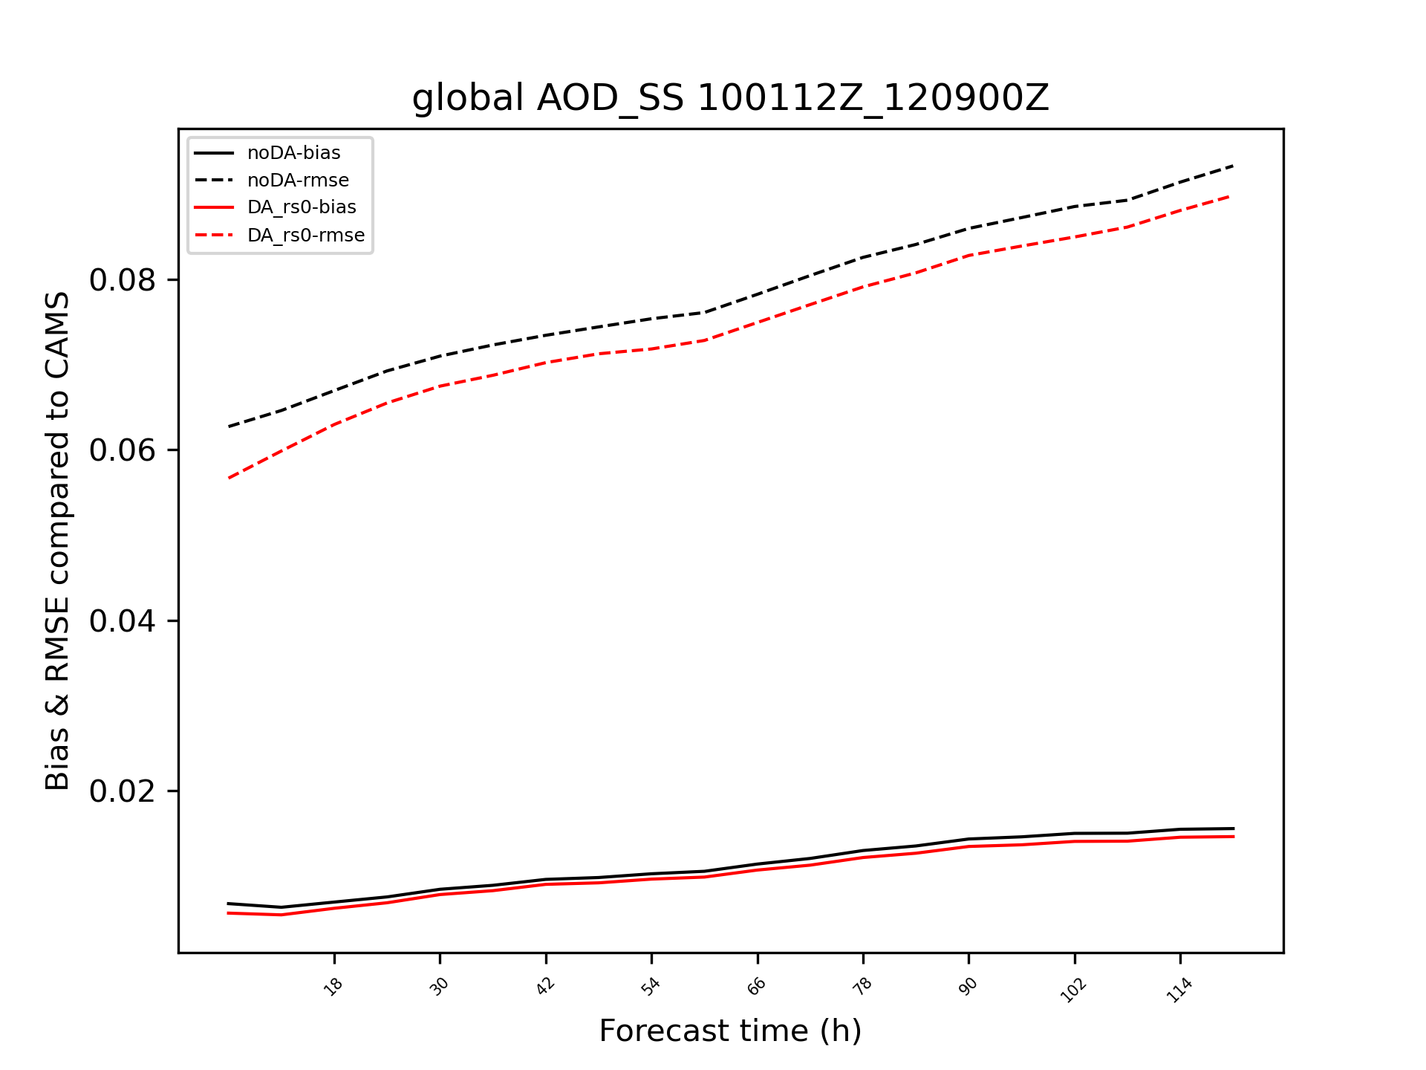
GCAFS Free Forecast Verification against CAMS
Aggregating 5-days forecasts from 138 initializations during Oct 1 to Dec 19 2023.
Reduction in total AOD RMSE by DA is statistically significant for 102 hours.
Major improvements in Dust and OC.
SU AOD
Total AOD
DU AOD
OC AOD
BC AOD
SS AOD

Slide 13
Summary
With DA, Global total AOD RMSE differences with CAMS reanalysis, with AERONET and MODIS observations are all reduced by > 10%.
Individual species improvements are variable, from a very large improvement in dust to degraded mean difference in SULF (though RMSE is nearly unchanged). Sea Salt is improved for the first time after 6 week spinup.
Observation quality control of superobbing further reduces forecast error than thinning.
Implement of VarBC reduces sulfate error by 5% verified by CAMS, though its impact on global total AOD is negligible.
Impact of DA on GCAFS AOD free forecast could last for nearly 5-days with statistical significance.

Slide 14
Future Work
Continue background error tuning experiments and verification with latest updates in GOCART model and emissions.
Prepare for reanalysis / retrospective runs.
Finalize bias correction and observation usage in GCDAS.

