Slide 1
Development of NEXUSv2 as a new component in the Unified Forecast System for applications to air composition modeling for AQMv8 and the Configurable Atmospheric Chemistry (CATChem) Component
Center Green Auditorium, Boulder, CO
September 8-12, 2025 Barry Baker, Patrick C. Campbell, Zach Moon, Raffaele Montouro, Wei Li, Youhua Tang

Slide 2
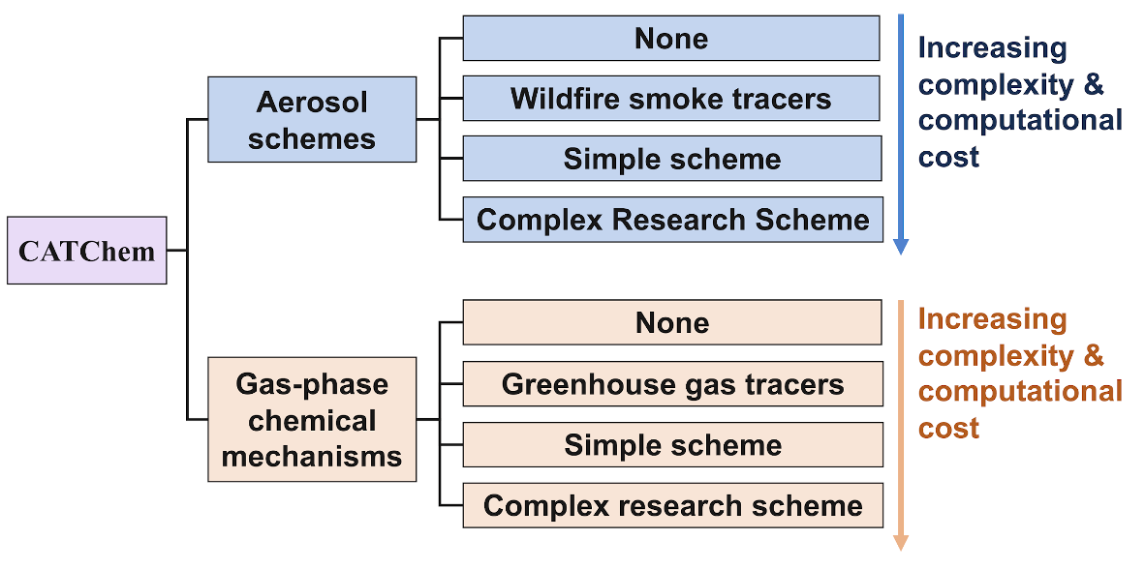
Create Chemistry Library/Component called CATChem
Stores all chemistry related code in one unified location
Will be flexible and configurable
For example, users can choose the aerosol scheme and the gas-phase chemical mechanism of the right complexity for their application
We will maintain link to authoritative repositories from external collaborators, with a focus on process level integration. Key examples include:
Model Independent Chemistry Module (MICM) - developed by NSF NCAR
The Community Regional Atmospheric Chemistry Multiphase Mechanism (CRACMM) - developed by US EPA, NOAA CSL, and the community
GOCART Process Library - developed by NASA and NOAA
Notes:
In my previous talk you heard about how we are creating a new chemistry component CATChem. Well, atmospheric chemistry is inherently dependent on external data sources, specifically for emissions forcings. This is in contrary to many other components in the UFS. So we are developing the NOAA Emission and Exchange Unified System or NEXUS to answer this call.

Slide 3
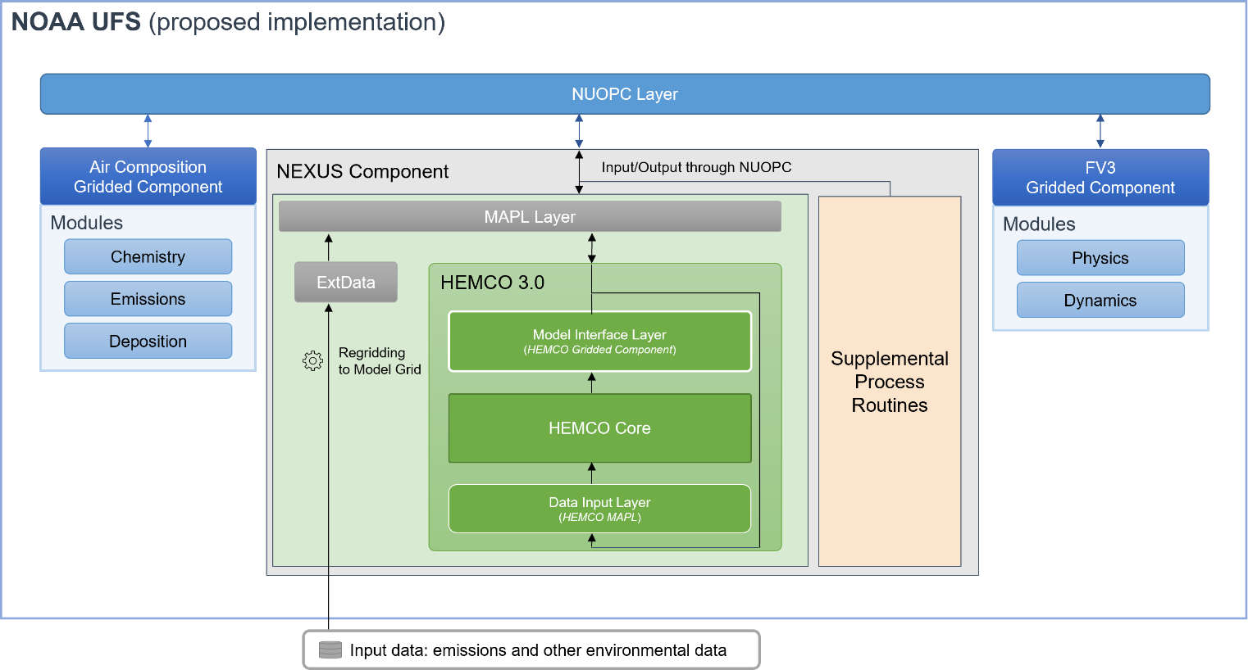
NEXUS
Barry Baker, Patrick Campbell, Wei Li, Zach Moon (ARL)
Aerosols
Historical
&
Future Projections
(IPCC, RCP)
Anthropogenic
&
Biofuel
Operations
Biomass Burning
Halogens
NEXUS
Model-Ready Emissions Data
Extensions
(Dust, Sea-Salt Biogenic, etc.)
Natural Sources
Research
Community emissions processing system for UFS atmospheric composition models (both global and regional)- Based on HEMCO (Lin et al. 2021)
Collaborators: Harvard, NASA, NCAR
Anthropogenic
Aircraft
&
Ship
Non-Emission Data
(Satellite O₃, LAI, Albedo, etc.)
Lin et al. https://doi.org/10.5194/gmd-14-5487-2021
Notes:
As you can see from the diagram, NEXUS is designed to provide model-ready emissions data for both research and operational applications within the Unified Forecast System.
NEXUS integrates various types of emission sources, including aerosols, anthropogenic and biofuel emissions, halogens, natural sources, and biomass burning. It also accounts for specialized categories like anthropogenic aircraft and ship emissions, as well as extensions for dust, sea-salt, and biogenic emissions. Furthermore, NEXUS incorporates non-emission data, such as satellite ozone, Leaf Area Index (LAI), and albedo, which are crucial for atmospheric modeling. We also consider historical and future projections, including those from the IPCC and RCP scenarios.
At its core, NEXUS is a community emissions processing system for UFS atmospheric composition models, applicable to both global and regional scales. It's core is based on HEMCO, a widely recognized system developed by Harvard. See Lin et al. in 2021. This work is a collaborative effort, and I want to acknowledge our key collaborators from Harvard, NASA, and NCAR. Within ARL, Patrick Campbell, Wei Li, Zach Moon, and myself are leading this development."

Slide 4
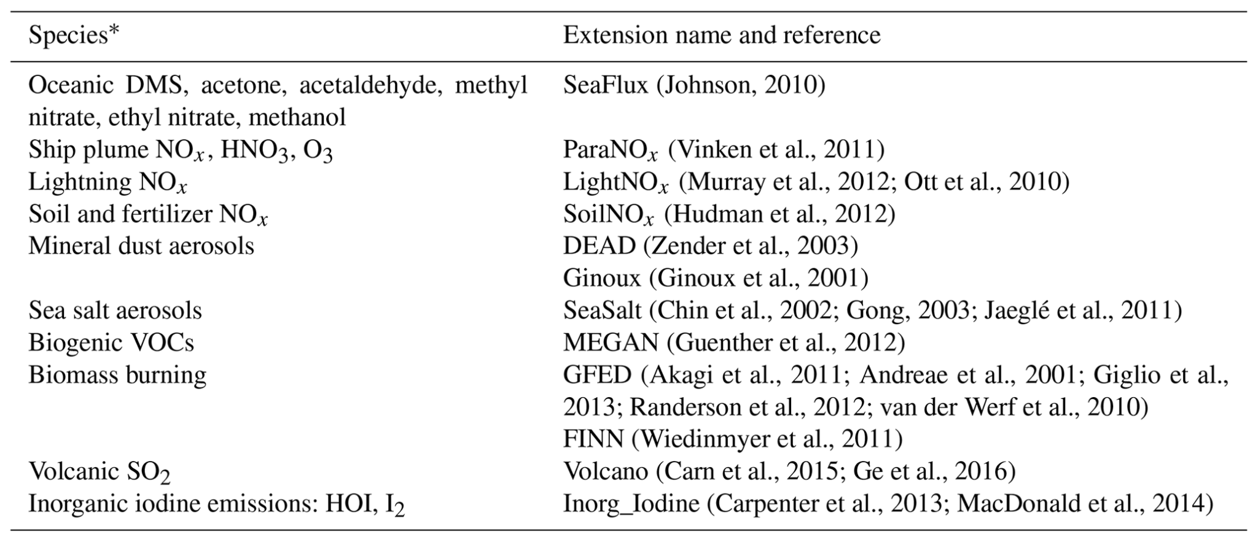
Current Extensions
Notes:
"This slide, titled 'Current Extensions,' highlights some of the key extensions we've developed for NEXUS. We've focused on enhancing its capabilities to handle various specialized emission types. This includes anthropogenic aircraft emissions, crucial for understanding air quality in flight corridors, and anthropogenic ship emissions, which are significant contributors in maritime regions. We've also incorporated modules for dust, sea-salt, and biogenic emissions, all of which play important roles in atmospheric composition. These extensions demonstrate NEXUS's flexibility and its ability to integrate diverse data sources to provide a comprehensive emissions picture."

Slide 5
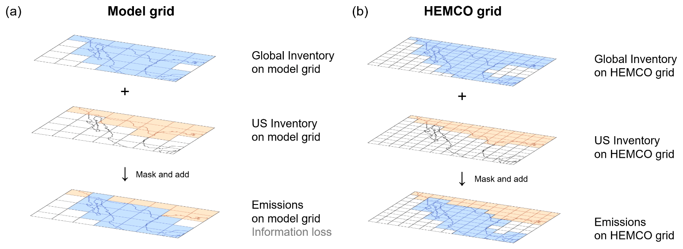
HEMCO Regridding Capabilities
Notes:
"Moving to slide 5, titled 'HEMCO Regridding Capabilities,' this slide is currently blank as it's a placeholder. However, I want to emphasize that a core strength of NEXUS, leveraging its foundation in HEMCO, is its powerful regridding capabilities. This allows us to take emissions data from various native resolutions and accurately remap them to the specific grids required by different UFS configurations, whether for global or regional applications, or with complex or reduced chemical mechanisms. This flexibility in regridding is crucial for seamless integration and efficient use of diverse emissions datasets within the modeling system."
Note that in the online coupled version of NEXUS regridding will be done with ESMF for both import data as well as when reading from external data sources.

Slide 6
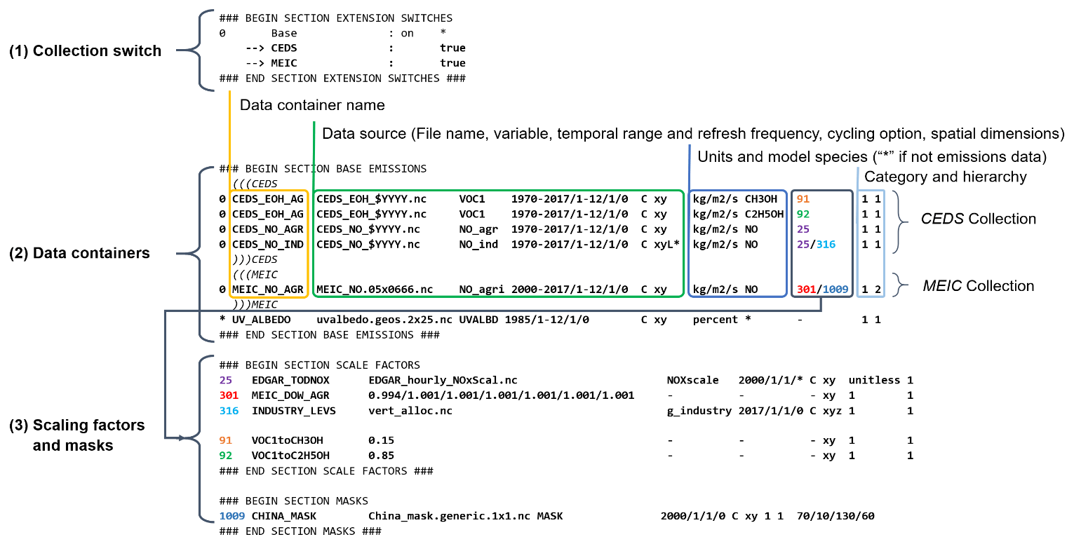
HEMCO Configurations
Notes:
he HEMCO configuration file is the central control panel for emissions processing within NEXUS. It allows us to define and manage all aspects of emission data, from applying specific scale factors and mapping different chemical species to outputting various diagnostics. This flexibility is crucial because it enables us to precisely tailor NEXUS to the unique requirements of any atmospheric modeling application, whether it's for research or operations. Essentially, it gives us complete command over how emissions information is prepared and utilized.

Slide 7
UFS NEXUS Planned Implementation
NUOPC Layer
NEXUS Gridded Component
Atmosphere Gridded Component or CDEPS etc
CATChem Gridded Component
Orchestrate and interface HEMCO within the UFS
Provide inputs and exports from the NEXUS Component
Harvard Emission Component (HEMCO)
ESMF Interface
HEMCO Core
Emissions Extensions -> Diagnostics

Slide 8
NEXUS Online or Offline
NEXUS is based off the HEMCO core system but has been extended for use with ESMF/NUOPC. NEXUS is currently able to run in an offline mode to generate emissions for our currently applications include UFS-AQM. CDEPS is currently already part of the UFS and the DEMIS component is already under development with a PR being submitted soon.
Offline
UFS
CDEPS
DATM
DLND DEMIS
NEXUS
Online
UFS
CDEPS DEMIS
NEXUS
ATM
CATChem

Slide 9

Advantages of using NEXUS
Before
After
Previously, each emissions inventory necessitated a dedicated Fortran module for data ingestion, unit conversions, and scale factor application.
Emissions had to be prepared ahead of time on the model grid for each chemical mechanism-> Huge data storage needed
Diagnostics and configuration hard coded
Simplifies emission data processing for UFS models
Offers flexibility for global and regional applications
Leverages community expertise and collaborations
Namelist configuration for all species mapping and diagnostics
Provides robust, model-ready emission information
Notes:
There are some key Advantages of using NEXUS for our workflow. Looking at the 'Before' scenario, you can see that previously, each emissions inventory required a dedicated Fortran module for data ingestion, unit conversions, and scale factor application. Emissions also had to be prepared ahead of time on the model grid for each chemical mechanism, leading to huge data storage needs, and diagnostics and configurations were hard-coded. This was a cumbersome and inefficient process.
Now, with NEXUS, as shown in the 'After' section, we've dramatically simplified emission data processing for UFS models. It offers much greater flexibility for both global and regional applications, and crucially, it leverages community expertise and collaborations, avoiding redundant efforts. The namelist configuration for all species mapping and diagnostics provides far more control and adaptability. Ultimately, NEXUS provides robust, model-ready emission information, streamlining our operations and enabling more efficient and accurate atmospheric composition modeling."

Slide 10
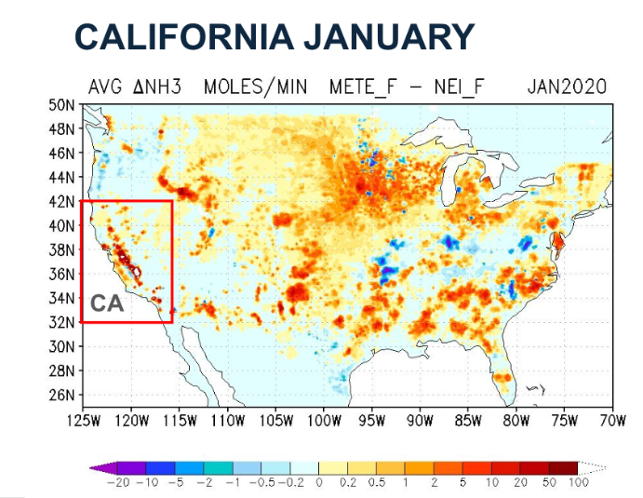
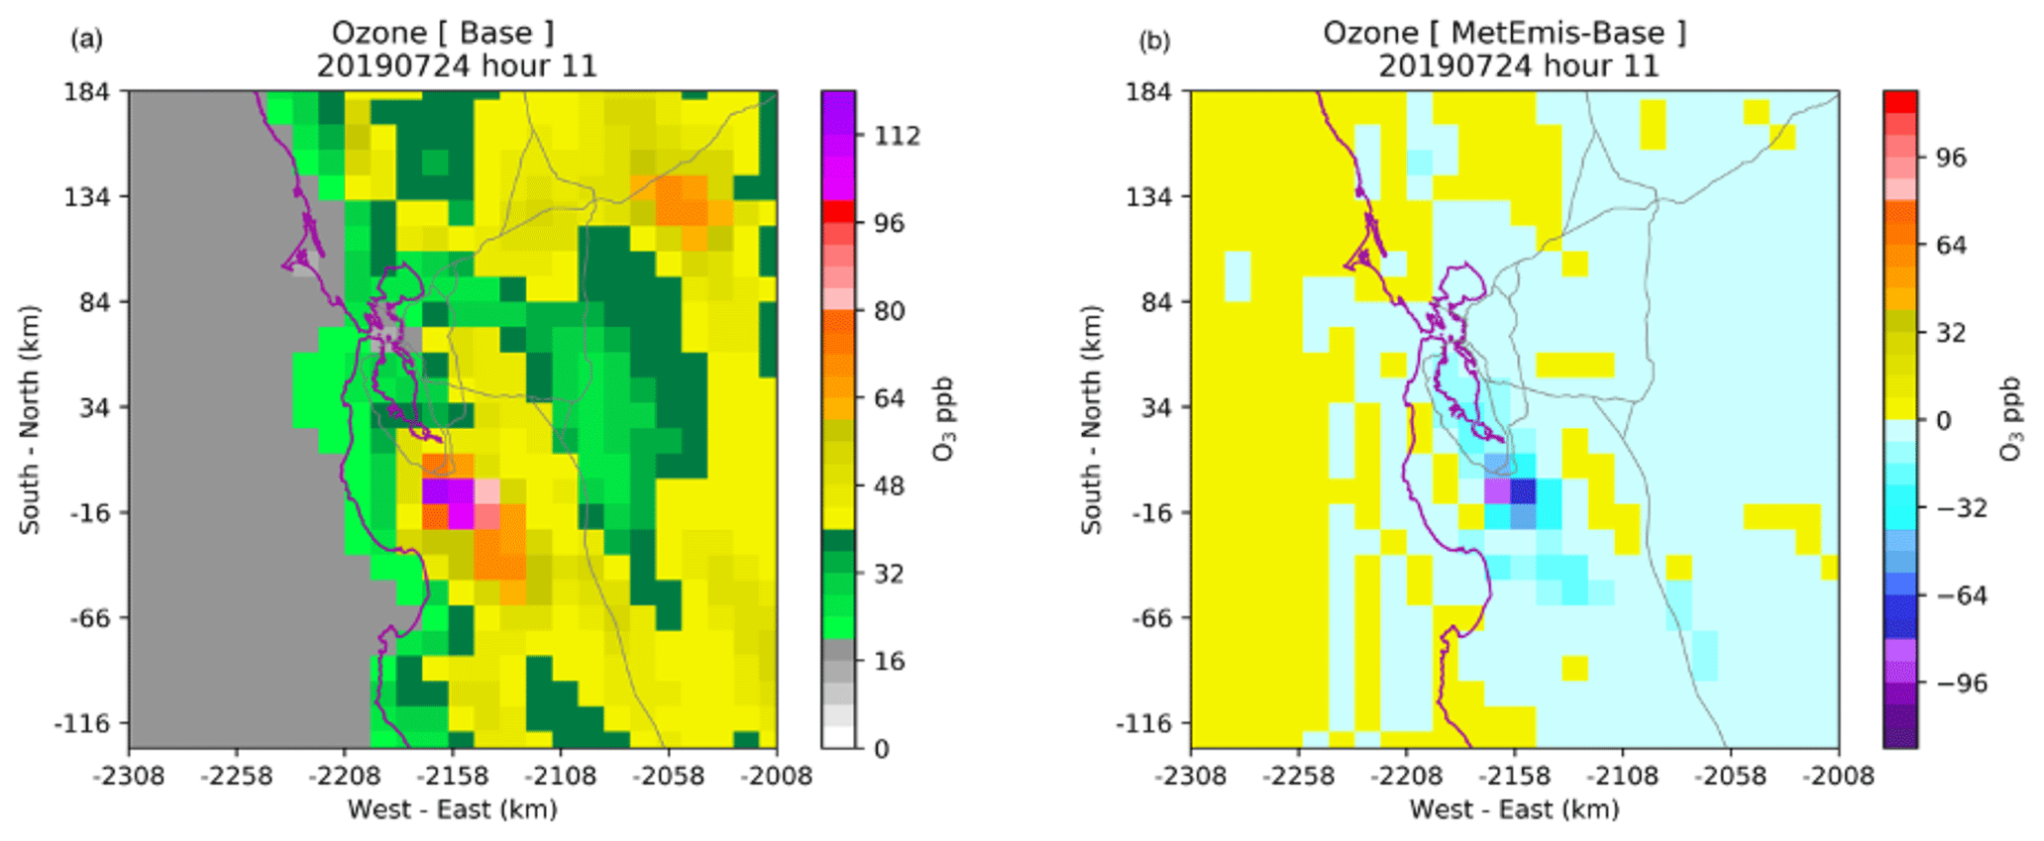
Future: MET Driven Emissions
Dynamic Meteorology-induced Emissions Coupler (MetEmis) development in the Community Multiscale Air Quality (CMAQ) model (Baek et al., 2023)
Weather-Induced Mobile Emissions
Weather-Induced Livestock NH₃ Emissions
Hourly ozone differences (MetEmis-Base)
San Jose, California
Notes:
We're exploring the concept of 'Weather-Induced Mobile Emissions' and 'Weather-Induced Livestock NH3 Emissions.'
The example shown here is from the Dynamic Meteorology-induced Emissions Coupler, or MetEmis, developed by Baek et al. in 2023 for the CMAQ model. As you can see from the hourly ozone differences in San Jose, California, meteorological conditions can significantly influence emissions, leading to noticeable changes in air quality. This highlights the importance of moving beyond static emission inventories and developing more sophisticated methods that allow emissions to respond to real-time weather. This is a critical direction for improving the accuracy of our air quality forecasts."

Slide 11
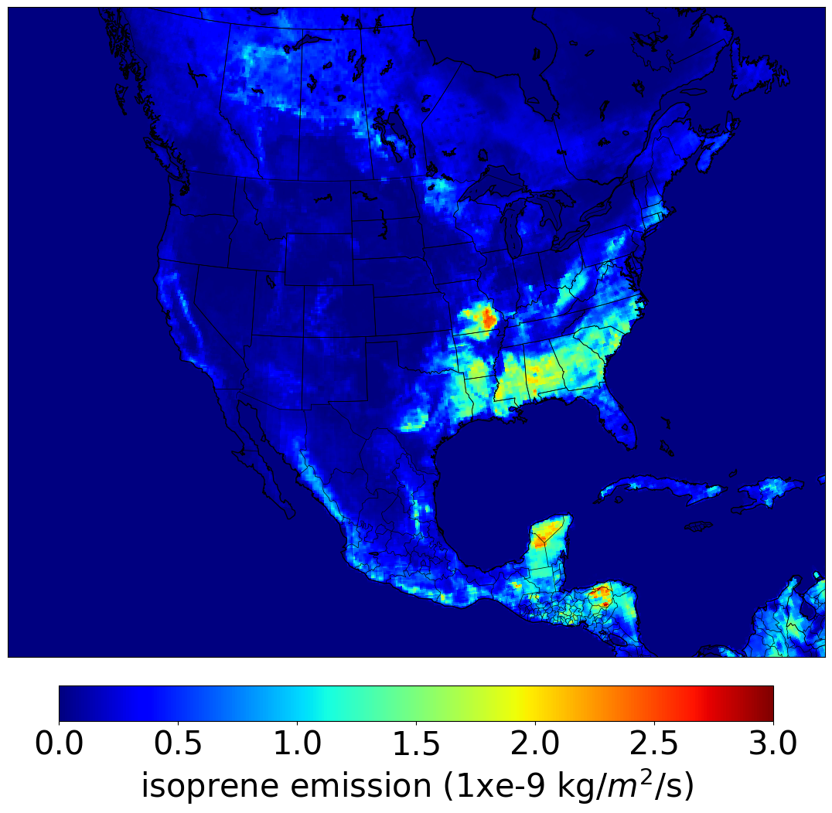
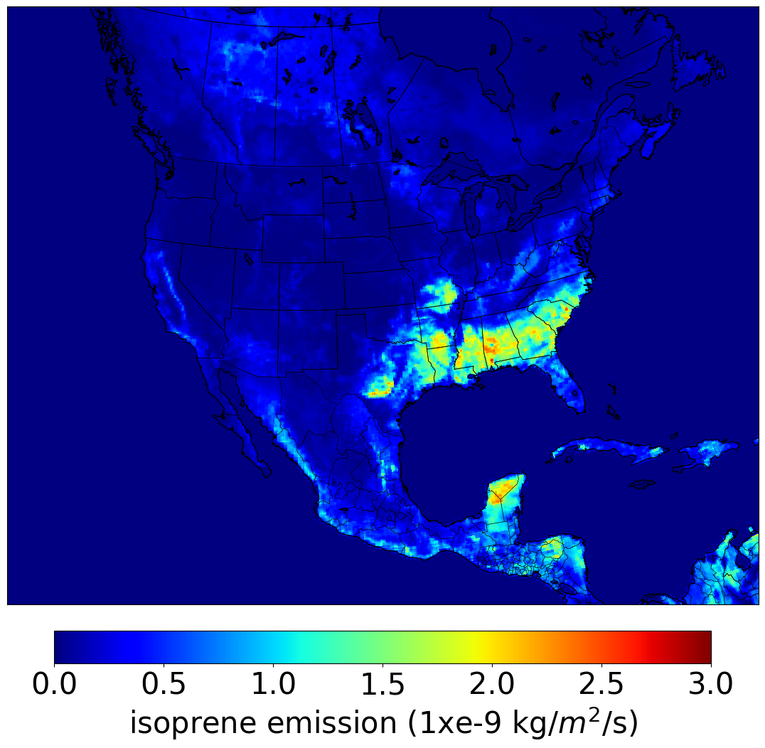
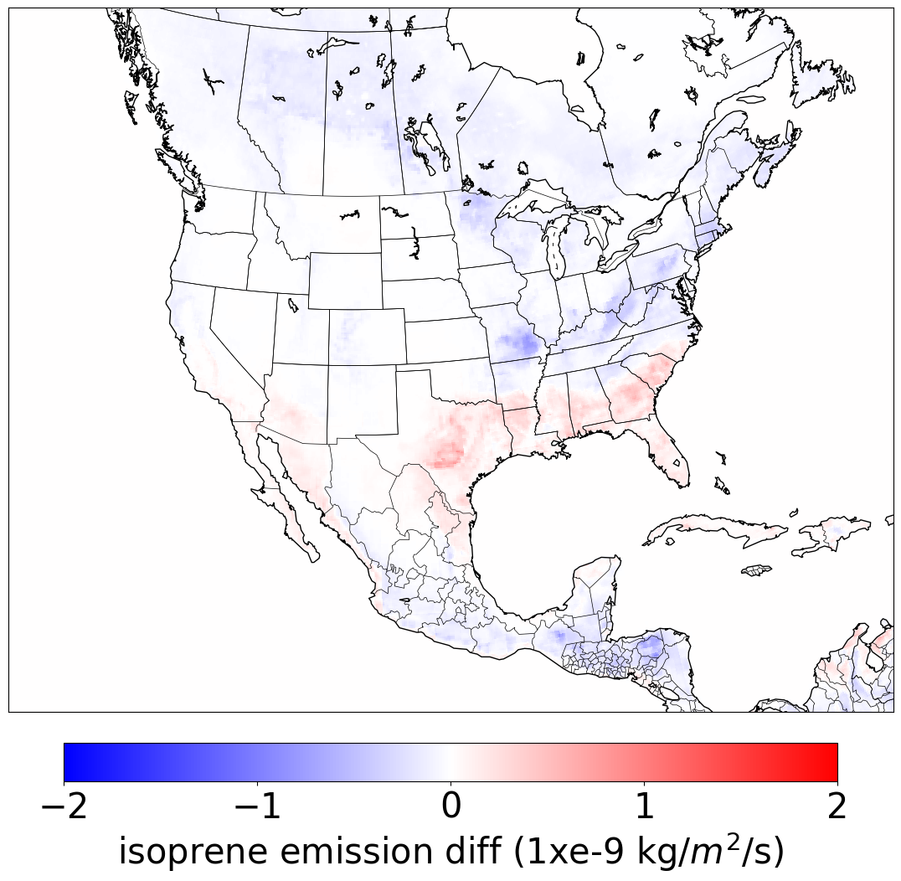
Improving Biogenic Emissions
With the decrease of anthropogenic emissions year after year biogenic emissions are becoming a larger source for ozone formation in comparison.
Biogenic emissions are modified in AQMv7 from BEIS -> MEGANv2.1
Update MEGANv2.1 with simplified canopy effects following Silva et al. (2020)
New Canopy effects improves ozone distributions
New canopy effects isoprene emissions with increased ISOP in the southeast US while decreases in the northern part of the domain
Old
New
New - Old
Notes:
As anthropogenic emissions decrease year after year, biogenic emissions are becoming an increasingly significant source for ozone formation. To address this, we've updated the MEGANv2.1 biogenic emissions scheme in AQMv7, specifically by incorporating simplified canopy effects based on the work of Silva et al. (2020).
The new canopy effects significantly improve ozone distributions, which you can see in the comparison of 'Old' and 'New' plots on the slide. Notably, the new canopy effects lead to increased isoprene emissions in the southeastern US, while showing decreases in the northern part of the domain. This refinement is critical for more accurate air quality and atmospheric composition forecasts within both the AQM and GEFS models."

Slide 12
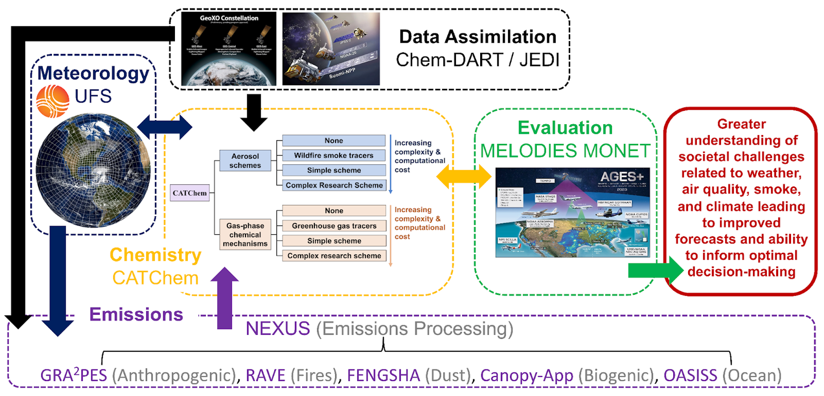
UFS-Chem
Notes:
"UFS-Chem is a key initiative to unify and streamline the chemistry capabilities within the Unified Forecast System. Its goal is to bring together various atmospheric chemistry processes and models into a more cohesive and user-friendly framework, promoting consistency and interoperability across different UFS applications. This allows for more robust and accurate simulations of atmospheric composition, supporting a wide range of research and operational needs."

Slide 13
Summary and Outlook
Provides model-ready emissions data for UFS models
Supports both global and regional applications with flexibility
Simplifies emissions processing, reducing data storage needs
Leverages community expertise from collaborations
Allows for better separation of concerns for each component
Aiming to add NEXUS to the UFS as a component model by the end of Fall

