Slide 1
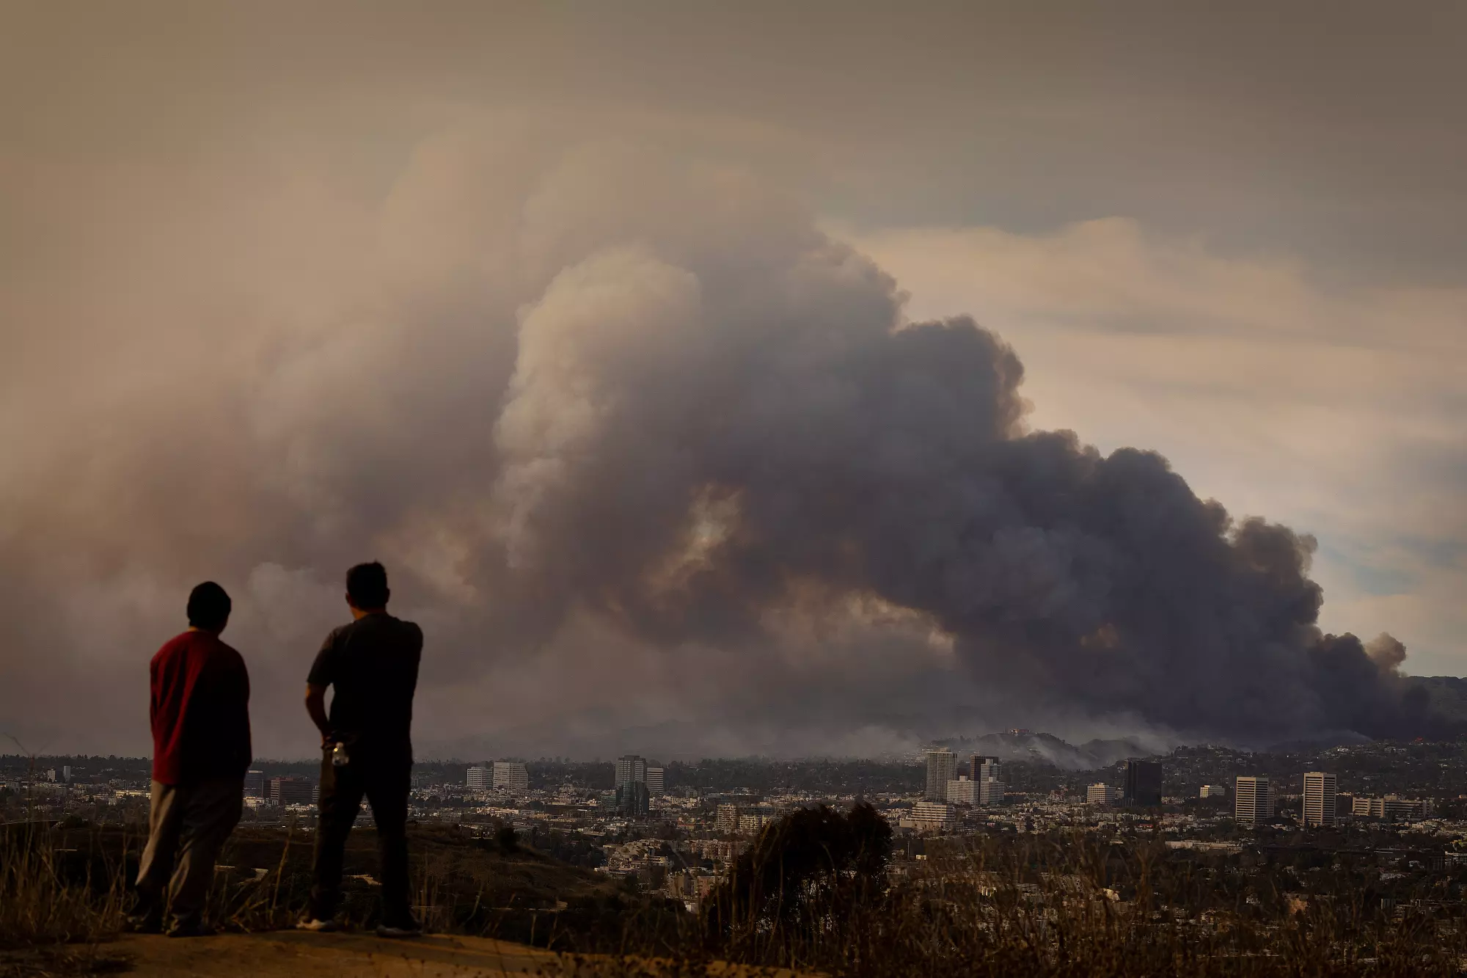

Updates to the RRFS-Smoke-Dust Model and Evaluation of the Real-time
RRFS-SD during the 2025 Fire Season in North America
Ravan Ahmadov¹ (ravan.ahmadov@noaa.gov)
Acknowledgement: J. Romero-Alvarez^{1,2}, H. Li^{1,2}, J. Schnell^{1,2}, S. Bhimireddy^{1,2}, E. James¹, M. Hu¹, G. Grell¹, B.Koziol³,
F.Yang⁴, P. Bhattacharjee⁴, B. Baker⁴, M.Cohen⁵, S.Kondragunta⁶, C. Xu⁶, F. Li⁷, W-T. Hung⁸, H. Kim⁸, C. Frite⁸, A. Navarrete⁹, RRFS and FIREX-AQ teams
¹NOAA/GSL ²CU Boulder CIRES ³EPIC ⁴NOAA/EMC ⁵NOAA/ARL ⁶NOAA/NESDIS ⁷SDSU ⁸GMU ⁹UC San Diego
Unifying Innovations in Forecasting Capabilities Workshop, September 11, 2025
Wildfires near Los Angeles, January 8, 2025

Slide 2
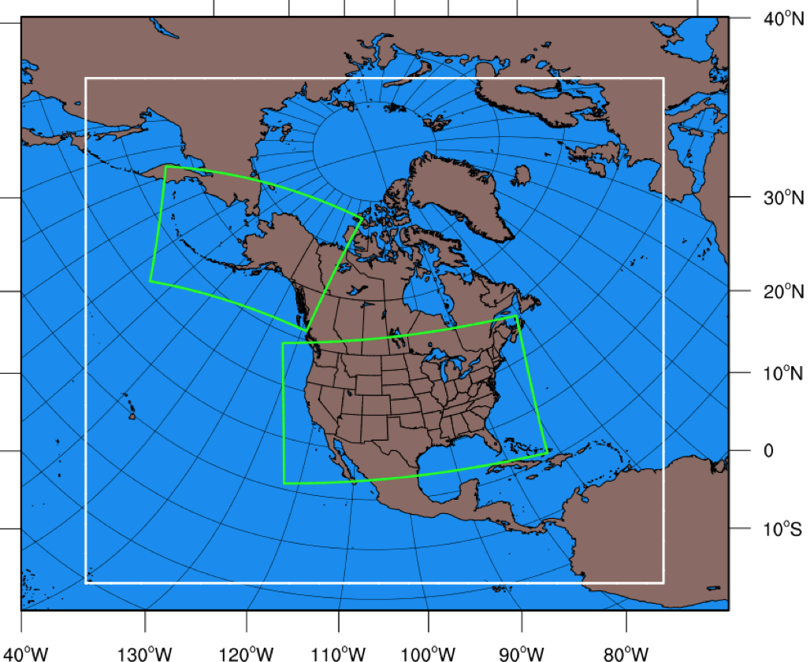
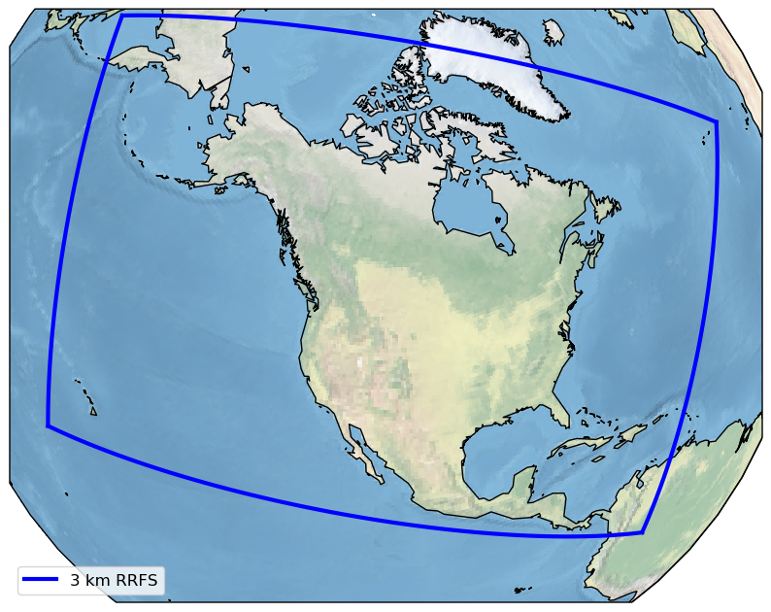
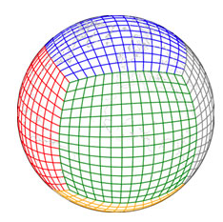
Transitioning of the RAP/HRRR-Smoke models to RRFS-Smoke-Dust (RRFS-SD)
RAP-Smoke
3 km resolution FV3 limited area model domain
HRRR-Smoke AK
HRRR-Smoke
Finite-Volume Cubed-Sphere
Dynamical Core (FV3)
https://ufscommunity.org/
NOAA’s new NWP model:
Rapid Refresh Forecasting System (RRFS)

Slide 3
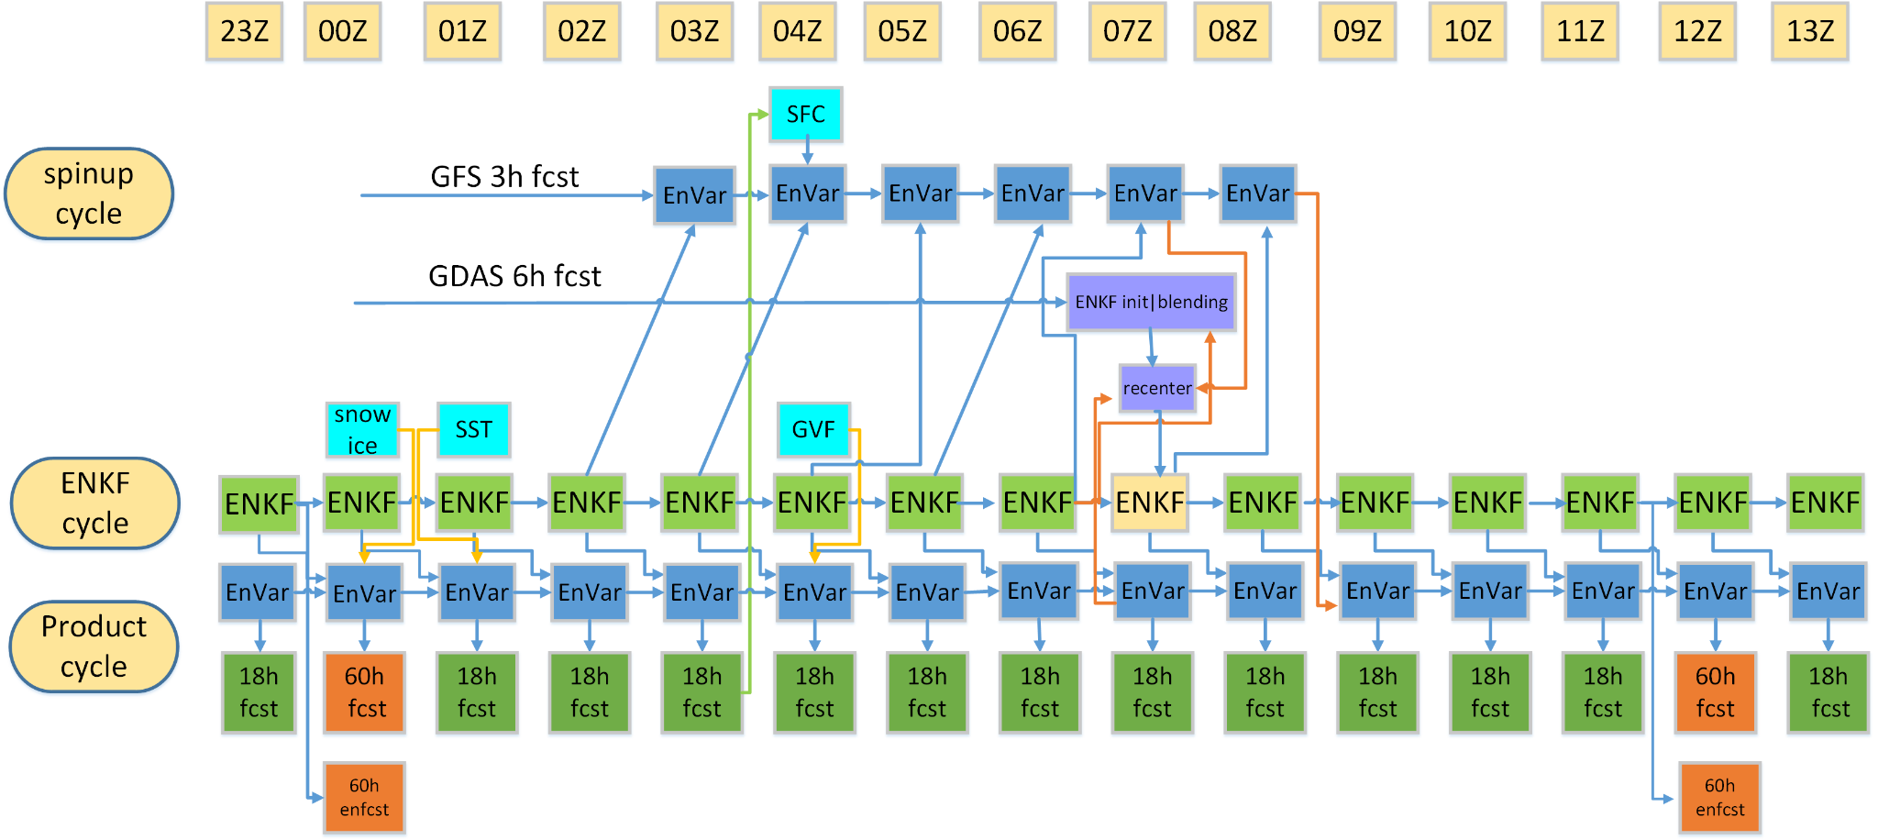
RRFS-SD hourly cycling with data assimilation
RAVE fire input
Updated every hour
5. Coupled surface/ atmos. interaction with updates
1. Spin-up cycle to combine
large scale and small scale
Information
6. Enhanced/tuned GSI/EnKF
and non-var cloud analysis
2. Two-way coupled deterministic / EnKF cycling:
Determ
cycle
3. Multi-scale analysis
from SDL/VDL
4. Hourly cycling to accumulate the impact of all available observations;
Continuous cycling of soil fields

Slide 4
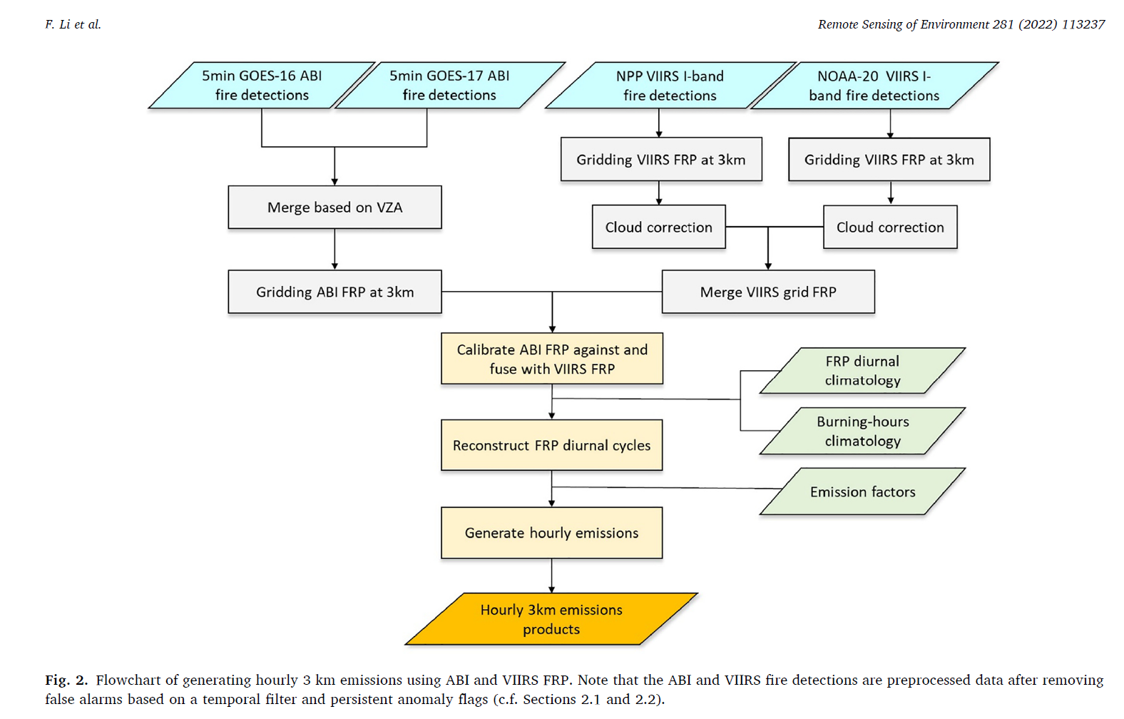
Regional ABI and VIIRS fire Emissions (RAVE)
Hourly satellite fire data from RAVE ingested
into the RRFS-Smoke model.
Unlike HRRR-Smoke, the RRFS-Smoke model
Is using the GOES-18/19 data in addition the VIIRS.

Slide 5
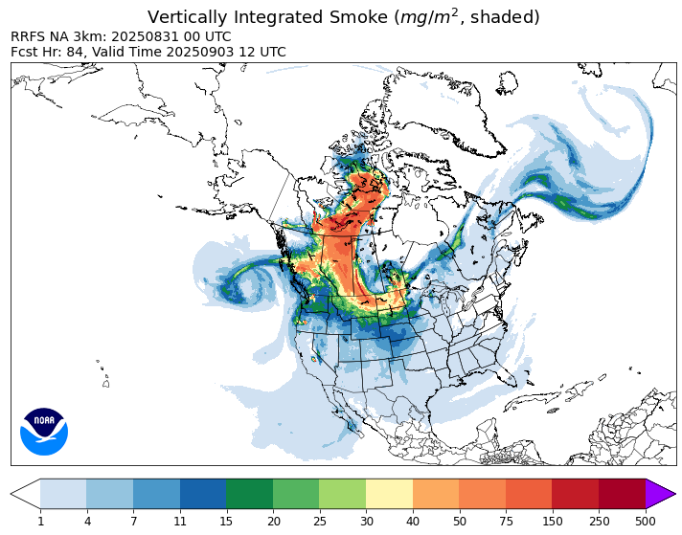
Capabilities of the updated RRFS-SD model
The model grid: 3km horizontal resolution, 65 vertical layers
Smoke (primary PM2.5 from wildland fire emissions) and fine and coarse dust aerosols are included.
The smoke emissions are based on the real-time RAVE data.
A new forecast is generated every hour. It goes out to 84 hours 4 times a day, 18 hours for other cycles.
Impact of smoke and dust aerosols on radiation and visibility are included.
A new fire weather index – Hourly Wildfire Potential is provided by the model. HWP is also used to predict wildfire emissions in the model.
The RRFS-SD model has been extensivelys tested in real time and for case studies.
The fire weather, smoke and dust fields are displayed on a public web-site:
https://rapidrefresh.noaa.gov/RRFS-SD/

Slide 6
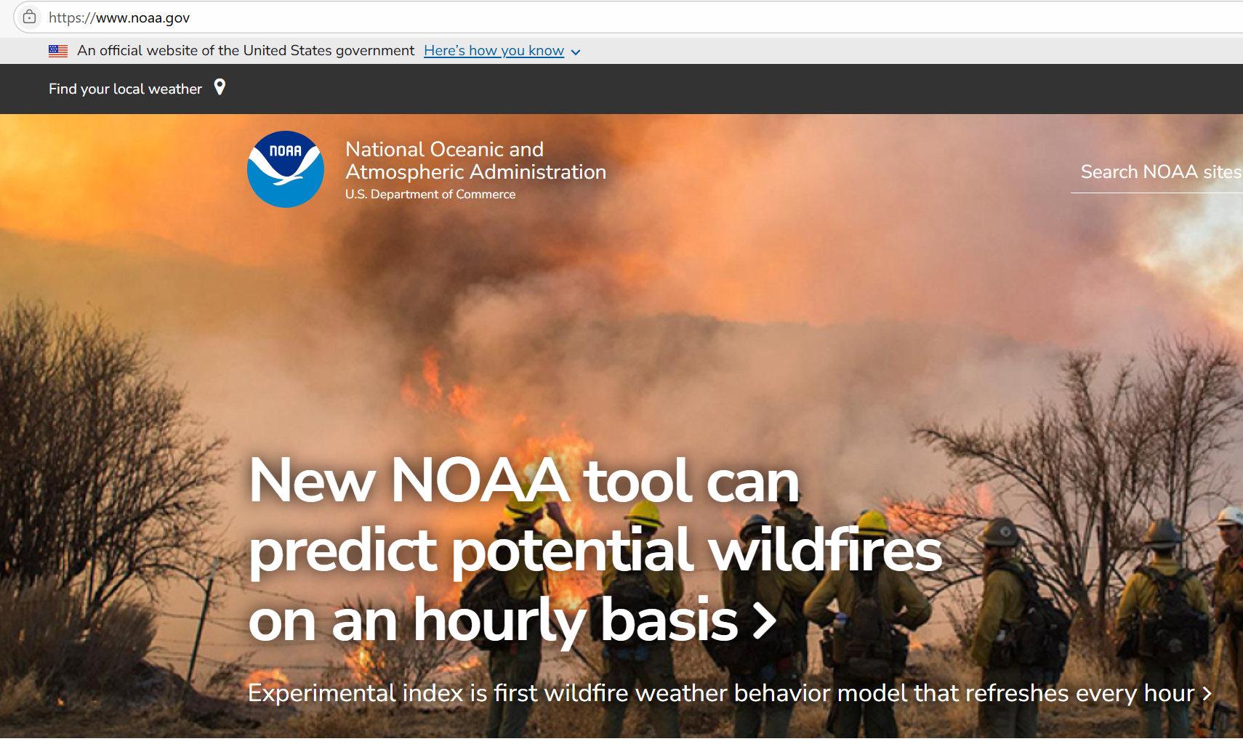
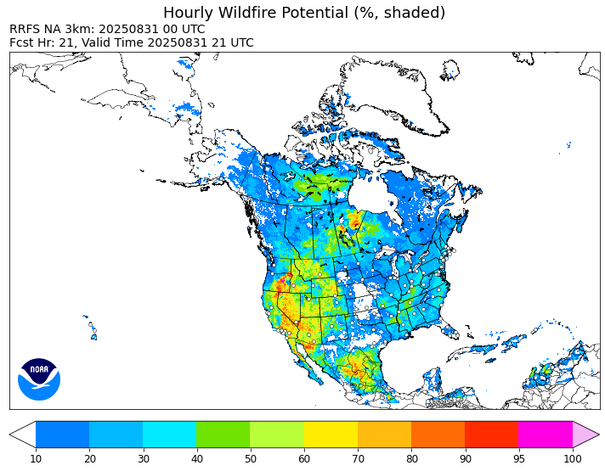
Hourly Wildfire Potential (HWP) diagnostic product for use in the RRFS-SD model
The capability to simulate fire weather depends on capturing mesoscale phenomena. Convection-allowing models (like HRRR and RRFS) with 3km grid spacing are capable of representing deep convective storms and their outflows, as well as terrain-induced circulations.
Hourly Wildfire Potential is a new diagnostic product based on hourly air temperature, humidity, wind gust potential and soil moisture model output.
HWP is provided in real time along with other NWP products from the experimental RRFS:
https://rapidrefresh.noaa.gov/RRFS/
James et al. Weather and Forecasting, 2025
Notes:
Eric takes over on this slide

Slide 7

RRFS-SD simulations for the FIREX-AQ field campaign, summer, 2019
Williams Flats wildfire
24 hour forecast
FIREX-AQ provides us with vast amount of in-situ and remote sensing measurements, and biomass flux estimates. These are valuable datasets to evaluate and improve our smoke forecast models.

Slide 8
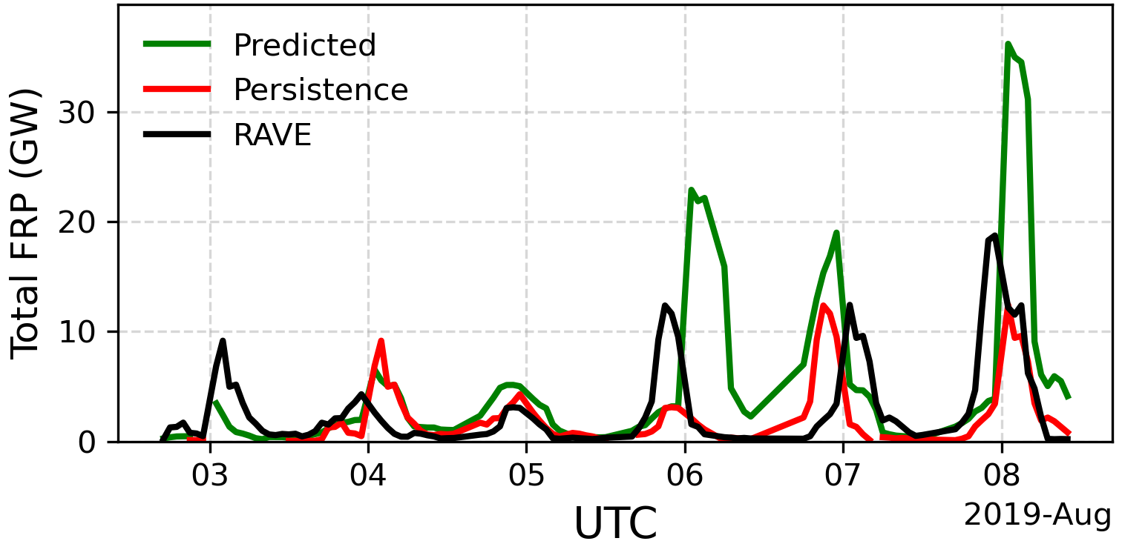
Hourly Fire Radiative Power (FRP) time series for the Williams Flats fire during FIREX-AQ

Slide 9
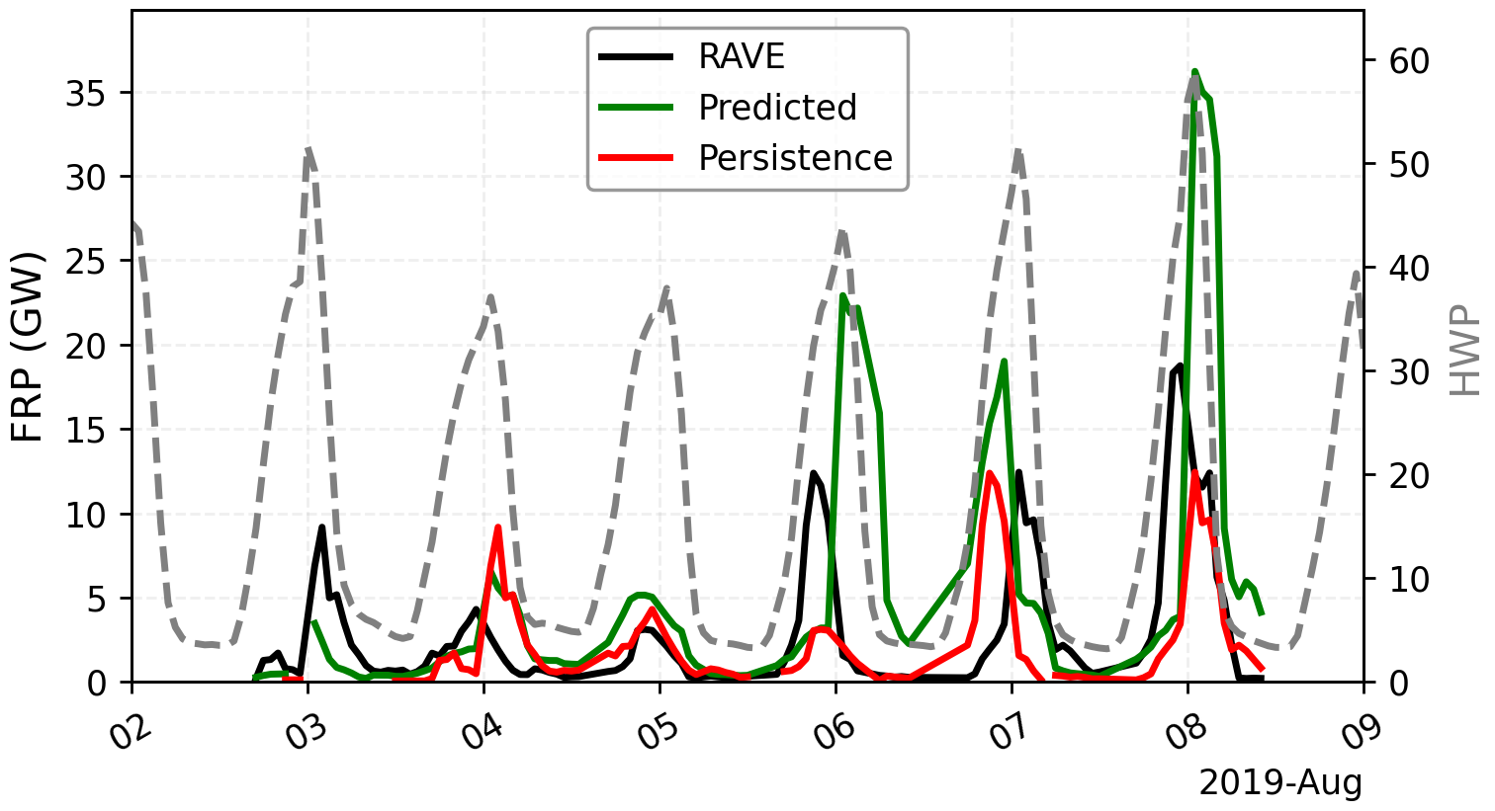
Hourly Fire Radiative Power (FRP) time series for the Williams Flats fire during FIREX-AQ

Slide 10
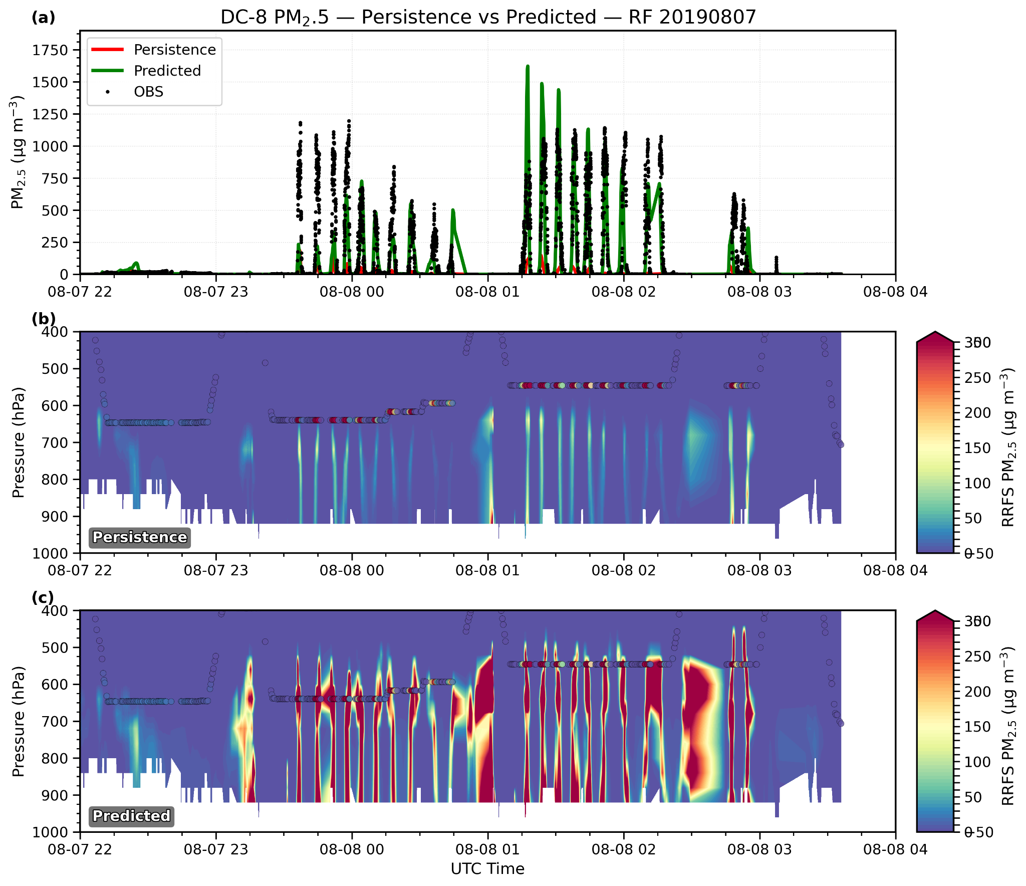
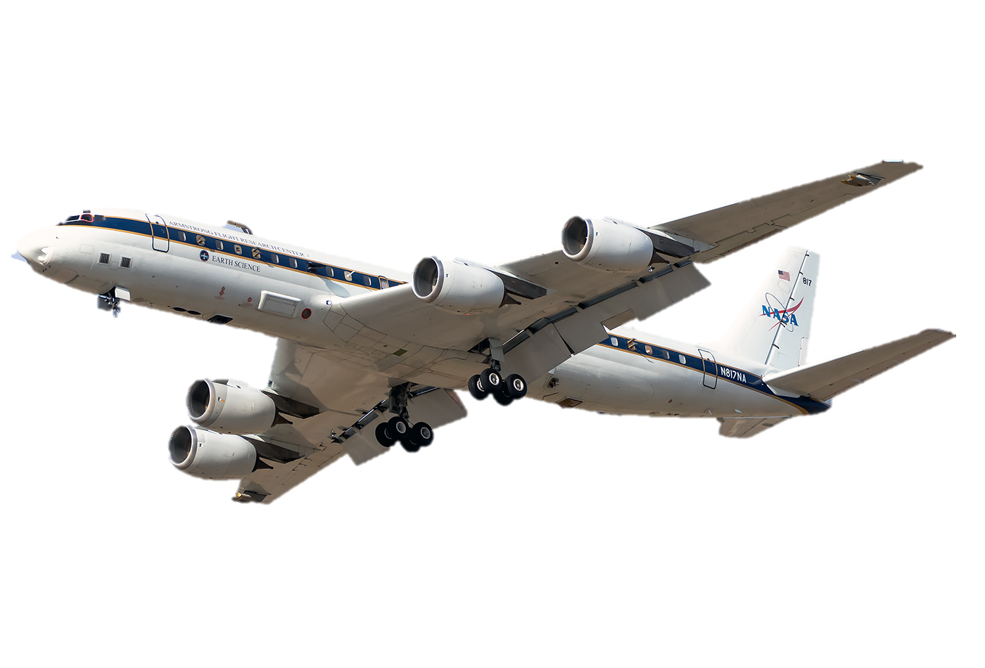
Verification of the RRFS-SD simulations by using the in-situ measurements onboard aircraft from FIREX-AQ
Model vs. aircraft measurements:
mean bias= -124.8 ug/m3
mean bias= - 36.8 ug/m3

Slide 11
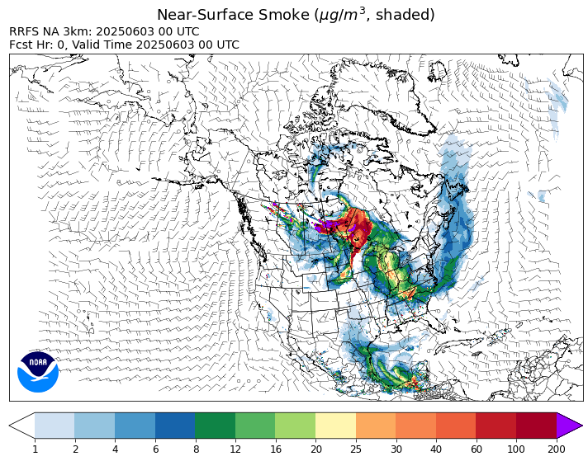
RRFS-SD forecast during summer 2025
https://rapidrefresh.noaa.gov/RRFS-SD/
Smoke transport from
the Canadian fires
into the US

Slide 12
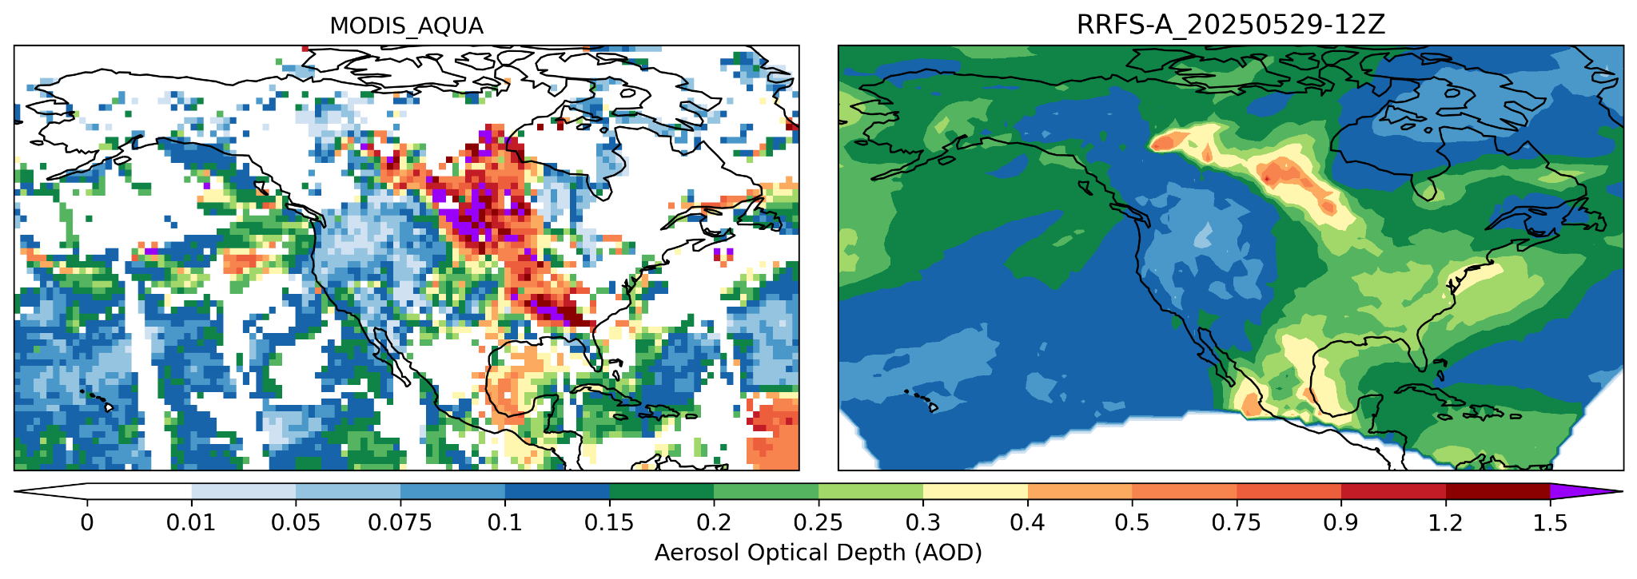
RRFS-SD forecast evaluation using the satellite AOD observations
MB=-0.16

Slide 13
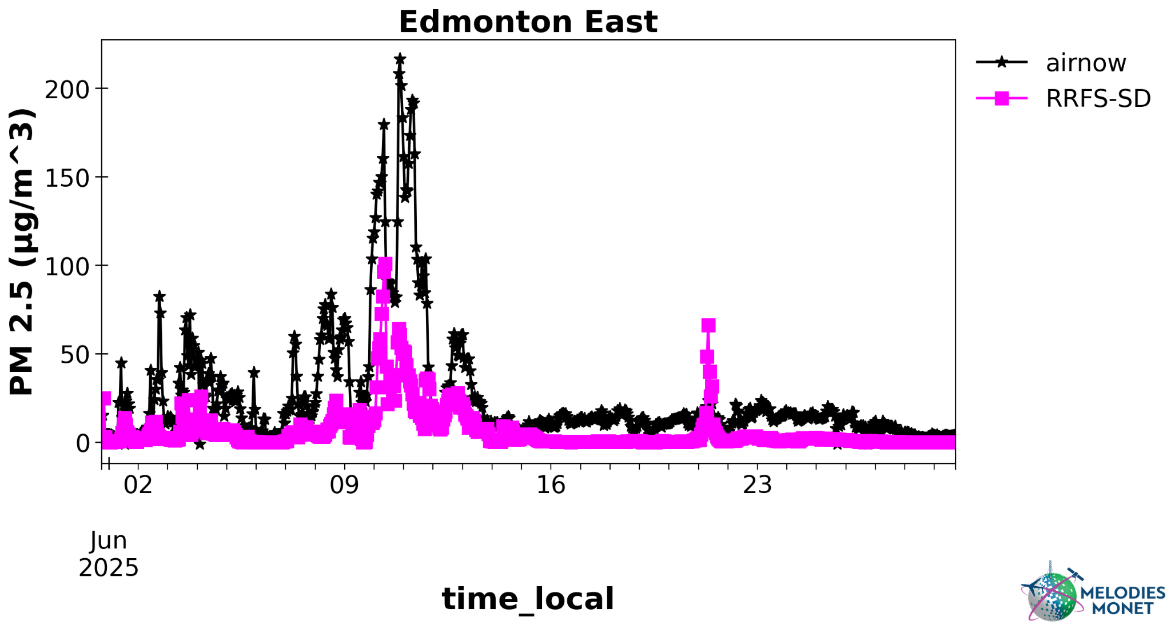
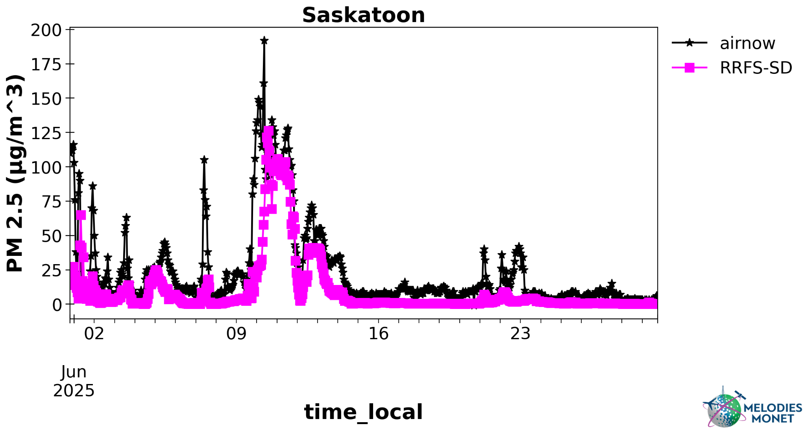
RRFS-SD forecast evaluation using the PM2.5 observations (June, 2025)
R2= 0.6
MB= -18.8
RRFS-SD does NOT include anthropogenic emissions or secondary aerosol formation.
There is no aerosol data assimilation is included.
R2= 0.64
MB= -13.8
Please check the poster by A.Navarrete:
Analysis of Extreme Wildfire Events in North America During the 2025 Fire Season Using Observations and RRFS-Smoke Model Output

Slide 14
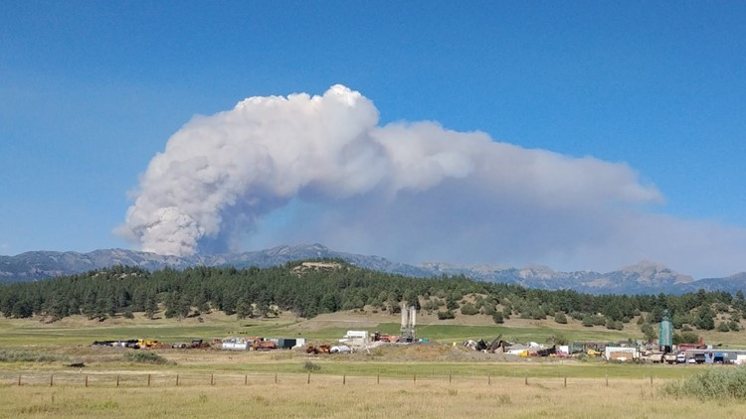
Thank you for your attention!
For questions and suggestions please contact us at smoke.gsl@noaa.gov

Slide 15
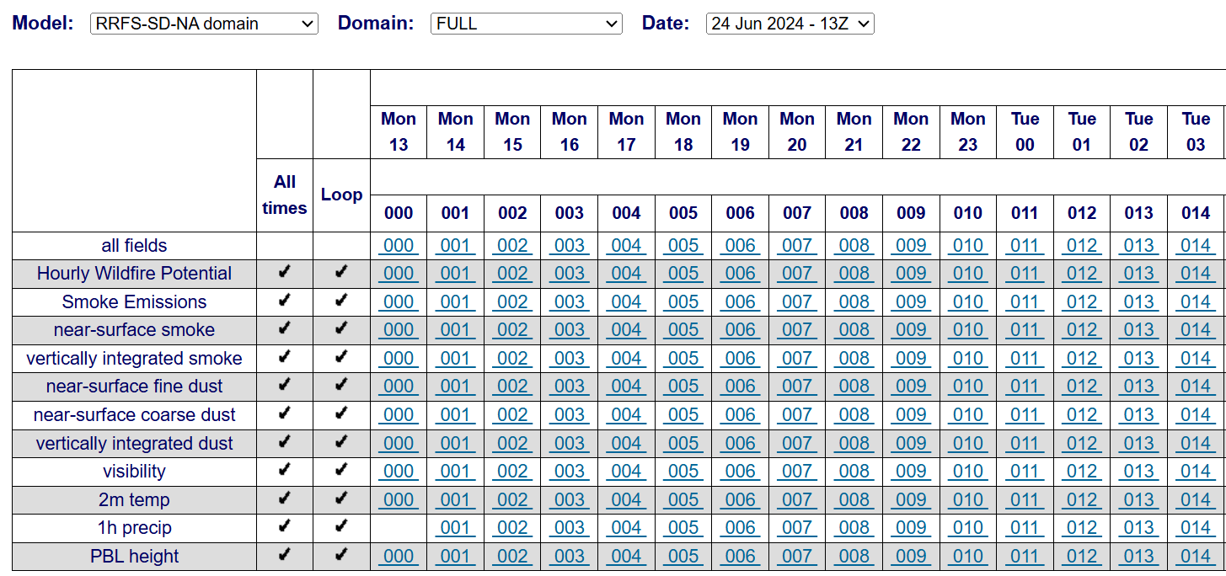
RRFS-SD website (https://rapidrefresh.noaa.gov/RRFS-SD/)

