Slide 1
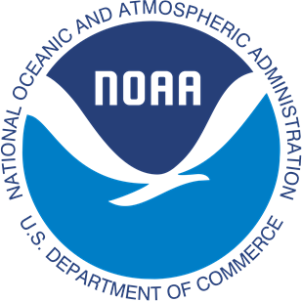
Development and Implementation of Regression Tests and Applications within the UFS-Coastal Framework
Yunfang Sun, Ufuk Turuncoglu, Ann Tsay, Hao-Cheng Yu, Joseph Zhang, Ali Abdolali, Jana Haddad, Mansur Jisan, Panagiotis Velissariou, Felicio Cassalho, Soroosh Mani, Xu Chen, Fariborz Daneshvar, Zizang Yang, Lei Shi, Denise Worthen, Ali Salimi-Tarazouj, Saeideh Banihashemi, Joseph Smith, Lucila J. Houttuijn Bloemendaal , Ed Myersn, Saeed Moghimi
NOAA/NOS’ Office of Coast Survey

Slide 2
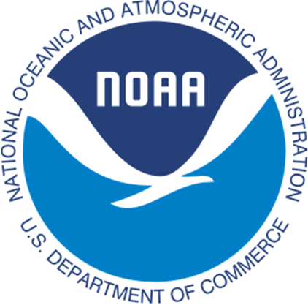
Outline
Introduction & UFS-Coastal
Duck, NC (Hurricane Sandy) Regression tests & Results
Scalability (Hurricane Ian)
Conclusion & Future works
NOAA/NOS’ Office of Coast Survey
Contact: Yunfang.sun@noaa.gov

Slide 3
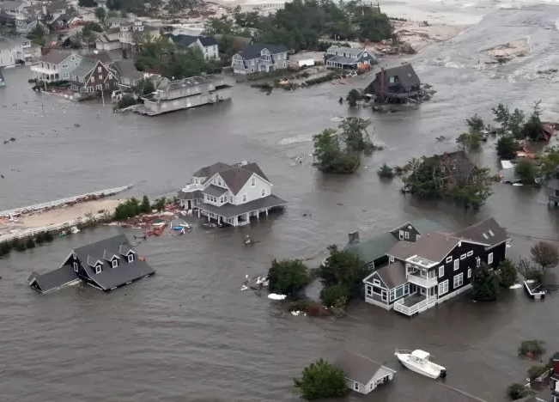
Introduction
Coastal hazards (storm surge, flooding, wave impacts) cause billions in damage and threaten lives every year.
Accurate forecasts in the nearshore zone are especially challenging due to dynamic wave-current interactions.
To be robust, models must be:
  Reliable: consistently reproduce observed conditions.
  Reproducible: same setup yields the same result anywhere.
  Systematically evaluated: standardized tests against real-world data.
Hurricane Sandy in October 2012.
Photo credit: U.S. Air Force
NOAA/NOS’ Office of Coast Survey
Contact: Yunfang.sun@noaa.gov

Slide 4
UFS-Coastal
UFS WEATHER MODEL
with new coastal components
Unified Forecast System Coastal model (UFS-Coastal) is forked from UFS-weather, adding coastal ocean models, is a modeling framework for coupled coastal applications and regional forecasts.
Fortran use
UFS Unified Driver (ESMF)
Fortran use
NUOPC Cap
NUOPC Cap
Wave
code
CMEPS
Mediator
Sea Ice
NUOPC Connectors
NUOPC Cap
ADCIRC
NUOPC Cap
NUOPC Cap
NUOPC Cap
SCHISM
ROMS
FVCOM
CDEPS
NUOPC Cap
NUOPC Cap
NUOPC Cap
NUOPC Cap
“Data” Atmosphere
“Data” Ocean
“Data” Wave
“Data” ...
NOAA/NOS’ Office of Coast Survey
https://github.com/oceanmodeling/ufs-weather-model
Contact: Yunfang.sun@noaa.gov

Slide 5
Objective
Design standardized regression tests: using high-quality observations during Hurricane Sandy at Duck, NC.
Evaluate multiple model setups:
  Hydrodynamic-only (SCHISM).
  Wave-only (WW3).
  Fully coupled wave-current simulations.
Assess coupling strategies:
  Radiation stress (traditional 2D).
  Vortex force (advanced 3D).
Demonstrate scalability by applying UFS-Coastal to a large regional storm event (Hurricane Ian, 2022).
NOAA/NOS’ Office of Coast Survey
Contact: Yunfang.sun@noaa.gov

Slide 6
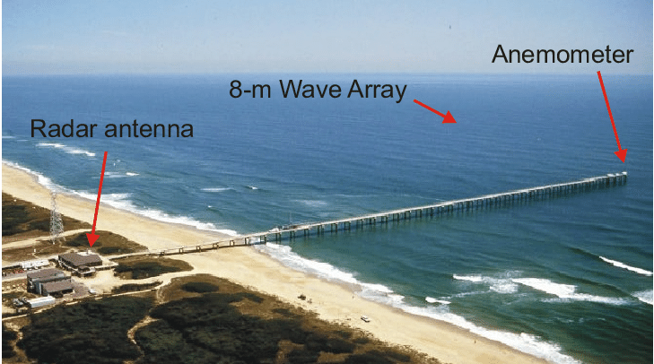
Duck, NC Regression Tests
Why Duck/FRF?
Longest continuous coastal wave–current dataset in the U.S.
Dense instrumentation: tide gauges, ADCPs, buoys, wave spectra.
Recognized international testbed for coastal processes.
Photo from Duck Field Research Facility
Coastal and Hydraulics Laboratory
U.S. ARMY ENGINEER RESEARCH AND DEVELOPMENT CENTER
NOAA/NOS’ Office of Coast Survey
Contact: Yunfang.sun@noaa.gov

Slide 7
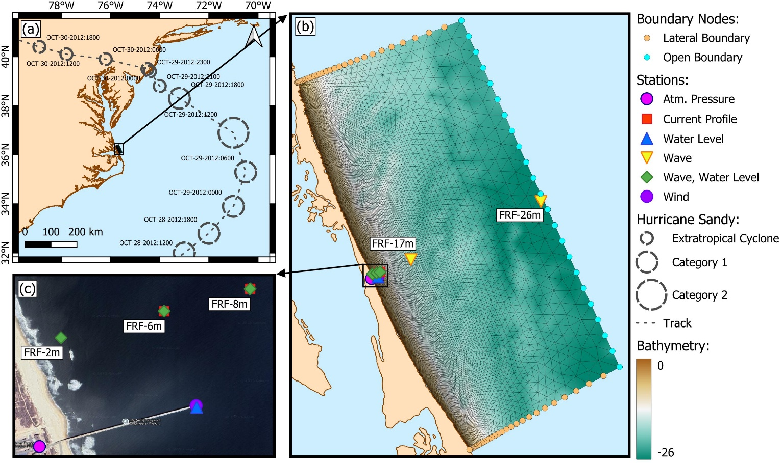
Hurricane Sandy
Originating as a tropical cyclone in the southwestern Caribbean Sea, Sandy moved northward parallel to the U.S. Atlantic coastline before sharply turning northwest toward the mid-Atlantic region. Sandy’s unique trajectory and extensive geographic scale made it one of the most severe storm surge and coastal flooding events.
NOAA/NOS’ Office of Coast Survey
Hurricane Sandy and the Duck domain
Contact: Yunfang.sun@noaa.gov

Slide 8
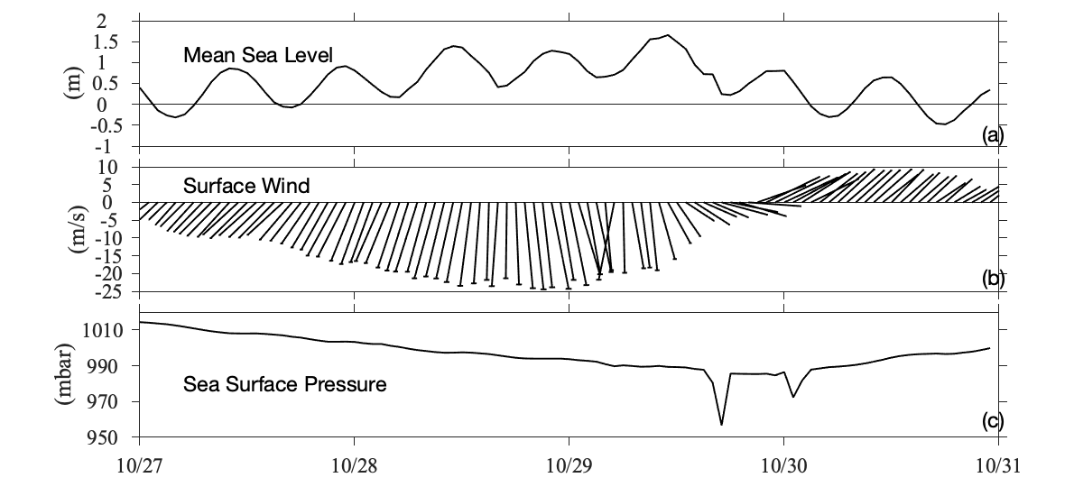
Experimental Design
Forcing: Uniform but time-varying observed atmospheric conditions (Wind speed & surface air pressure).
Validation Targets:
  Sea surface height.
  Nearshore currents.
  Significant wave height.
  Wave spectra.
Case | Components | Details
#1 | ATM+WW3 | Without sea level
#2 | ATM+WW3 | With sea level
#3 | ATM+SCH
#4 | ATM+SCH+WW3 | Longuet-Higgins Radiation Coupling
#5 | ATM+SCH+WW3 | 3D Vortex Coupling
NOAA/NOS’ Office of Coast Survey
Contact: Yunfang.sun@noaa.gov

Slide 9
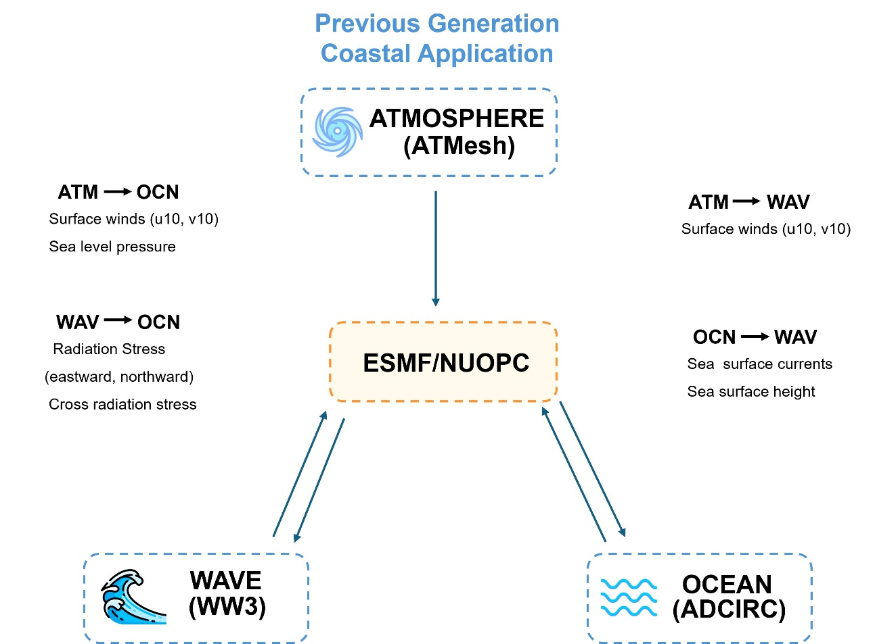
Longuet-Higgins Radiation Coupling
NOAA/NOS’ Office of Coast Survey
Contact: Yunfang.sun@noaa.gov

Slide 10
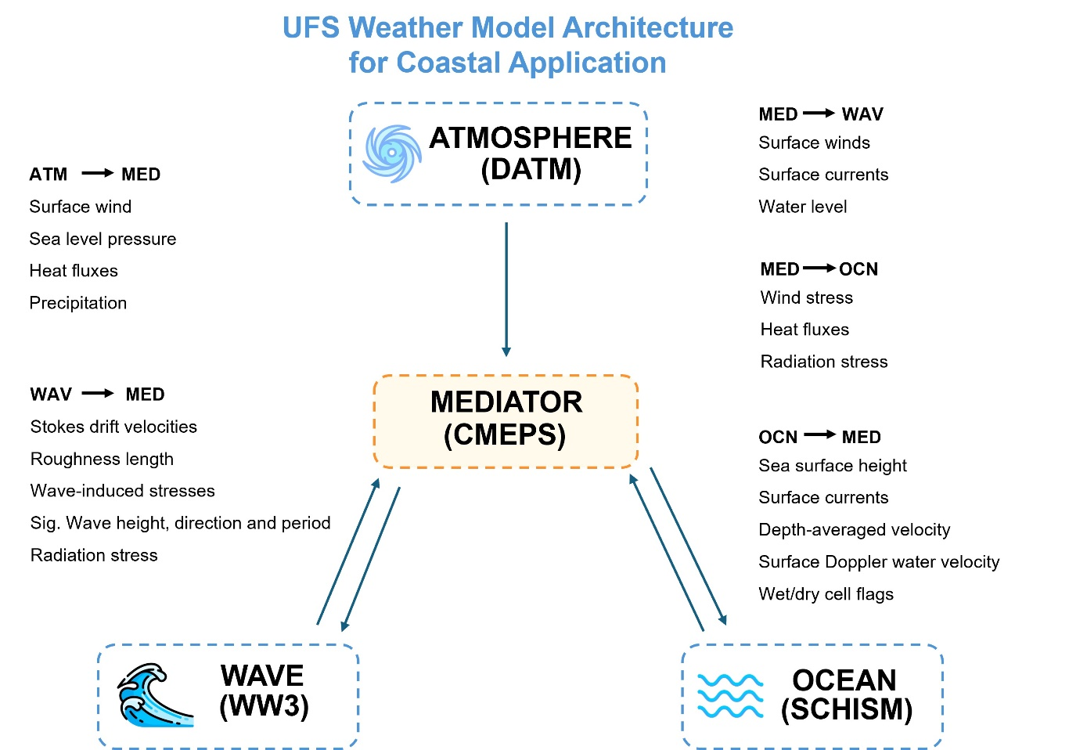
3D Vortex Coupling
NOAA/NOS’ Office of Coast Survey
Contact: Yunfang.sun@noaa.gov

Slide 11
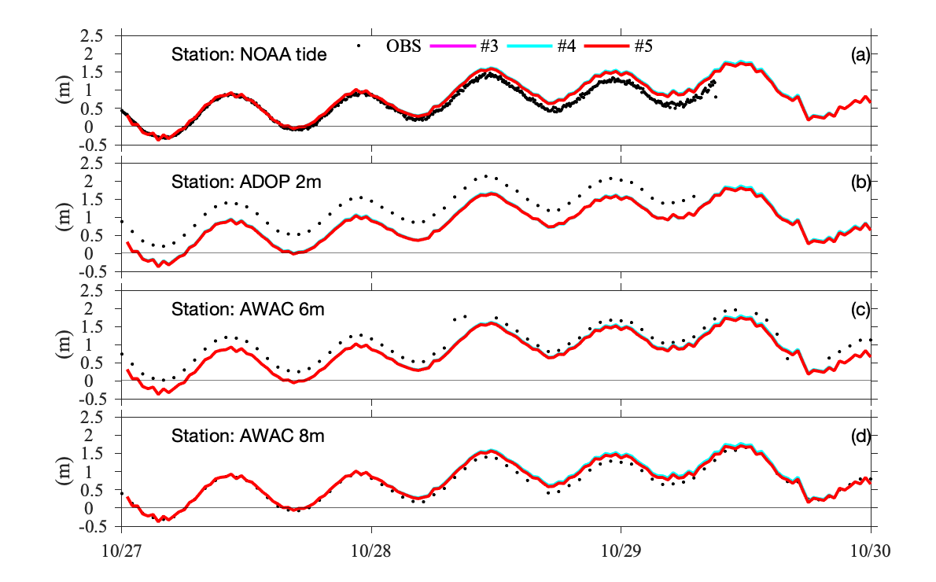
Results: Hydrodynamic-only
Water level simulations match FRF tide gauges well.
Captures tidal signal and storm-driven setup.
Provides reliable baseline hydrodynamic conditions.
NOAA/NOS’ Office of Coast Survey
Contact: Yunfang.sun@noaa.gov

Slide 12
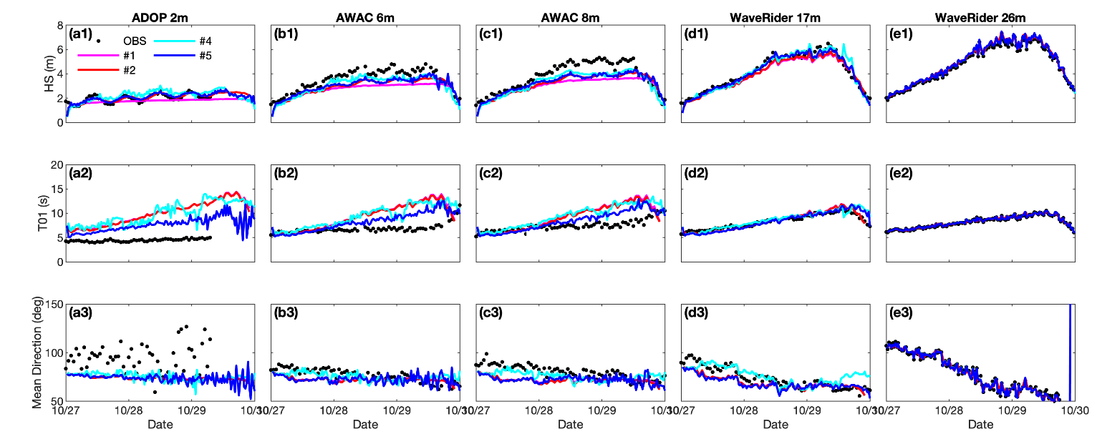
Motivations:
Significant wave height aligns with buoy observations.
Frequency spectra show dominant peak reproduced.
Slight underestimation in extreme events.
NOAA/NOS’ Office of Coast Survey
Contact: Yunfang.sun@noaa.gov

Slide 13
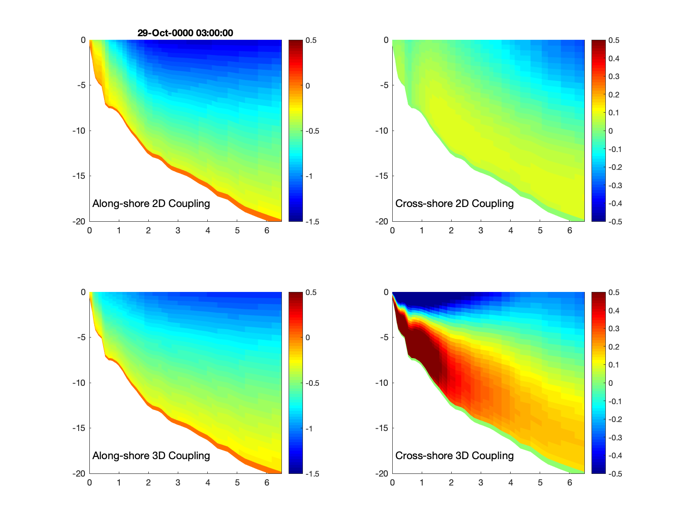
Results: Coupled Simulations
Radiation Stress:
Captures broad-scale trends in nearshore setup.
Lower computational cost, but less detailed currents.
Vortex Force:
Realistic 3D current structures.
Improved accuracy under energetic wave conditions.
Better representation of surf-zone circulation.
NOAA/NOS’ Office of Coast Survey
Contact: Yunfang.sun@noaa.gov

Slide 14
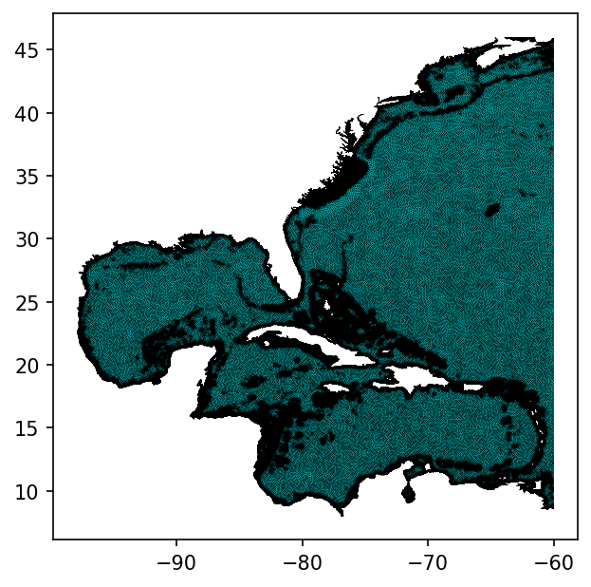
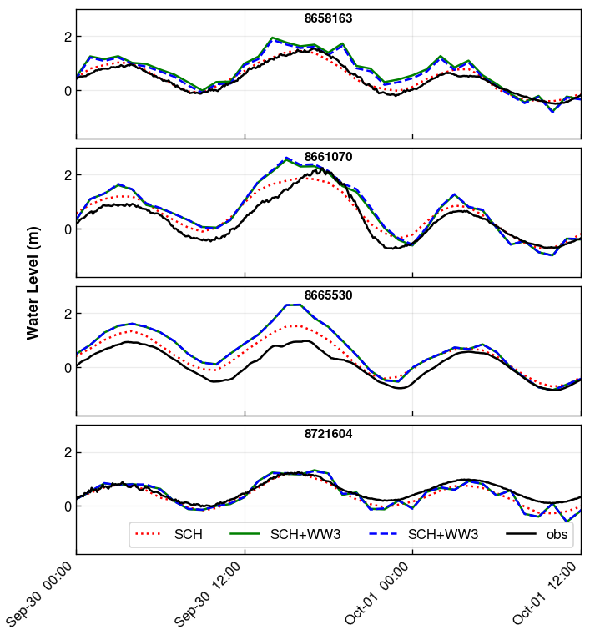
Scalability: Hurricane Ian (2022)
Atlantic domain application:
Basin-scale setup covering U.S. East Coast.
Hurricane Ian (2022) used as test case.
Importance:
Demonstrates UFS-Coastal can scale from testbed → regional storm forecasting.
Operationally relevant for surge, flooding, and wave hazards.
2D coupling case
NOAA/NOS’ Office of Coast Survey
Contact: Yunfang.sun@noaa.gov

Slide 15
Conclusions
Standardized regression tests provide a foundation for reproducible, reliable coastal modeling.
Coupling strategy matters: vortex force improves nearshore realism, radiation stress remains useful for efficiency.
UFS-Coastal scales effectively from local testbeds to regional hazards like Hurricane Ian.
This work strengthens NOAA’s ability to forecast storm surge, coastal flooding, and wave dynamics.
NOAA/NOS’ Office of Coast Survey
Contact: Yunfang.sun@noaa.gov

Slide 16
The end
Thank you for your attention!
Q/A
NOAA/NOS’ Office of Coast Survey
Contact: Yunfang.sun@noaa.gov

