Slide 1
Recent SCHISM coupling development under NOAA's UFS-coastal framework
HaoCheng Yu¹, Joseph Zhang¹, Yunfang Sun², Ali Abdolali³, Ufuk Turuncoglu⁴, Joseph Smith⁵, Saeed Moghimi²
1. VIMS, 2. NOAA, 3. US Army Corp., 4. UCAR, 5. OSU
September 11, 2025

Slide 2
Diagram Modified from:
UFS System Architecture: Sub-system: Forecast Models
Contributors: Rocky Dunlap, Rahul Mahajan, Dom Heinzeller, Mike Barlage, Ben Cash
code
UFS WEATHER MODEL
with new coastal components
Actual model components included in any given application and run sequence are configurable.
Fortran use
code
UFS Unified Driver (ESMF)
code
Fortran use
NUOPC Cap
NUOPC Cap
WWIII
code
code
CMEPS
Mediator
Sea Ice
NUOPC Connectors
NUOPC Cap
ADCIRC
NUOPC Cap
NUOPC Cap
NUOPC Cap
SCHISM
ROMS
FVCOM
CDEPS
Data models to bring in forcings and support isolation of coupling feedbacks.
“Data” component can substitute for the above active components to bring in forcings from file.
NUOPC Cap
NUOPC Cap
NUOPC Cap
NUOPC Cap
“Data” Atmosphere
“Data” Ocean
“Data” Wave
“Data” ...

Slide 3
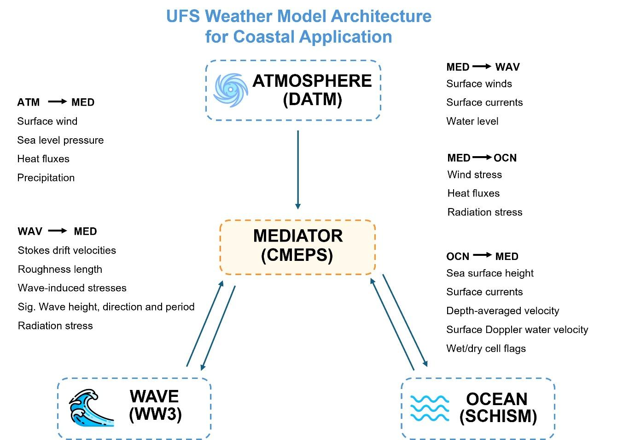
SCHISM+WW3 coupling
LON
Radiation stress
Stoke drift velocity
Sig. Wave height, direction, period
Ocean momentum flux
Wave bottom friction flux
Wave number
Bernoulli head
Orbital velocity
VOR

Slide 4
UFS-coastal collaboration
SCHISM-WW3 coupling
  Collaborate with Ufuk, Ali, YunFang, & Denise to test LON/VOR coupling
  Duck case
    Ali’s WW3 test case for Sandy (2012)
      Finish test
        Issues fixed
          ESMF triangulation error: from ESMF team, Bob & Ufuk, also schism-cap
          SCHISM: all sflux vars are added in the cap.
            Also fix some DATM exchange variable issues. 🡪Benefit to CICE coupling
          Zero values along the boundary: fixed by modifying WW3 cap
          Orbital velocity code fixed by modifying WW3 cap
          Still some exchange fields need to be further checking (compare with SCHISM-WWM)
            Stoke’s velocity, ocean momentum flux, and bottom friction flux
            Consult with Aron, Ali, John and other developers to discuss and fix the code.
        LON coupling now works under UFS, VOR needs further developments.
  SECOFS test
    Based on UFS code fixed from Duck case
    1 month simulation test and preliminary validation

Slide 5
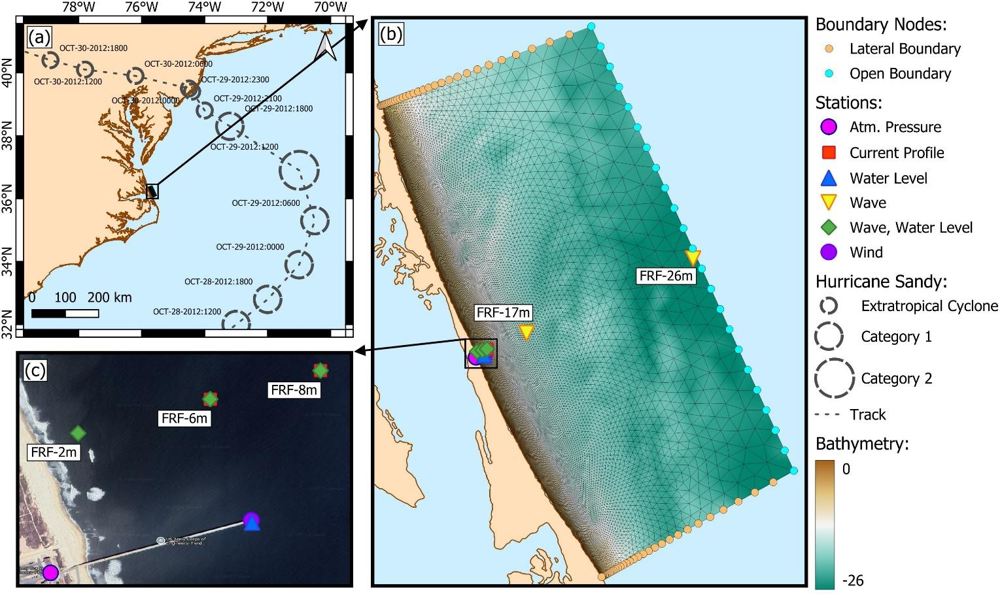
Sandy Test –SCHISM+WW3 3D Vortex coupling
(based on Ali’s DUCK case setup)
Open BC + Wind forcing
  Uniform Elevation + Wind (time series)
    from Yunfang’s download buoy data
  Wave spectrum density
    from Ali’s spec netcdf
Period: 2012/10/27~30, 3 days
2-way coupling: every 5 mins
Test branch:
  feature/coastal-app, based on d2752eb
  LON/VOR coupling test
    WW3 switch:
    NCO PDLIB SCOTCH SCRIP SCRIPNC NOGRB DIST MPI PIO PR3 UQ FLX0 SEED ST4 STAB0 NL1 BT1 DB1 MLIM FLD2 TR0 BS0 RWND WNX1 WNT1 CRX1 CRT1 O0 O1 O2 O3 O4 O5 O6 O7 O14 O15 IC0 IS0 REF0
Compare with SCHISM-WWM (same setup)

Slide 6
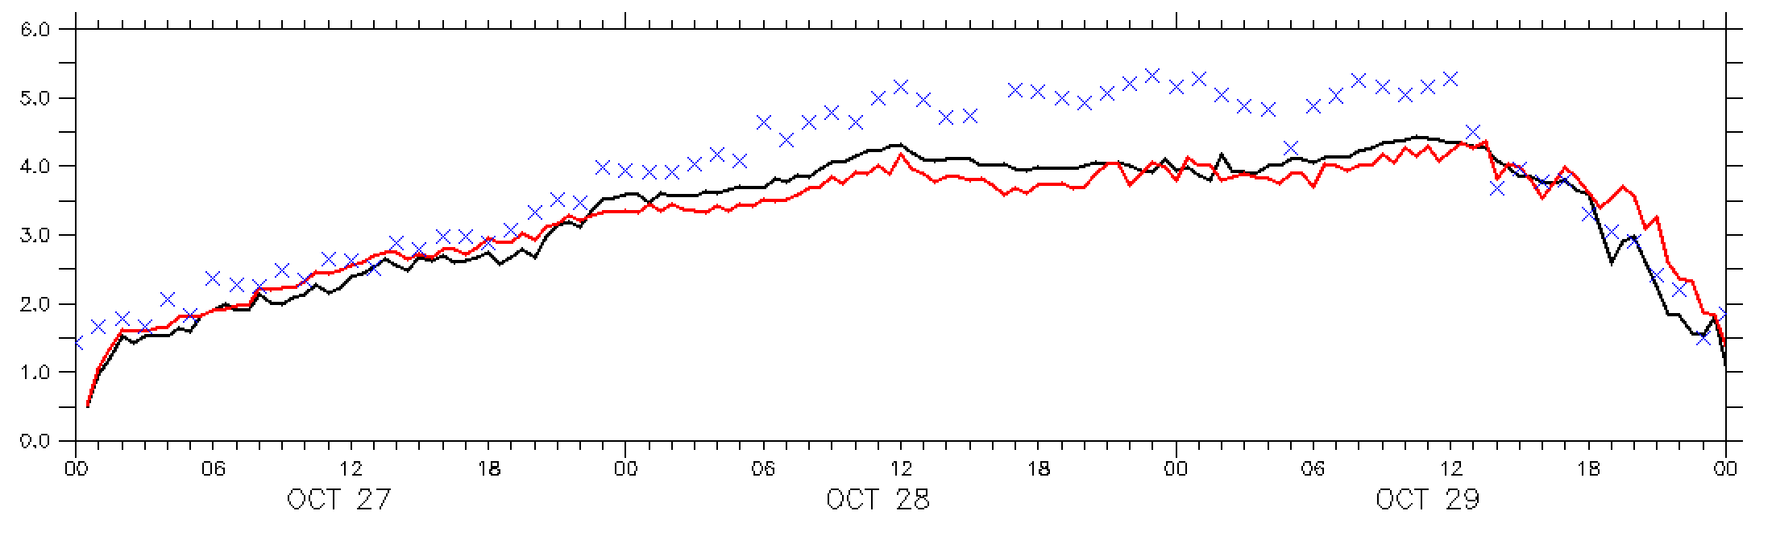
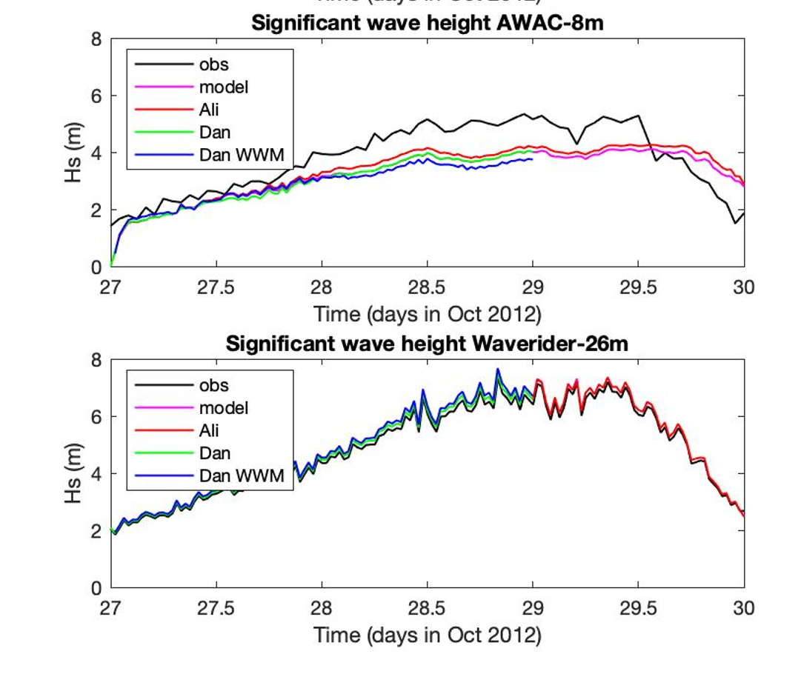
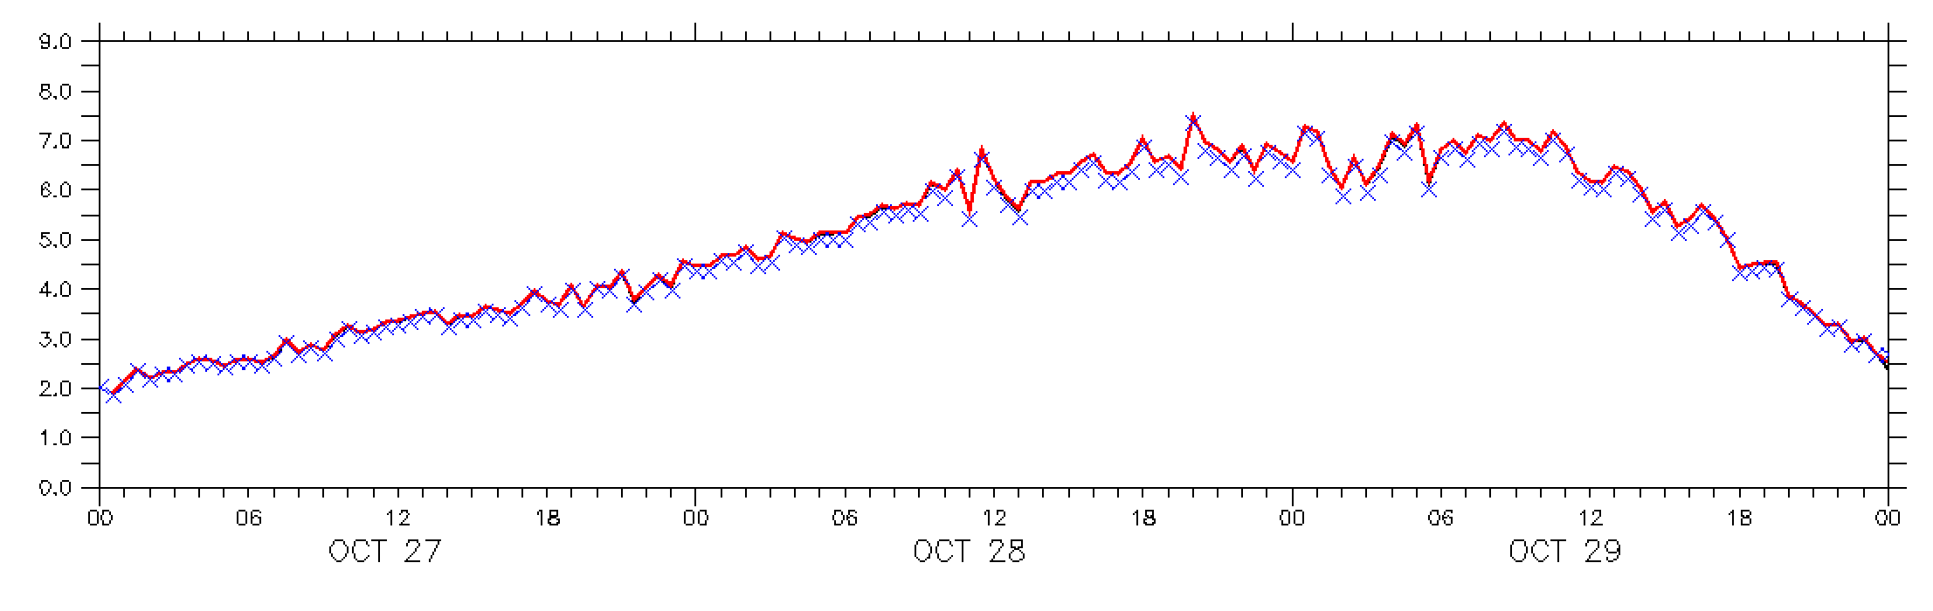
Hs Validation
AWAC-8m
Waverider-26m
LON
VOR
Obs
LON
VOR
Obs
YunFang’s previous comparison

Slide 7
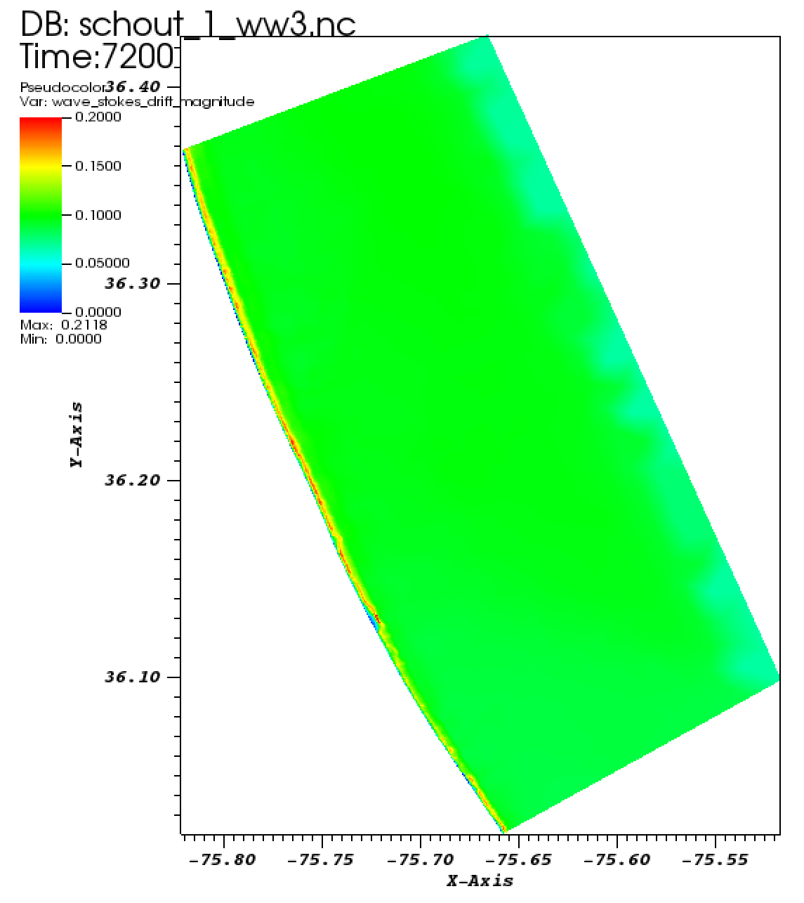
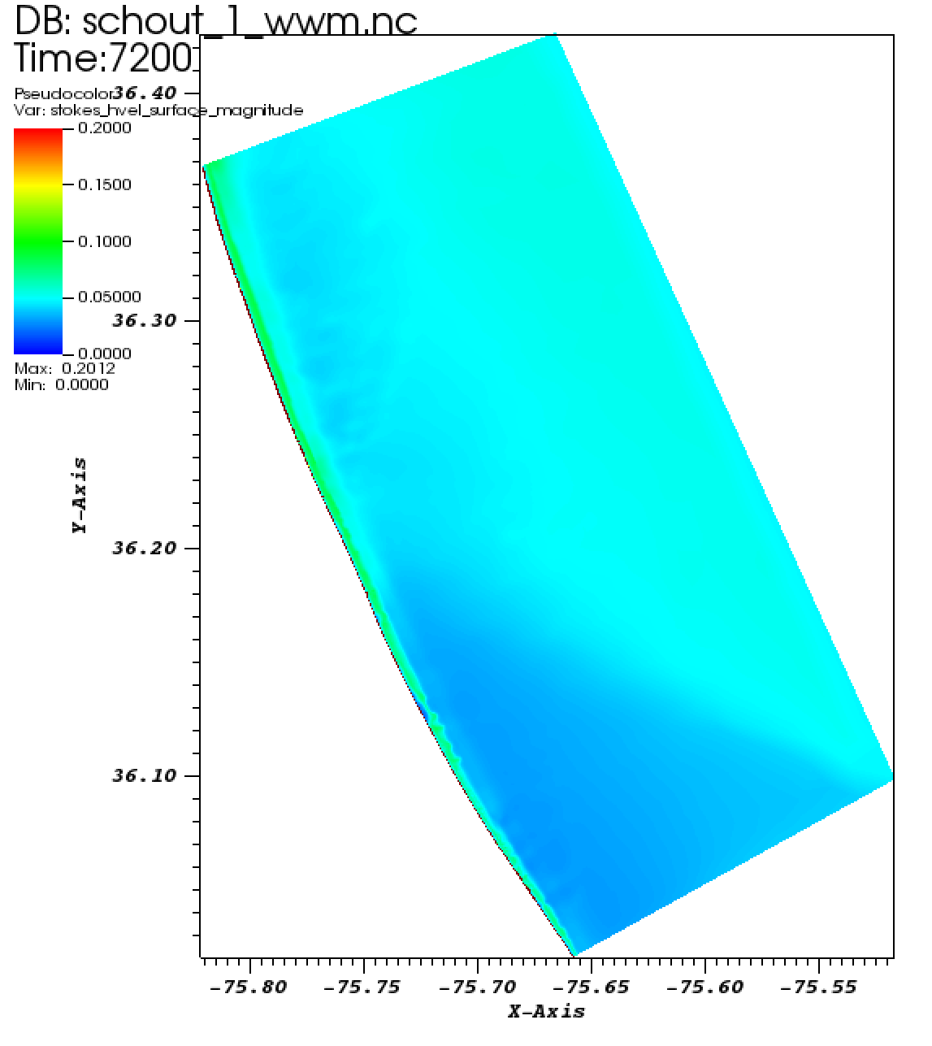
Stoke’s drift velocity
SCHISM-WW3
SCHISM-WWM

Slide 8
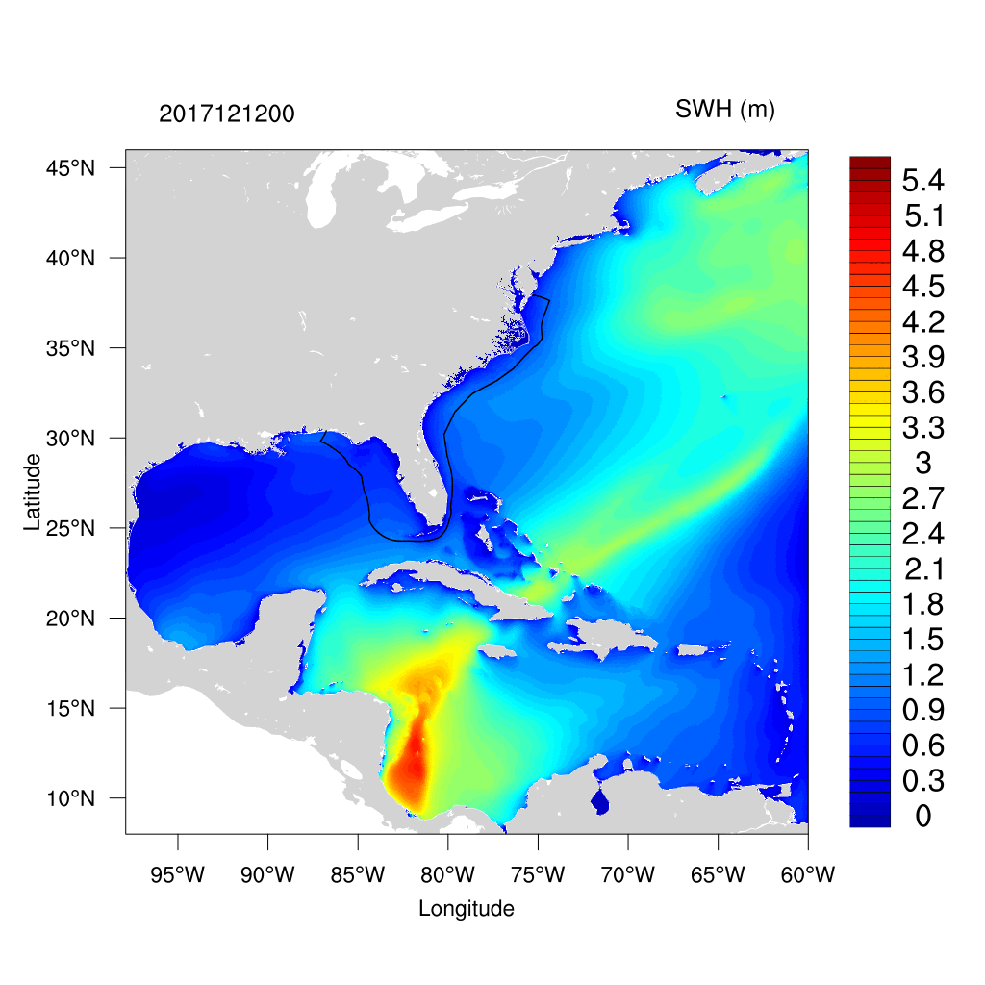
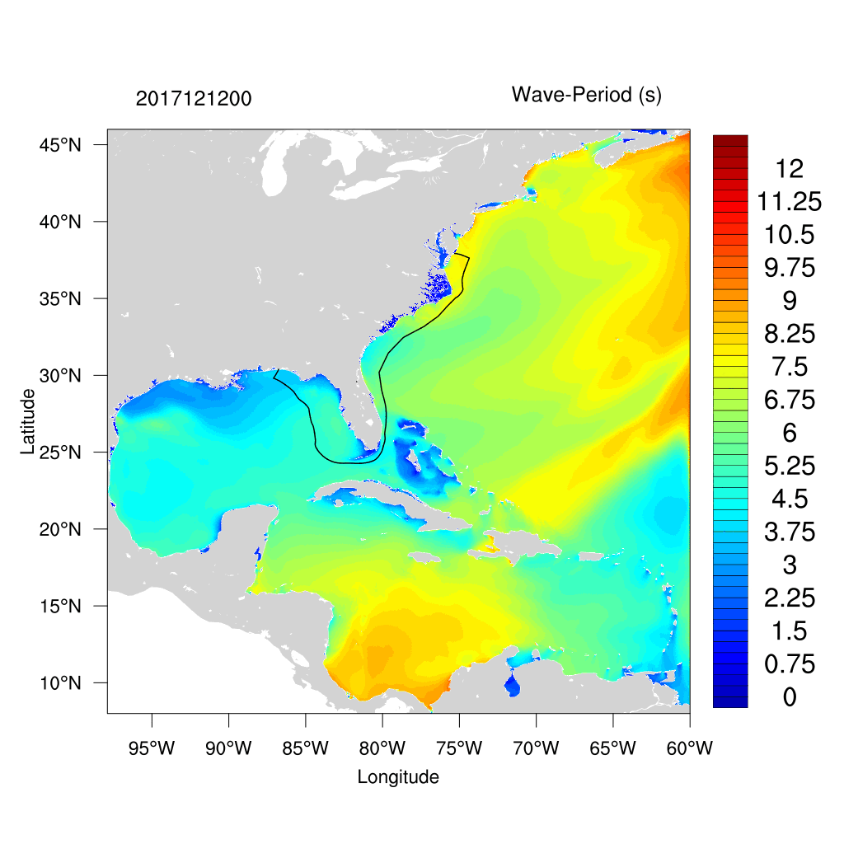
SECOFS Couple case
Hs
SECOFS single domain with WW3 Atlantic domain
Model configuration
  GFS datm forcing
  Simulation period: 2017/12/1~2017/12/31
  LON-coupling
  Couple every 5 mins
  Mesh size and cpu cores specified
    WW3: 557481 nodes, 4240 cores
    SCHISM: 1309159 nodes, 1779 cores
Runtime
  1 day simulation on Hercules:
    UFS-SCHISM-WW3
      With no-parmetis=off
        Tooks about 156 mins
          Initialization: 120 mins
            CMEPS/CDEPS initialization
          Time stepping (both models): 36 mins
      With no-parmetis=on
        Tooks about 14 mins
          Initialization: 2 mins
          Time stepping (both models): 12 mins
    Standalone SCHISM: 12 mins
    UFS-SCHISM: 12 mins
Total run time for 30 days: 381 mins
Tp
Same core count for SCHISM

Slide 9
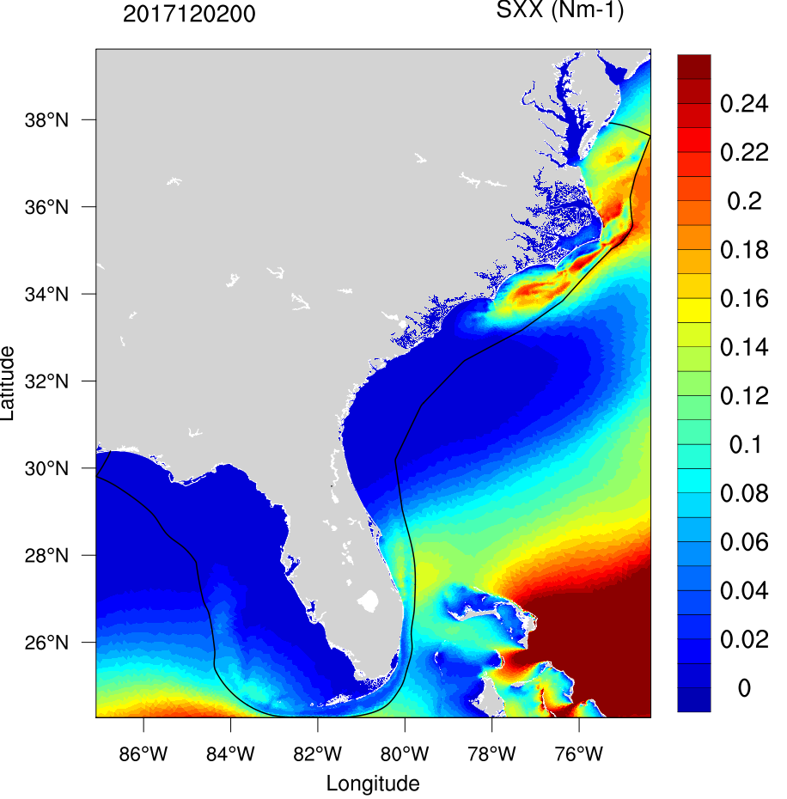
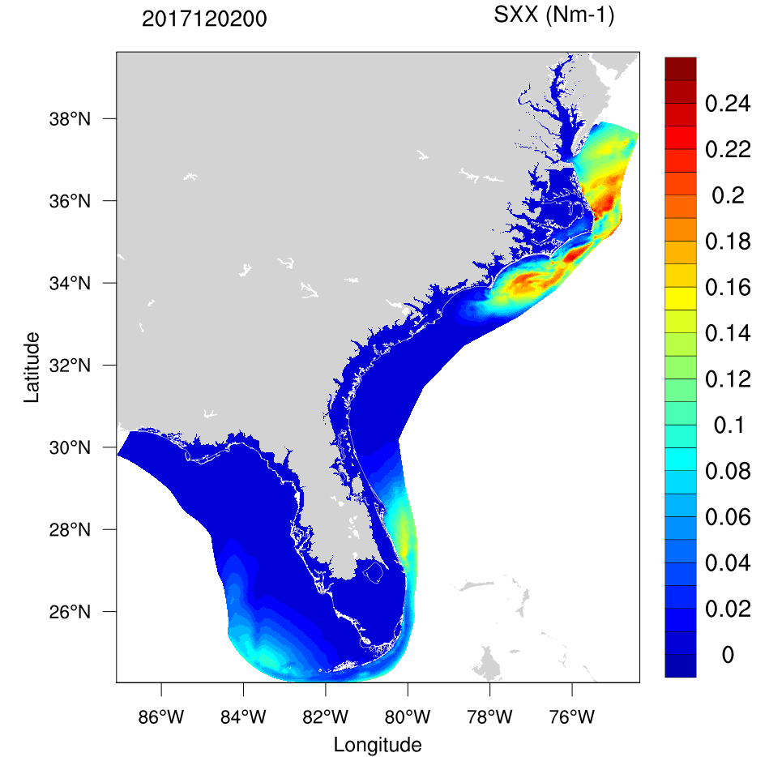
SXX in both model
WW3 calculated
SCHISM received

Slide 10
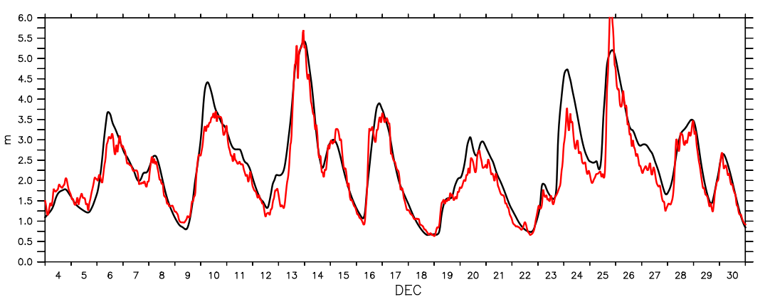
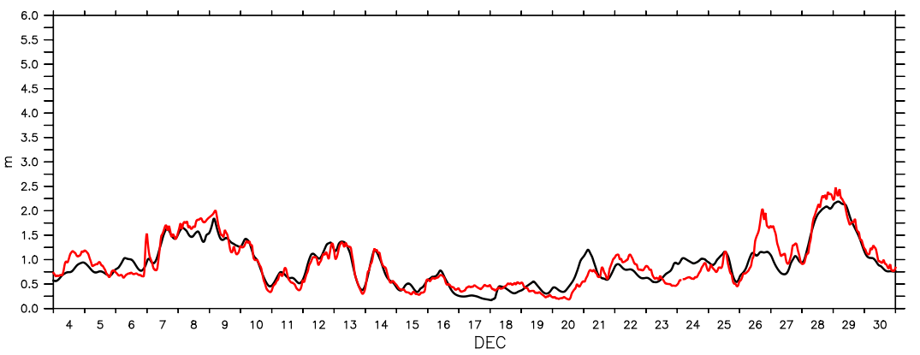
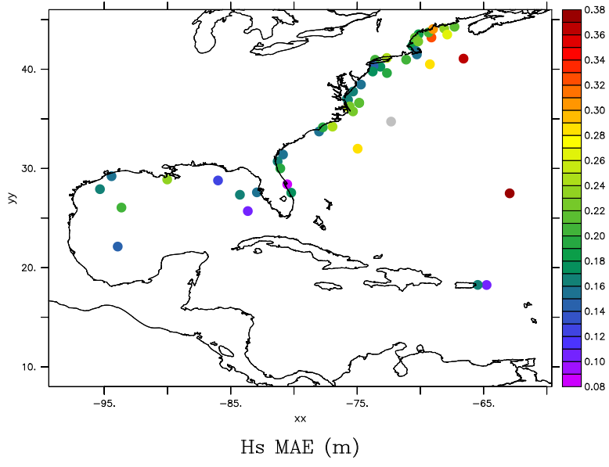
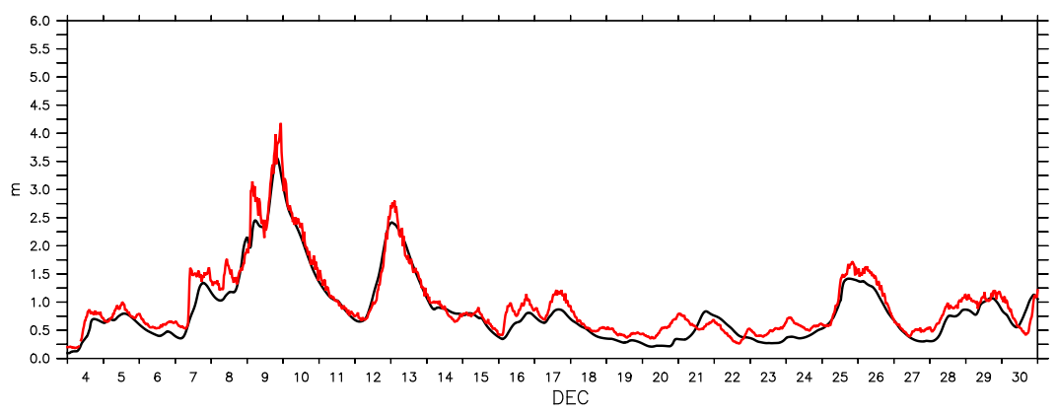
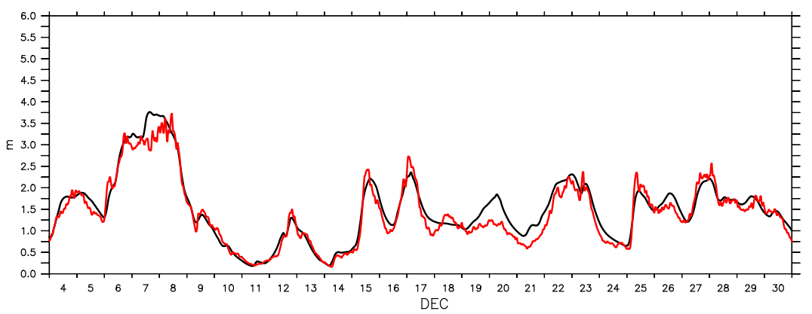
Hs validation from NDBC buoy
Model
Observation
Period: 2017/12/4~2017/12/31
Skip first 3 days
Overall MAE : 0.2 m
Couple domain

Slide 11
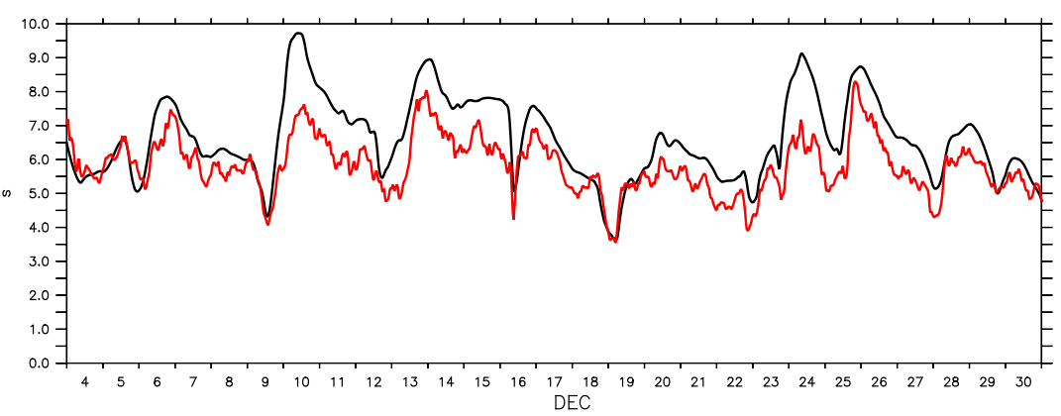
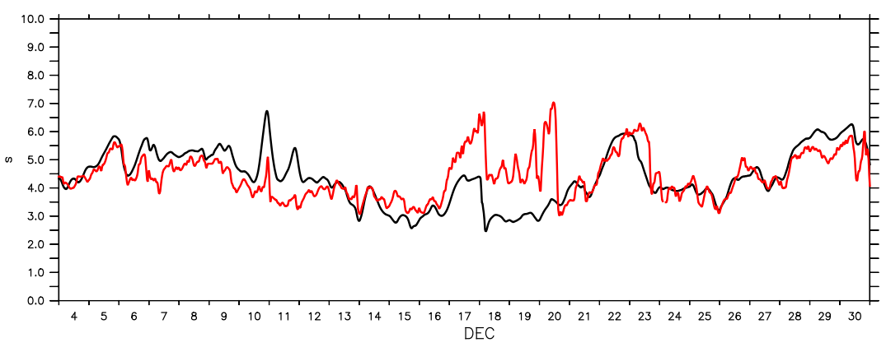
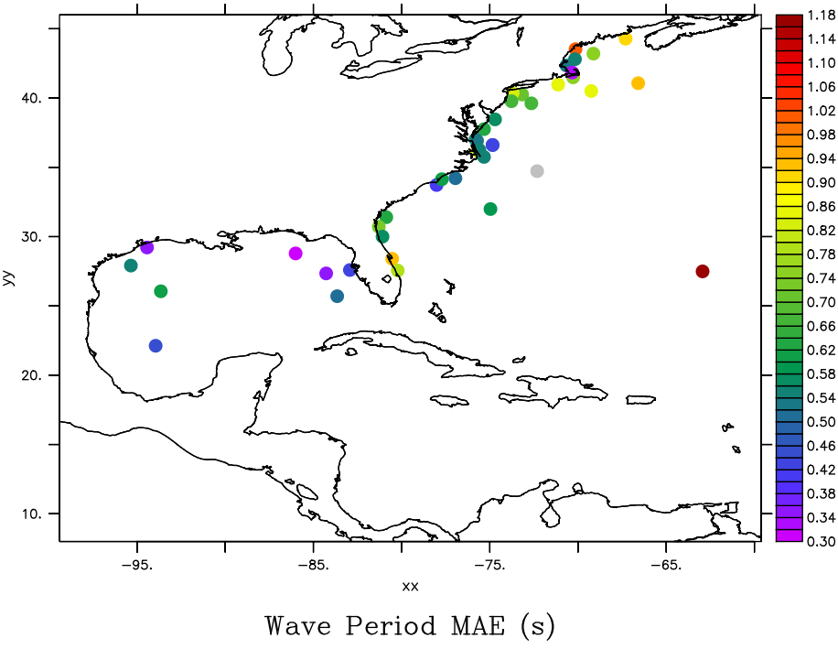
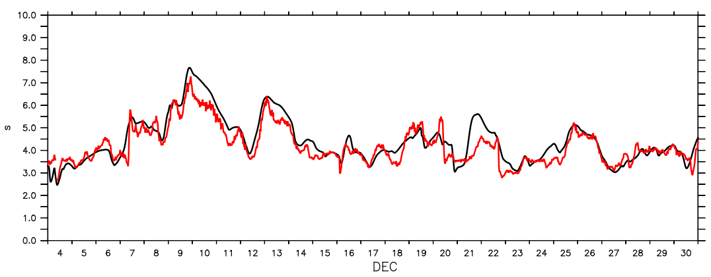
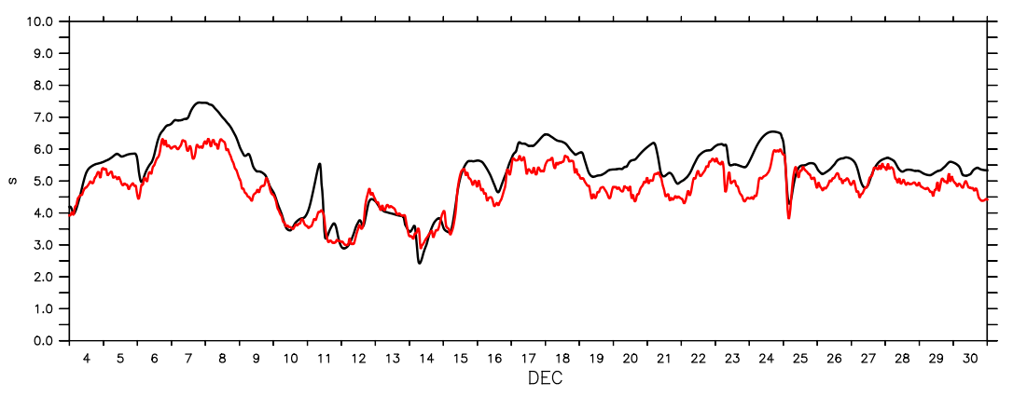
Tp validation from NDBC buoy
Period: 2017/12/4~2017/12/31
Skip first 3 days
Overall MAE: 0.64s
Model
Observation

Slide 12
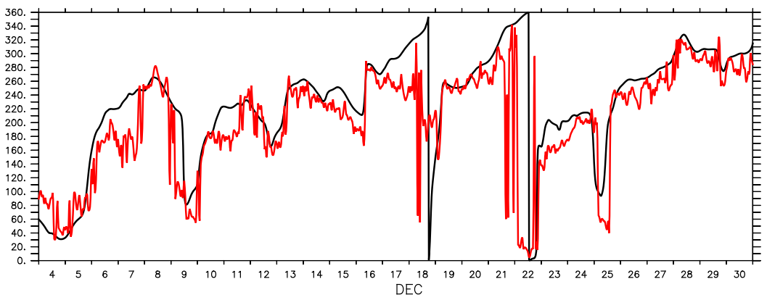
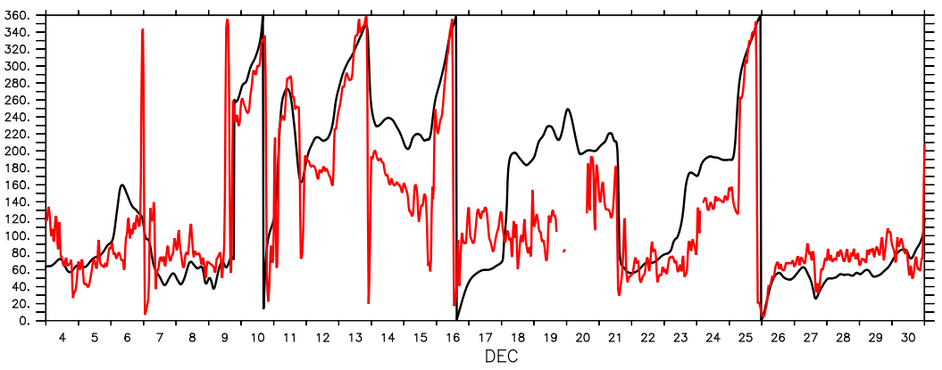
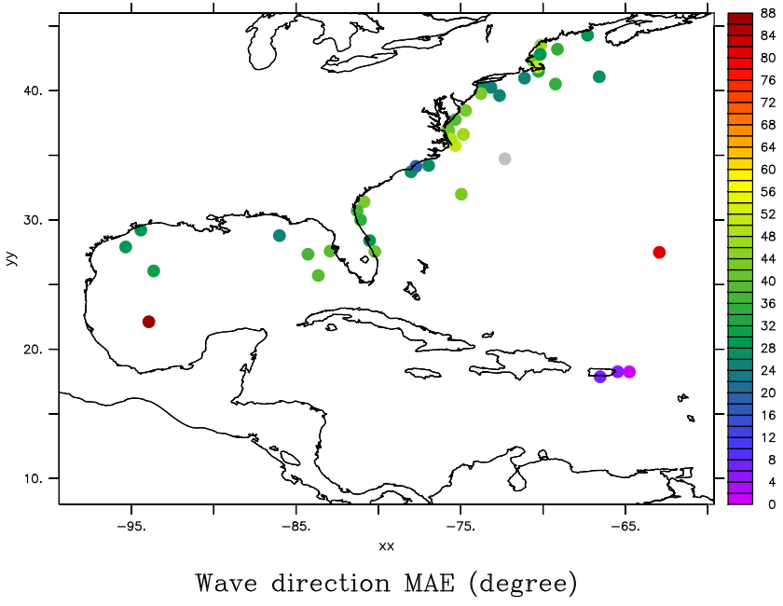
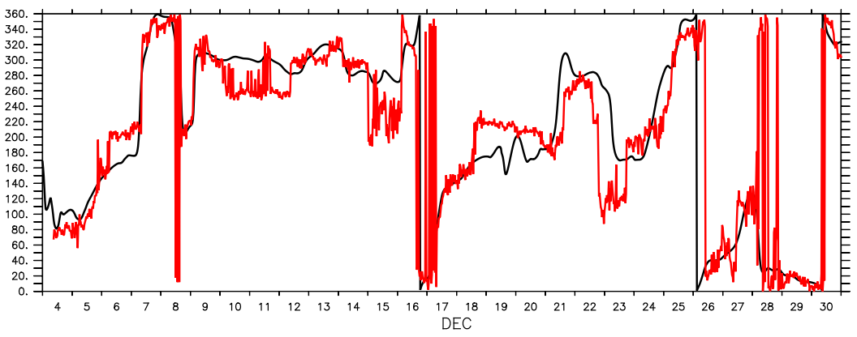
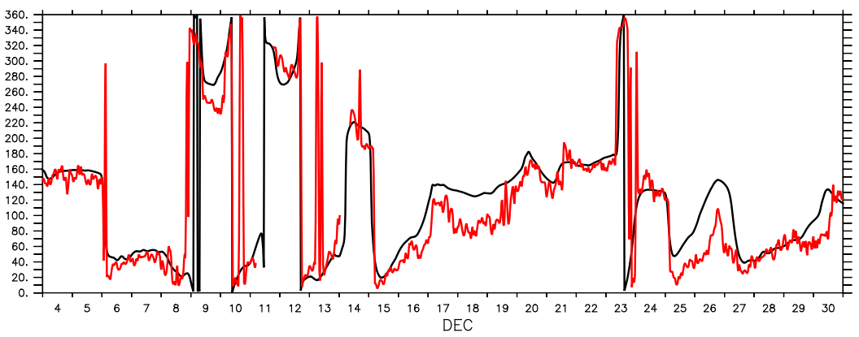
Dir validation from NDBC buoy
Period: 2017/12/4~2017/12/31
Skip first 3 days
Overall MAE: 36 degree
Model
Observation

Slide 13
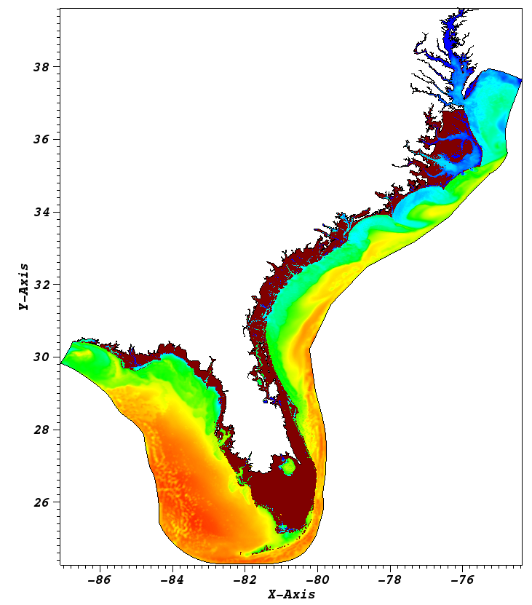
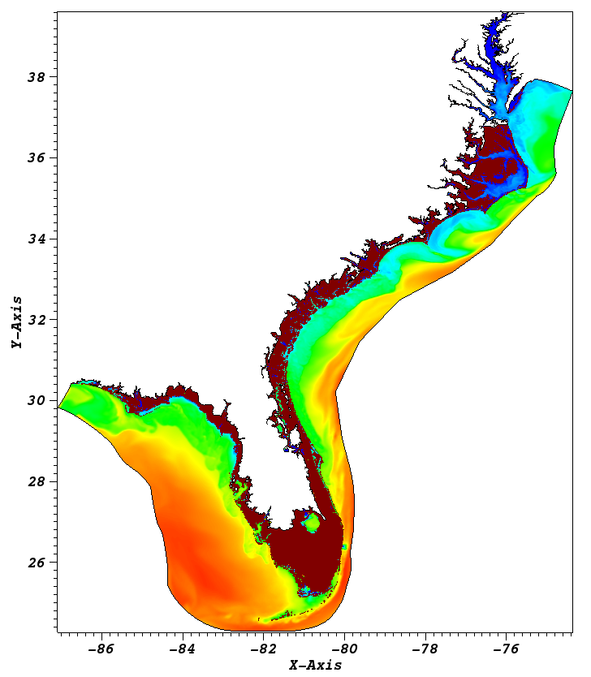
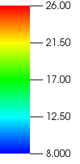
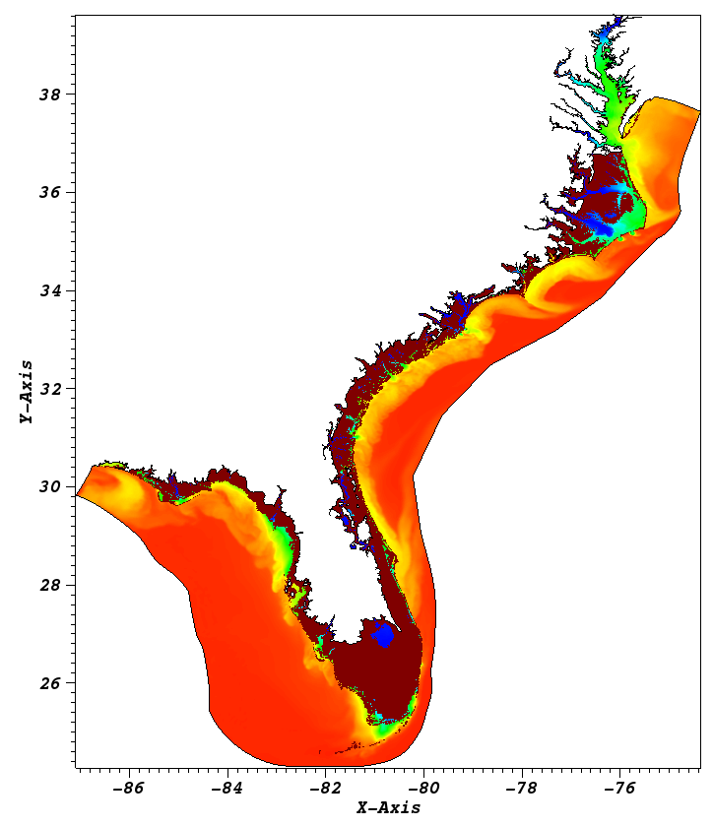

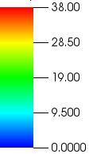
SCHISM-WW3 vs. SCHISM
SCHISM-WW3
SCHISM
2017/12/12 01:00
SST
SST
  Similar but with significant difference
SSS
  Similar
SSS

Slide 14
