Slide 1
Recent METplus advancements for verifying HAFS forecasts
Kathryn Newman^{1,2}, Michael Kavulich^{1,2}, John Halley Gotway^{1,2}, Brianne Nelson^{1,2}, Minna Win-Gildenmeister^{1,2}, Samuel Trahan^{2,3,4}, Michelle Harrold^{1,2}
¹ NSF National Center for Atmospheric Research
² Developmental Testbed Center
³ NOAA/Global Systems Laboratory
⁴ CU Cooperative Institute for Research in Environmental Sciences
UIFCW | UFS Applications - Coastal, Marine, Oceans, and Ecology
11 September 2025

Slide 2

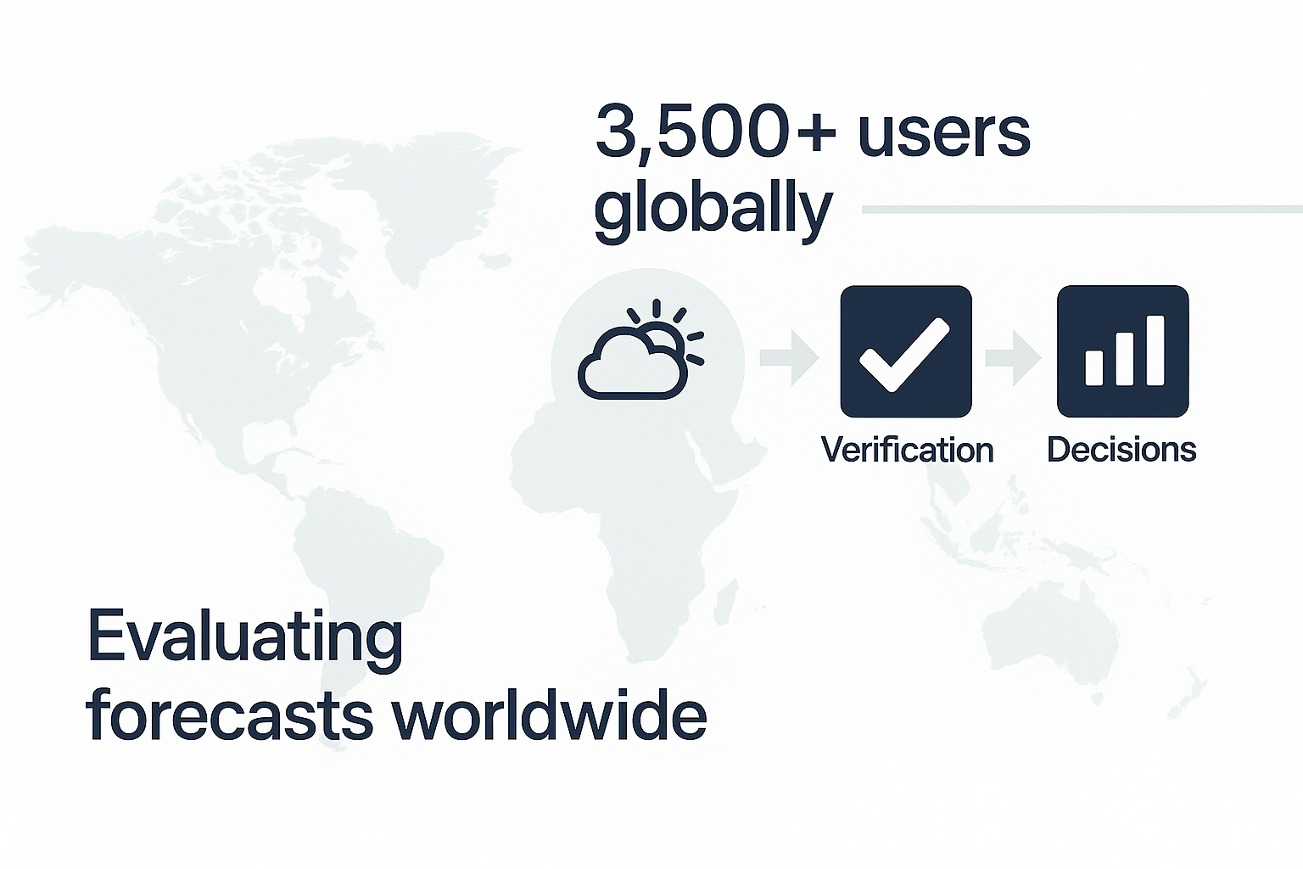
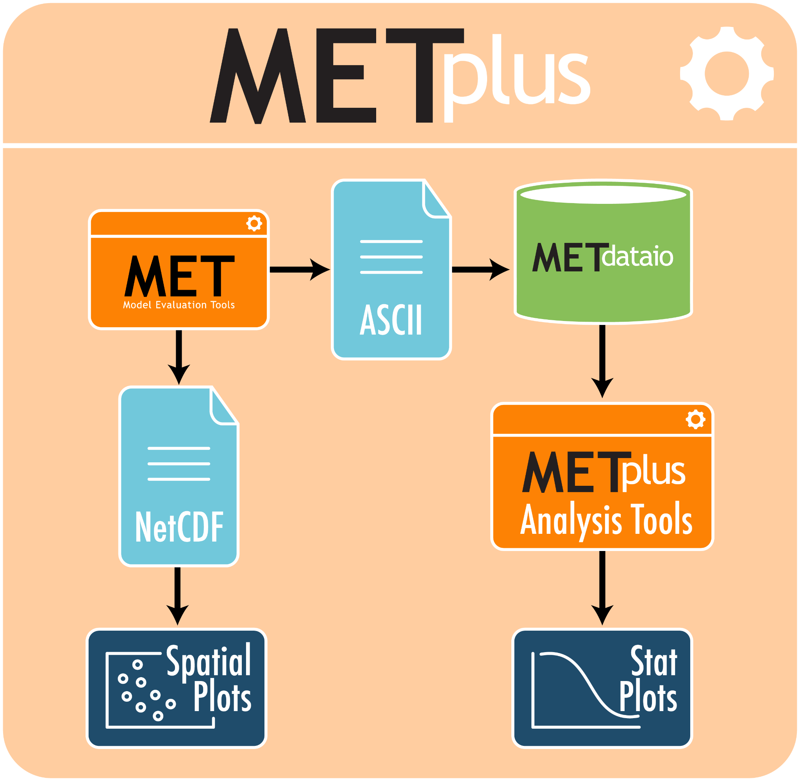
A highly configurable verification framework that spans a range of temporal and spatial scales
Community-driven, extensible, scalable
METplus is…
Over 150 statistics and diagnostics for point and gridded datasets
User support via GitHub Discussions
Use cases for easy spin-up
METplus has…
A versatile toolkit that enables objective and reproducible evaluations over a broad range of weather and climate applications
METplus provides…

Slide 3

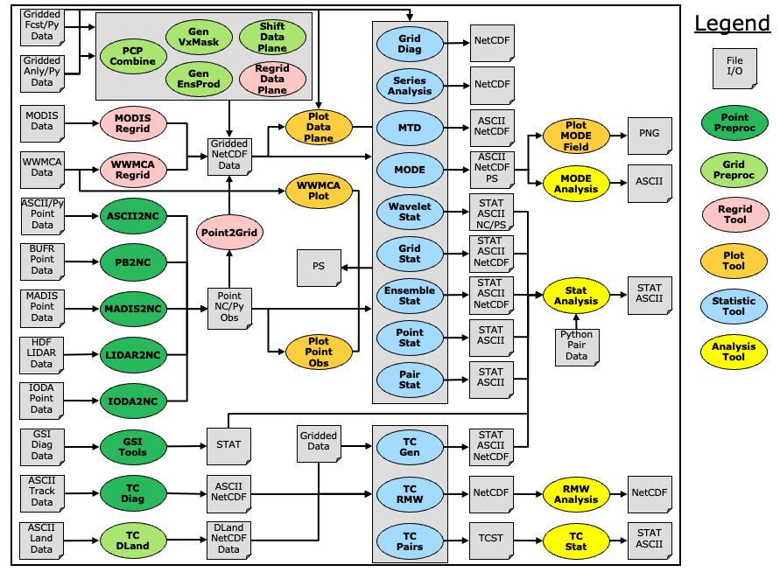
36 Command Line Executables
Statistical Methods (12)
Grid (5) and Point (7) Preprocessing
Regridding (4), Plotting (4), and Aggregation/Analysis (4)
Feature Highlights
Continuous, categorical, probabilistic, and ensemble statistics
Object-based, scale-decomposition, and neighborhood methods
Tropical cyclone track and intensity evaluation

Slide 4
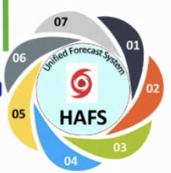

HAFS verification framework
Adding METplus verification
Primary goal: Facilitate the rapid and straightforward comparison of experimental configurations and operational benchmarks
Who is the intended audience?
HAFS developers
Community researchers
DTC teams performing T&E
Decision makers
Unified approaches for incorporating METplus across UFS application workflows
Enable the use of METplus for HAFS community developers to support rapid performance feedback on innovations

Slide 5
HAFS verification framework
hafs_vx workflow
Rocoto-based workflow for running METplus verification with HAFS (hafs_vx)
HAFS
Separate workflow: easier development, leverages SRW framework
Runs parallel to the HAFS workflow or using staged model output
Allows retrospective or real time verification
Employs Unified Workflow tools (uwtools) to generate experiments from a yaml config file
User HAFS settings (system.conf)
User verification settings (config_vx.yaml)
HAFS VX
generate_vx_workflow.py
./run_hafs.py
Rocoto verification workflow
METplus conf file templates
Rocoto HAFS workflow
HAFS run scripts
Verification run scripts
Obs
METplus
HAFS output
Verification output

Slide 6
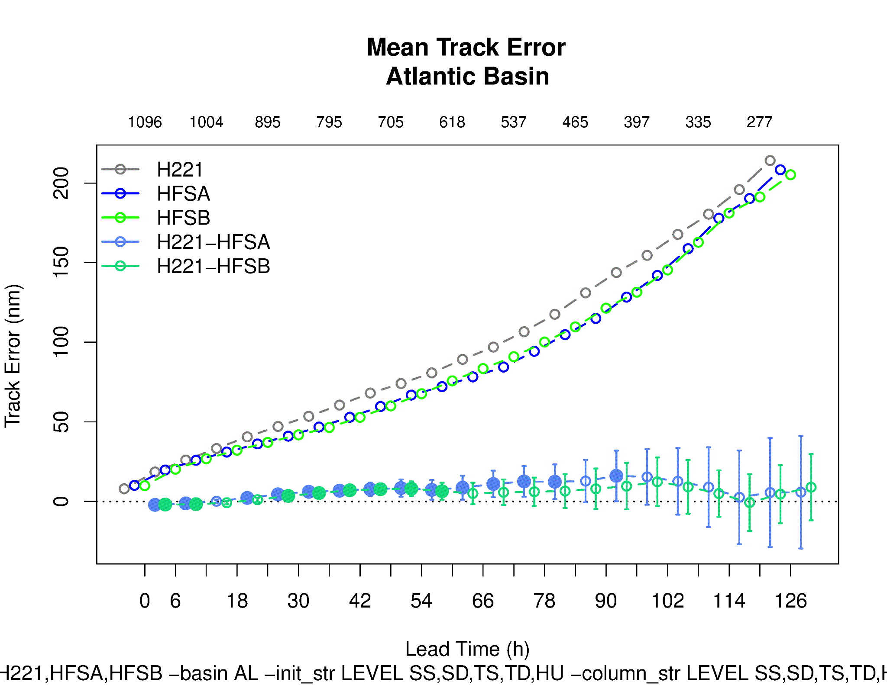
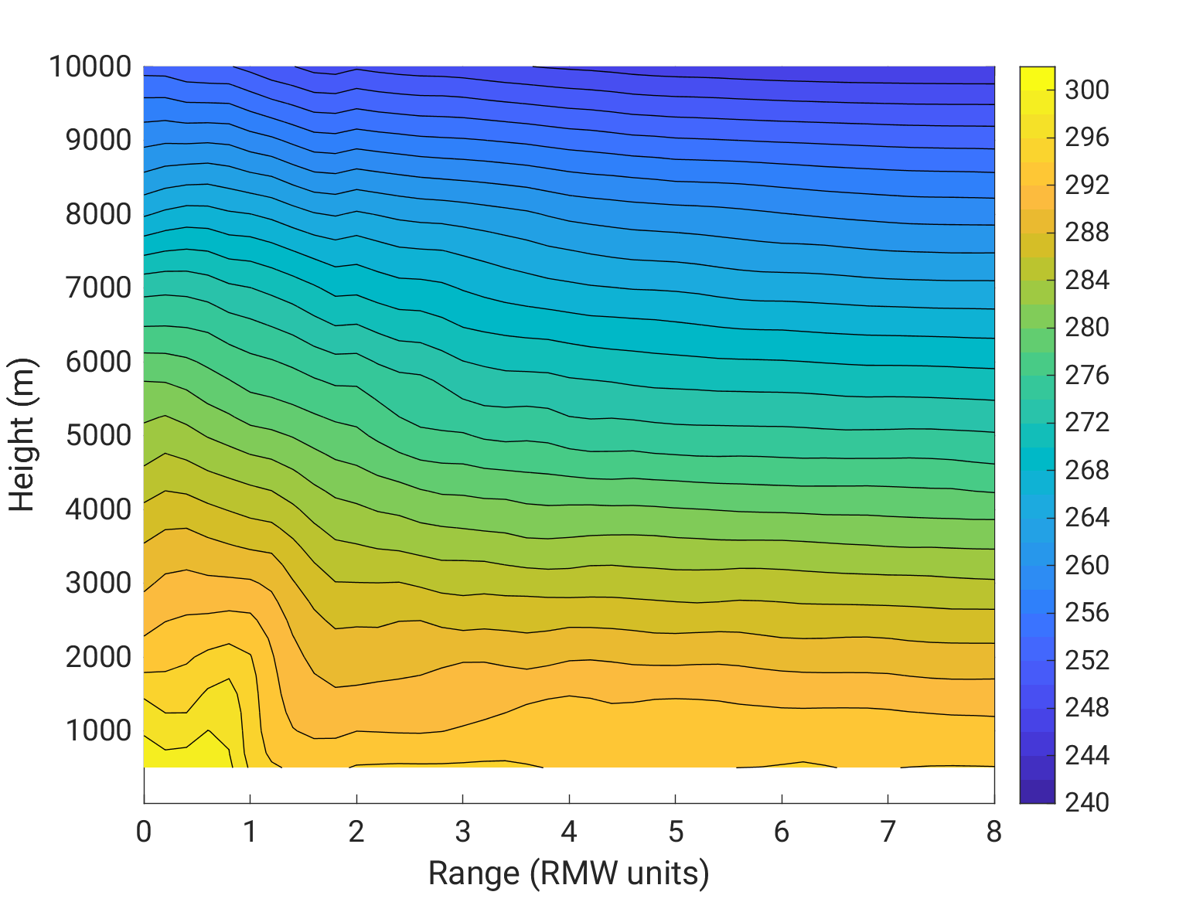
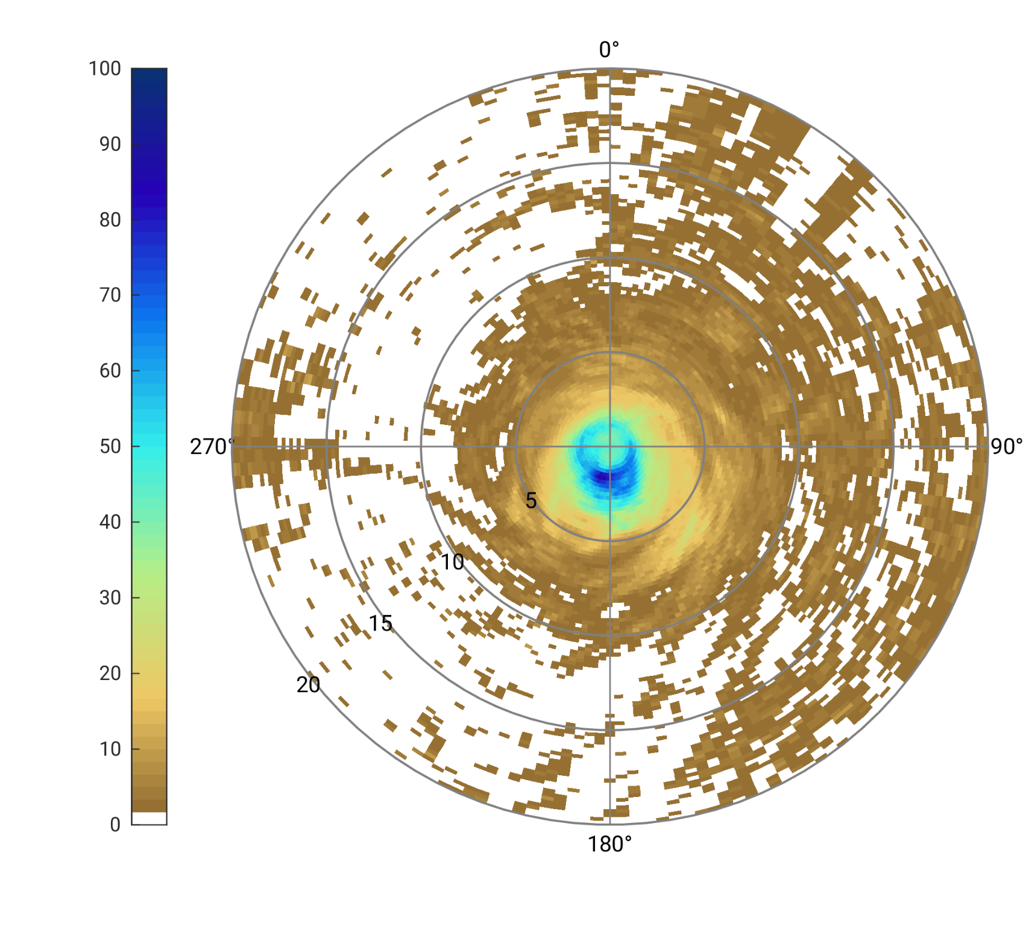
HAFS verification framework
Current capabilities
Computes track-based (i.e., using Best Track) metrics using tc-pairs and tc-stat tools.
Stratification options consistent with NHC verification system
Track, intensity, wind radii error, skill, relative performance
Rapid intensification contingency table statistics
Regrids model data onto moving range-azimuth grid centered on points along the storm track and aggregates using tc-rmw and rmw-analysis tools.
New in METv12.1.0:
Range/azimuth grids fully supported in MET
Tools can read grid and compute statistics
Automatic regridding supported

Slide 7
Going all-in on “Unified” METplus verification
“Unified” Vx Framework
Next steps: Merge existing verification capabilities of SRW and HAFS into an independent, application-agnostic verification workflow
Enhancements (e.g., new verification metrics, data types, and plots) shared among all applications
Application based configurations
User verification settings (config_vx.yaml)
SRW/RRFS
HAFS
generate_vx_workflow.py
Global
Rocoto vx workflow
METplus conf file templates
AIWP
Vx run scripts
…
Obs
METplus
Forecast output
Verification output

Slide 8
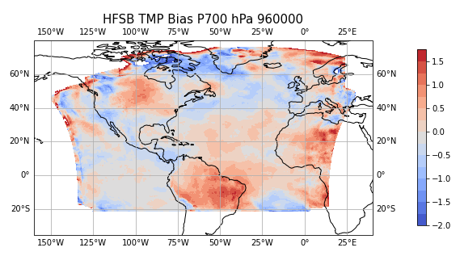
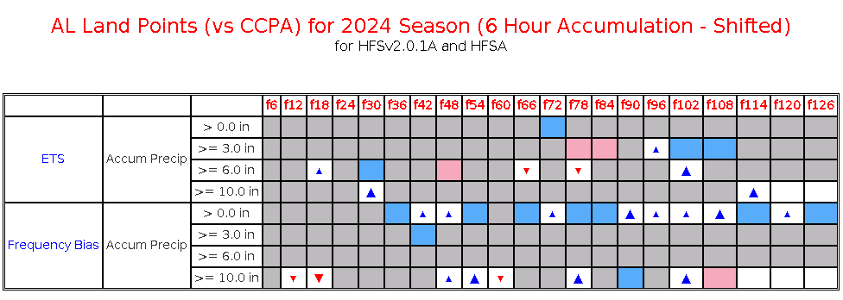
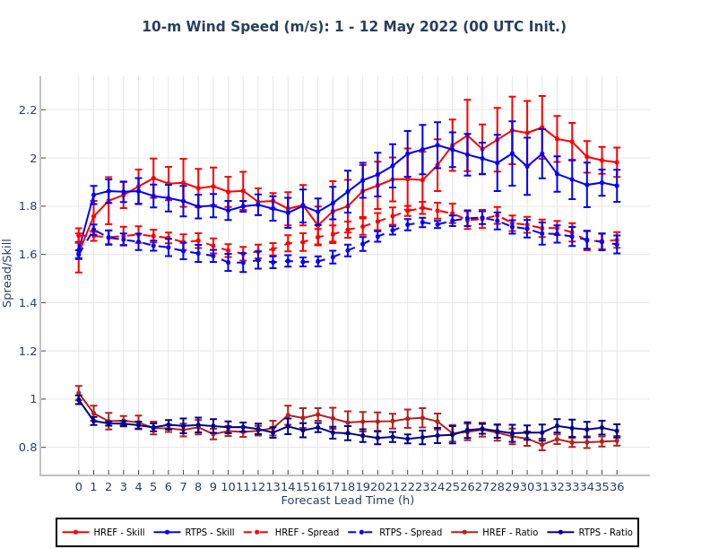
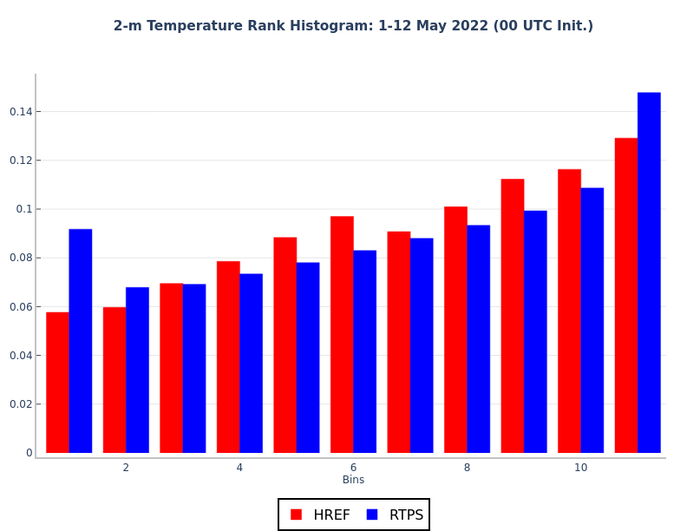
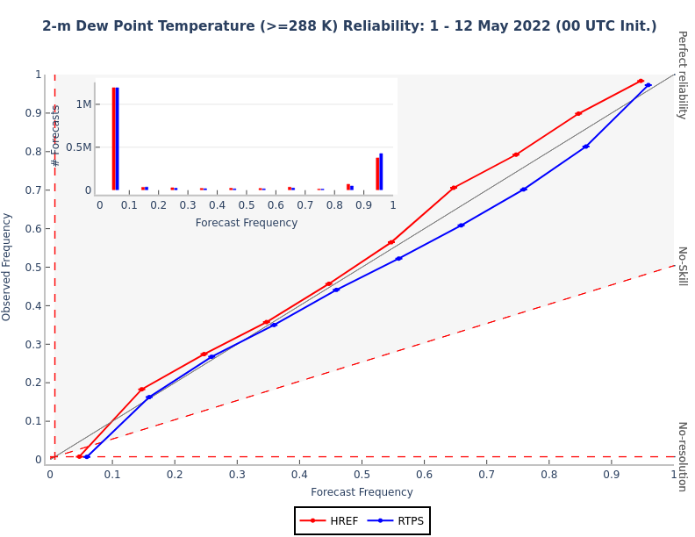
Unified verification framework
Upcoming functionality for HAFS
Verification against gridded model output to compute metrics using grid-stat, point-stat, series-analysis, gen-ens-prod, ensemble-stat
Integration of SRW App functionality
Data ingest for observations
Command line plotting via METplotpy
Scorecards, including interactive scorecards
Large scale vx
QPF scorecard
Rank Histograms
Spread/Skill/Ratio
Reliability Diagrams

Slide 9
Summary
HAFS verification framework
Verification workflow established within hafs-community repository
Initial capabilities focused on tropical cyclone specific METplus tools
Ongoing enhancements to METplus tropical cyclone tools
Unified verification workflow
Expand verification capabilities and reduce redundancies across applications
Establish TC specific configurations
Extend to ensemble-based verification within HAFS
Kathryn Newman
NSF NCAR
knewman@ucar.edu

