Slide 1

Welcome to the
Unifying Innovations in Forecasting Capabilities Workshop
September 9, 2025
A Unified Forecast System (UFS) Collaboration Powered by the Earth Prediction Innovation Center (EPIC)
Center Green Auditorium, Boulder, CO

Slide 2
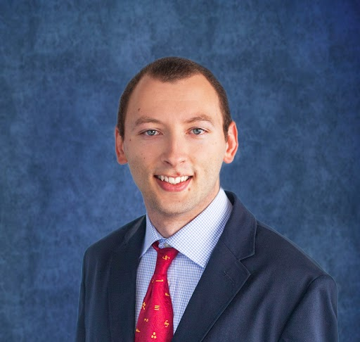
Today’s Master of Ceremonies
Jan Ising
EPIC Program DA and HPC Lead
NOAA/Weather Program Office

Slide 3
Live Streaming Announcement
The UIFCW is an open event that will be live-streamed online and recorded. By staying in the room (and online), you understand that your image, in video or still, and any sound recorded alongside it, will live-streamed over social media and recorded. The videos will be submitted to NOAA for review before sharing publicly. The information that you provide will be used for websites, agenda's, and event descriptions.
For more information on NOAA's Privacy policy: https://www.noaa.gov/sites/default/files/legacy/document/2021/Mar/NOAAPrivacyPolicy_Final_May2017.pdf

Slide 4
Tuesday, September 9th
09:00 AM – 09:15 AM – Welcome & Kickoff
09:15 AM – 09:30 AM – Opening Remarks by Dr. Everett Joseph, NCAR Director
09:30 AM – 10:15 AM – State of EPIC and the UFS (Highlight success stories and
impact to the community)
10:15 AM – 10:45 AM – Break
10:45 AM – 11:30 AM – Testing and Continuous Integration Updates
11:30 AM – 12:00 PM – Current Status of Earth System Models: High Level Efforts:
CESM, Global Models, GFS, ECMWF, Etc.
12:00 PM – 01:00 PM – Lunch

Slide 5
Tuesday, September 9th
01:00 PM – 02:00 PM – Data Assimilation Update and Discussion
02:00 PM – 03:00 PM – UFS Coupling: How the UFS is Being Expanded to Include
Additional Environmental Modeling Components
03:00 PM – 03:30 PM – Break
03:30 PM – 04:00 PM – NOAA’s AI Transformation
04:00 PM – 04:30 PM – Keynote-Topic: Coupled Modeling to Improve Marine
Weather Forecasts of Winds and Waves for Maritime
Shipping
04:30 PM - 05:30 PM – Meet The Community (Panel Discussion)
05:45 PM – 07:00 PM – Networking Mixer w/ Local WFO Boulder
Presentation
07:15 PM Informal gathering at Avery Brewery

Slide 6
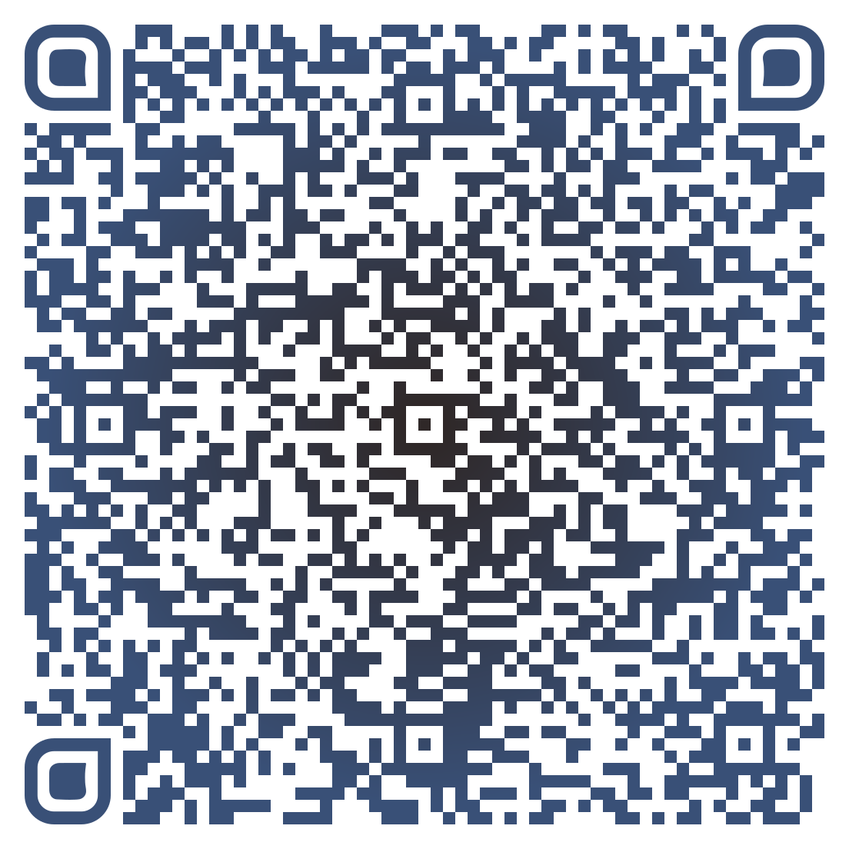



Connect With Us!
Participant Guide
Connect with us on Slido, X, and Instagram
Access Slido & the Livestream from the UIFCW Event Page:
@NOAAEPIC
#UIFCW25
Wi-Fi: UCAR Visitor
No password is required.

