Slide 1





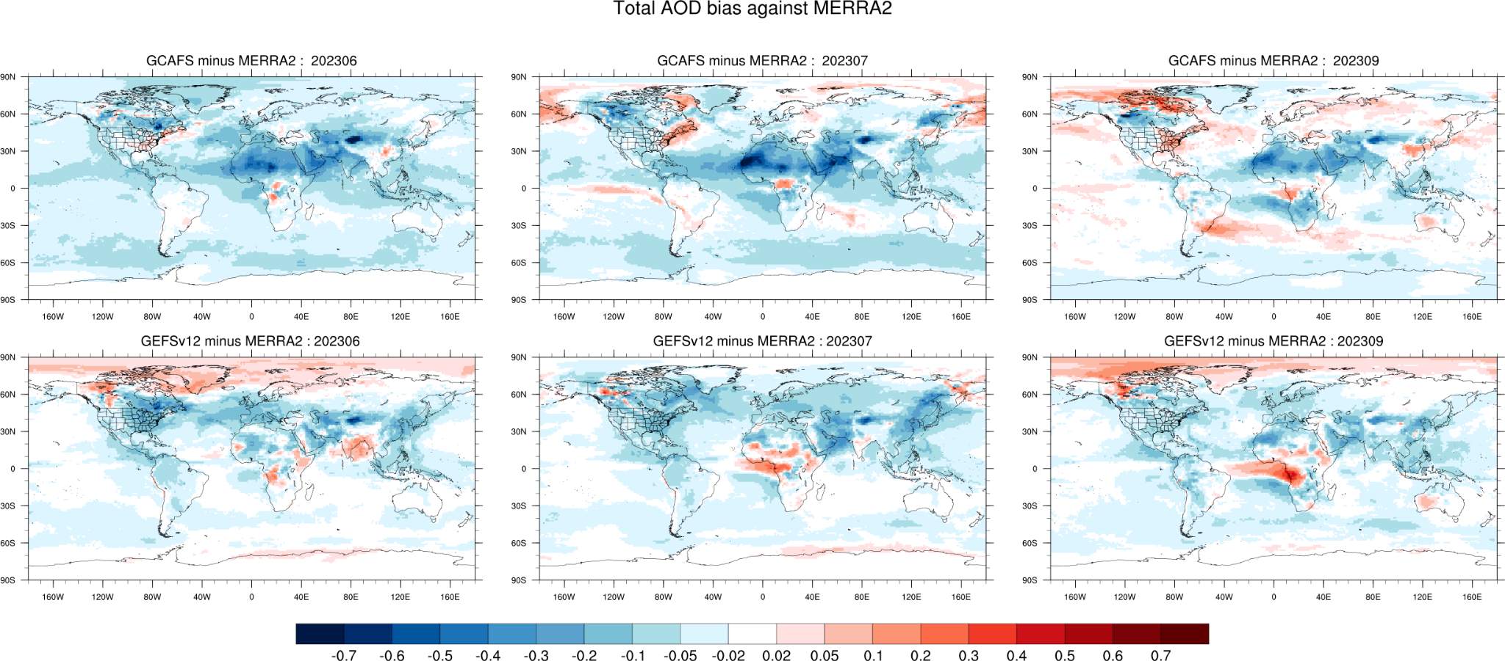
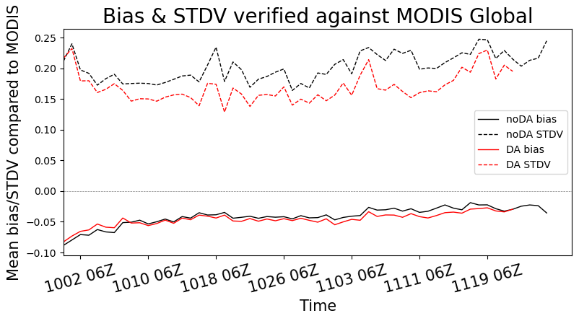
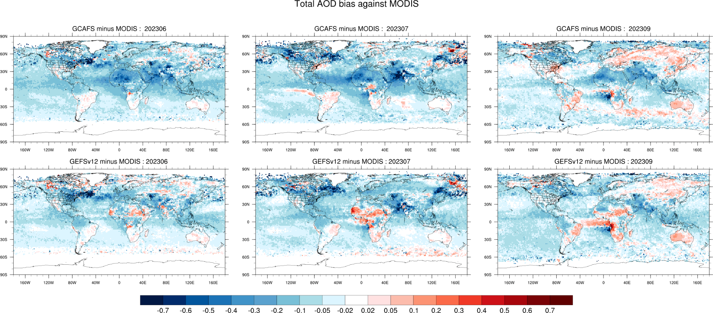
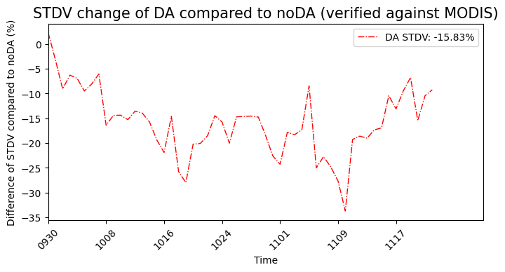
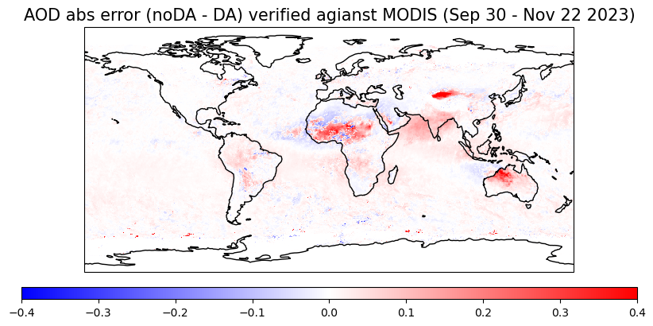
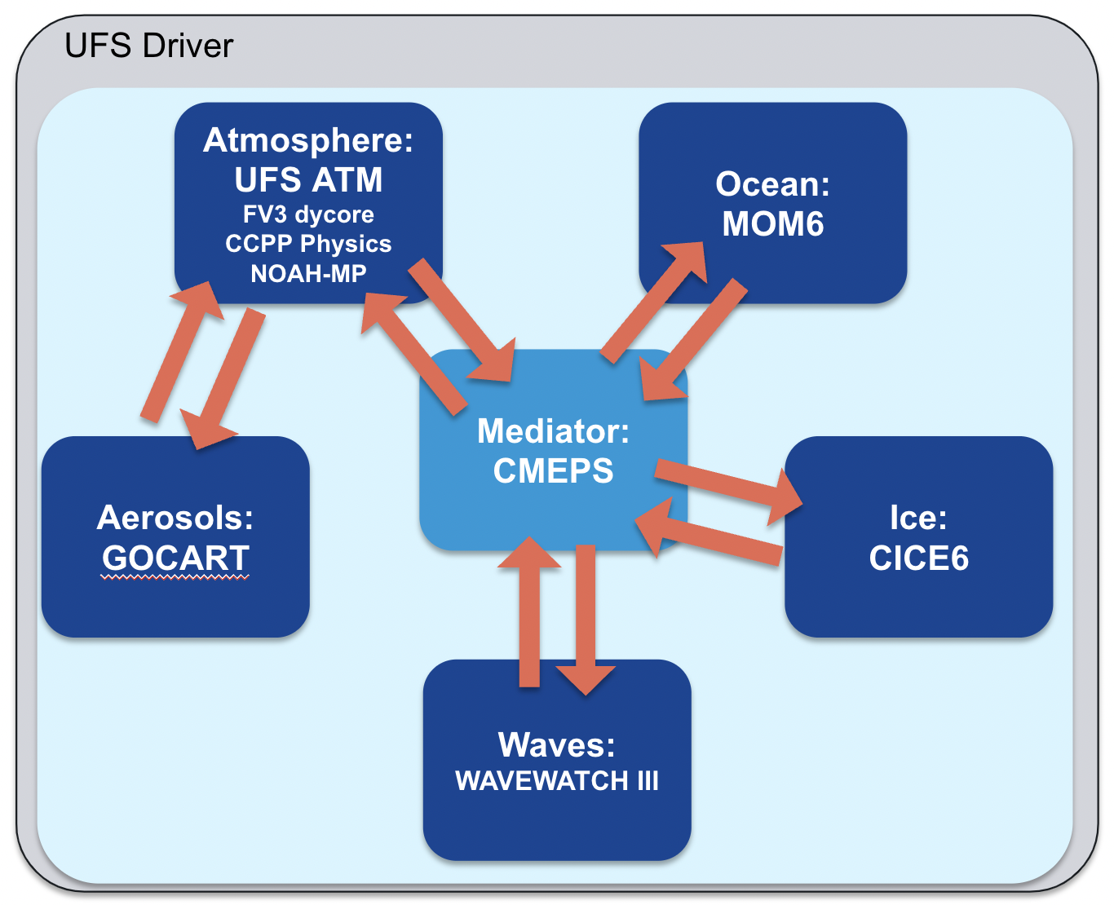
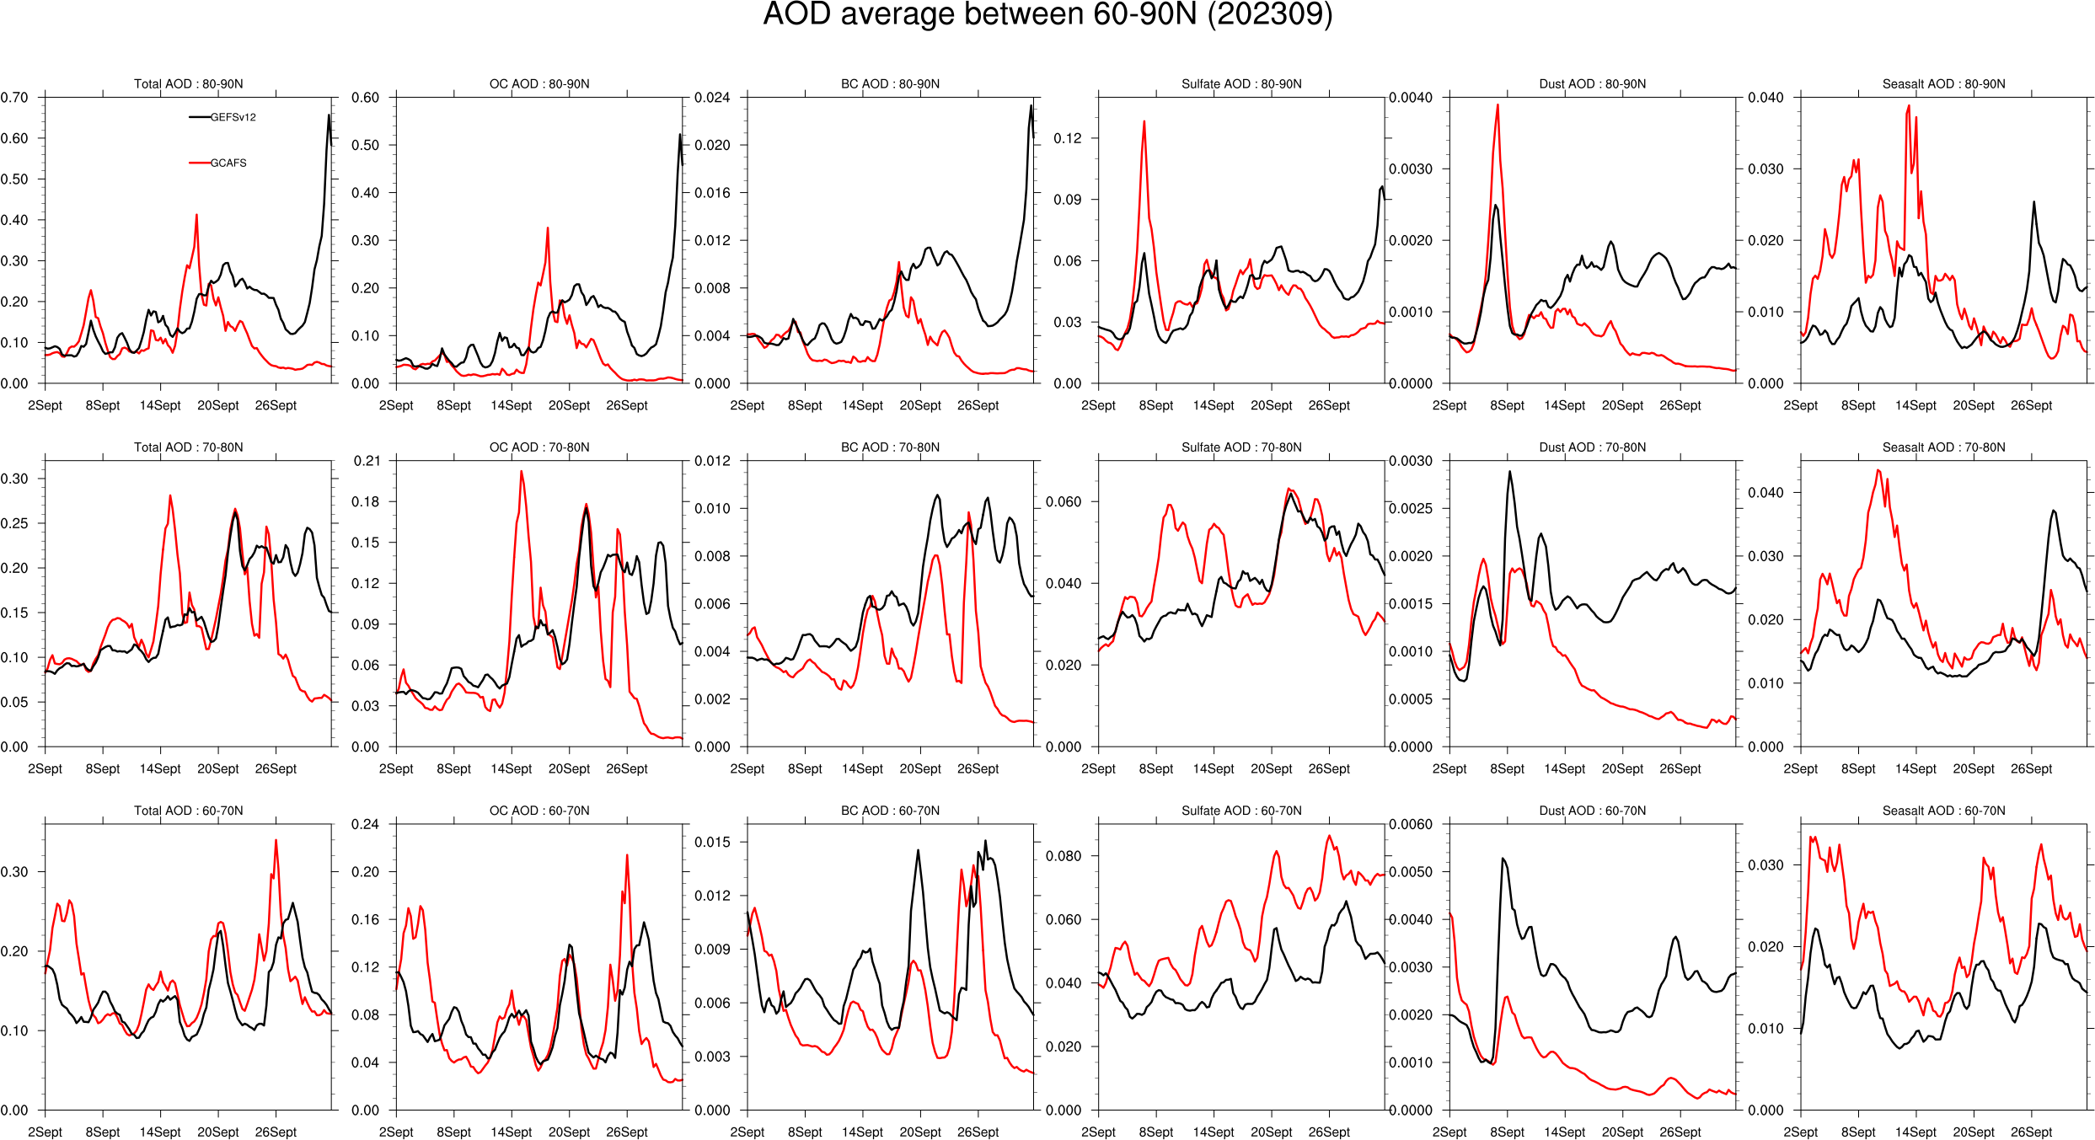
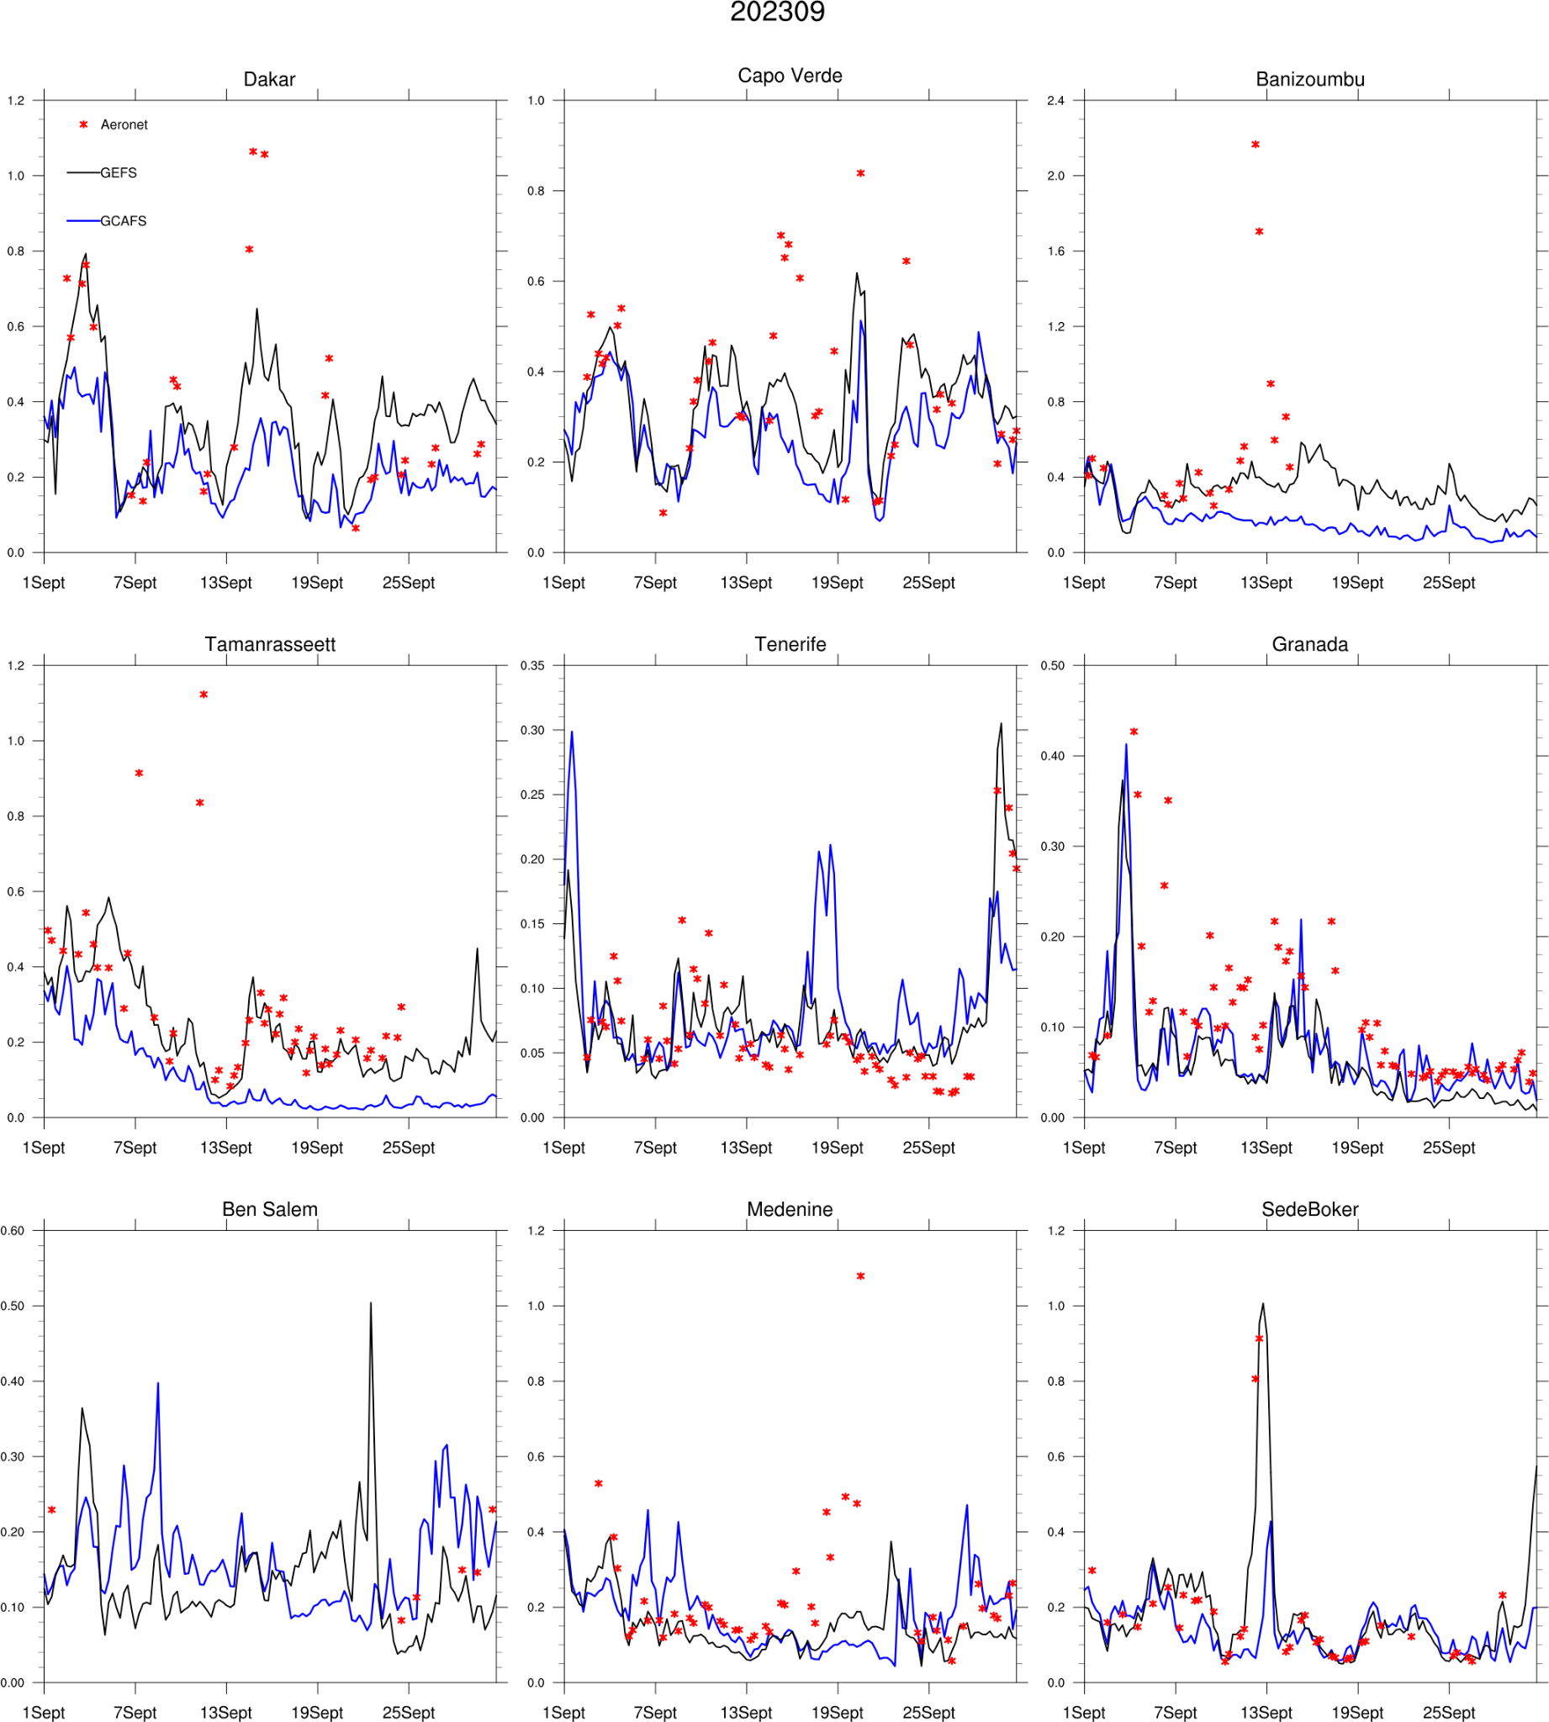
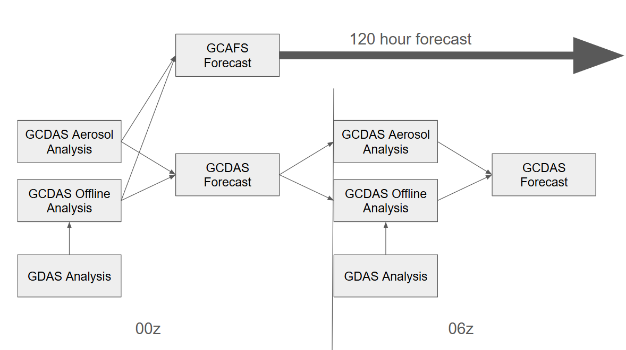
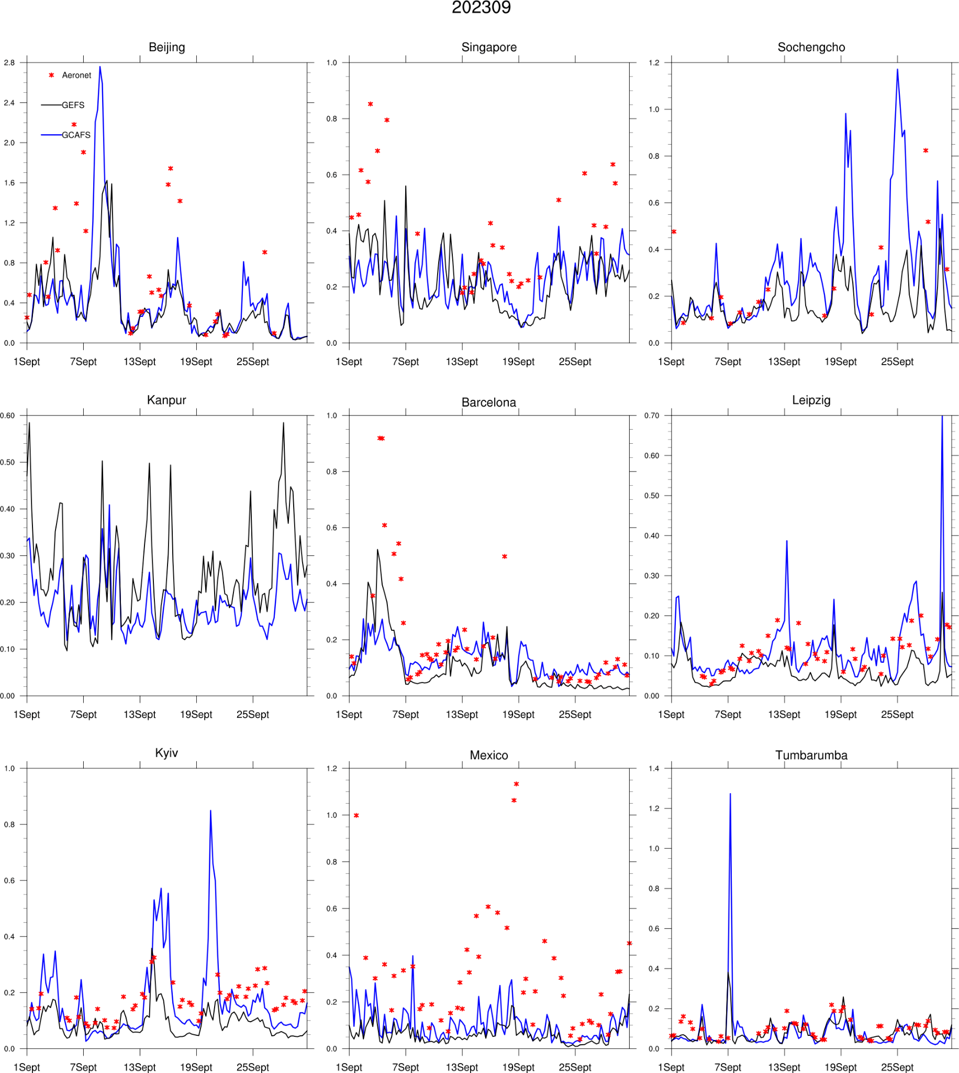
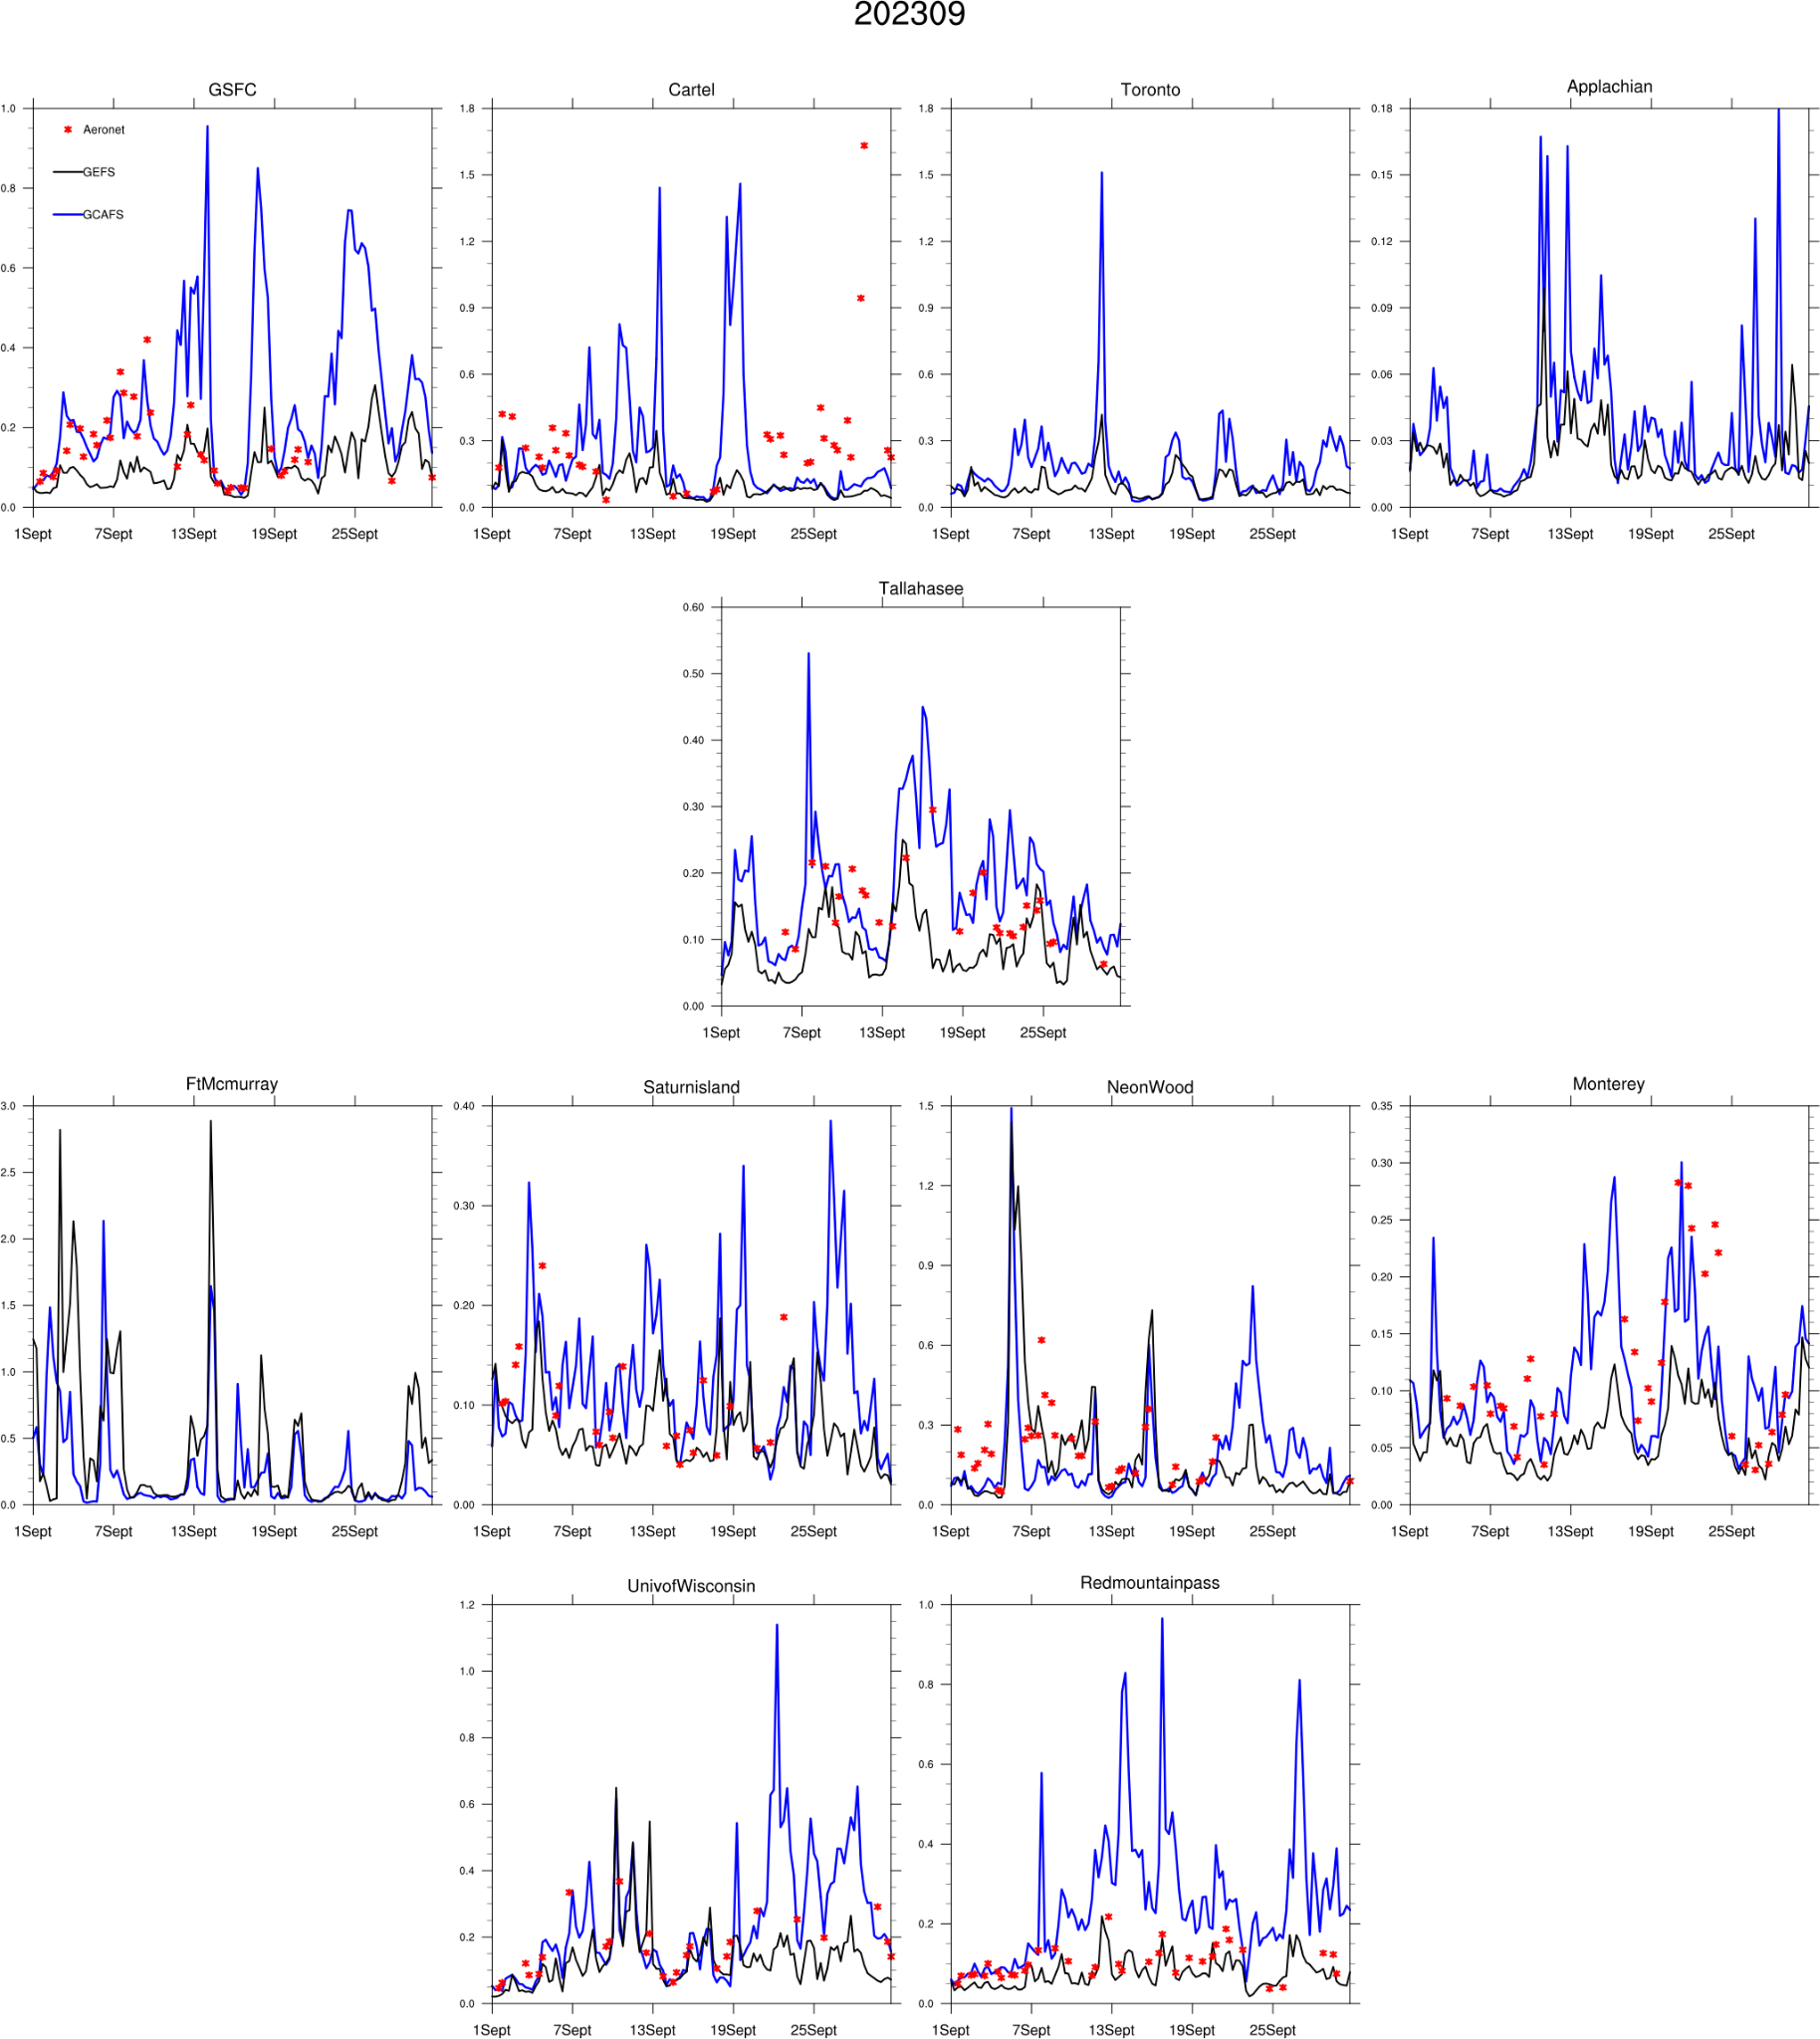
Introduction of NOAA’s new UFS based operational prototype, the Global Chemistry and Aerosol Forecast System (GCAFSv1)
Barry Baker, Cory Martin, Li Pan, Yaping Wang, Andrew Tangborn, Partha S. Bhattacharjee, Fanglin Yang, Youhua Tang, Bing Fu, Raffaele Montuoro, Li (Kate) Zhang, Bo Huang, Jerome Barre
NOAA Air Resources Laboratory, Atmospheric Sciences Modeling Division, College Park, MD
Earth Resources Technology Inc. Department of Atmospheric, Oceanic and Earth Sciences, George Mason
Cooperative Institute for Satellite and Earth System Science, UMCP, College Park MD.
George Mason University, Fairfax, VA, USA
NOAA Environmental Modeling Center, College Park, MD
5 NOAA Chemical Science Lab, Boulder, CO
Introduction
contact: Barry.Baker@noaa.gov
Global Comparisons
DA vs noDA
NOAA is proud to introduce GCAFSv1, its new UFS-based operational prototype for global chemistry and aerosol forecasting. This system provides critical global analyses and forecasts of various aerosols, including dust, sea salt, sulfate, and black carbon, which are vital for a range of applications such as UV predictions, surface particulate matter estimations, and forecasts of dust storms and wildfire smoke. GCAFSv1 also serves as a foundational system, providing lateral boundaries and initial conditions for regional models like the UFS-AQM, and lays the groundwork for a more comprehensive aerosol and trace gas operational forecasting system in the future. Its development and evaluation were the result of extraordinary efforts by a diverse team of contributors from government, academia, and the private sector.
Comparisons of GCAFS with MERRA2 and MODIS data reveal a consistent underprediction of dust concentrations, a deficiency that becomes particularly pronounced during the summer months. This issue is likely linked to the current parameterizations of drag partition and soil moisture within the dust emission scheme. However, GCAFS demonstrates a notable improvement in September, contrasting with GEFSv12, which tends to show significant particulate matter (specifically organic carbon) accumulation at high latitudes during this period. Furthermore, GCAFS exhibits a complex pattern of both improvements and degradations in Central Africa, a phenomenon observed to be directly influenced by seasonal biomass burning activities in the region.
GCAFS is with and without DA is compared to MODIS AOD. DA clearly improves the majority of the global specifically in dust regions and fire regions
GCAFS Configuration
GCAFS is configured at a C384 resolution (approximately 25km) with 127 vertical levels, utilizing the GFSv17 physics suite for high-resolution atmospheric and composition forecasts. It integrates the NASA Goddard Chemistry Aerosol Radiation and Transport (GOCART2G) model as an inline component within the UFS. GOCART features 5 dust bins, 5 sea salt bins, hydrophilic and hydrophobic black and organic carbon, and sulfate. Dust emissions are described using the FENGSHA scheme, while large-scale wet scavenging employs Jacob wet deposition. Radiative feedback is enabled in the physics scheme, allowing prognostic aerosols to influence meteorological predictions.
Anthropogenic emissions are generated using the NOAA Emission and eXchange Unified System (NEXUS) using a global monthly emission datasets such as CEDS or CAMS-GLOBAL and applying diurnal profiles using CAMS-TEMPO.
The GCAFS system will consist of the GCAFS free forecast, which produces gridded aerosol forecast products for dissemination, and the Global Constituent Data Assimilation System (GCDAS). The three-dimensional variational (3DVar) aerosol analysis with first-guess at appropriate time (FGAT) using 3-hourly backgrounds will be performed using the Joint Effort for Data assimilation Integration (JEDI) framework. It is expected that this will be either the first, or as part of the first, implementation of JEDI in NWS operations.
Observations
VIIRS EPS 550nm AOD products from NESDIS will be assimilated using the CRTM
  S-NPP, NOAA-20, NOAA-21 platforms
  Variational Bias Correction (VarBC) using one of the platforms as an anchor
Background Error
Climatological background errors modeled using explicit diffusion and with statistics computed using previous forecasts.
Flow dependent standard deviation using the variance partitioning method that estimates error through the variance of neighboring model grid cells.
Control variables are the individual 3D aerosol tracers
The meteorological analysis is provided by the Global Data Assimilation System (GDAS) interpolated to the GCAFS resolution. The difference between the interpolated GDAS and the previous GCDAS forecast is computed and used as the analysis increment as input to the forecast model.
Red: DA is better; Blue: DA is worse
Changes in large scale wet deposition show a large improvement between GEFS-Aerosol and GCAFSv1. GEFS-Aerosol shows an accumulation of organic carbon in high latitude regions. GCAFSv1 uses the sophisticated Jacobs et al wet deposition scheme tuned for the UFS leading to drastic improvement in high latitude regions. While GCAFS v1 still can achieve higher concentrations in these regions which are mostly due to boreal wildfires, it no longer accumulates concentrations as the large scale wet deposition acts.
Conclusion
GCAFSv1 represents a significant advancement in global aerosol forecasting, providing high-resolution analyses and forecasts critical for various applications including UV predictions and air quality. The system's robust configuration, integration of GOCART2G, and sophisticated data assimilation capabilities, including the use of JEDI for VIIRS AOD, demonstrate improved performance over previous systems. Near future enhancements will focus on replacing GEFS-Aerosol, implementing advanced aerosol data assimilation, and while longer term incorporating more complex chemistry models to support a comprehensive constituent modeling and analysis system for both global and regional air quality predictions.
GCAFS will be used for operational surface PM, as well as boundary conditions for the National Air Quality Forecast Capability with the UFS-AQM. GCAFS is also used by the International Cooperative for Aerosol Prediction (ICAP) and the World Meteorological Organization (WMO).
Comparisons with AERONET
African Dust Regions
African Dust regions are showing similar performance
Other months show that dust is underperforming with a likely cause relating to the drag partition.
  Ongoing work to improve this is underway
  Notable degradation in Tamanrassetand Banizoumbu
Global stations GCAFSv1 shows similar performance to GEFSv12 using the same emissions
Kyiv in particular is showing improvements
Many North American sites are showing similar performance, with a few showing improvements, particularly Monterey and Tallahassee
GCAFS Cycling Flowchart
00z
06z
12z
18z
Concept of Operations
GCAFS free forecast
GCAFS free forecast
The GCAFS system comprises a free forecast component, which generates gridded aerosol products for dissemination, and the Global Constituent Data Assimilation System (GCDAS) for cycling. GCDAS operates four times daily, performing constituent analysis followed by a 9-hour short-term forecast to advance the data assimilation cycle. Meteorological analysis is sourced from the Global Data Assimilation System (GDAS) and interpolated to the GCAFS resolution. Twice daily, at 00z and 12z analysis times, the GCAFS free forecast is initialized identically to the GCDAS forecast but extends for 120 hours instead of 9 hours.
GDAS Analysis
GCDAS fcst
GDAS Analysis
GCDAS fcst
GDAS Analysis
GCDAS fcst
GDAS Analysis
Global Stations
GCDAS Analysis
GCDAS Analysis
GCDAS Analysis
GCDAS Analysis
Future Work
For GCAFSv1, the main advancements are to 1) implement the forecast system as a replacement for GEFS-Aerosol, 2) use the latest model code and parameterizations (updated microphysics, GOCART, etc.) and 3) implement aerosol data assimilation to constrain the forecasts. Version 2 of GCAFS would incorporate additional features potentially including, but not limited to: nitrates in the GOCART model, higher forecast resolution, longer forecasts, and geostationary AOD assimilation.
The long term vision of GCAFS is to leverage more complex chemistry models (such as those being developed by NOAA OAR labs in UFS-Chem) to have a holistic constituent modeling and analysis system that includes a nested domain for higher resolution prediction and scale-aware chemistry to increase complexity in the nested domain to support surface air quality predictions in addition to global aerosol and trace gas forecasts.
North America
Acknowledgements
We extend our gratitude to all contributors to GCAFS v1, especially acknowledging the partnership with NASA for the collaborative development of GOCART2G. We also thank the GFS and GEFS development teams for establishing the atmospheric and physics foundations. Finally, we appreciate the diligent contributions and ongoing support from the NOAA OAR labs, which are crucial for GCAFSv1 and future advancements incorporating gas phase chemistry and aerosols.
Notes:
"Good morning/afternoon, everyone. I'm here today to introduce NOAA's groundbreaking new operational prototype: the Global Chemistry and Aerosol Forecast System, or GCAFSv1. This system represents a significant leap forward in our ability to monitor and predict global atmospheric conditions.
GCAFSv1 is a UFS-based system designed to provide critical global analyses and forecasts for a wide range of aerosols, including dust, sea salt, sulfate, and black carbon. These forecasts are vital for numerous applications, from predicting UV levels and estimating surface particulate matter to forecasting major events like dust storms and wildfire smoke.
GCAFSv1 also serves as a foundational system. It provides essential lateral boundaries and initial conditions for regional models, such as the UFS-AQM, and lays the groundwork for even more comprehensive aerosol and trace gas operational forecasting systems in the future. "Key Features and Configuration (1 minute)
The system is designed for high-resolution atmospheric and composition forecasts, operating at a C384 resolution, which is approximately 25 kilometers, with 127 vertical levels. At its core, GCAFSv1 integrates the NASA Goddard Chemistry Aerosol Radiation and Transport, or GOCART2G, model as an inline component within the Unified Forecast System.
GOCART2G is a bulk aerosol model. Dust emissions are described using the NOAA developed FENGSHA scheme, and large-scale wet scavenging is handled by the Jacob wet deposition scheme. A crucial advancement in GCAFSv1 is the enabled radiative feedback in the physics scheme, which allows prognostic aerosols to directly influence meteorological predictions.
Furthermore, anthropogenic emissions for GCAFSv1 are generated using the NOAA Emission and eXchange Unified System, or NEXUS, which utilizes global monthly emission datasets and applies diurnal profiles. The system itself comprises two main components: the GCAFS free forecast, which generates our gridded aerosol products, and the Global Constituent Data Assimilation System, or GCDAS. The aerosol analysis within GCDAS is performed using the Joint Effort for Data assimilation Integration, or JEDI, framework, a significant milestone as it's expected to be among the first implementations of JEDI in NWS operations, assimilating VIIRS AOD products from NESDIS."Future Outlook and Impact (1 minute)
"Looking ahead, GCAFSv1 represents a significant step forward, but our work doesn't stop here. The main advancements for GCAFSv1 include its implementation as a direct replacement for GEFS-Aerosol, the utilization of the latest model code and parameterizations, and crucially, the implementation of aerosol data assimilation to constrain our forecasts.
In the near future, we envision version two of GCAFS incorporating even more advanced features, such as nitrates in the GOCART model, higher forecast resolution, longer forecast lead times, and the assimilation of geostationary AOD. Our long-term vision for GCAFS is to leverage more complex chemistry models, like those being developed by NOAA OAR labs in UFS-Chem. This will allow us to create a truly holistic constituent modeling and analysis system that includes nested domains for higher resolution predictions and scale-aware chemistry, ultimately supporting surface air quality predictions in addition to global aerosol and trace gas forecasts.
GCAFS is poised to have a substantial impact. It will be used operationally for surface PM and will provide essential boundary conditions for the National Air Quality Forecast Capability with the UFS-AQM. Furthermore, GCAFS will be a key contributor to international collaborations, including the International Cooperative for Aerosol Prediction, or ICAP, and the World Meteorological Organization, WMO. Thank you."

