Slide 1
NOAA’s Seasonal Forecast System
Philip Pegion - NOAA/PSL
Neil Barton - NCEP/EMC
Xiaqiong (Kate) Zhou - NCEP EMC
September 8-12, 2025

Slide 2
Introduction
The Seasonal Forecast System (SFS) will be a global coupled application of the UFS
The SFS will provide ensemble forecast guidance out to 12 month lead time
A 40 year reforecast dataset will accompany the forecasts, just like the GEFS reforecasts, this dataset will provide the climatology and historical skill needed for S2S forecasts.

Slide 3
The SFS development team
NOAA is in the second year of developing the Seasonal Forecast System (SFS), which is slated to replace the Climate Forecast System version 2 (CFSv2) in 2028.
Funded jointly by the Weather Program Office and the Office of Science and Technology Integration Modeling Program
The SFS development team spans multiple NCEP centers, OAR labs, research universities, and the Developmental Testbed Center.
The team has 3 focus areas:
1)Model Development (atmosphere,land,ocean,sea-ice,ensembles, products, infrastructure)
2) Evaluations and evaluation tools
3) Data assimilation and Reanalysis

Slide 4

Progress over the last year.
In the past year, the SFS development team has carried out and analyzed many experiments:
Role of initial conditions (ocean/sea-ice and land)
Sun et al. “Importance of Ocean Initialization in ENSO Predictions: Accuracy Versus Consistency”
Physics improvements and tuning
Dependency on model resolution
Monthly mean data from several of the 30-year reforecasts are available via the NOAA Open Data Dissemination (NODD). With more experiments posting soon. We are also looking into putting select daily fields in the AWS bucket.

Slide 5
Summary of reforecasts presented here
 | Initial Conditions | Version | Resolution | Forecast length
baseline | Interpolate GEFS replay | SFS_baseline_hydro | C96/mx100 | 4 months
cpc_ics | GLORe & CORe | SFS_baseline_hydro | C96/mx100 | 12 months
c96_beta.0.1 | GLORe & CORe | Beta v0.1 | C96/mx100 | 12 months
beta0.1 | GLORe & CORe | Beta v0.1 | C192/mx025 | 12 months
30 years (1994-2023), May 1 and Nov. 1 initializations 11-ensemble members

Slide 6
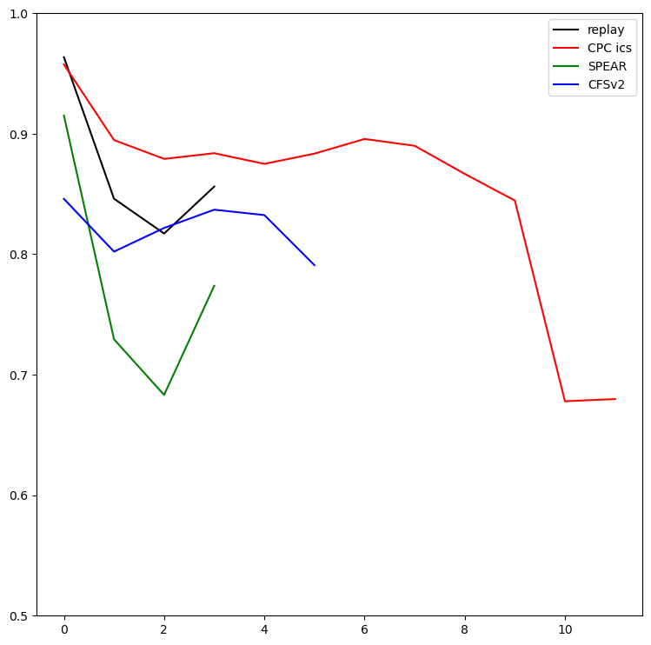
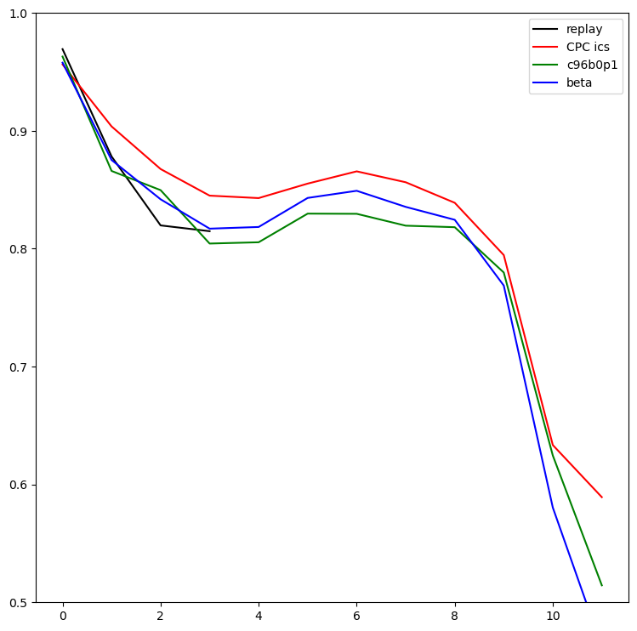
Preliminary Results
Nino 3.4 Forecast Skill: May init. 1994-2016
Nino 3.4 Forecast Skill: May init. 1994-2023
ACC
ACC
Lead (months)
Lead (months)
Baseline experiments with CPC ICS shows substantial improvement in skill over CFSv2 and SPEAR
Latest model version shows slight degradation in skill at 1-degree

Slide 7
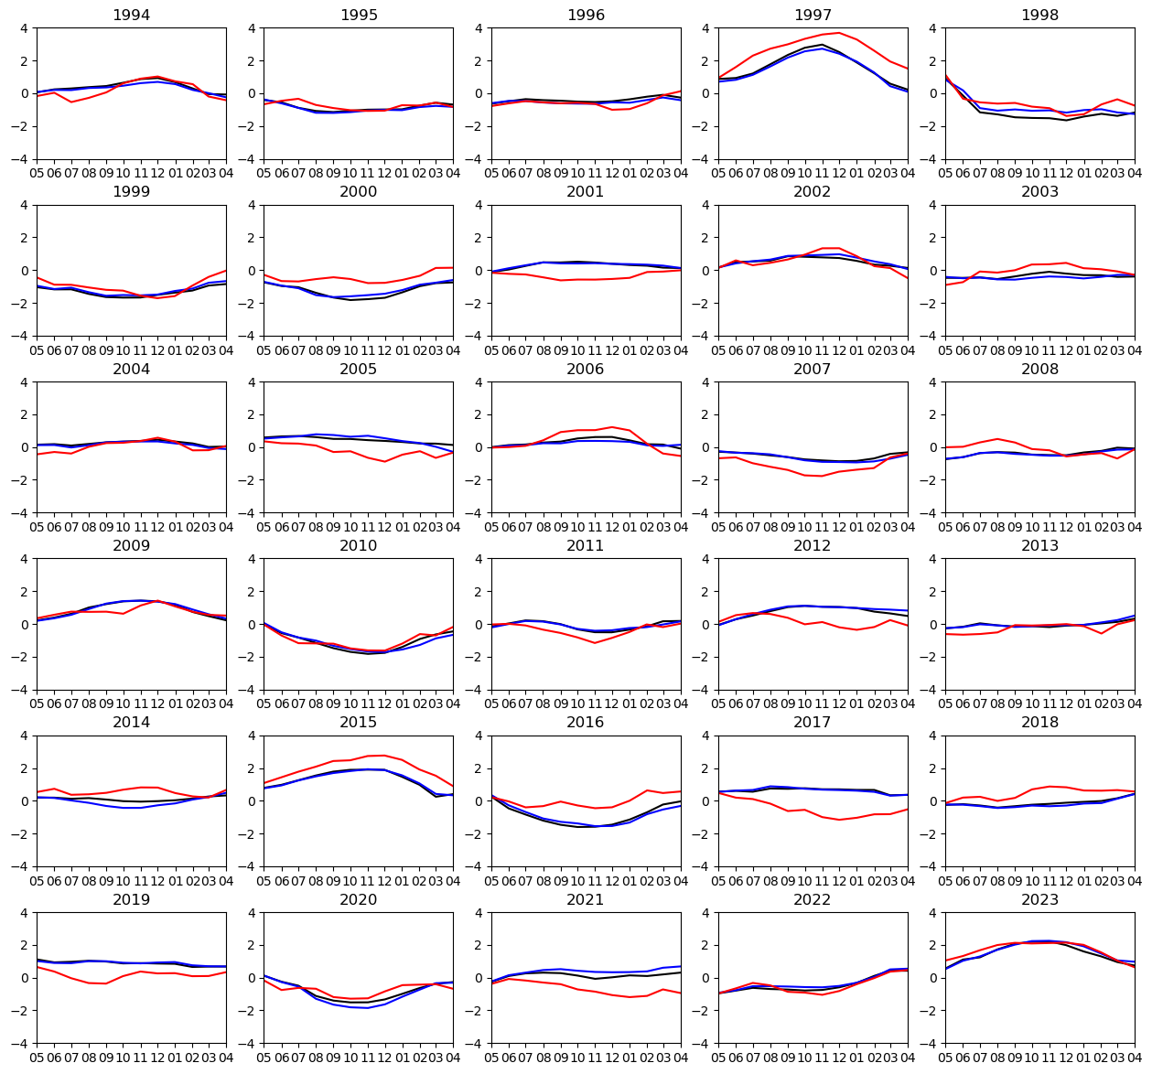
NINO3.4 forecast by year
CPC_ics
C96_Beta v0.1
ERA-5
Degradation in skill can be attributed to a handful of years.

Slide 8
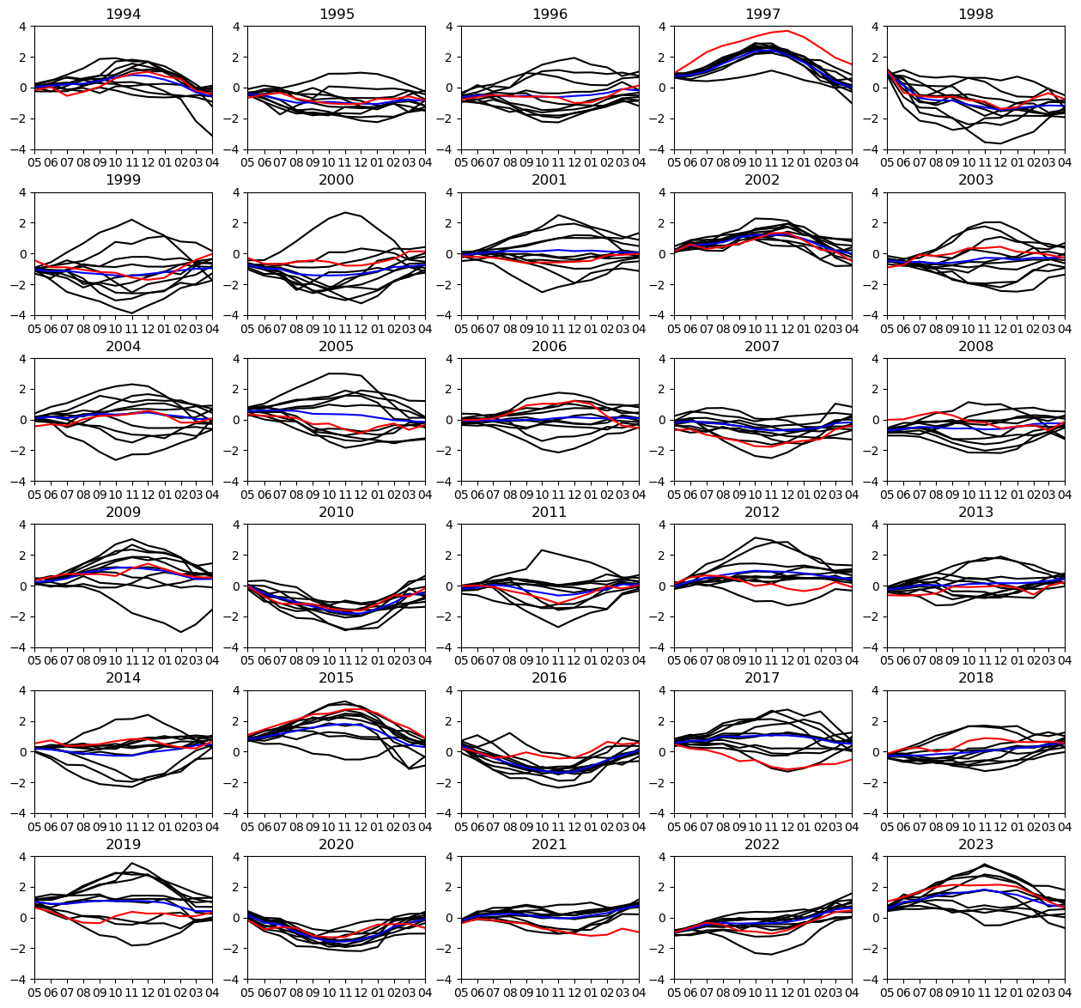
NINO3.4 forecast by year
Beta v0.1 members
Beta v0.1 ensemble mean
ERA-5
Ensemble Spread is too large

Slide 9
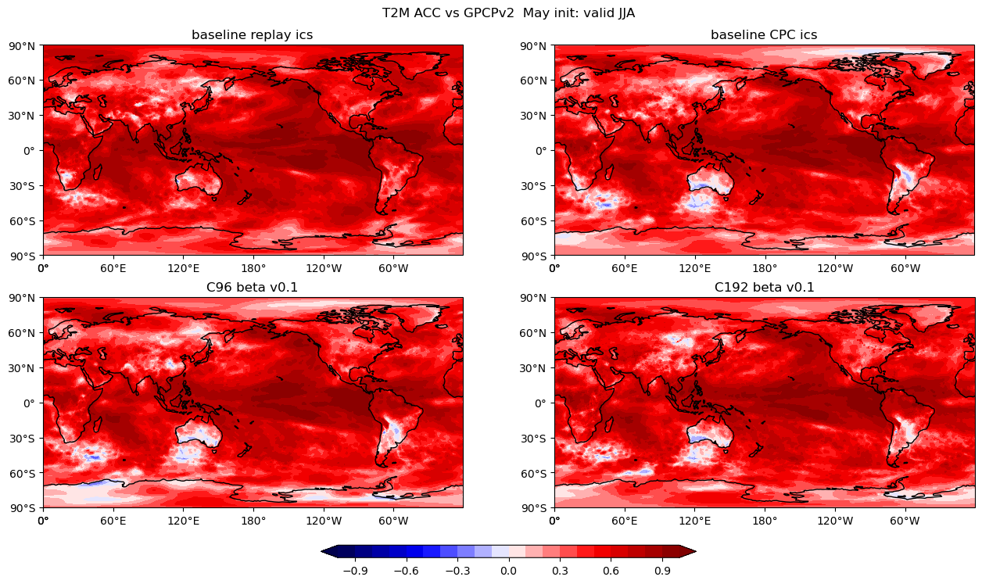
2 m temperature skill
Replay ICS provide better skill over land.

Slide 10
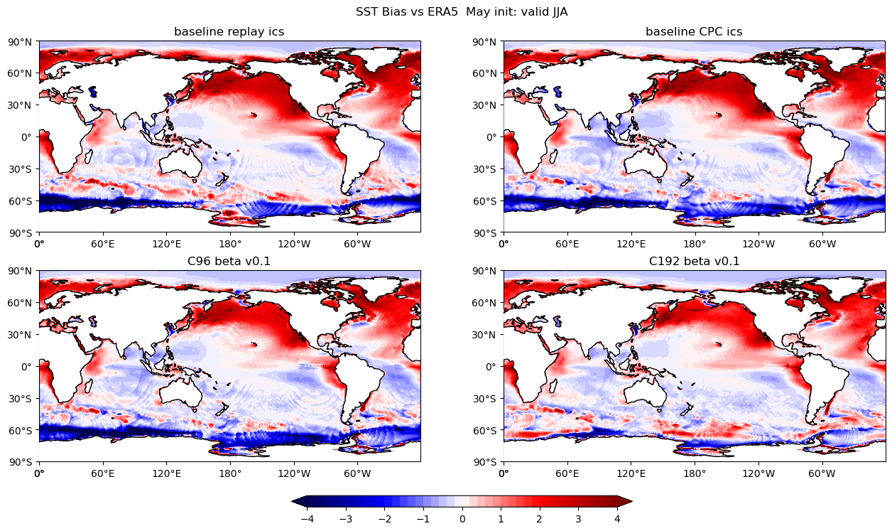
Known Issues:warm SST bias in summer mid to high latitudes

Slide 11
Next Steps
Continued model development to reduce biases, improve ensemble spread, forecast Skill
Will being testing reforecasts with GFSv17 and reanalysis scout run initial conditions when ready
Since the current version of SFS is substantially better than the current CFSV2 EMC is planning on starting a near real time ‘beta’ version of the SFS.
Current plans are to run re-forecasts on the fly, which will allow for model improvements to get into the beta version sooner.
Coupled reanalysis to support SFSv1 is under development, which is needed to create consistent initial for reforecasts that are consistent with the operational GFSv17 analysis

