Slide 1
UFS 101
Hendrik Tolman
September 10, 2025

Slide 2
BLUF
For several years, the Unified Forecast System (UFS) has been an idea focusing on improving operational forecasting at NOAA as a community partnership.
By now the idea has become a reality, particularly with the several UFS implementations in operations and several code releases that allow for researcher to easily install operational model applications on their computers.
This presentation is about the core UFS, not about the UFS support provided by EPIC. For the latter, see https://epic.noaa.gov/ and other talks this week.

Slide 3
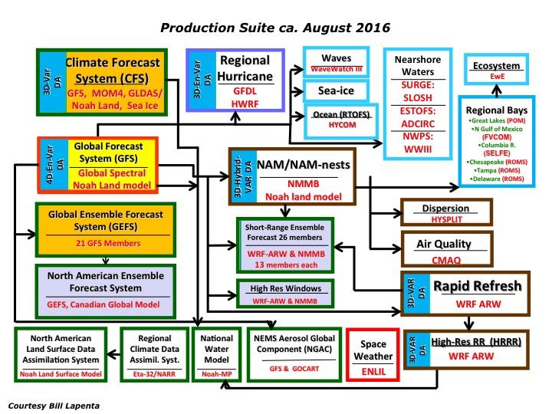
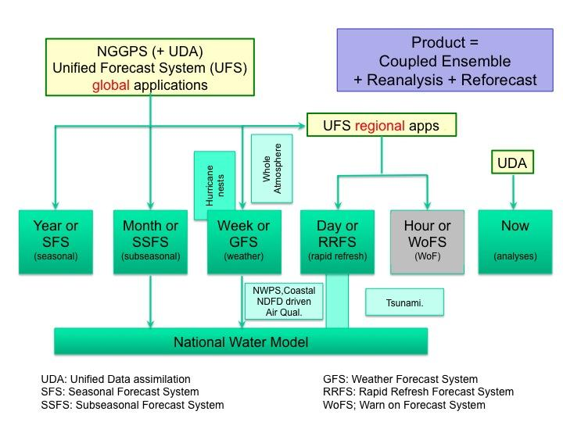
History: Simplifying the NCEP Production Suite
Moving to < 10 major systems
Roadmap Fig. 1
In 2016, 26 major systems
Roadmap Fig. 2

Slide 4
About the UFS
    “System” in UFS =
    code + governance + community
The Unified Forecast System (UFS) is a comprehensive, community-developed Earth modeling system, designed as both a research tool and as the basis for NOAA’s operational forecasts.
Planning and evidence-based decision-making support improving research and operations transitions and community engagement.
UFS is configurable into multiple applications that span local to global domains and predictive time scales from less than an hour to more than a year.
UFS is a unified system because the applications within it share science components and software infrastructure.
UFS is a paradigm shift that will enable NOAA to simplify the NCEP Production Suite, to accelerate use of leading research, and to produce more accurate forecasts for the U.S. and its partners.
Purpose
Governance
Scope
Design
Impact

Slide 5







Components and Contributors Jan 2020
JEDI driver
ESMF/NUOPC driver
space weather
hurricane, medium-range weather, S2S, coastal, marine configurations
short-range weather
NUOPC cap
space weather mediator
NUOPC cap
CMEPS
mediator
NUOPC cap
NUOPC cap
NUOPC cap
NUOPC cap
ionosphere
IPE
atmosphere UFSATM
ocean
MOM6
HYCOM
sea ice
CICE
wave
WW3
storm surge
ADCIRC
CCPP physics driver
air quality
NUOPC cap
NUOPC cap
CCPP cap
CCPP cap
CCPP cap
CCPP cap
CCPP cap
CCPP cap
micro-
physics
planetary boundary layer
deep and shallow cumulus
radiation
RRTMG
aerosols/
chemistry
GOCART
CMAQ
land surface
Noah, Noah-MP
Industry Partners
AER
Amazon
University Partners
Florida State Univ.
Univ. of Notre Dame
Univ. of Colorado/CIRES
Colorado State Univ./CIRA
Harvard University
many others
Federal Partners
JCSDA
DOE
EPA
Navy
Courtesy C. DeLuca

Slide 6
UFS mandates
In NOAA
  NOAA Science Council report on community modeling (2017)
  UFS Vision and Roadmap documents, signed by NWS, NOS, OAR and NESDIS AAs (developed 2018, published 2020)
  NOAA Administrative Order 201-118 entitled “Software Governance and Public Release Policy” (2024)
  NOAA Modeling Strategy (2024)
In Law:
  LEGEND Act (15 U.S.C. § 8512a) (2022)
  SHARE IT act (Public Law No: 118-187) (2025)

Slide 7
LEGEND Act
Purposes.--The purposes of this section are–
(1) to support innovation in modeling by allowing interested stakeholders to have easy and complete access to operational model codes and to other models, as the Administrator determines appropriate; and
(2) to use vetted innovations arising from access described in paragraph (1) to improve modeling by the Administration.
  NDAA Dec. 2022 Section 10601, LEGEND Act. “LEARNING EXCELLENCE AND GOOD EXAMPLES FROM NEW DEVELOPERS”
  Directed at NOAA
  “Open Source”
  With some exceptions
    Obsolescent code
    Restricted code
  Mentioning EPIC
  Models and Data
  Foundational for UFS

Slide 8
UFS references
Link, J., S., H. L. Tolman and K. Robinson, 2017: NOAA’s Unified Modeling Strategy, Nature, 549, 458-458.
Link, J. S., H. L. Tolman, E. Bayler, C. Holt, C. W. Brown, P. B. Burke, J. C. Carman, S. L. Cross, J. P. Dunne, D. W. Lipton, A. Mariotti, R. D. Methot, E. P. Myers, T. L. Schneider, M. Grasso, and K. Robinson, 2017: High-level NOAA unified modeling overview, NOAA report https://doi.org/10.7289/V5GB2248
Tolman, H. L., and J. Cortinas, 2020: A strategic vision for NOAA’s physical environmental modeling enterprise. Report, NOAA. 9 pp https://doi.org/10.25923/0rac-9017
Tolman, H. L., and J. Cortinas, 2020: 2017-2018 roadmap for the production suite at NCEP. Report, NOAA. 35 pp. + Appendices https://doi.org/10.25923/kr4a-zy63
Jacobs, N. A., 2021: Open Innovation and the Case for Community Model Development. BAMS, 102, E2002–E2011.
Uccellini, L. W., R. W. Spinrad, D. M. Koch, C. N. McLean, and W. M. Lapenta, 2022: EPIC as a Catalyst for NOAA’s Future Earth Prediction System. BAMS, 103, E2246–E2264.
Alves, J., H. Tolman, A. Roland, A. Abdolali, F. Ardhuin, G. Mann, A. Chawla, and J. Smith, 2023: NOAA’s Great Lakes Wave Prediction System: A Successful Framework for Accelerating the Transition of Innovations to Operations. BAMS, 104, E837–E850.
Tolman, H. L., 2025: What makes a successful community model for research and operations? Lessons learned from WAVEWATCH III ®. BAMS, EOR.

Slide 9
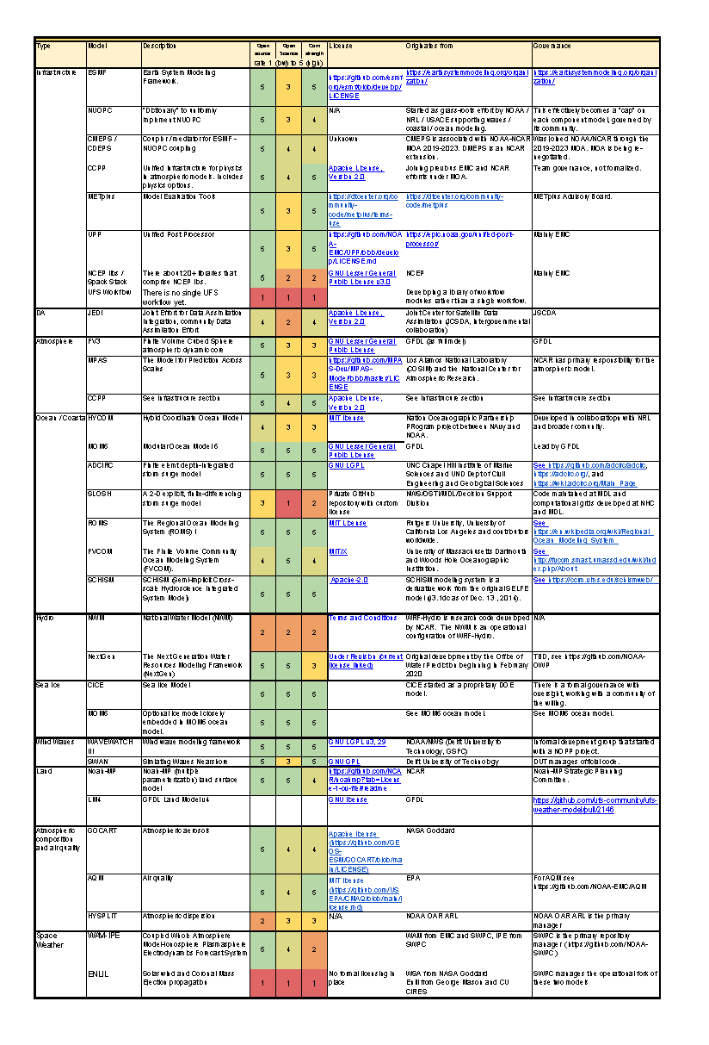
Software Stack (July 2024)
This is the core of the UFS
  Infrastructure (ESMF, NUOPC, CMEPS, DMEPS, libraries))
  DA (JEDI)
  Atmosphere (FV3, CCPP, MPAS)
  Ocean (MOM6, ADCIRC, +6 !!)
  Hydro (NWM, NextGen)
  Sea Ice (CICE, “MOM6”)
  Wind Waves (WW3, SWAN)
  Land (Noah-MP, LM4)
  Atmospheric composition / Air Quality (GOCART, HYSPLIT, …)
  Space weather (WAM-IPE, ENLIL)
To be updated later this year
  Adding languages and need for software modernization (other talk this week)
Ownership based governance

Slide 10
UFS component models
UFS-SC needs to develop a more formal definition
What defines a UFS component model?
  UFS working groups and teams decides this is a focal model
  UFS Steering Committee only needs to be included if there are conflicts
  Component model is UFS-ready once
    Code management principles are acceptable
    “Wrapping” with ESMF / NUOPC is developed / owned
    Applications (coupled) are defined
  Ownership: UFS is not a funding opportunity!

Slide 11
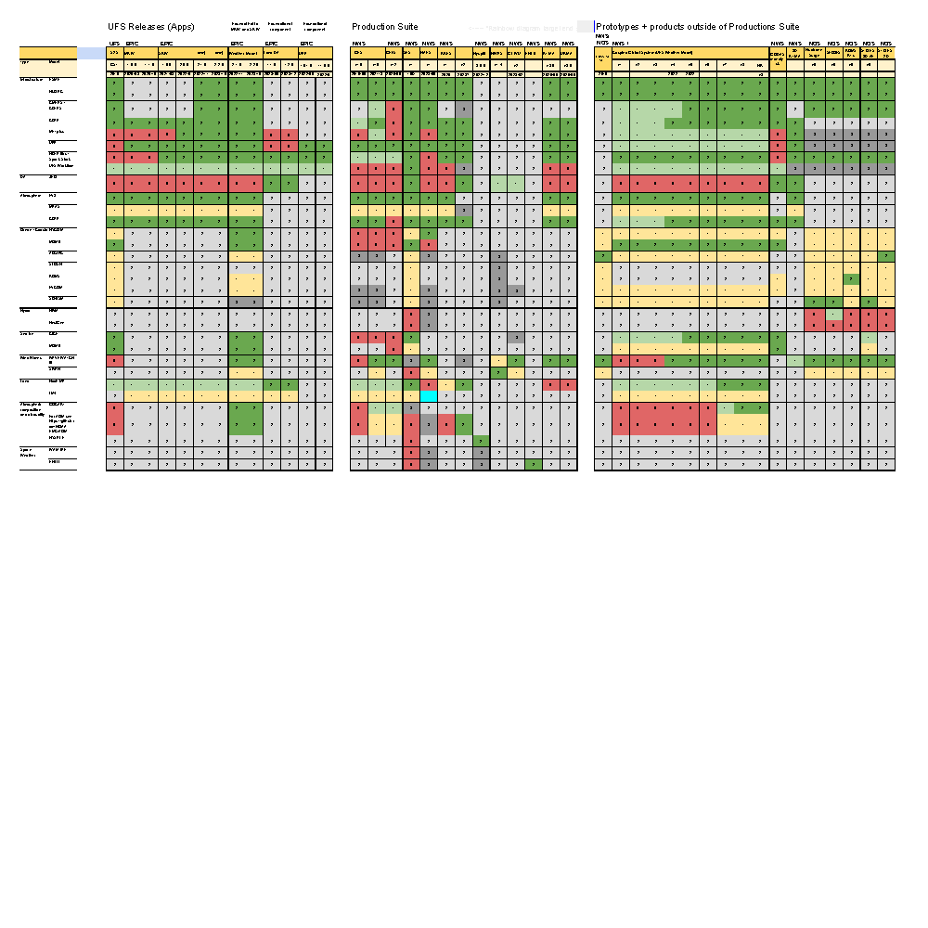
Applications (July 2024)
Evidence based decision making occurs here
  EPIC UFS releases
  Production Suite
  R&D applications
Not same tools for all components
  3 or 4 ocean models needed for full NOAA mission
Governance per application (generally well defined)
Glossary for Applications:
S2S: Subseasonal to Seasonal; GST: Graduate Student Test; MRW: Medium Range Weather; SRW: Short range Weather; UPP: Unified Post Processor; GFS: Global FS; GEFS: Global Ensemble FS; SFS: Seasonal FS; HAFS: Hurricane FS; RRFS: Rapid Refresh FS; NWPS: Nearshore Wave PS; GLWU: Great Lakes Waves; RTMA: Real Time Mesoscale Analysis; URMA: Unrestricted RMA; GODAS: Global Ocean DA System; SECOFS: Southeast Coast Operational FS; STOFS: Surge and Tide Operational FS; NECOFS: Northeast Coast Operational FS

Slide 12
UFS progress
Simplifying the production suite:
  Reduce the complexity of the Production Suite, measured as the reduction in the number of major applications (baseline is 26 in 2016)
  70% planned, 23% achieved (HAFS and RRFS are next big steps)
Building the community:
  reducing the cost of setting up GFS modeling system outside of the NOAA
  Was $15M+ for GFS, now 1 person 1 day on your computer
  NSF starting to support UFS (6 projects funded in 2023)
Improving Operations: Evidence driven, community teams
  Much larger teams supporting development
NOAA planning:
  10 Year NOAA Modeling Strategy (UFS, JEDI)
  NOS modeling strategy
  NOAA Administrative Order 201-118

Slide 13
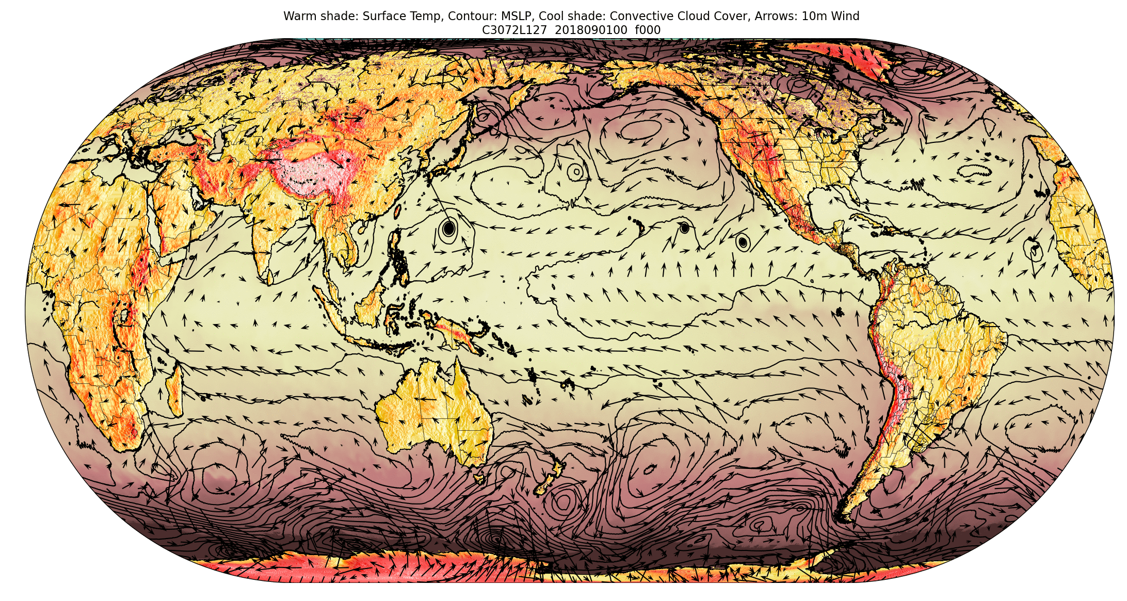
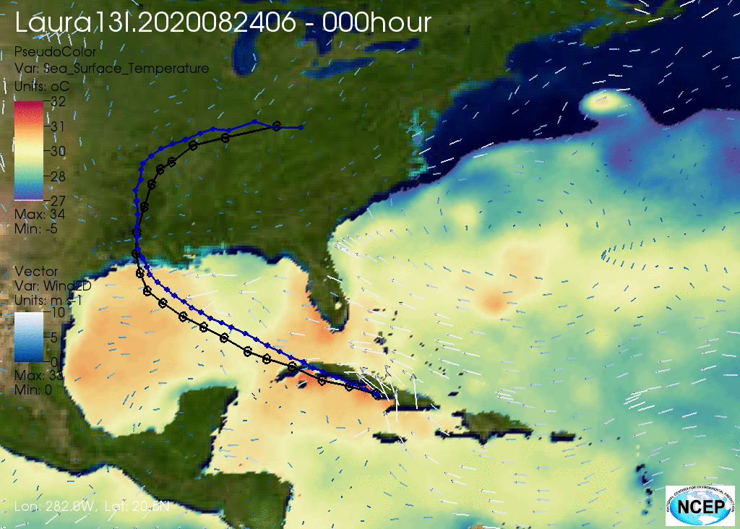
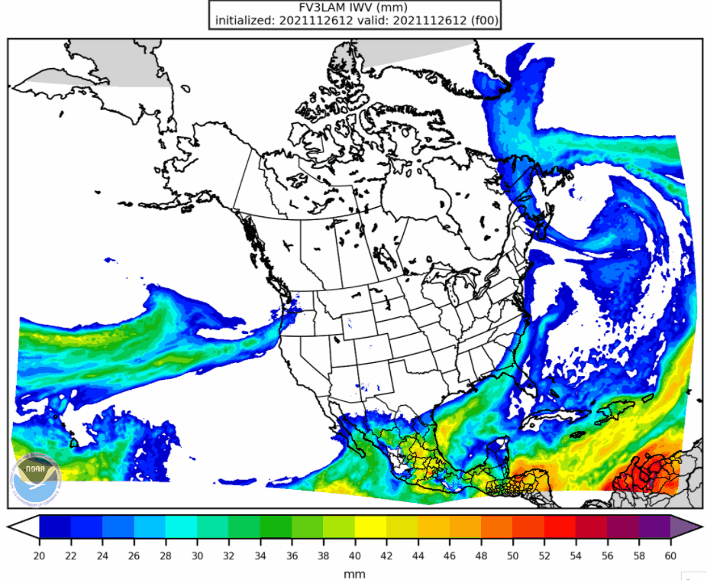
UFS is real!

Slide 14
Next Steps
Governance ……………
Next UFS strategy document to be developed before the next UIFCW
Software modernization focus
  Other talk at UIFCW
  Position paper “Software modernization for the UFS” DOI: 10.25923/gfbx-pk53
  Starting to discuss next generation coupling approaches within the UFS
MPAS inclusion (WoFS and more ?)
Applications, Applications, Applications …..
EPIC, EPIC, EPIC ….. https://epic.noaa.gov/

Slide 15
Questions ?

