Slide 1
Testing & continuous integration updates in UFS
Alex Richert, Lynker/NOAA EMC
Marshall Ward, NOAA GFDL
Tuesday, September 9, 2025

Slide 2
Overview
The role of testing in UFS
The value of unit testing
Unit testing successes and challenges in MOM6
Tools of unit testing: CTest & GitHub-based continuous integration (CI)

Slide 3
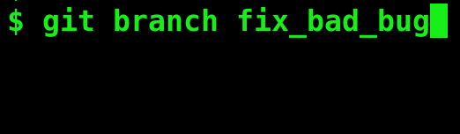
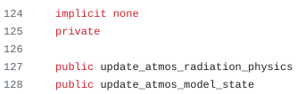

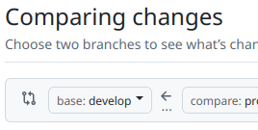

UFSWM code changes are end-to-end tested on HPC platforms
Create new Git branch
Make code changes
Run regression tests on HPC platforms
Ursa
Gaea
On failure
On success
Orion
Hercules
Review/approval/merge
Pull request
WCOSS2/
Acorn

Slide 4
Debugging a large code base is a challenge
UFSWM regression tests take time and effort to run on the tier-1 platforms
A bug inside a submodule may manifest in non-obvious ways
The culprit code is not always the point of failure
Example: Numerical inaccuracies that cause RT output checks to fail

Slide 5
Unit testing emphasizes testing individual code components
Each unit – typically a function or subroutine – is tested in isolation
The largest single effort in deploying it is the developing initial infrastructure
Unit testing boosts overall code health and reduces technical debt
Unit testing is not a replacement for end-to-end regression testing, good coding practices, and code reviews
Compared with end-to-end testing, unit testing allows us to find bugs faster and at the source

Slide 6
Unit testing in the MOM6 ocean model
Models require multiple forms of unit testing
Infrastructure code with a clear outcome Was my input forcing opened and read correctly?
Numerical equivalence Does my diffusivity match the expected result?
Property testing Is my new grid monotonically increasing?

Slide 7
Infrastructure Testing
Unit test design follows standard principles when the outcome is well-defined:
call test_open_param_file()
remove_spaces(" 1 2 3") == "123"
Numerical tests may have specific well-defined results:
cuberoot(1.) == 1.
cuberoot(0.125) == 0.5
Other tests may utilize a consistency test:
|x - cuberoot(x)³| < 2×10⁻¹⁵|x|

Slide 8
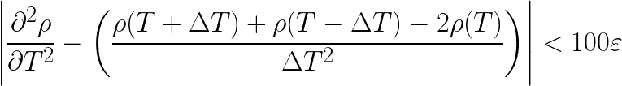
Tolerance testing: Equation of State
Seawater density ρ(T,S,p) is computed using one of several equations of state.
MOM6 unit tests rely on traditional tolerance tests to verify derivatives of ρ:

Slide 9
Example: Error in Wright EOS
The values of WRIGHT drho_dT_dT disagree.
-1.1402818751119731E-02 and -7.2448371213340561E-03
differ by -4.15798163E-03 ( -4.46E-01), tol= 3.11848682E-04
z0 = T*(b1 + b5*S + T*(b2 + b3*T)) z1 = (b0 + pressure + b4*S + z0) z3 = (b1 + b5*S + T*(2.*b2 +2.*b3*T)) z4 = (c0 + c4*S + T*(c1 + c5*S + T*(c2 + c3*T))) … drho_dt_dt = (z3*z6 - z1*(2.*c2 + 6.*c3*T + a1*z5) + (2.*b2 + 2.*2.*b3*T)*z4 - z5*z8)/z2_2 - (2.*(z6 + z9*z5 + a1*z1)*(z3*z4 - z1*z8))/z2_3
Should have been a three!

Slide 10
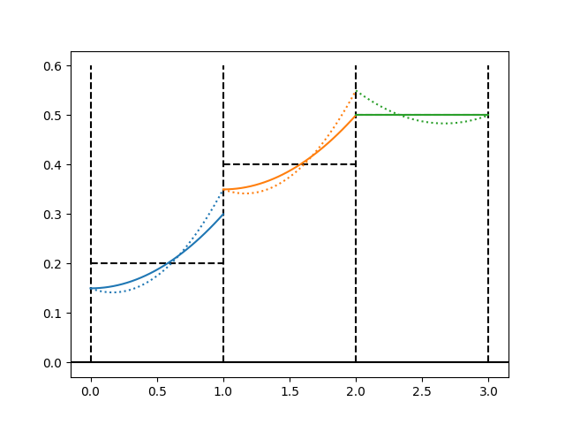
Property Testing: Remapping
Fields must be remapped to dynamically changing vertical coordinates.
Mappings must be monotonic:
Interior polynomials cannot have extrema
Edge values can be discontinuous as long as they are also monotonic
Strategy: Apply random input to search for property violations.

Slide 11
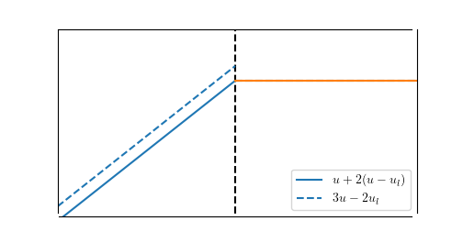
Example: floating-point remap error
k-1
k
k+1
Mathematically equivalent u_{r}, but 3u-2u_{l} breaks monotonicity! Second form u + 2(u - u_{l}) more accurately preserves residuals.
Even a minimal error can disrupt layer search methods, such as when mapping density to a particular layer.

Slide 12
Dimensional unit testing
Scaling variables in proportion to dimensions provides additional verification.
Consider any equation in the model:
u_{n+1} = u_{n} + Δt × F
Apply a rescaling that is consistent with their dimensions:
u’ → (L / T) u
Δt’ → (T) Δt
F’ -> (L / T²) F
Unit tests must also pass in these rescaled units.
(And if L and T are powers of 2, then results are bit-reproducible.)

Slide 13
Example: Double diffusion bug
A double-diffusive correction to the vertical diffusivity was implemented as
Kd_lay(i,j,k-1) = Kd_lay(i,j,k-1) + 0.5**KS_extra(i,K)
After a dimension rescaling
Kd_lay → (L²/T) Kd_Lay Ks_extra → (L²/T) Ks_extra
the error was quickly detected and resolved.
Should be multiply!

Slide 14
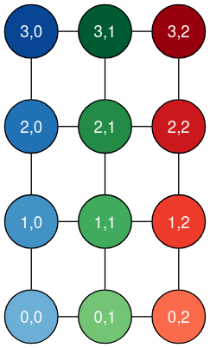
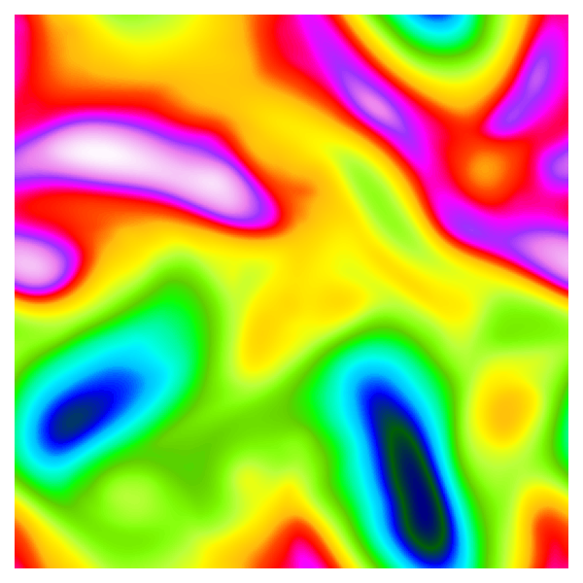
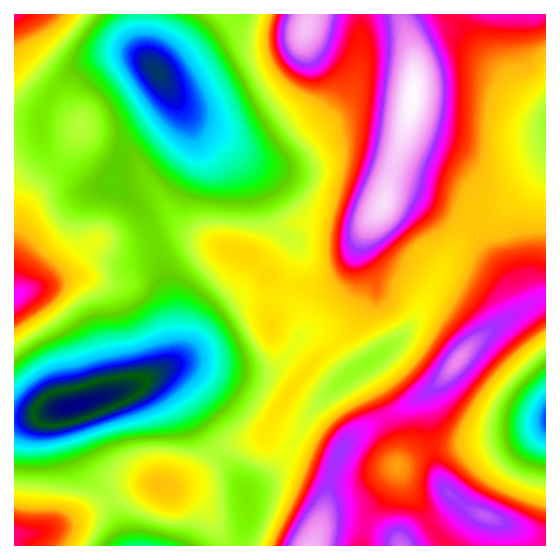
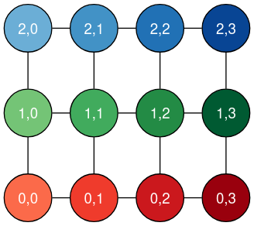
Rotational Unit Testing
MOM6 can rotate the problem in memory and verify that any directional components are consistent.

Slide 15
Example: Thickness diffusivity
Rotational testing revealed a sign inconsistency in the thickness diffusivity work:
subroutine thickness_diffusivity_full() ! … Work_u(I,j) = Work_u(I,j) - dWork(I,j) ! … Work_v(I,j) = Work_v(I,j) + dWork(I,j)
Testing cannot determine the sign, but can reveal a physically inconsistent result.

Slide 16
Limitations of MOM6 unit testing
Testing is self-consistent, but not necessarily truth
Based on fundamental physical principles
Platform independent design
Numerical testing must consider floating point error
Strongly modular design, but limited scalability
Every module has a custom test framework
Difficult for new contributors to provide their own unit tests
The greatest impediments to unit testing in MOM6 are simple, rapid test design and CI integration.

Slide 17
Determining ground truth outputs for complex code is hard
Partial solution 1:
Organize code into smaller, simpler pieces
Partial solution 2:
Test known edge cases
Partial solution 3:
Verify certain output value properties (e.g., enforce "all values in array X are positive")
Partial solution 4:
Use a golden master code version to establish baseline results, especially for legacy code (e.g., NCEPLIBS)

Slide 18
CTest provides testing within the CMake framework
CTest defines tests as shell commands:
target (production) executables,
wrapper scripts, or
test-specific executables linked to a production library,
where success depends on return code.
CTest tests are simple to run:
$ cmake ...
$ make
$ make test

Slide 19
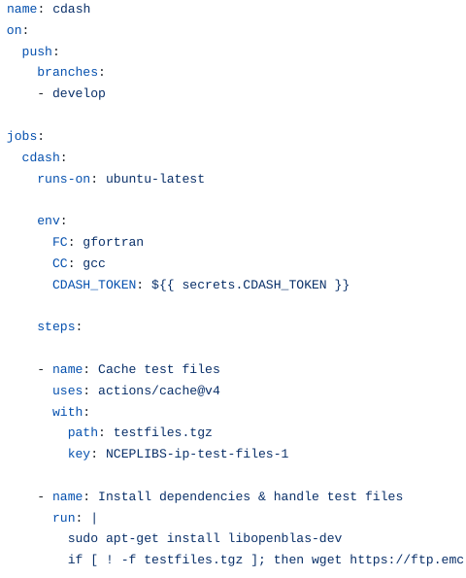
GitHub Actions allows us to automate unit testing workflows
GitHub Actions workflow:
Defined as a YAML file, typically running shell code
Developer proposes changes:
Unit test workflows must run and pass
Build caching:
UFS dependencies take more time to build (45-60+ minutes) than models
The Spack package manager works neatly with GitHub's caching facilities
Reusing dependencies means less time waiting on CI runs
For further reading, see
github.com/NOAA-EMC/NCEPLIBS/wiki/

Slide 20
Demo: Adding new, unit-tested code
Make my code change
Code my unit test
Add my unit test in CTest
Create PR, run updated unit test suite through GitHub Actions

Slide 21


Slide 22
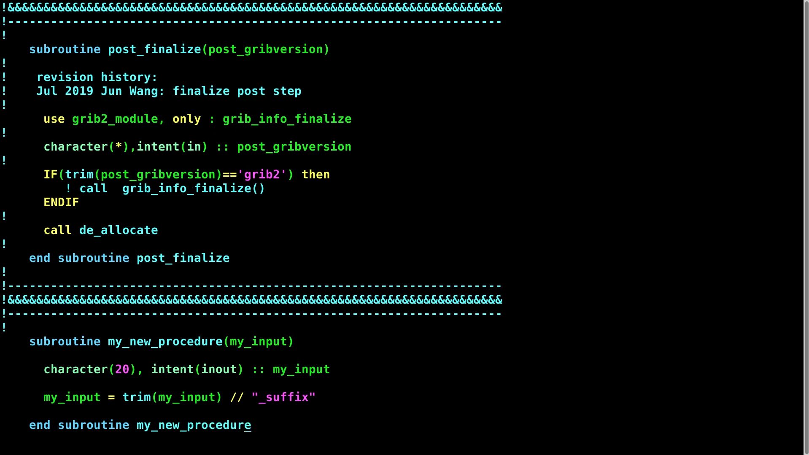

Slide 23


Slide 24
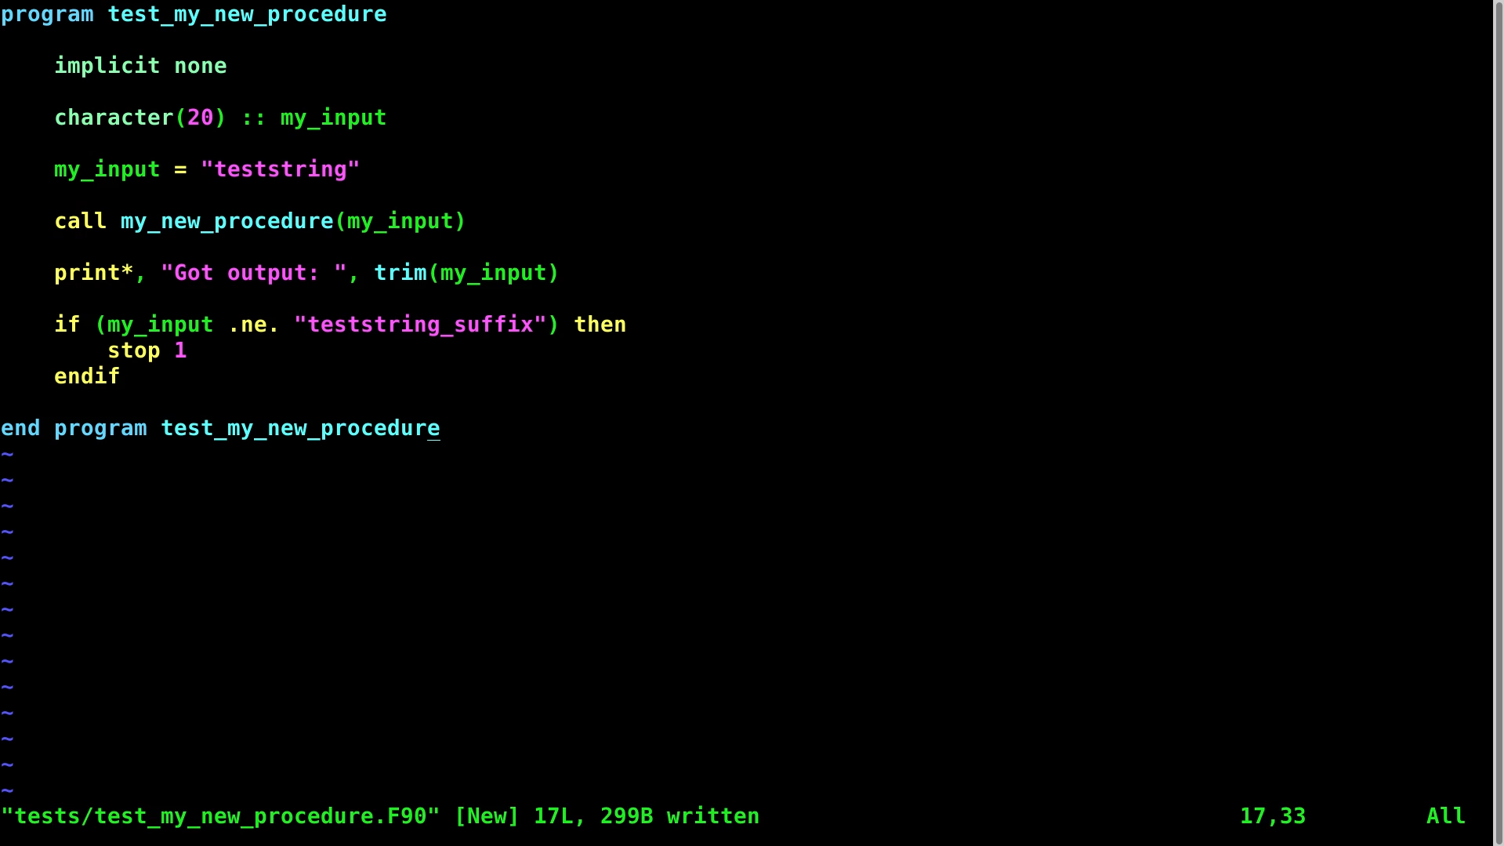

Slide 25


Slide 26
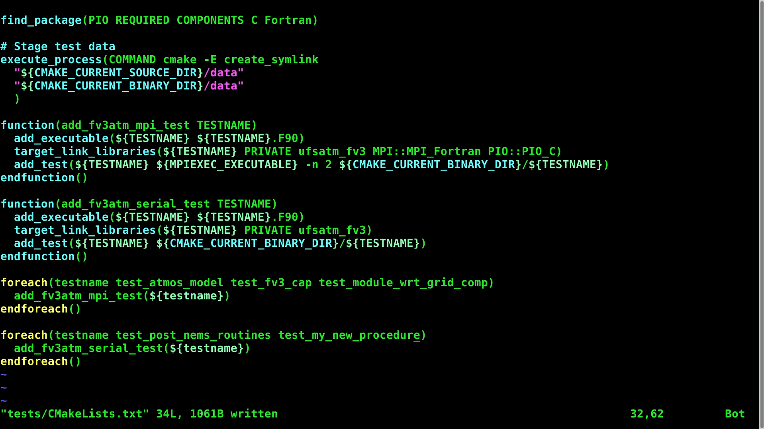

Slide 27
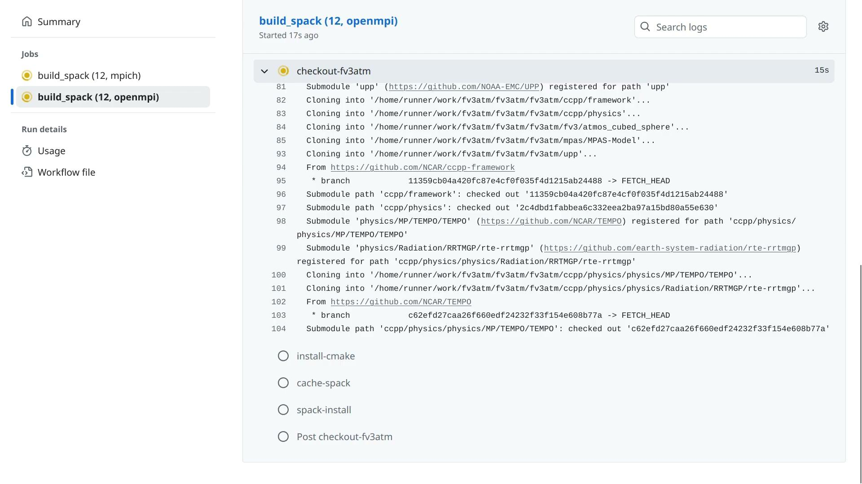

Slide 28
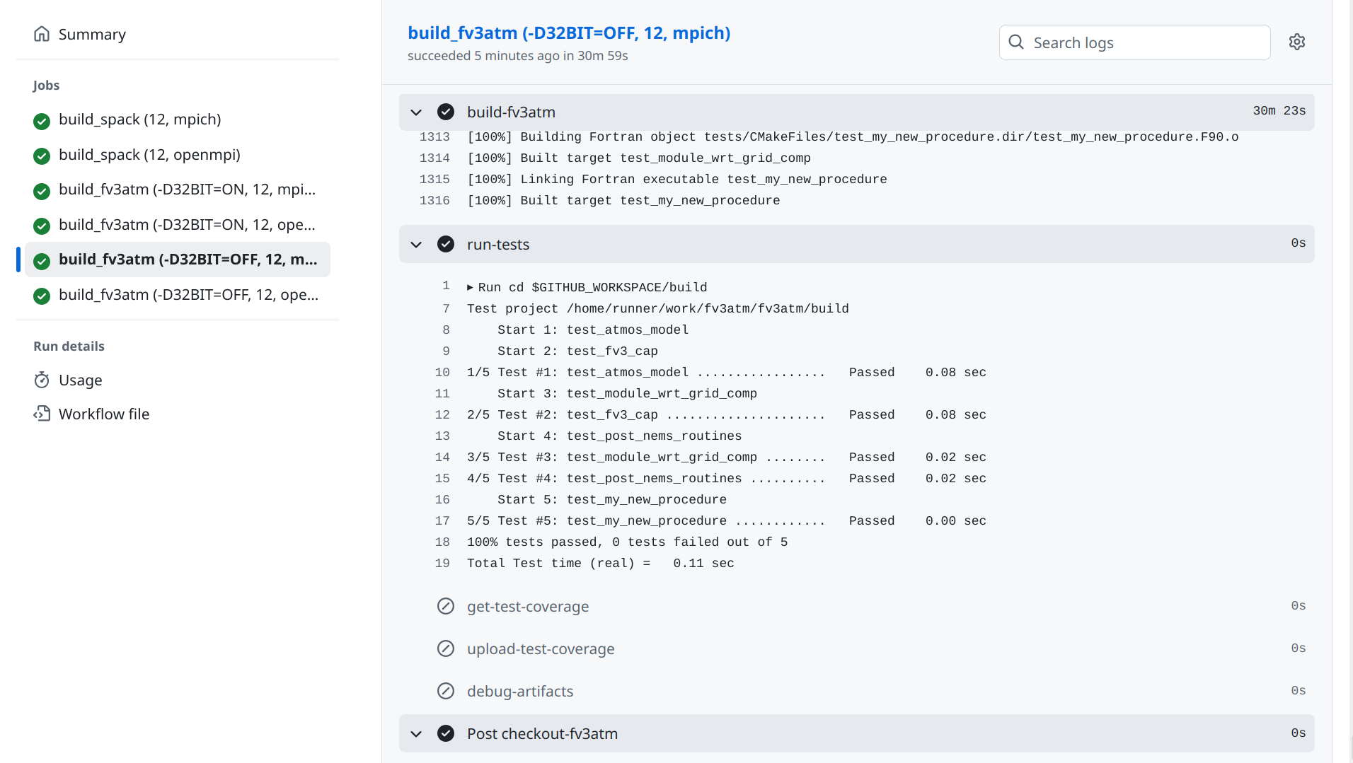

Slide 29
Conclusions
Unit testing represents an opportunity to accelerate development and improve code health in UFS applications
NCEPLIBS, fv3atm, and MOM6 are examples of opportunities & challenges for applying unit testing in UFS
CMake & GitHub are well suited for incorporating and automating unit testing
alexander.richert@noaa.gov
marshall.ward@noaa.gov

