Slide 1


Integrating the Community into the Development, Use, and Support of the Community Earth System Model (CESM)
David Lawrence
CESM Chief Scientist
NSF National Center for Atmospheric Research

Slide 2
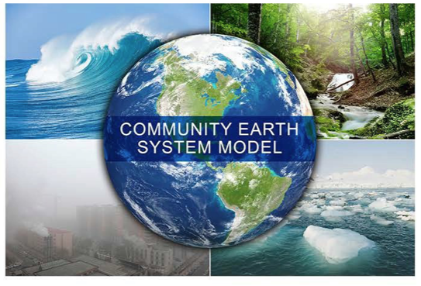
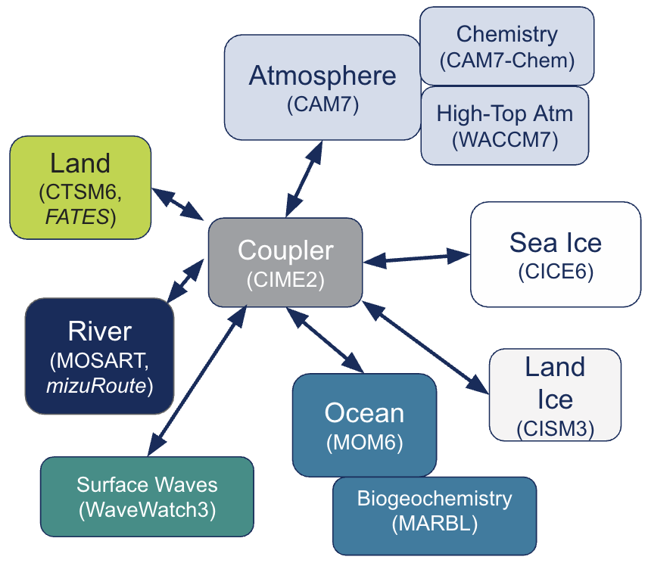
What is the Community Earth System Model
CESM is a powerful and flexible fully interactive Earth System modeling framework that has been developed and used for over 30 years by the community to study:
Earth system variability
Earth system change; projections and feedbacks
Earth System predictability
climate change impacts
Earth system interactions (chemistry-climate, land-atmosphere, ocean-atmosphere, weather-climate, solar-climate, cryosphere-climate, ...)
paleoclimate
…. and more
CESM2, Danabasoglu et al. (2020)
Component models for CESM3 listed above
Notes:
A quick summary of what CESM (the model is)
Its a powerful and flexible Earth System Model that is developed by in NCAR in collaboration with the community. It is used widely both nationally and internationally.
I would say it differentiates itself from most ESMs by its usability, flexibility and the support provided for its use.

Slide 3
What is the Community Earth System Model
CESM is a successful example of community modeling
Strong community participation in development and application of model through Working Groups (2000+ researchers)
Widely used nationally and internationally, e.g., 400+ talks using CESM / CESM output at AGU
CESM papers / output widely cited (CESM1, CESM2, and CESM Large Ensemble papers all >1000 citations)
CESM typically among upper tier of models in terms of the quality of the simulated climate
Notes:
A quick summary of what CESM (the model is)
Its a powerful and flexible Earth System Model that is developed by in NCAR in collaboration with the community. It is used widely both nationally and internationally.
I would say it differentiates itself from most ESMs by its usability, flexibility and the support provided for its use.

Slide 4
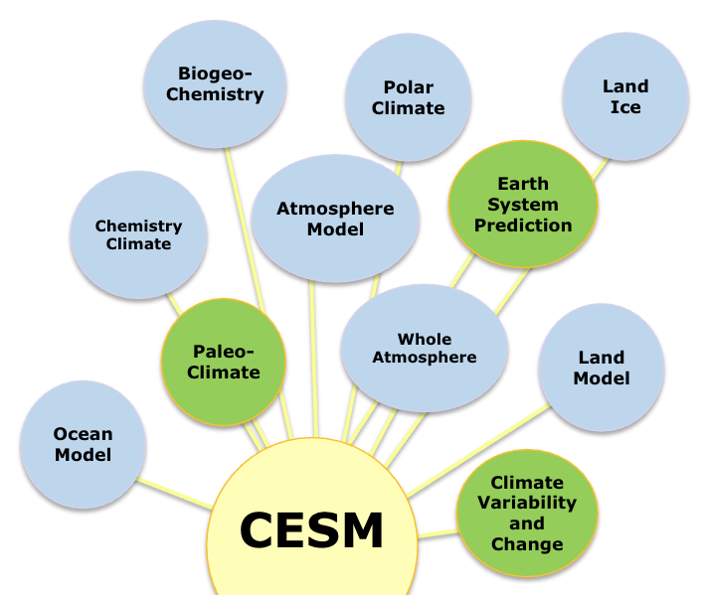
CESM Working Groups and Governance structure provide platform for engaged community model development and application
CESM Working groups
Internal (NCAR-based) and external (community) co-chairs
Open membership
Forum for discussion and management of model development activities through
weekly(ish) hybrid development meetings
winter hybrid working group meetings hosted at NCAR
Working Group computing allocations can support non-NCAR scientists to complete community simulations
CESM Scientific Steering Committee (mostly external) and Advisory Board (fully external)
Additional community governance and input
Notes:
Each working group has 2-3 co-chairs mixed with NCAR & Community
New CESM v3 release expected later this year
Annual working group workshops (winter) offset from CESM meeting (summer)

Slide 5
Community Earth System Model, version 3 (CESM3)
The CESM community is pushing towards finalization of CESM3, representing 5+ years of model development and improvement across all CESM component models
Targeting release of CESM3 in Spring 2026
Plan for (at least some) participation in CMIP7
Notes:
A quick summary of what CESM (the model is)
Its a powerful and flexible Earth System Model that is developed by in NCAR in collaboration with the community. It is used widely both nationally and internationally.
I would say it differentiates itself from most ESMs by its usability, flexibility and the support provided for its use.

Slide 6
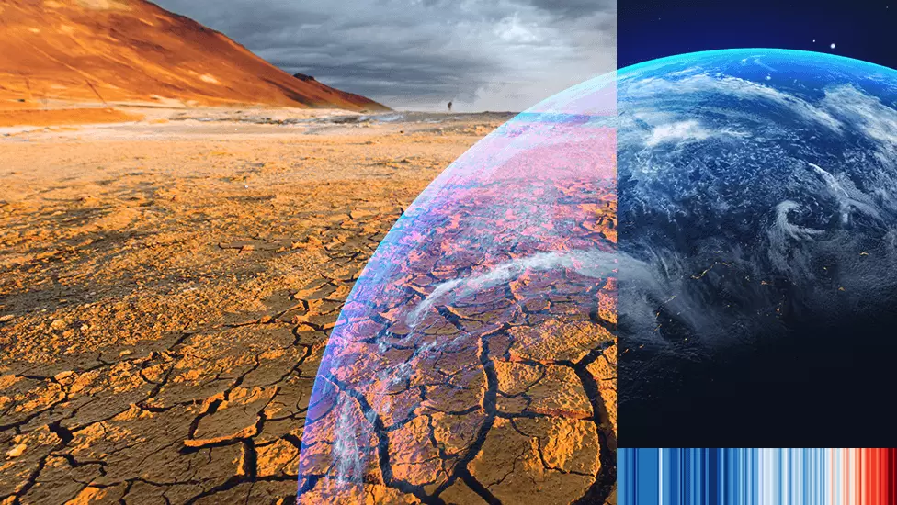
Forces driving the future of Earth System modeling
Urgent need for actionable information (weather/climate impacts, consequences of intervention or mitigation, risks of tipping points)
Earth System predictability across timescales (NCAR - ESPAT), S2S → S2D → 30-yr projections
Increasing demand for high-resolution (~0.25º) and ultra high-resolution (km-scale) configurations in modeling hierarchy
Growth and potential of machine learning, hybrid modeling, and emulators to transform models
Changing computing architectures → need for code modernization
Calls for improved accessibility of ESMs and output (e.g., to global south)

Slide 7
CESM supports a range of Earth system science research through a single model framework
Chemistry
(CAM6-Chem)
Atmosphere
(CAM6)
High-Top Atm
(WACCM6)
Land
(CLM5
BGC-Crop)
Sea Ice
(CICE5)
Coupler
(CIME)
Rivers
(MOSART)
Land Ice
(CISM2)
Ocean
(POP2)
Surface Waves
(WaveWatch2)
Biogeochemistry
(MARBL)

Slide 8
CESM supports a range of Earth system science research through a single model framework
T, P, Solar Radiation, Longwave Radiation, Humidity, Wind, CO2, etc. from observations (reanalysis)
Data Atmosphere
Sea Ice
(CICE5)
Coupler
(CIME)
For example, you can turn on and turn off different components and replace them with a Data model
Ocean
(POP2)

Slide 9
CESM supports a range of Earth system science research through a single model framework
T, P, Solar Radiation, Longwave Radiation, Humidity, Wind, CO2, etc. from observations (reanalysis)
Data Atmosphere
Sea Ice
(CICE5)
Coupler
(CIME)
For example, you can turn on and turn off different components and replace them with a Data model
Ocean
(POP2)
Biogeochemistry
(MARBL)

Slide 10
CESM supports a range of Earth system science research through a single model framework
Data Atmosphere
Land
(CLM5
BGC-Crop)
Coupler
(CIME)
For example, you can turn on and turn off different components and replace them with a Data model
Rivers
(MOSART)

Slide 11
CESM supports a range of Earth system science research through a single model framework
Data Atmosphere
Land
(CLM5
BGC-Crop)
Coupler
(CIME)
And, within each component model, there are many choices you can make about parameterizations, complexity levels, etc.
Land use change
Biogeochemistry
Crops
Prescribed vegetation
Ozone damage
Methane emissions
# soil layers
No anthro
…

Slide 12
CESM supports a range of Earth system science research through a single model framework
Data Atmosphere
Land
(CLM5
BGC-Crop)
Coupler
(CIME)
And, within each component model, there are many choices you can make about parameterizations, complexity levels, etc.
Land use change
Biogeochemistry
Crops
Prescribed vegetation
Ozone damage
Methane emissions
# soil layers
No anthro
…
This flexibility enables a wide range of users with diverse research interests and priorities to engage with CESM

Slide 13
Interactive CESM Poll at UCAR Members Meeting
What does the CESM research community
value and or want for the future of CESM?

Slide 14
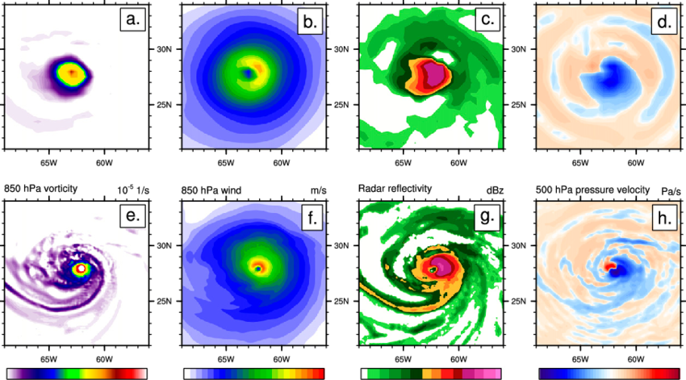
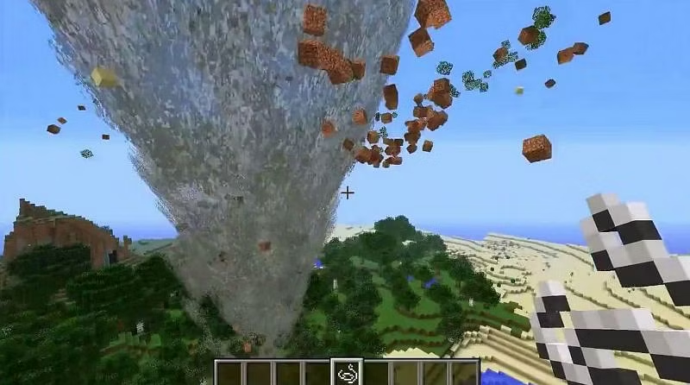
Interactive CESM Poll at UCAR Members Meeting
Q1: Do you or your group/dept use CESM in your research?
Q2: Are there more lines of code in CESM or Minecraft? Answer: CESM 3.6 million, Minecraft 1.8 million
Q3: What is the approximate ratio of the number of developers for CESM vs Minecraft? Answer: 0.1 (70/700)

Slide 15
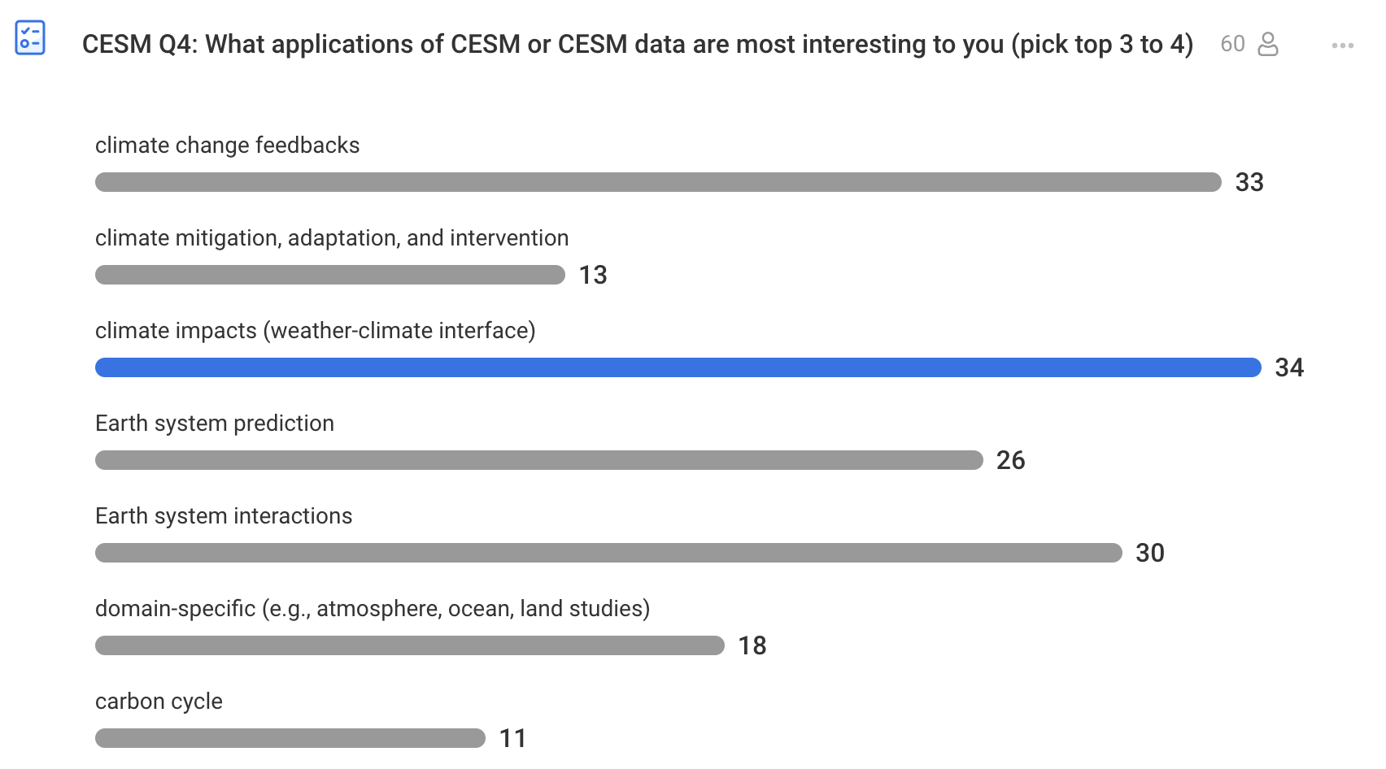
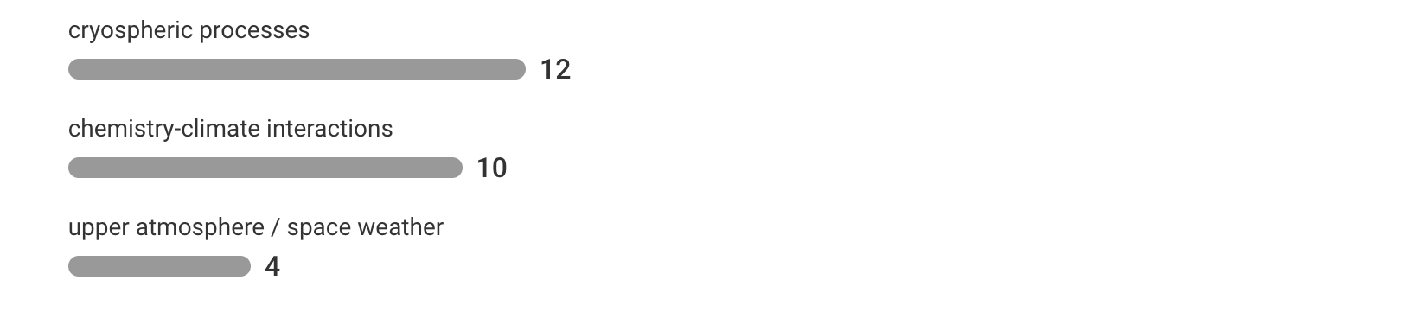
UCAR Members meeting poll

Slide 16
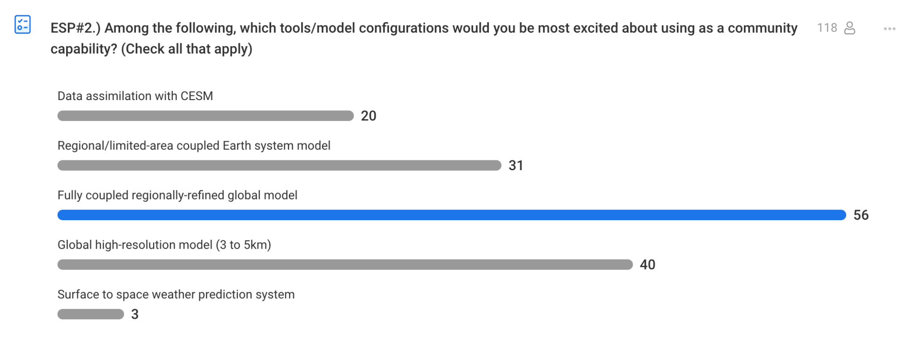
UCAR Members meeting poll

Slide 17
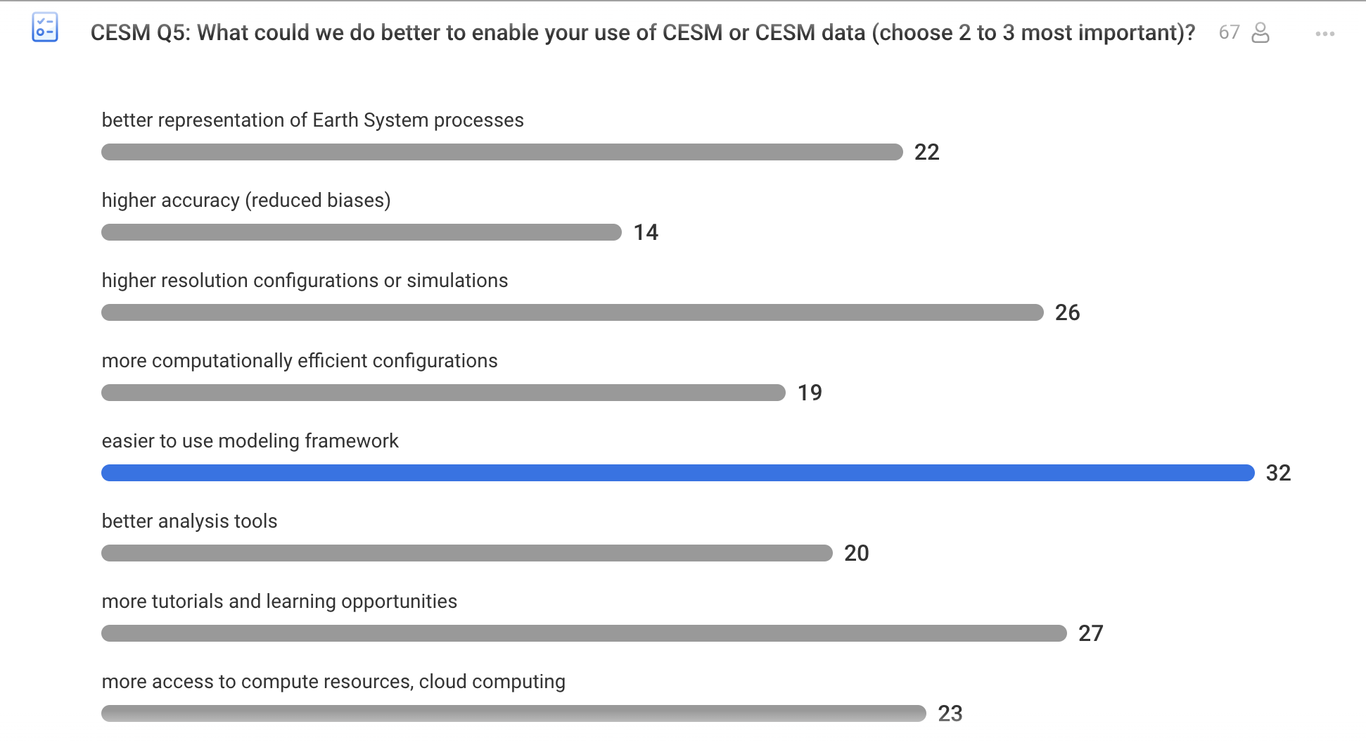
UCAR Members meeting poll

Slide 18
Foundations for Community Modeling

Slide 19
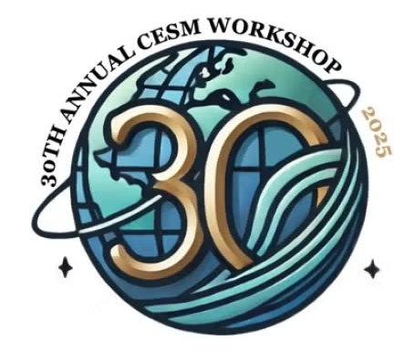
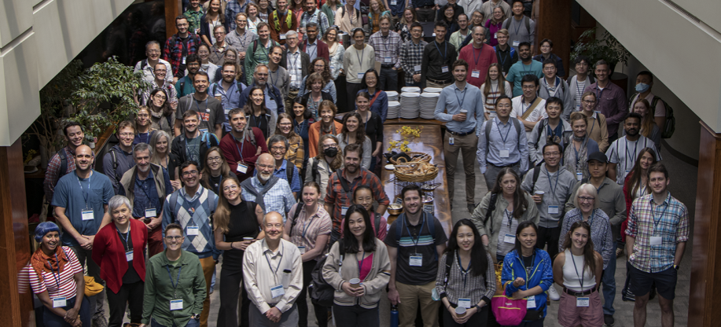
CESM Workshops
The annual CESM Workshop and winter Working Group meetings bring together developers and users to report on progress, to share scientific results, to discuss the direction of CESM, and to network with colleagues
June 9-11, 2025
Cross Working Group sessions allows focus on emerging science and tech priorities
AI/ML for CESM
high res CESM dev
actionable science

Slide 20
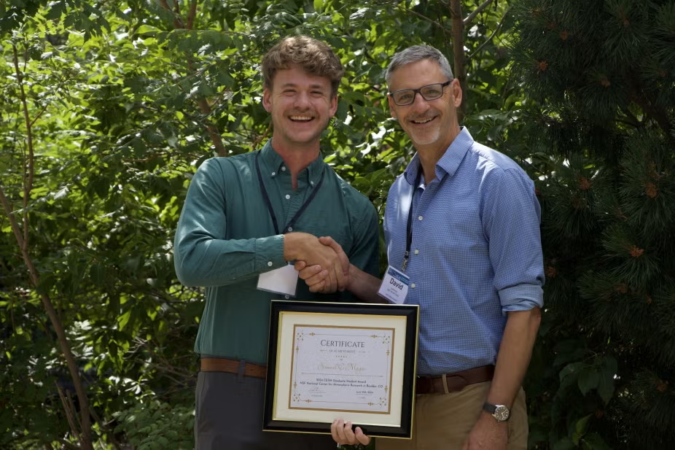
CESM Workshops
Annual CESM Graduate Student Award
June 9-11, 2025

Slide 21

Learning and engagement opportunities
Tutorials
Annual CESM Tutorial
80+ students
materials freely available online
Jupyter notebook-based
Cloud-based allows for remote tutorials at AGU, AMS, and elsewhere

Slide 22
Learning and engagement opportunities
Tutorials
CESM Tutorial (80+ students, online materials)
Cloud-based allows for remote tutorials at AGU, AMS, and elsewhere
Mentoring
NCAR CESM staff host graduate students / postdocs / and faculty visits

Slide 23
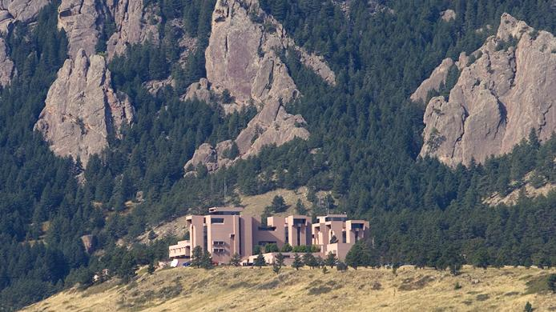
Learning and engagement opportunities
Tutorials
CESM Tutorial (80+ students, online materials)
Cloud-based allows for remote tutorials at AGU, AMS, and elsewhere
Mentoring
NCAR CESM staff host graduate students / postdocs / and faculty visits
Notes:
QR Code link to the CESM Tutorial; mention that based on Jupyter notebooks now and runs in the cloud.

Slide 24
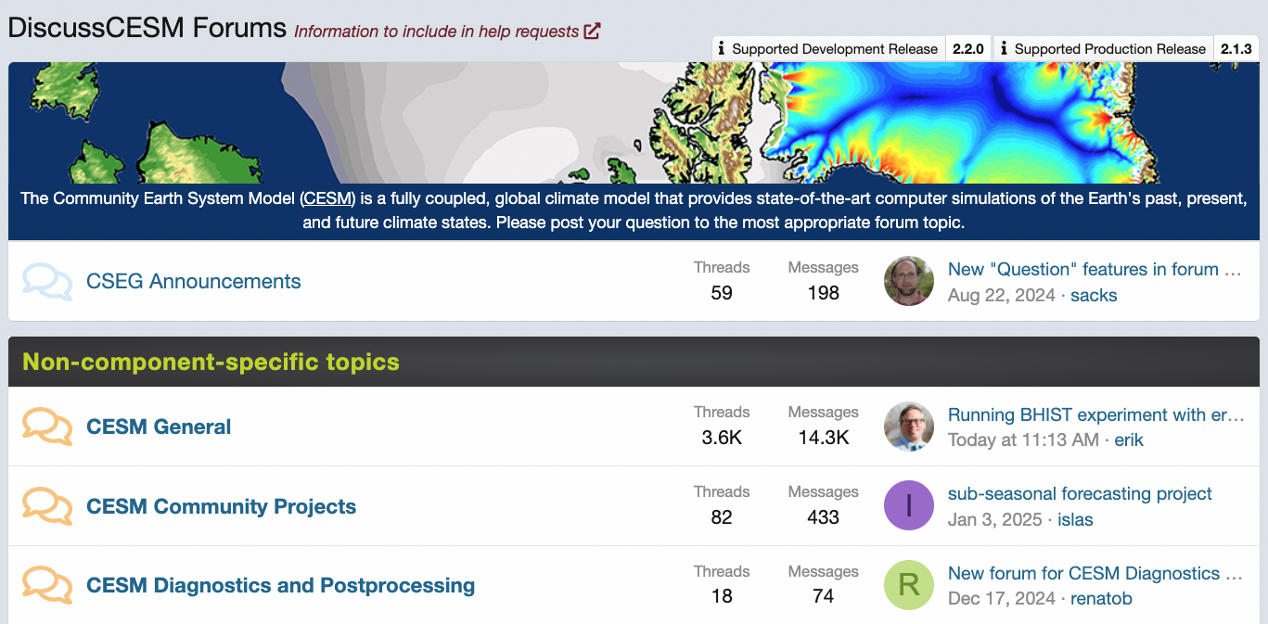
User Support: DiscussCESM Forum
https://bb.cgd.ucar.edu/cesm/
Notes:
including institutions such MIT, other MA

Slide 25
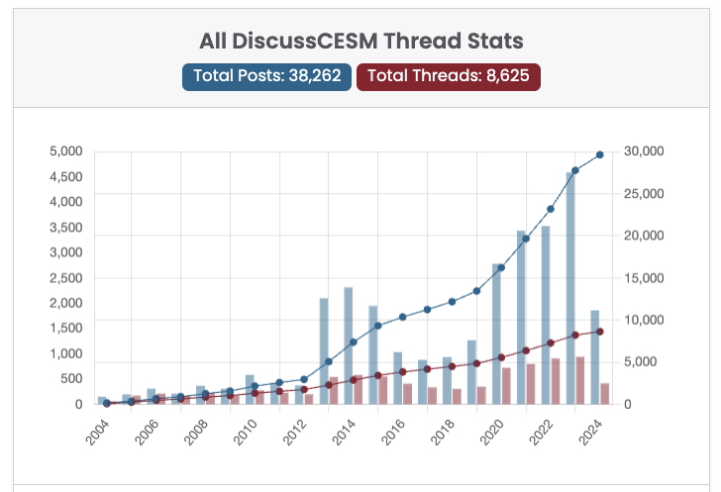
DiscussCESM Forum
https://bb.cgd.ucar.edu/cesm/
Notes:
including institutions such MIT, other MA

Slide 26
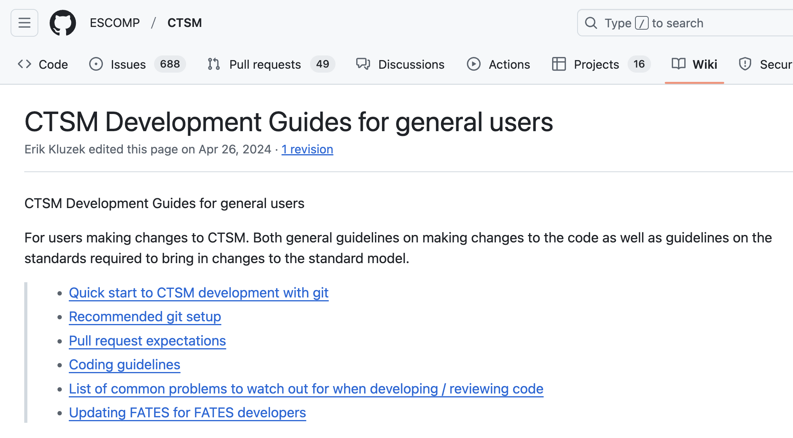
Support for Developers
Easy to run and understand ‘quick look’ test suite

Slide 27
Open Development Process: Open meetings
Run | Description | Nyrs | Diags / Github | Purpose of the run + comments
54 | New baseline tag = cesm2_3_alpha16g | 150 | #420 | Baseline (dust tuning dust_emis_fact = 1.3) Issue: ENSO amplitude too large + double ITCZ
64 | 54 + gustiness | 58 | #440 | Purpose: Convective gust enhancement of U10 Gustiness reduces ENSO amplitude => Lab sea freeze around yr 50
64e,f,i,j | Start from 64 at yr 43 + perturbation | 80 | #463 | Purpose: How robust is Lab Sea freeze in 64? (Lab sea freeze)
64g,h | Start from 64 at yr 33 + perturbation | 80 | #463 | Purpose: How robust is Lab Sea freeze in 64?
73, 75 | Cold branch | 18,62 | #460 | Cold branch = more cam6-like
74, 76 | Warm branch | 22,41 | #471 | Warm branch = latest greatest clubb
73b,75b | Same as 73,75 starting from run 54 yr 50 | 63,38 |  | Start from spunup state (Use ocn/atm spunup state - no ice/lnd spinup)
73c,75c,66c | Same as 73,75 starting from run 54 yr 50 | 34,34,19 |  | Start from spunup state (Ocn/atm/lnd/ice spunup state)
64intel | Same as 64 but with new intel compiler | 50 | #464 | Purpose: does new intel compile produce same climate ?
64 series: 64 reduced enso amplitude but freeze around year 50 64e,f,g,h: Perturbation of 64 to see to test the robustness of the Lab sea freeze.
Cold/warm branch: create new baseline with all the desirable features to reduce ENSO amplitude and double ITCZ
Warm branch = latest greatest CLUBB mods
Cold branch = fallback to a cam6-like configuration
73b, 75b: Test whether starting from ocean spinup state gives the same conclusion

Slide 28
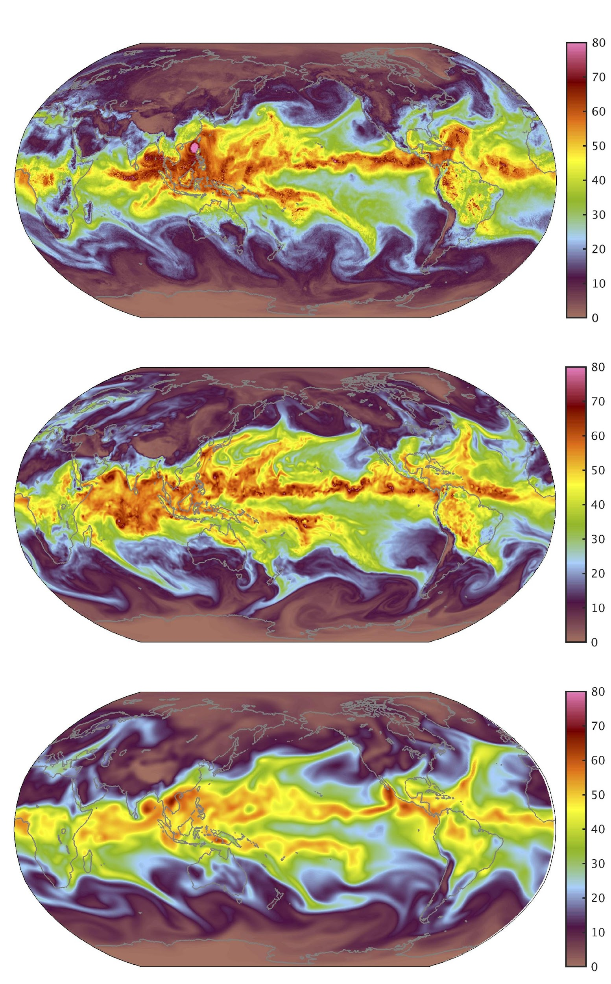
Publicly available CESM output
Significant contributions to CMIPs
CESM1 and CESM2 large ensembles (40 and 100 members)
Seasonal to Multiyear (SMYLE) Prediction Ensembles
Last Millennium ensemble
Single forcing ensemble
CESM1.3(HR): 0.25º atm/lnd, 0.1º ocn
10-member ensemble of historical and several projections
Set of decadal prediction expts (1980-2022 init dates)
Perturbed Parameter Ensembles (CLM, CAM)
… and more
Vertically Integrated Water Vapor (IWV, in mm)
Chang et al. (2020, JAMES)

Slide 29
Some current and future community-supporting activities

Slide 30

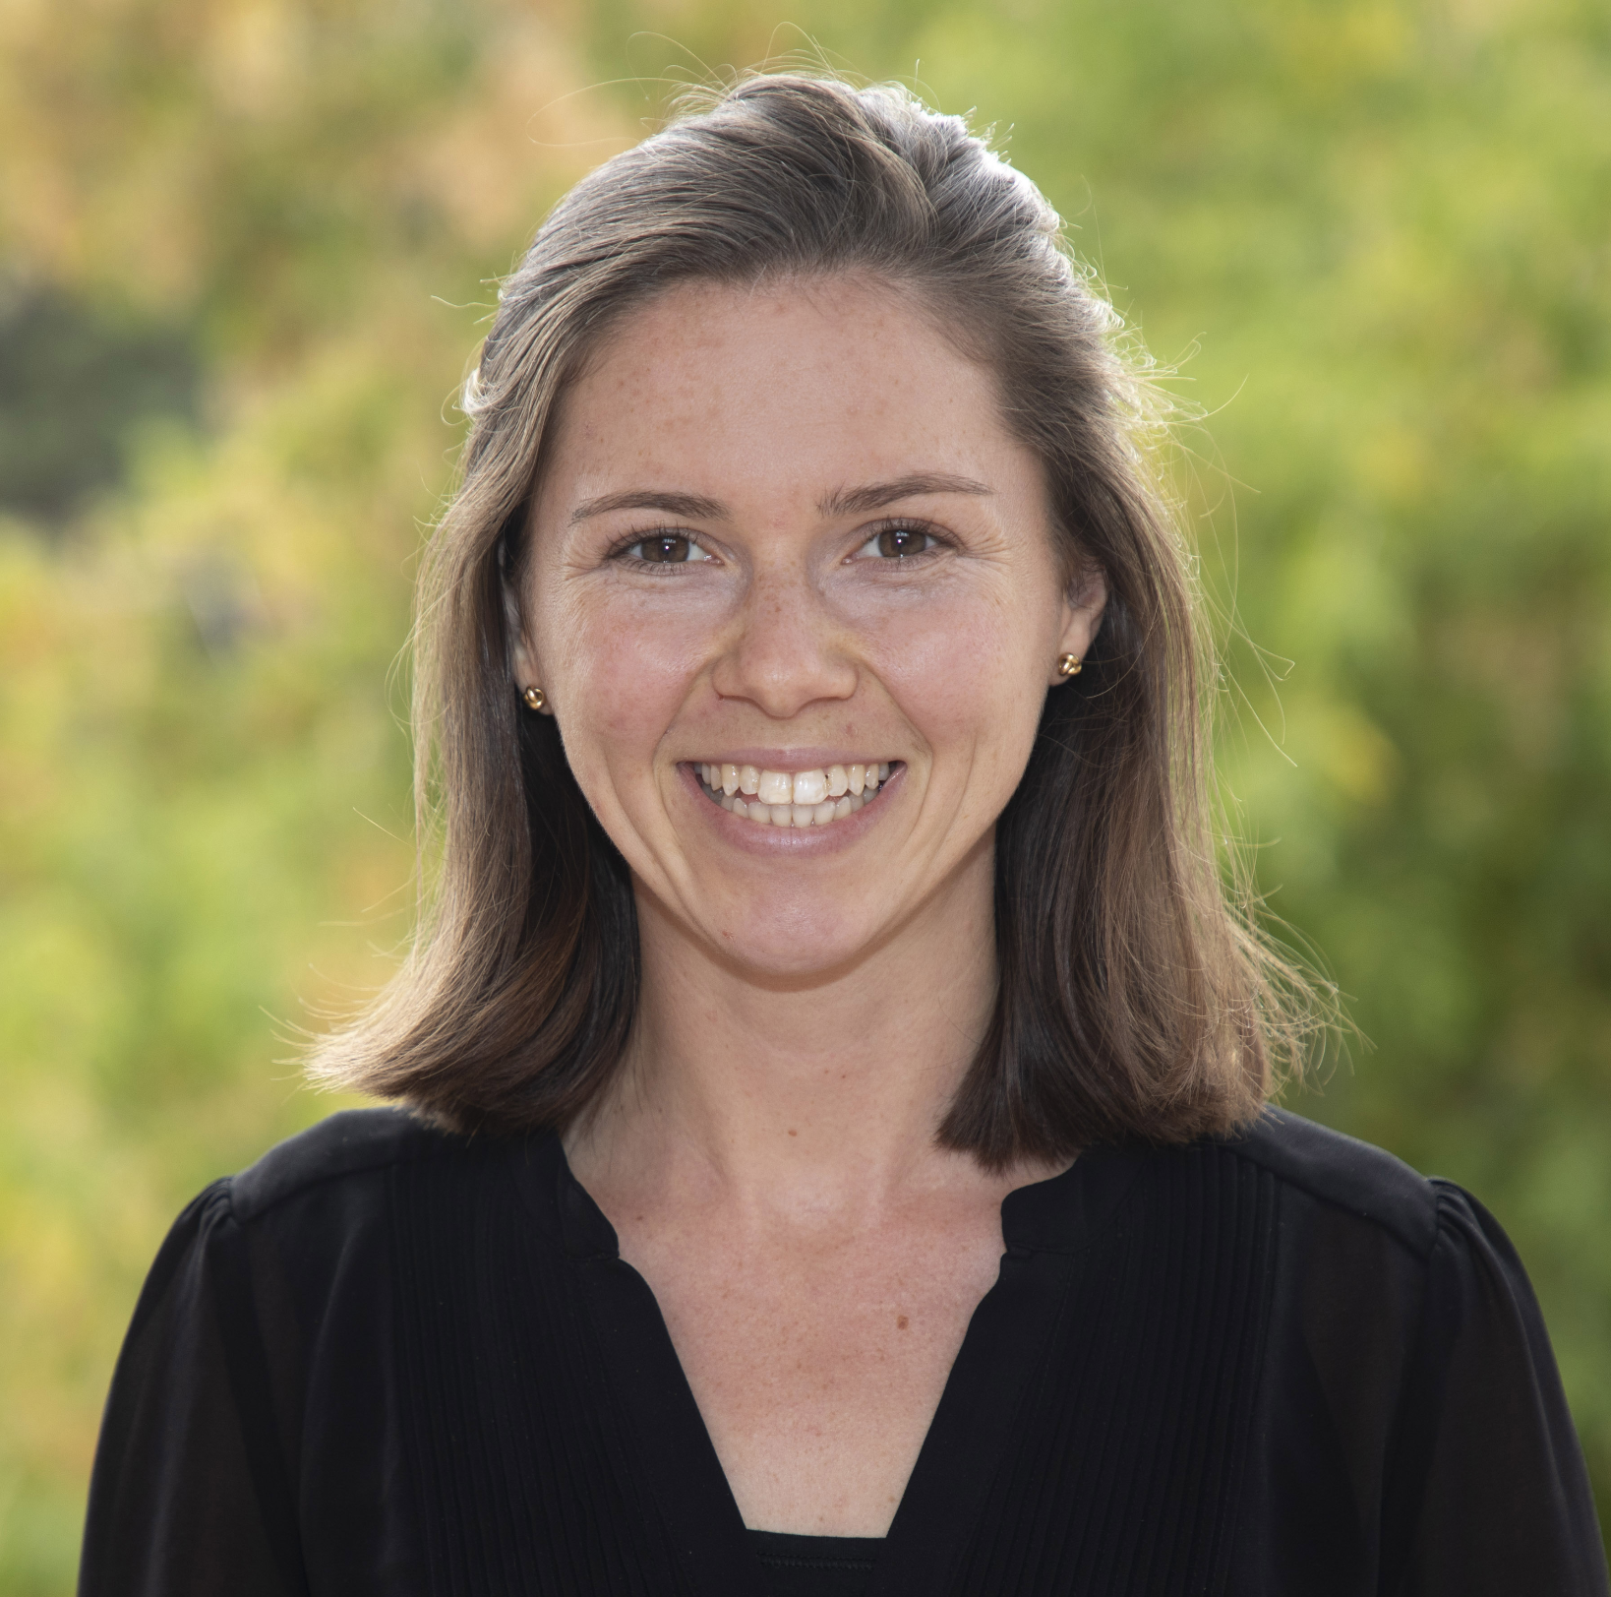
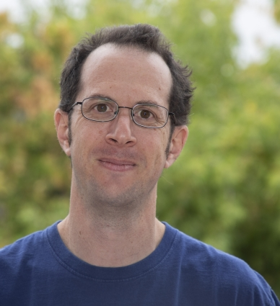
CESM Unified Postprocessing and Diagnostics (CUPiD)
A grassroots collaborative effort to unify CESM postprocessing and diagnostics
Python code that
runs in an easy-to-generate conda environment
can be launched via CESM workflow or independently
Diagnostics for single/multiple runs and single/multiple components
Unified post-processing tools (including timeseries generation, compression, regridding, CMORization)
Enables easy distribution of CESM workflow and analysis tools to the external community
https://github.com/NCAR/CUPiD
Notes:
(mnl, 3 min; 3:10)

Slide 31
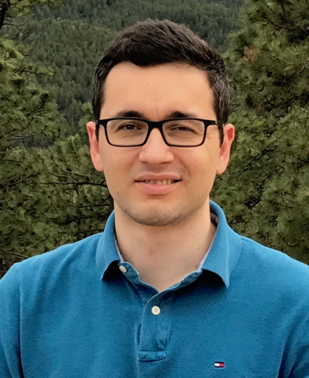
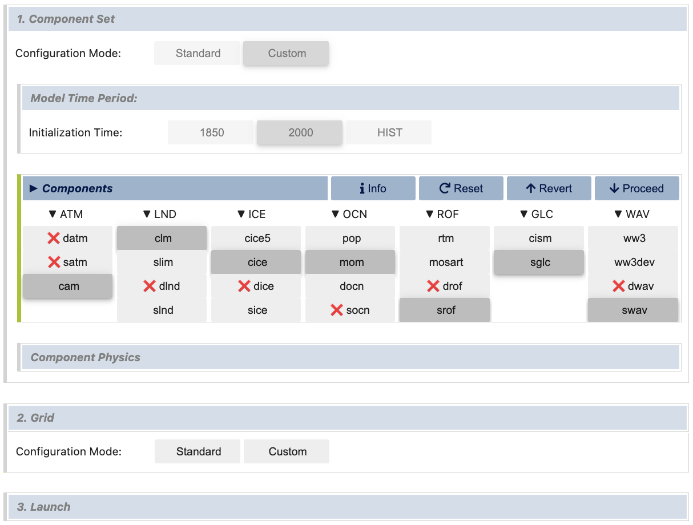
Ease-of-use: visualCaseGen
A user-friendly graphical interface (GUI) to assist users in creating CESM experiments
Key features:
Easy exploration and setup of CESM configuration options
Rapid generation of custom configurations:
Mix and match settings in a compatible manner
Create or interactively modify model grids
Alper
Altuntas

Slide 32
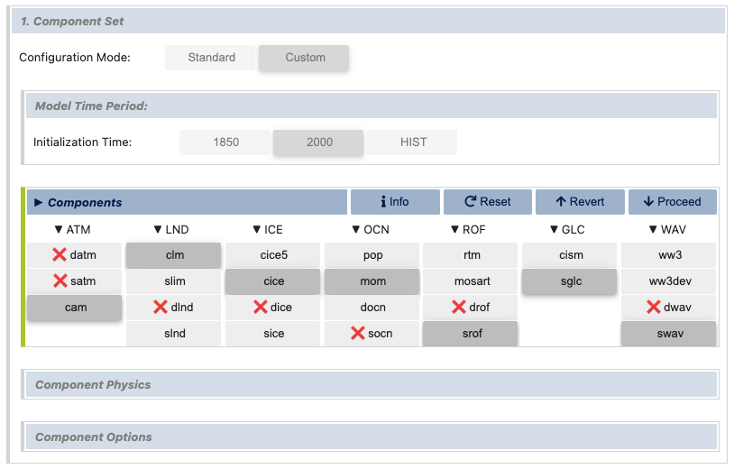
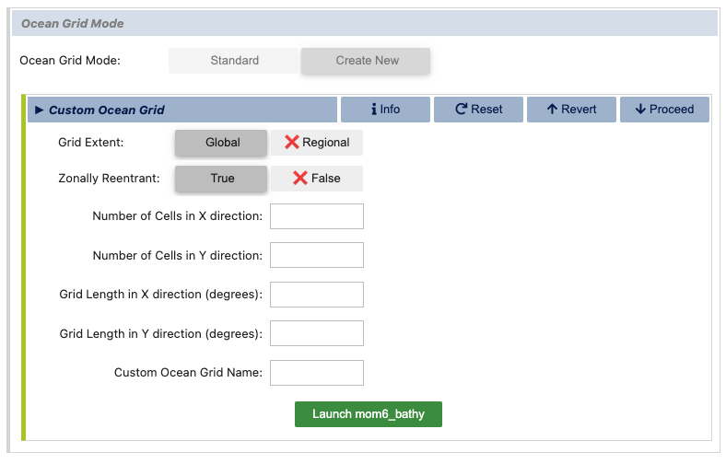
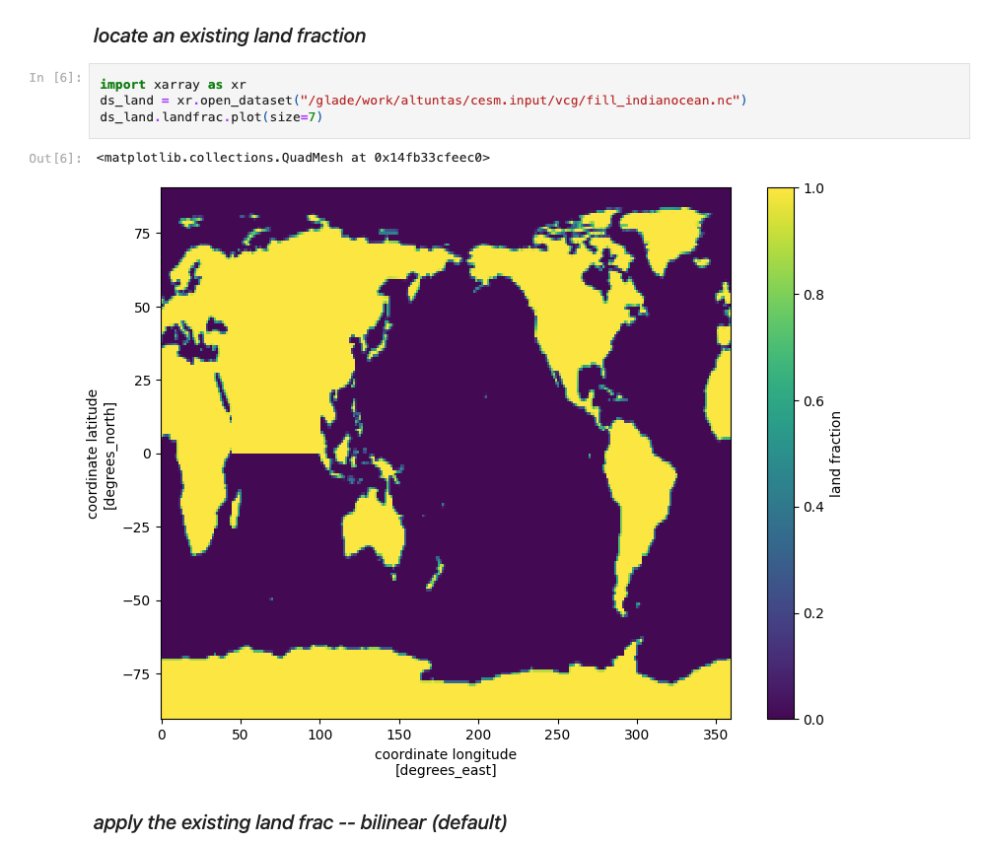
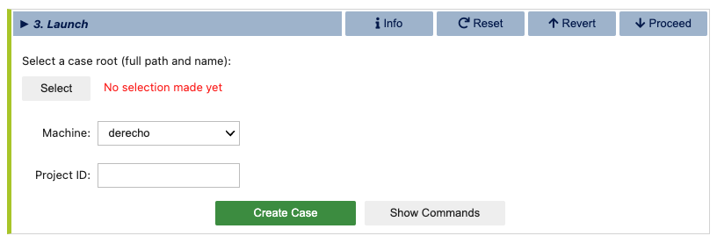
A typical visualCaseGen Workflow
1. Choose Components and Settings
2.a Choose/Create Model Grids
Alper
Altuntas
2.b Modify Grids
3. Create Case
Alper Altuntas

Slide 33
Ease-of-use: visualCaseGen
Useful for teaching
Substantial simplification in the setup of idealized configurations (e.g., in the ocean bathymetry, continental geometry, or land surface properties)
Ridge World: A coupled case with idealized bathymetry, continental geometry and land surface properties
Wu et al (2021) doi:10.1029/2021GL093966

Slide 34


Faculty Network for Teaching with CESM
Facilitates sharing of information and resources to help faculty best utilize CESM and its component models in their curricula
Survey to gauge needs/interest
70+ faculty responded
Pilot program with 5+ faculty in FY2026 to build out best practices with enhanced NCAR support
https://www.cesm.ucar.edu/classroom

Slide 35


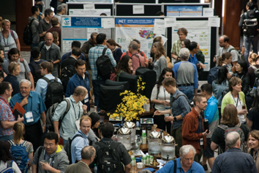
CESM’s success is driven by the strong participation of
an extended research community
NSF NCAR provides a collaborative hub, maintaining the CESM framework and fostering engagement with the science, development, and societally-beneficial applications of CESM through
Working Group management structure
Clear governance structures
Easy-to-use, flexible, open source, and portable model
Workshops and tutorials
Visitor programs
Collaborative and open model development
Lots of publicly available, easily accessible, and useful model output
Robust user and developer support

Slide 36
Lessons from the CESM experience:
Key to community modeling is to provide real, sustained, diverse, and productive opportunities for engagement to enable the community to participate as supported partners

Slide 37
Ownership
CLM5 paper: 40 out of 55 co-authors external to NCAR
CESM2 paper: 8 out of 31

Slide 38
Topics
DiscussCESM
Notion of supported configurations
Open process
Awards
Newsletter
Code standards
Documentation, publications
Portable model (including being strict about decisions about what packages to allow)
Ease of use (survey results), CaseGen tool, better naming of grids
CESM Faculty Community of Practice
Analysis tools
Calibration tools
Notes:
User base has grown and reaching new people

Slide 39
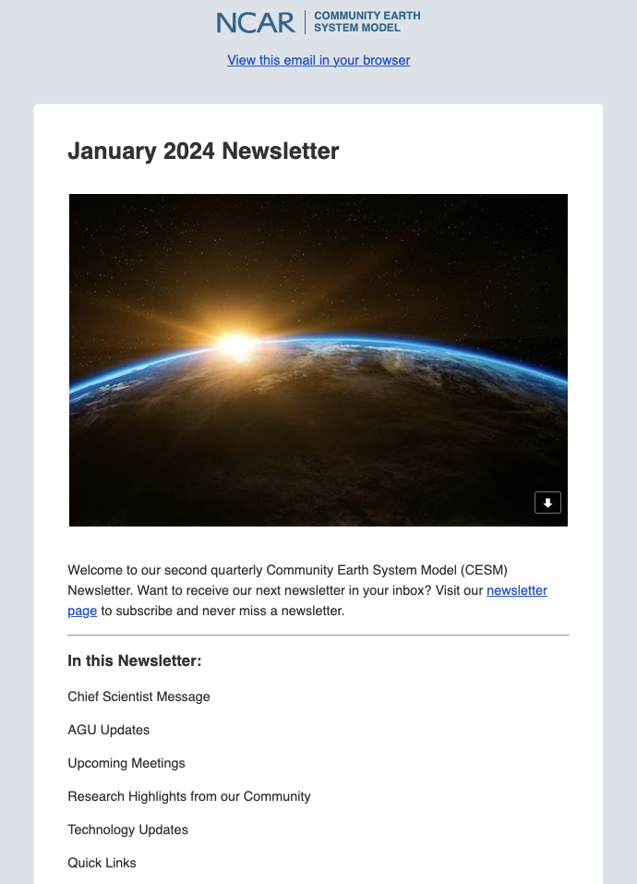

The CESM Newsletter
Additional way to communicate with CESM research community
Updates on events
Point users to new or under-advertised features of CESM
Research highlights from across community
Quick links to common pages (CGD Youtube, User support forum, Release pages, etc)
Scan QR code to sign up or visit cesm.ucar.edu

Slide 40

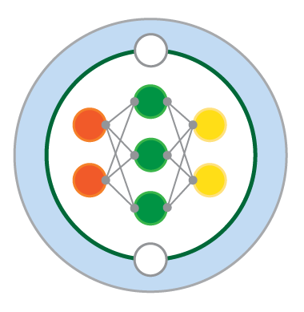




Towards a machine learning enhanced version of CESM (CESM3-MLe)
Learning the Earth with Artificial intelligence and Physics
NSF Science and Technology Center
M²LInES
Schmidt Futures
Robust and flexible Implementation of ML-based parameterizations requires Fortran-Python bridge
FTorch
FTorch implementation with CESM working fairly well
Needs an integration plan to bring fully into CESM3 infrastructure
Documentation
Testing, edge case evaluation
GPU-CPU combo testing
Ideally, some consistency across US modeling centers
ML-parameterization

Slide 41
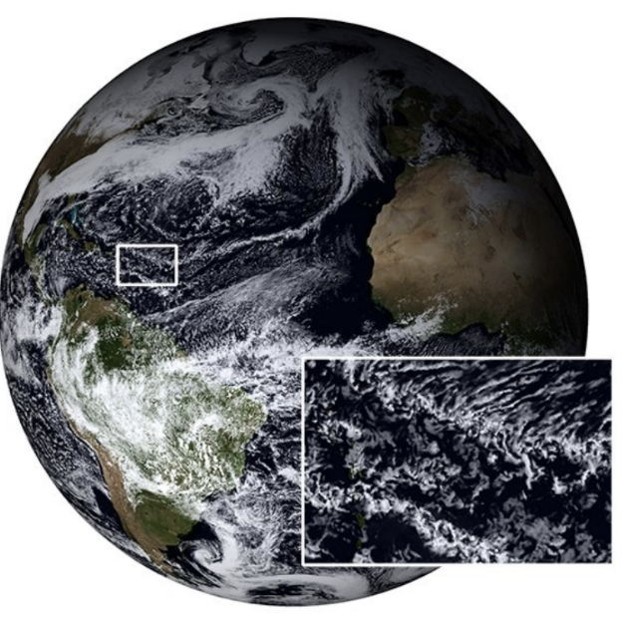
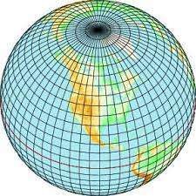
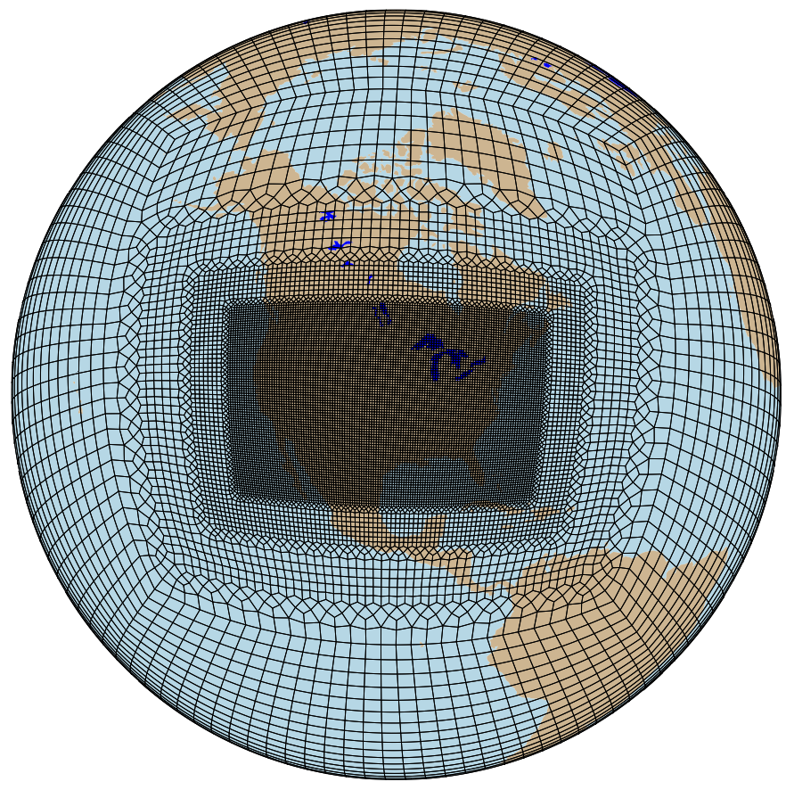
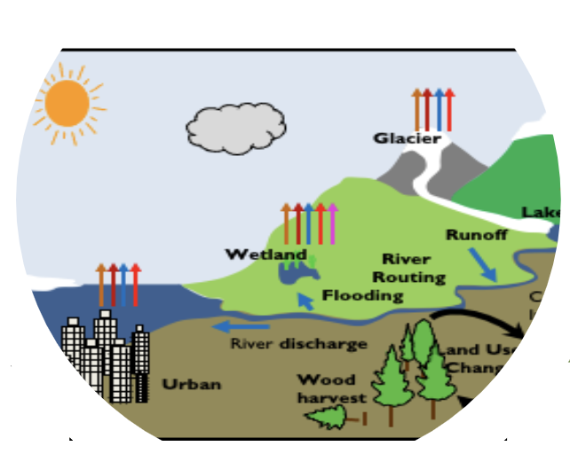
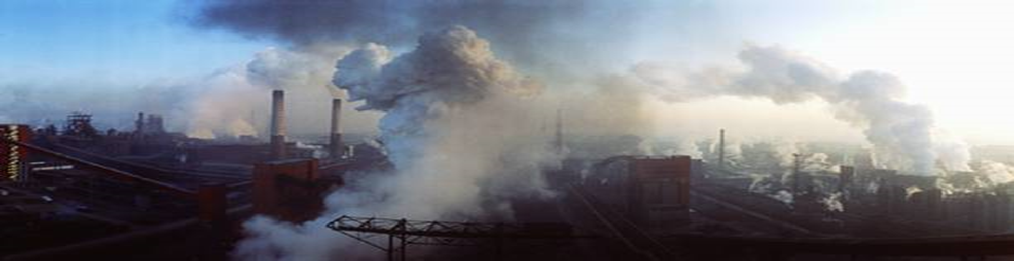
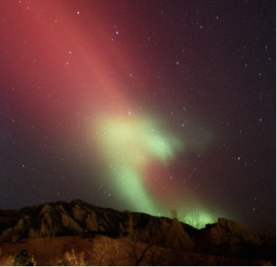
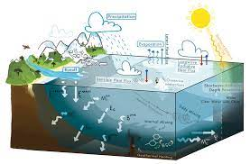
Unified modeling framework
“Pick and Choose” menu of options – All components interact and are ready to play
Global High Resolution
Global Low Resolution
Regionally- refined
Ocean
Land / Hydrology
Chemistry
Space Weather
Notes:
In order to provide some of the societally needed information, kilometer-scale simulations are sometimes needed. One of the key tools that NCAR has developed between 2024 and 2030 is a unified modeling framework that provided Earth system science and Earth system prediction capabilities from timescales from minutes to centuries and spatial scales from urban to continental & global scales, including complex representations of the land, cryosphere, ocean, marine biogeochemistry, chemistry in the atmosphere, etc, As a result of this framework, and inclusion of coupling at high resolution between the land, ocean and the atmosphere, we understand and can predict better tracks of Hurricanes, just like the one that’s passing through right now. Enabled by the high-resolution capabilities, connections to hydrological predictions and crop modeling, we are able to better understand and predict impacts on storm-related flooding, water quality and availability, and make predictions of what might happen to crops.
Via our hubs and developed connection with social scientists, NCAR has been able to stretch into areas on how these impact and interact with local communities.

Slide 42
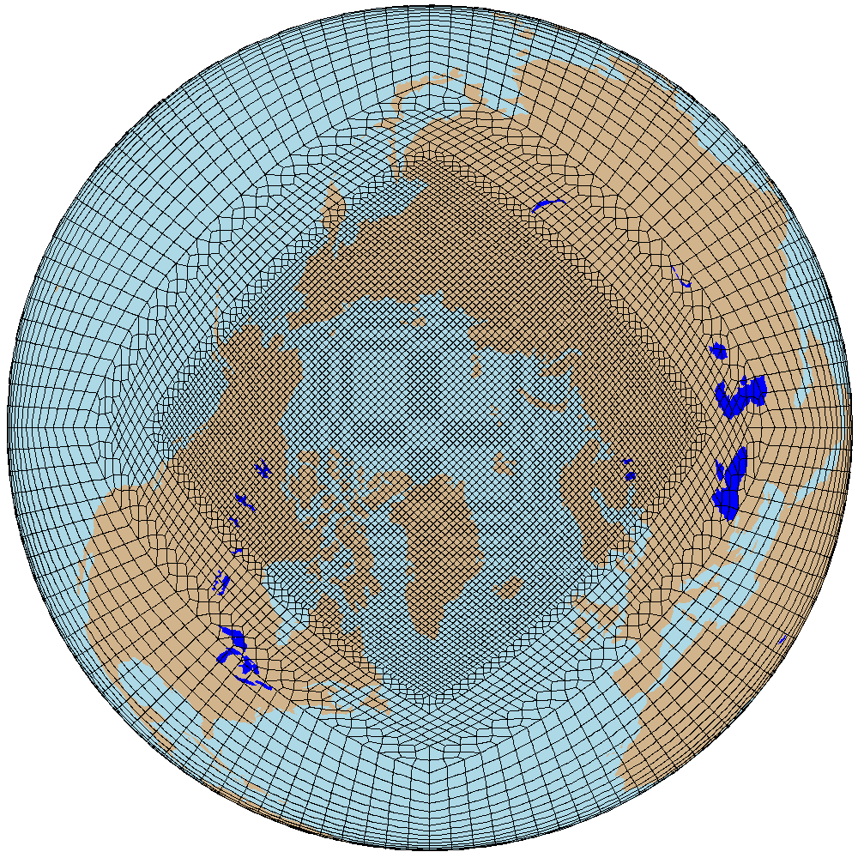
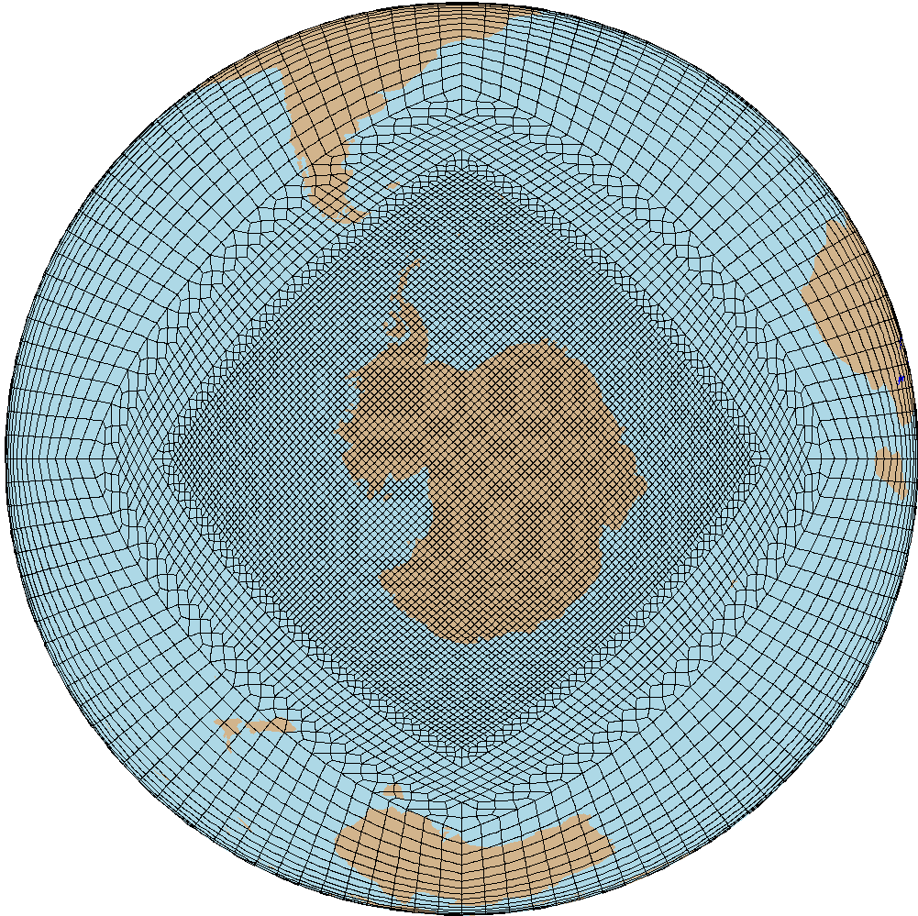
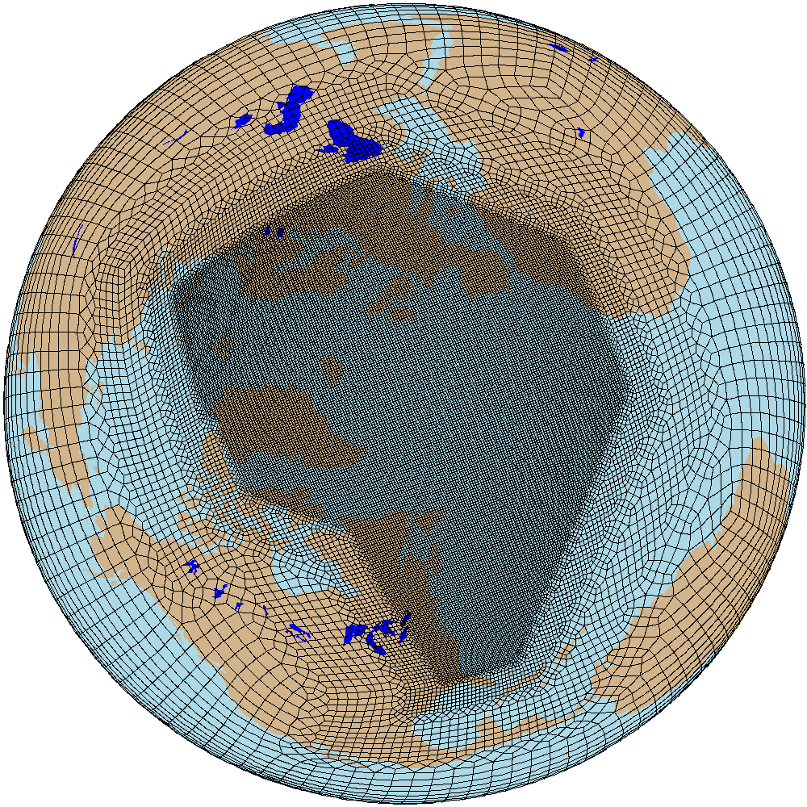
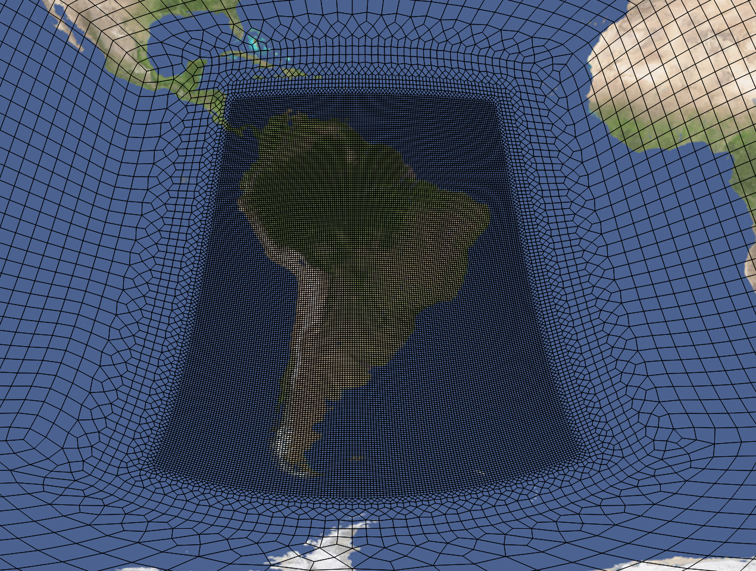
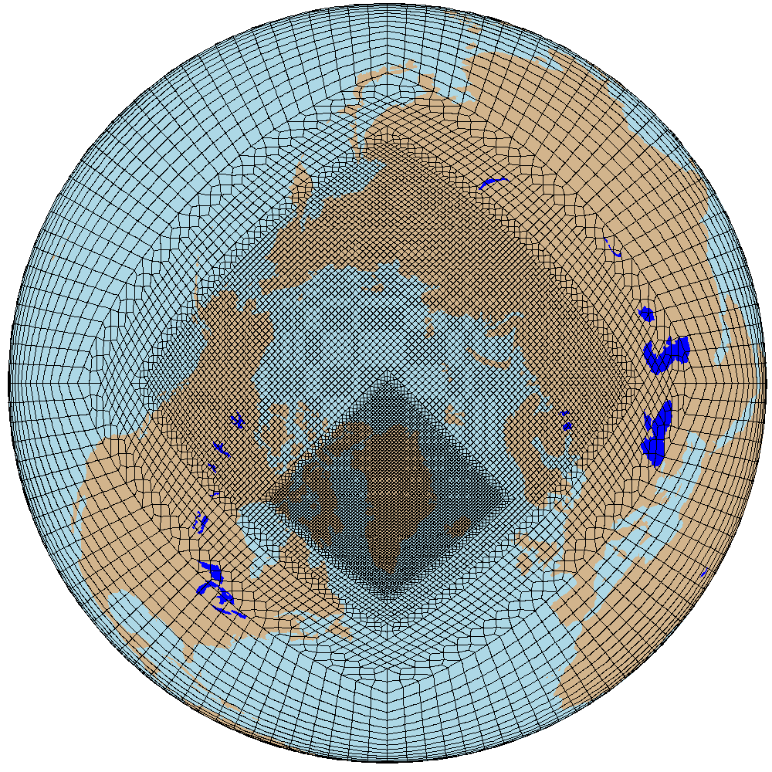
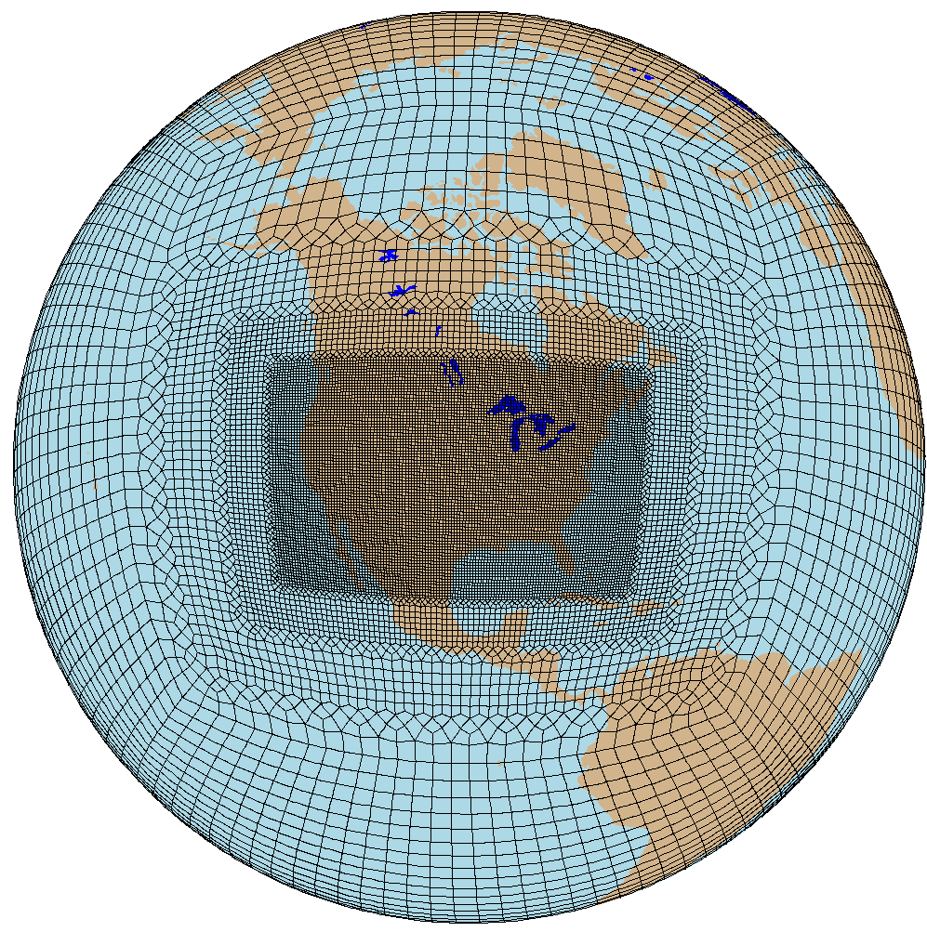
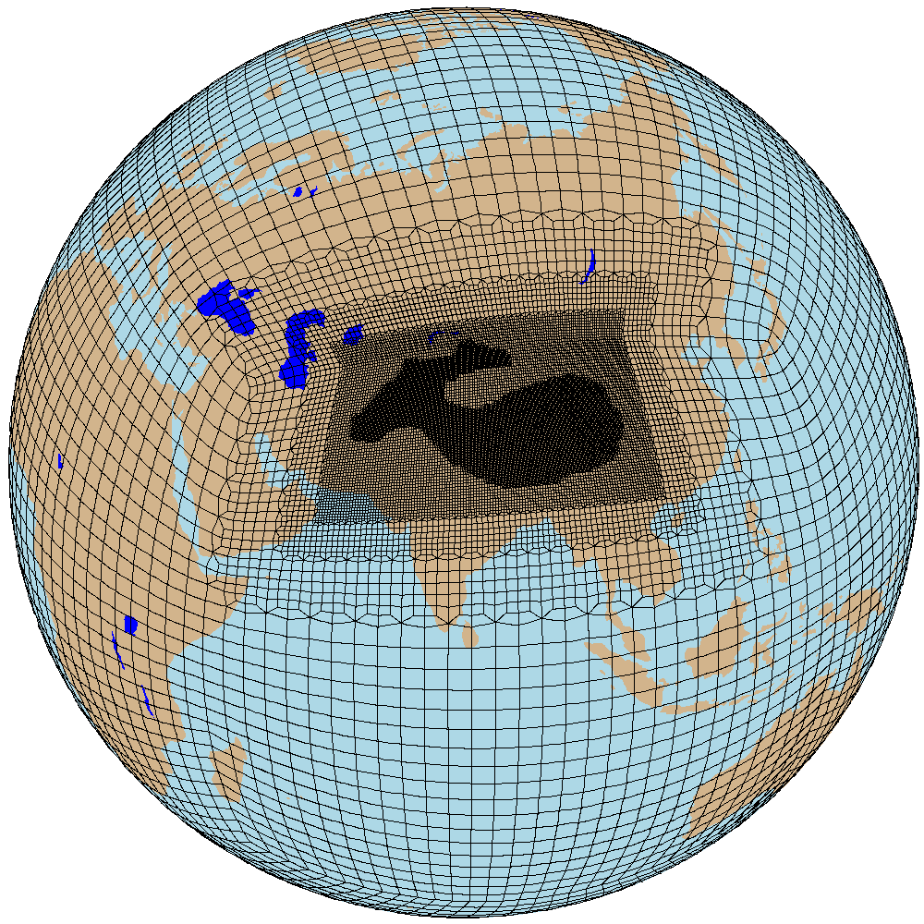
Variable-resolution spectral element (SE) dycore grids
CESM (w/ university collaborators) has developed a library of variable-resolution grids for various scientific applications
S. AMERICA 1/8˚, 1/16˚
ANTARCTICA 1/4˚
NATL 1/8˚
ARCTIC 1/4˚
ARCTICGRIS 1/8˚
CONUS 1/8˚
HMA 1/16˚
Herrington, Callaghan, Wijngaard, Datta, Wills

Slide 43
Working towards CESM3

Slide 44

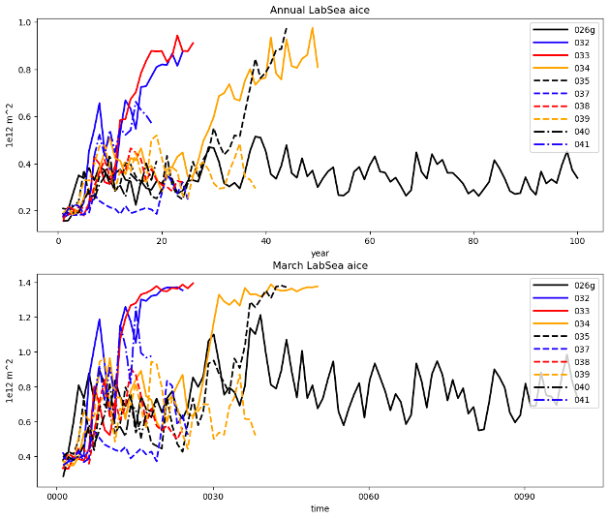
Earth System Model development is hard … and can be slow
Many interacting Earth System processes, requiring deep understanding and coordination across interdisciplinary teams
Targeting improved or good simulation of wide range of climate, weather, and Earth System features (ranging from SMB on ice sheets to net land C sink to reasonable ozone hole recovery to good ENSO behavior to …)
Complexity of CESM framework continually increasing
Expanding range of model applications drives diverse model development priorities
Unforeseen problems are the norm!
CESM3 test runs
Notes:
User base has grown and reaching new people

