Slide 1
UFS Coupling:
How the UFS Is Being Expanded to Include Additional Environmental Modeling Components
Overview of UFS components, their coupling, and highlights of newly developed capabilities
Ligia Bernardet

Slide 2
Background materials
Programmatic
UFS Strategic Plan 2021-2025
UFS Organization and Governance 2021 (draft)
Technical
Dunlap et al. (UFS SAICCT), 2021. UFS Architecture Diagrams
Wang, J. et al. , 2023. Model infrastructure development in UFS weather model
Worthen, D. et al., 2024. Coupling Infrastructure Capability in UFS Weather Model
Thanks for fruitful discussions: Jun Wang, Dustin Swales, Becky Schwantes, Pedro Jimenez, Hendrik Tolman, Brian Dobbins, Ann Tsay, ESMF Team, and many UFS colleagues

Slide 3
UFS Weather Model Components
Mediator: CMEPS
Data Models: CDEPS
Sea ice: CICE6
Waves: WW3
Fire: Community Fire Behavior Model
Atmosphere: FV3 and MPAS dycores, CCPP and Stochastics Physics, WAM
Land: LM4, Noah MP (but also RUC, Noah, and NoahMP as CCPP parameterizations)
Ocean: MOM6, ROMS (HYCOM being phased out)
Coastal: ADCIRC, SCHISM
Lakes: FVCOM (and CLM Lake as CCPP parameterization)
Aerosols and Chemistry: CMAQ, GOCART, CATChem (GFDL AM4.1)
Note that some components are not part of the authoritative UFS WM but are used by UFS Apps
Notes:
SCHISM has been implemented by Dr. Joseph Zhang (College of William & Mary) and other developers around the world, and licensed under Apache. SELFE was developed at the Oregon Health Sciences University. However, there are now significant differences between the two models.
SCHISM (Semi-implicit Cross-scale Hydroscience Integrated System Model) is an open-source community-supported modeling system based on unstructured grids, designed for seamless simulation of 3D baroclinic circulation across creek-lake-river-estuary-shelf-ocean scales.

Slide 4
UFS Components Outside of Weather Model
Coupling exchange via disk or in-core
Pre-processing: UFS-UTILS
Data Assimilation: JEDI
Post-processing: UPP
Vortex tracker: GFDL
Verification: METplus
I/O: ESMF Write Grid Component
(...)
Workflow: global workflow, RRFS workflow, HAFS workflow, SRW App workflow, Unified Workflow Tools, and others

Slide 5
Why Does the UFS have (sub) Components?
Harness existing community efforts
Enable hierarchy for scientific and software tests
Provide flexibility of applications
Short-Range Weather (RRFS): atm
Hurricane (HAFS): atm and ocean
Medium-Range Weather and S2S (GFS/GEFS/SFS): atm, ocean, sea ice, waves
Air Quality (AQM): atm + CMAQ
Coastal: DATatm + SCHISM + WW3 and other configurations
Etc.

Slide 6
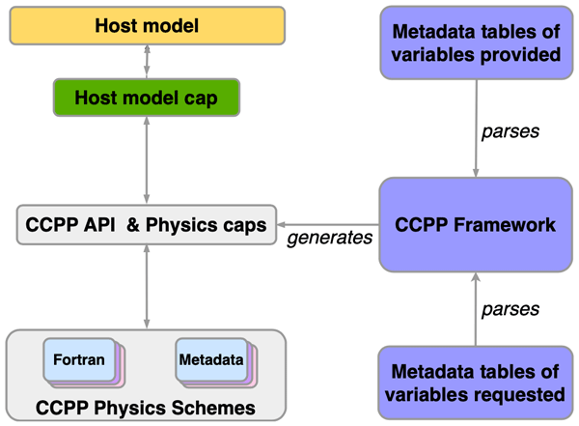
Coupling Strategies: Intra-component
Multi-agency: DTC, NOAA, NCAR
Navy
The CCPP Framework is used to couple physics to the host model
From Heinzeller et al., 2023

Slide 7
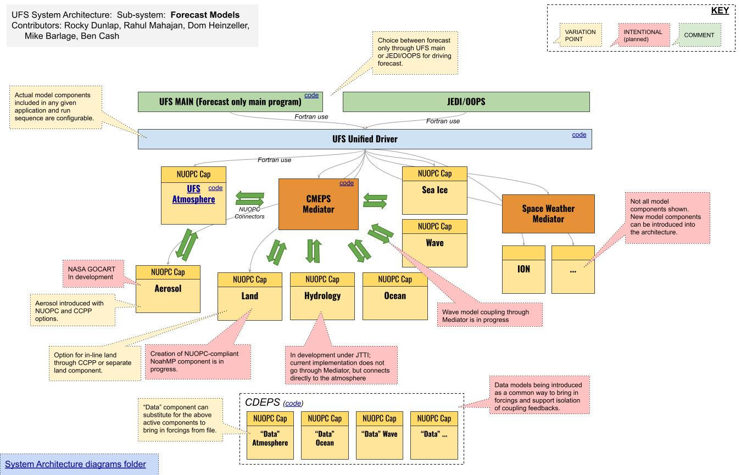
Coupling Strategies: Inter-Component with ESMF
Multi-agency: NOAA, NASA, NCAR, Navy
NUOPC Layer extends ESMF for more interoperability
CMEPS is a NUOPC-compliant mediator that standardizes coupling science

Slide 8
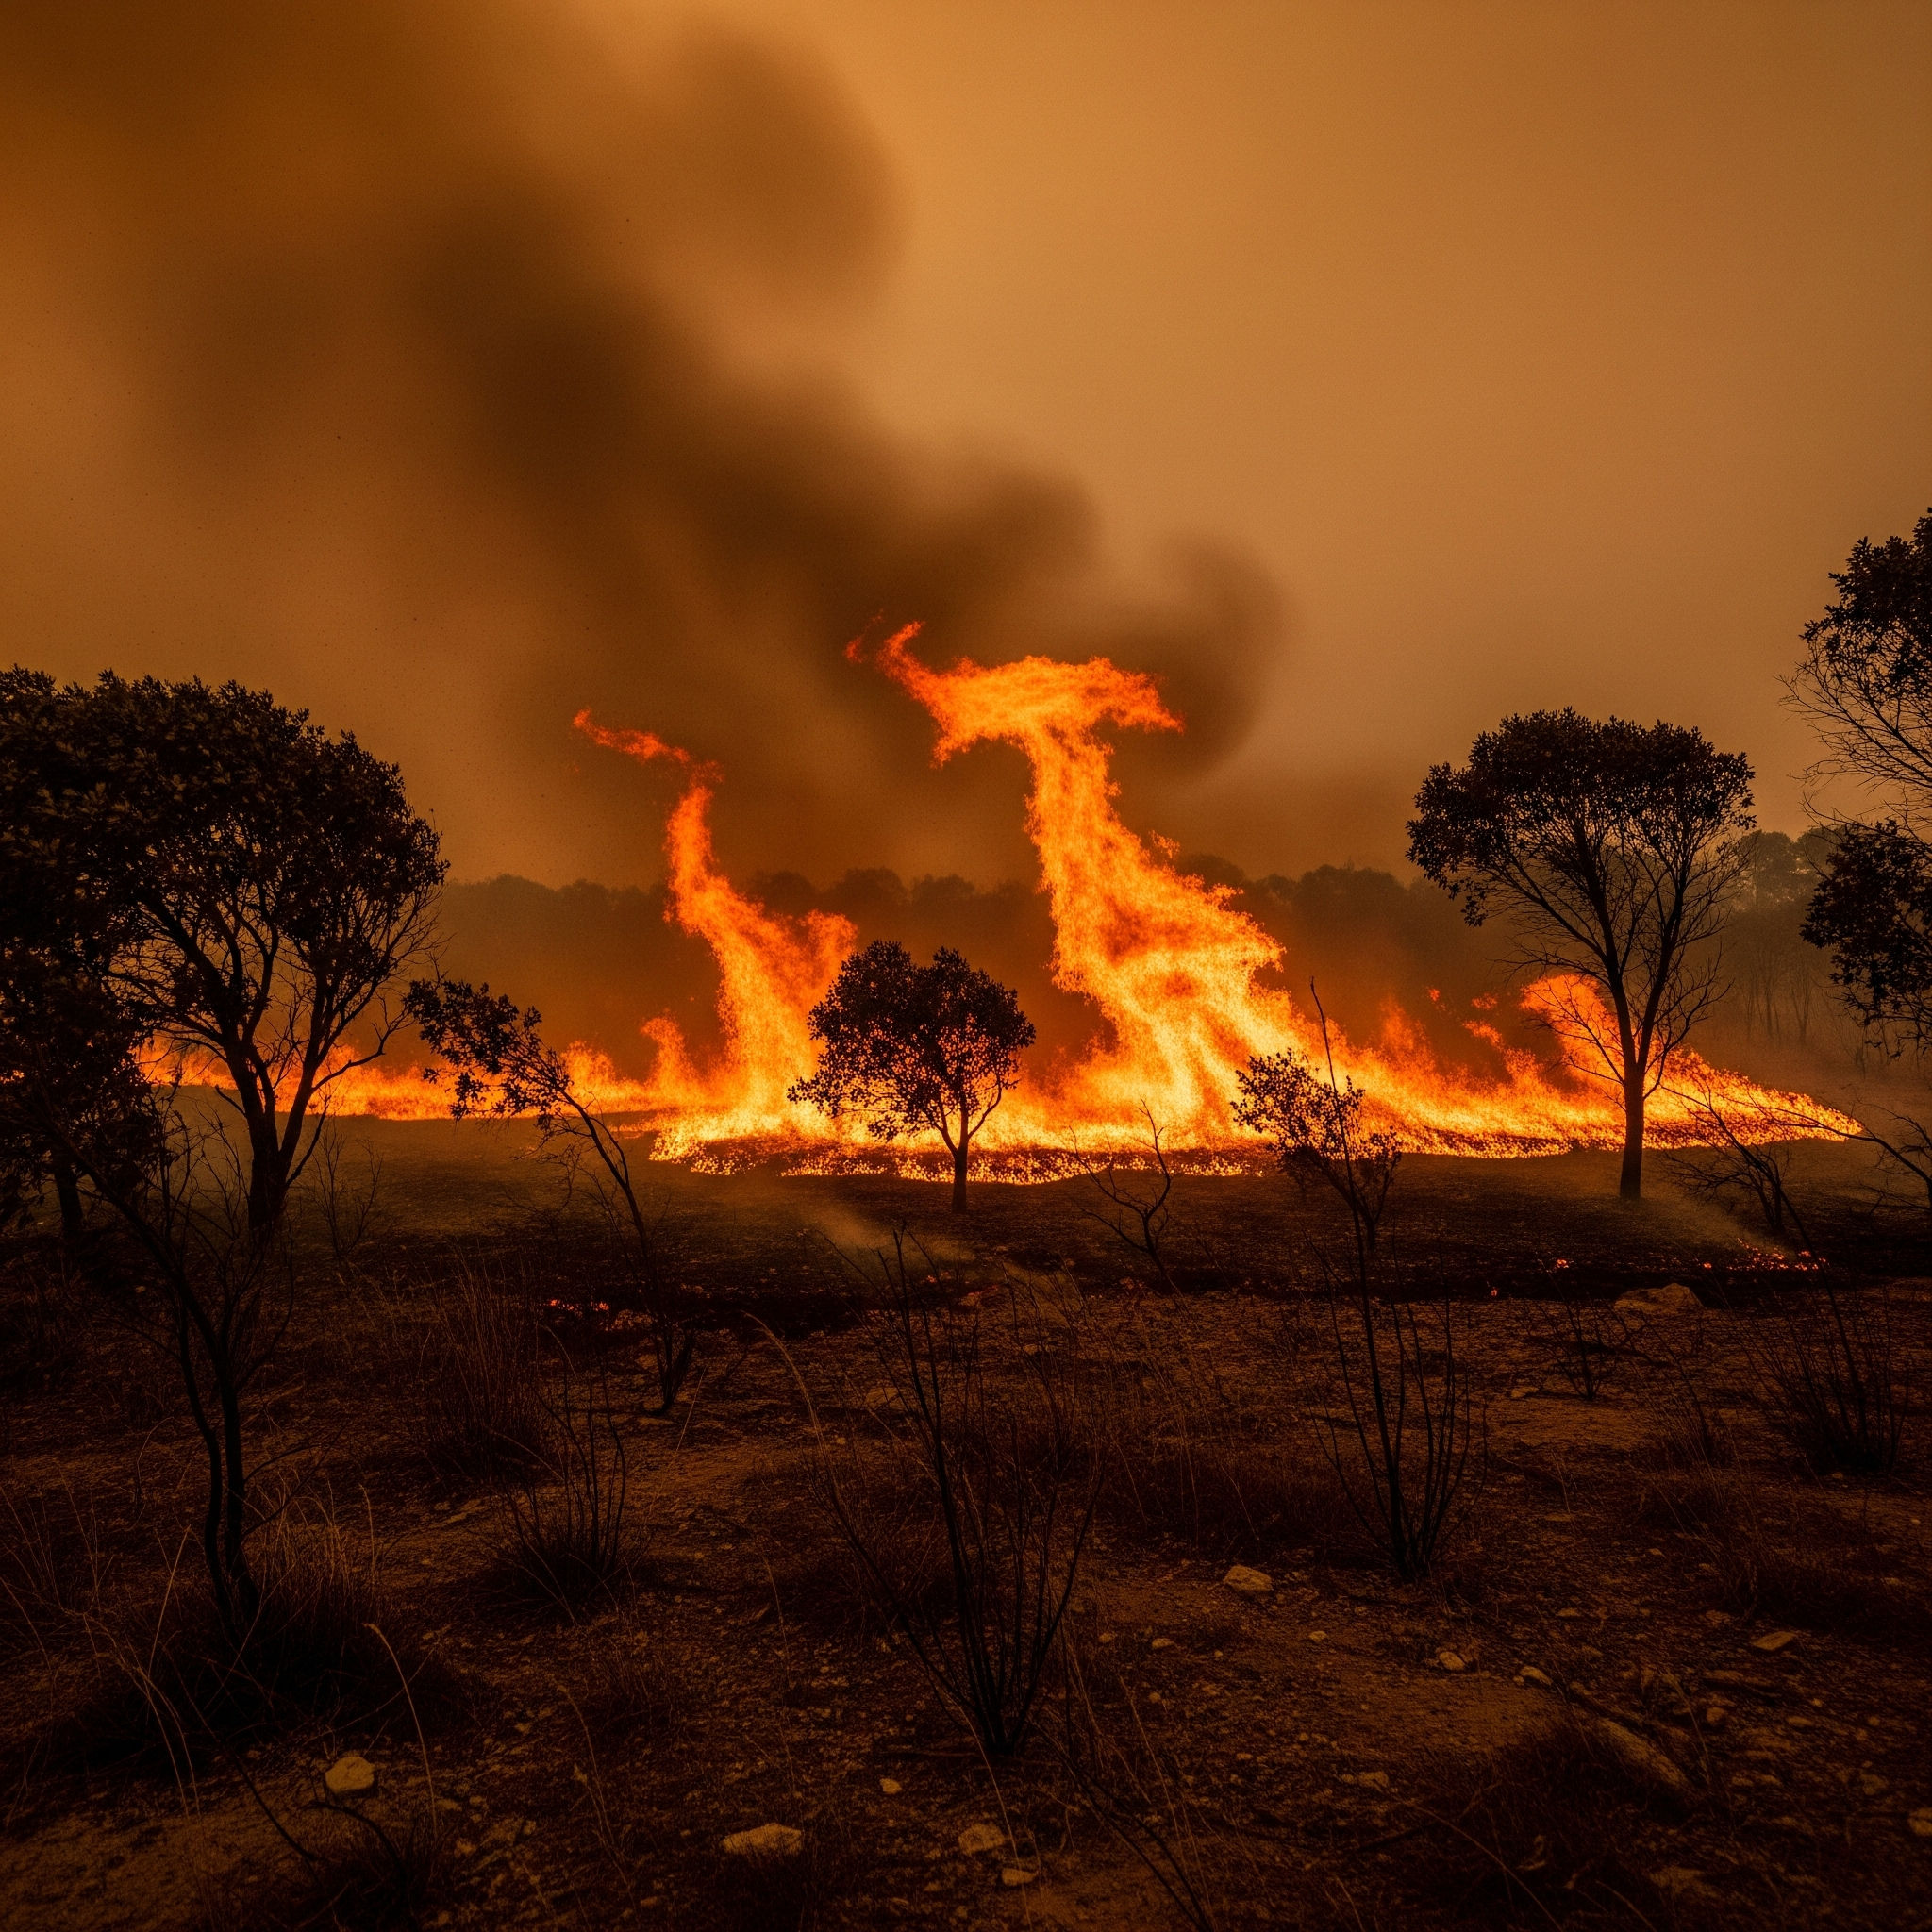
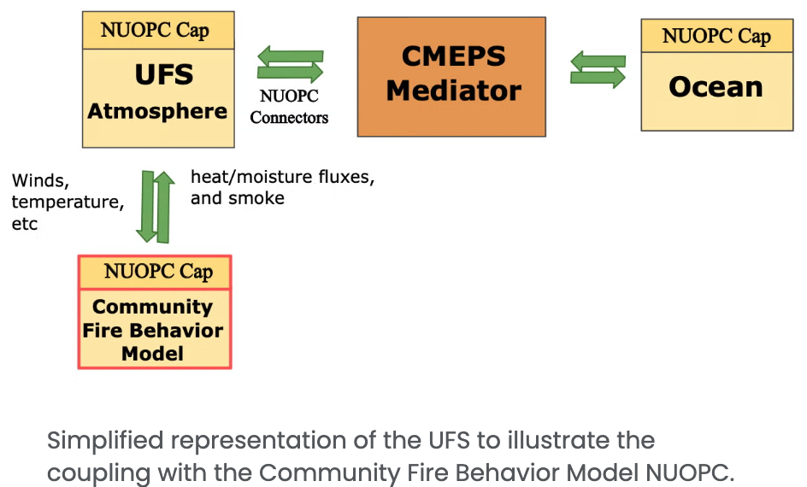
New (1) : Fire Behavior Model
See P. Jimenez talk Thu 10:45 AM
Jimenez et al., 2025. https://doi.org/10.5194/gmd-2024-124 (led by NCAR)
By Gemini
https://ral.ucar.edu/model/community-fire-behavior-model#ufs3

Slide 9
New (2): MPAS dycore (Led by DTC and GSL)
See Thu 1 PM SRW Session & 3:30 PM MPAS Panel
Under development: UFS Weather Model with MPAS dycore
BEFORE
AFTER
FV3-ATM NUOPC Cap
UFSATM NUOPC Cap
ESMF fcst grid comp
FV3-ESMF fcst grid comp
MPAS-ESMF fcst grid comp
FV3ATM Driver
FV3ATM Driver
MPASATM Driver
FV3 dycore
CCPP Physics
FV3 dycore
CCPP Physics
MPAS dycore
Schematic courtesy of Dustin Swales (NOAA GSL and DTC)
Notes:
The physics-to-dynamics coupling occurs at the atmospheric driver level.
There are then two overlying infrastructure layers:
ESMF layer, which couples to the atmospheric driver.
NUOPC Cap, which interfaces with the underlying ESMF infrastructure layer.
The atmospheric driver contains the pieces to advance the ATM forward in time (e.g. call radiation, call physics, call dynamical-core)
The ESMF layer defines the “Entry points”, or wrappers to contents of the atmospheric driver (e.g. Call forecast_phase1, which contains calls to radiation and physics, for example).
Build System (CMake)
Build MPAS dynamical core.
Build CCPP Physics and link to MPAS.
Runtime (ATM driver)
Initialize MPAS dynamical core.
Initialize CCPP Physics
Run forecast phase(s)
Finalize model

Slide 10
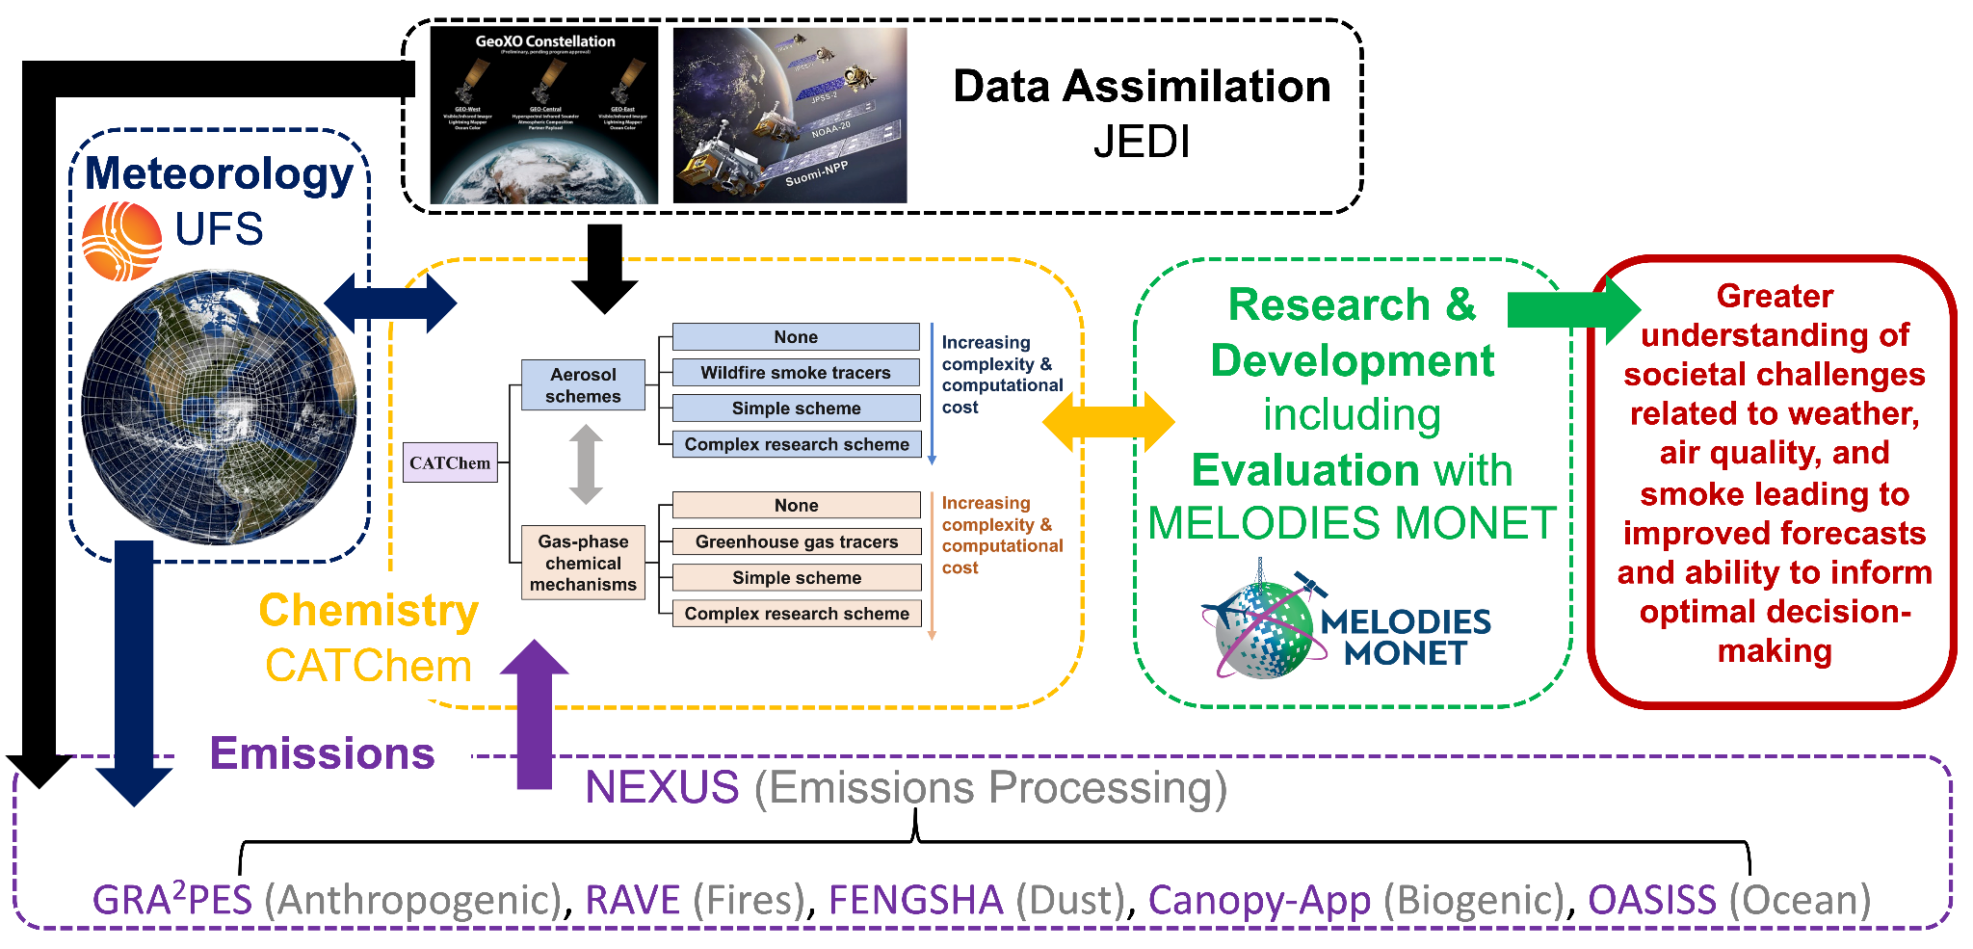
New (3): CATChem - under development
See B. Baker Thu 1PM AQ Session
Chemistry library and modeling component
All UFS chemistry-
related code in one location
CATChem will be coupled to the UFS WM using CCPP and/or NUOPC
Led by NOAA Labs
He et al., 2025
Notes:
Configurable ATmospheric Chemistry (CATChem)

Slide 11
What is Involved in Adding New Components
Projects via funding agency (e.g., NOAA OSTI/WPO/CPO)
Application targets (need for research and/or operations)
Scientific innovation
Collaboration with ESMF coupling team
Do no harm
RTs (including on computational expenses and robustness/reliability)
Backwards compatibility
Concurrence for anything that hampers operations
Coding Standards (purview of the component)
Ownership: designated entity responsible for its maintenance

Slide 12

Final Remarks
The UFS is under active development with new components recently added
Keys to having an efficient and effective coupled system
Effective technical coupling
Effective governance
Complexity brings power
Complexity increases maintenance overhead
By Gemini

