Slide 1

Welcome to the
Unifying Innovations in Forecasting Capabilities Workshop
September 10, 2025
A Unified Forecast System (UFS) Collaboration Powered by the Earth Prediction Innovation Center (EPIC)
Center Green Auditorium, Boulder, CO

Slide 2
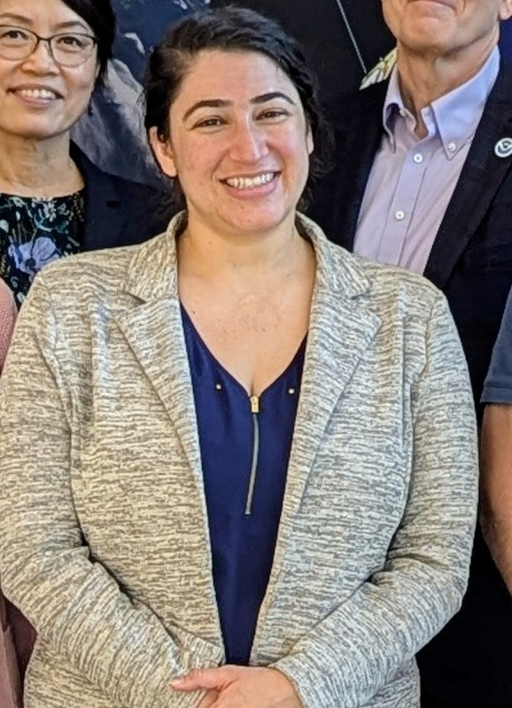
Today’s Master of Ceremonies
Shira Francis
Deputy Program Manager
NOAA/NWS/OSTI-M/IBSS

Slide 3
Live Streaming Announcement
The UIFCW is an open event that will be live-streamed online and recorded. By staying in the room (and online), you understand that your image, in video or still, and any sound recorded alongside it, will live-streamed over social media and recorded. The videos will be submitted to NOAA for review before sharing publicly. The information that you provide will be used for websites, agenda's, and event descriptions.
For more information on NOAA's Privacy policy: https://www.noaa.gov/sites/default/files/legacy/document/2021/Mar/NOAAPrivacyPolicy_Final_May2017.pdf

Slide 4
Wednesday, September 10th
09:00 AM – 09:05 AM – Welcome
09:05 AM – 09:20 AM – NOAA-Current Status and Priorities (High-level overview)
09:20 AM – 10:20 AM – Student/Lapenta Presentations
10:20 AM – 10:45 AM – Break (Student/New User Session Begins)
10:45 AM – 11:15 AM – UFS Community Social Science Survey Results
11:15 AM – 12:00 PM – UFS Coastal Project Overview
12:00 PM – 01:00 PM – Lunch

Slide 5
Wednesday, September 10th
01:00 PM – 03:00 PM – Parallel Sessions with Q&A:
UFS Application-Global Applications Across Scales
(South Bay Auditorium)
Cross-Cutting - Data Assimilation
(Center Bay Auditorium)
03:00 PM – 03:30 PM – Break
03:30 PM – 05:00 PM – Emerging Technologies: AI / ML
05:00 PM – 05:45 PM – Creating Better Feedback Loops Between Users and
Developers Panel Discussion
05:45 PM – Adjourn

Slide 6
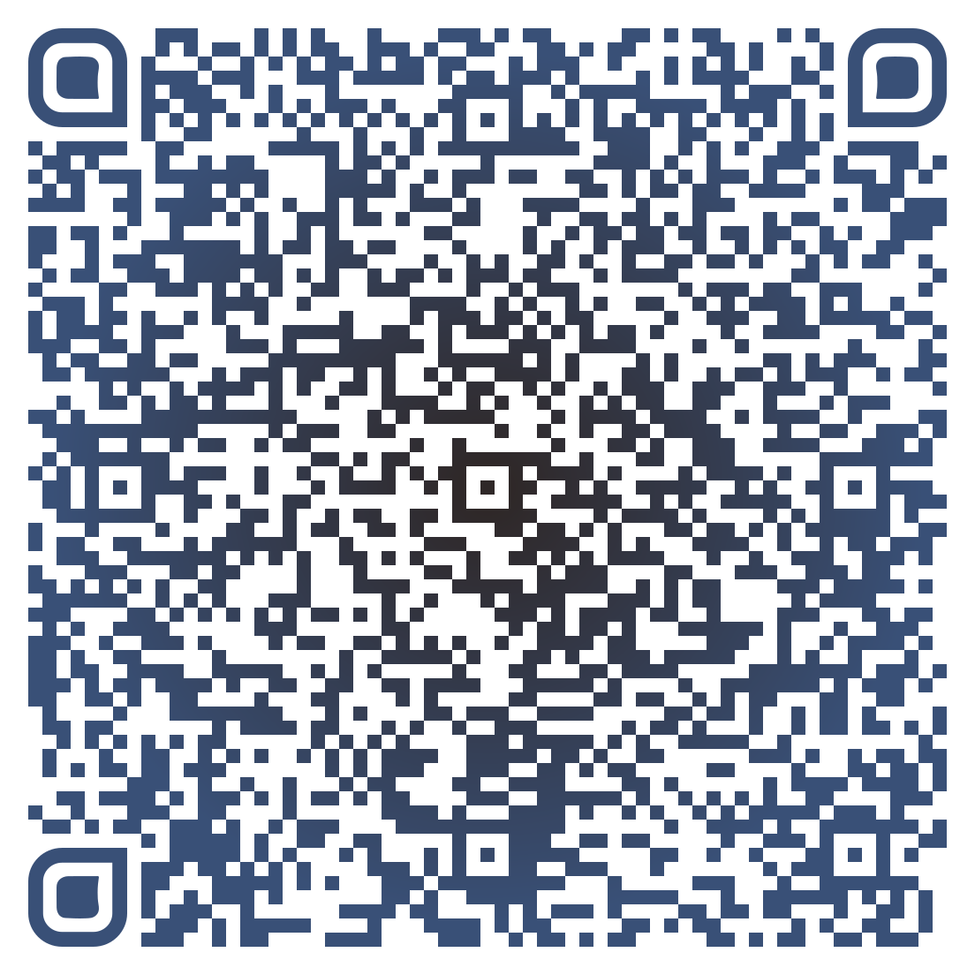



Connect With Us!
Participant Guide
Connect with us on Slido, X, and Instagram
Access Slido & the Livestream from the UIFCW Event Page:
@NOAAEPIC
#UIFCW25
Wi-Fi: UCAR Visitor
No password is required.

