Slide 1
The UFS Student Experience:
Accomplishments, Challenges, and
Recommendations
Rowin Smith
2025 Lapenta Intern
Center Green Auditorium, Boulder, CO
September 8-12, 2025

Slide 2
The UFS Student Ambassador Program
Goal: Get students interested in earth systems modeling
Technical Path
Engagement Path
Created a tutorial using the SRW to model severe weather
Provided feedback to the UFS development team
Created a post-tutorial survey
Created a social media campaign to promote the UFS and NOAA internships to students
Helping host the UFS workshop this fall and presenting my work
Notes:
Spell out the acronyms the first time the first time you mention it
The UIFCW is for the UFS community, not an EPIC conference
First year we’re doing a student track at the UFS workshop
Explain the what the tutorial is and why it is valuable

Slide 3
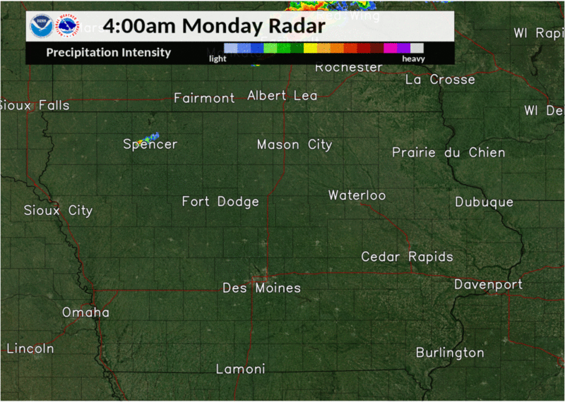
Overview of Test Case
Chose to use a derecho
Based on work done in (Gallus Jr. and Harrold 2023)
above: radar loop of the August 10, 2020 derecho

Slide 4
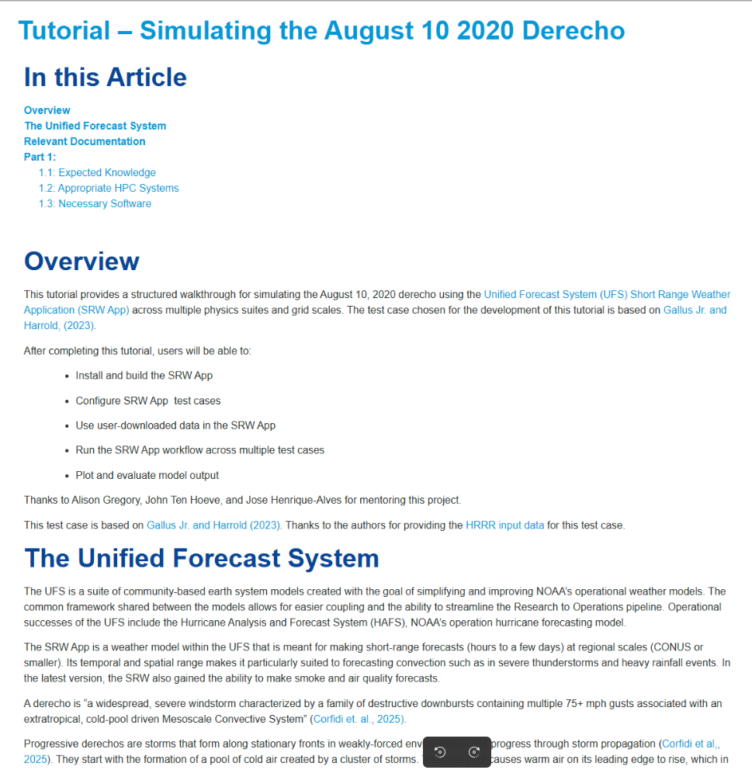
The SRW App Tutorial
Uses the Short Range Weather model
Four different test cases
Users will then be able to run their own forecast cases
Includes a feedback survey

Slide 5
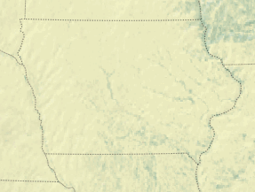
The SRW App Tutorial

Slide 6
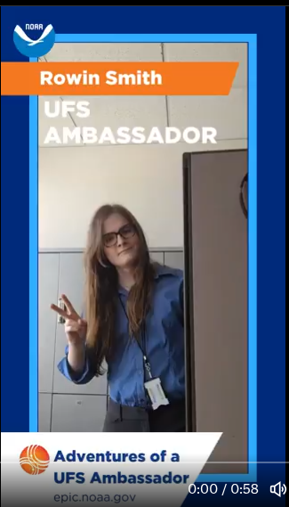
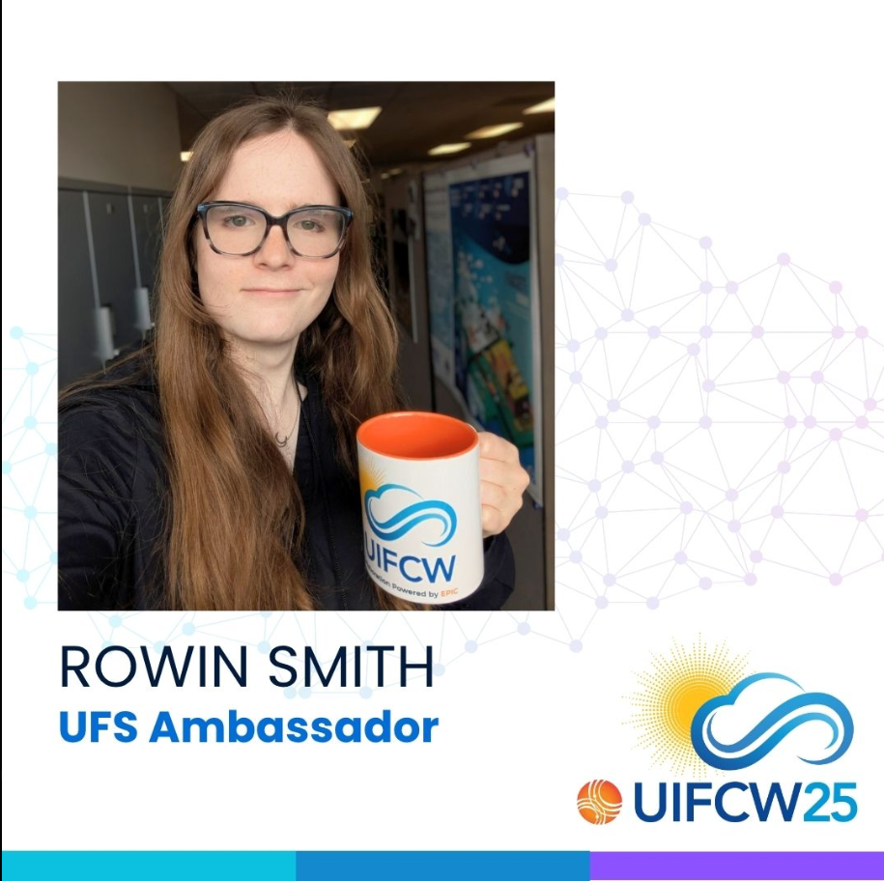
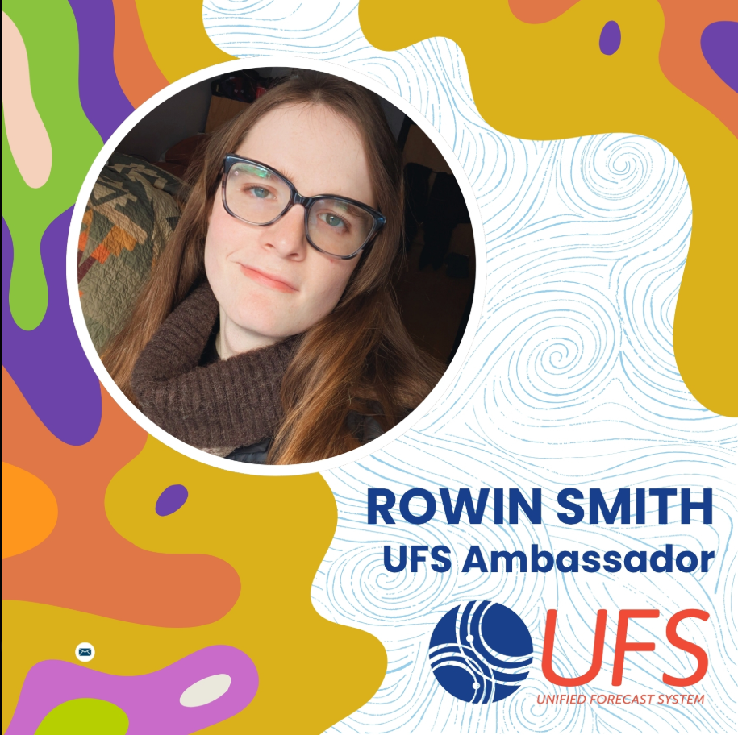
Social Media Campaign
‘Lapenta Live’ theme
Weekly series of posts
Promotes both the UFS and NOAA internships

Slide 7

Challenges
Technical Path
Engagement Path
Complexity of the UFS software
Unexpected bugs
Limited configurability
Container portability
Limited reach of EPIC social media
Lack of peers engaging with the UFS
Notes:
-Cut out names on edit logs
-Video with genealogical tree instead of

Slide 8
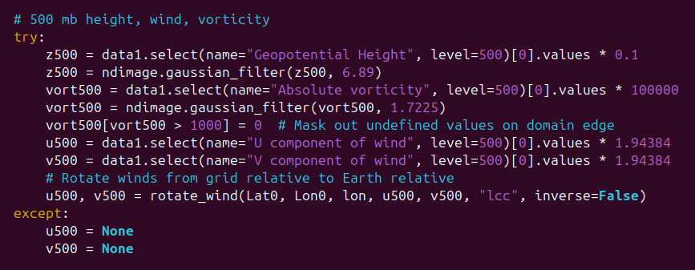
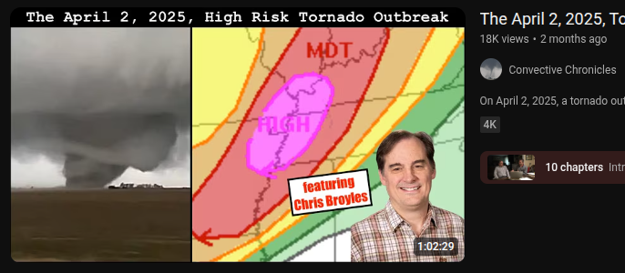
Lessons Learned
Technical Path
Engagement Path
Students need direct support
Cleaner code and more extensive documentation
Work with existing influencers
Increase direct engagement with departments
Notes:
-

Slide 9
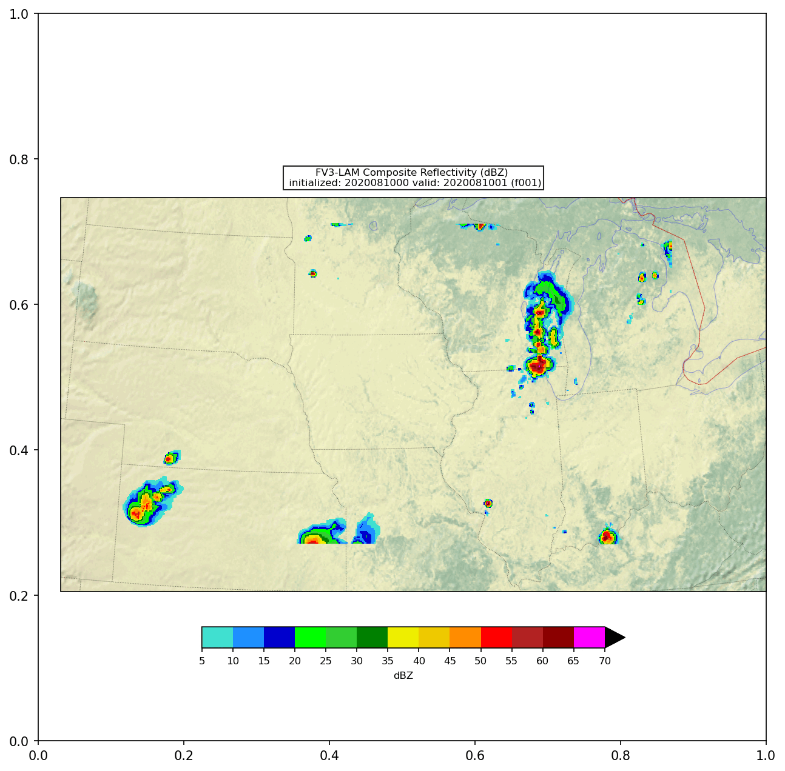
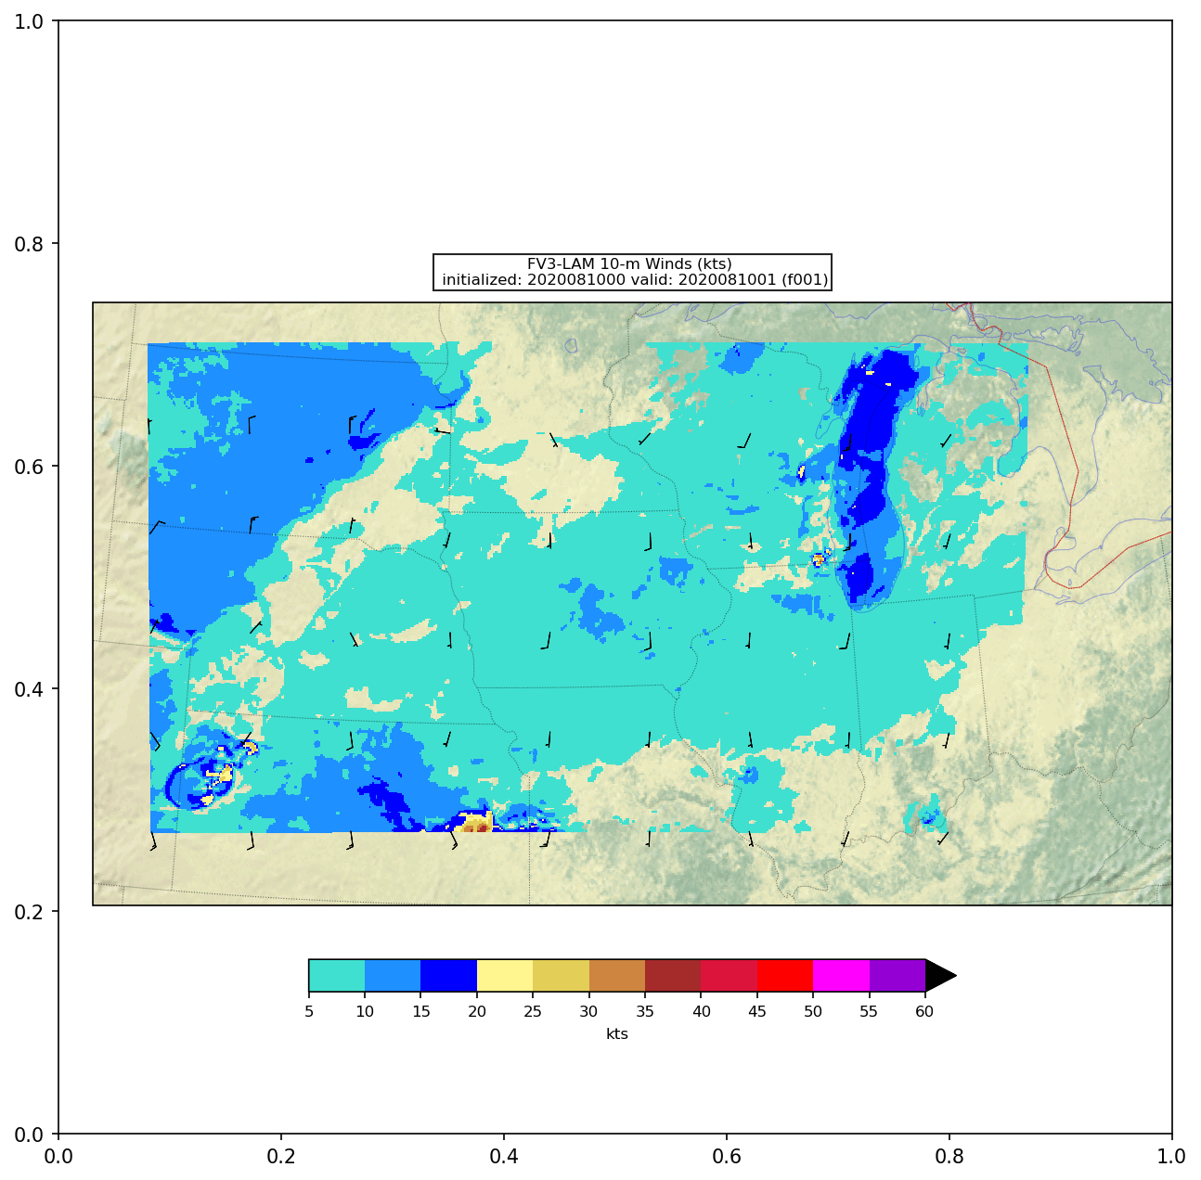
Personal Impact of UFS
Using the UFS has empowered me to do further research

Slide 10
Acknowledgements
Alison Gregory, Jose-Henrique Alves, John Ten Hoeve
Priya Pillai, Adam Clark, Jen Vogt, Charlene Barone
Bill Gallus and Michelle Harrold
UCAR
Everyone who provided feedback

Slide 11
