Slide 1
AEROSOL DATA ASSIMILATION USING GLOBAL CHEMISTRY AND AEROSOL FORECAST SYSTEM (GCAFS)/JEDI
Speaker: Michael Kwadwo Benneh* ¹
Contributors: Cheng-Hsuan Lu ^{2,3}, Shih-Wei Wei ^{2,3}, Aara’L Yarber ¹, Cheng Dang ², Cory R. Martin ⁴, Andrew Tangborn ⁴, Sen Chiao ¹
¹ NOAA Cooperative Science Center for Atmospheric Sciences and Meteorology, Howard University, Washington, DC 20059, USA
² Joint Center for Satellite Data Assimilation, UCAR, Boulder, Colorado 80301, USA
³ Atmospheric Sciences Research Center, State University of New York at Albany, Albany, New York 12226, USA
⁴ NOAA NWS NCEP Environmental Modeling Center, College Park, MD 20740, USA

Slide 2
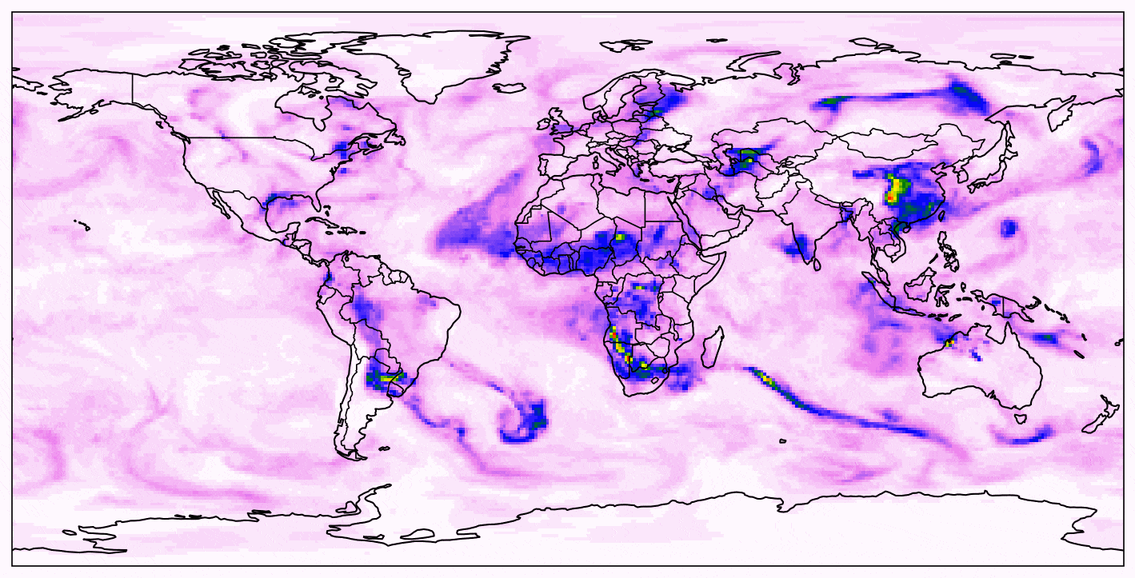

An Introduction to Aerosol Forecasting
Aerosols - fine, solid or liquid particles in the atmosphere (e.g., dust, smoke, pollution, sea salt).
Impacts on forecasts:
Weather: Modifying radiation balance, cloud formation, and precipitation patterns.
Air quality: Affect PM2.5/PM10 concentration, health, and visibility.
Forecasting challenges:
Accurate aerosol forecasts require realistic initial conditions (ICs).
IC’s can often be biased due to sparse in-situ observations and model limitations.

Slide 3
Goal and Objective
Goal:
Demonstrate the current aerosol data assimilation (DA) capabilities of NOAA’s GCAFS/JEDI and establish a foundation for the next phase, i.e., develop a framework to extend the system toward vertical profile-level assimilation for improved aerosol representation in initial conditions and forecasts.
Objectives:
Phase I – Assimilation of VIIRS AOD:
Assimilate NOAA VIIRS aerosol optical depth (AOD) observations to constrain aerosol fields in the model’s initial conditions (ICs).
Evaluate model performance post-assimilation using independent observations and MODIS to quantify improvements in forecast accuracy.
Phase II – Vertical Profile Comparison:
Compare model vertical profiles with CALIOP extinction coefficient profiles.
Analyze concentration differences and identify representative discrepancies between
modeled and observed vertical structures.

Slide 4
Model Setup and DA Method
Option | Model
CCPP | FV3-GFS-v17-coupled-p8
Land Surface | Unified Noah Land Surface Model
PBL | Saturated Eddy-diffusivity Mass-Flux scheme
Chemistry | GOCART
Fire emission | QFED
Microphysics | Thompson microphysics
Radiation | Rapid Radiative Transfer Model
Model - GCAFS - weakly coupled model
Assimilation framework - JEDI
Domain/resolution - Global, C96 = 1 degree~100km
Forecast length - 6h/cycle for 16 days
Control - UFS forecast with regridded MERRA-2 data into IC’s
Assimilation method - 3DFGAT

Slide 5
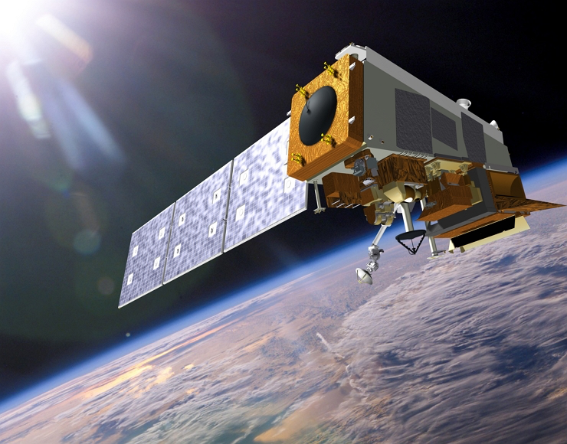
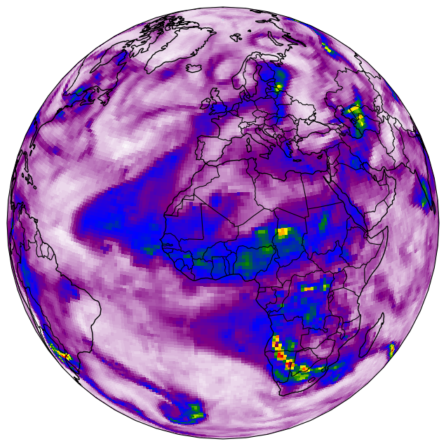

DA Method: 3DFGAT
NOAA VIIRS obs
DA
3DFGAT
Analysis (xª)
xª
model forecast
IC’s
Previous window
Current window
t

Slide 6
Phase I
ASSIMILATING NOAA VIIRS AEROSOL OPTICAL DEPTH (AOD) OBSERVATIONS
Experiment period - 2023.09.30.00z - 2023.10.16.00z

Slide 7
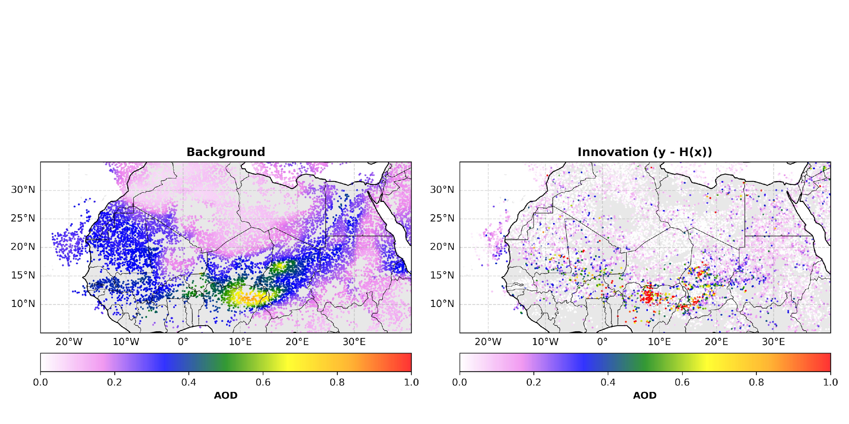
Results: Innovation (observations -background (H(x))
How far is our the background (in observation space) from our observations?
*Forecast time: 2023.10.08 12z
The highlighted region points to a noticeable difference in aerosol loading in the Sahel and sub-Sahel region. The model moderately underestimates aerosol on average over the North African region.

Slide 8
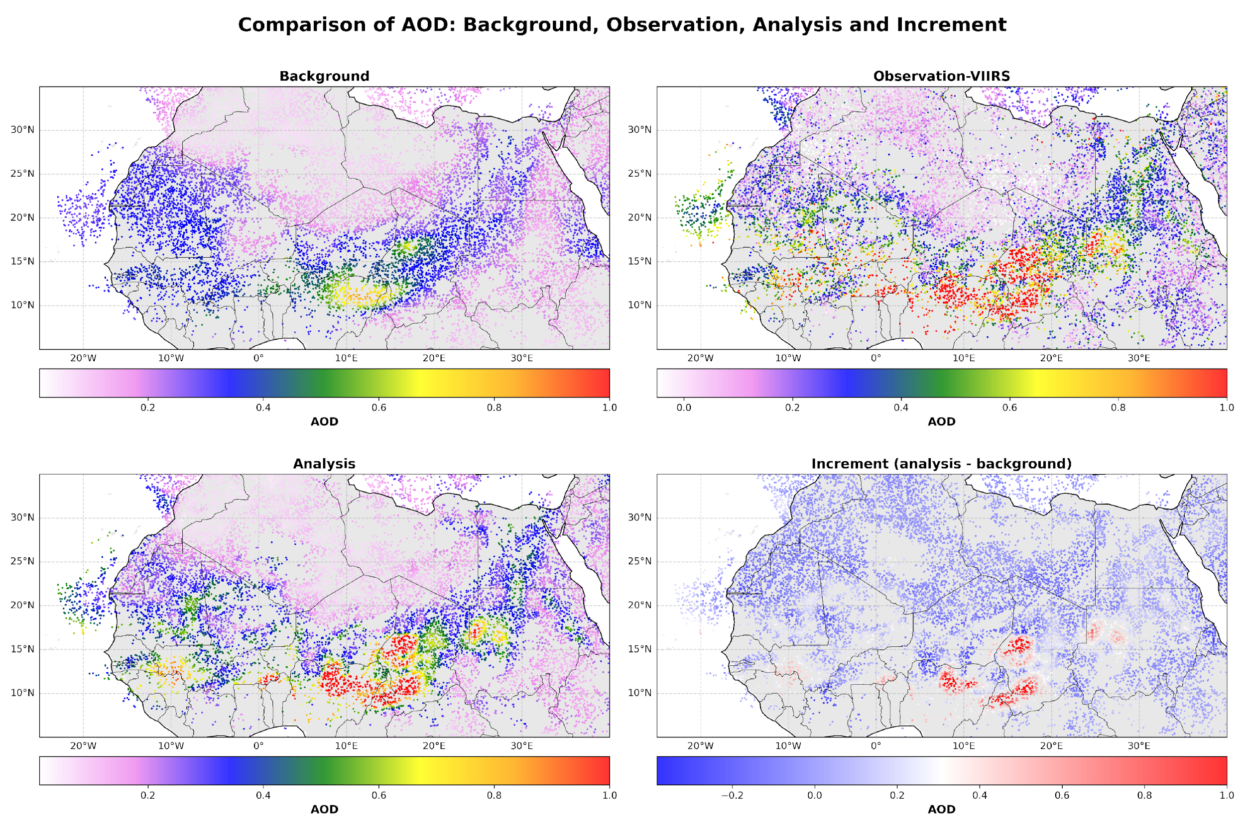
Results: Increment (analysis - background)
How much correction is done to our model state.
*Forecast time: 2023.10.08 12z
The DA method adjusts the background by constraining the analysis toward the observations, reducing overestimations and compensating for underestimations.
In effect, biases are reduced in the background field, pulling the analysis closer to the observations in regions where values are over- or underestimated.

Slide 9
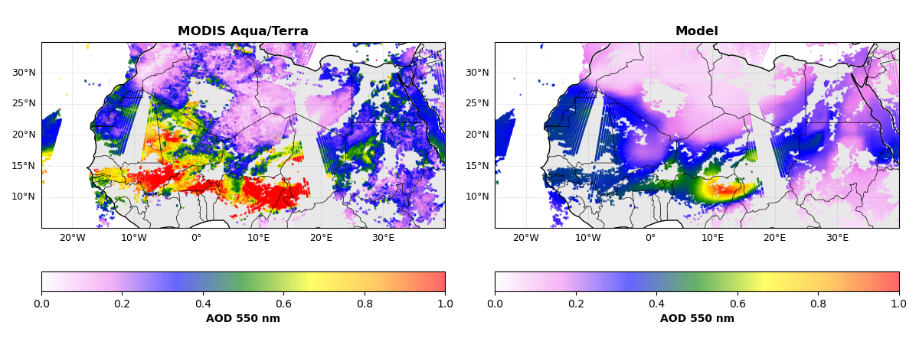
Results: Verification with MODIS (Terra/Aqua)
*Forecast time: 2023.10.08 12z –f12
Verification shows model underestimate AOD in Area within the Sahara and Sahel/sub-Sahel region.
On the average model predicts spatial patterns moderately.

Slide 10
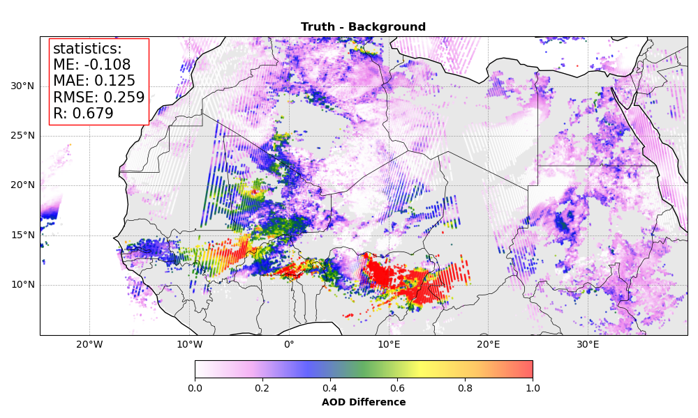
Results: Verification with MODIS (Terra/Aqua)
*Forecast time: 2023.10.08 12z - f12
Metric | Interpretation
Bias | The model underestimates AOD on average.
Mean Absolute Error | Deviation of the model from the truth.
RMSE | Indicates the effect of large errors resulting in the deviation
Correlation (R) | Moderate-to-strong spatial agreement between model and truth.
Remarks
The analysis fields exhibit appropriate adjustments relative to the background (forecast), indicating that the assimilation system effectively applied increments derived by optimally combining information from the background and observations.
The analysis shows that the DA system successfully reduced large misfits in AOD.

Slide 11
Phase II
in preparation for next step,
COMPARE MERRA-2 WITH
CALIOP EXTINCTION VERTICAL PROFILES.

Slide 12
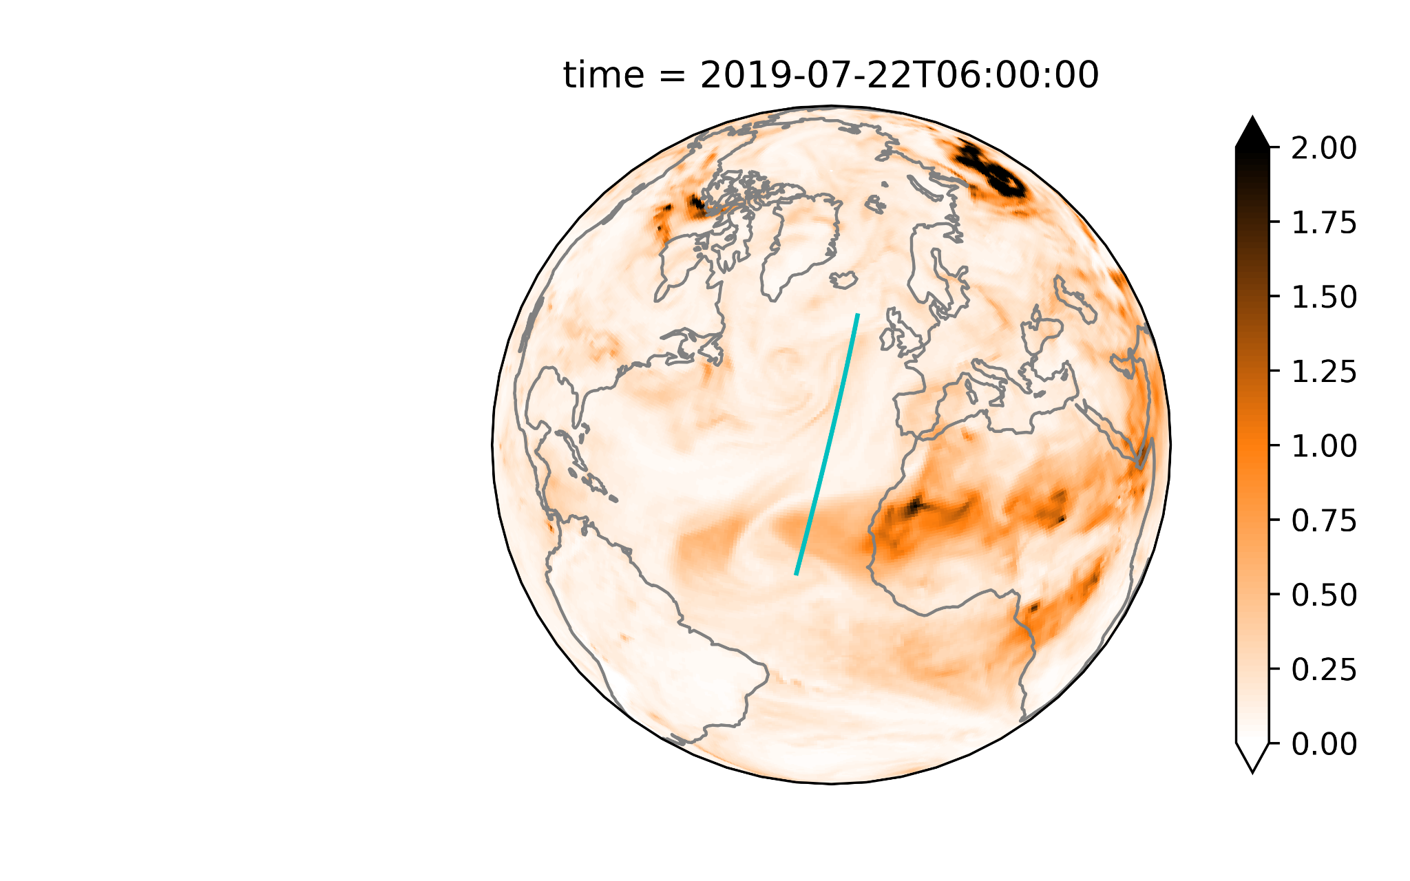
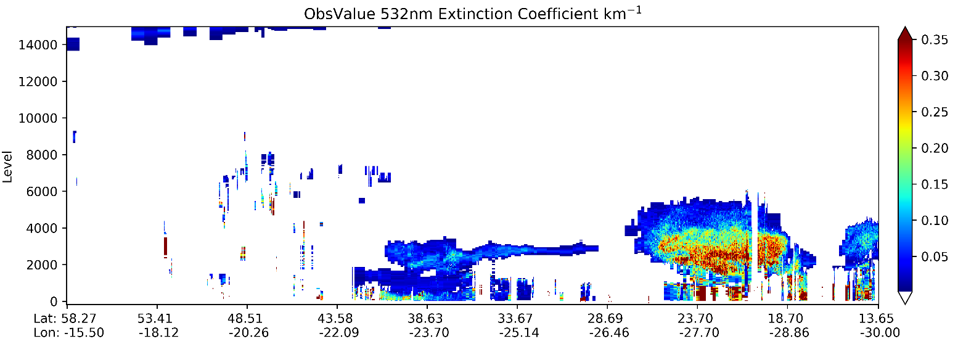
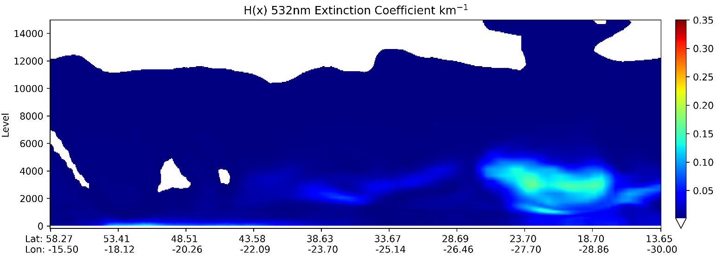
DEMO lidar operator: LiDAR H(x) of Extinction Coefficient from JEDI/UFO/CRTM with GOCART GEOS-5 LUT
MERRA-2 AODANA
MERRA-2 shows reasonable distribution.
Assimilation of extinction/backscatter profile may improve it.
The operator for attenuated backscatter is under development.
LiDAR operator is still under development.
*White area: ext < 0.001
Notes:
LiDAR operator is still under development, not in develop branch yet.

Slide 13


Slide 14
Summary:
AOD is a measure of extinction of light over a whole atmospheric column, it carries a limited amount of information on the chemical composition and sizes of particles and also cannot provide information on the vertical distribution in the atmosphere.
Consequently, the resulting analysis is largely determined by the prior information contained in the model state at a given time. This provides very limited ability for AOD DA to correct aerosol speciation, size, and vertical distributions in the atmosphere.
Next Steps:
Conduct high resolution experiment restricted to the temporal window of valid CALIOP dataset June (2006-2023).
Compare model state with CALIOP extinction profiles.
Develop the CALIOP Lidar Forward Operator.
Working on the capability to assimilate CALIOP profiles in JEDI.

Slide 15


Acknowledgments
The authors acknowledge:
NOAA Environmental Modeling Center (EMC) for providing the GCAFS model and for their contributions in reviewing the code, initial conditions, and observations data used in the data assimilation process.
NOAA R&D Mississippi State University High Performance Computing (MSU-HPC) - Orion
NOAA Office of Oceanic and Atmospheric Research (OAR), Air Resources Laboratory (ARL), for their support in providing the tool that allowed integration of MERRA-2 reanalysis data into the initial conditions.
The technical support from the Consortium for Advanced Data Assimilation Research and Education (CADRE) and Joint Center for Satellite Data Assimilation (JCSDA) team.
This research is supported by the U.S. Department of Commerce, National Oceanic and Atmospheric Administration, Weather Program Office (NA24OARX459C0004) and Educational Partnership Program (NA22SEC4810015).

Slide 16



Michael.Benneh@bison.howard.edu
Contact me

