Slide 1
Evaluating UFS Heat and Moisture Fluxes Using Eddy Covariance Observations from the New York State Mesonet
Anna Glodzik¹, Scott Miller¹, Sarah Lu¹, Jason Covert¹, Andrew Newman², Mike Ek², Kathryn Newman², Helin Wei³
¹Atmospheric Sciences Research Center, University at Albany
²National Center for Atmospheric Research
³Independent contractor
Center Green Auditorium, Boulder, CO
September 8-12, 2025

Slide 2
Advanced Coupling Evaluation Metrics in METplus for UFS Land Surface Models
Use New York State Mesonet (NYSM) observations to evaluate UFS high-resolution (HR) forecast model output
Quality control of NYSM data prior to comparing with the model and evaluation of energy budget closure
Comparisons of standard and flux variables to identify model’s skill for fluxes and Bowen Ratio across sites and the diurnal cycle, diagnose where energy
exchange deviates between the model and observations ​

Slide 3
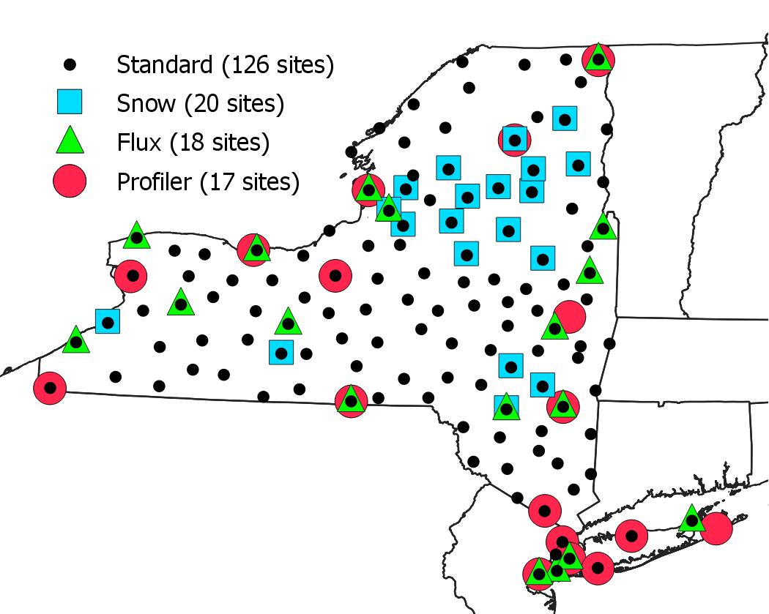
New York State Mesonet
126 weather stations across the state that measure standard meteorological variables plus solar radiation, soil temperature and moisture profiles, snow depth
Contains several sub-networks, including a flux network beginning in 2018. Currently 100+ site years of 30-minute flux data from 18 sites
Operated by the University at Albany, the NYSM collects, archives, and processes data every 5 minutes

Slide 4

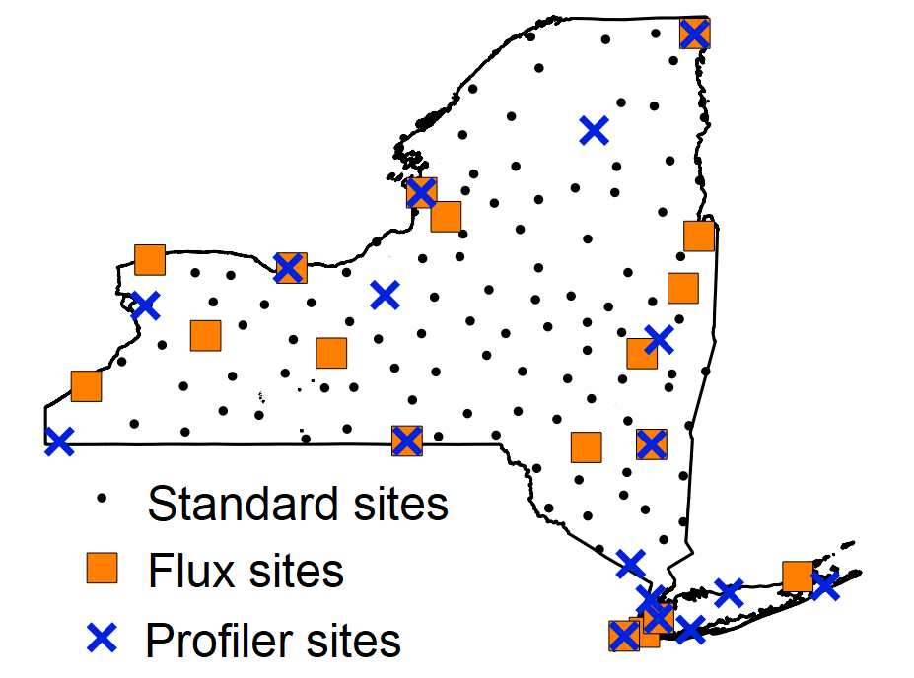
Datasets
Computations
Analysis
Coupled UFS model output
T, q, Bowen ratio, PBL height
HR Model Comparisons
Time series analysis
Diurnal analysis
METplus use cases
Standard: T, q,...
Flux: Bowen ratio (latent and sensible heat)
Profiler: PBL height
Evaluation Metrics for LSM Processes
Quality controlled
Despiked
New York State Mesonet

Slide 5
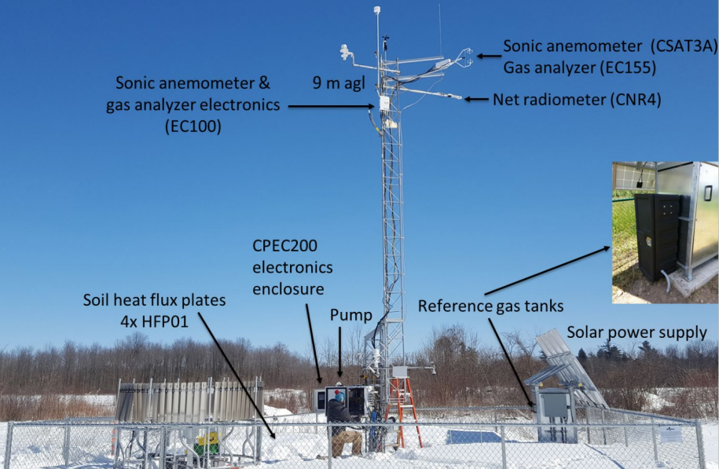
Flux Network
Radiation components, soil heat flux, turbulent fluxes of momentum, sensible and latent heat, and carbon dioxide
Process-based variables like Bowen Ratio
Turbulence sensors measure at 10 Hz

Slide 6
Quality Control of Flux Data
UFS High Resolution Model Prototype Runs
QC flag is included in the final dataset for each flux reading
Based on a series of three tests that assign a value of 1-9 to each reading
Additional despiking of fluxes and manual QA was conducted
Combined 30 minute flux data with 5 minute standard data for easy analysis and comparison with the HR model
QC'd data yielded a 72% energy budget closure network wide
16 day, 3 hourly forecast
Initialized July 19th, 2020 at 00 UTC

Slide 7
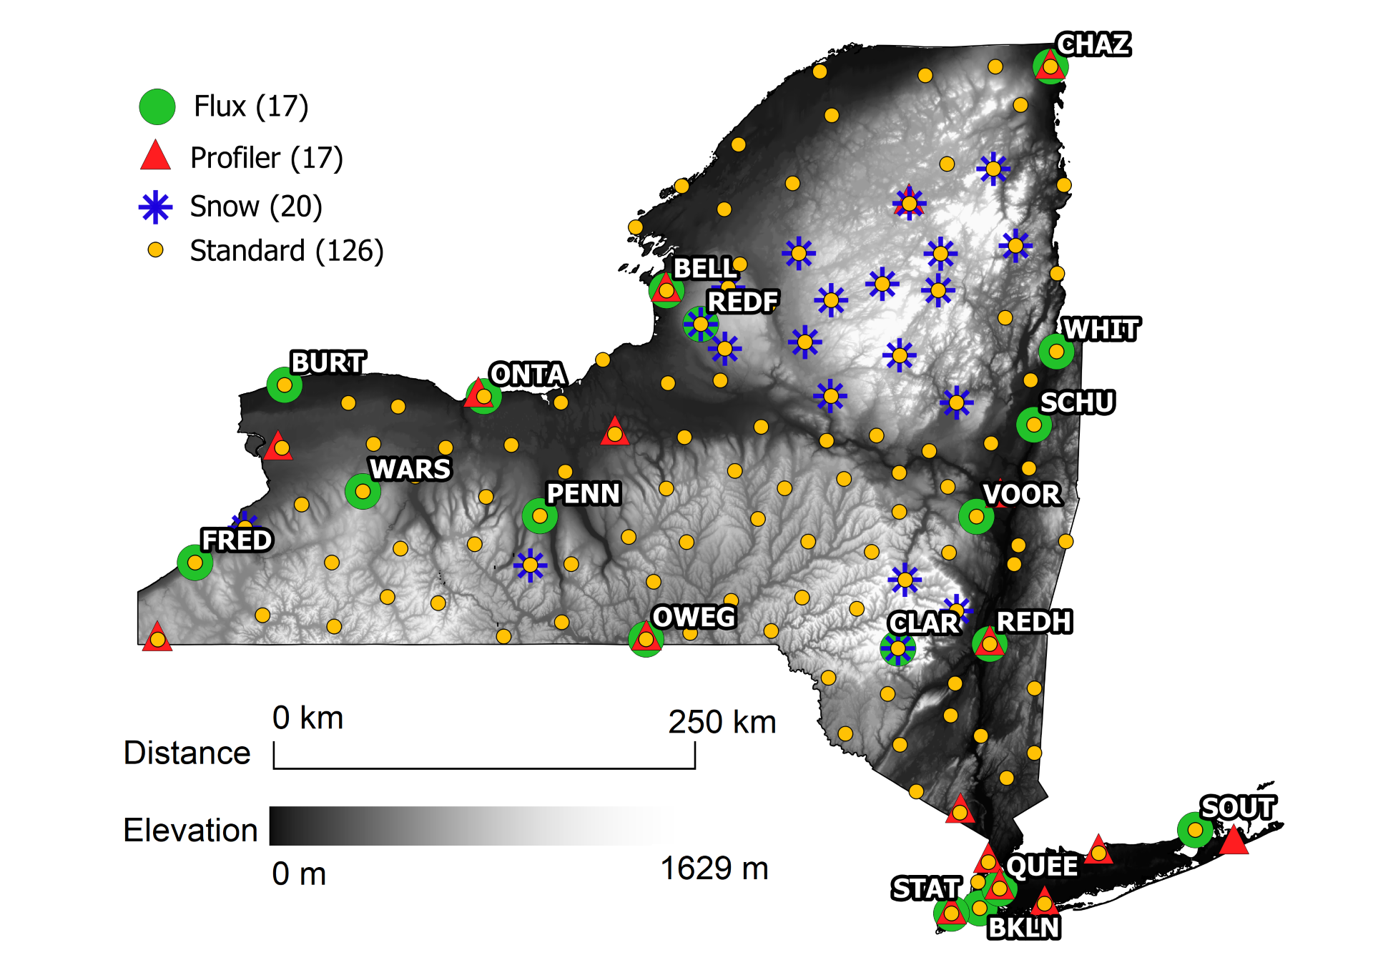
Bellville- grass field

Slide 8
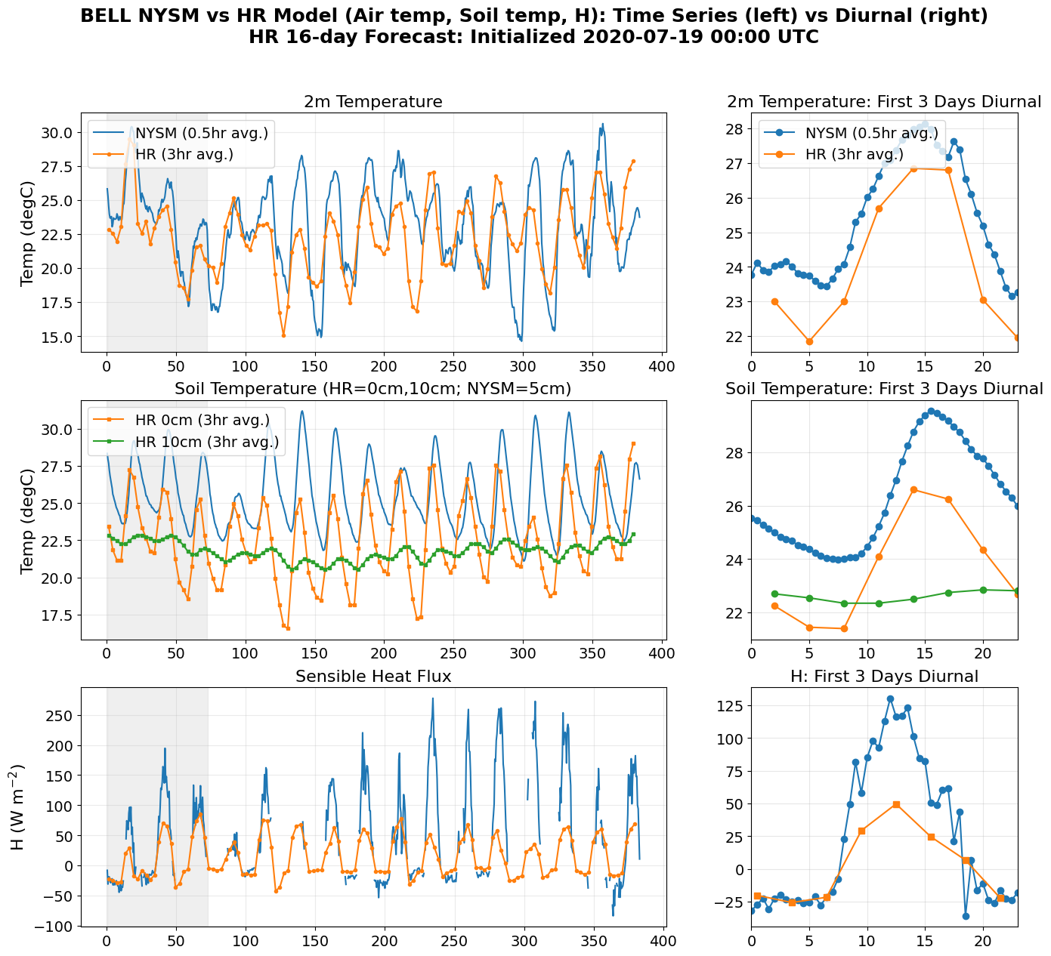
Model comparisons:
Sensible Heat Flux
Both air and soil temperatures are underestimated by the HR model
Difference in air and subsurface temperature is smaller than in observations -> underestimated sensible heat

Slide 9
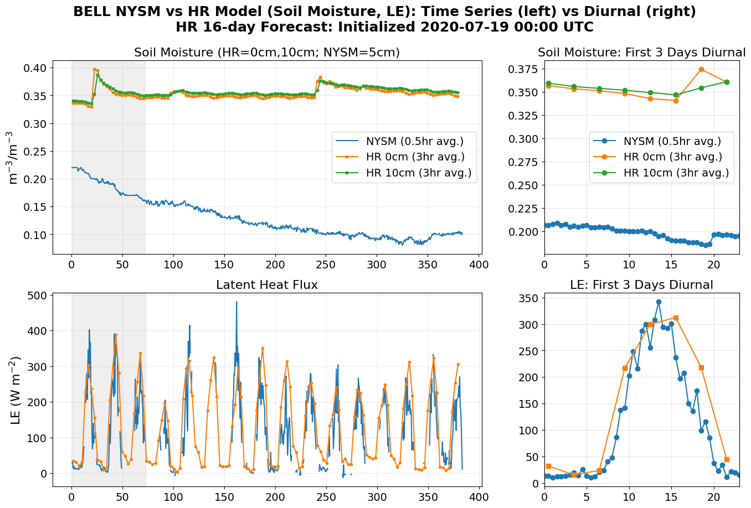
Model Comparisons: Latent Heat Flux
Larger overestimation of soil moisture at both depth levels
Higher soil moisture = more energy for evaporating water rather than for warming = leading to higher LE and lower H
Model is underestimating total available energy

Slide 10
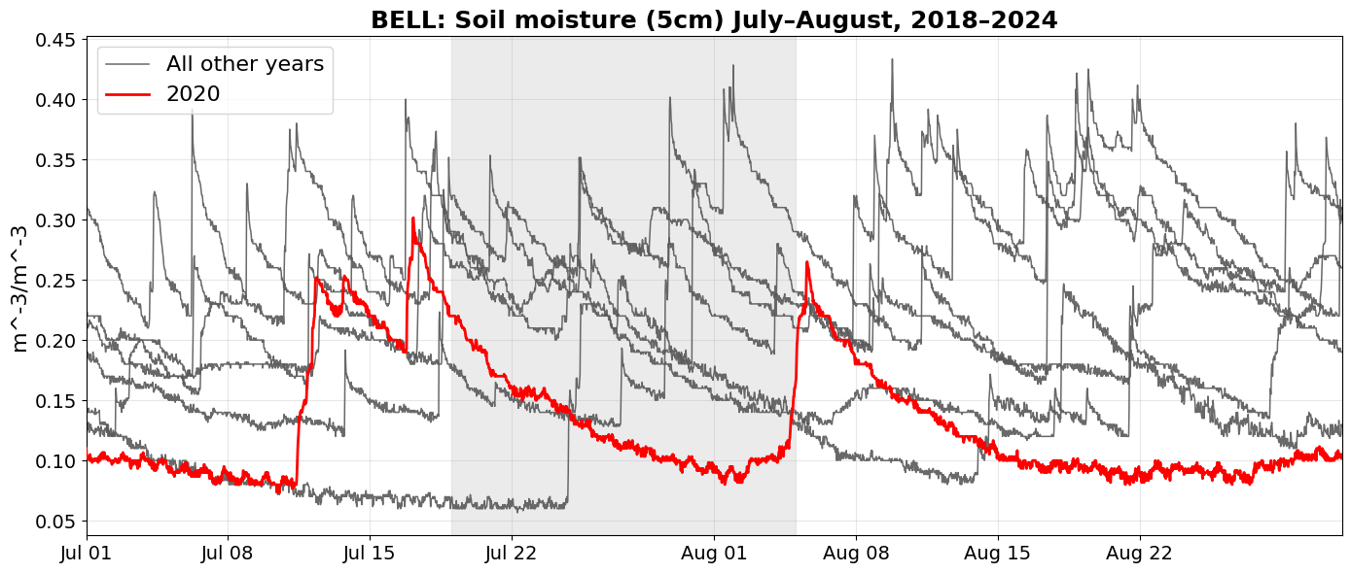
Was it just a dry year?
Yes, consistently lower moisture levels during 16-day period in 2020 compared with other years across all sites

Slide 11
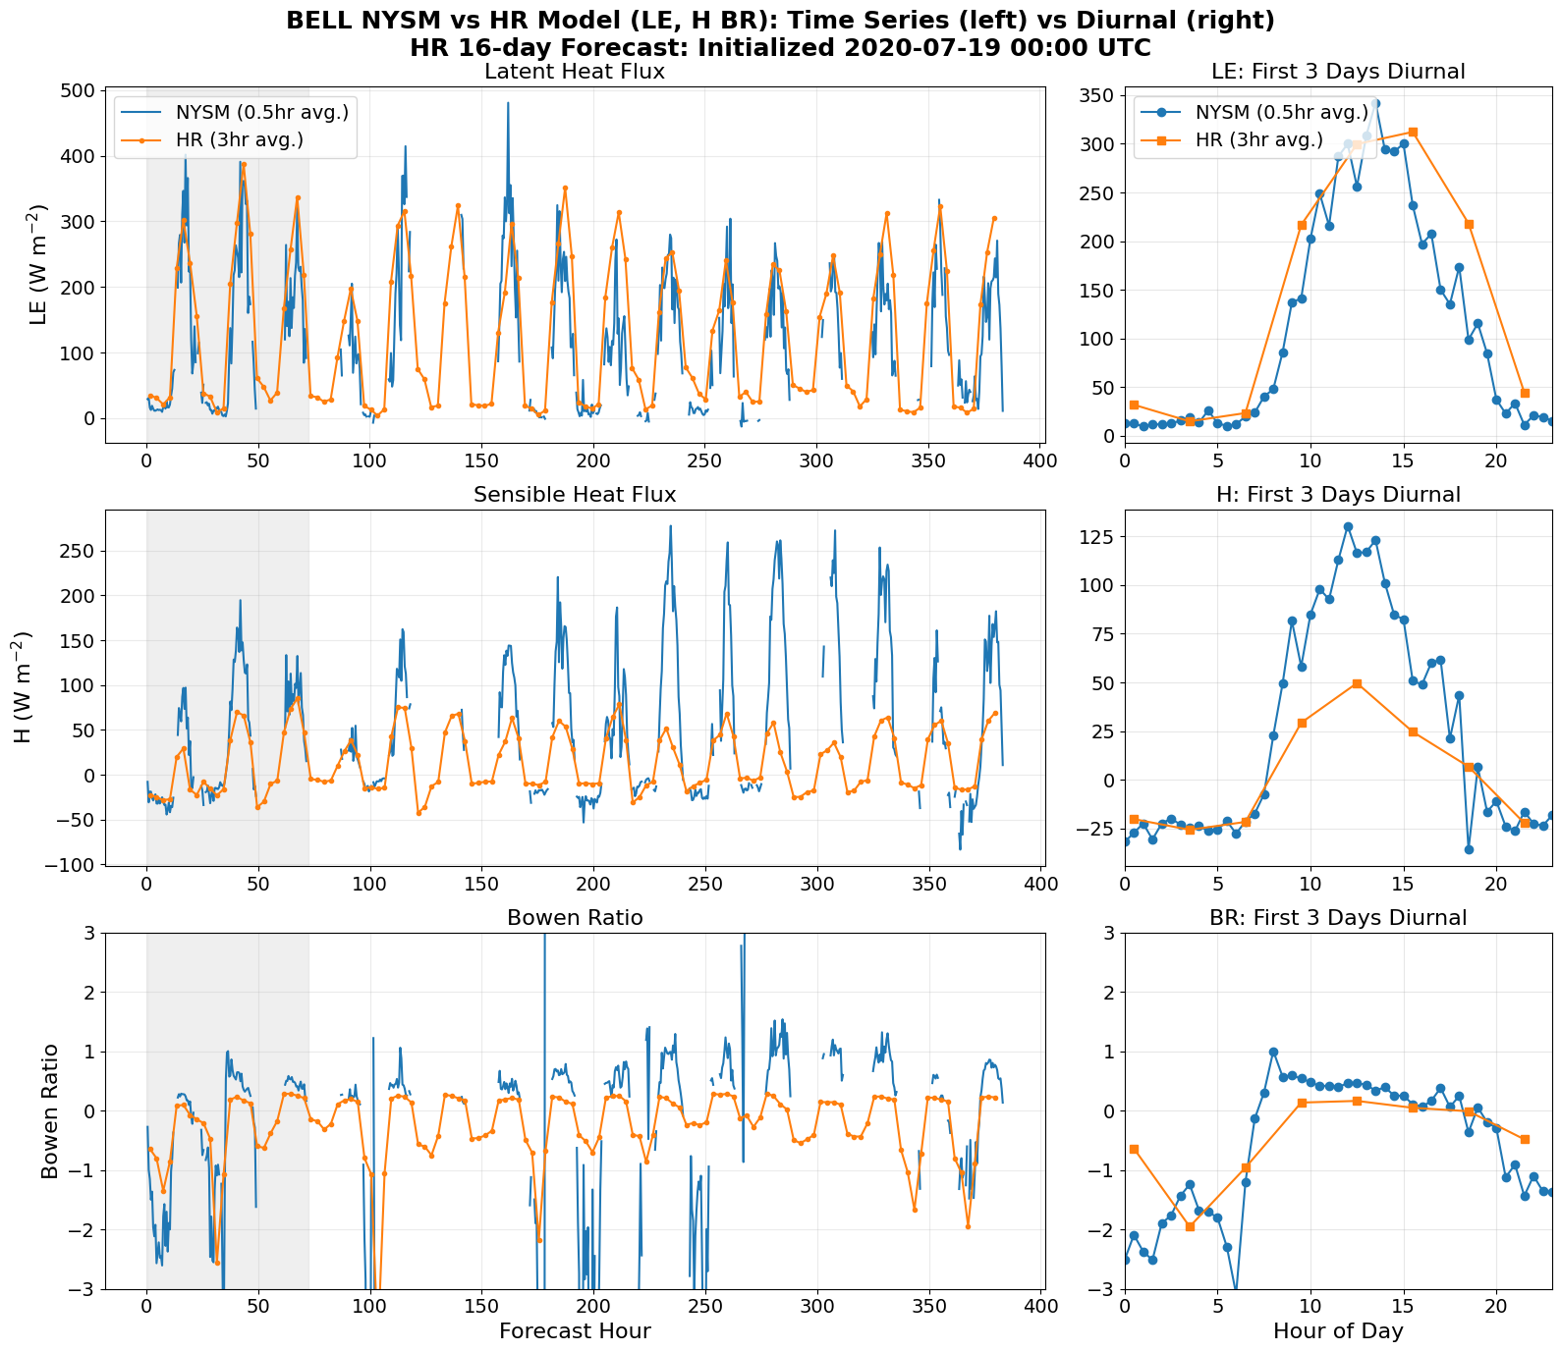
Model Comparisons: Bowen Ratio
Underestimation of total available energy
Partition of energy between the turbulent fluxes is incorrect, attributing more to latent heat than sensible
Leading to underestimation of Bowen ratio by the HR model during daytime hours

Slide 12
Future Work
Further analysis of evaluation metrics
Update model run/ new initialization time every 3 days for better agreement over time
Datasets
Computations
Analysis
Coupled UFS model output
T, q, Bowen ratio, PBL height
HR Model Comparisons
Time series analysis
Diurnal analysis
METplus use cases
Standard: T, q,...
Flux: Bowen ratio (latent and sensible heat)
Profiler: PBL height
Evaluation Metrics for LSM Processes
Quality controlled
Despiked
New York State Mesonet

Slide 13
Thank you! Questions?
NOAA Weather Program Office FY22 JTTI
Award number: NA22OAR4590181

