Slide 1
UFS Community
Social Science Survey Results
Alison Gregory, Community Engagement Specialist, UCAR CPAESS
Dr. Hannah Love, Co-Founder, Divergent Science LLC
September 10, 2025

Slide 2
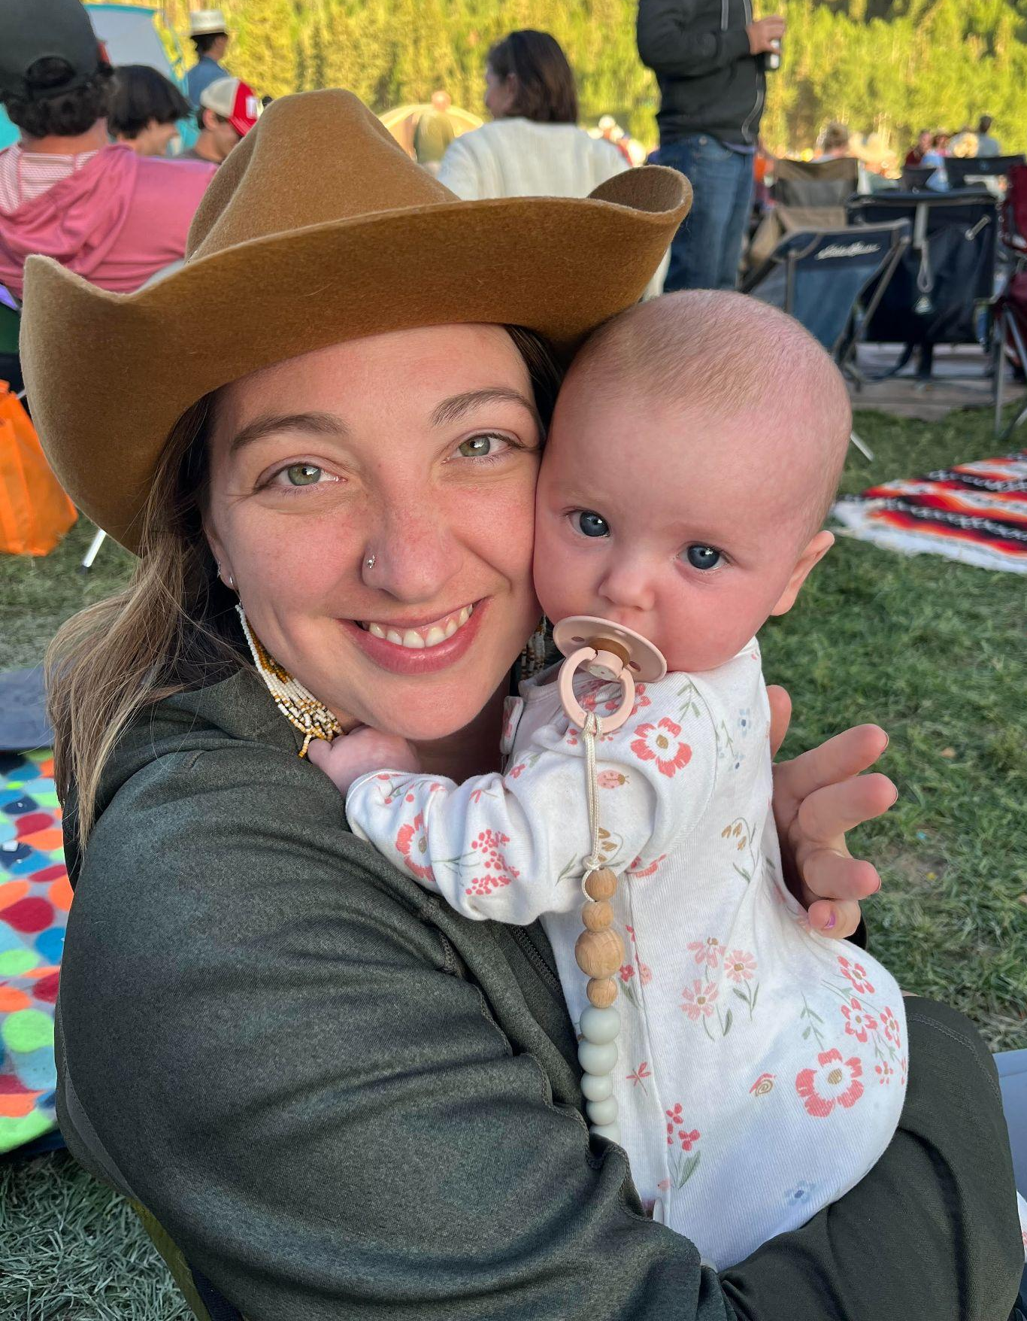
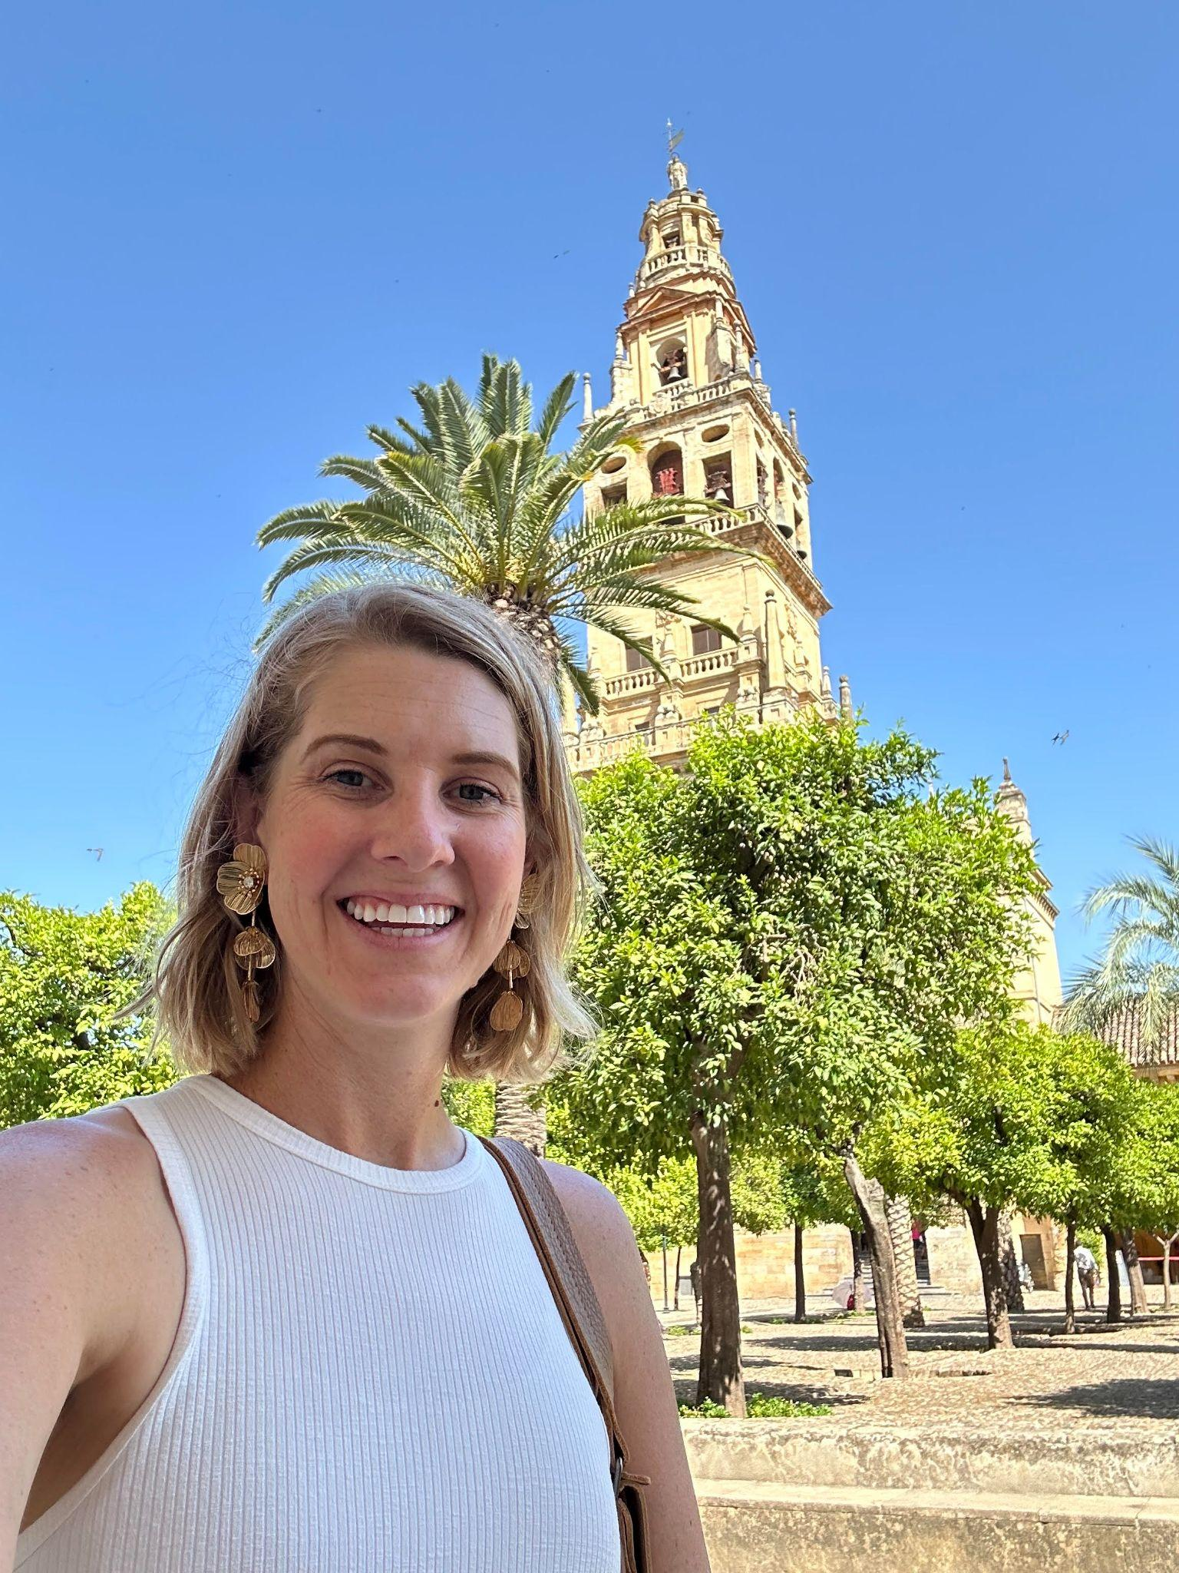
Introductions
Alison
Gregory
Hannah
Love, PhD.
Co-Founder of Divergent Science LLC
Social Network Analyst
Team Scientist
Ph.D. Sociology
UFS Community Engagement Specialist
Social Network Analyst
Master’s Environmental Sociology, Bachelor’s Atmospheric and Oceanic Science

Slide 3
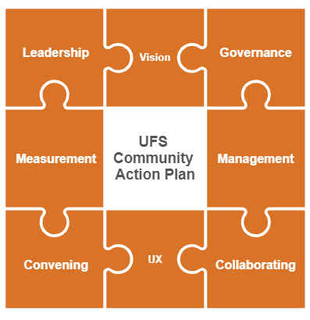
UFS Community Engagement Strategy
And here!
We are here!
And here!
Notes:
Ali
Last year I introduced myself and told you why we need a community engagement strategy. I shared this strategy with you and told you that we needed to first understand the community, then define the community strategy, and then continue to support the community.

Slide 4
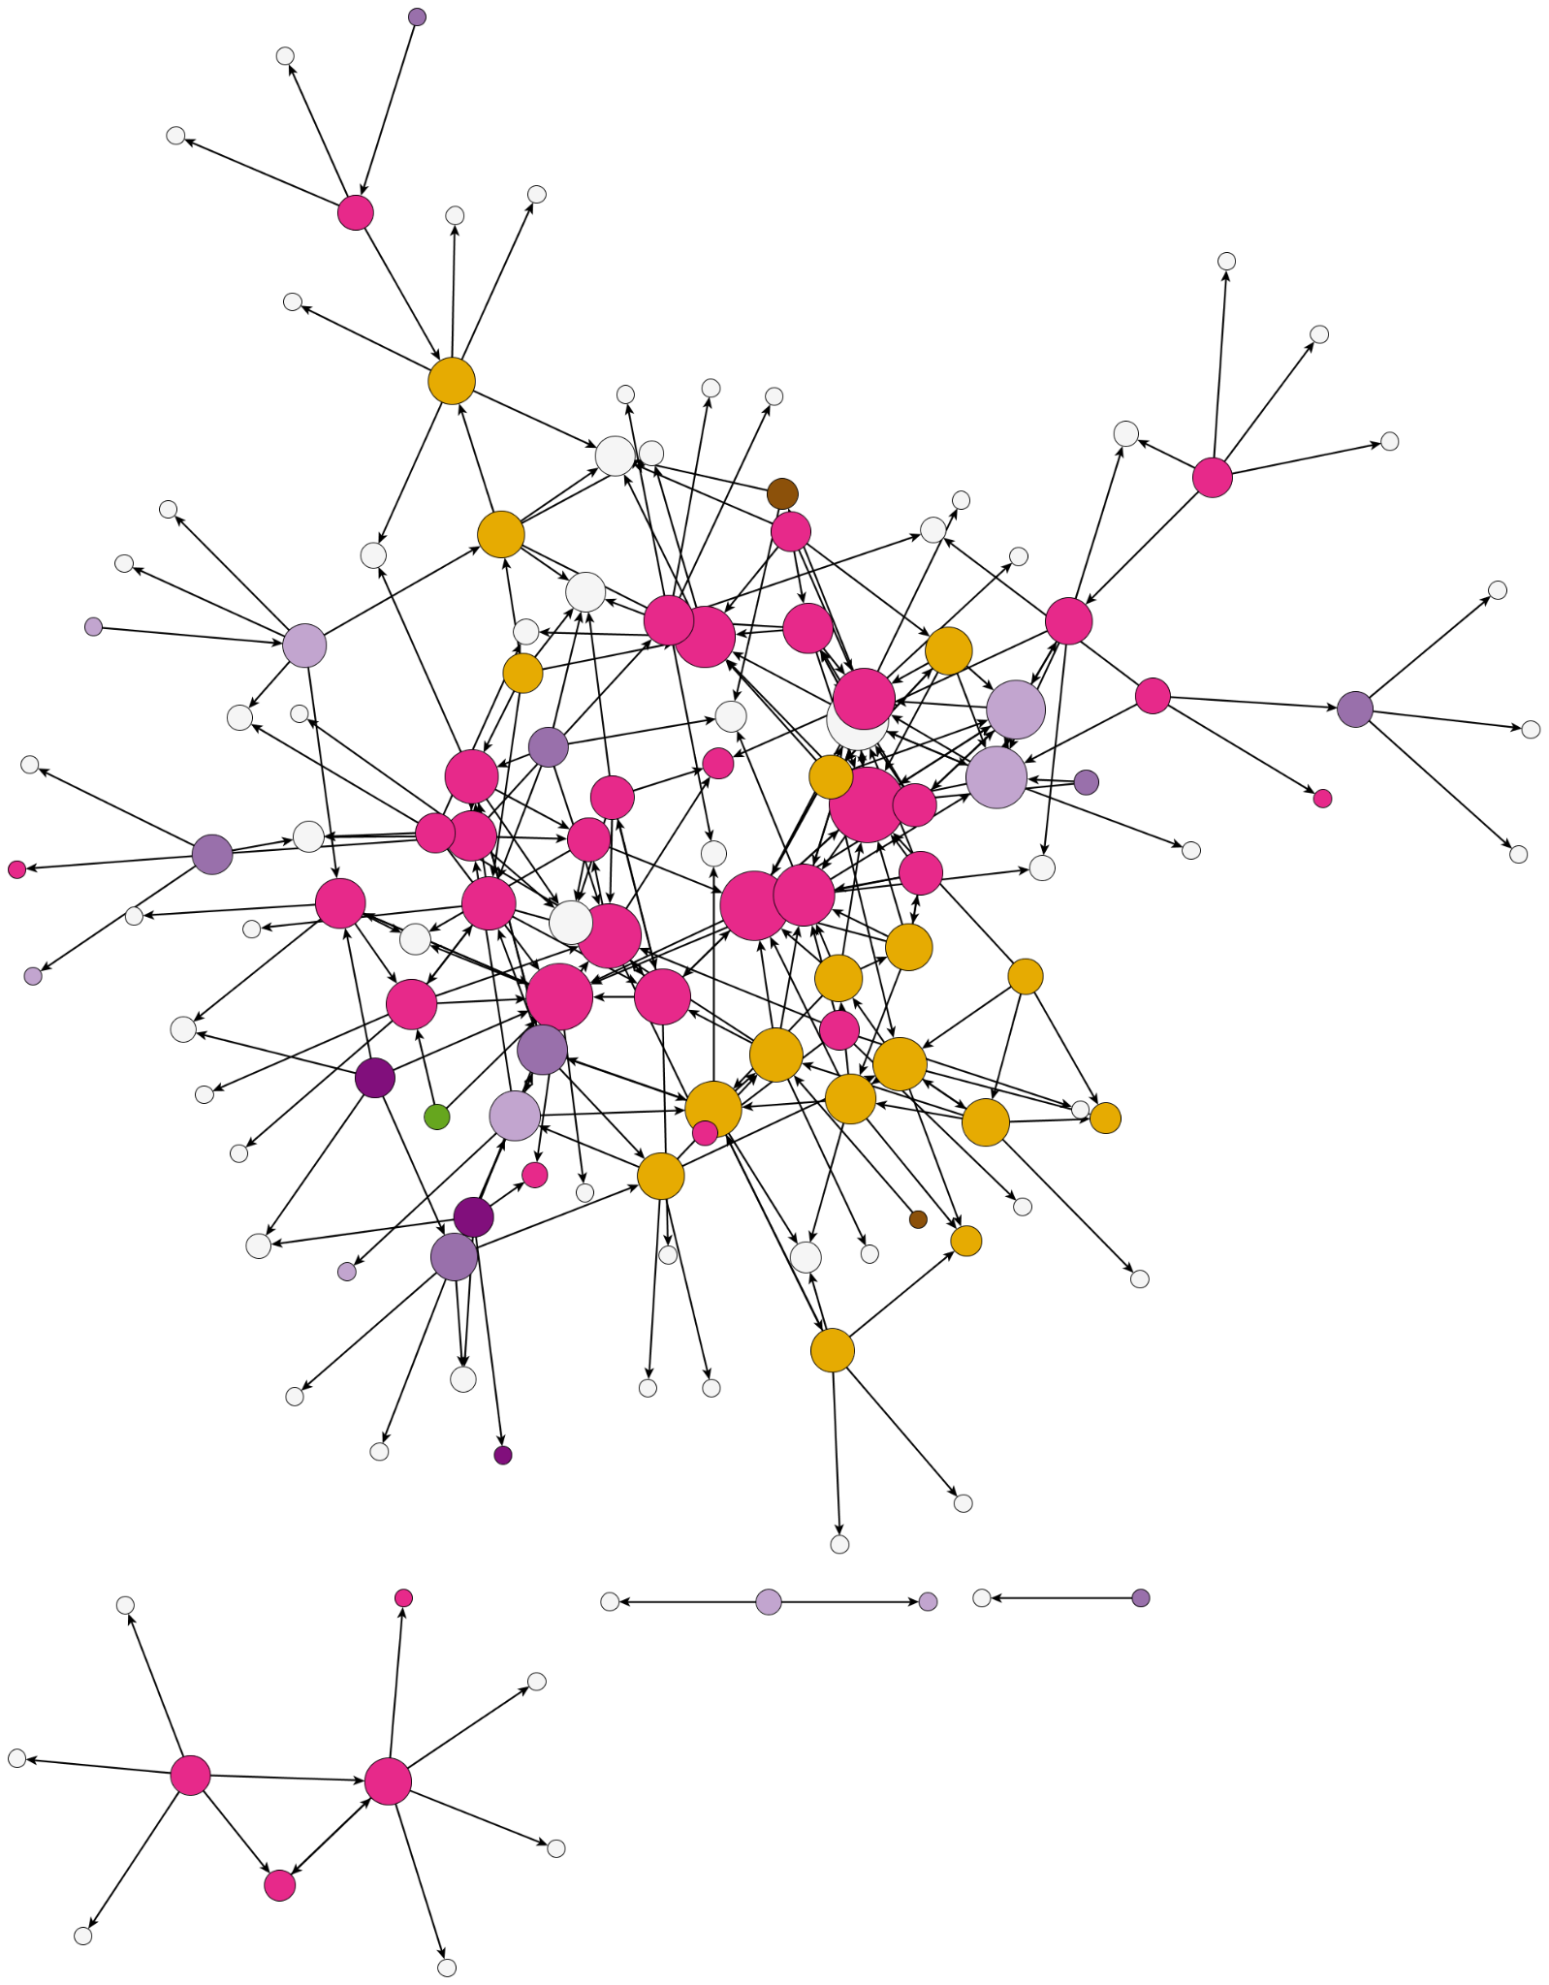
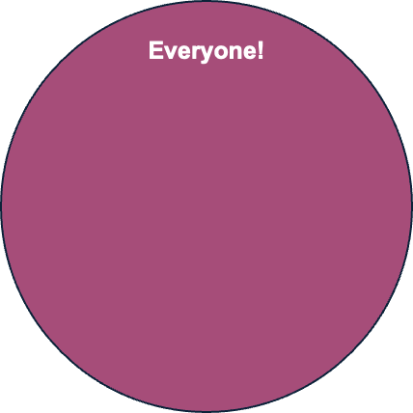
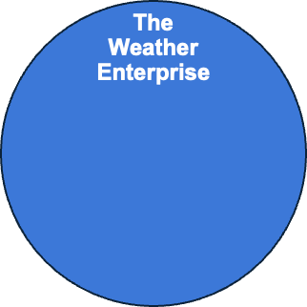
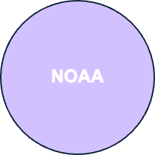
Where We Are Now
Notes:
Ali
Last year we looked at the UFS community and said it looks like this. I told you that this is hard to study, hard to measure, and hard to monitor.
Reminder - UFS Strategic Plan written in 2021 used the word community 76 times. The UFS Organization and Governance Document used the word community 79 times. But what is it? Who is it?
Today I am going to show you how our network ACTUALLY looks more like this. And how we’re now a step closer to being better able to study, measure, and monitor our community! **improve

Slide 5
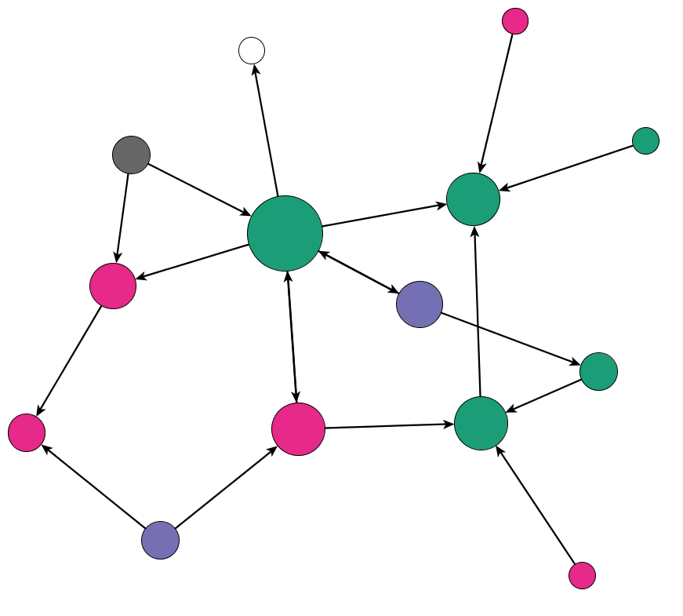
Background
What is Social Network Analysis (SNA)?
A tool to visually represent relationships and how they grow over time
Why SNA for the UFS?
Many stakeholder groups (federal, industry, academic, etc.)
Informally bound by common interests
Stored common knowledge
Notes:
Hannah (part 1):
Ask the audience: who knows what social network analysis is?
Possible questions to investigate with social network analysis:
How does the learning network in a university classroom change from the beginning of the semester to the end of the semester?
How does a scientific team catalyze when they receive funding?
Use social network analysis to demonstrate how:
The network grew and changed over-time
New members became part of the in-group?
An intervention like funding or professional development impacts the network
Ali (part 2)
Definition:a flexible group of professionals, informally bound by common interests, who interact through interdependent tasks, guided by a common purpose and thereby embodying a store of common knowledge.

Slide 6
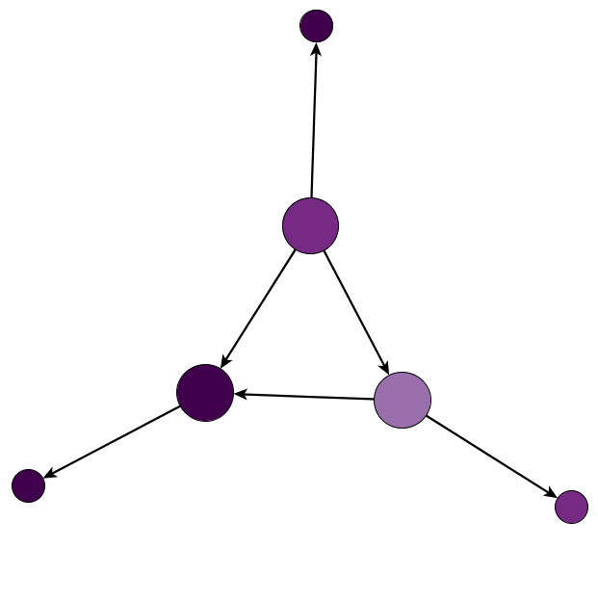
Reading a SNA Diagram
Agreement Scale
Agree
Neutral
Disagree
No Response
Nodes represent a member of our community.
Colors represent characteristics of the nodes.
All diagram have a legend to describe what the color means.
Each diagram has edges or lines connecting the nodes.
Sized by “degree.” Degree is a measure of how many people, on average, is each person connected to the network.
Notes:
Hannah
Nodes are the circles. Each node represents a member of the team.
Different colors of nodes represent different characteristics of the network. Diagram has a legend to describe what the color means.
Each diagram has edges or links connecting the nodes. If a person says they are connected to another node then they will have a link connecting them.
Nodes in the diagram are sized by “degree.” Degree is a measure of how many people, on average, is each person connected to the network. If a person is connected to an average of 10 people their node will be larger than someone who is connected to 5 people. We do this so it’s easier to read the diagrams.
Nodes are the circles. Each node represents a member of the team.
Different colors of nodes represent different characteristics of the network. Diagram has a legend to describe what the color means.
Each diagram has edges or links connecting the nodes. If a person says they are connected to another node then they will have a link connecting them.
Nodes in the diagram are sized by “degree.” Degree is a measure of how many people, on average, is each person connected to the network. If a person is connected to an average of 10 people their node will be larger than someone who is connected to 5 people. We do this so it’s easier to read the diagrams.

Slide 7
CAUTION: How NOT to put these data into practice:
Don’t change your whole program based on a handful of diagrams
Don’t overinterpret the data (e.g., don’t force your team to be friends)
Language limitations
  We left the interpretation of words like “learn,” and “advice,” up to the imagination of the survey respondent.
  So what I think looks like fun to you might not be what I think is fun.
  I might not claim I get advice from someone because I consider it personal advice and not professional advice.
It’s sooooo tempting, but don’t spend too much time trying to figure out which node you are in the network
Notes:
About the whole system
Why we chose NOT to define these terms – this group MIGHT want precise definitions. Explain our rationale.
Infuse MORE humor
Emphasize that this effort made a DIFFERENCE

Slide 8
Methods
Online survey
  UFS Steering Committee Open Meeting Attendees
Snowball Sampling
  You list your 5 closest colleagues
    Those colleagues get a link to the survey as well

Slide 9
This Network: Demographics
212
People in our network
80
People responded to the survey
65%
Respondents attend Steering Committee meetings at least sometimes
53%
Respondents are members of a Working Group or Cross-Cutting Team
Notes:
30% Response Rate

Slide 10
This Network: Demographics
88%
Respondents are mid-career or later
71%
Respondents have Doctoral Degree
97%
Respondents have Doctoral Degree OR Master’s Degree
Notes:
Demographics here
70% white
30% Response Rate
Average Age
X% had doctoral degrees
Pick a few that are interesting

Slide 11
Edges - Who do you work with?
I attend the same meetings, conferences, or workshops as this person.
I occasionally meet one-on-one with this person.
I have collaborated on a shared research project, publication, or presentation with this person.
Notes:
Combined Work Metric
To identify how users are connected to one another in the network we combined 3 key questions from the survey

Slide 12
3 Observations of Our Network
Homogeneity
Code users and non-code users
Different kinds of working relationships

Slide 13
This Network: Job Type
Job Type
Academia - Cooperative Institute
Academia - College or University
Research Institute
NOAA
Private Sector - NOAA Contractor
Fed - Non-NOAA
Private Sector - Non-NOAA
Notes:
Ask the audience: What do you notice? (4mins)
Core in the middle
Arms
Long paths for people on the outside
Cluster in lower left that is not connected
Academic partners are not connected to main cluster
There are bridge ties to isolated networks
heterogeneity refers to a significant variation in the structural properties or the attributes of nodes within a network, which goes beyond what is expected by chance
homophily refers to the principle that individuals with similar attributes are more likely to form connections and relationships within a network,

Slide 14
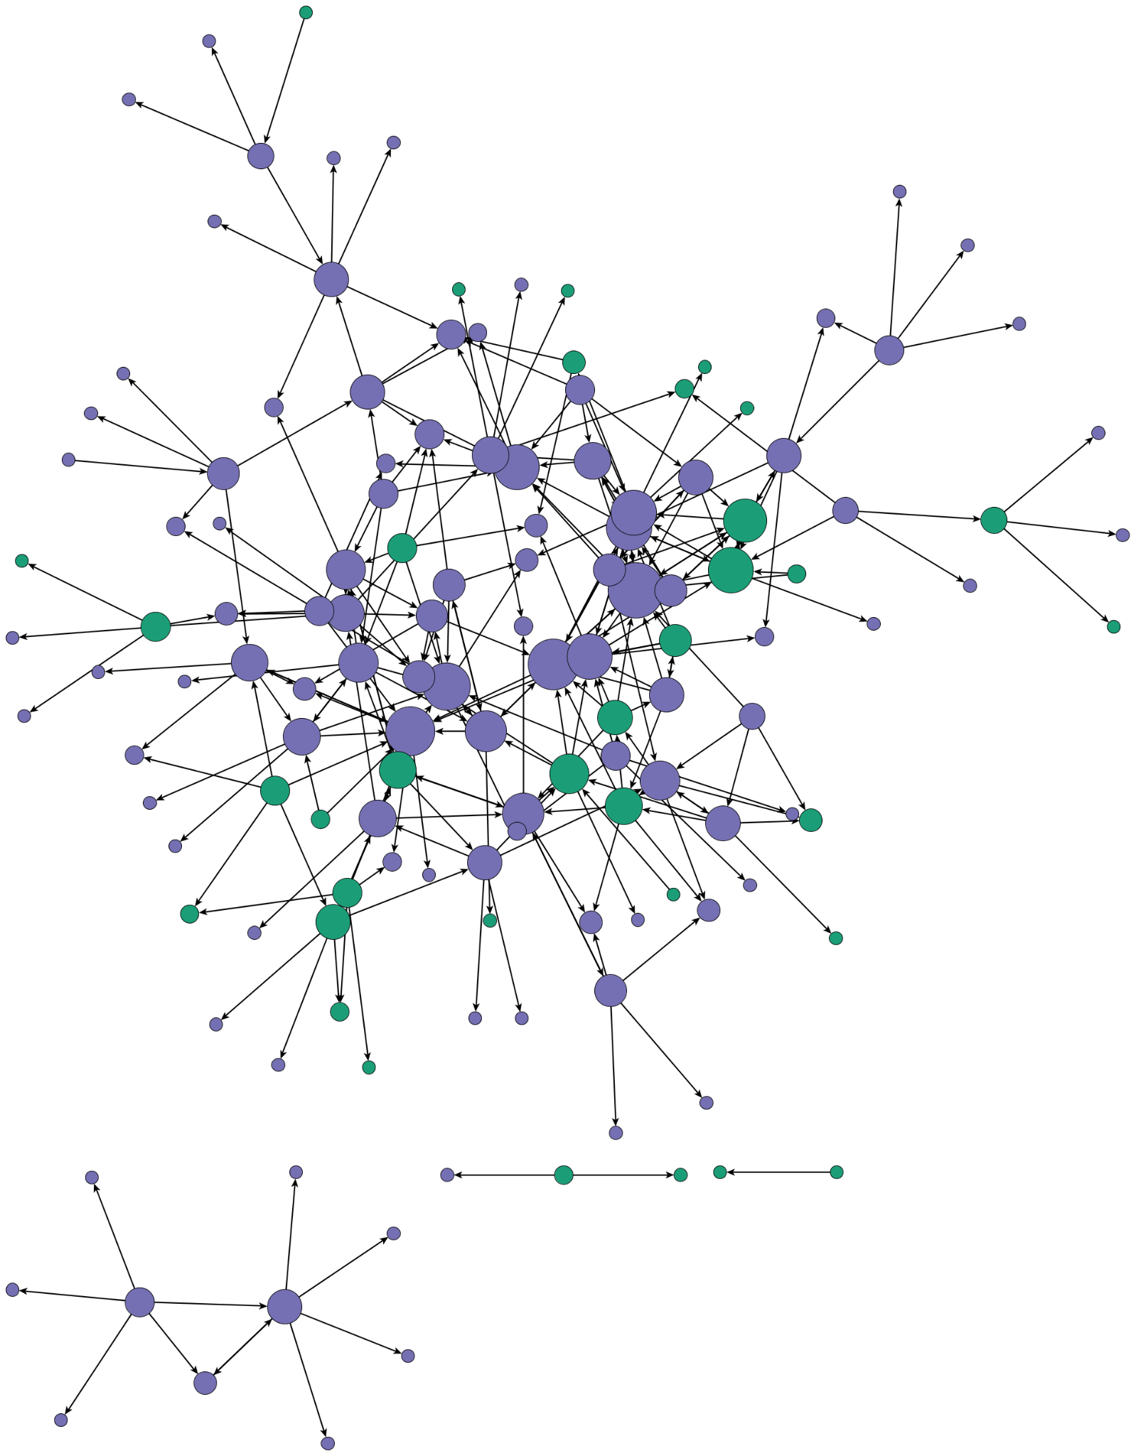
This Network: Opportunity
From the Literature
  Different kinds of direct contacts increase knowledge sharing
  Increasing network connectivity increases knowledge flow through the network
  An actors degree centrality increases the knowledge received
Knowledge, Networks, and Knowledge Networks: A Review and Research Agenda (Phelps et al. 2012)
Affiliation
NOAA
Non-NOAA
Notes:
Literature shows that there are benefits that are inclusive…Opportunity bring into core (one step away to bring them in) – suggestions?? Invite unique partners onto projects
https://business.uoregon.edu/sites/default/files/media/PhelpsHeidlWadhwa_2012_JoM.pdf

Slide 15
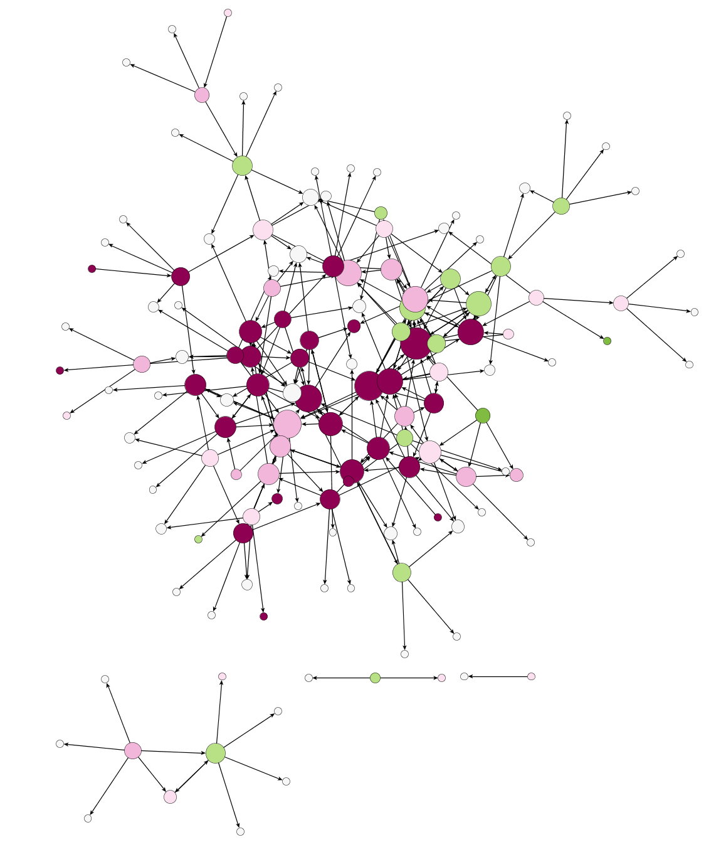
How familiar are you with the UFS code base and related applications?
Scale | Color
No Response
Not Familiar
Slightly Familiar
Somewhat Familiar
Moderately Familiar
Extremely Familiar
Notes:
If time, ask the audience: What do you notice? (4mins)

Slide 16
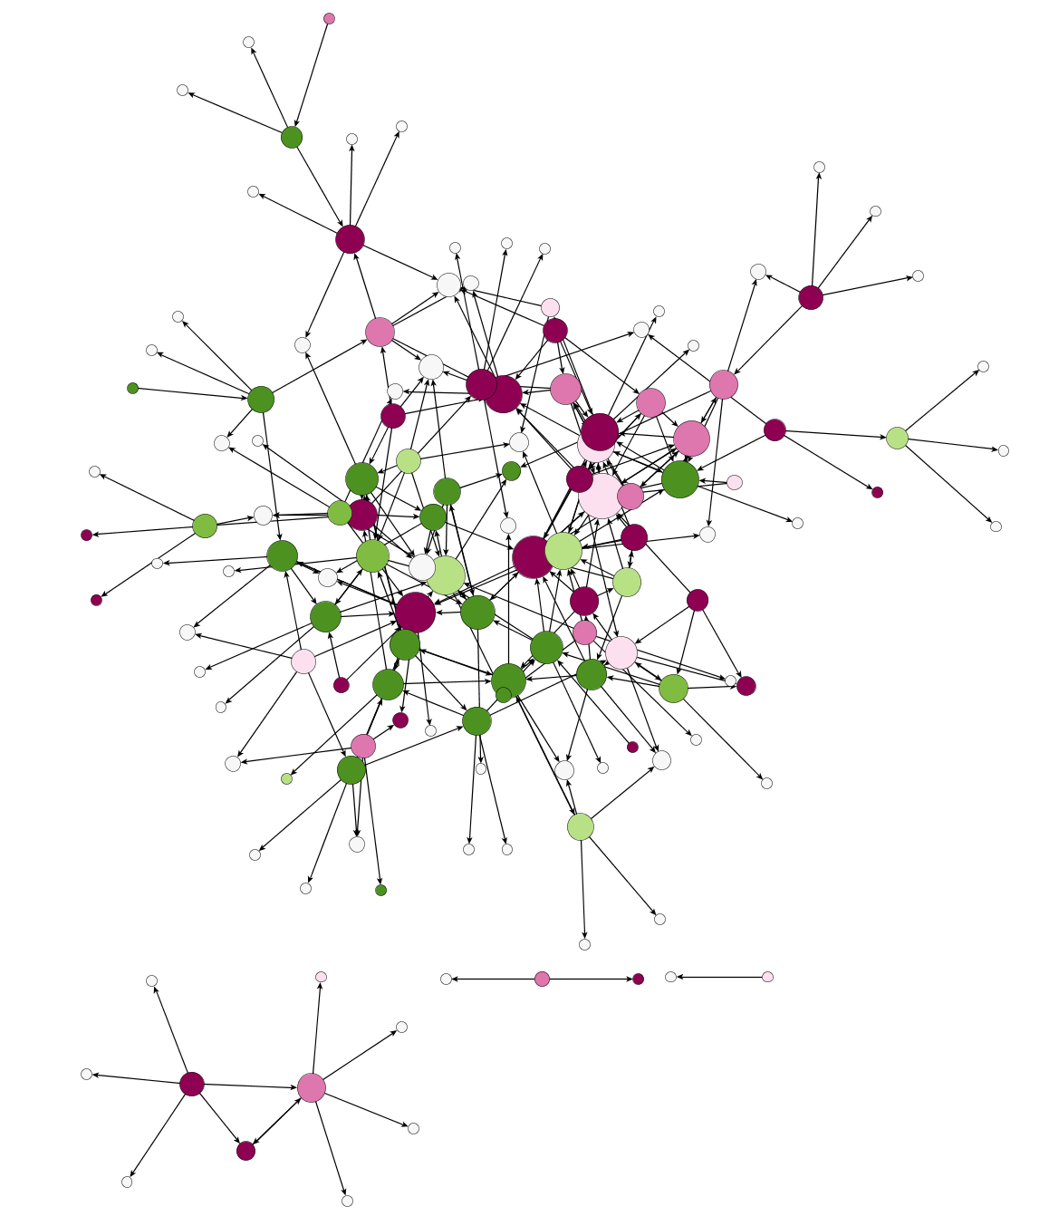
How often do you run the UFS code or associated applications?
Scale | Color
No Response
N/A
Never
Rarely
Sometimes
Often
Very Often
Notes:
Hannah
-need to find out why one side of the network is using the code and one isn’t

Slide 17
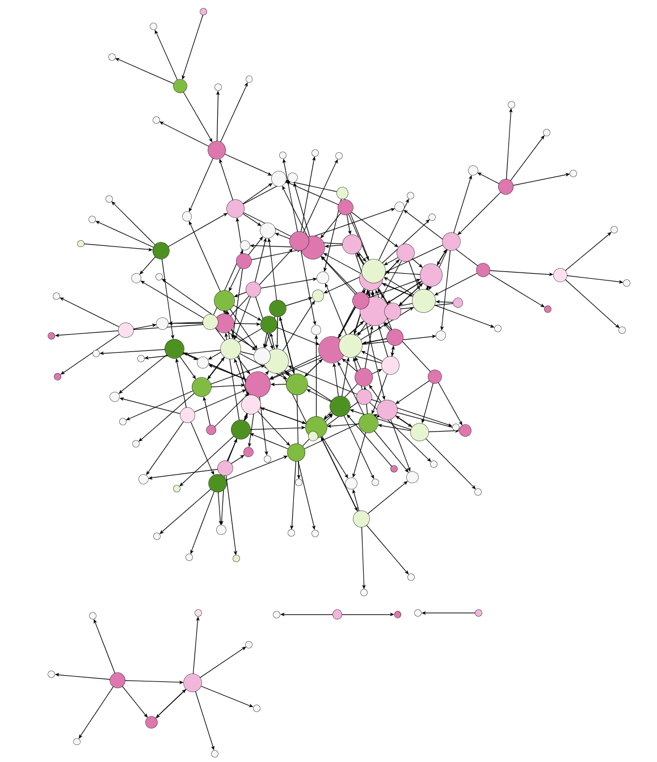
How often do you contribute code to the UFS (Github, etc.)?
Scale | Color
No Response
N/A
Never
Rarely
Sometimes
Often
Very Often

Slide 18
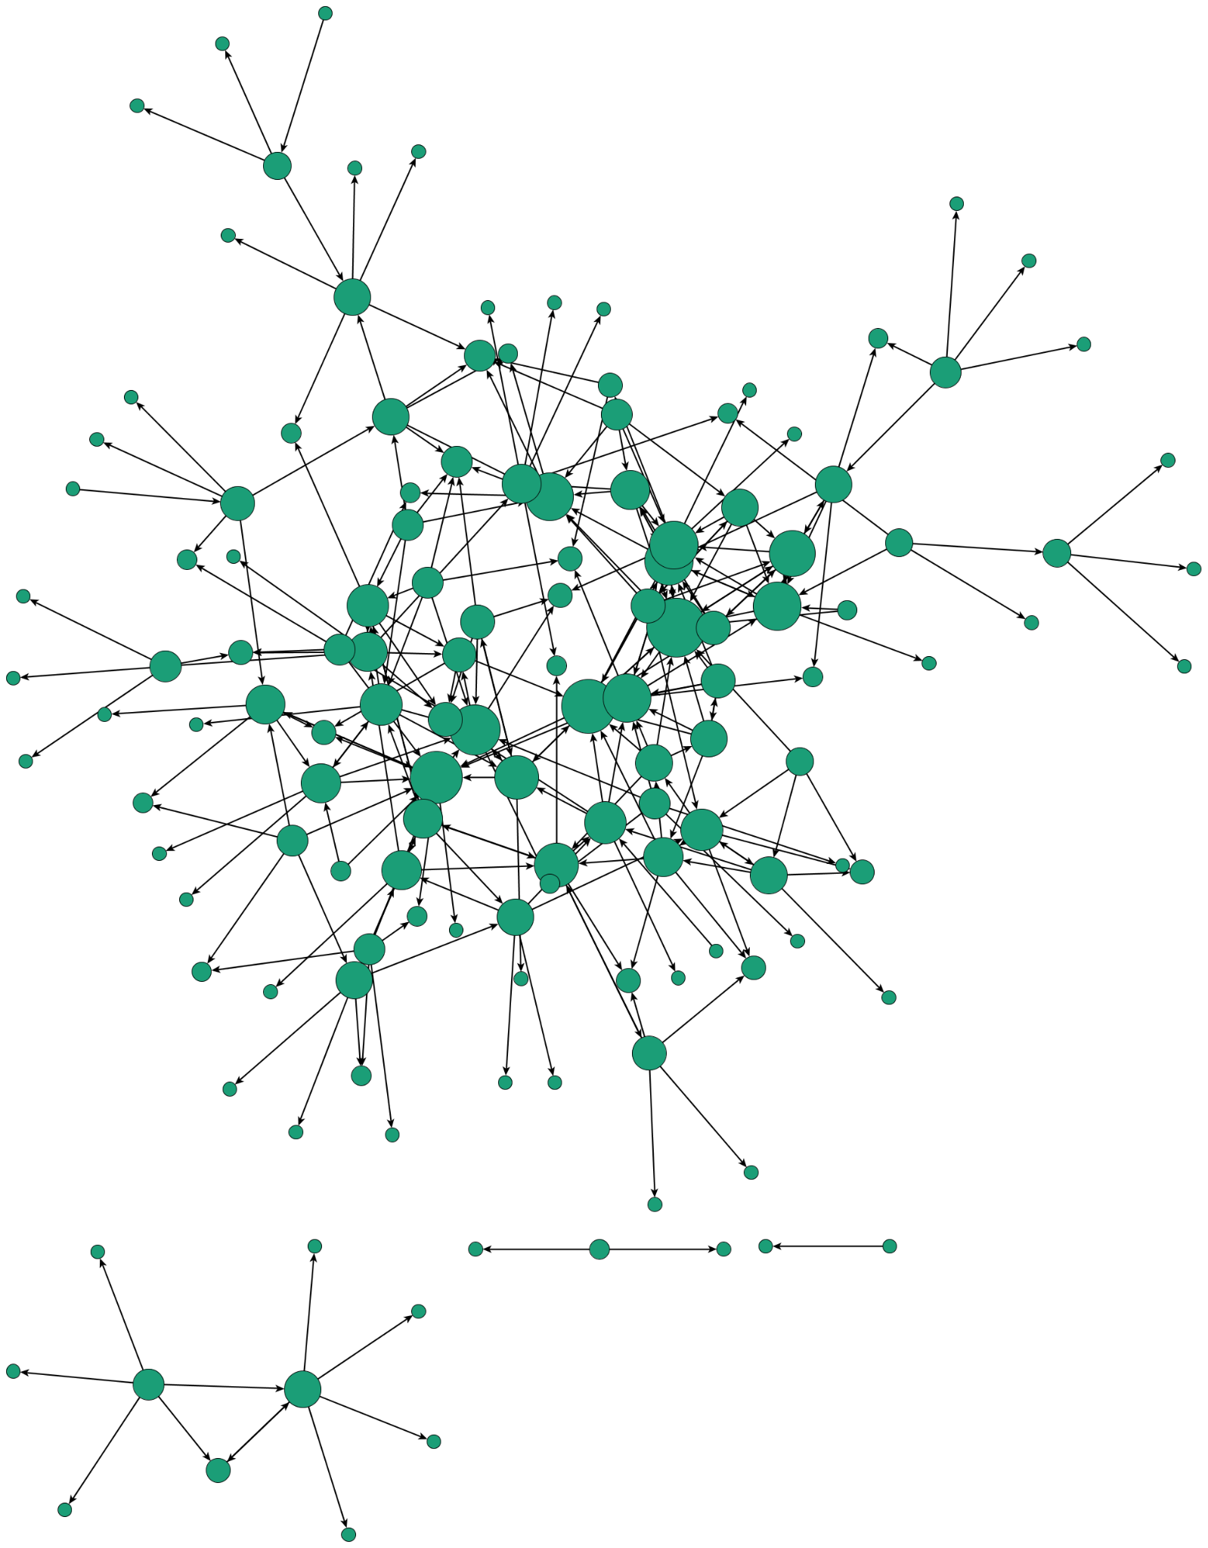
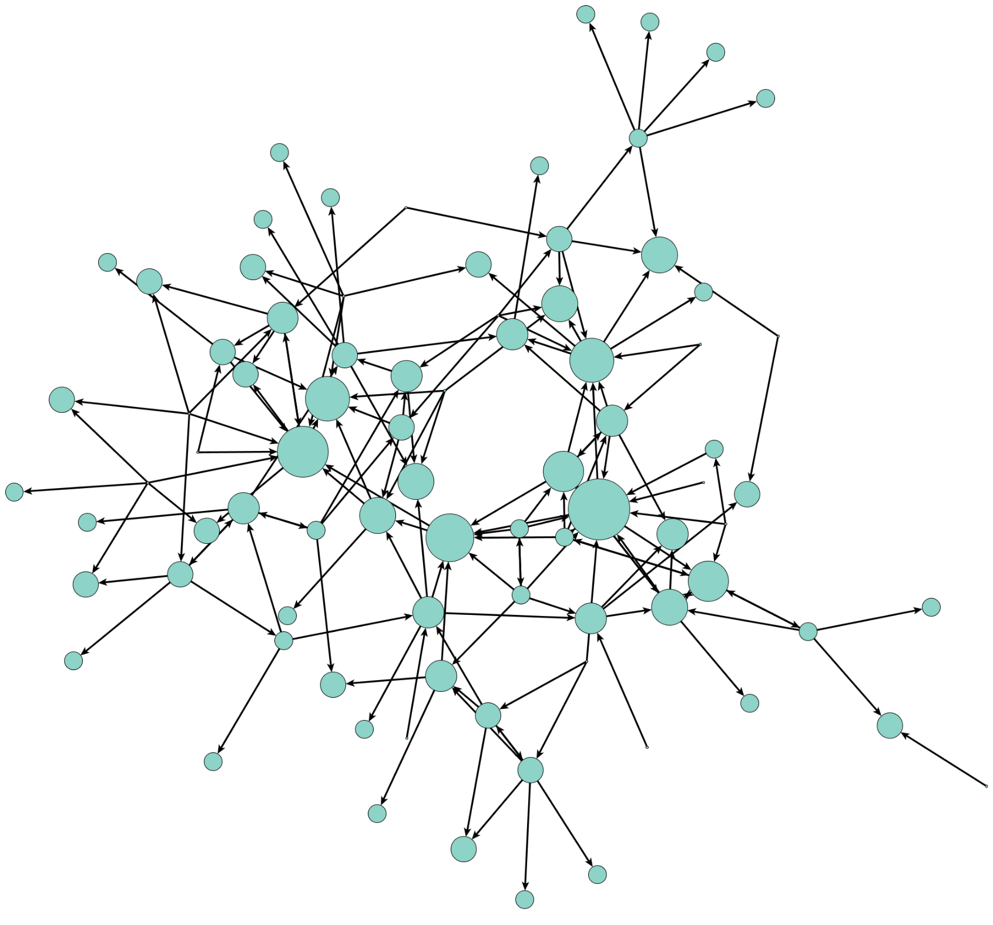
Work versus Advice Network
Notes:
Hannah -
This is the work network you recognize on your left, and the advice network on the right. This means that the person selected “I go to this person for advice
What do we notice?
Less individuals in this network

Slide 19
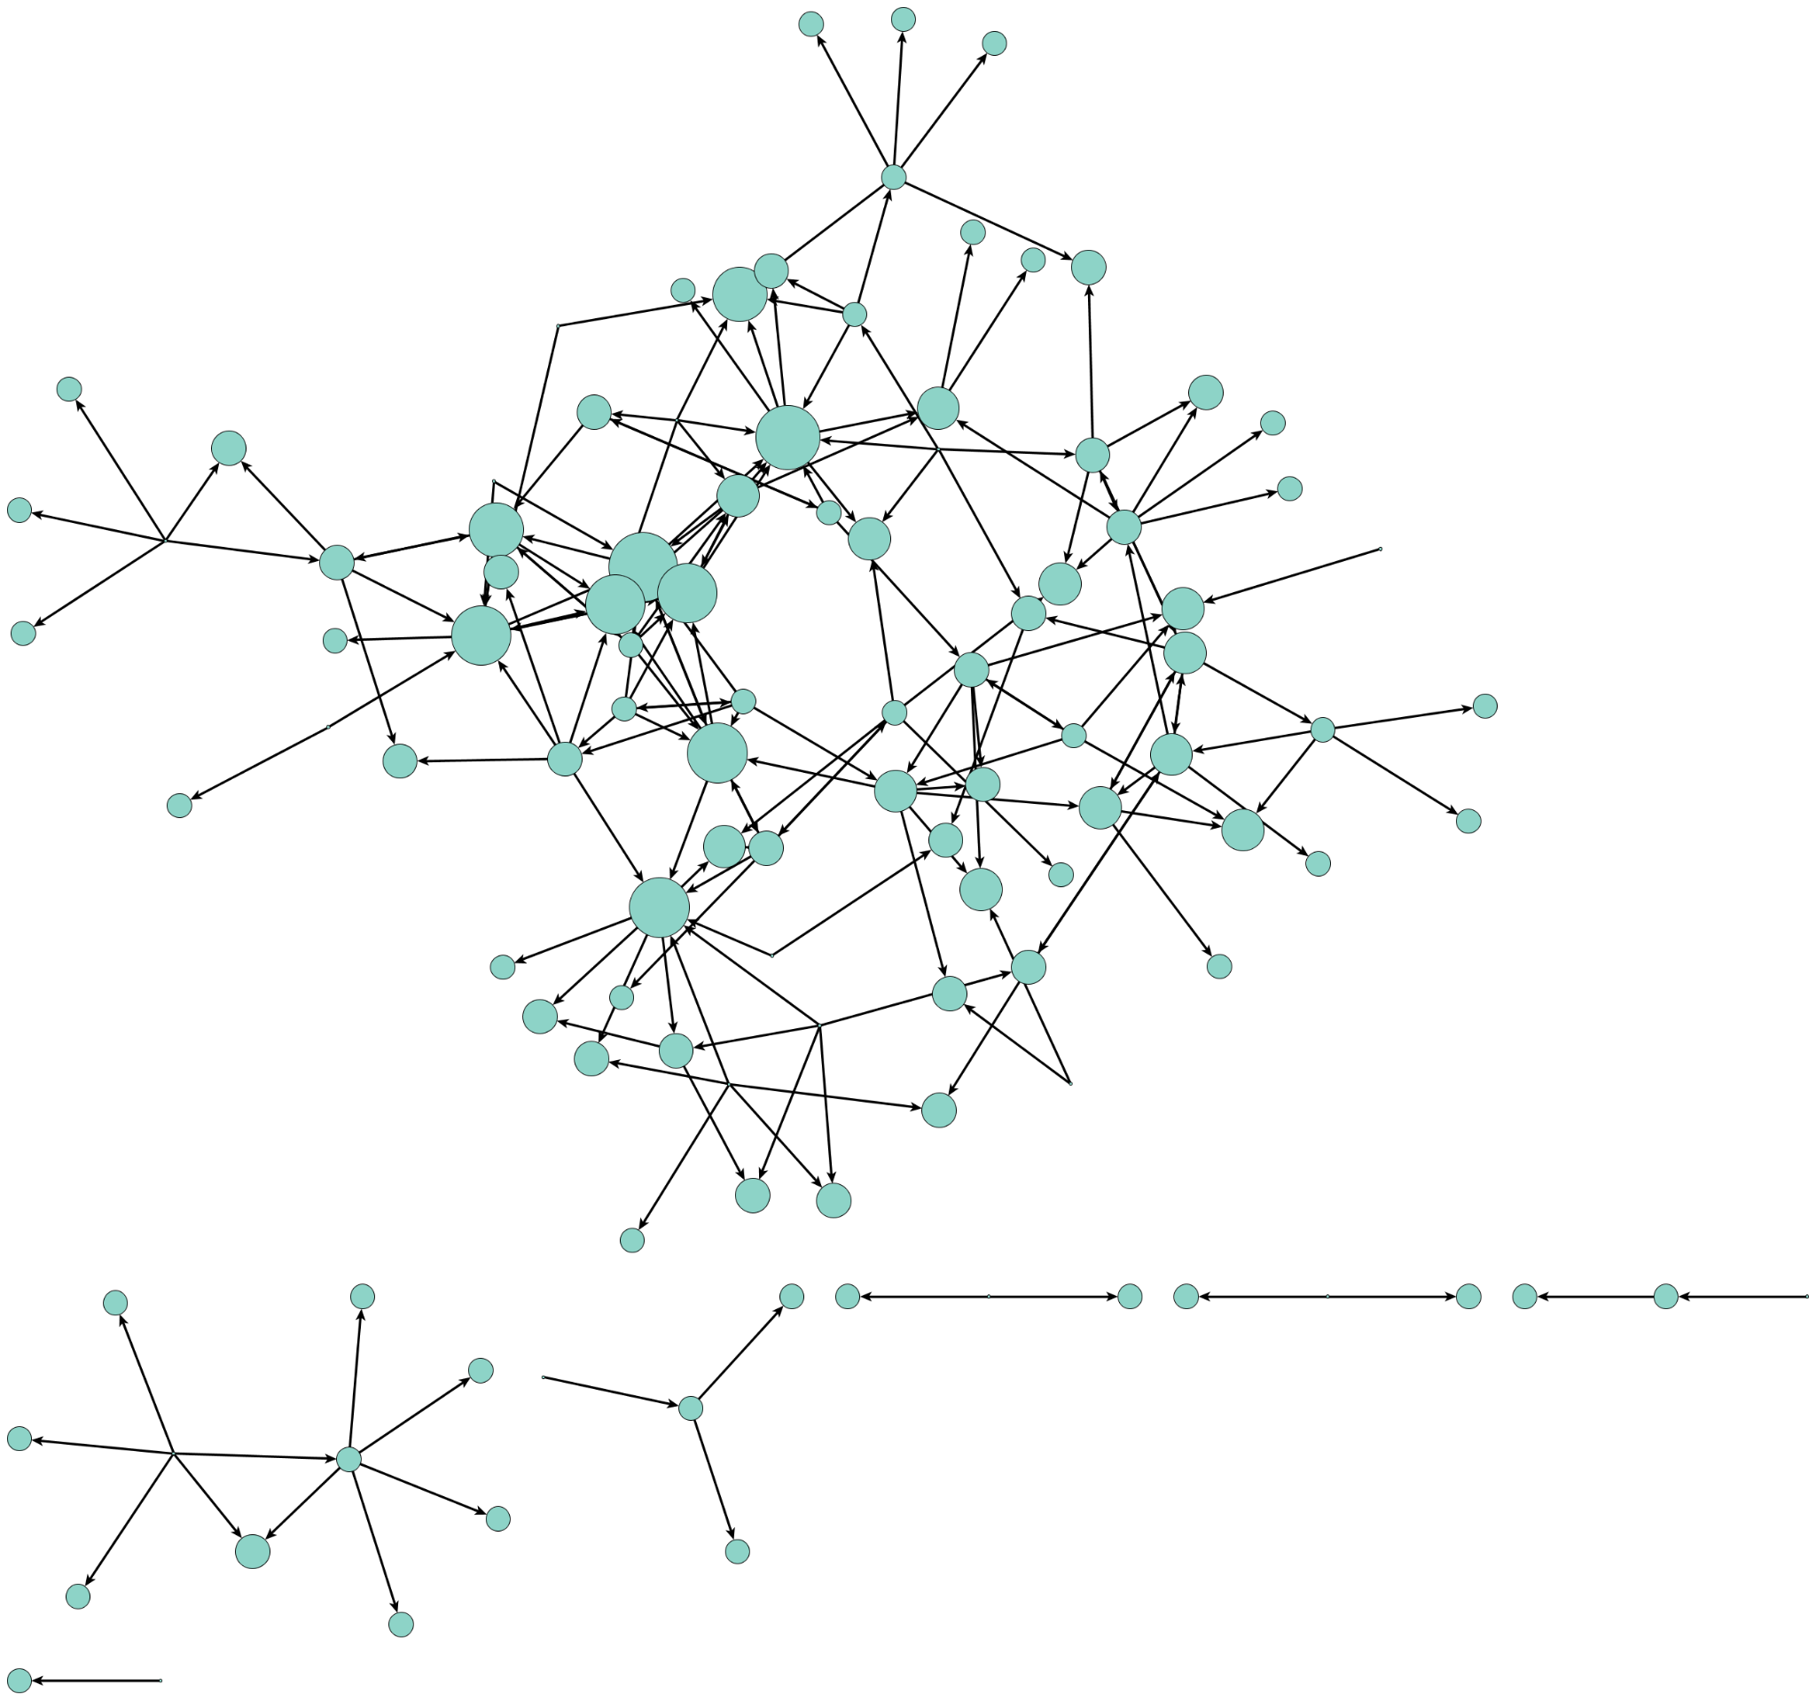
Work versus Learning Network
Notes:
Hannah -

Slide 20
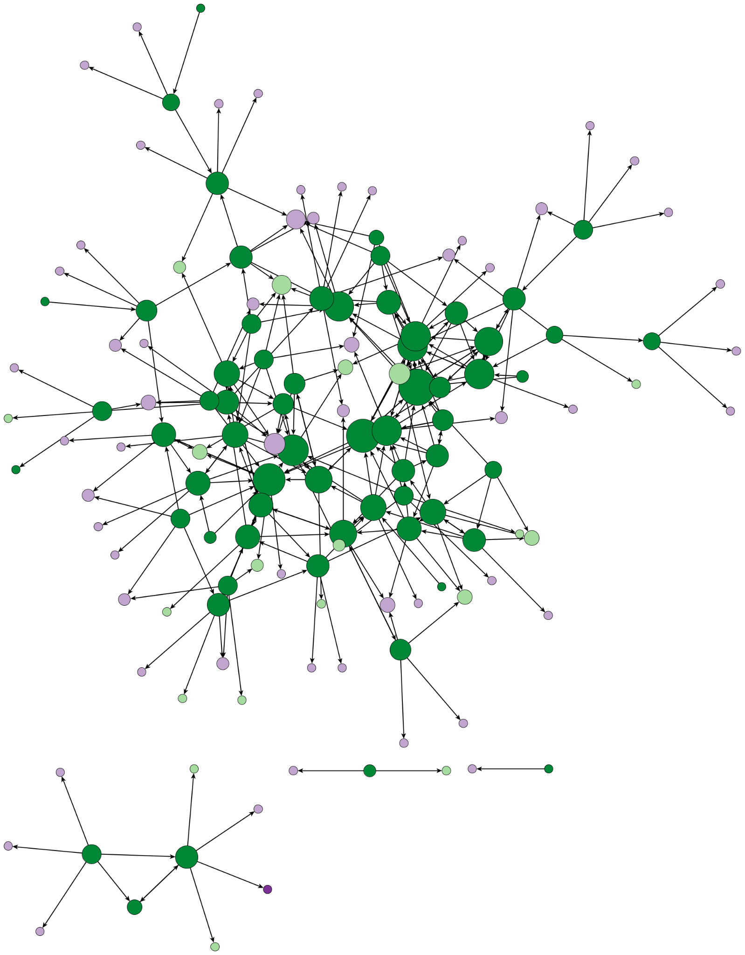
Opportunities for Growth
Expand Network Survey to larger UFS community
Increase survey response rate
Use results to create engagement metrics and improve engagement strategies
Notes:
ALI
Who took the survey
Of course we only had a 30% response rate, 100% response rate would have improved these results although with snowball sampling method 30% is pretty standard
Don’t force friendships, just think about who you should collaborate with etc.
Send survey to mailing

Slide 21
Conclusion
Engagement Strategy
SNA
Engagement Metric
Observation
Goal
Homogeneity in our network
Involve more stakeholder groups
EXPAND
# of total nodes
% Job Category of nodes
Code users and non-users in our network
Bridge between users and non-users
# unique connections (Degree)
CONNECT
Different Kinds of Working Relationships
Increase knowledge transfer
# of edges (connections) in work, learn, and advice networks
STRENGTHEN

Slide 22
Questions?
Thank You!
Alison Gregory agregory@ucar.edu
Hannah Love teamdivergentscience@gmail.com

Slide 23
Future Analysis
Complete list of Attributes
Social Network Survey Questions
What is your age? Select one.
I contribute valuable ideas to the UFS community. Select one.
The UFS is important to my current work. Select one.
I feel responsible for the success of the UFS. Select one.
How often do you contribute code to the UFS (Github, etc.)? Select one.
What is your highest education level? Select one.
How familiar are you with the UFS code base and related applications? Select one.
What gender identity best describes you?
What is your race and/or ethnicity? Select all that apply.
What best characterizes your job type? Select one.
What employment/career level best describes you? Select one.
Are you a member of a UFS Working Group or Cross-Cutting Team? Select one.
How often do you run the UFS code or associated applications? Select one.
Do you attend UFS Steering Committee Meetings? Select one.
Completion
  Relationship
  I see this person as a leader.
  This person is a mentor to me.
  I learn from this person.
  I seek advice from this person.
  Work
  I attend the same meetings, conferences, or workshops as this person.
  I occasionally meet one-on-one with this person.
  I have collaborated on a shared research project, publication, or presentation with this person.
  Combined
  Psych Safety
  I feel comfortable sharing new ideas with this person.
  I feel this person has my best interests in mind.
  I feel this person is qualified to give me good advice in this field.
  I trust this person.
Notes:
10 seconds
Goal is let audience know that this was a BIG study and we are showing a fraction of it.

Slide 24
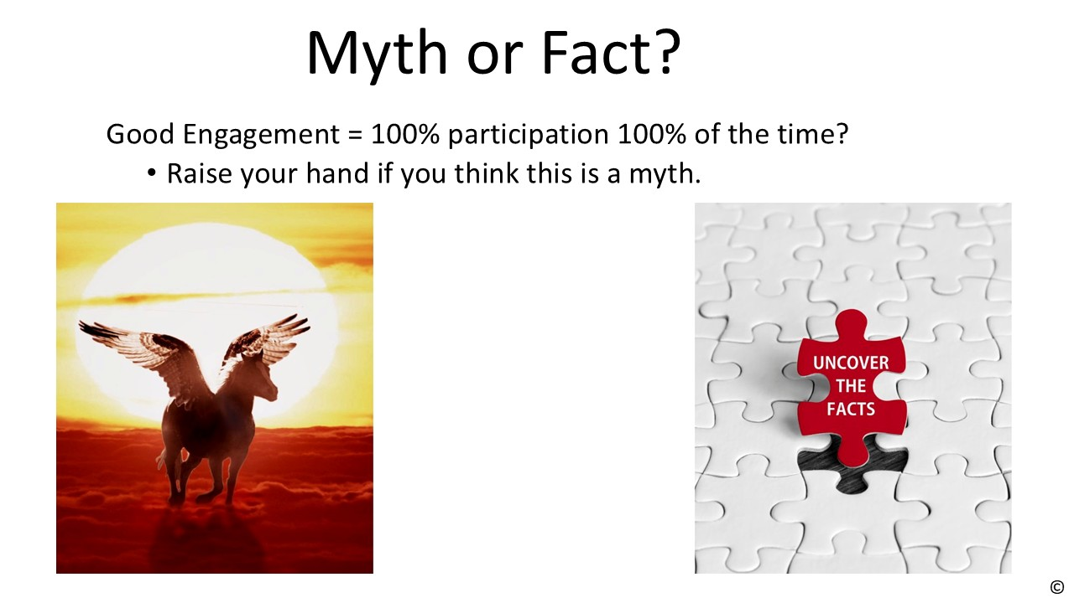

Slide 25
Familiar with the code Run the code Contribute to the code

