Slide 1
Improving Tropical Variability in the UFS for S2S Prediction
Lisa Bengtsson, NOAA OAR PSL
Acknowledgments:
Development: Jongil Han (EMC), Luc Gerard (RMI Belgium)
Diagnostic tools and discussions: Maria Gehne (PSL)
UCAR Center Green, Boulder, CO
September 8-12, 2025

Slide 2
UFS coupled global applications:
GFSv17, GEFSv13 and SFSv1
GFSv17, GEFSv13 and SFSv1 will be the first global coupled applications to become operational under the UFS infrastructure.
A lot of innovations over the past 5 years have helped improve tropical variability in these systems:
FV3-MOM6 coupling
Improved initialization
Improved physics (from GFSv16 to GFSv17):
https://vlab.noaa.gov/web/ufs-r2o/atmospheric-physics/gfsv17-gefsv13-prototypes
See also Fanglin Yang’s poster

Slide 3
Focus in this talk: moisture sensitivity in convection parameterization.
In cumulus convection parameterization, we generally talk about three building blocks:
Trigger: When/where to activate the convection scheme.
Cloud-model: Effect of convection on the environment.
Closure: Regulation of the amount of convection by the grid-scale variables.

Slide 4
Two Ways to Close Convection: A Simplified View
Closure 1: Convection amount is regulated by grid-scale buoyancy - diagnostic each time-step. (prog_false)
Closure 2: Convection amount is regulated by grid-scale buoyancy and moisture flux convergence - prognostic with memory in time. (prog_true)
Closure 2 is used in GFSv17 and GEFSv13 pre-operational prototypes, but was not included in SFS prototypes until recently.
A Prognostic-Stochastic and Scale-Adaptive Cumulus Convection Closure for Improved Tropical Variability and Convective Gray-Zone Representation in NOAA’s Unified Forecast System (UFS). Bengtsson et al. 2022 DOI: https://doi.org/10.1175/MWR-D-22-0114.1

Slide 5
Experiment design - members, years, version
SFSbeta0.1
30 IC’s: November 01, 1994-2024
1 year forecast lead-time.
11 Ensemble members
C96/1degree (~100km atmosphere/~100km ocean).

Slide 6
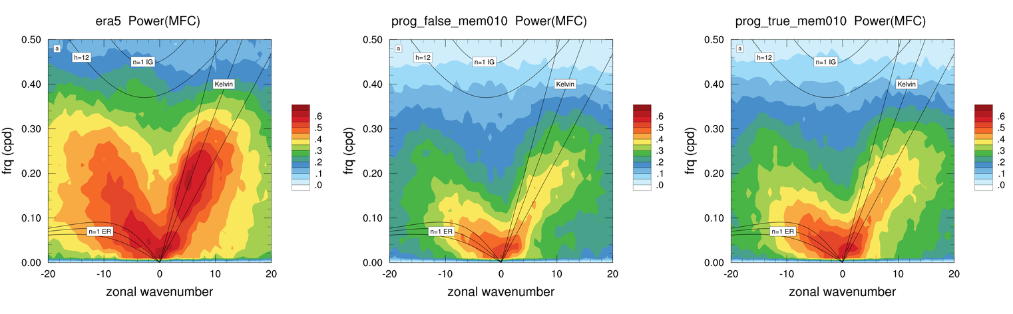
Relationship between Moisture Flux Convergence and Precipitation in Tropical Wave Bands
ERA5 MFC <> PRATE coherence²
prog_false MFC <> PRATE coherence²
prog_true MFC <> PRATE coherence²
Coherence² between MFC and precipitation is enhanced when MFC is included as a source term in the closure.
Following the method of Wheeler and Kiladis, 1999 and Dias et al. 2018

Slide 7
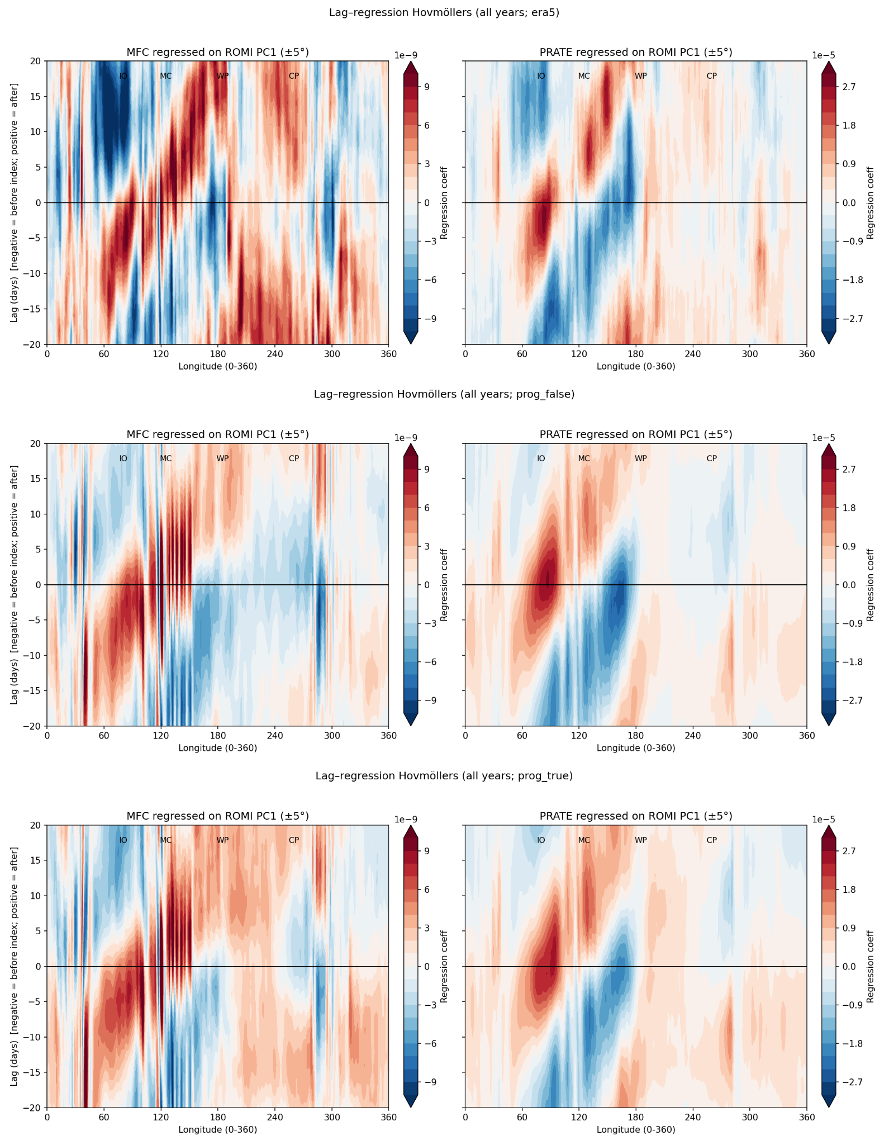
Does low-level moisture flux convergence lead precipitation in the MJO?
All years, all members
MFC
PRATE
Lag-longitude regressions (Hovmöller) of MFC and PRATE on ROMI
Lag = 0 = reference phase of ROMI
Negative lags = conditions before; positive = after
Key findings
MJO propagates eastward (IO → MC → Pacific)
MFC peaks 2–5 days before rainfall at same longitude → convergence as a precursor to convection
ERA5: stronger regression of MFC at negative lags over western/central Pacific → early moistening ahead of IO/MC convection
Effect is enhanced in “prog_true” vs “prog_false” experiment
ERA5
prog_false
prog_true

Slide 8
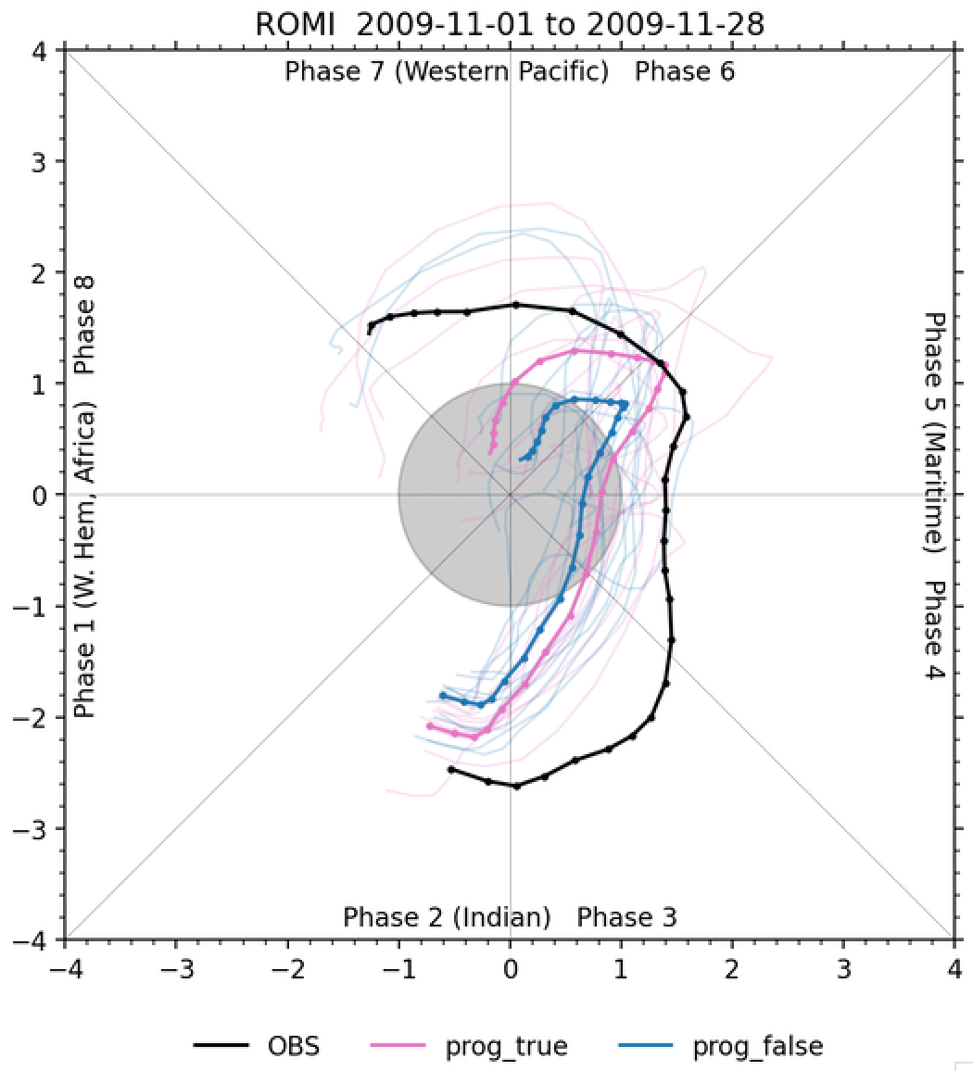
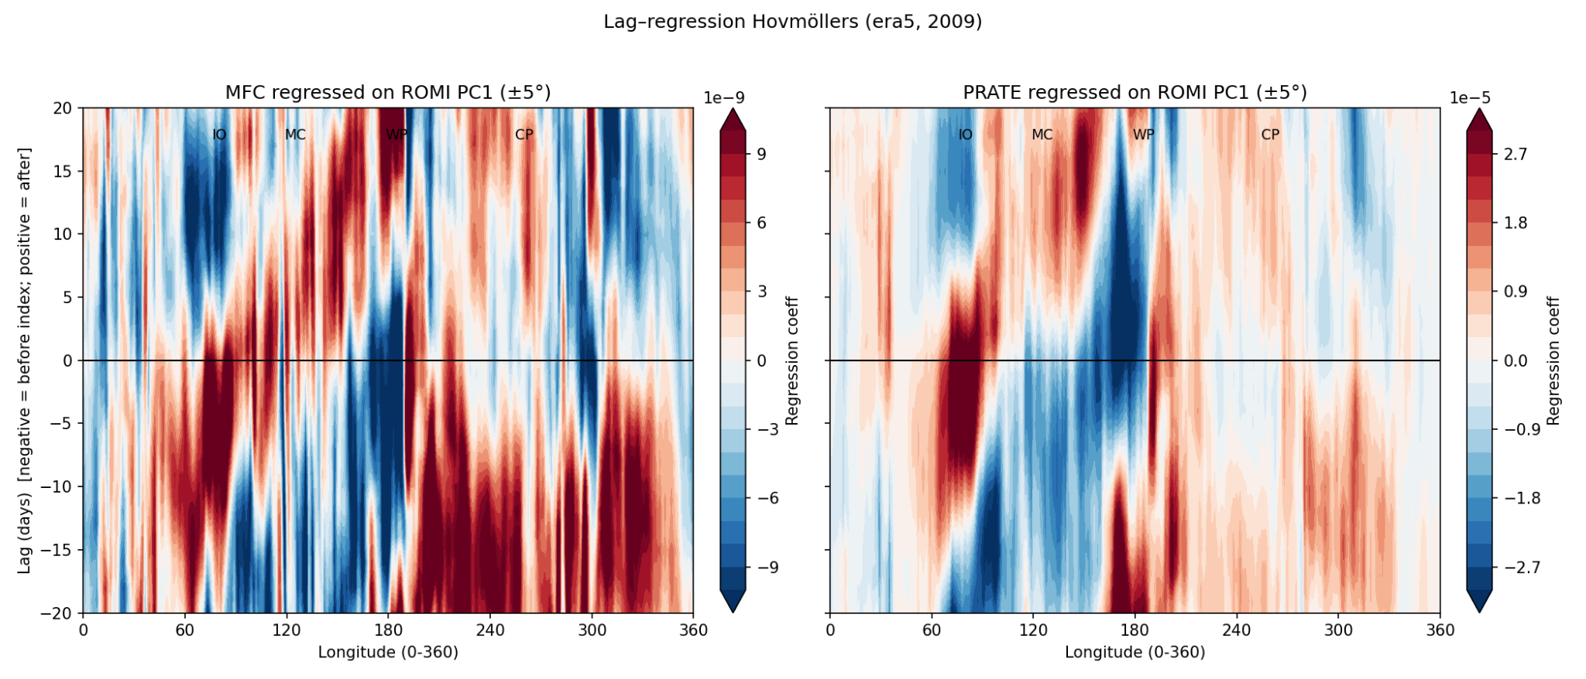
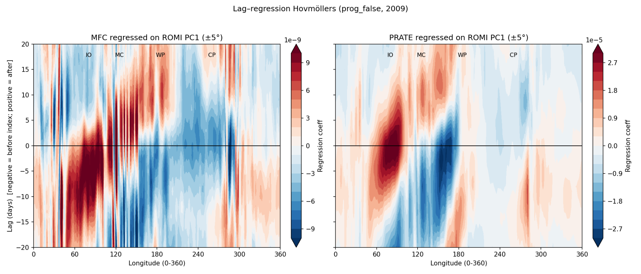
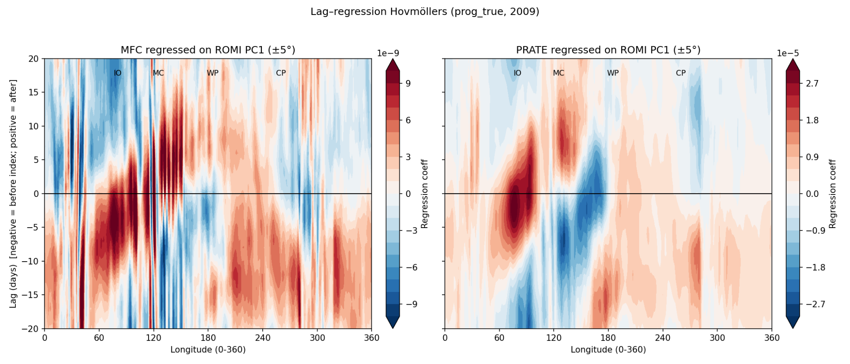
2009 - Maritime Continent Crossing
2009, all members
MFC
PRATE
ERA5
prog_false
prog_true

Slide 9
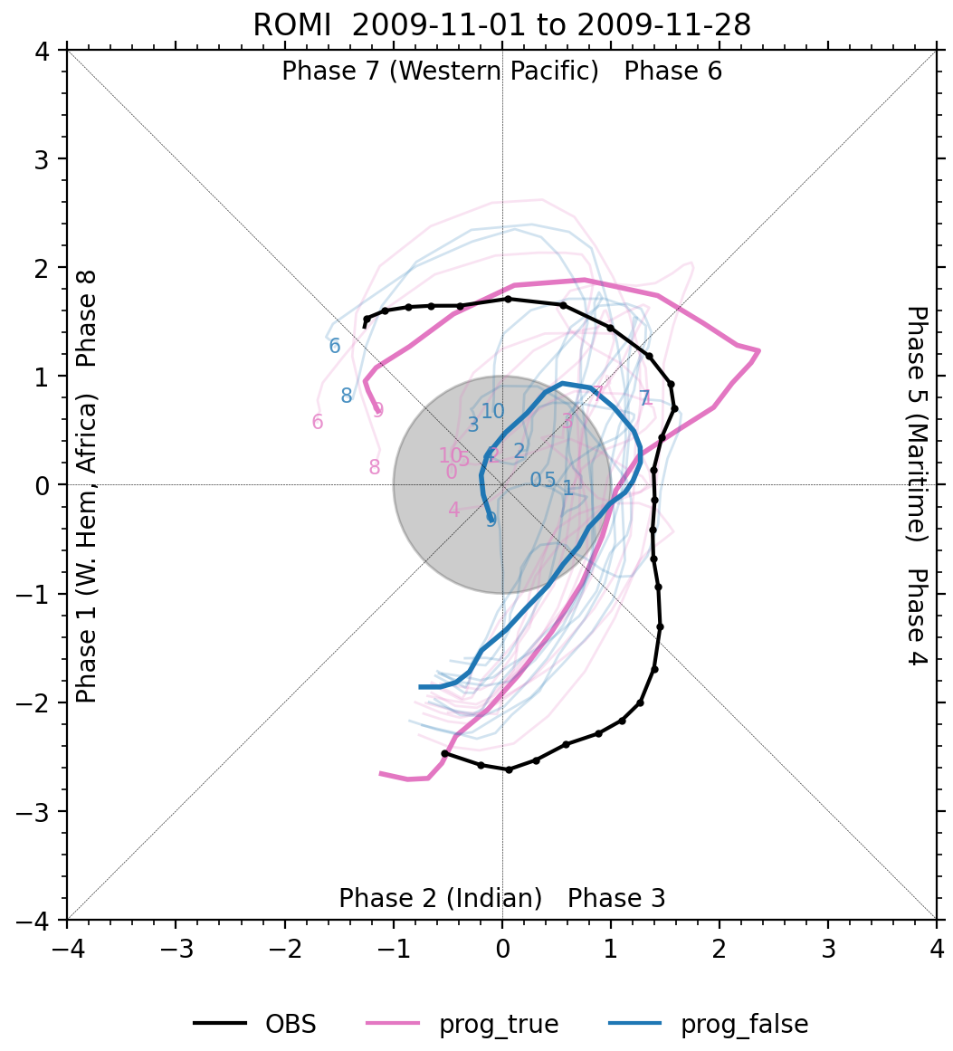
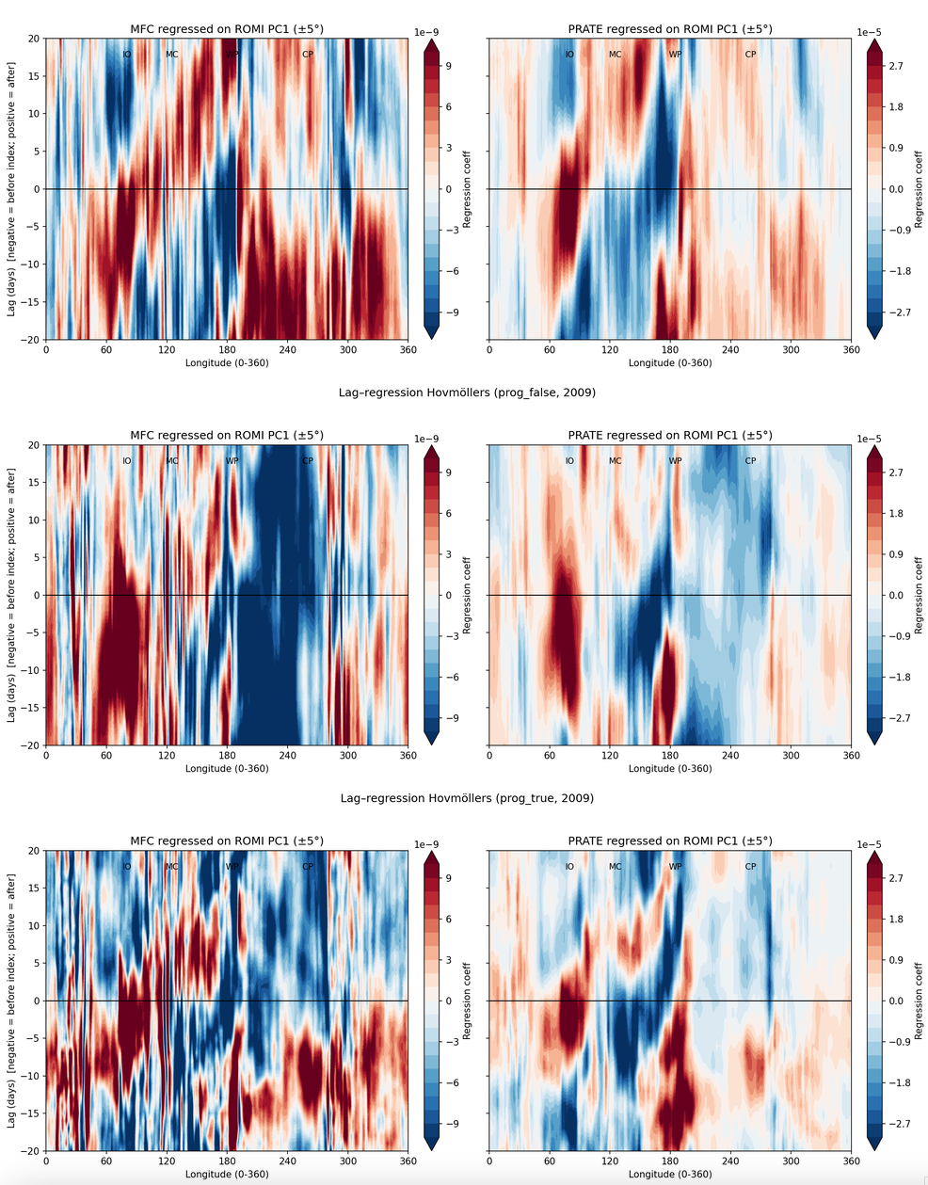
2009 - Maritime Continent Crossing
2009, member 9
MFC
PRATE
ERA5
prog_false
Successful vs. unsuccessful MC crossings – what can we learn?
Enhanced regression of MFC onto ROMI at negative lags over western/central Pacific → circulation moistens Pacific ahead of IO/MC convection
Preconditioning by MFC supports eastward MJO propagation across the Maritime Continent barrier
prog_true

Slide 10
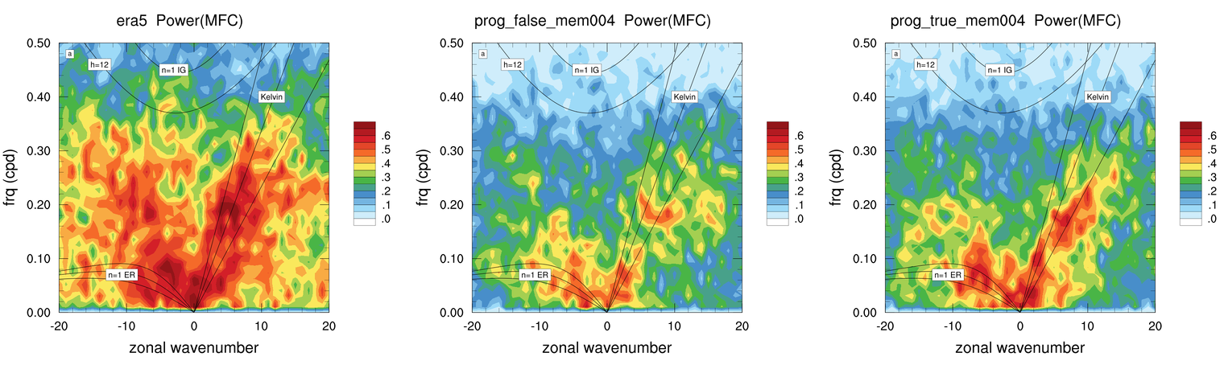
2009 - Maritime Continent Crossing
ERA5 MFC <> PRATE coherence²
prog_false MFC <> PRATE coherence²
prog_true MFC <> PRATE coherence²
MFC/PRATE coherence² in member that crosses the Maritime Continent.

Slide 11
Summary
Including Moisture Flux Convergence in a Prognostic Convection Closure Strengthens MJO Preconditioning and Propagation in NOAA’s UFS
By including MFC in the closure, convection can be sustained by large-scale convergence, not only by grid-scale buoyancy.
In the CP/EP, large-scale flow often produces convergence anomalies ahead of deep convection. With the new closure, the model projects these anomalies more strongly onto convection.
The regression pattern could reflect earlier or stronger convective moistening, which aligns with the observed eastward preconditioning.
It does not necessarily mean that the circulation itself is different (though feedbacks may modify it).
Instead, it suggests that the convective heating response is better aligned with MFC anomalies.
This alignment amplifies the apparent statistical relationship between MFC and ROMI in the regression.

Slide 12
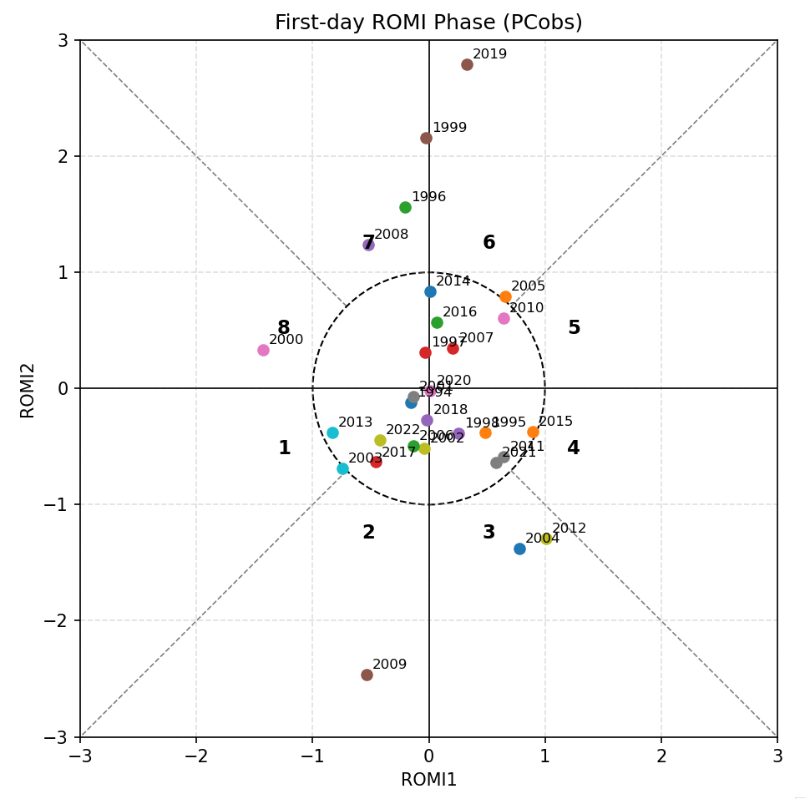
Motivation for an MJO testbed
Out of the 30 November 1 IC’s (1994-2024), only 9 cases have an observed ROMI amplitude larger than 1.
Not ideal to study impact of physics (if the model struggles to initilize the MJO).
See Juliana Dias talk on creating an MJO testbed (cases) for the global UFS applications.

Slide 13
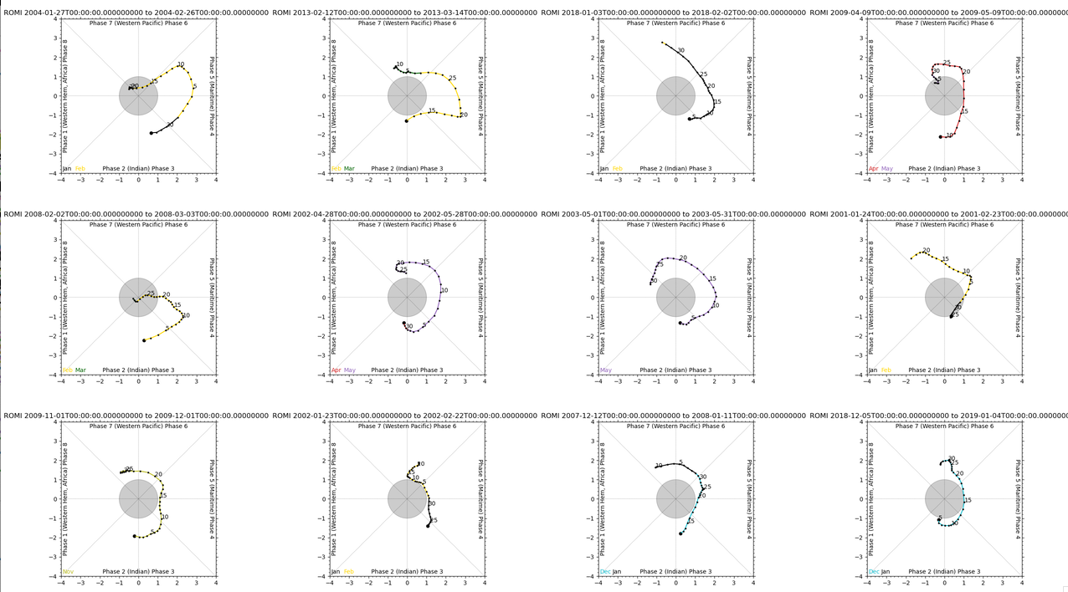
New cases to consider

Slide 14
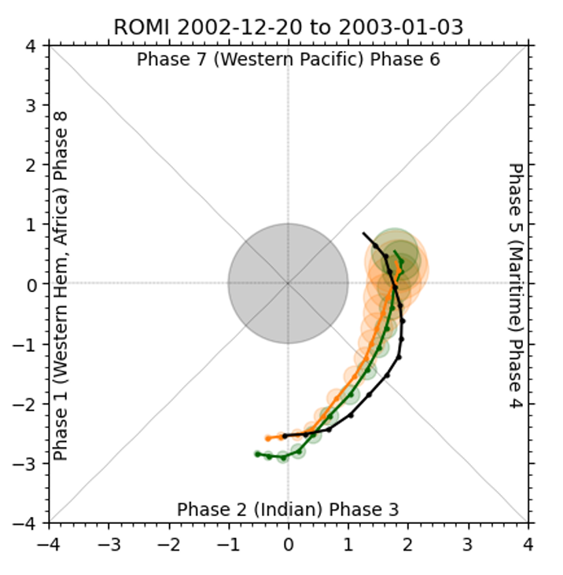
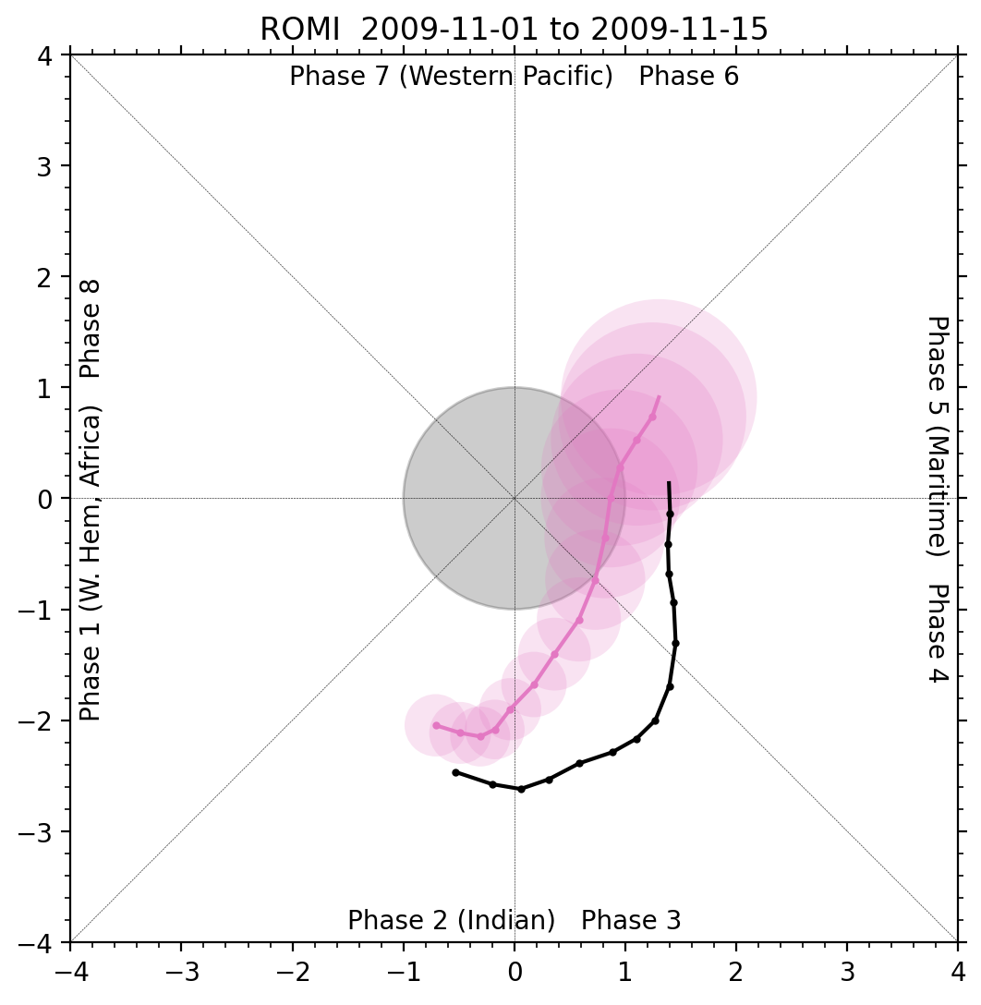
Ensemble spread is much larger in SFS_beta0.1 compared to previous SFS prototypes
SFS baseline
SFS beta_0.1
IC perturbations from ERA5 EDA system.
IC perturbations from CORe ENKF DA system.

Slide 15
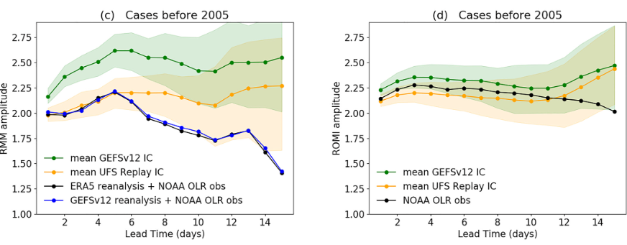
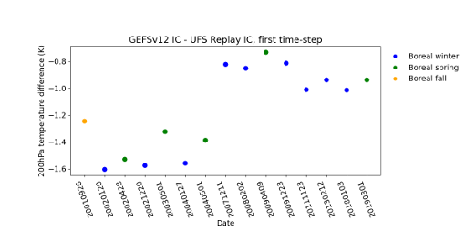
The crucial role of the initial state in MJO prediction
In preparation for SFSv1 we found the MJO amplitude very sensitivity to initialization (UFS-Replay vs GEFSv12 reanalysis)
Upon examination of the initial state variables we found large initial upper level temperature differences
Bengtsson, L. et al. (2025). The crucial role of the initial state in MJO prediction. Geophysical Research Letters, 52, e2025GL115833. https://doi.org/10.1029/2025GL115833

Slide 16
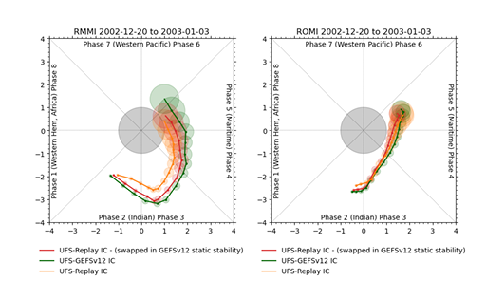
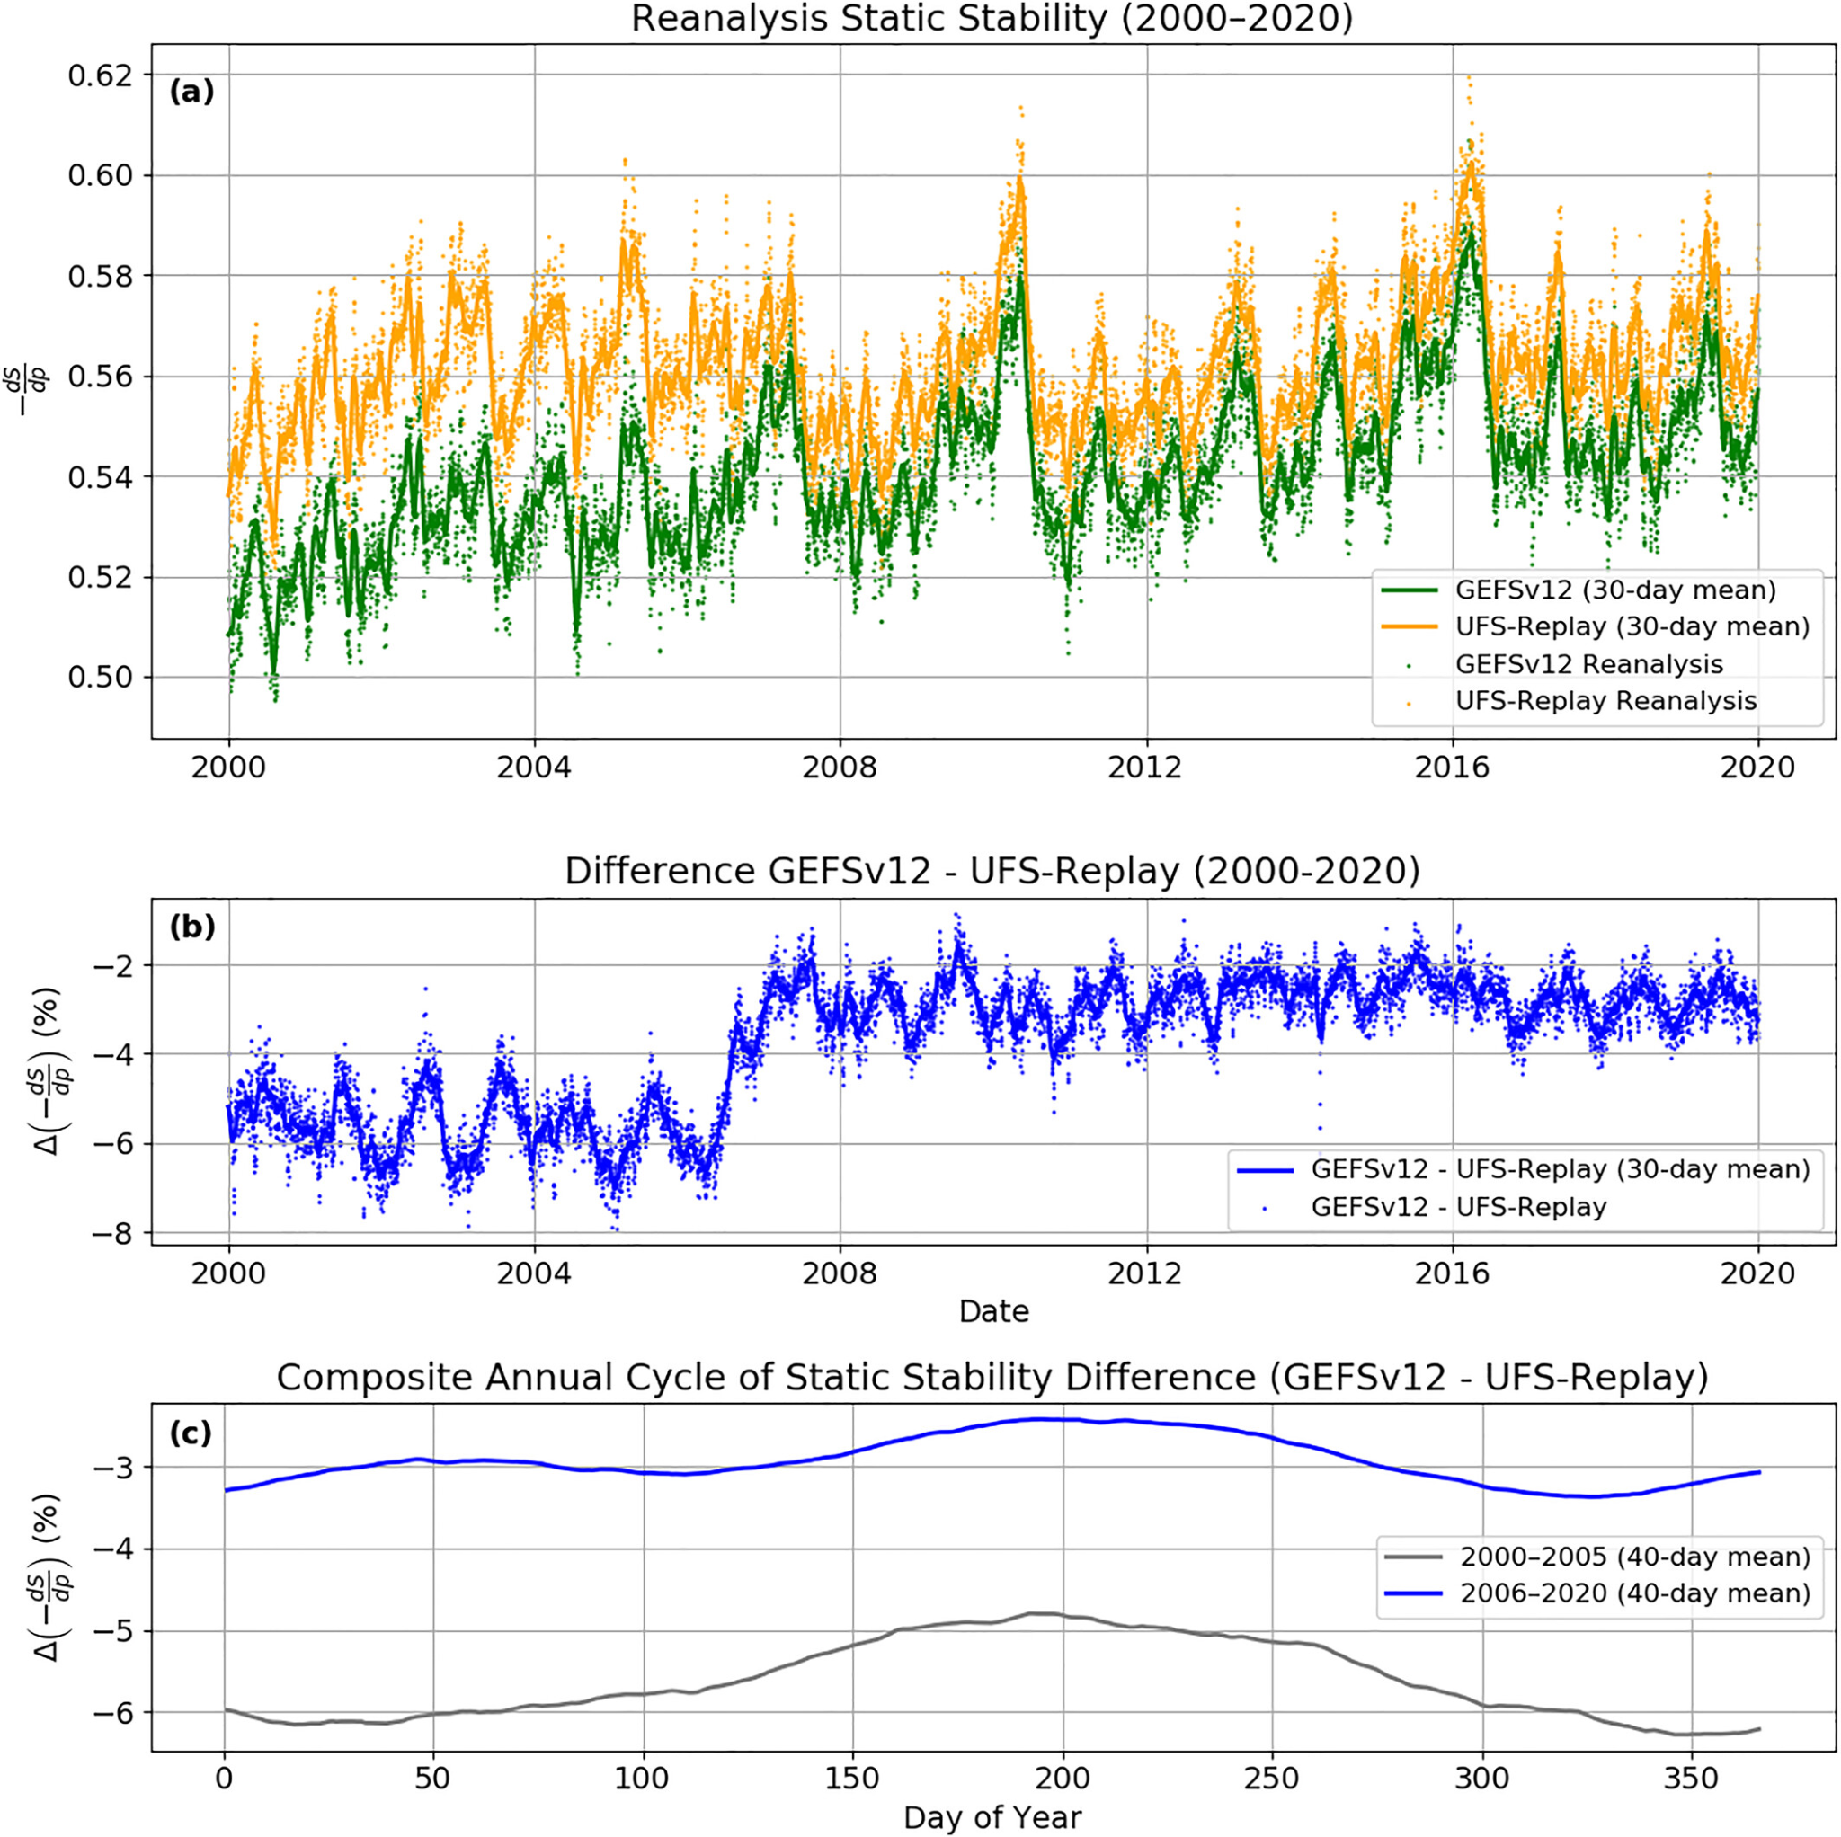
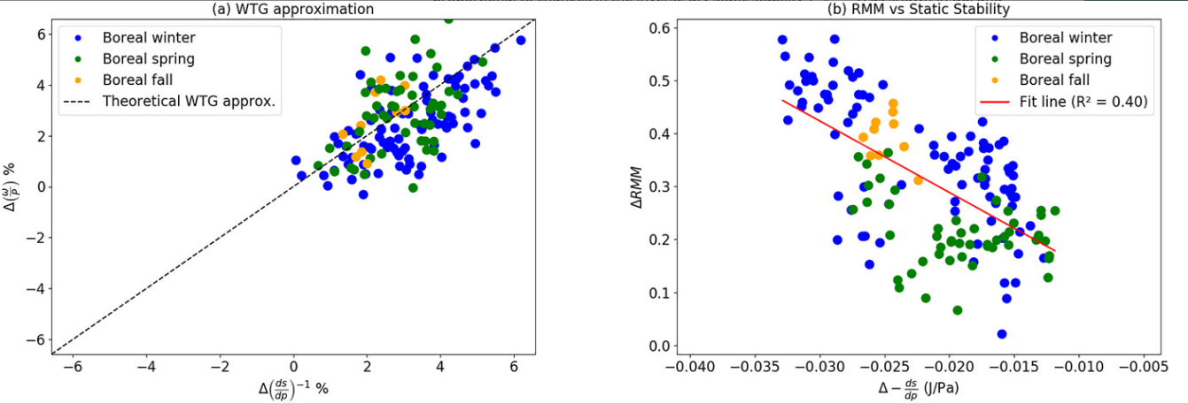
The crucial role of the initial state in MJO prediction
An atmosphere that is colder aloft is more statically unstable
Following the weak temperature gradient approximation; given the same heating, vertical velocity is proportional to static stability.
Enhanced vertical velocity increases upper level divergence.
Bengtsson, L. et al. (2025). The crucial role of the initial state in MJO prediction. Geophysical Research Letters, 52, e2025GL115833. https://doi.org/10.1029/2025GL115833

Slide 17
Conclusions
Physics Development:
Examined how moisture flux convergence (MFC) sensitivity in new cumulus convection closure influences the MJO.
Prog_true scheme shows an enhanced regression of MFC onto ROMI at negative lags over the western/central Pacific, suggesting the circulation moistens the Pacific in advance of IO/MC convection.
Case study: This preconditioning by MFC appears beneficial for eastward MJO propagation across the Maritime Continent.
Initial condition sensitivty:
Found large sensitivity in circulation based MJO metrics due to differences in the initial state static stability.
The differences in static stability enhances vertical motion (given the same heating, following the weak temperature gradient approx).
Bengtsson, L. et al. (2025). The crucial role of the initial state in MJO prediction. Geophysical Research Letters, 52, e2025GL115833. https://doi.org/10.1029/2025GL115833

