Slide 1
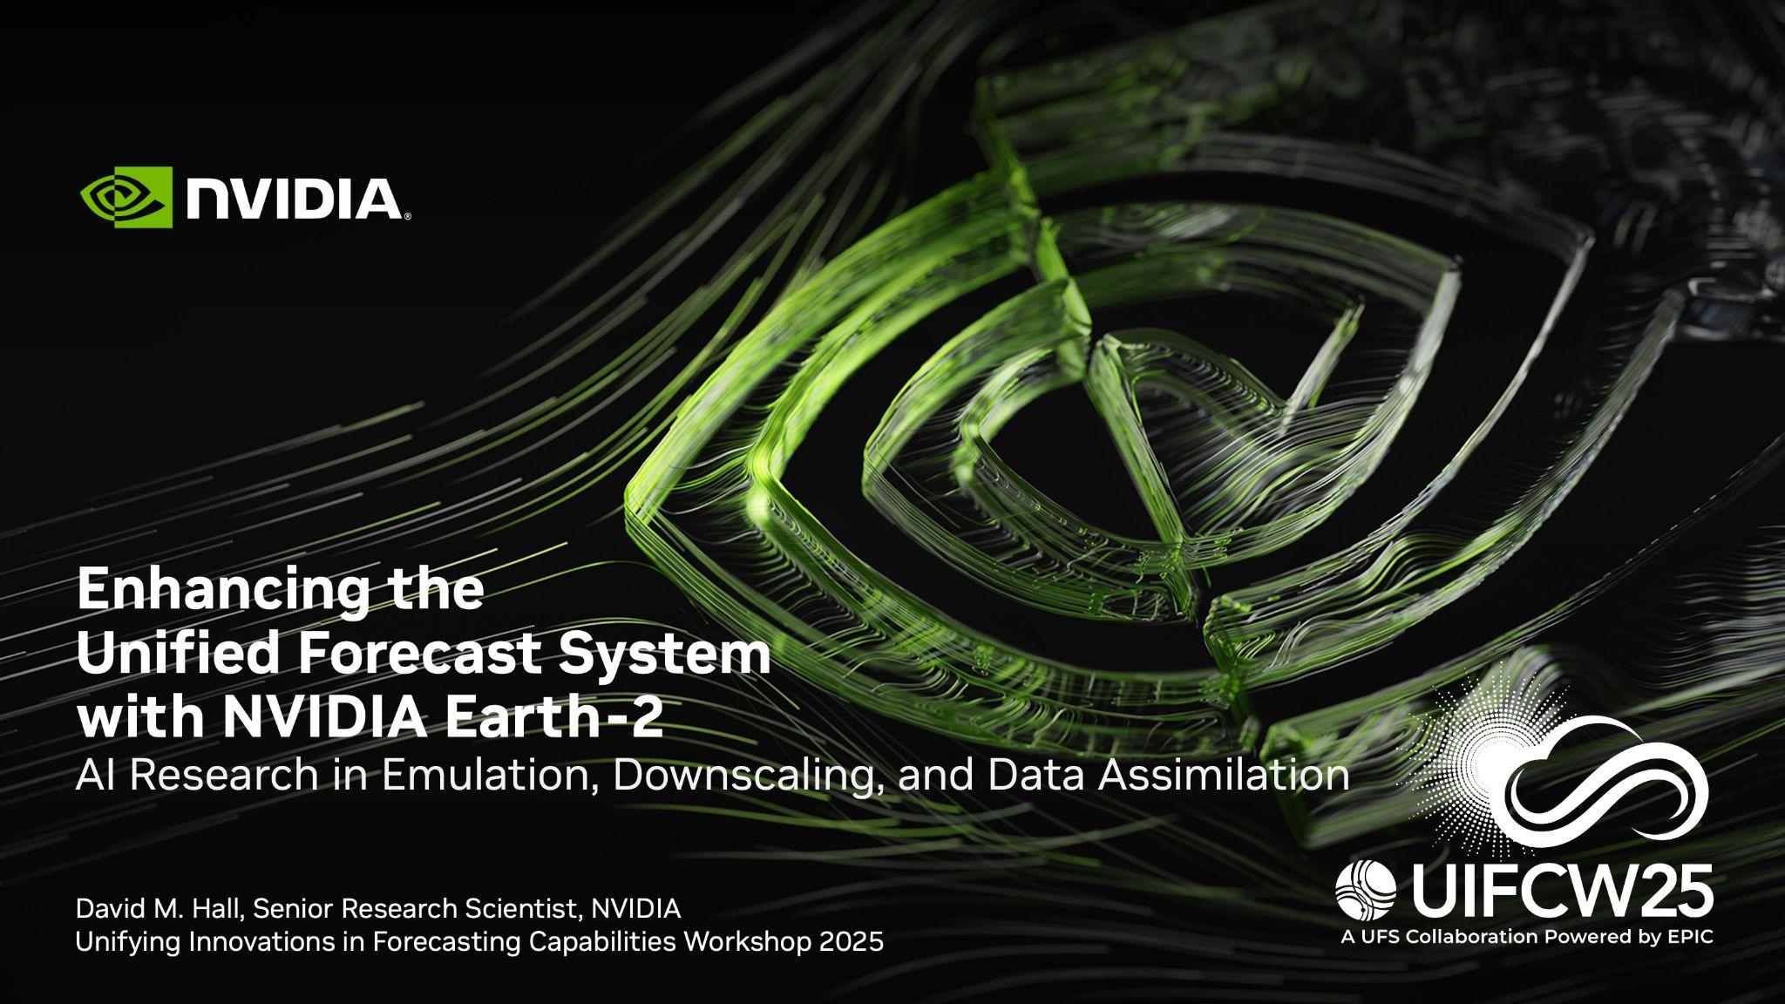
Notes:
Good morning. Thank you for the invitation to speak today. Today my goal is to demonstrate how AI based technologies, like those developed by NVIDIA's Earth-2 research team, have the potential to complement and enhance the Unified Forecast System.

Slide 2
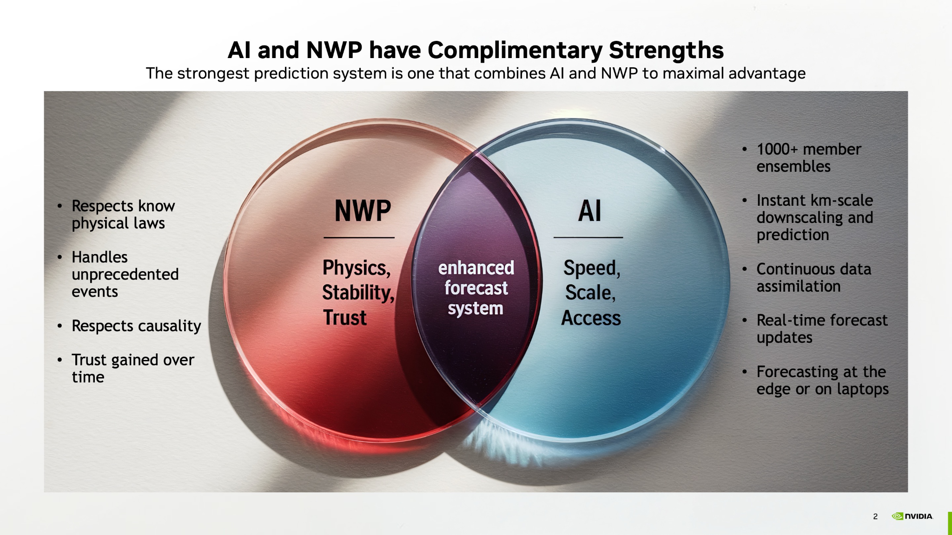
Notes:
Artificial intelligence and conventional NWP have complimentary strengths. NWP provides a physical foundation: maintaining conservation laws, handling unprecedented events, and understanding causality. However, computational limits cap what's feasible within an operational forecast window. AI on the other hand has the potential to address some of these challenges by enabling 1000+ member ensembles, instant km-scale downscaling, continuous data assimilation, real-time forecast updates, and forecasting at the edge or on modest hardware. In my opinion, the strongest system is one that takes maximal advantage of each.

Slide 3
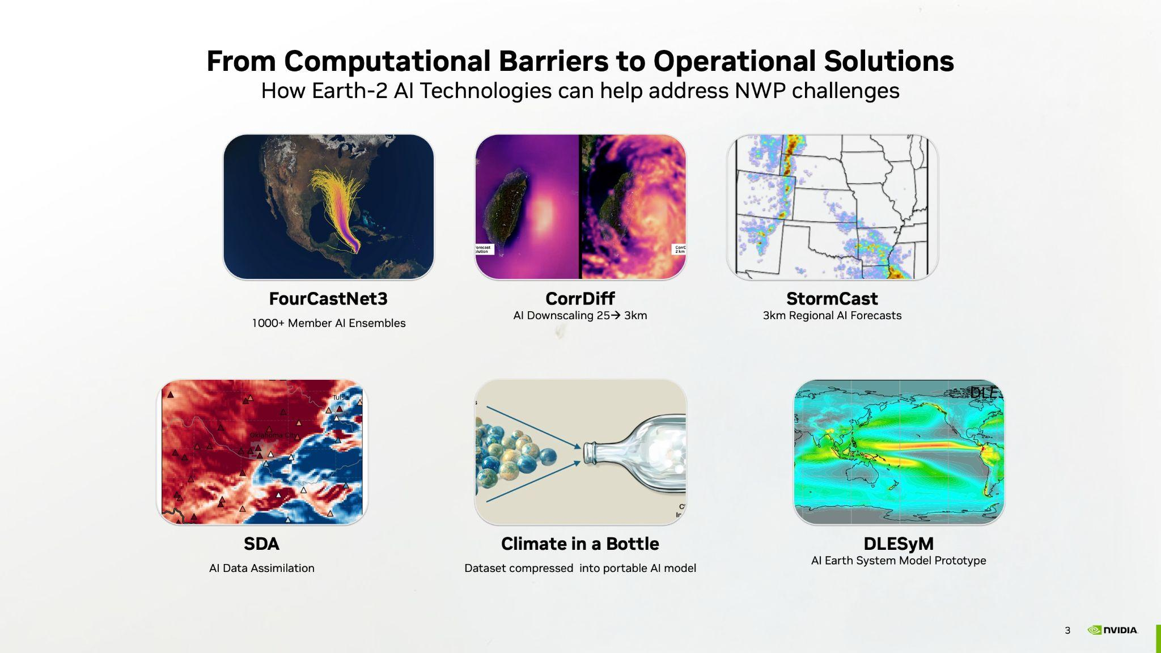
Notes:
NVIDIA’s Earth-2 Research team has developed a suite of AI models that can augment UFS in helpful ways, which I will detail in this talk. But as a brief overview, NVIDIA FourCastNet 3 generates 1000s of well calibrated ensemble members. CorrDiff can downscale ensemble members in seconds. NVIDIA StormCast can provide instantaneous regional forecasts. AI-accelerated data assimilation could enable real-time forecasting. NVIDIA’s Climate in a bottle compresses massive datasets, making them portable and accessible. And DLESyM is our prototype for a coupled AI Earth-System model.

Slide 4
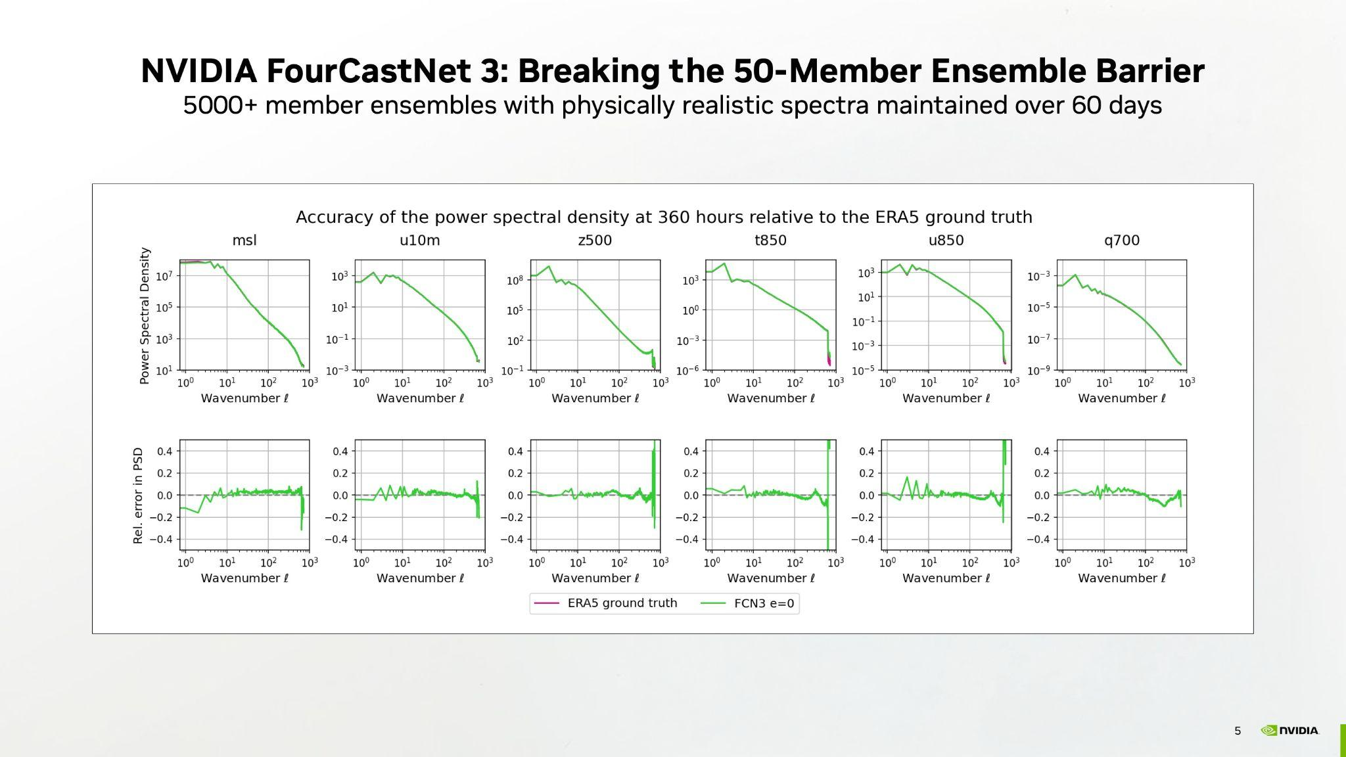
Notes:
FourCastNet 3 is our latest spherical neural operator model for global weather prediction, delivering fundamental advances over previous AI weather models.
Unlike previous AI models including FourCastNet 2, it maintains accurate energy spectra over time, correctly handles spherical geometry, and produces properly calibrated probabilistic ensembles with thousands of members.
These plots show spectral power density of FourCastNet 3 in green for various atmospheric fields. Compared with ERA5 at 15 days lead time, the spectra are accurately maintained across all wavenumbers, from planetary scales to the smallest resolvable features.

Slide 5
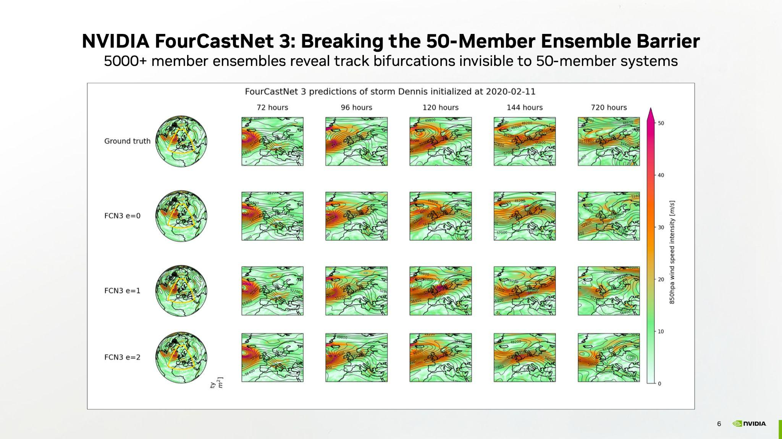
Notes:
These visualizations show the ensemble diversity of FCN3.
Each row represents a different member initialized from perturbed UFS initial conditions, evolving over 30 days. Note that the vorticity patterns maintain physical consistency while exploring different storm tracks and intensification scenarios.
The operational impact could be significant. As discussed in the FCN3 paper, during the 2024 Atlantic hurricane season, studies of 5,000-member ensembles revealed track bifurcations and intensity outliers that were completely missed for ensemble sizes smaller than 500 members.
High spectral accuracy coupled with large ensembles is potentially a game changer for emergency management.

Slide 6
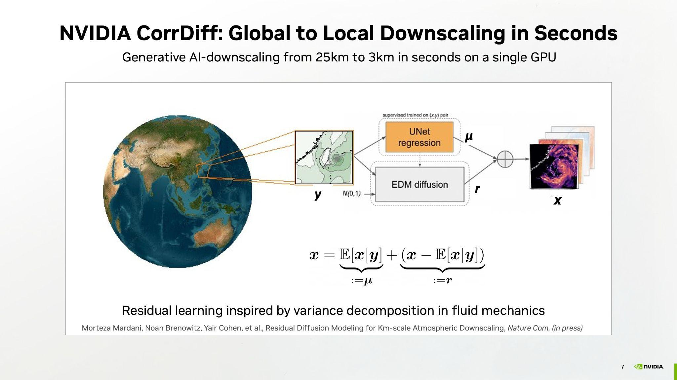
Notes:
NVIDAI CorrDiff is our AI model which downscales from global to regional scales. Traditional downscaling can take hours on hundreds of processors, which is impractical for ensemble predictions. CorrDiff performs accurate downscaling in seconds on one GPU.
The architecture is inspired by Reynolds decomposition from fluid dynamics, which separates mean flow from perturbations. A U-Net predicts the deterministic mean, then a diffusion model adds stochastic variability. This separation focuses generative learning on small-scale features while preserving large-scale patterns. The result is 25-kilometer global forecasts transformed to 3-kilometer resolution, a thousand-fold increase in grid points, with physically consistent convective structures.

Slide 7
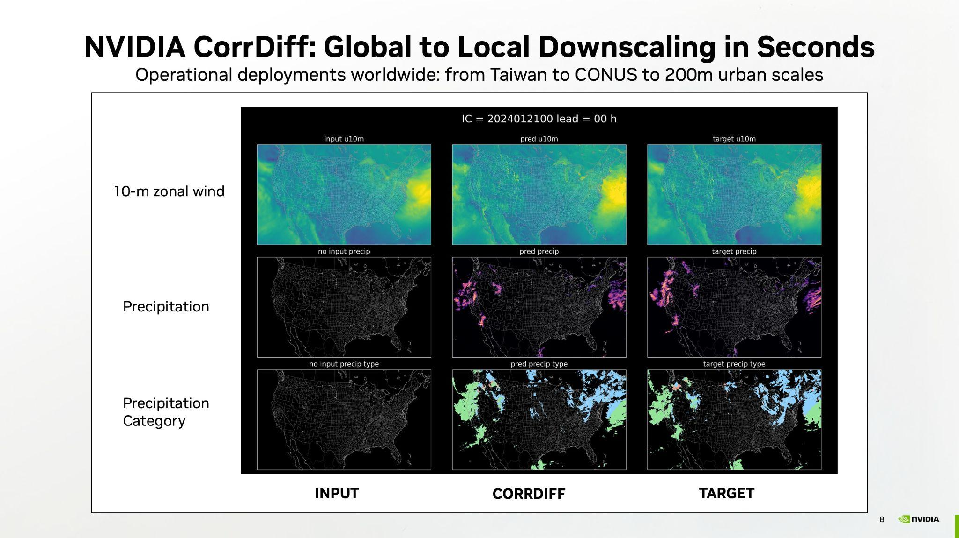
Notes:
These validation panels show CorrDiff performance over the Continental United States. The left column show the coarse 25-kilometer input, the center shows CorrDiff output, and the right shows the high-resolution target field.
Notice that CorrDiff recovers fine-scale winds, precipitation structures, and even precipitation types that were completely absent in the input. The models is not interpolating, rather it is employing learned physical relationships between scales.
CorrDiff's spatial locality enables regional adaptation, from Taiwan's initial deployment to CorrDiff-US for CONUS which is now processing GEFS outputs operationally. Taiwan's disaster center cut typhoon forecasting costs 50-fold. While G42 in the UAE achieved 200-meter resolution downscaling for the Abu Dhabi region.

Slide 8
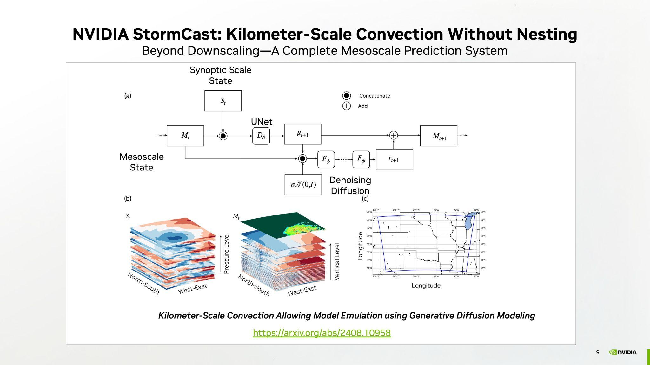
Notes:
NVIDIA StormCast built on our success with CorrDiff pushing beyond downscaling to become a complete mesoscale prediction system that can enhance UFS's convection-allowing capabilities.
Similar to CorrDiff, the architecture combines synoptic-scale and mesoscale information through a hybrid approach. The UNet handles deterministic evolution while the denoising diffusion model captures stochastic convective-scale variability.
Unlike CorrDiff, StormCast generates new kilometer-scale predictions directly from any resolution initial conditions including UFS analyses, without the need for grid nesting and complex boundary condition treatments. Trained on HRRR data, StormCast learned to emulate convection-allowing dynamics, generating 3-kilometer forecasts in seconds rather than the hours required by traditional nested models.

Slide 9
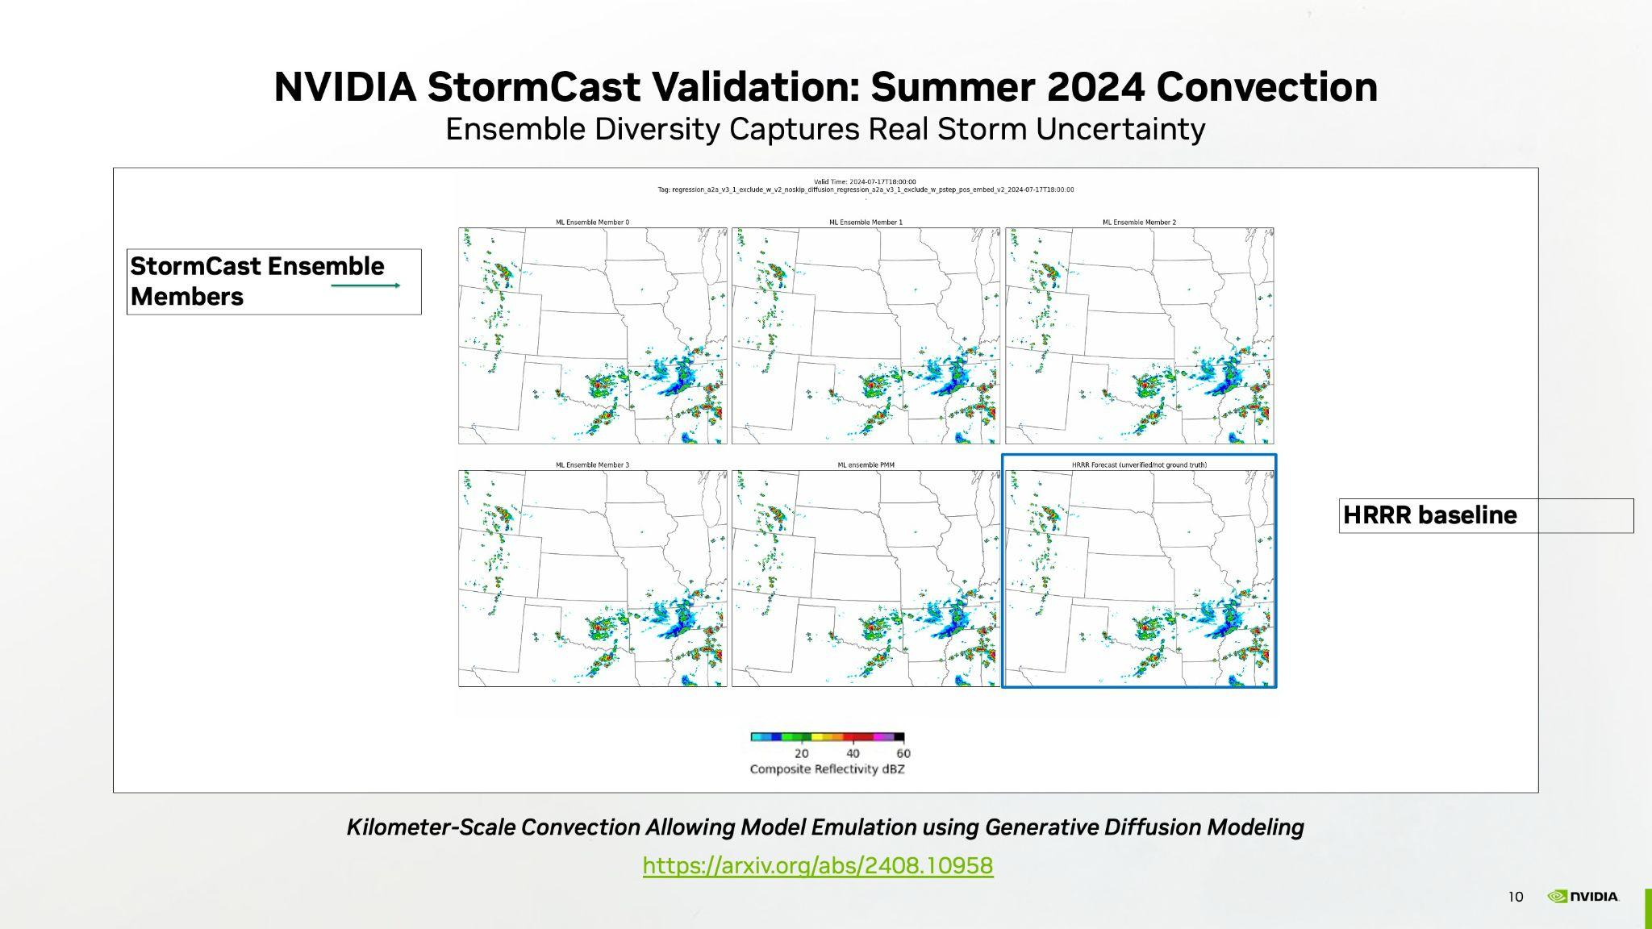
Notes:
This July 2024 case demonstrates StormCast's ability to generate realistic convective structures. Each ensemble member shows slightly different but meteorologically consistent patterns, capturing the inherent uncertainty in convective initiation and evolution. Each member has skill comparable to HRRR's single deterministic solution shown in the blue box. For UFS operations, this means rapid convection-allowing guidance without running expensive nested domains. When GEFS indicates potential severe weather, StormCast can instantly generate kilometer-scale ensemble forecasts for that specific threat area, providing probabilistic convective-scale guidance that complements UFS's global products.

Slide 10
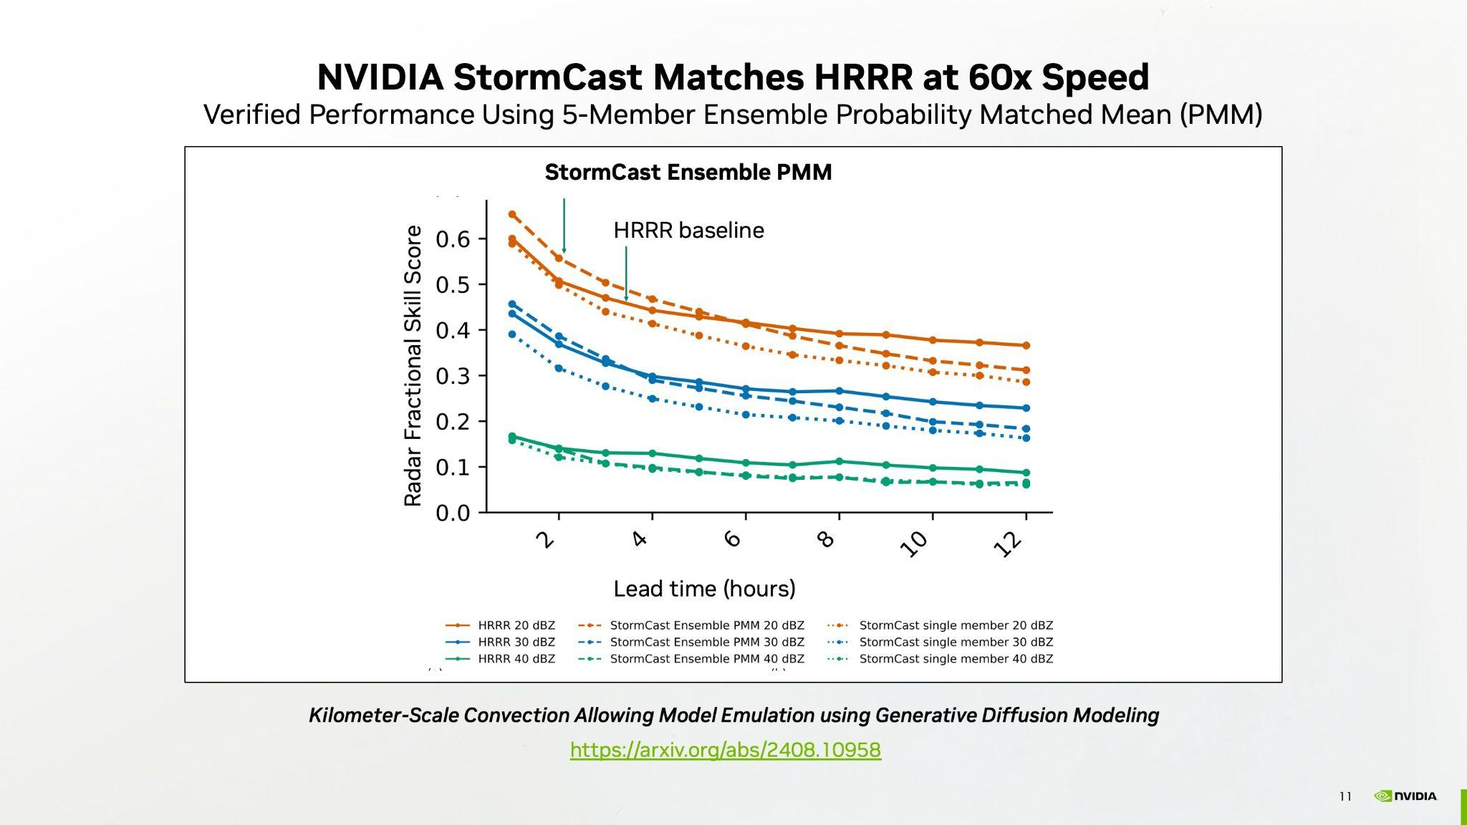
Notes:
This validation plot shows StormCast matching HRRR's skill through 12-hour forecasts across all reflectivity thresholds. The dashed lines, representing StormCast's Probability Matched Mean, track closely with the HRRR model's solid lines, particularly at the critical 40 dBZ threshold for severe weather.
This performance enables a potentially new operational paradigm: UFS provides the large-scale forcing and synoptic evolution, while StormCast adds convective-scale detail on demand. Instead of maintaining computationally expensive CONUS-wide convection-allowing models, centers can dynamically focus high-resolution ensemble resources wherever they're needed most

Slide 11
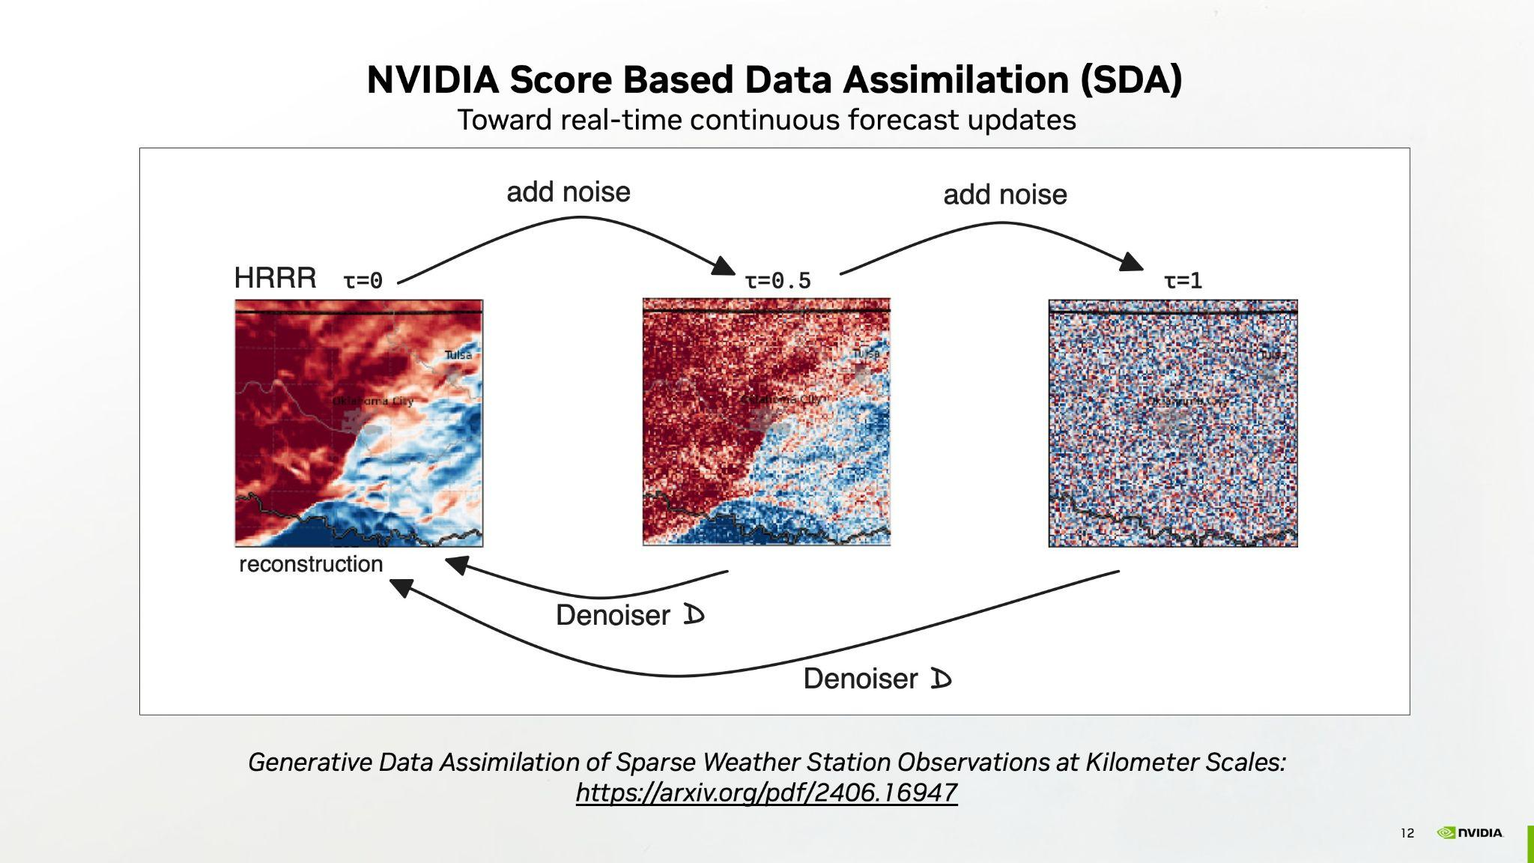
Notes:
Next let’s discuss our work on AI-based data assimilation. Traditional data assimilation represents a major computational bottleneck in operational forecasting. Current methods require complex variational algorithms like 3d-var, 4d-var, ensemble Kalman filters, and multiple preprocessing steps. The HRRR system, for example, requires over an hour to assimilate observations into gridded analyses.
The score-based data assimilation approach demonstrated here leverages generative AI. A diffusion model is trained on multiple years of HRRR analysis data at 3km resolution, learning the statistical properties of realistic atmospheric states.
During inference, score-based data assimilation guides the generation process using Bayesian principles.

Slide 12
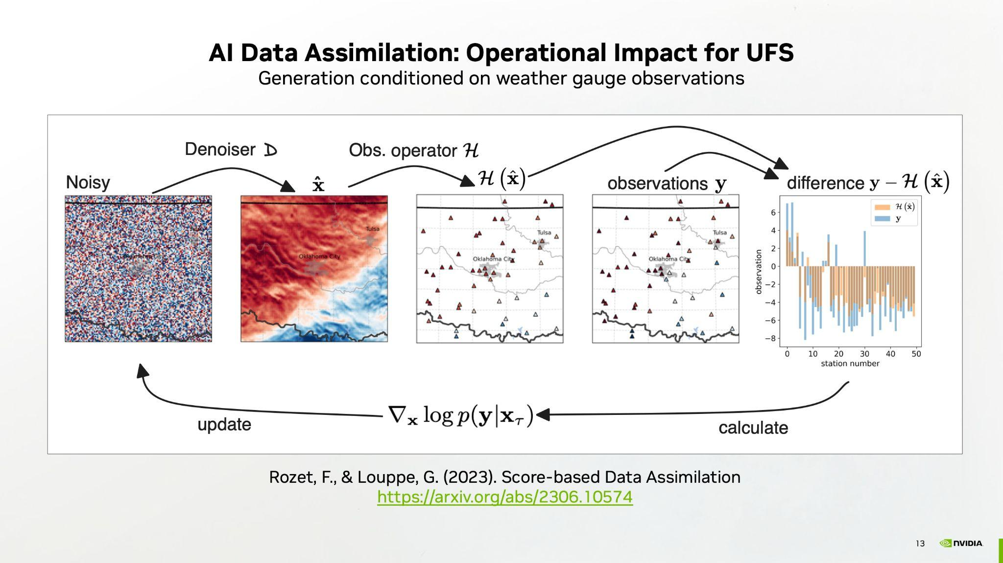
Notes:
This visualization demonstrates the generation of complete 3km atmospheric states from 40 irregularly-spaced weather stations across Oklahoma. The model produces physically coherent features including gust fronts and convergence lines associated with precipitation systems from sparse observations. Quantitative validation shows a 10% improvement in RMSE compared to operational HRRR when evaluated at withheld station locations despite being limited to only surface stations.
Potential operational advantages of AI data assimilation include continuous assimilation capability with sub-hourly updates, immediate integration of new observation networks, and natural ensemble generation for uncertainty quantification.

Slide 13
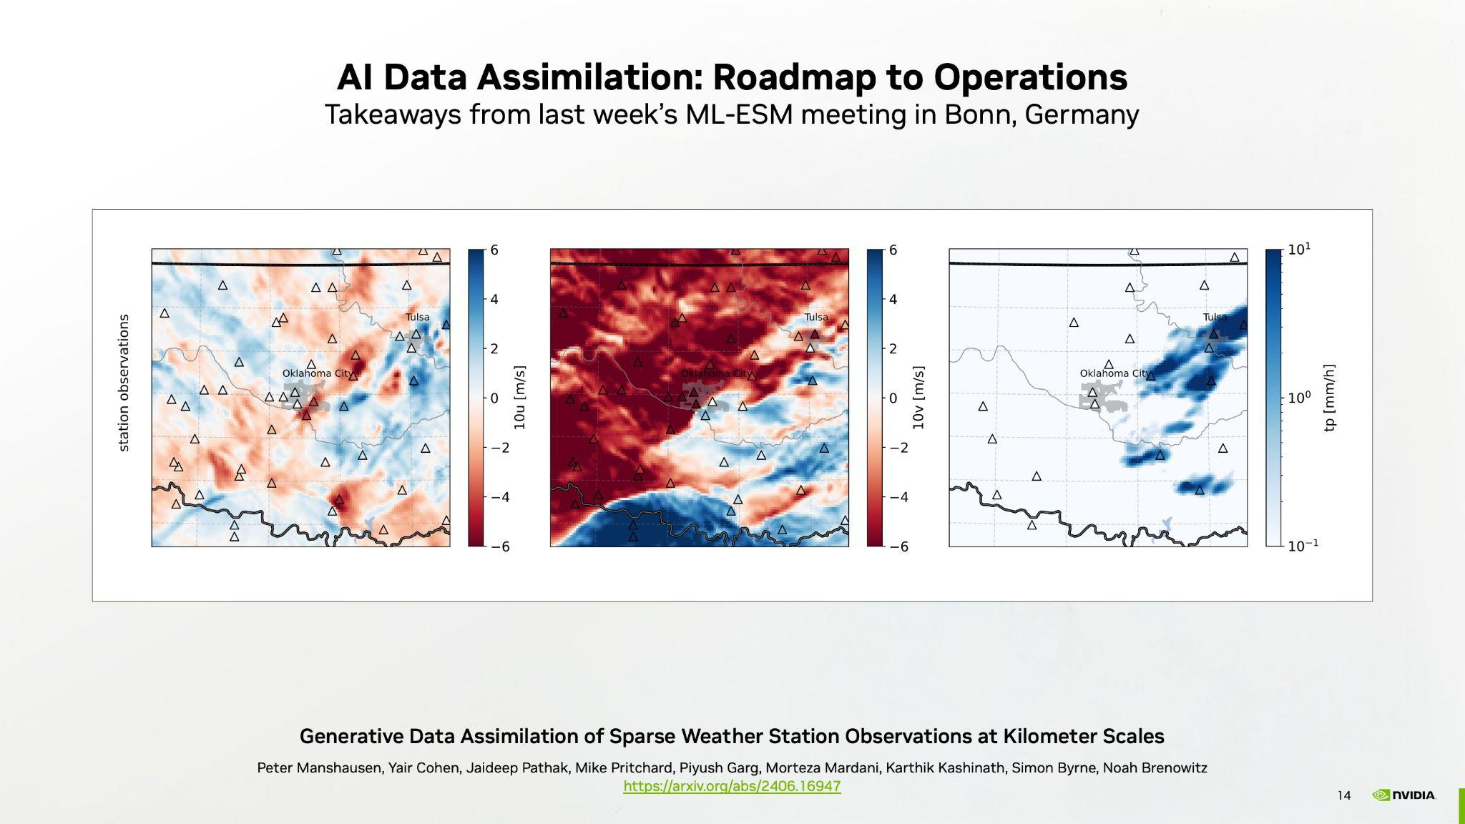
Notes:
The meeting I attended last week in Bonn, Germany on Machine Learning for Earth System Modelling revealed multiple AI based data assimilation breakthroughs. Climate.ai's AIDA method assimilates Level 1 observations directly, with no analysis step. Score-based data assimilation methods like the ones NVIDIA explored eliminate forward operators entirely, updating in seconds not hours. And Tomorrow.io demonstrated rapid AI based forecast updates using their microwave constellation.
Models trained on observations bypass model biases. Stephen Penny from SofarOcean showed ML-based 4D-Var running 10x faster using backpropagation. And ocean teams demonstrated diffusion models adapting to new observation types without retraining.
It seem to be heading toward a paradign shift where every observation immediately updates forecasts. The consensus is that different DA components need different AI approaches, but computational barriers that limited observation use for decades are quickly fading.

Slide 14
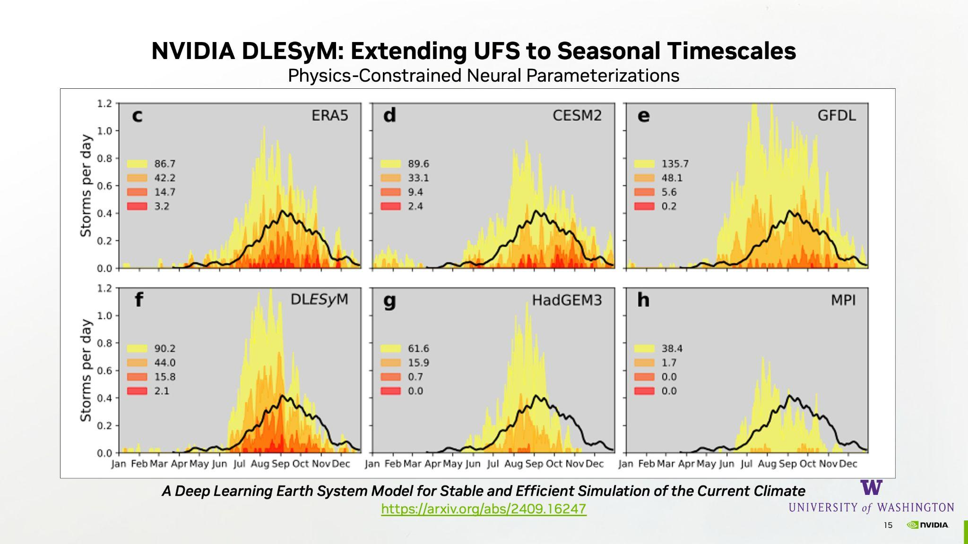
Notes:
DLESyM—the Deep Learning Earth System Model—represents a breakthrough in AI stability for extended simulations. Developed with Professor Dale Durran at University of Washington, it's a fully coupled atmosphere-ocean model that runs stably for thousands of years.
These panels show tropical cyclone climatology—storms per day throughout the year. The black line shows the seasonal cycle, with peak activity in late summer. Top row shows observations and traditional climate models; bottom row includes DLESyM in panel f. Notice how DLESyM reproduces the correct seasonal distribution and intensity statistics, comparable to established models like HadGEM3 and MPI.
A key achievement DLESyM accomplished was simulating1000 years maintaining realistic cyclogenesis patterns without drift or collapse, which was impossible for previous AI models. This stability comes from physics-constrained neural networks that respect conservation principles while running 100x faster than traditional Earth system models.
For UFS, this approach could lead to more robust seasonal-to-subseasonal prediction. One can generate hundreds of seasonal ensemble members to properly sample tropical cyclone risk, ENSO variability, and extreme event statistics. Operational centers could run full Earth system ensembles at scales currently impossible with traditional models, bridging the gap between weather and climate prediction."

Slide 15
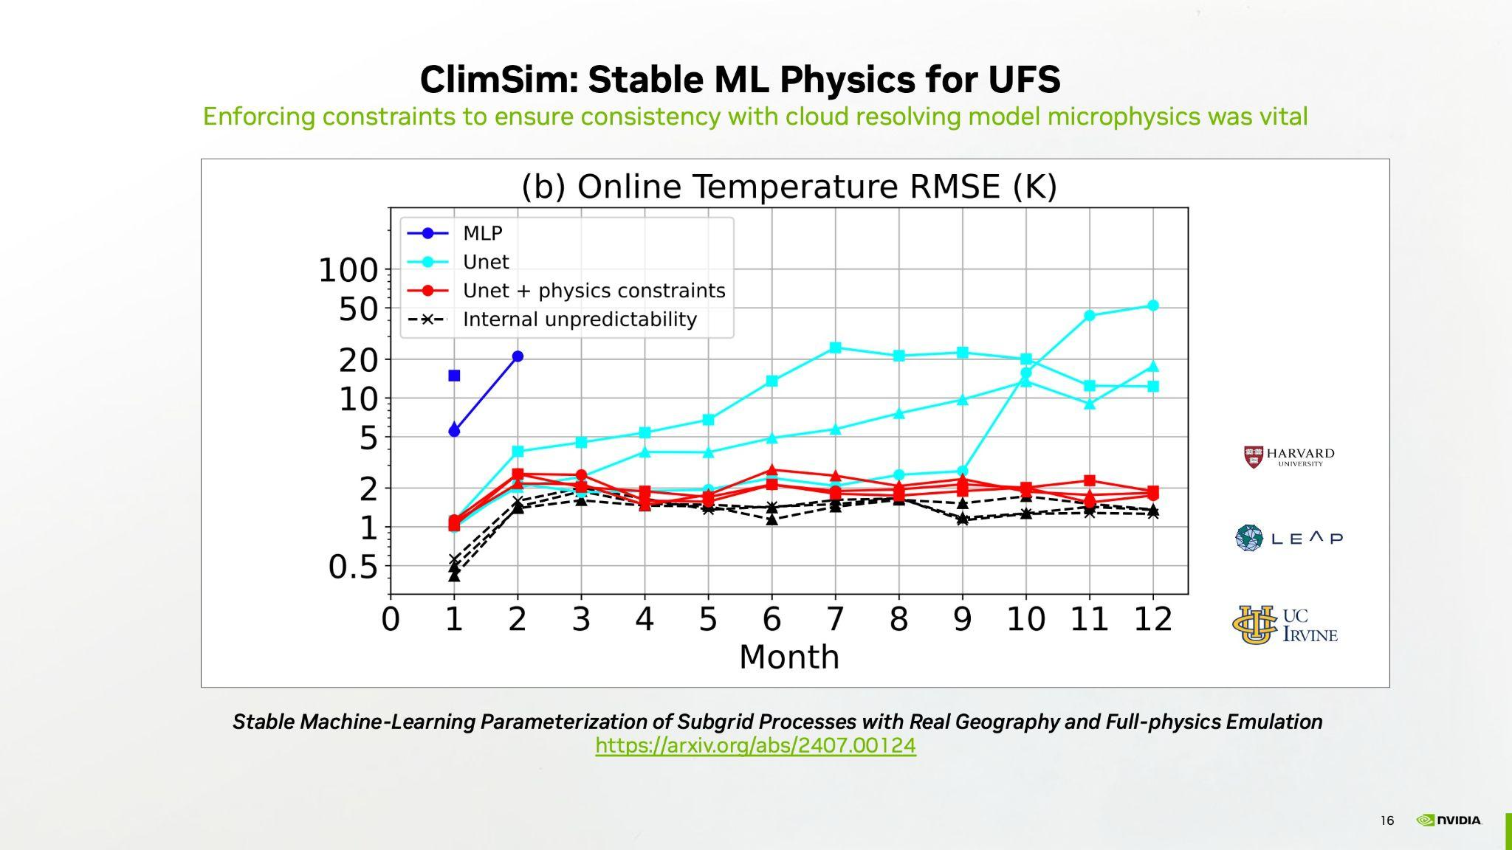
Notes:
NVIDIA's ClimSim project, developed with Harvard and UC Irvine, provides a potential pathway for stable Machine Learning integration into UFS physics. The breakthrough is physics-constrained learning that maintains conservation laws and microphysical consistency. This graph shows the dramatic difference. Unconstrained ML crashes within months, while ClimSim's physics-constrained approach maintains stability for years. The red line shows errors comparable to natural climate variability even after a full year of simulation. ClimSim provides both the training data, with over 100 million samples, and the cloud-based testing platform for the UFS community to develop ML parameterizations.

Slide 16
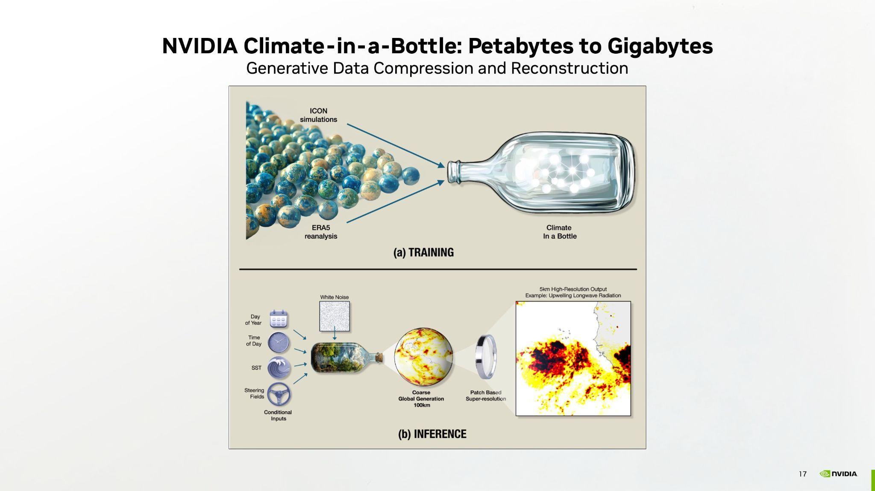
Notes:
Climate-in-a-Bottle addresses two fundamental barriers limiting climate science to well-funded institutions.
First is compression. The top diagram shows our approach: training a diffusion model on petabytes of high-resolution climate data, ICON simulations and ERA5 reanalysis. The model learns the patterns generating weather, compressing decades of data into a gigabyte-sized neural network, a thousand-fold reduction.
Second is accessibility. The bottom shows inference. Given simple inputs like time, location, or atmospheric conditions, the model generates complete 5km global atmospheric states. Traditional datasets require supercomputers just to store and process data of this volume. Climate-in-a-Bottle runs on laptops, democratizing access to climate data globally.

Slide 17
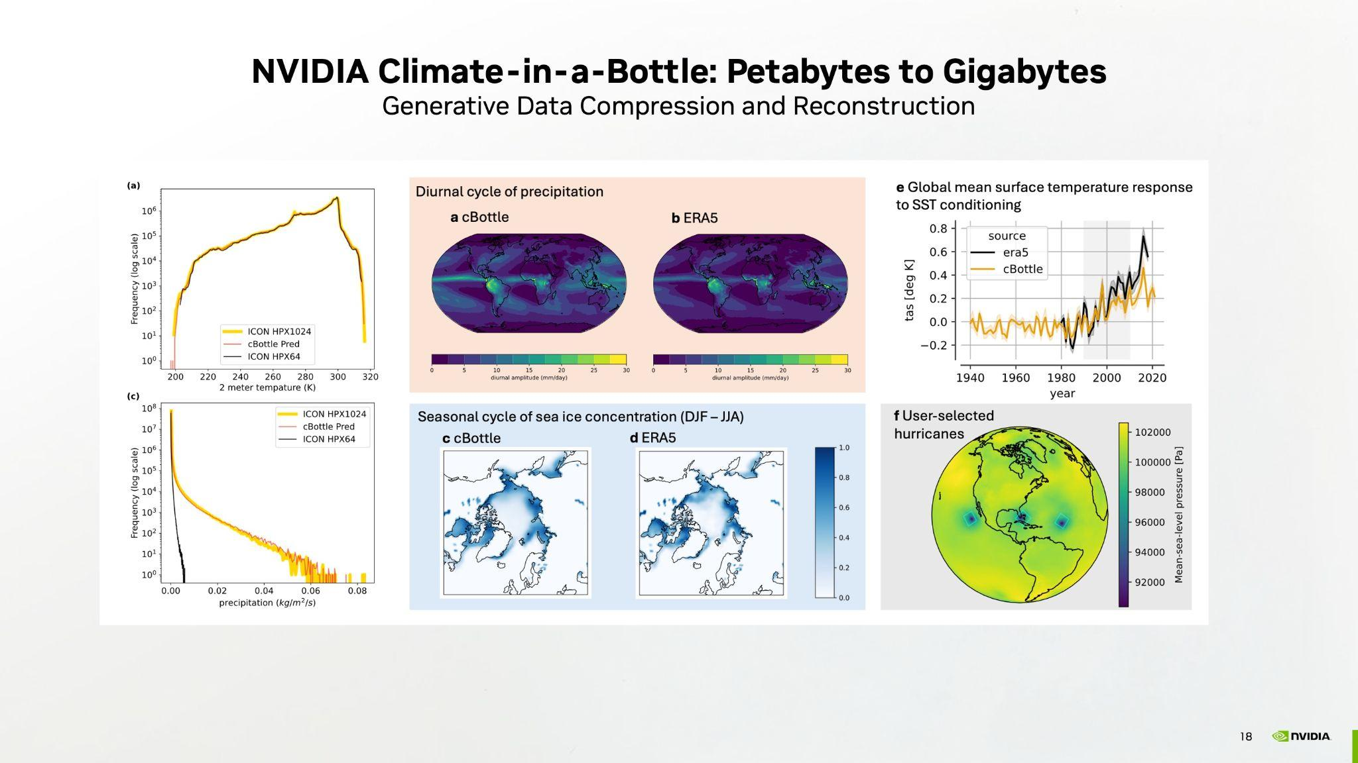
Notes:
These plots confirm Climate-in-a-Bottle maintains fidelity despite massive compression. Top left shows temperature reconstruction matching the ICON source data. Sea ice concentration and hurricane climatology show the model captures complex phenomena accurately.
Applications span operational needs including instant climate statistics for any location, reconstruction of missing satellite channels, and interactive scenario exploration. For UFS, this enables portable training datasets, real-time bias correction, and rapid sensitivity analysis. The broader impact is that researchers worldwide can now access and explore climate data previously restricted to supercomputing centers.

Slide 18
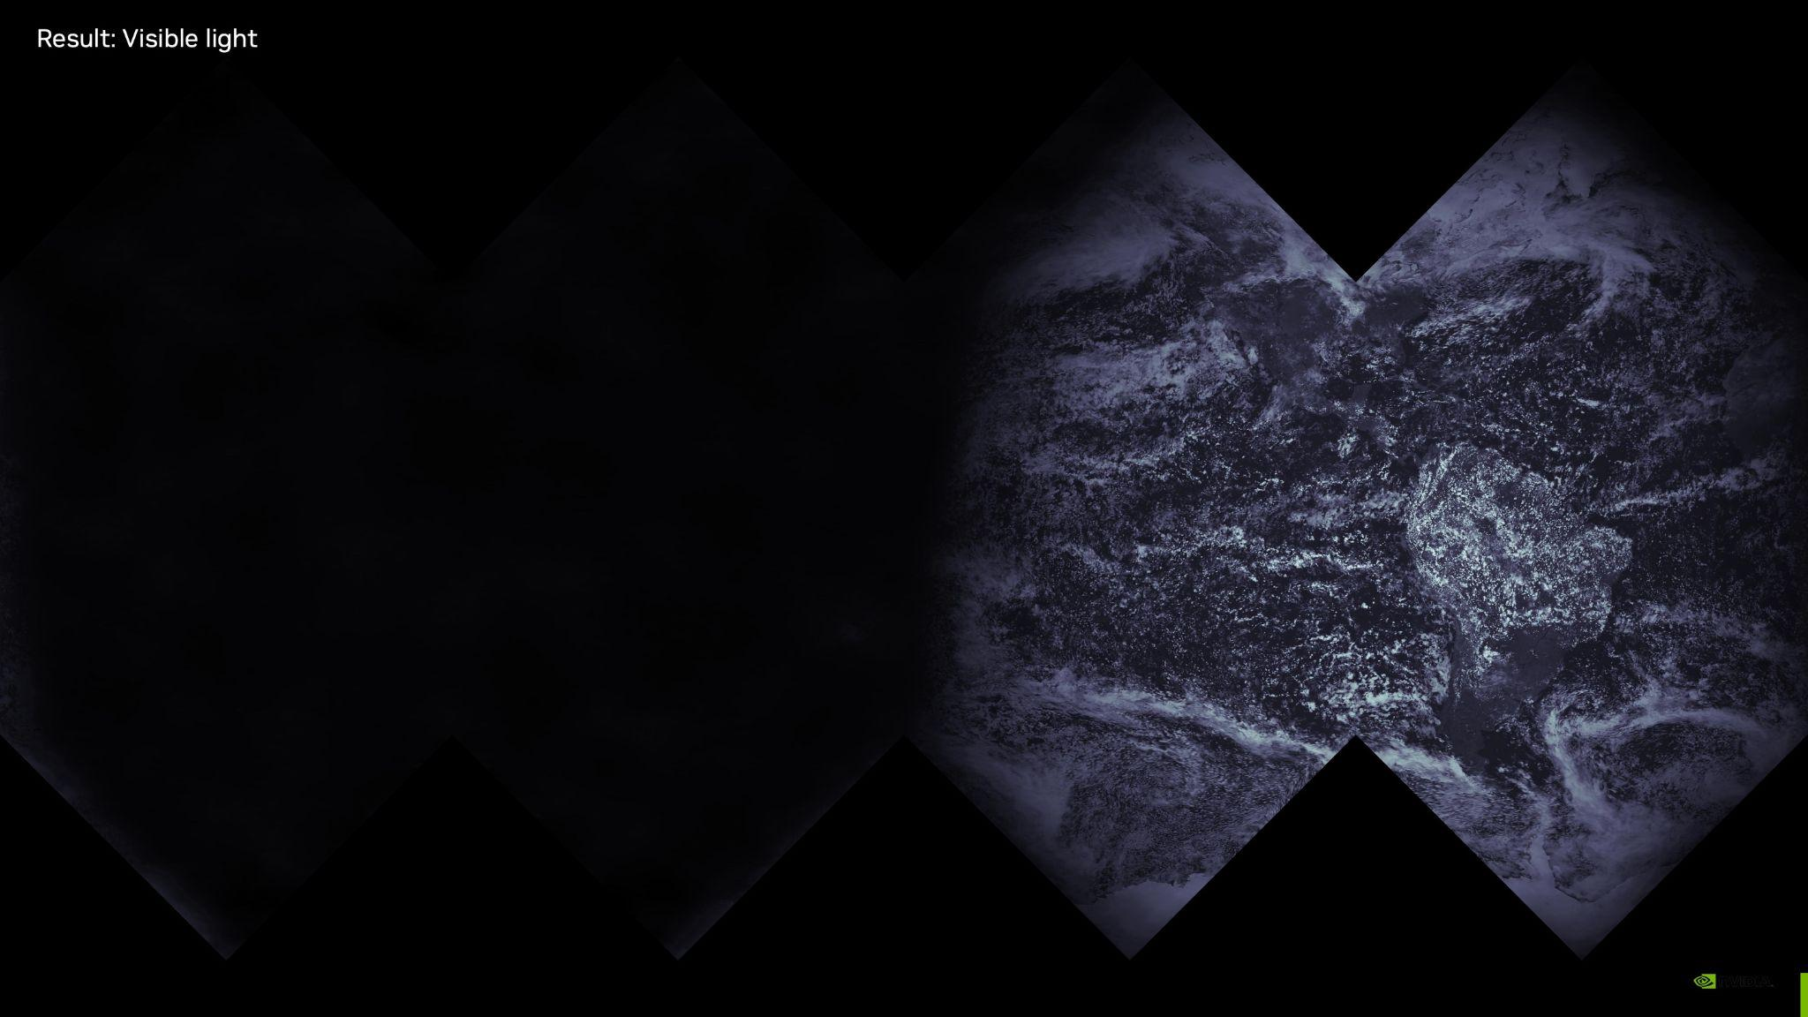
Notes:
The next few slides show some eye candy demonstrating the high-quality global output produced by the compressed, generative climate in a bottle model.
Climate-in-a-Bottle generates realistic atmospheric states at 5km global resolution. The visible light field, shown here shows authentic cloud structures, storm systems, and atmospheric patterns emerging from the learned climate distribution.

Slide 19
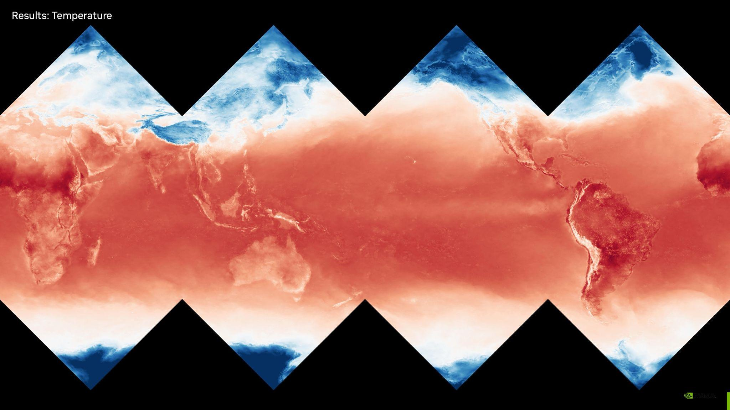
Notes:
Surface temperature reconstruction displays proper latitudinal gradients, land-sea contrasts, and regional variations. The model has learned physical relationships between geography, solar input, and temperature distribution, enabling instant climate statistics for any location.

Slide 20
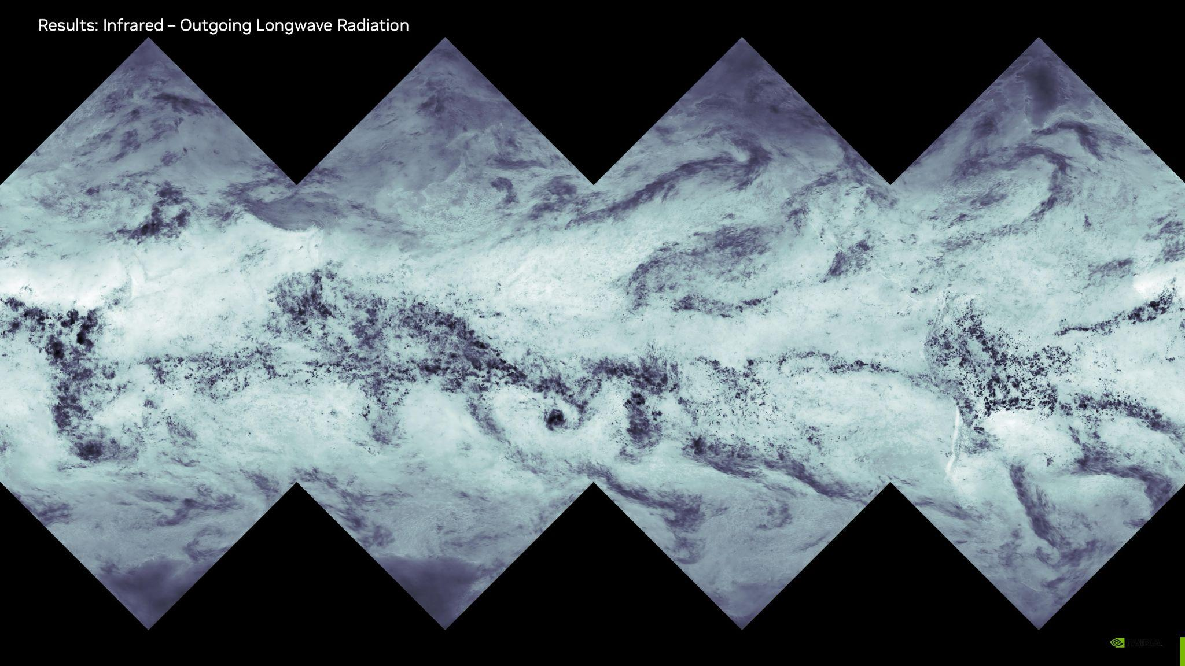
Notes:
Outgoing longwave radiation captures cloud-radiation interactions correctly. Dark regions indicate deep convection blocking infrared emission. Tropical convergence zones and storm systems appear where expected. The model demonstrates understanding of radiative physics.

Slide 21
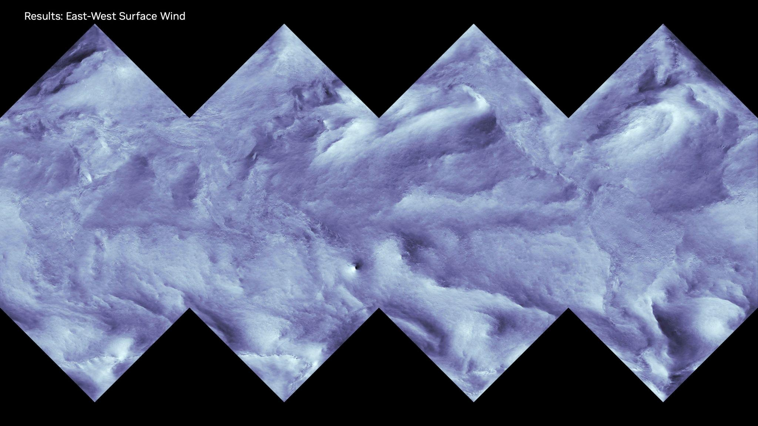
Notes:
East-west wind components show realistic trade winds, westerlies, and convergence zones. The model maintains proper atmospheric circulation including monsoons and jet streams. These patterns emerge naturally from the learned relationships.

Slide 22
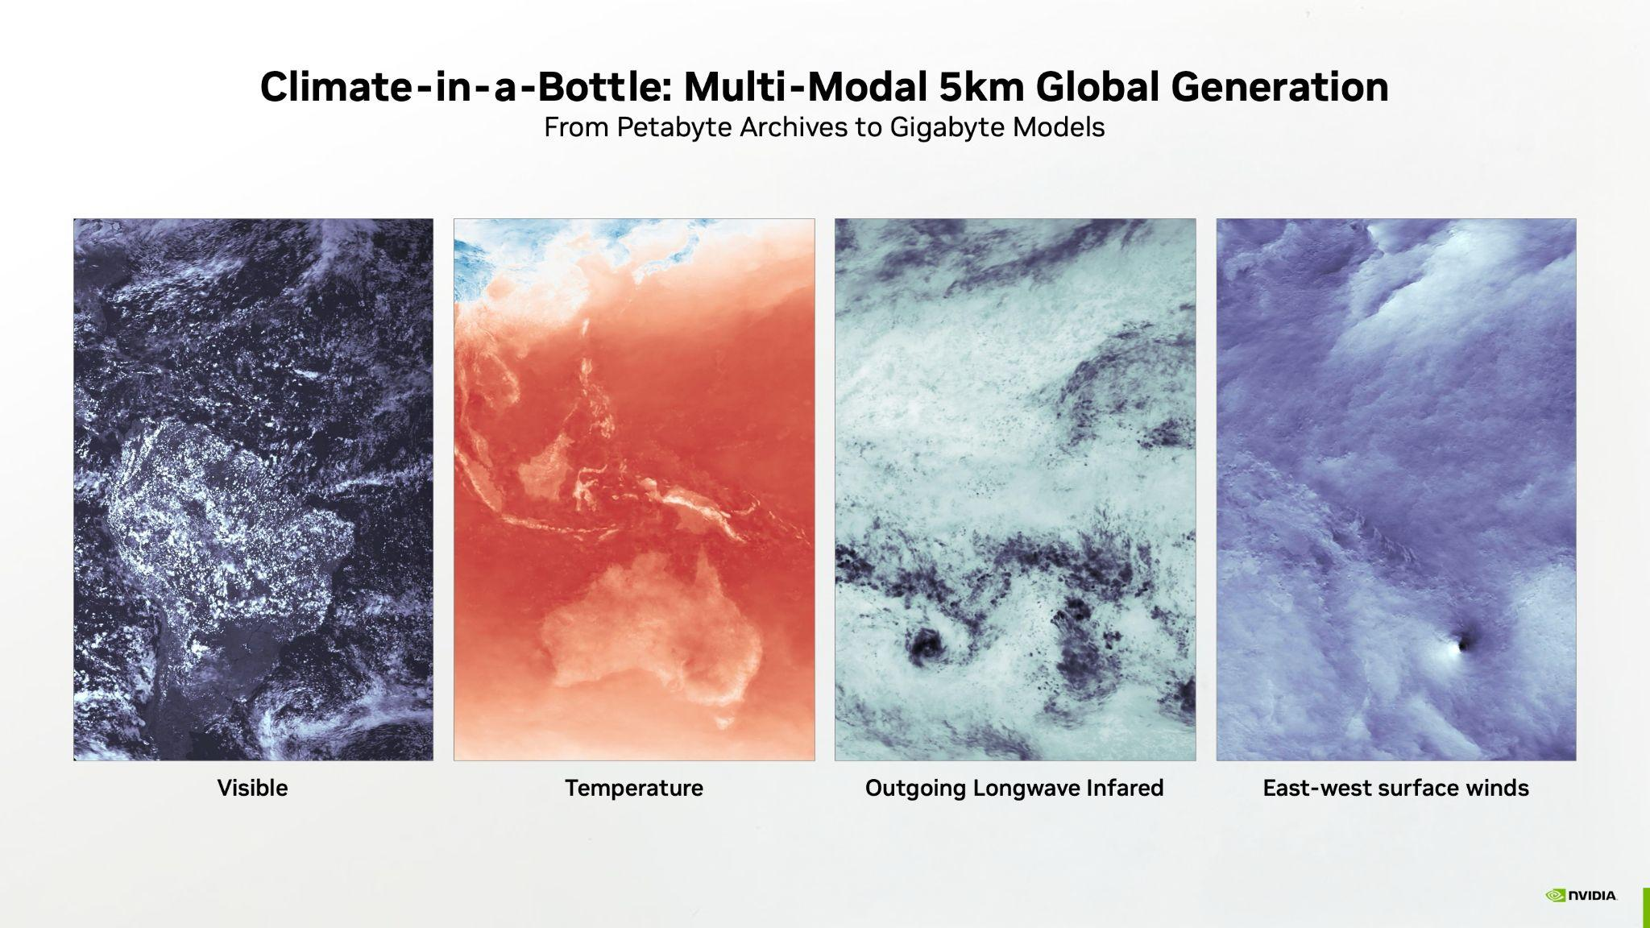
Notes:
These four fields demonstrate Climate-in-a-Bottle's reconstruction fidelity at 5km global resolution. Each shows physically consistent patterns—cloud structures, temperature gradients, radiation, and circulation. Generated from a model 1000x smaller than the original data, these results enable instant reconstruction, gap-filling, and scenario exploration on standard hardware. The model has learned the underlying relationships that generate weather patterns, making climate data accessible beyond supercomputing centers.

Slide 23
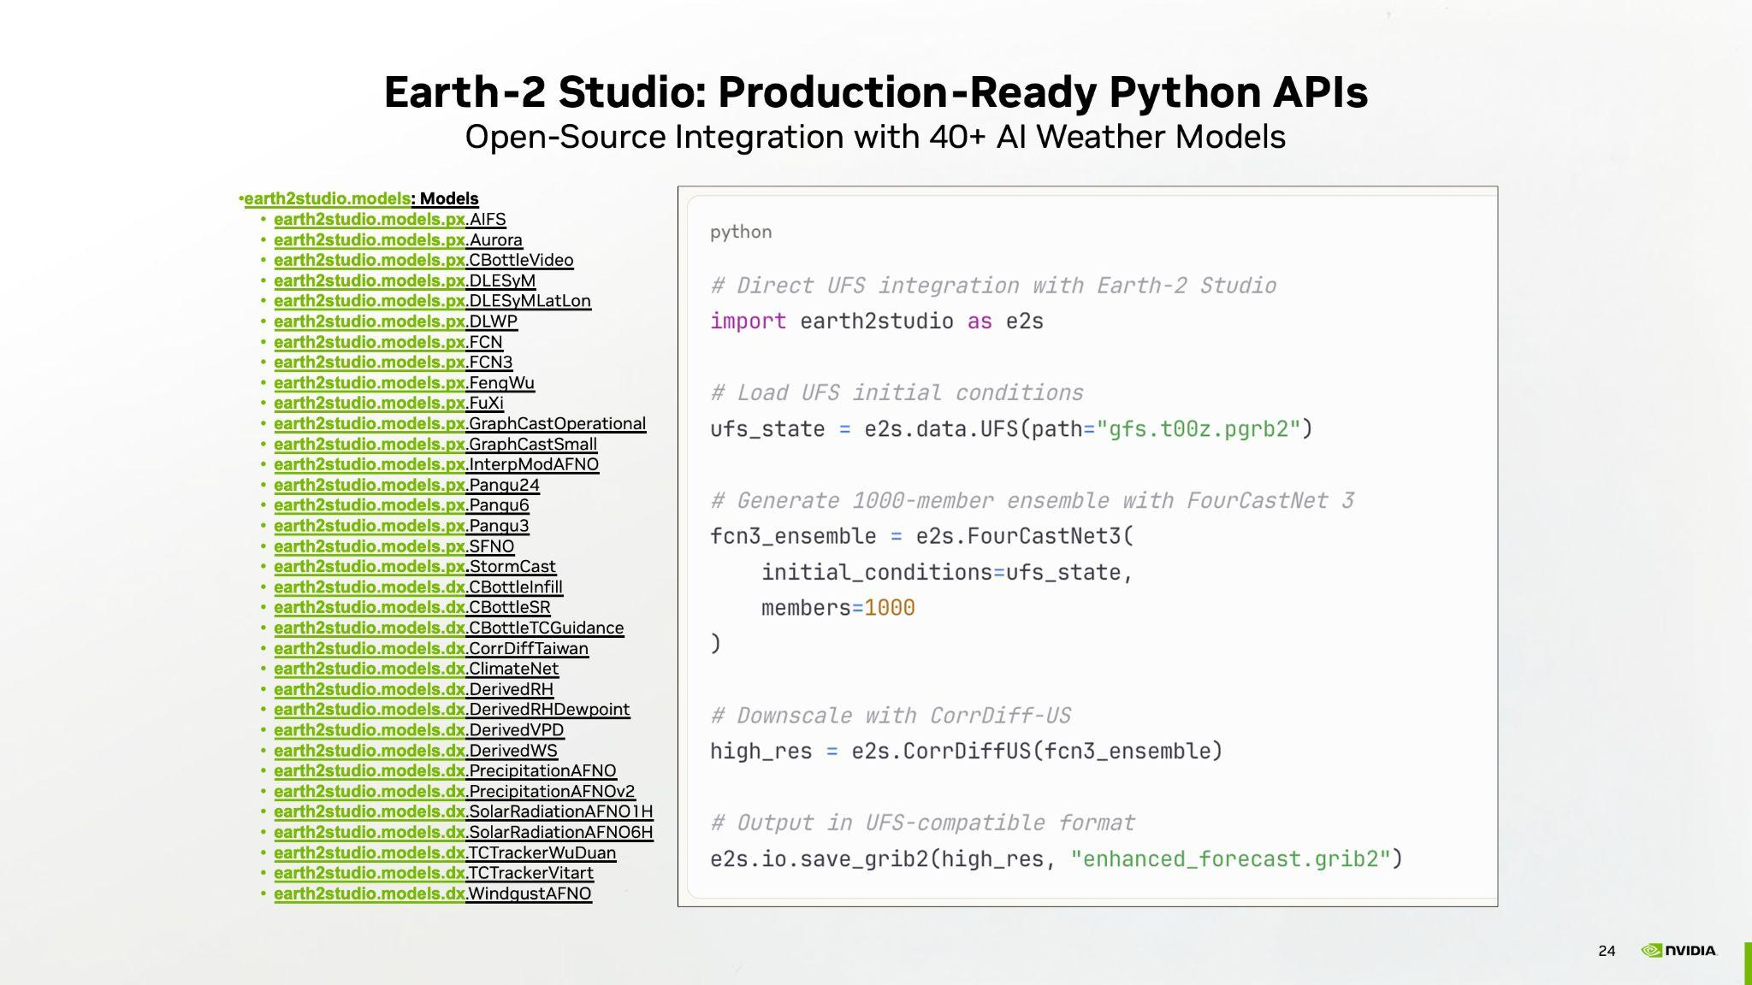
Notes:
NVIDIA's Earth-2 Studio, which is part of our Physics NeMo package, provides the operational bridge between NVIDIA's AI models and UFS workflows. With simple Python APIs, UFS systems can seamlessly integrate FourCastNet 3 for ensemble generation, CorrDiff for downscaling, and StormCast for convective detail. The system handles all data format conversions, maintains GRIB2 compatibility, and provides error handling for operational robustness. Models are containerized and optimized for both on-premise and cloud deployment. This is production-ready technology available today.

Slide 24

Notes:
For those interested in exploring these Earth-2 capabilities further, NVIDIA GTC is happening in Washington D.C., October 27-29. It's where much of the technical development we've discussed gets presented in detail—you can attend hands-on workshops with Earth-2 Studio, see how other centers are tackling integration challenges, and engage directly with the research teams behind these models. If it's useful, there's a 20% discount available with code GTCDC20. Thank you for your time today—I'm happy to discuss any questions about what we've covered.

