Slide 1


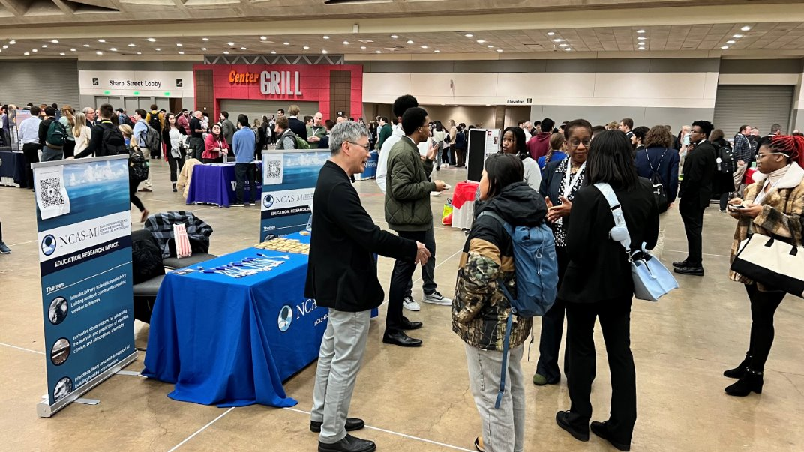
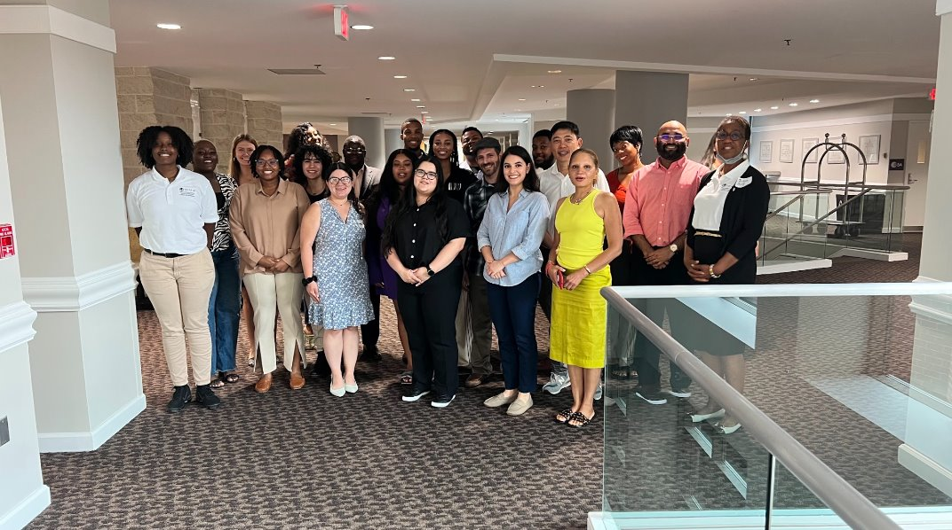
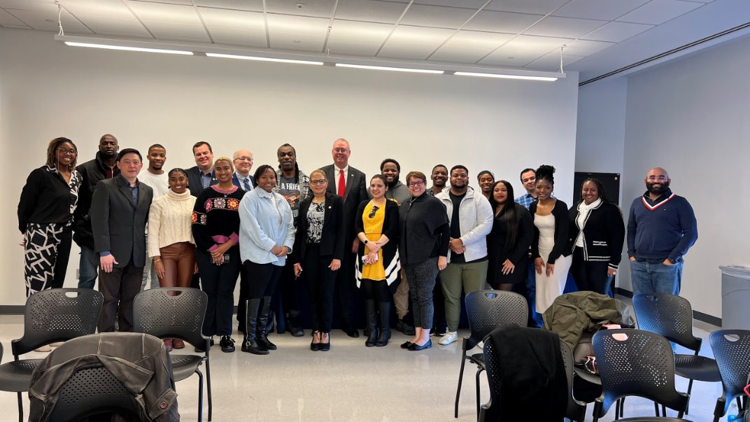
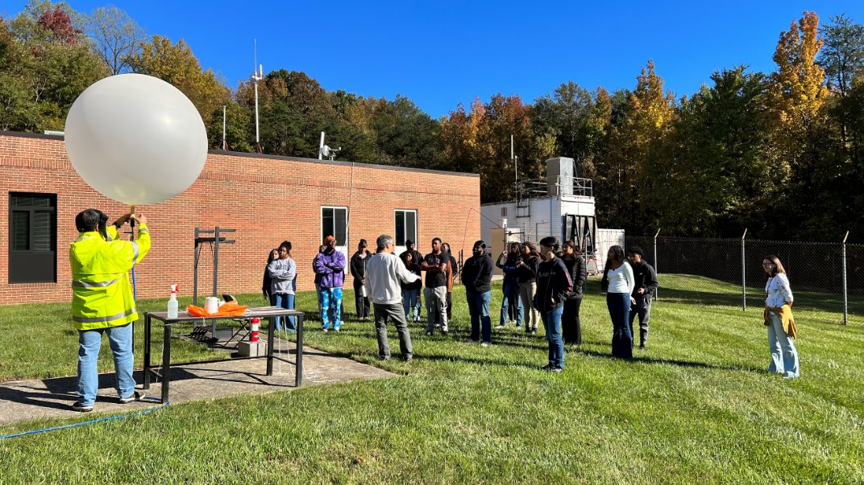
Two Decades of Partnership with NOAA Line Offices: Challenges and Opportunities for the NOAA Center for Atmospheric Sciences and Meteorology (NCAS-M)
Sen Chiao
Aara’L Yarber, Nakul Karle, Feng Hsiao, Oscar Chimborazo
NCAS-M is supported by the U.S. Department of Commerce, National Oceanic and Atmospheric Administration, Educational Partnership Program under Agreement NA22SEC4810015

Slide 2
Presentation Overview
Brief History of NCAS-M
Goal and objectives of NCAS-M
Education and training framework
Some updates on current research projects
Summary: Challenges, priorities, and opportunities

Slide 3
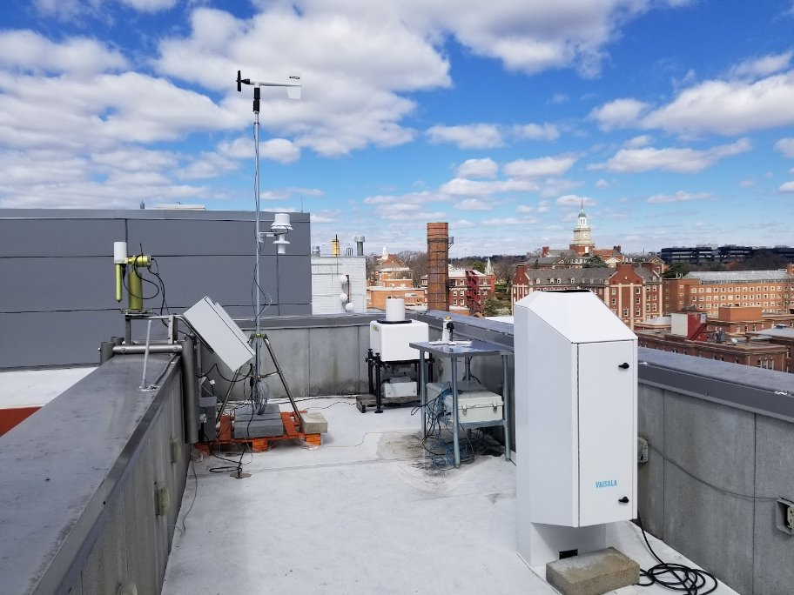
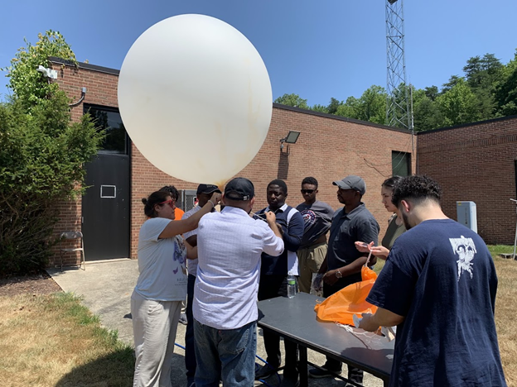
Research Themes
NCAS-M collaborates with NOAA Line offices in support of the mission in three thematic areas:
Innovative observations for advancing climate, weather, and air quality analysis and prediction.
Interdisciplinary scientific research to strengthen NOAA modeling and forecasting activities for building community resilience against extreme weather, water, atmospheric, and climate events.
Integrated research in support of building public safety through Impact-Based Decision Support Services (IDSS).
NCAS-M at Howard University and the HU Beltsville Campus

Slide 4
NCAS-M Highlights​
Since its inception in 2001, hundreds of NCAS-M graduate and undergraduate students from Howard University and our partners have benefitted from NOAA-sponsored fellowships, internships, and other opportunities. ​
Between 2016 and 2019 alone the program supported 95 students: 30 Ph.D., 24 MS, 41 BS. ​
The atmospheric science graduate program with support from NCAS-M has produced approximately 54% of the African American Ph.Ds. in Atmospheric Sciences that have matriculated in the US over the past decade.​
Additionally, the program has nationally supported the graduation of 20% of Latinx recipients who earned PhD degrees in Atmospheric Sciences. ​
Close to 96% of the students have found employment in a technical field related to their study.​
The NOAA award has provided research opportunities to both faculty and students, which have resulted in publications and data products that are used by NOAA.​

Slide 5
Some on-going projects with NOAA Line Offices
Notes:
NWS/EMC, OSTI, OAR/GSL, NSSL

Slide 6
Advancing Hurricane Structure and Intensity Forecasts NCAS-M: Feng Hsiao, Sen Chiao EMC: Bin Liu, Zack Zhang PSU: Xingchao Chen
Current Projects:
Project 1: Hurricane Data Assimilation (CADRE: HAFS-JEDI)
Focus:
Optimize dropsonde data assimilation in JEDI by migrating and adapting proven quality control (QC) and observation error methodologies from the GSI system.
Improving initial conditions by better utilizing all-sky satellite observations, particularly in challenging stormy environments.
Project 2: Hurricane Physics Parameterization
Focus: Evaluating and improving the representation of sub-grid scale processes, especially convection, critical for realistic hurricane inner-core structure and evolution.

Slide 7
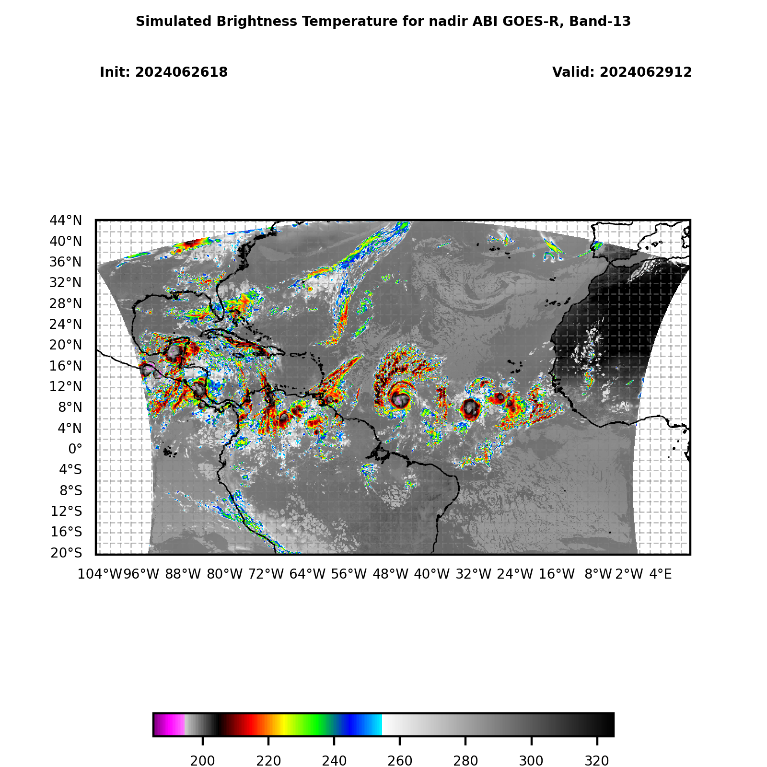
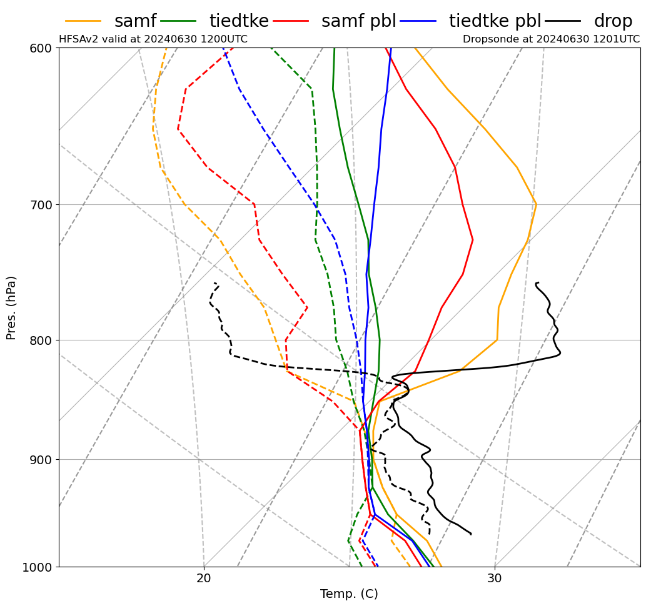
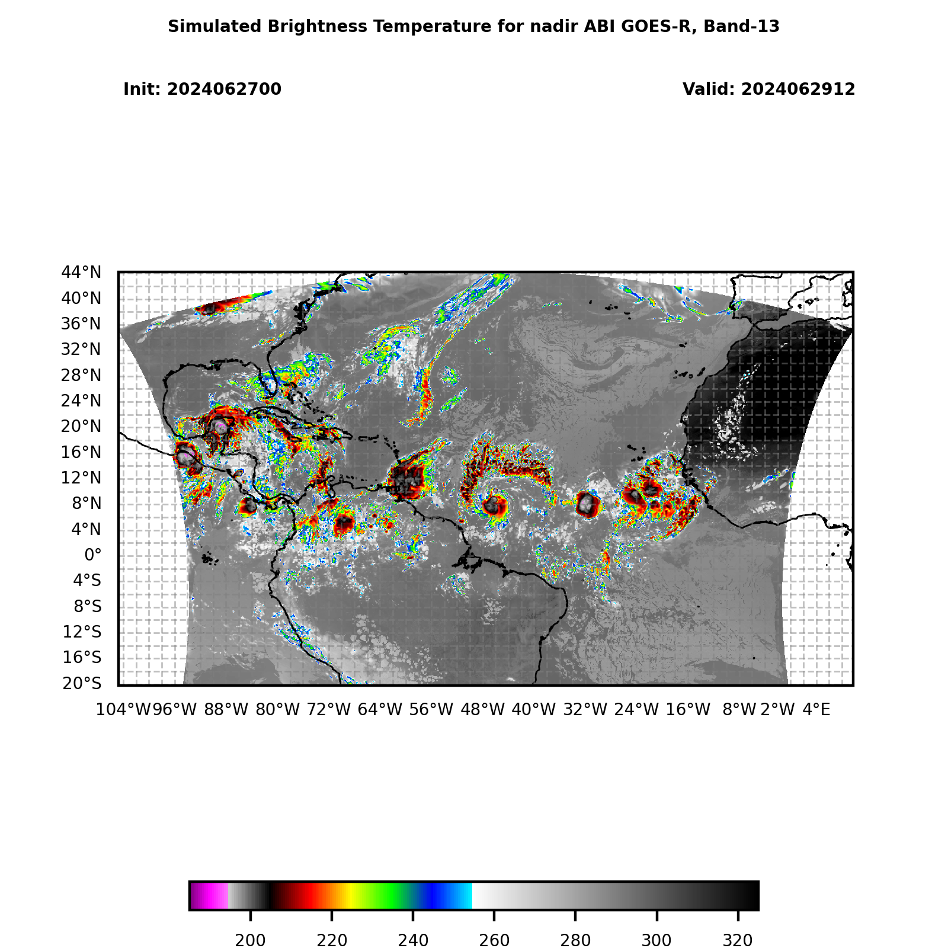
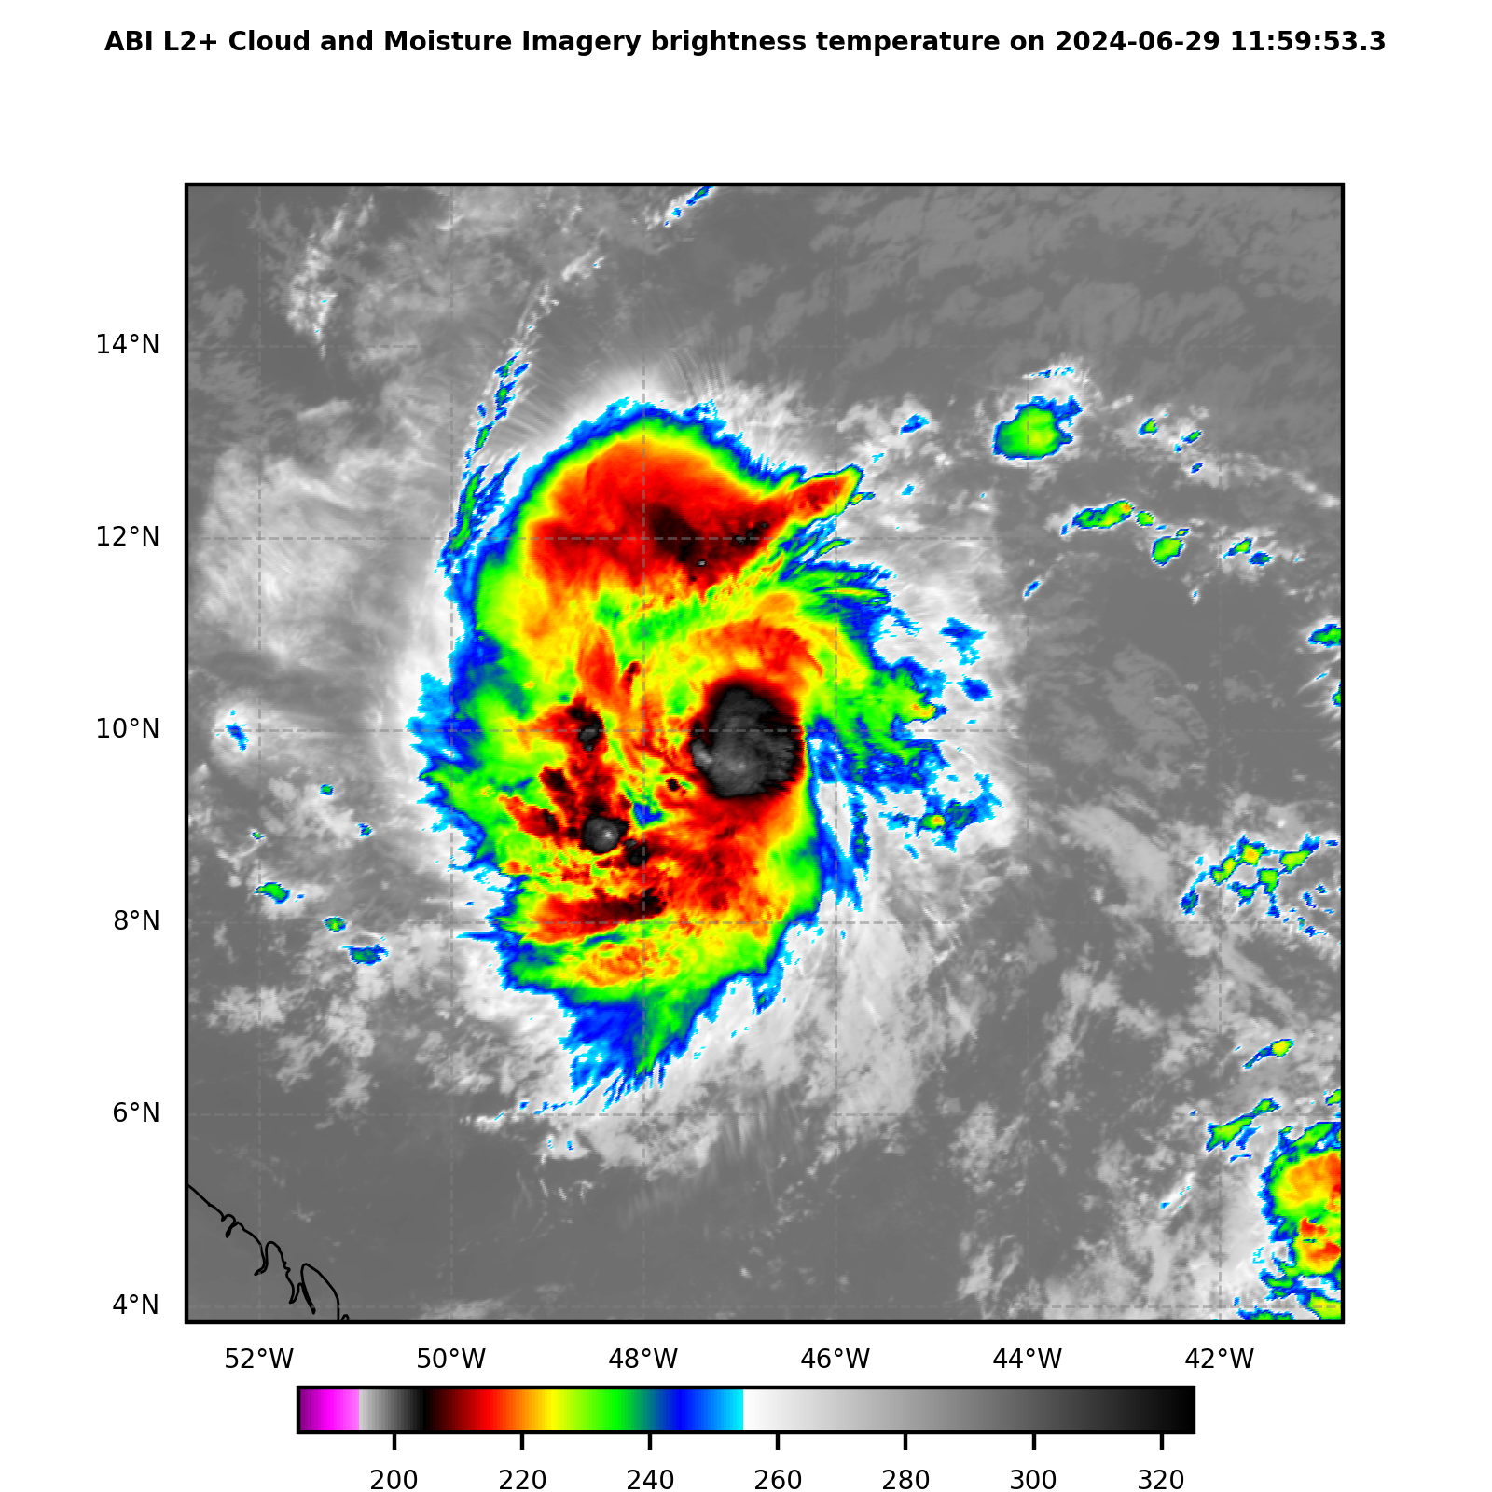
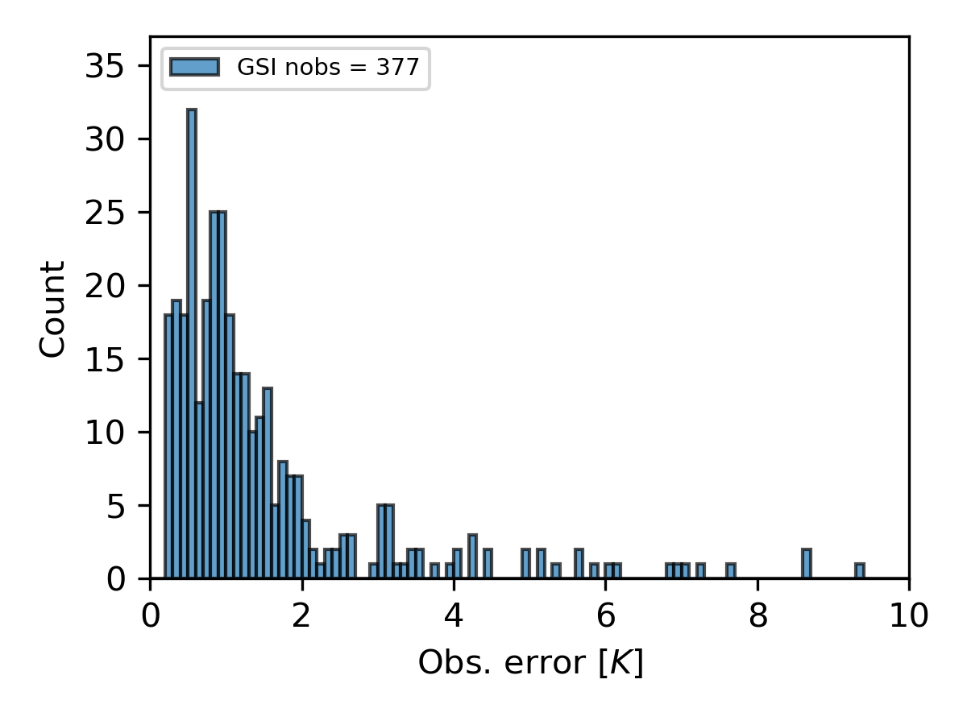
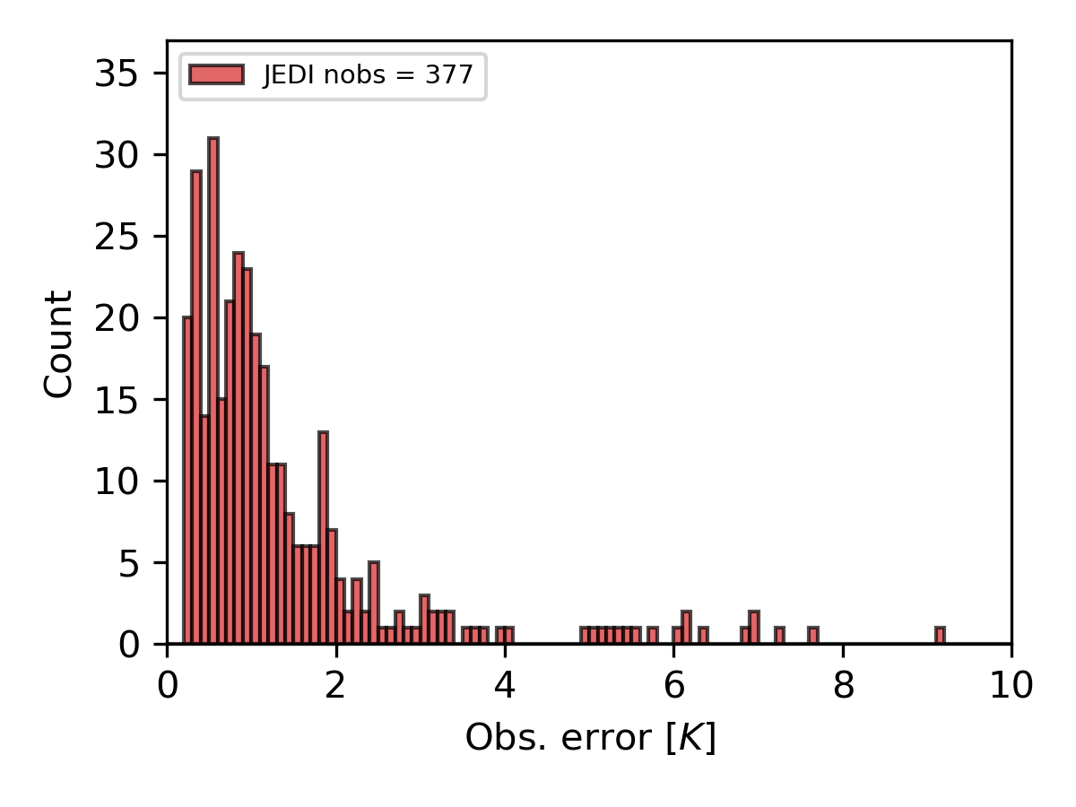
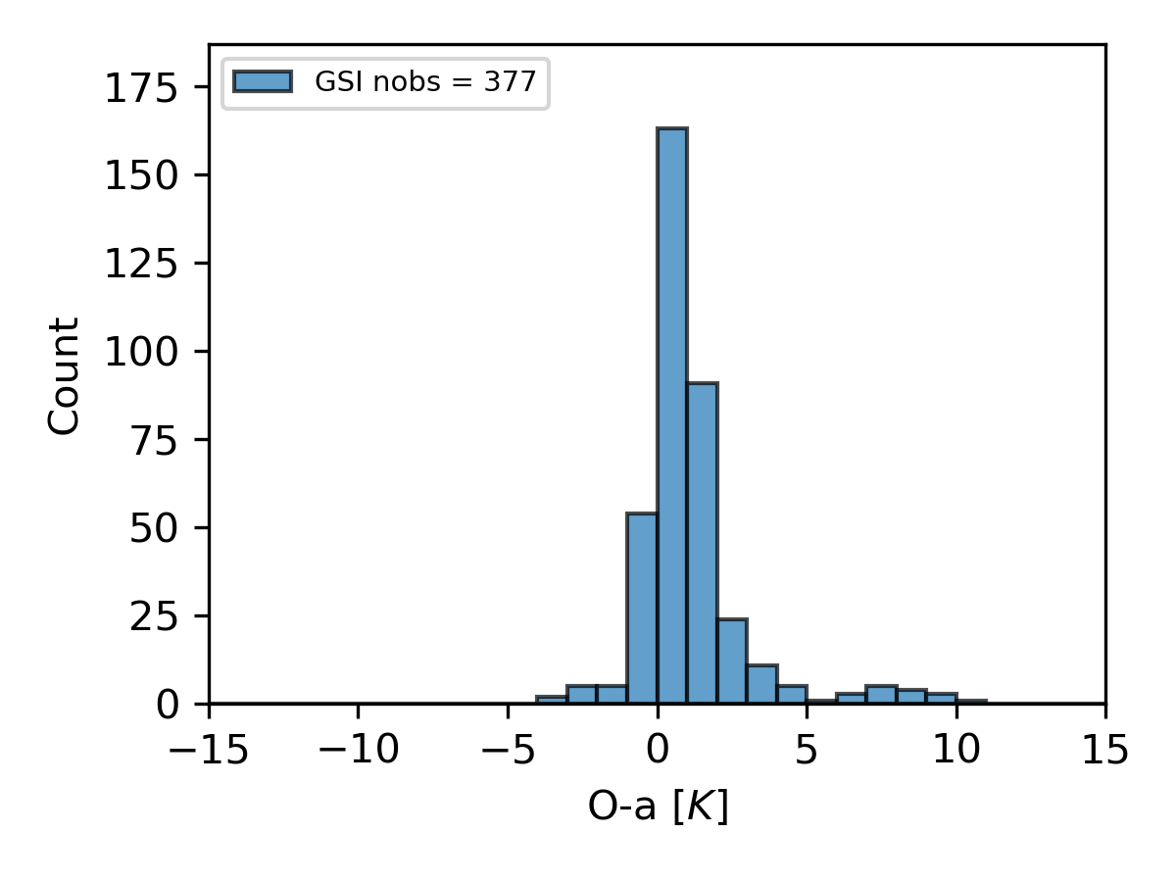
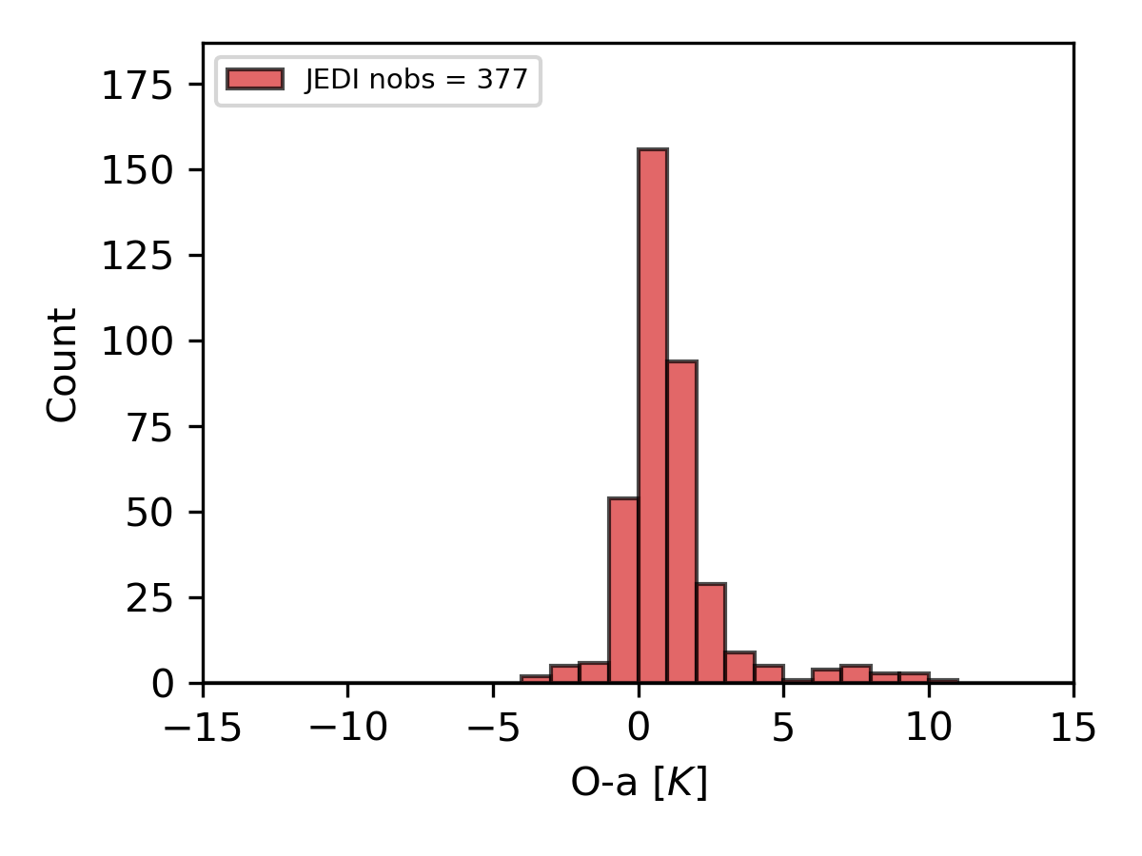
Hurricane Data Assimilation (DA) Project:
Key Activities:
Conducted a test run to forecast Hurricane Beryl genesis using 6-km HAFS.
Hurricane Physics Parameterization Project:
Key Activities:
Case Study Focus: Evaluating scheme performance on the inner-core structure of Hurricane Berly (2024).
NO DA
6hr DA
GOES-16
Migrate GSI's quality control (QC) procedures and dynamic observation error to the JEDI framework.

Slide 8
Towards an Integrated Research Strategy
Opportunities:
Leveraging Improved Initial Conditions: DA advancements provide better starting points to evaluate the impact of different physics schemes, particularly during rapid intensification period.
Physics Informing DA: Characteristics of different physics schemes (e.g., their impact on background error statistics or spin-up) can inform optimal DA strategies.
Shared Testbeds: Case studies (Berly 2024, Ian 2022) can serve as testbeds for evaluating the combined impact of improved DA and optimized physics.

Slide 9
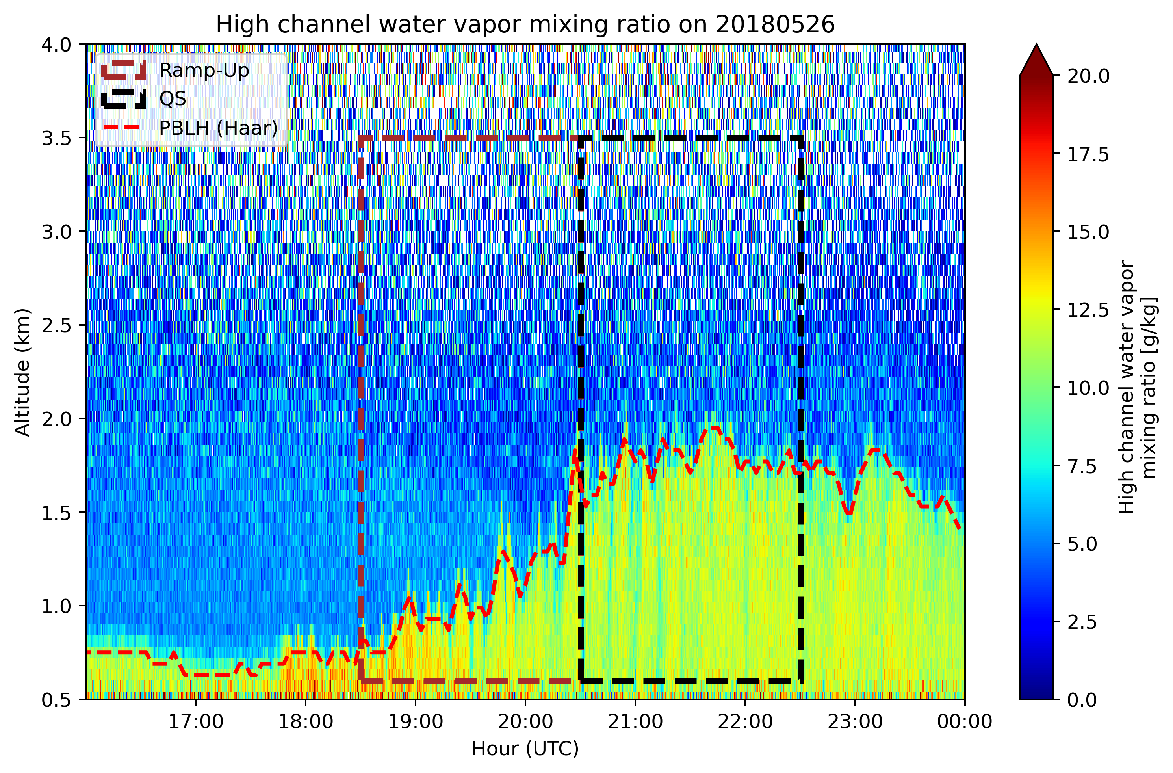
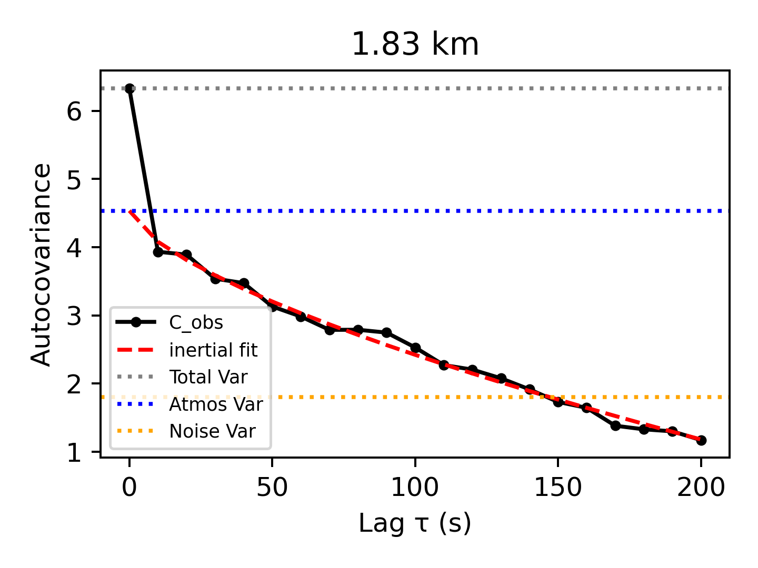
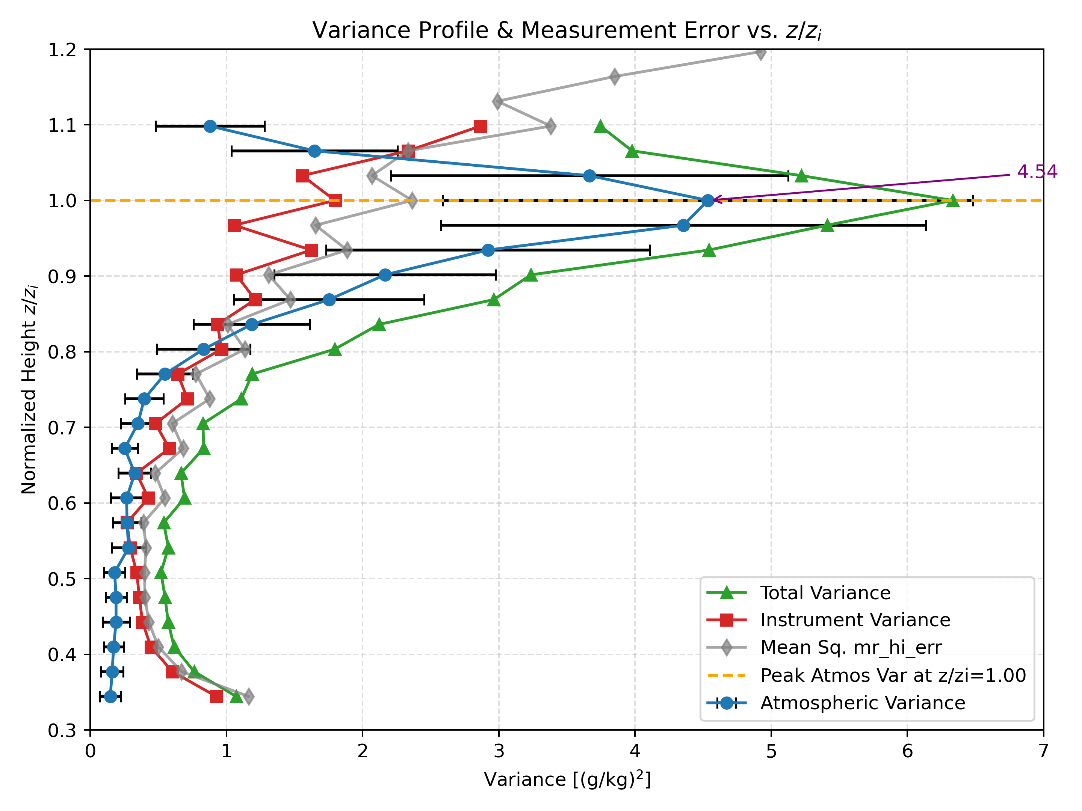
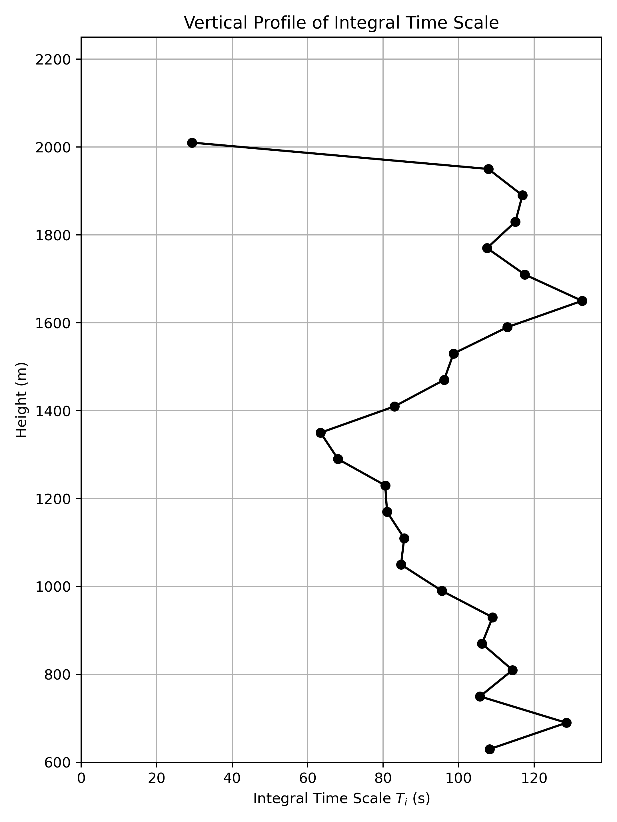
Higher-Order Turbulence Statistics in the Convective Mixed Layer: Insights from Raman Lidar During Ramp-Up (RU) Quasi-Stationary(QS) Periods (NCAS-M: Nakul Karle, Sen Chiao. OAR/GSL: David Turner, Duane Rosenberg, and Isidora Jankov)
26 May 2018, ARM SGP site, Oklahoma
For QS period, after removing the outliers, we use the autocovariance framework from (Lenschow et al., 2000) to calculate higher order moments
Autocovariance decays following Kolmogorov 2/3 law
Structure function in the inertial subrange used to interpolate back to zero lag
Positive skewness above z_{i} indicate convective updrafts transport of moisture from boundary layer to free atmosphere
Negative skewness below z_{i} corresponds to dry air intrusions from free atmosphere that reduce humidity levels more sharply
Active mixing
Longer-lived eddies close to zi
Shorter-lived eddies
Well mixed layer
Longer-lived eddies
Notes:
Raman lidar at ARM SGP site allows high resolution vertical profiling of water vapor mixing ratio (q)
In this study we are focusing on two phases of the convective mixing layer (CML): Ramp-Up (RU) when the CML is actively growing, and Quasi-Stationary (QS) when the CML is almost steady
Since lidar dataset is inherently noisy, direct higher order moment estimates are contaminated by noise
We compute autocovariance of q time series, extrapolate first few lags back to lag zero, separating atmospheric variance from noise variance
Decay slope follows Kolmogorov’s 2/3 law, validating turbulence scaling
Variance profile peaks at zi indicating active mixing
Skewness is negative below zi indicating strong downdrafts importing dry air
Positive skewness above zi indicates moist updrafts penetrating above the mixed layer

Slide 10
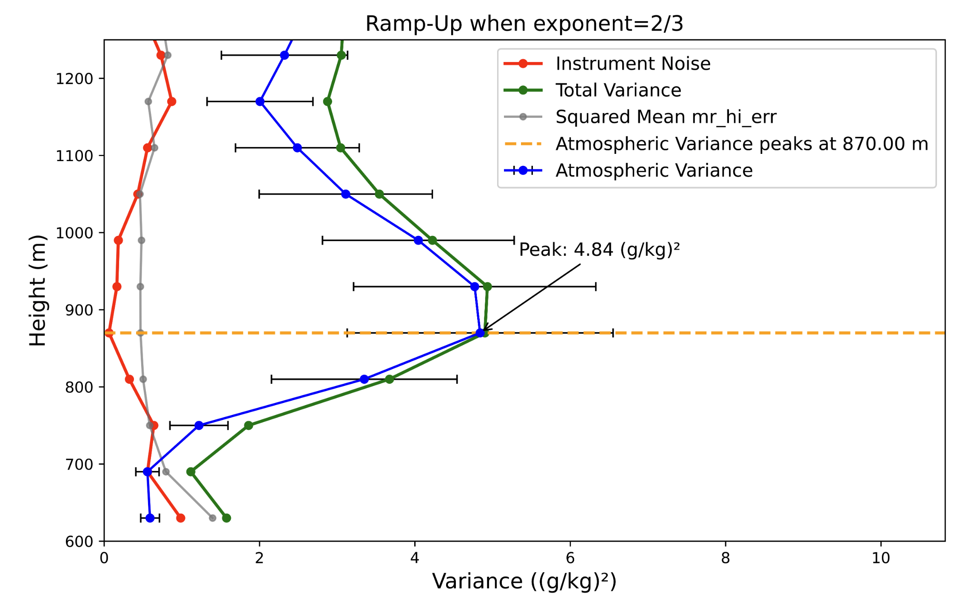
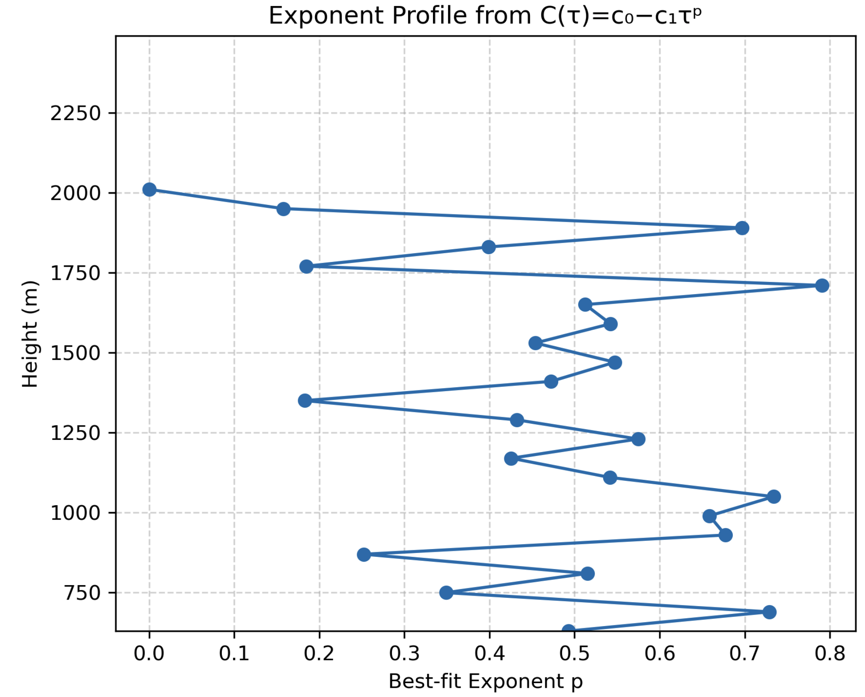
Ramp-Up period when the CML is actively evolving
Variance profile
Instrument noise and atmospheric variance cannot be resolved correctly
Usually in the QS period, exponent p is 2/3
During the morning ramp-up, we often see departure from the Kolmogorov-Obukhov τ^{2/3} scaling
Hypothesis: During the ramp-up period, z_{i} evolves faster than the turbulence can equilibrate.
The inertial cascade is contaminated by entrainment and shear, so the ‘2/3’ becomes local and conditional, not universal.
Notes:
We observed in the Ramp-Up that autocovariance method shows incomplete separation of noise and atmospheric variance near zi
Variance estimates are less robust compared to QS phase
During the ramp-up turbulence does not appear to consistently follow Kolmogorov’s 2/3 law near zi
This indicate breakdown of classical inertial-subrange scaling
We hypothesized that
Boundary layer top evolves faster than turbulence adjusts
Inertial cascade interfered by entrainment and vertical shear, as a result the 2/3 exponent becomes conditional and localized near the CML top
Ramp-up dynamics seem to differ fundamentally from QS, i.e. turbulence statistics at zi are non-stationary and scale dependent
This work highlights need for conditional frameworks when interpreting higher order statistical turbulence moments during evolving boundary layer phrases

Slide 11
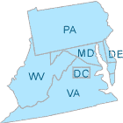
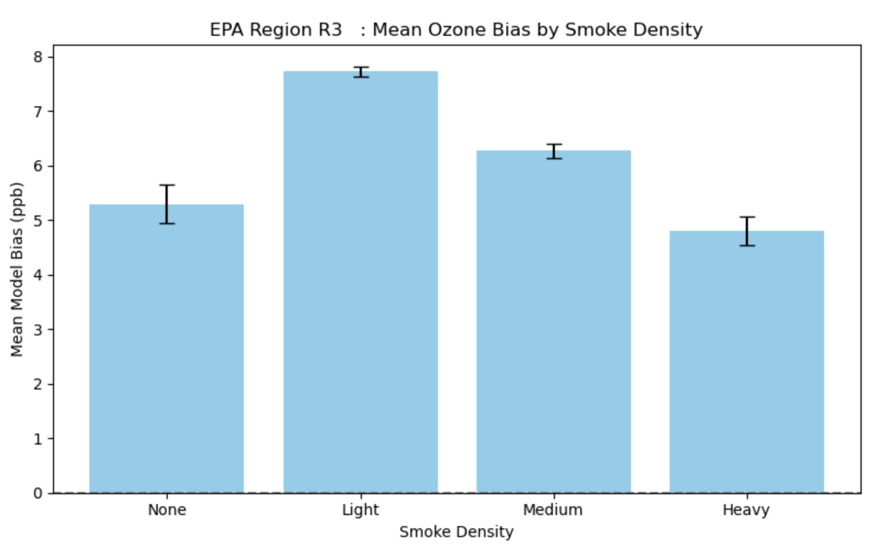
Mean UFS-AQM Ozone Bias by Hazard Mapping System (HMS) Smoke Category in EPA Region 3 (July 2023)
Ozone Forecast Biases in UFS-AQM During Varying Smoke Conditions in EPA Region 3
NCAS-M: Aara’L Yarber, Sen Chiao. OSTI: Jack Kain, Youngsun Jung
In July 2023, ozone was consistently overestimated in EPA Region 3.
Bias was smaller during heavy smoke events compared to light, medium, or no-smoke days.
This suggests wildfire smoke changes ozone chemistry in ways the model must better capture.

Slide 12
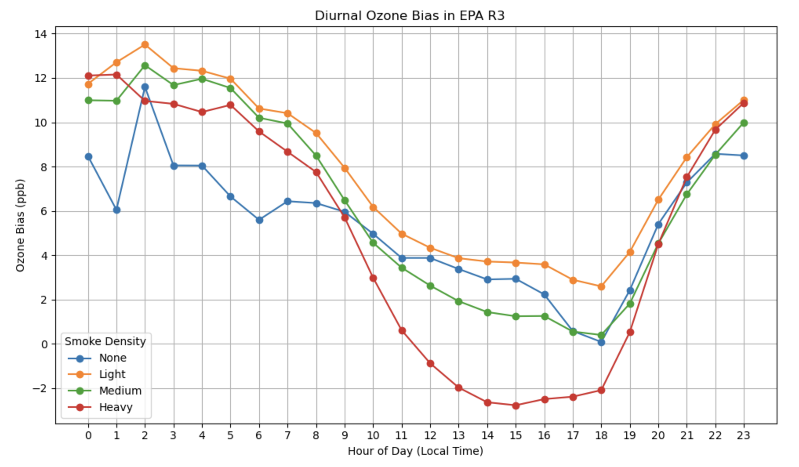
Diurnal Cycle of UFS-AQM Ozone Bias by HMS Smoke Category in EPA Region 3 (July 2023)
Biases larger in morning and evening, smaller midday.
On heavy smoke days, the model underestimates midday ozone.
Next steps: We are now exploring if heavy smoke is suppressing ozone formation (likely by reducing photolysis). Insights may help improve NOAA’s air quality forecasting.

Slide 13
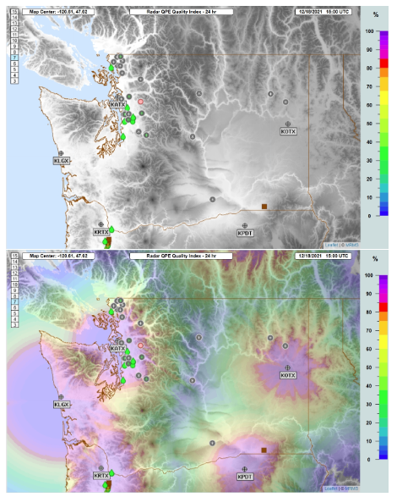
NCAS-M & NOAA: Advancing Precipitation Estimation with Artificial Intelligence
NCAS-M: Oscar Chimborazo, Sen Chiao; NSSL: Andrew Osborne, Jian Zhang, Robert Clark
Challenge: Radar-based Quantitative Precipitation Estimation (QPE) is limited in mountainous regions due to beam blockage, complex terrain, and atmospheric variability.
AI/ML Collaboration: NCAS-M at Howard University collaborates with NOAA’s National Severe Storms Laboratory (NSSL) to apply Artificial Intelligence (AI) and Machine Learning (ML) — specifically Convolutional Neural Networks (CNNs) — trained on NOAA’s Multi-Radar Multi-Sensor system (MRMS) data to improve QPE accuracy.
Impact for NOAA: Joint NCAS-M–NSSL research leverages NOAA MRMS system. Uses NOAA high-performance computing (Orion). Supports NOAA’s mission to improve precipitation forecasts for extreme events (e.g., Atmospheric Rivers).
Radar Quality Index (RQI) over the U.S. Northwest, illustrating terrain-induced radar coverage limitations.

Slide 14
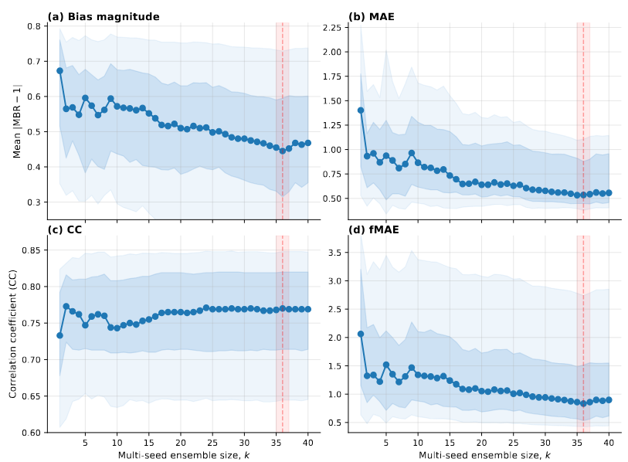
Current AI/ML Research Highlights
AI/ML Model Development
CNN trained on 29 variables, including MRMS-derived predictors, terrain, and atmospheric fields.
Trained two model variants based on loss functions (MAE, fMAE) plus a hybrid (MAE+fMAE) product and ensemble multi-seed procedure.
Evaluated precipitation events, several linked to Atmospheric Rivers (ARs).
Preliminary Findings:
CNNs lowered MAE and fractional MAE compared to MRMS Q3EVAP in several cases.
Correlation with gauges increased; MBR shifted toward unity.
Larger k improves the central tendency of the four metrics (MBR, MAE, CC, fMAE); however, variability is still a challenge that needs to be addressed.
Performance improves with ensemble size k, with fMAE models achieving the lowest bias. Ensemble experiments with ~36 members show the best performance so far, but variability across events remains and motivates exploring ensembles beyond 40 members.
Notes:
Fractional MAE (fMAE), MBR is mean bias ratio

Slide 15









In spite of the dynamic environment… NCAS-M continues to provide academic support, mentorship, internships, research experiences, and community outreach aligned with NOAA’s goals. The center serving as conduit to build a diverse, highly skilled workforce equipped to advance NOAA’s goals in weather prediction, environmental protection, and community resilience.
Thank You
NCAS-M is supported by the U.S. Department of Commerce, National Oceanic and Atmospheric Administration, Educational Partnership Program under Agreement No. NA22SEC4810015.

