Slide 1

Welcome to the
Unifying Innovations in Forecasting Capabilities Workshop
September 11, 2025
A Unified Forecast System (UFS) Collaboration Powered by the Earth Prediction Innovation Center (EPIC)
Center Green Auditorium, Boulder, CO

Slide 2
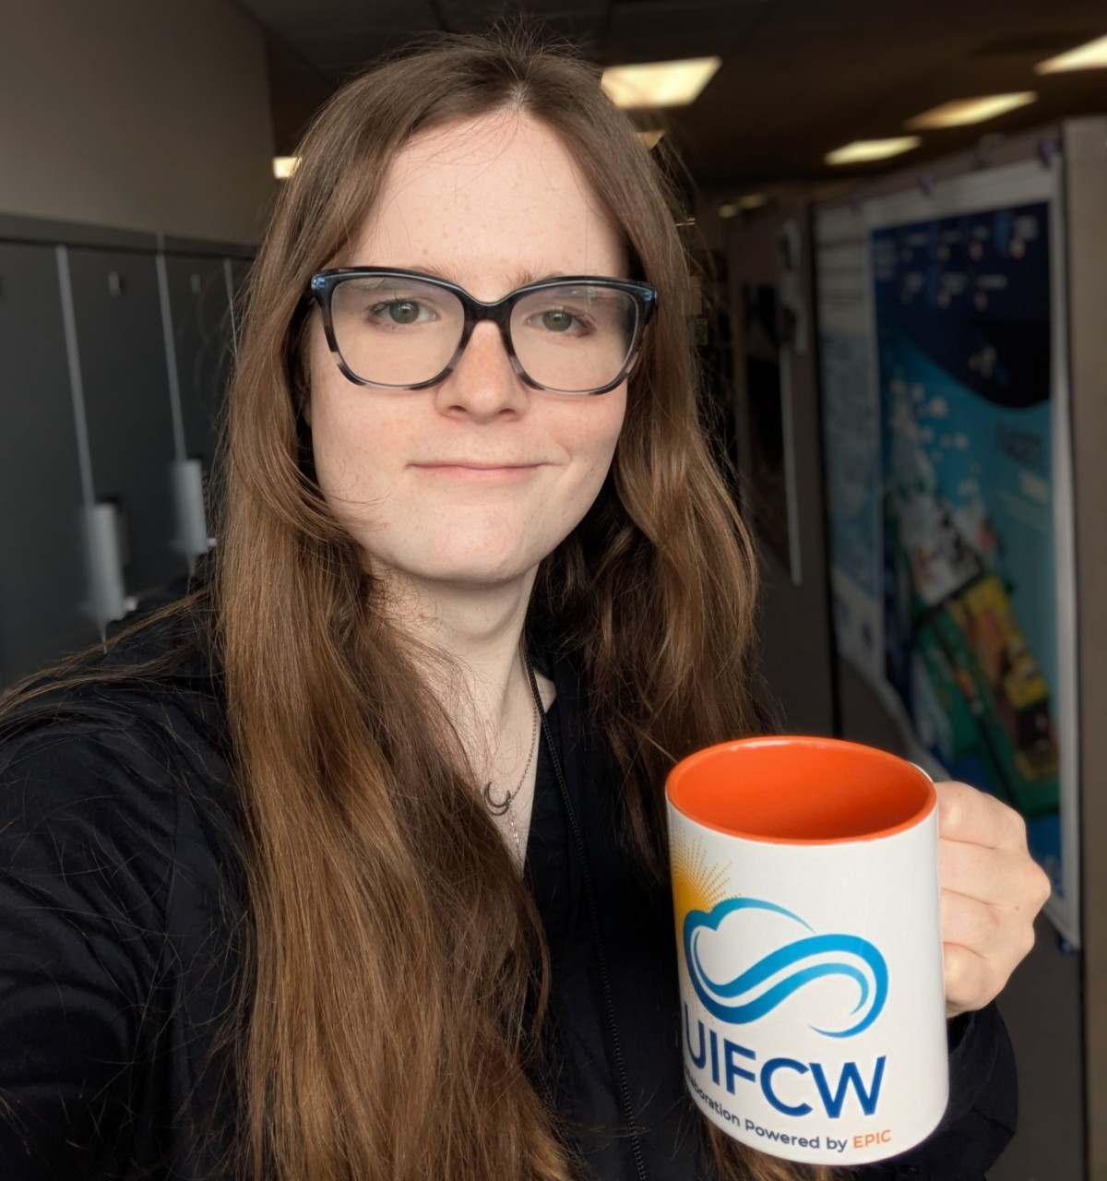
Today’s Master of Ceremonies
Rowin Smith
UFS Student Ambassador
Colgate University, NOAA (through William M. Lapenta internship)

Slide 3
Live Streaming Announcement
The UIFCW is an open event that will be live-streamed online and recorded. By staying in the room (and online), you understand that your image, in video or still, and any sound recorded alongside it, will live-streamed over social media and recorded. The videos will be submitted to NOAA for review before sharing publicly. The information that you provide will be used for websites, agenda's, and event descriptions.
For more information on NOAA's Privacy policy: https://www.noaa.gov/sites/default/files/legacy/document/2021/Mar/NOAAPrivacyPolicy_Final_May2017.pdf

Slide 4
Thursday, September 11th
09:00 AM – 09:15 AM – Welcome
09:15 AM – 10:15 AM – R2O facets and how to engage in R2O to advance the UFS
09:30 AM – 12:00 PM – Training #3: Introduction to Running Idealized Test Cases
via the UFS Hierarchical System Development Framework
(Rm 2603)
09:30 AM – 12:00 PM – Training #4: NOAA AI Learning Journeys Tutorial
(Rm 2126)
10:15 AM – 10:45 AM – US Navy’s Earth System Prediction Capability Efforts by
Naval Meteorology and Oceanography Enterprise
10:45 AM – 11:15 AM – Fire Behavior Model Being Coupled to the UFS
11:15 AM – 12:00 PM – Poster Session
12:00 PM – 01:00 PM – Lunch

Slide 5
Thursday, September 11th
01:00 PM – 03:00 PM – Parallel Sessions with Q&A:
UFS Application - Coastal, Marine, Oceans and Ecology
(includes HAFS applications)
(North Bay Auditorium)
UFS Application - SRW App, RRFS, MPAS
(Center Bay Auditorium)
UFS Application - Air Quality, Atmospheric
Composition, Aerosols (smoke, dust and fire
capabilities)
(South Bay Auditorium)
03:00 PM – 03:30 PM – Break

Slide 6
Thursday, September 11th
03:30 PM – 04:15 PM – MPAS Collaborations and Community Engagement
03:45 PM – 05:00 PM – OPTIONAL: Tour of the National Science Foundation National Center for Atmospheric Research (NCAR) Mesa Lab (bus leaves for Lab at 3:03 and 3:30pm, last bus back to UCAR at 6pm)
04:15 PM – 04:45 PM – Generation of grid-mesh with multi-refinements for using MPAS to predict severe weather over multiple regions
04:45 PM – Adjourn

Slide 7
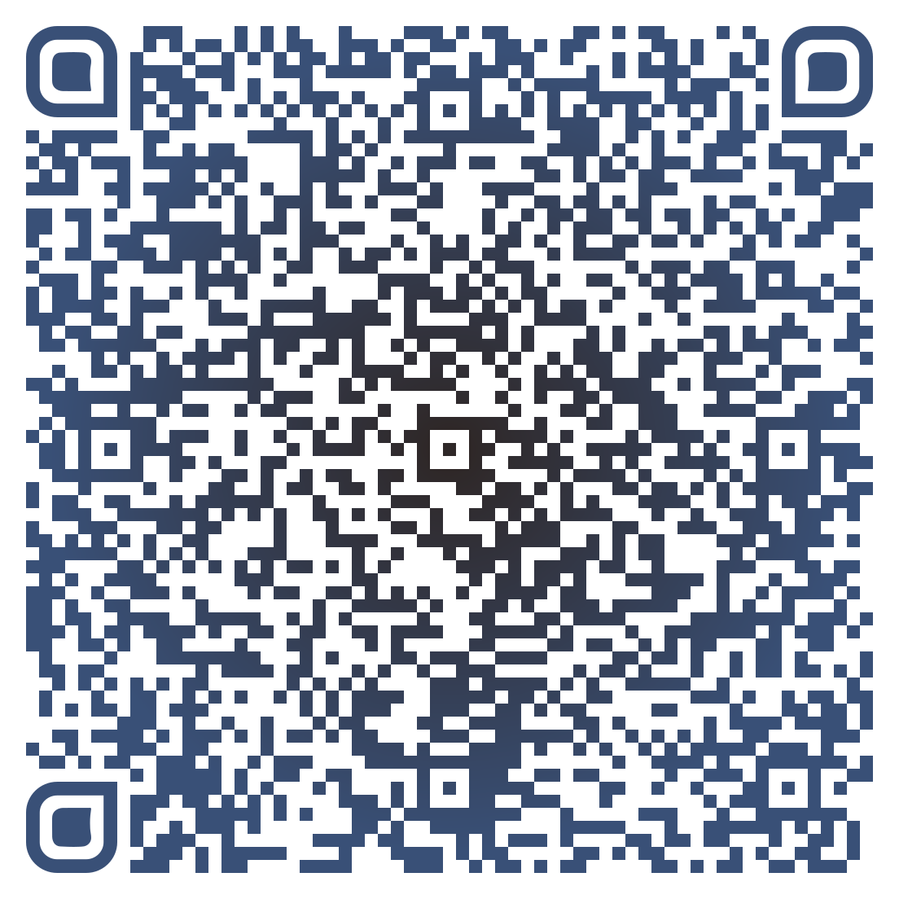



Connect With Us!
Participant Guide
Connect with us on Slido, X, and Instagram
Access Slido & the Livestream from the UIFCW Event Page:
@NOAAEPIC
#UIFCW25
Wi-Fi: UCAR Visitor
No password is required.

Slide 8

Please take the
UIFCW Post Event Survey

