Slide 1
Implementation of the MPAS-A Dynamical Core in the UFS
Dustin Swales^{1,2}, Ligia Bernardet^{1,2}, Grant Firl^{1,2,3},
Soren Rasmussen^{2,4}, Vanderlei Vargas^{1,2,3}, Lulin Xue^{2,4}
¹National Oceanic and Atmospheric Administration (NOAA) Global Systems Laboratory
²Developmental Testbed Center
³Colorado State University, Cooperative Institute for Research in the Atmosphere
⁴NSF National Center for Atmospheric Research, Research Applications Laboratory

Slide 2
Goal(s)/Question(s)
Enable MPAS Dynamical core for use in the UFS Weather Model (UWM).
Initially targeting RRFSv2 application: regional and uncoupled.
Generalize UWM atmospheric component: multiple dynamical cores coupled to CCPP Physics.
Lay groundwork for full (potential) MPAS-dycore integration.
How much of the existing infrastructure can we leverage?
What is dycore-specific/agnostic?
What infrastructure do we need to build?
Notes:
1 min

Slide 3
Background
The Unified Forecast System (UFS) Weather Model (UFSWM) is a multi-component (e.g. Atmosphere, Ocean, etc…) Earth System Model (ESM).
The Atmospheric component of the UFS has two* major components, the dynamics (FV3) and the physics (CCPP).
The Model for Prediction Across Scales Atmosphere (MPAS-A) is a standalone Atmospheric model with its own dynamical core (core_atmosphere) and physics**.
* There are other minor components (e.g Unified Post-Processing (UPP) and Stochastic Physics).
** There is an ongoing effort to develop and share physics across the MPAS-A and UWM (See Clark Evans talk (next!)).
Notes:
1 min

Slide 4
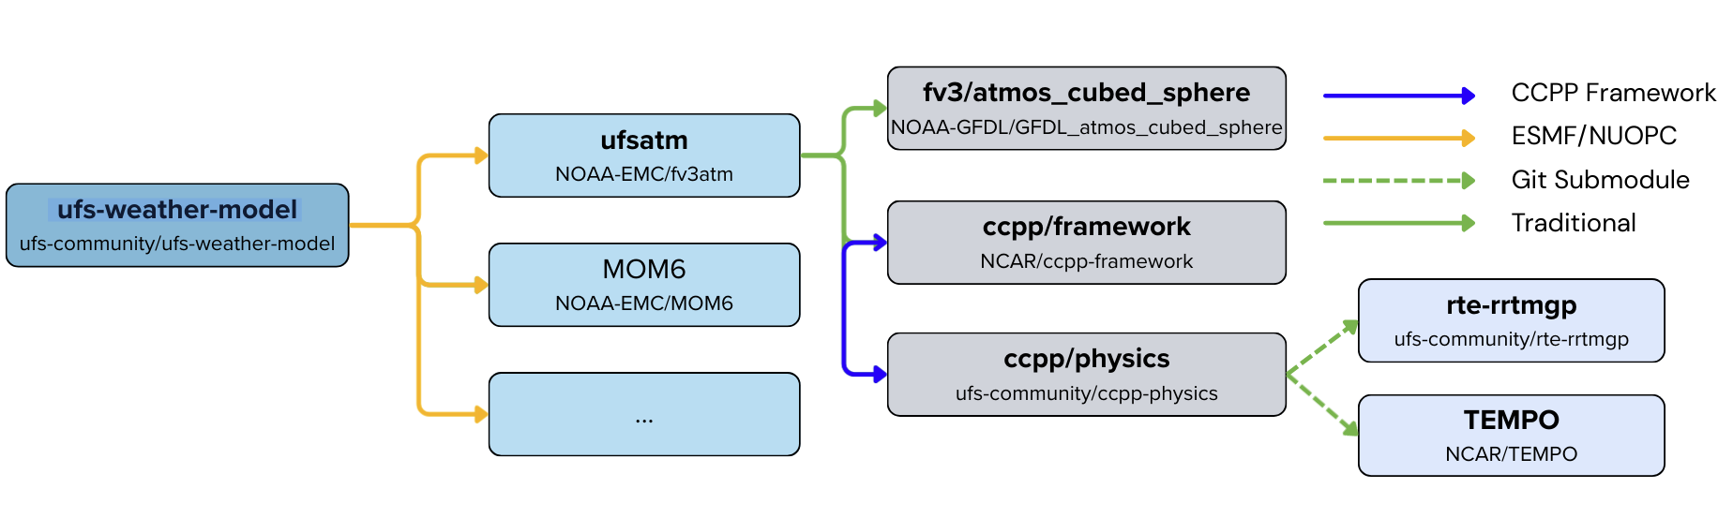
UWM Architecture (FV3-Atmosphere)
Scheme-to-Scheme coupling (blue):
CCPP Framework - Group/couple individual physics parameterizations.
Physics-to-Dynamic coupling (green):
The CCPP Physics/FV3 dycore are coupled w/o using any specialized “infrastructure”.
ESM coupling (orange):
ESMF/NUOPC -Connect the ESM components.
Notes:
Left to right: 2 min

Slide 5
UWM Architecture (FV3-Atmosphere)
Scheme-to-Scheme coupling (blue):
CCPP Framework - Group/couple individual physics parameterizations.
Physics-to-Dynamic coupling (green):
The CCPP Physics/FV3 dycore are coupled w/o using any specialized “infrastructure”.
ESM coupling (orange):
ESMF/NUOPC -Connect the ESM components.
Notes:
Intra-Physics coupling. Scheme-to-Scheme, Group-to-Group, or call to static API (CCPP SCM)

Slide 6
UWM Architecture (FV3-Atmosphere)
“Atmospheric driver”
Scheme-to-Scheme coupling (blue):
CCPP Framework - Group/couple individual physics parameterizations.
Physics-to-Dynamic coupling (green):
The CCPP Physics/FV3 dycore are coupled w/o using any specialized “infrastructure”.
ESM coupling (orange):
ESMF/NUOPC -Connect the ESM components.
Notes:
P2D Coupling: Handles evolution of atmospheric state. Stochy and 3D physics. ESMF Infrastructure above. CCPP Framework below.

Slide 7
UWM Architecture (FV3-Atmosphere)
Scheme-to-Scheme coupling (blue):
CCPP Framework - Group/couple individual physics parameterizations.
Physics-to-Dynamic coupling (green):
The CCPP Physics/FV3 dycore are coupled w/o using any specialized “infrastructure”.
ESM coupling (orange):
ESMF/NUOPC -Connect the ESM components.
Notes:
ESMF infrastructure layer containing hooks to the forward integration step(s) described in the P2D coupling layer. Overlaying NUOPC Cap that uses EMSF forecast grid components.

Slide 8
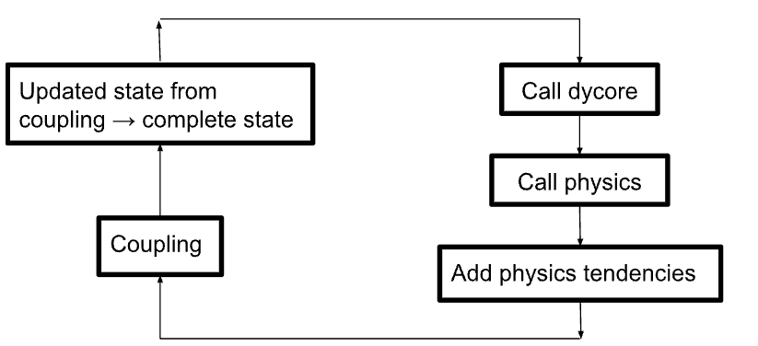
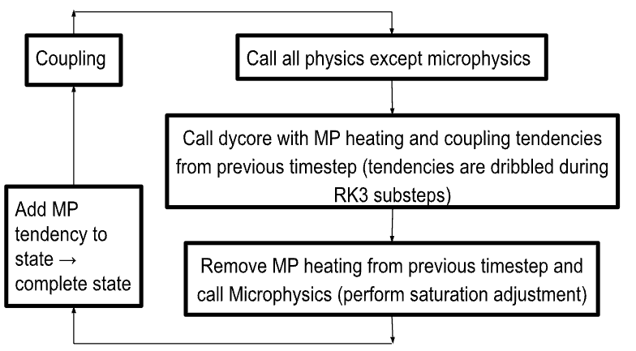
Physics to Dynamics (P2D) Coupling
UFS-FV3 MPAS-A
*
The major differences are the (a) physics grouping and (b) the sequencing.
Between the calls to the physics groups and dycores, the evolution of the prognostic state is handled differently between models.
*There are UFS applications that are configured with a “fast-physics” step within the FV3 dycore
Notes:
1min

Slide 9
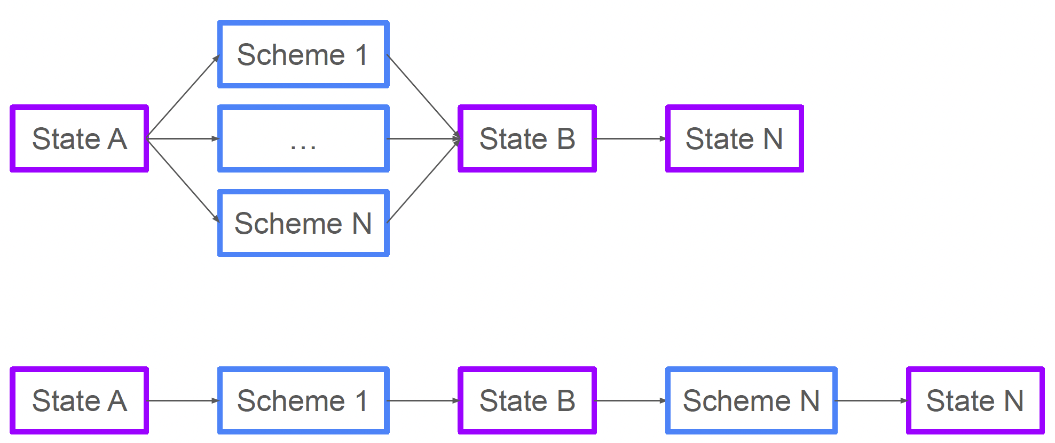
Scheme-to-Scheme Coupling: CCPP Physics
To accommodate the different P2D coupling strategies, the host-model needs control over the evolution of the internal physics state. (e.g. process-splitting (top) vs. time-splitting (bottom)).
Notes:
1min

Slide 10
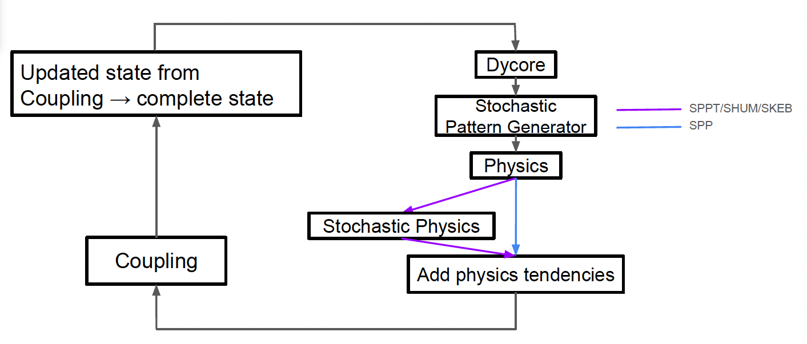
Other P2D Coupling: 3D Physics
For FV3 based UWM applications, the Stochastic Physics parameterizations are invoked within the P2D coupling.
This will be the same for MPAS-dycore in the UWM. Effort underway!
Notes:
1min

Slide 11
ESMF and NUOPC Infrastructure
ESMF Forecast grid component:
Responsible for integrating the Atmosphere forward in time.
Interfaces directly with the P2D coupling.
ESMF Write grid component:
Responsible for asynchronous input/output.
Needed for operational production runs. MPAS’s native IO, PIO, not sufficient for this level of throughput.
NUOPC Cap:
Enables either FV3 or MPAS based atmospheric forecasts.
Coupling to other ESM components.
Notes:
1 min

Slide 12
Status
UFS Atmosphere component has been refactored/partitioned to accommodate multiple dynamical cores (FV3ATM -> UFSATM).
Initial MPAS based atmospheric driver has been created for UFS.
All CCPP Physics schemes were refactored to provide tendencies.
Stochastic pattern generator and physics are under development using standalone MPAS.
NUOPC/ESMF infrastructure created for MPAS-enabled UWM forecasts.
Notes:
1 min

Slide 13
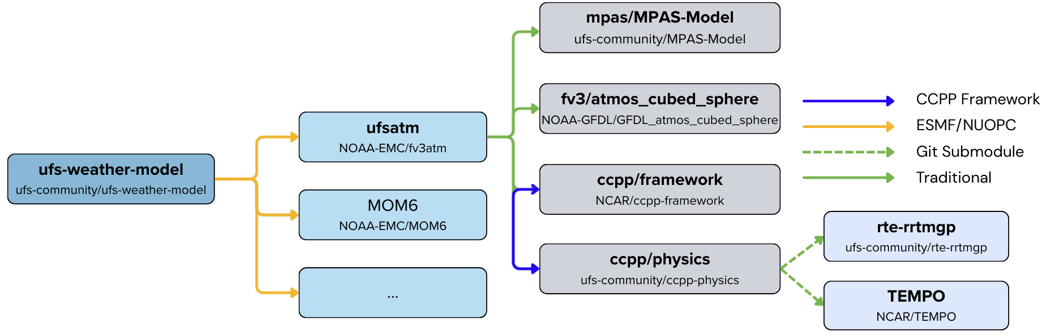
UWM Architecture (UFS Atmosphere)
The Atmospheric component has separate interfaces for the FV3 and MPAS-A dynamical cores.
The UWM uses a single NUOPC Cap for the Atmospheric component.
Notes:
1 min

Slide 14
Next Steps for RRFSv2
The P2D coupling needs to be built to integrate the forecast forward in time. Efforts (parallel) to address this are ongoing/underway.
Integrate stochastic physics developed in standalone MPAS to UWM.
Create ESMF Write Grid component for asynchronous I/O.

Slide 15
Beyond RRFSv2
Uncoupled global atmosphere only experiments with MPAS “should” be straightforward with the proper ICs.
(There are no plans to evaluate this as part of this initial effort).
Coupled UFS applications (e.g. GFS/GEFS) will require additional effort to enable MPAS.
UFS applications that use nested regional domains could be revisited with MPAS (e.g. HAFS).
Further enabling science questions about P2D coupling. (Good framework in place for this!)

