Slide 1
Academic research that benefits NOAA: UAlbany experiences
Cheng-Hsuan (Sarah) Lu
University at Albany, State University of New York

Slide 2

There is impactful NOAA-relevant research conducted by faculty members from Department of Atmospheric and Environmental Sciences (DAES) and Atmospheric Sciences Research Center (ASRC), UAlbany.
This presentation focuses on the research activities by Lu research group.

Slide 3
Lessons learned from prior NOAA projects

Slide 4
MAPP CTB 2014: Improving cloud microphysics and their interactions with aerosols in the NCEP global models
UAlbany - NCEP - GSFC team
Objective: Improve the representation of aerosol processes, cloud microphysics, and aerosol-cloud-radiation interactions in NCEP global models
Adopt GSFC’s physically-based aerosol and cloud microphysics package (MAM-7 modal aerosol scheme and MG scheme)
UFS: GOCART (a bulk mass scheme)
Project outcomes:
The option to determine aerosol optical properties from MERRA-2 climatology was implemented by NCEP
Targeted for GFS v17
NCEP reports GFS forecasts with OPAC vs MERRA-2 in Cheng and Yang (2023)

Slide 5
CPO MAPP 2018: Joint NOAA-NASA development of a data assimilation system for aerosol reanalysis and forecasting
CU - GSFC - UAlbany team
Objective: Develop JEDI-based aerosol DA system to improve aerosol forecasting and produce aerosol reanalysis
Adopt GSFC’s Neural Network Retrieval algorithm to produce VIIRS AOD, and prototype AOD data assimilation using GEFS-Aerosols as forward model and JEDI as the DA system
UFS: JEDI with VIIRS AOD data assimilation is in parallel test
Project outcomes:
Development of JEDI-based aerosol data assimilation
Generate NOAA Aerosol Reanalysis version 1.0 for 2016
Refined to generate multiple-year aerosol reanalysis (led by B Huang at NOAA)

Slide 6
NGGPS R2O 2015: Investigation of aerosol effects on weather forecast using NCEP Global Forecast System
UAlbany - NCEP team
Objective: Investigate how much complexity is needed to accurately represent the aerosol processes and effectively account for aerosol effects
Loosely coupled system: aerosol fields from low-resolution aerosol forecast model are fed to high-resolution GDAS, affecting aerosol radiative effects in physics and radiance calculation in data assimilation
UFS: Aerosol information from GEFS-Aerosols are not utilized in GDAS
Aerosol-aware data assimilation and the impact on weather forecast are reported in Grogan et al. (2022), Wei et al. (2021, 2022, 2025),

Slide 7
Project outcomes range from peer-reviewed journal publication to algorithm adoption for GFS/JEDI applications

Slide 8
Productive R2O projects benefit from:
Engagement with NOAA scientists
Knowledge sharing (e.g., leveraging GSFC’s GOCART R&D)

Slide 9
Ongoing research activities

Slide 10

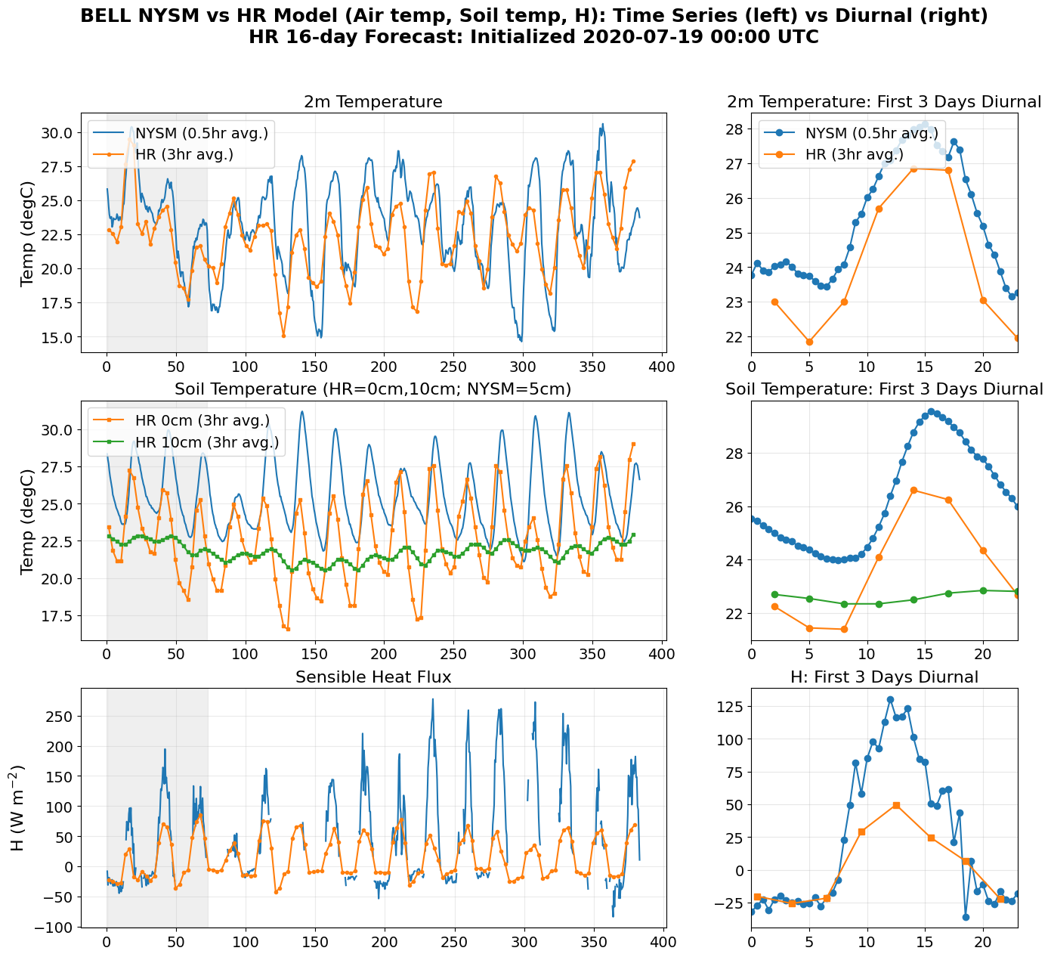
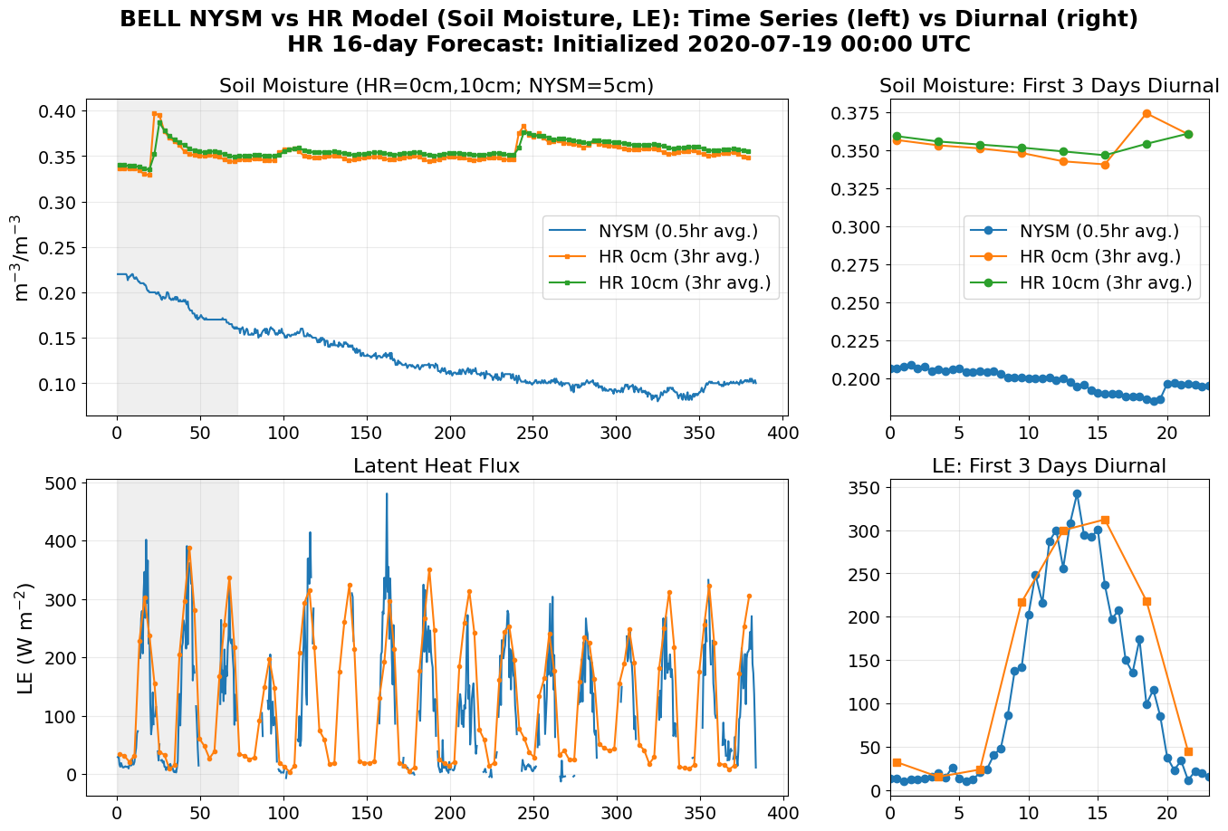
Evaluating UFS Heat and Moisture Fluxes Using Eddy Covariance Observations from the New York State Mesonet (Student Session)
Background: 18 NYSM eddy covariance sites with 7+ years of 30-minute turbulent flux and Bowen ratio measurements allow for evaluation of the UFS HR model's surface energy exchange
Objective: Quantify UFS skill for fluxes and Bowen ratio across sites, seasons, and the diurnal cycle, diagnose where energy exchange deviates between the model and observations
Anna Glodzik
NYSM and UFS flux/Bowen ratio comparisons can inform land-atmosphere coupling metrics in METplus.
Energy-partitioning accuracy can be quantified both in real time and retrospectively, and identify when and where the UFS misrepresents land surface processes
NOAA Joint Technology Transfer Initiative (JTTI)

Slide 11

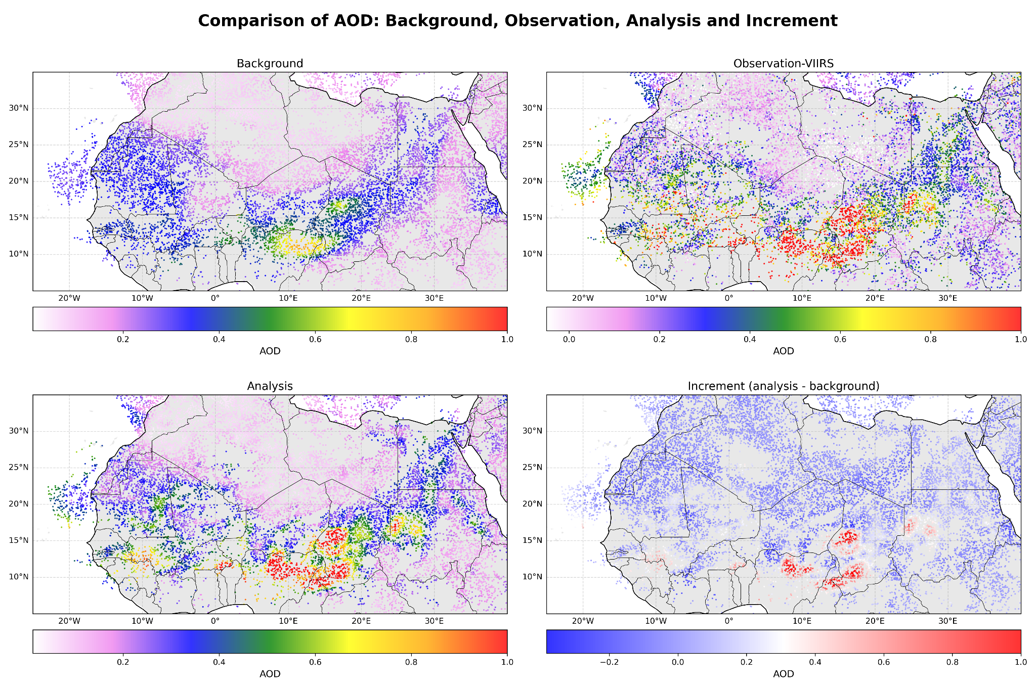
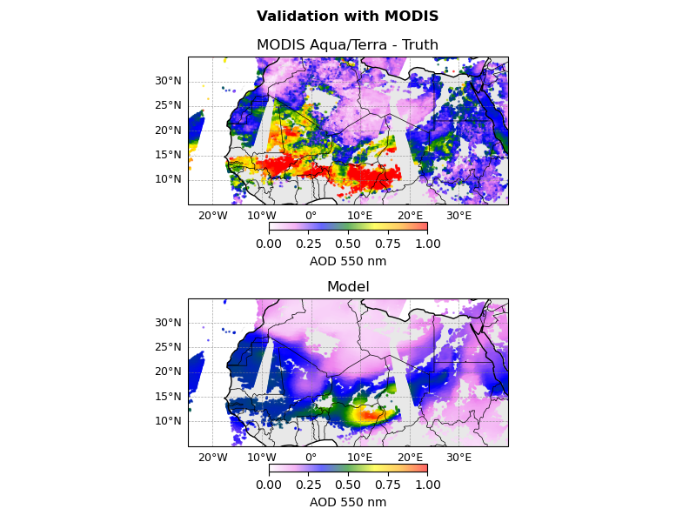
Aerosol Data Assimilation using GCAFS/JEDI
(Student Session)
Background: Despite the clear benefit of AOD assimilation for aerosol forecasts and analyses, AOD assimilation has limited positive impact on the vertical profiles of aerosol loading.
Objective: Advance JEDI aerosol data assimilation capability by conducting R&D on assimilating aerosol backscatter profiles from CALIOP.
Michael Benneh
(Howard Univ.)
Adopt NCEP/EMC AOD DA workflow (POC: Cory Martin, EMC)
Demonstrates the current capabilities of GCAFS/JEDI aerosol DA system
The results with VIIRS AOD assimilated are verified using MODIS AOD
Consortium for Advanced Data Assimilation Research and Education (CADRE)

Slide 12

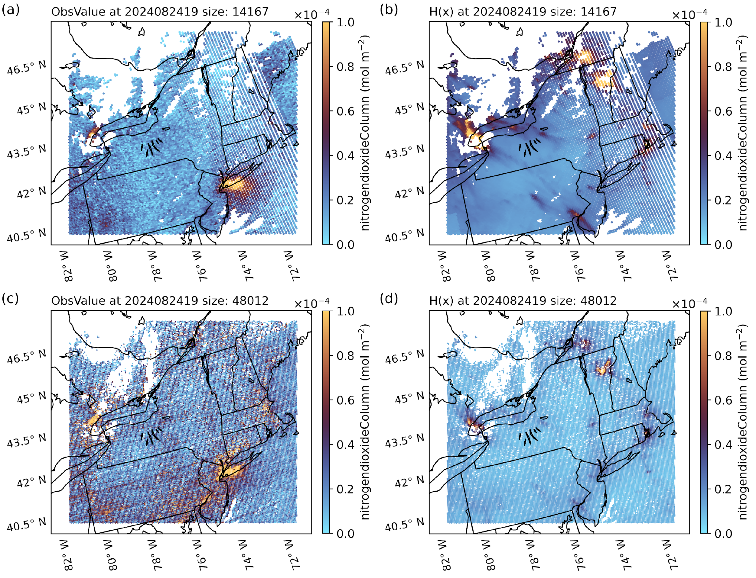
Atmospheric Composition in JEDI
Approach: Evaluate AQ model output using JEDI paired model-observations with forward operator calculations by interfacing JEDI with Versatile Interface for Native Data (VIND) and METplus.
Objective: Provide a unified tool to evaluate model systematically and enable the cross comparison among observations.
Dr. Shih-Wei Wei
JPSS Proving Ground and Risk Reduction (PGRR)
TROPOMI and TEMPO NO2 vs WRF-Chem

Slide 13

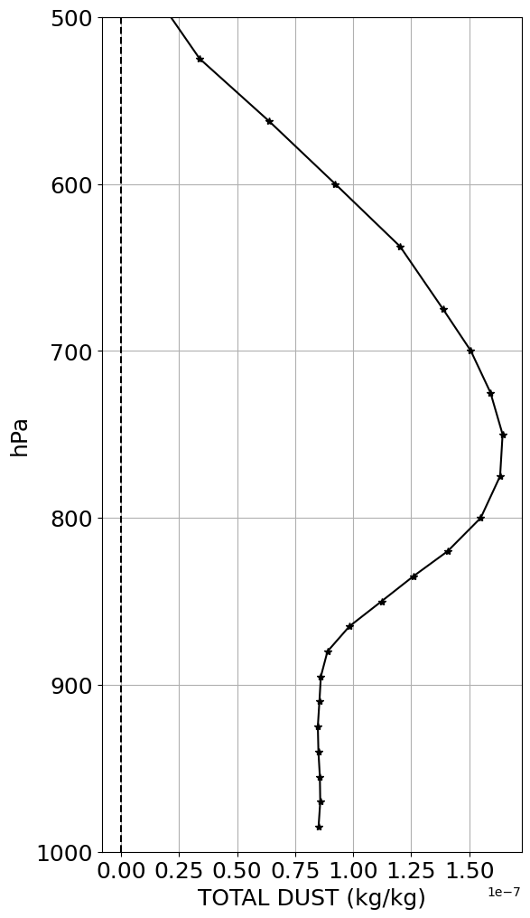
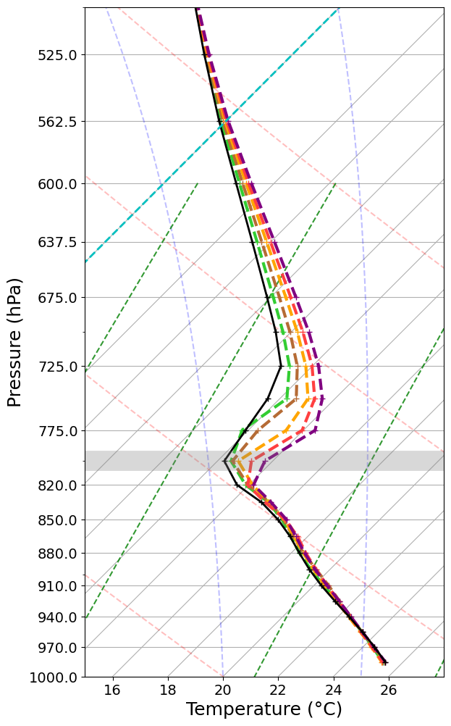
Radiative effects of dust on African Easterly Waves
Background: AEWs are a major source of synoptic and mesoscale rainfall variability over West Africa. They are also the main precursors for East Atlantic TC genesis events.
Objective: Investigate the dust radiative impact on the AEW environment using MERRA-2 reanalysis as well as numerical experiments with CCPP-SCM and UFS.
Figure 1. (a) Average dust profile over the southern region of the AEW trough. (b) Temperature profiles around noon on the first day of simulation, averaged under different dust concentrations.
Christian Barreto-Schuler
The southern region of the AEW trough over the eastern Atlantic is associated with convective activity.
Gradual increases in mid-tropospheric dust led to a stronger thermal inversion above the boundary layer.
Preliminary results indicate that deep convection is delayed with an increase in DUAOD values
National Science Foundation (NSF)

Slide 14

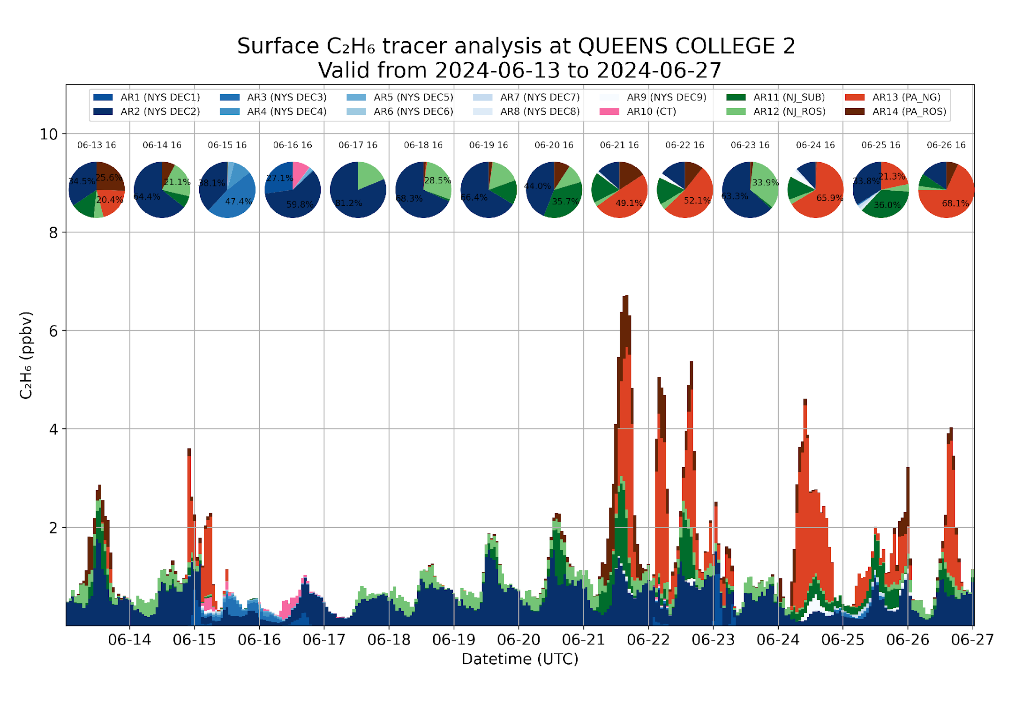
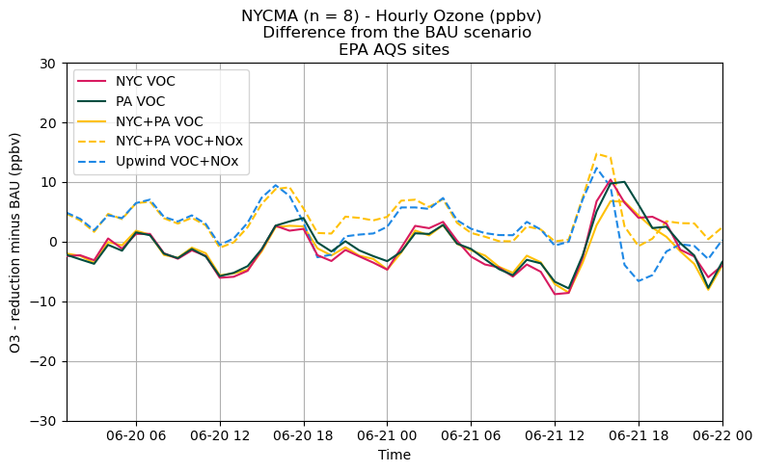
Anthropogenic VOC tracer and sensitivity analysis using WRF-Chem
Background: Anthropogenic volatile organic carbon (VOC) emissions have been shown to impact New York City (NYC) ozone (O₃) concentrations more than previously thought
Objective: (1) Understand how regional transport of VOCs affects NYC, especially on O₃ exceedance days (2) How can NY State (NYS) implement VOC reduction policies to mitigate O₃ concentrations?
Notable VOC transport into NYC; 4 out of 7 O₃ exceedance days modelled were impacted by regional transport
NYS alone cannot decrease VOC emissions without increasing O₃; need for interstate collaboration to effectively reduce O₃ concentrations
The New York State Energy Research and Development Authority (NYSERDA)
Liam Sheji
Fig. 1 Results from WRF-Chem ethane tagged tracer analysis at Queens College, NY
Fig. 2 Time series of surface O₃ from WRF-Chem 50% precursor reduction scenarios

Slide 15
Anticipated project outcomes that benefit NOAA:
NOAA funded projects: potential operational applications for METplus and JEDI
Non-NOAA projects: enhance our understanding of key processes for improving weather and air quality forecasts

Slide 16
R2O activities benefit from:
Engagement with NOAA scientists
Knowledge sharing
Leverage UFS community modeling resources (code repo, EPIC support)

