Slide 1
MPAS Evaluations During the 2025 NOAA/Hazardous Weather Testbed Spring Forecasting Experiment
Adam J. Clark^{2,4}, Kent Knopfmeier^{2,3}, Yunheng Wang^{2,3}, Nusrat Yussouf^{2,3}, Israel Jirak¹, Louis Wicker^{2,4}, Clark Evans⁵, David Dowell⁵, Craig Schwartz⁶, Ryan Sobash⁶, Michael Duda⁶, and William Skamarock⁶
1 NOAA/NWS/NCEP Storm Prediction Center, Norman, Oklahoma
2 NOAA/OAR National Severe Storms Laboratory, Norman, Oklahoma
3 Cooperative Institute for Severe and High-Impact Weather Research and Operations, University of Oklahoma, Norman, Oklahoma
4 School of Meteorology, University of Oklahoma, Norman, Oklahoma
5 NOAA/OAR Global Systems Laboratory, Boulder, Colorado
6 National Center for Atmospheric Research, Boulder, Colorado
Center Green Auditorium, Boulder, CO
September 11, 2025

Slide 2
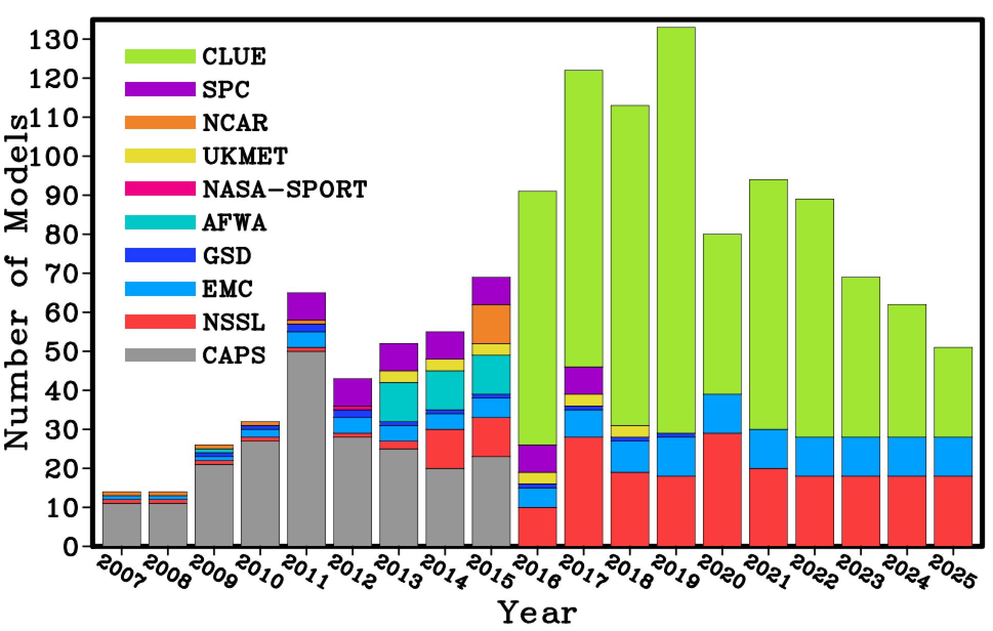
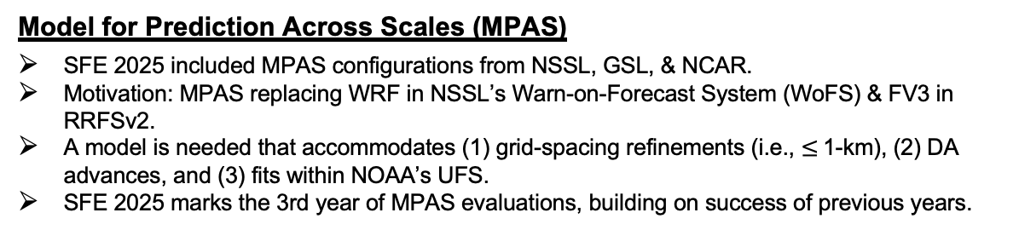
2025 NOAA/HWT Spring Forecasting Experiment
SFEs are five-week experiments jointly organized and facilitated by SPC and NSSL
The 2025 SFE was hybrid with 75 remote and 56 in-person participants.
HWT SFE Model Contributions
SFE Goals include:
Testing & evaluation of emerging technologies for severe weather prediction
Accelerating R2O; developing & strengthening O2R pathways
Facilitating experiments to: optimize deterministic and ensemble CAMs informing Unified Forecast System Development [using Community Leveraged Ensemble (CLUE) framework].
Model for Prediction Across Scales (MPAS)
SFE 2025 included MPAS configurations from NSSL, GSL, & NCAR.
Motivation: MPAS replacing WRF in NSSL’s Warn-on-Forecast System (WoFS) & FV3 in RRFSv2.
A model is needed that accommodates (1) grid-spacing refinements (i.e., $≤$1-km), (2) DA advances, and (3) fits within NOAA’s UFS.
SFE 2025 marks the 3rd year of MPAS evaluations, building on success of previous years.

Slide 3


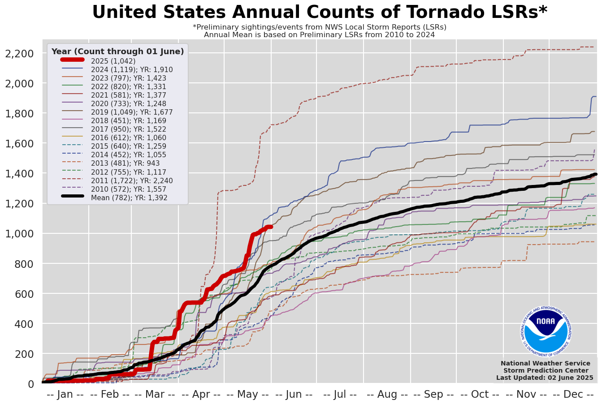
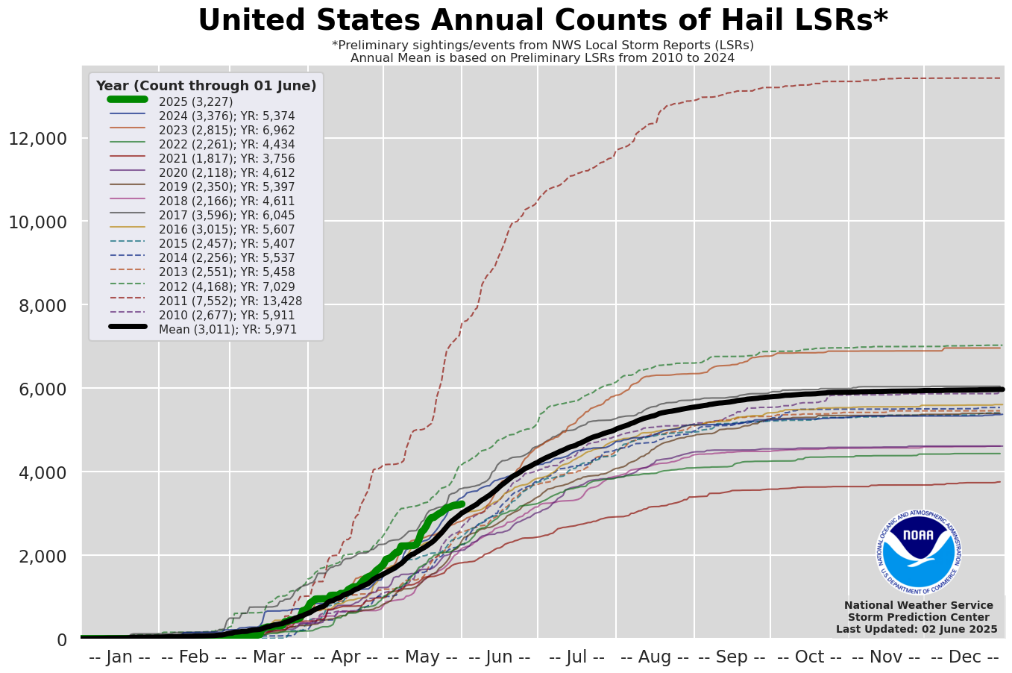
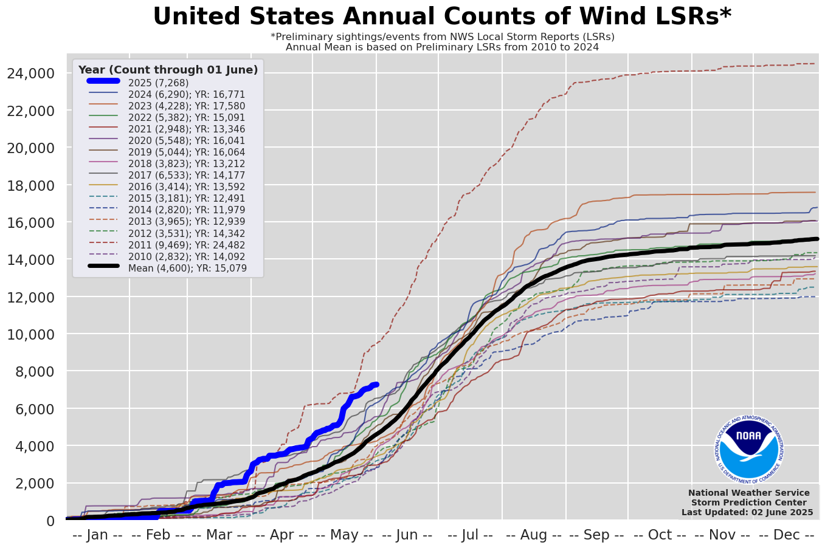
SFE 2025 featured average severe weather activity
SFE
SFE
SFE
Cumulative severe weather reports
Box around SFE period.
Above average activity for the year, but mainly from March and April.
SFE period was average.

Slide 4
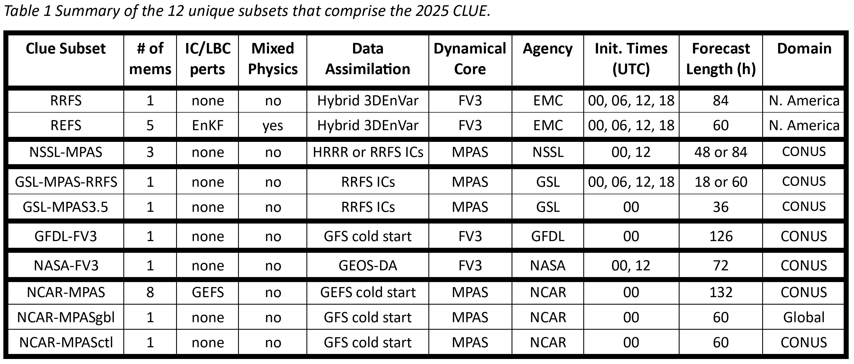
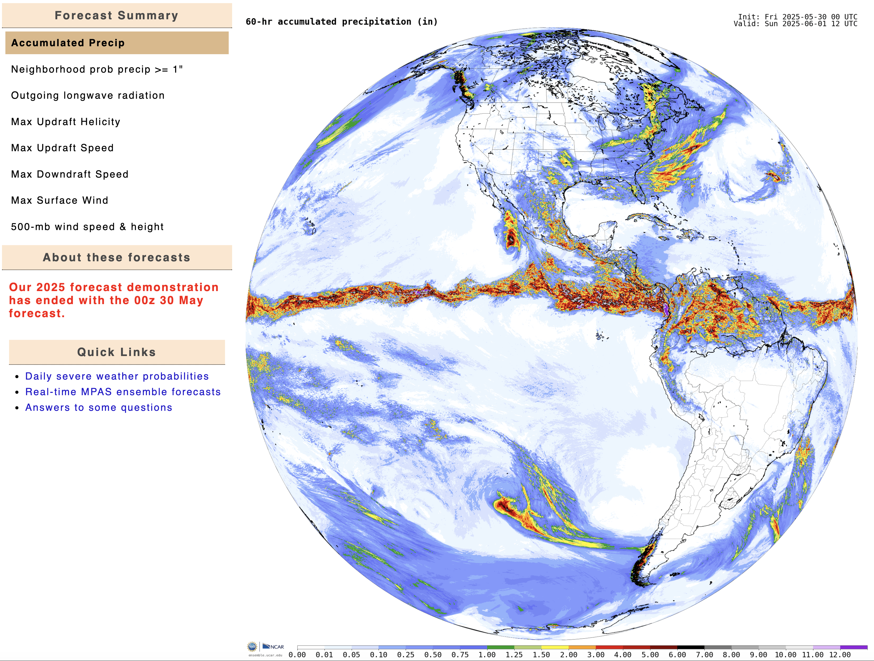
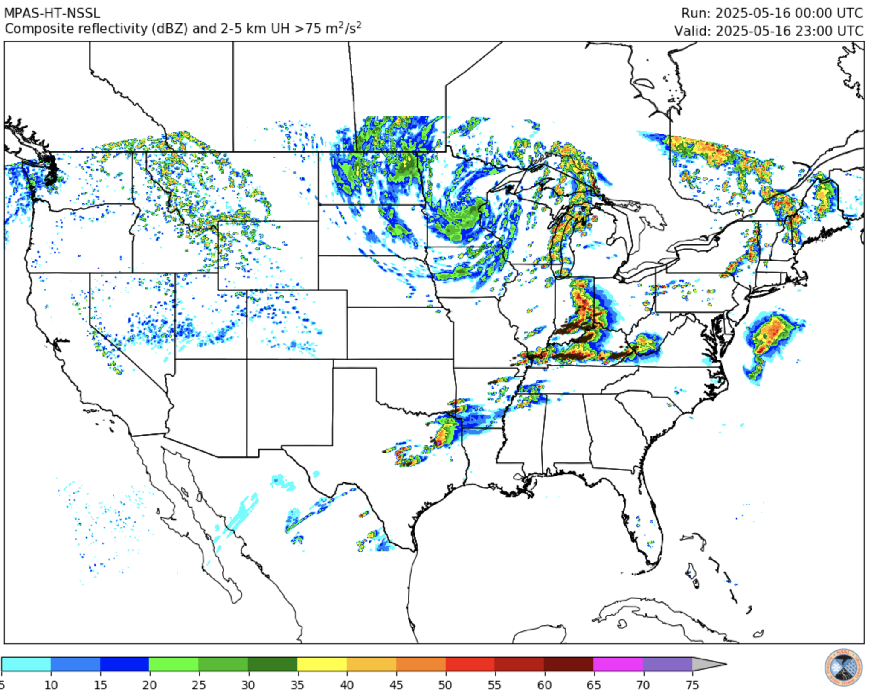
SFE 2025 MPAS configurations
MPAS configurations
ensemble.ucar.edu
cams.nssl.noaa.gov
NSSL: Three unique regional configurations initialized at 00 & 12Z.
Two initialized from the HRRR with Thompson and NSSL microphysics.
One initialized from RRFS with Thompson microphysics.
GSL: Two unique regional configurations
GSL-MPAS-RRFS: RRFSv2 Development System
GSL-MPAS3.5: Grid-spacing sensitivity experiment
NCAR: 8-member ensemble, and global CAM experiment
NCAR-MPAS: GEFS initialized, CONUS refined mesh ensemble
NCAR-MPASgbl: Global 3-km grid-mesh initialized from GFS
NCAR-MPASctl: control run with regional 3-km mesh

Slide 5
SFE 2025 Evaluations
MPAS-related evaluations
Evaluations presented herein
(D)eterministic CAMS | CAM (E)nsembles | (C)alibrated Guidance | (A)nalyses | (A)rtificial (I)ntelligence
D1: Day 1 Deterministic Flagships | E1 & E2: Day 1 REFS vs. HREF | C1: Medium-Range GEFS Severe ML guidance | A1: Mesoscale Analysis Background | AI1: Global NWP Emulators: GFS ICs
D2: Day 2 Deterministic Flagships | E3: Day 2 REFS vs. HREF | C2: Medium-Range CAM Severe ML guidance | A2: Upscale Mesoscale Analysis Background | AI2: Global NWP Emulators: EC ICs
D3: Day 3 Deterministic Flagships |  |  | A3. Storm-Scale Analysis | AI3: Global NWP Emulators: IC Comparison
D4: 00Z RRFS vs. Operational CAMs |  |  |  | AI4: Global Ensemble NWP Emulator
D5: 12Z RRFS vs. Operational CAMs |  |  |  | AI5: WoFSCast vs. WoFS
D6: RRFS vs. HRRR Data Assimilation
D7: MPAS Resolution Sensitivity
D8: Day 2 Regional vs. Global CAM configurations
Major Themes
RRFS/REFS
MPAS Development
AI4NWP
Medium-range severe hazards

Slide 6
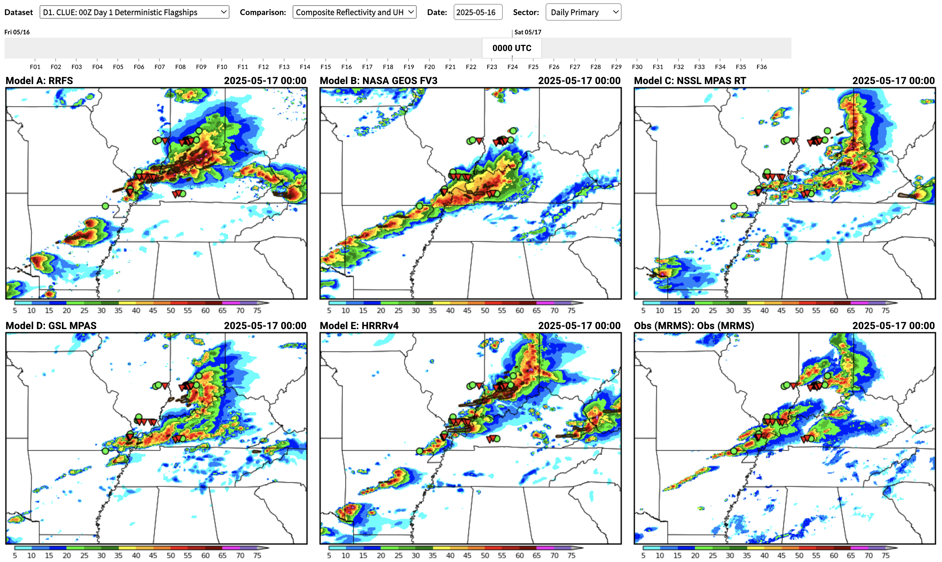
Day 1 00Z Deterministic Flagships
Goal: Gauge progress for severe weather predictions for a single deterministic model from each SFE contributor relative to HRRRv4.
UH & composite reflectivity evaluated over forecast hours 12-36. Consider timing of CI, convective mode, displacement errors, etc.
Comparisons were blinded, and models revealed after ratings were assigned.
MPAS RT (NSSL) and GSL MPAS (GSL) were compared to HRRR, RRFS, and NASA GEOS.
RRFS
NASA GEOS
MPAS-RT
GSL MPAS
HRRR
MRMS OBS
Displacement errors
Miss
Hit
Spurious storms

Slide 7
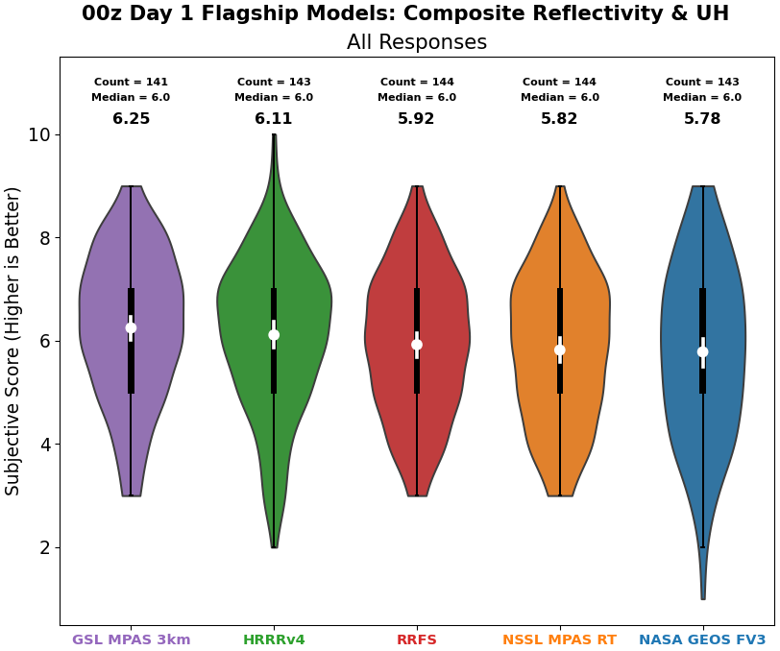
Deterministic Flagships: Composite Reflectivity & UH
Performance tightly clustered, but GSL MPAS had highest average ratings (differences not significant).
Relative to 2024, less spread in average ratings. HRRR went down, RRFS & NASA GEOS went up (GSL MPAS & MPAS RT were not rated last year).
New to SFE 2025: Weekly results that were reviewed Fridays showed large week-to-week variability. Need multiple weeks for robust performance measures.
Best
Worst

Slide 8
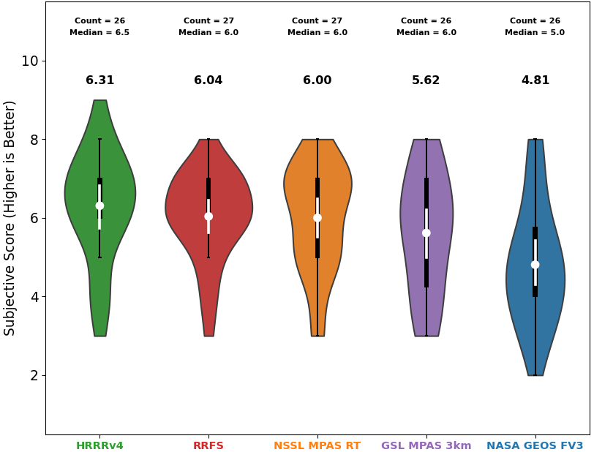
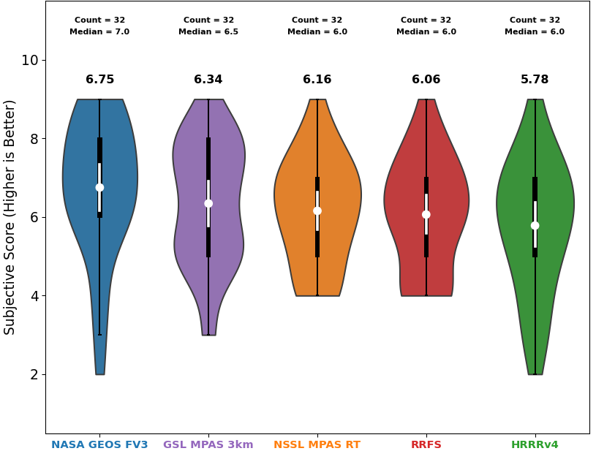
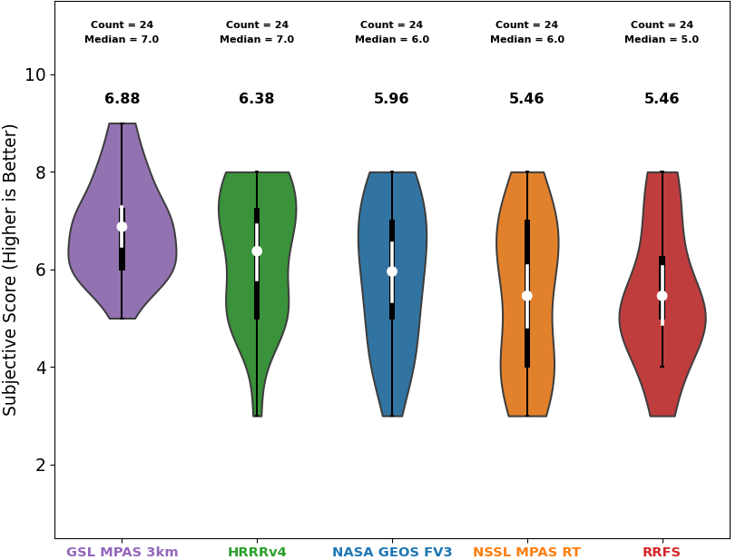
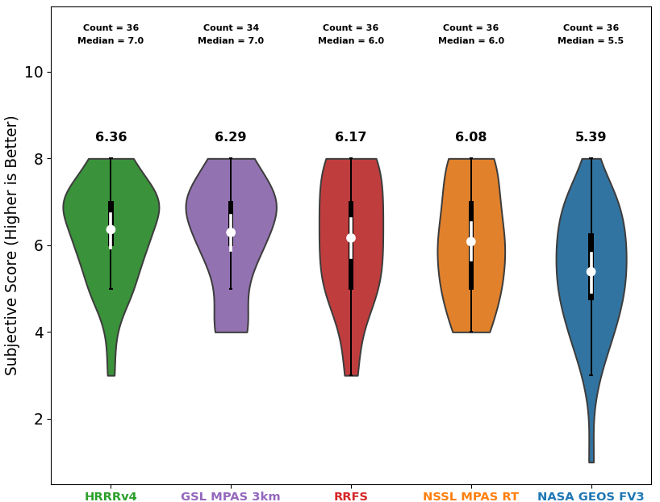
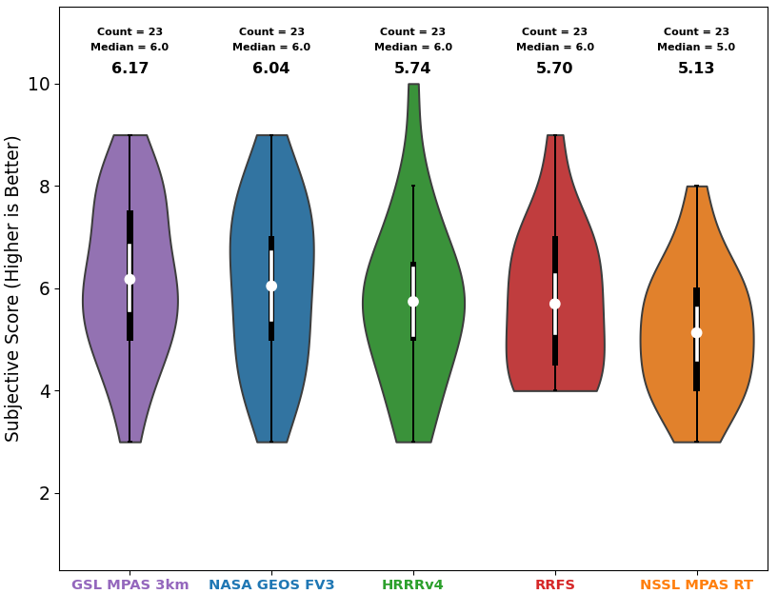
Deterministic Flagships: Composite Reflectivity & UH
Week 1
Week 2
Week 3
Mirror image of week 2
Mirror image of week 1
Highest impact days
Week 4
Week 5
High weekly variability in ratings.
Weeks 1 & 2 mirror images.
Week 3 contained highest impact events, so notable that GSL MPAS performed so well.

Slide 9
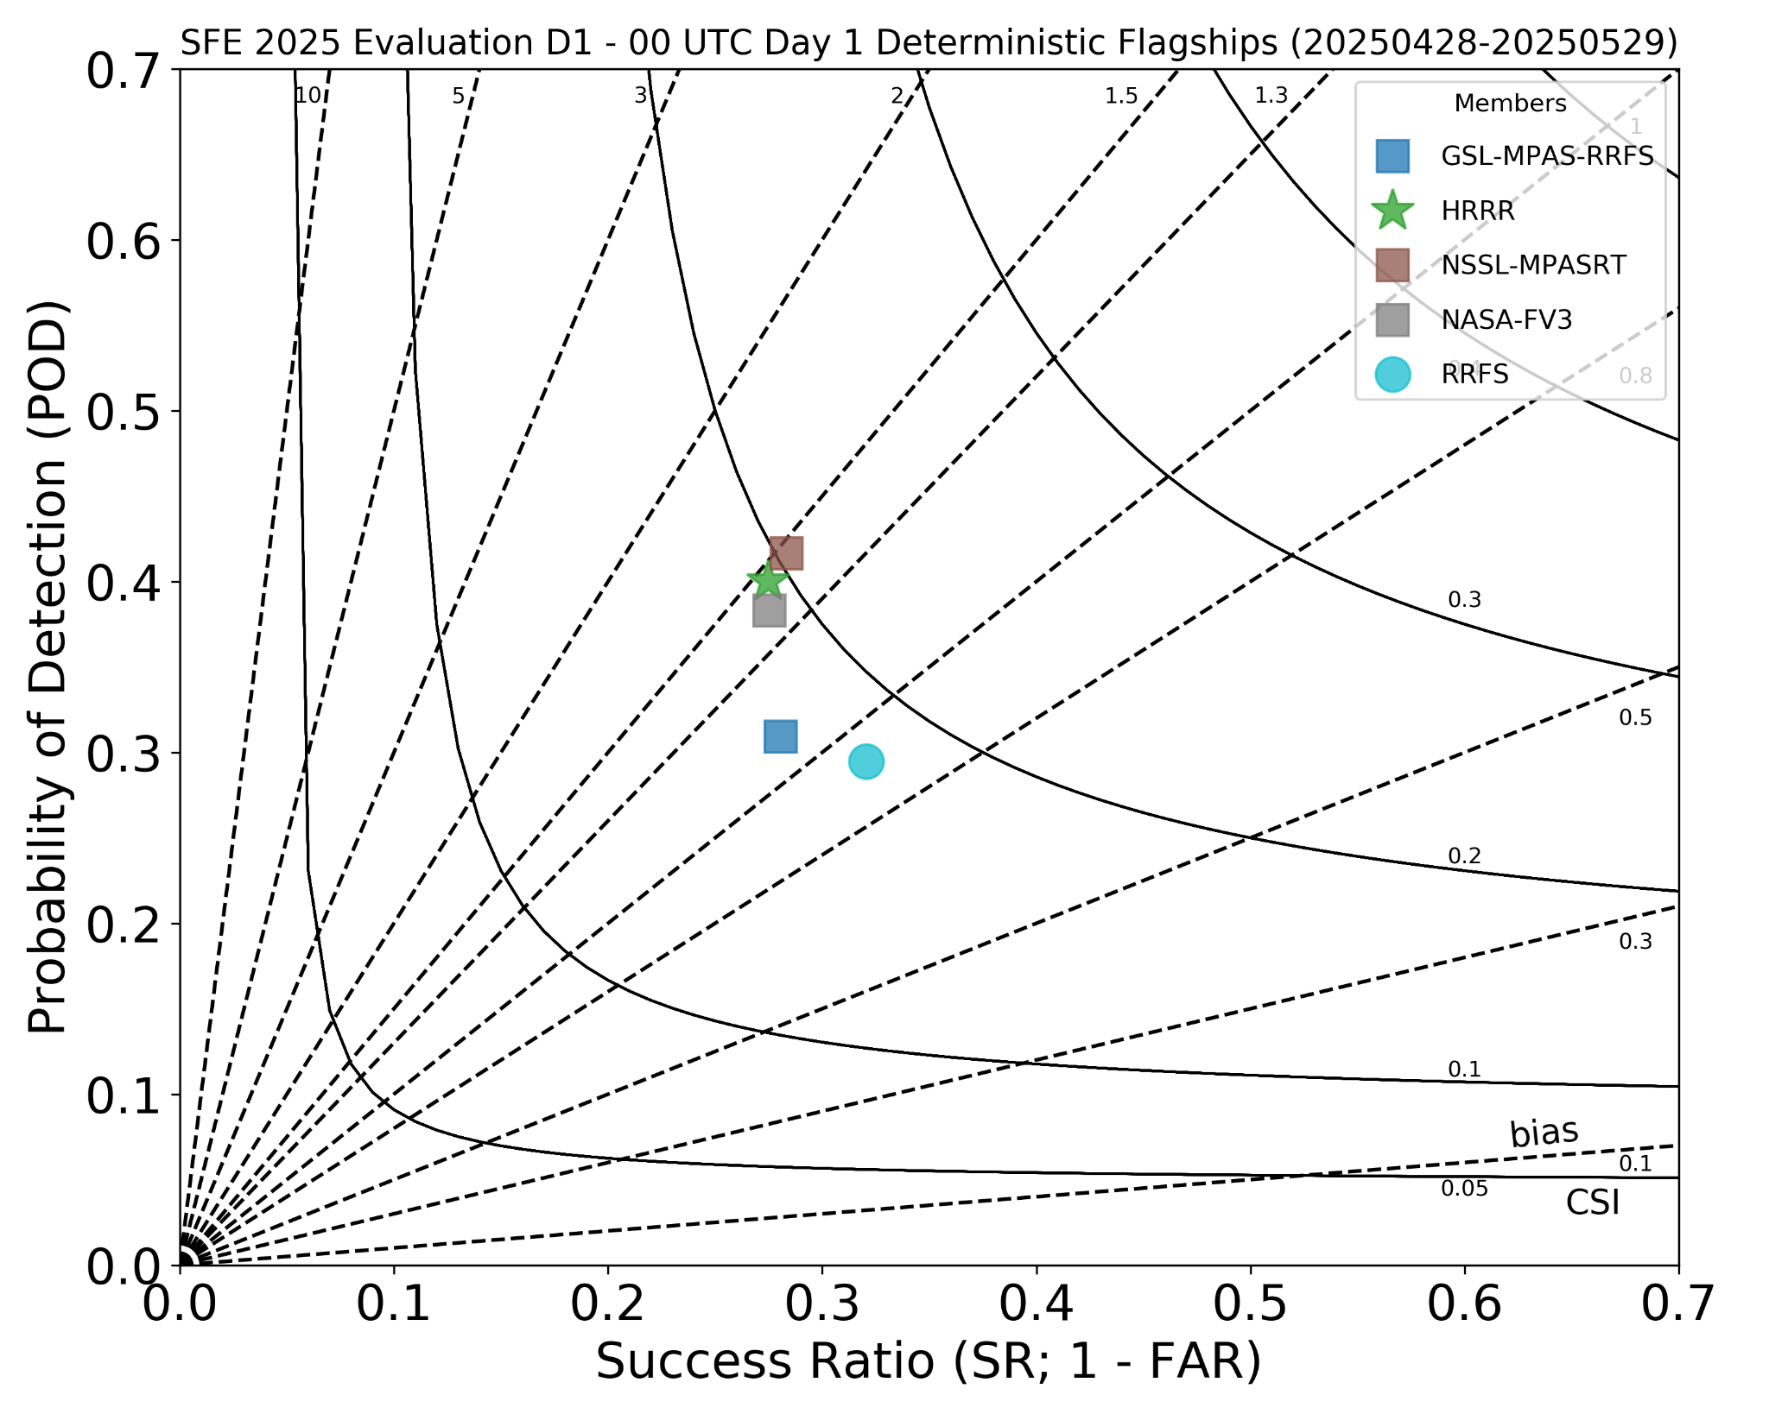
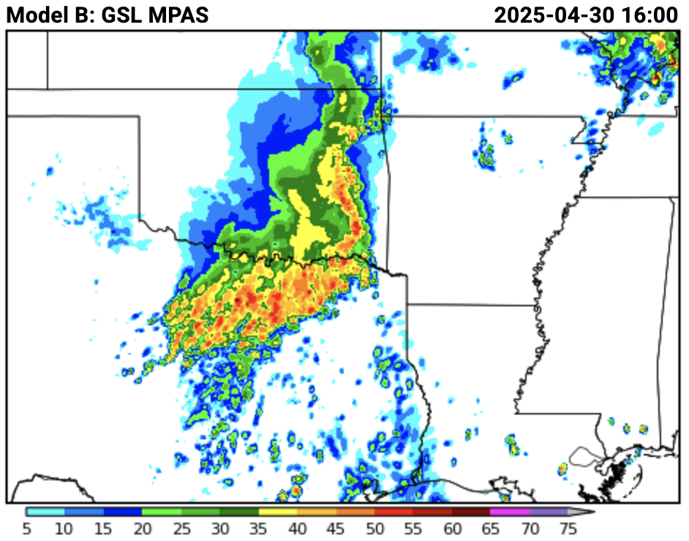
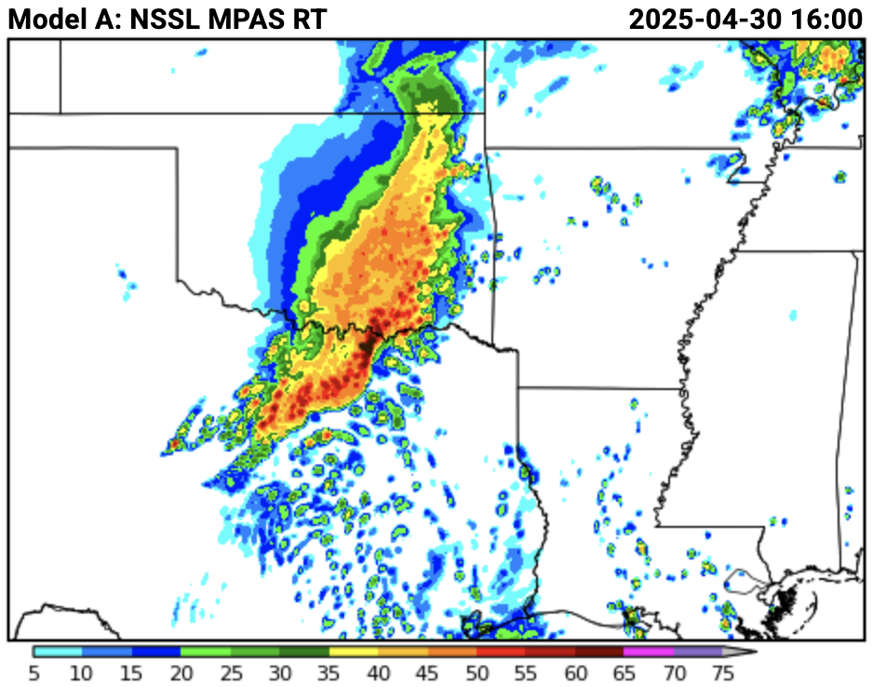
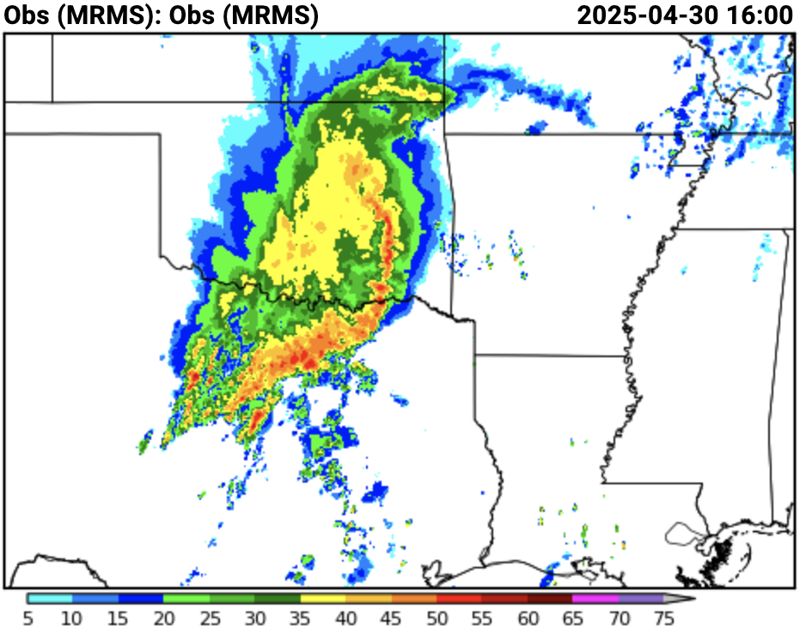
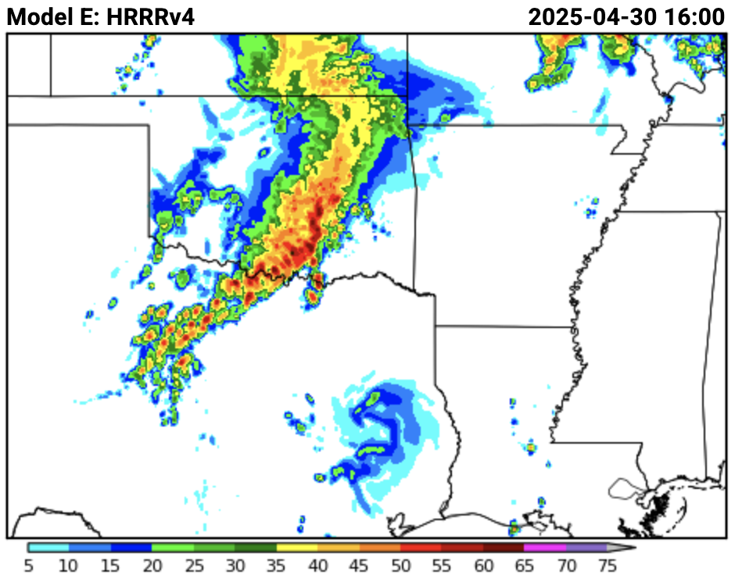
Deterministic Flagships: Composite Reflectivity & UH
Objective results – Performance diagram (40 dBZ)
Objective results don’t match subjective ones. This is very unusual for the SFE.
Hypothesis: Lower bias in GSL MPAS hurting relative performance.
NSSL MPAS RT
Example case
HRRR
Best depiction of stratiform and convective core intensity
High biases in cores and stratiform.
GSL MPAS
High biases in cores and stratiform.

Slide 10
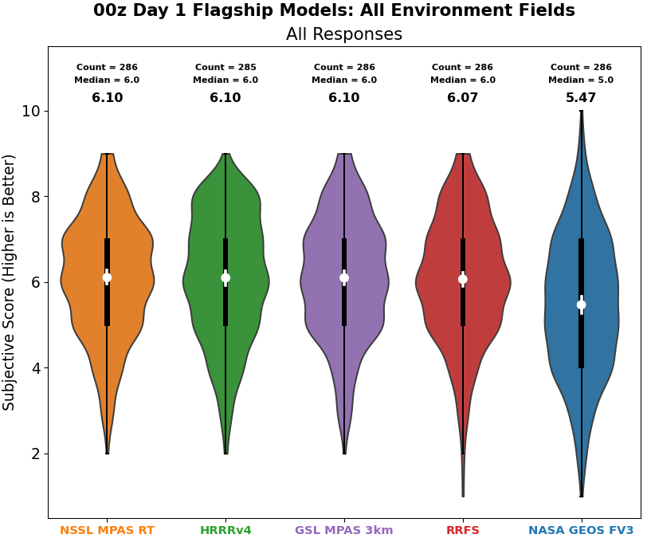
Day 1 Deterministic Flagships: Environment Fields
MPAS runs and HRRR had almost identical average ratings for environment fields – temperature, dewpoint, and SBCAPE.

Slide 11
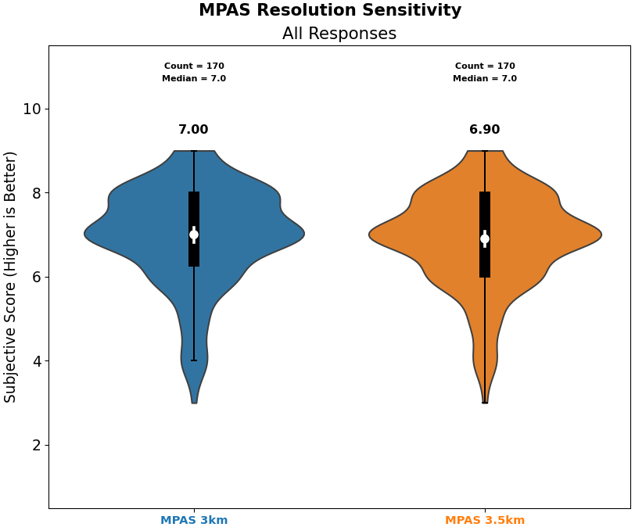
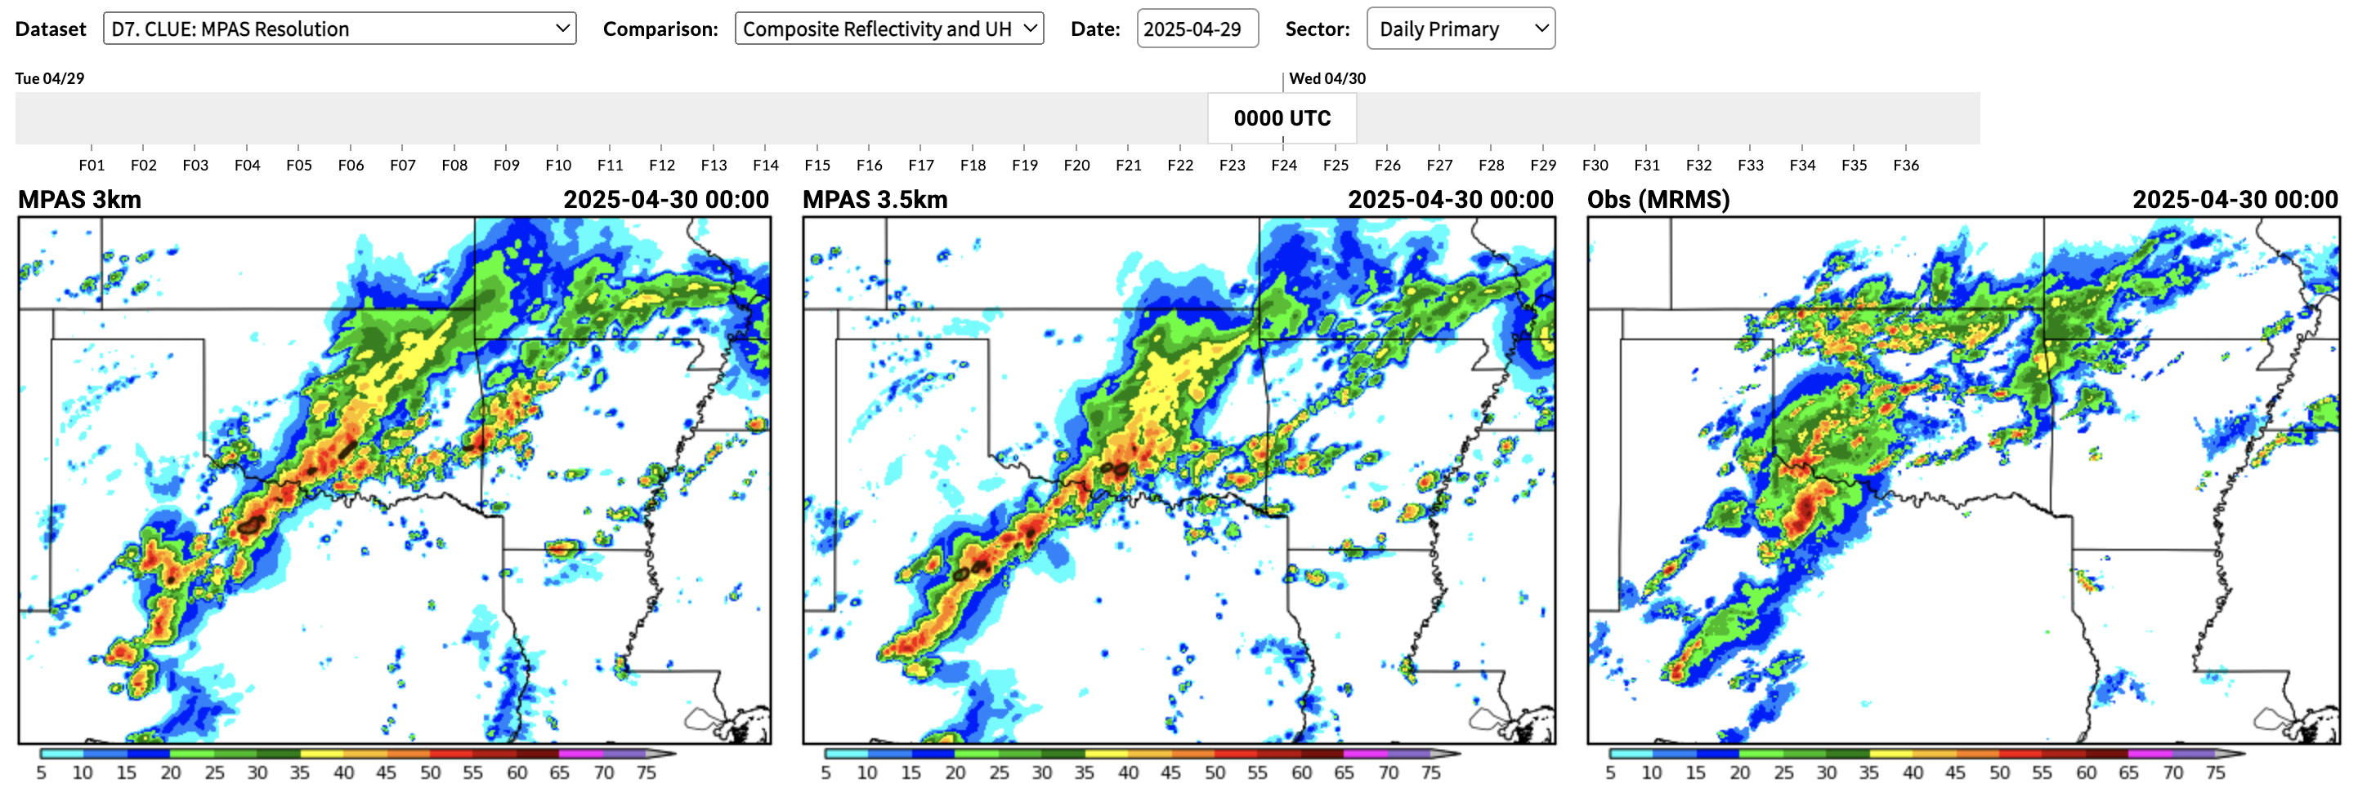
MPAS Resolution Sensitivity
Question: Does using 3.5-km grid-spacing noticeably improve or degrade forecast quality relative to 3-km?
Result: Almost impossible to distinguish between 3-km and 3.5 km grid-spacing MPAS configurations.

Slide 12

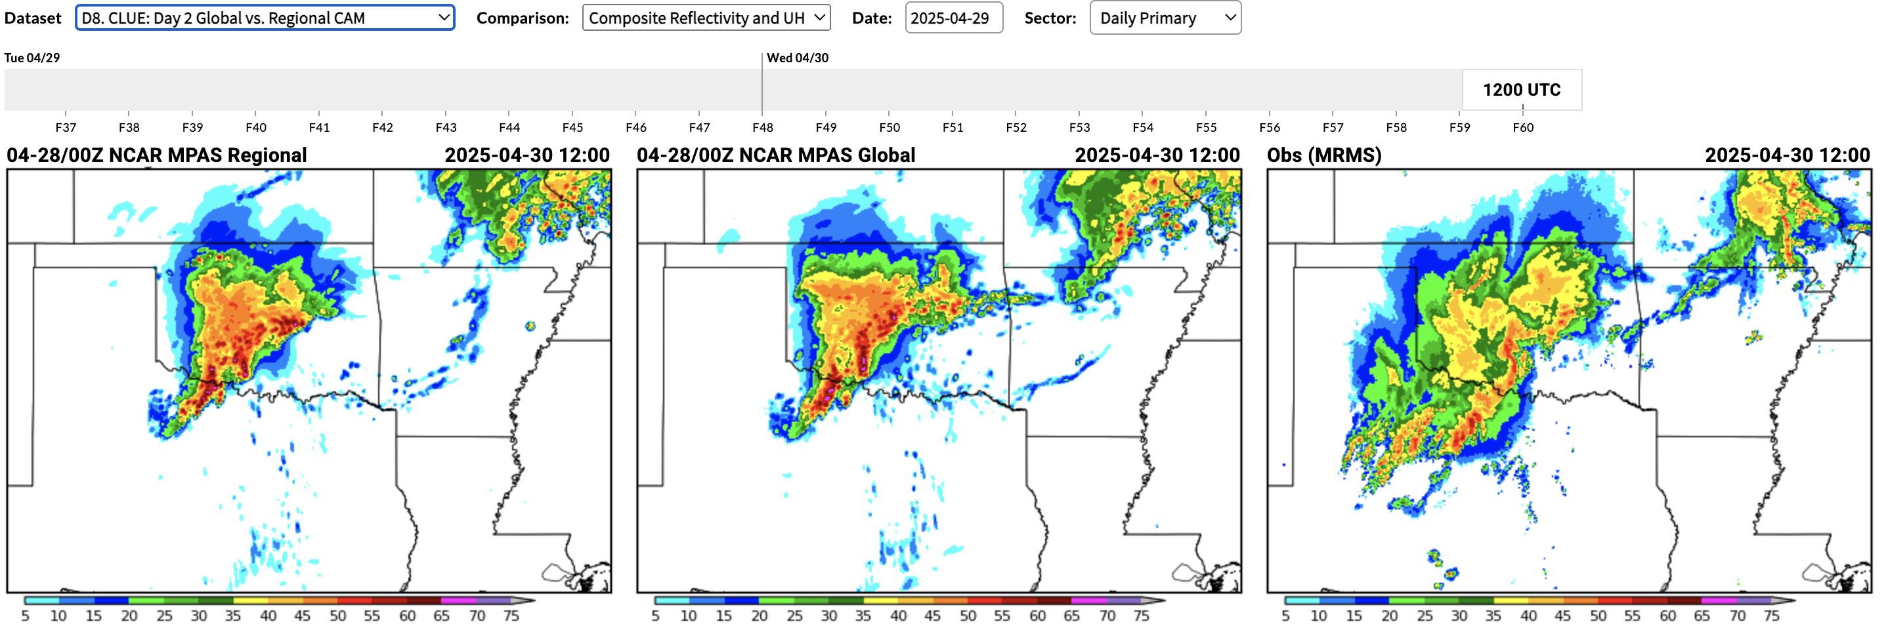
MPAS Regional vs. Global CAM
Question: Does a uniform 3-km grid-spacing global CAM provide any advantage relative to a similarly configured model with a coarser global mesh locally refined to 3-km grid-spacing over the CONUS?
Result: Almost impossible to distinguish between regional and global CAM configurations.

Slide 13
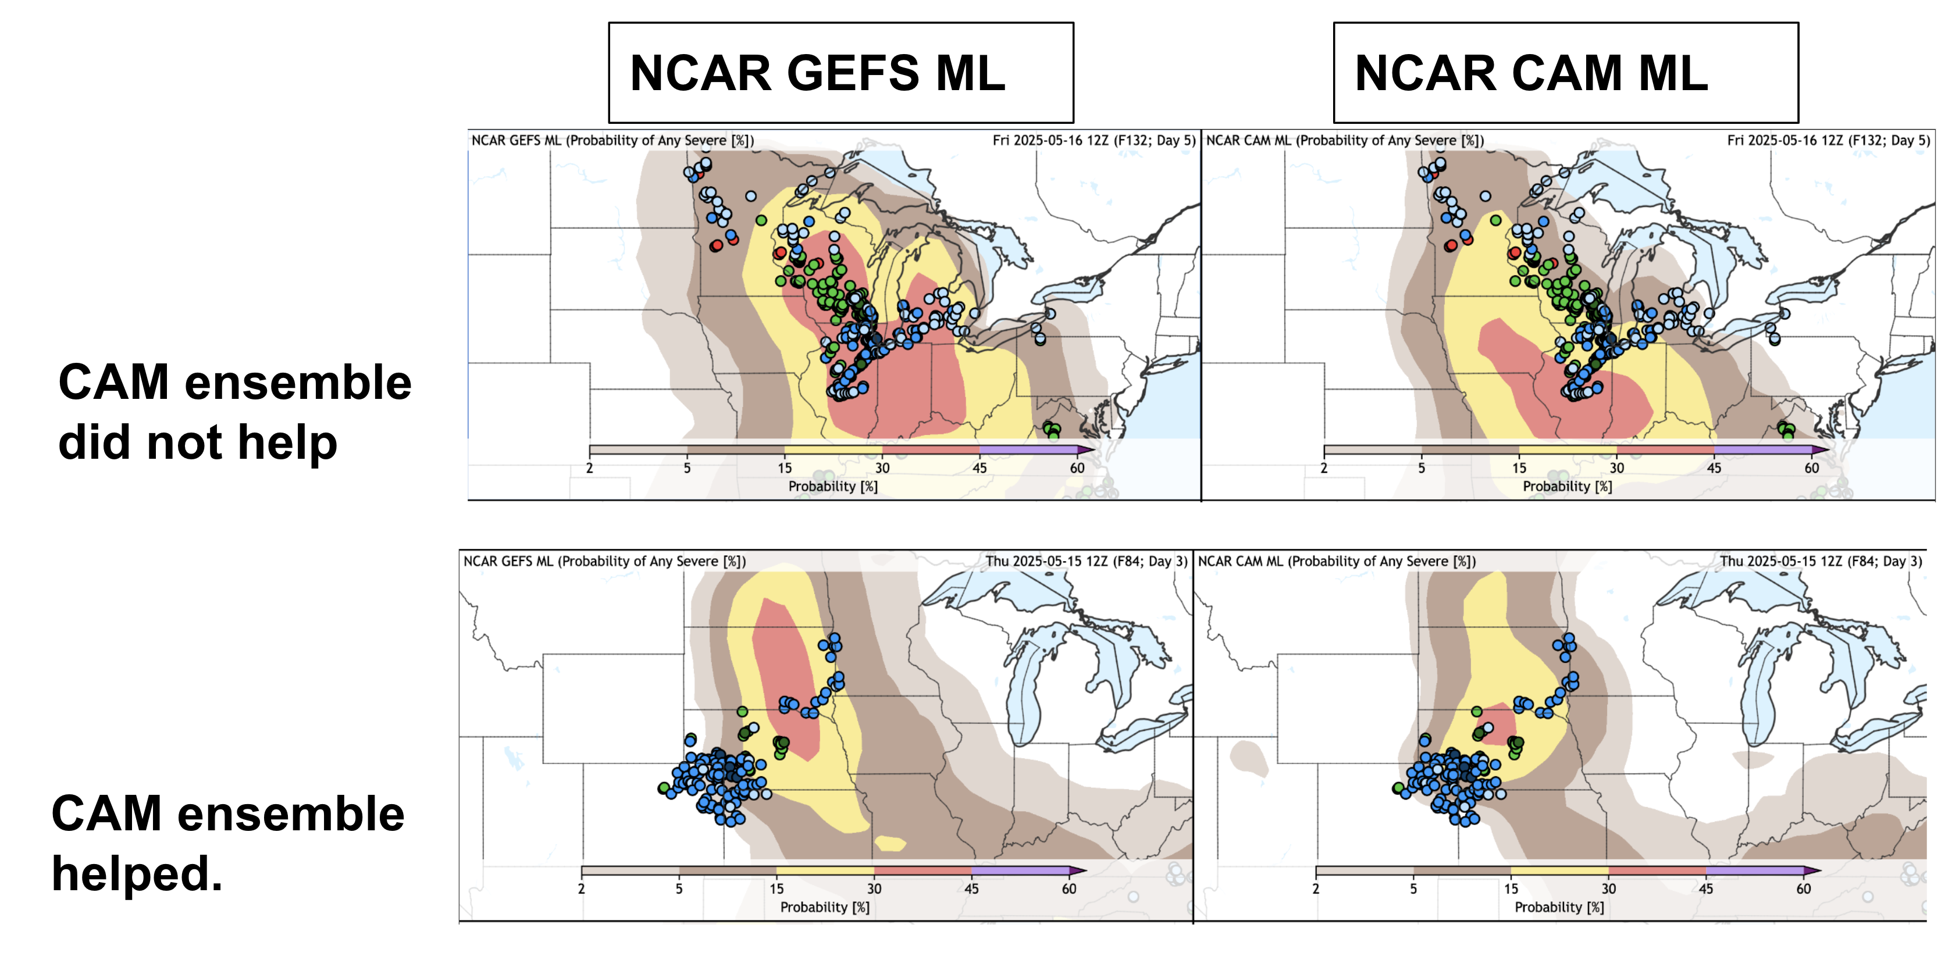
NSF NCAR Extended Range MPAS Ensemble
Question: Can extended range CAM ensembles provide value relative to GEFS when used in ML algorithms?
Day 5 Severe Weather Forecasts
Corridor of LSRs better captured with GEFS
CAM and GEFS subjective ratings at Days 3-5 were similar.
Some days CAM did better; other days GEFS did better.
LSRs in NE CO better captured with CAM

Slide 14

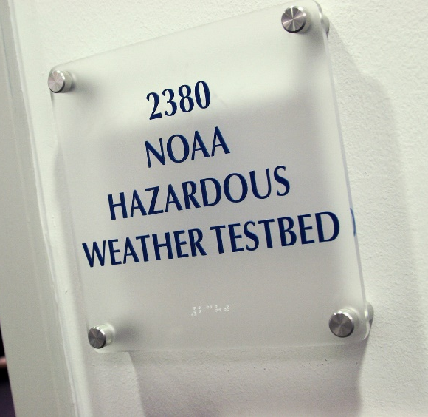
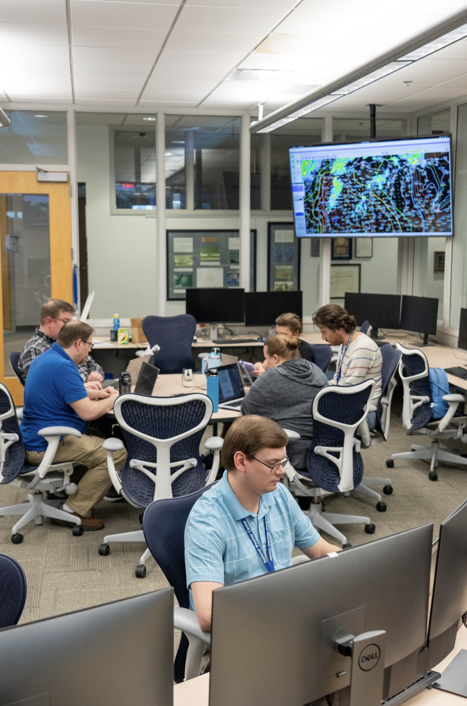

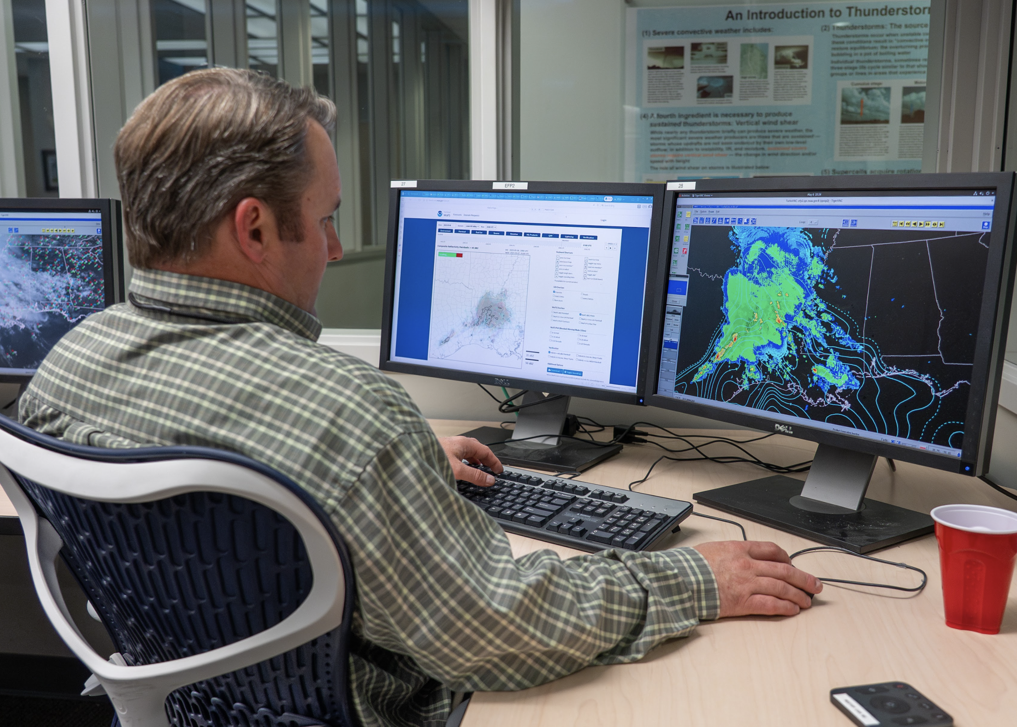
SFE 2025 Takeaways
SFE 2025 Final Report
Deterministic MPAS configurations performed very well and were consistently ranked as good as or better than the HRRR.
There were discrepancies in objective verification statistics. We need to dig deeper to learn why.
What’s next?
MPAS-based WoFS in development (P. Skinner’s presentation). Real-time testing planned for Spring 2026.

