Slide 1
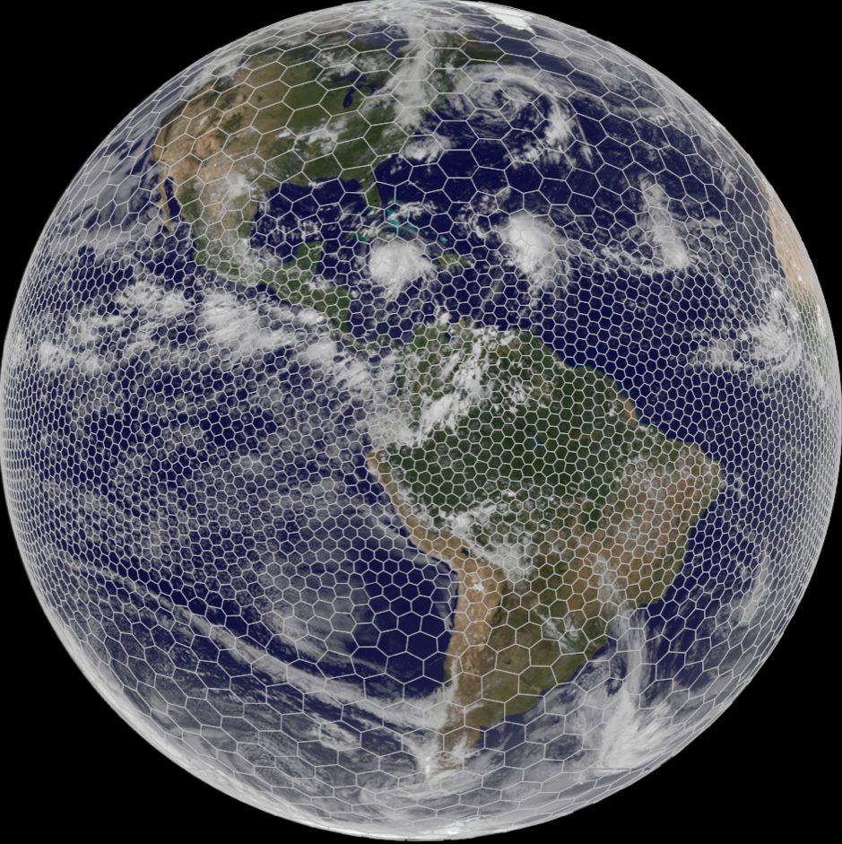
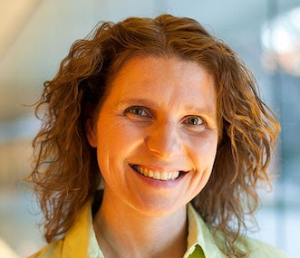
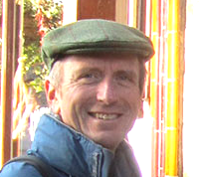
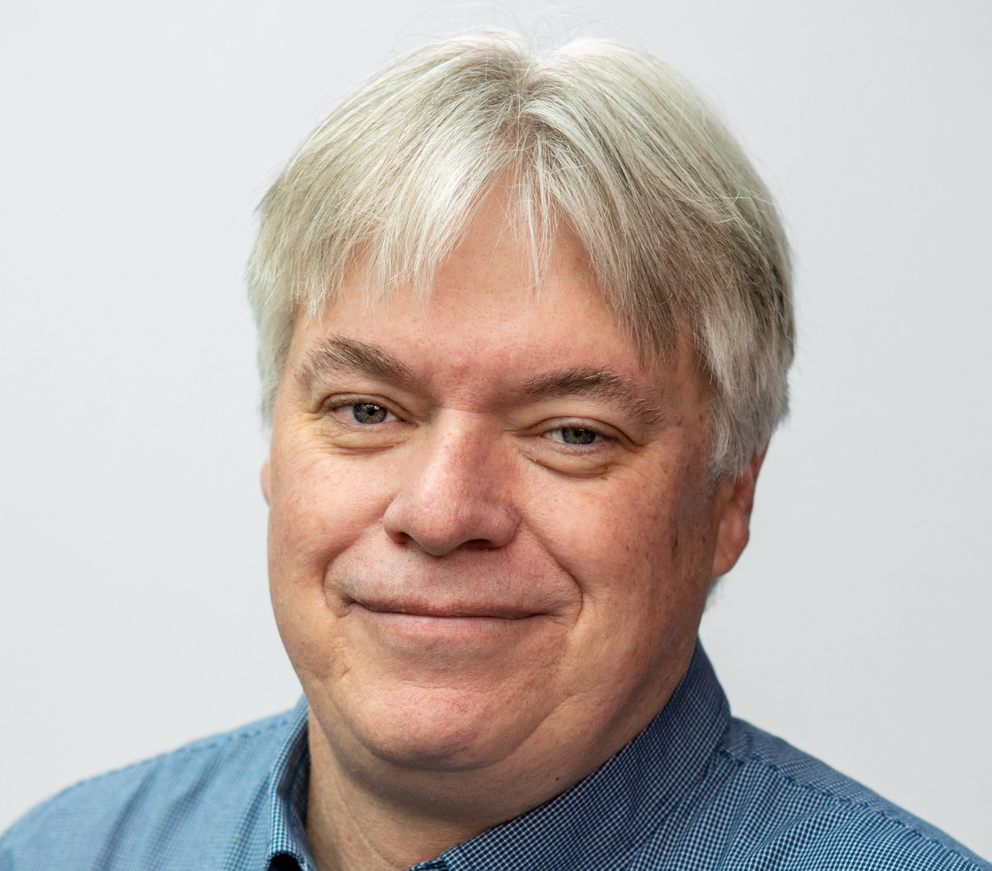
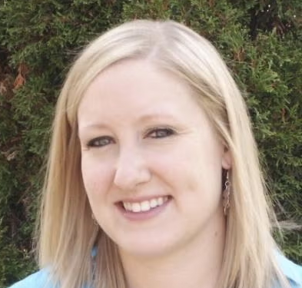
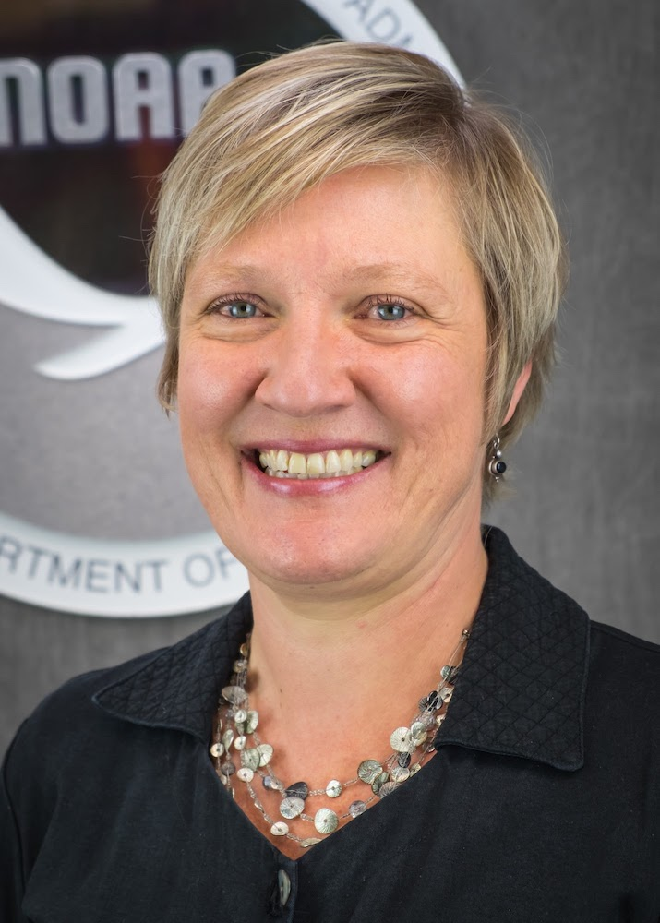
MPAS Collaborations
&
Community Engagement
Christiane Jablonowski
Professor
University of Michigan
Bill Skamarock
Senior Scientist
NSF NCAR
A discussion with panelists to highlight and explore collaborative efforts and strategies advancing MPAS in the community.
Center Green Auditorium, Boulder, CO
September 11, 2025
Louis Wicker
Meteorologist and Chief Scientist of the Warn on Forecast Program
NOAA NSSL
Kathryn Newman
Deputy Director of Science, JNT
NSF NCAR
Ligia Bernardet
Chief, Earth Prediction Advancement Division
NOAA GSL and DTC

Slide 2
Question 1
There are a number of orgs/labs/programs involved in the use of MPAS in UFS and in research and operations, each with its own mission and priorities. Would you share an example of where we’re already working together and that has led to success?

Slide 3
Question 2
What does successful community support for MPAS development look like to you? What are gaps or needs to further accelerate progress?

Slide 4
Question 3
A major challenge to R2O raised in the SRW App parallel session earlier today, was system and software complexity. What approaches have you found successful? What is a key component to success or a key challenge we need to overcome?

