Slide 1

Welcome to the
Unifying Innovations in Forecasting Capabilities Workshop
September 12, 2025
A Unified Forecast System (UFS) Collaboration Powered by the Earth Prediction Innovation Center (EPIC)
Center Green Auditorium, Boulder, CO

Slide 2
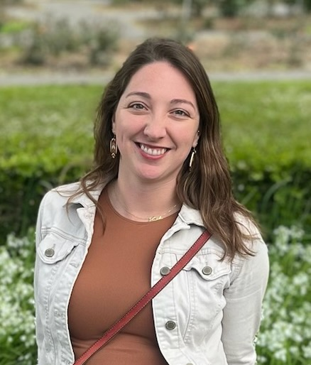
Today’s Master of Ceremonies
Alison Gregory
Community Engagement Specialist
UCAR CPAESS

Slide 3
Live Streaming Announcement
The UIFCW is an open event that will be live-streamed online and recorded. By staying in the room (and online), you understand that your image, in video or still, and any sound recorded alongside it, will live-streamed over social media and recorded. The videos will be submitted to NOAA for review before sharing publicly. The information that you provide will be used for websites, agenda's, and event descriptions.
For more information on NOAA's Privacy policy: https://www.noaa.gov/sites/default/files/legacy/document/2021/Mar/NOAAPrivacyPolicy_Final_May2017.pdf

Slide 4
Friday, September 12th
09:00 AM – 09:15 AM – Welcome
09:15 AM – 10:15 AM – Community Engagement / Collaboration
10:15 AM – 10:45 AM – Break
10:45 AM – 11:15 AM – UFS Coastal Code Development, Applications, and Use Cases
11:15 AM – 12:00 PM – Commercial Weather Observations
12:00 PM – 01:00 PM – Lunch

Slide 5
Friday, September 12th
01:00 PM – 01:30 PM – CoCoRaHS / Citizen Science
01:30 PM – 02:00 PM – WINGS Fellowship Transition
02:00 PM – 03:30 PM – “Pair and Share” Action Items
03:30 PM – 04:00 PM – Debrief: Findings, Recommendations and Closing Statements
04:00 PM – Adjourn, Travel Home!

Slide 6
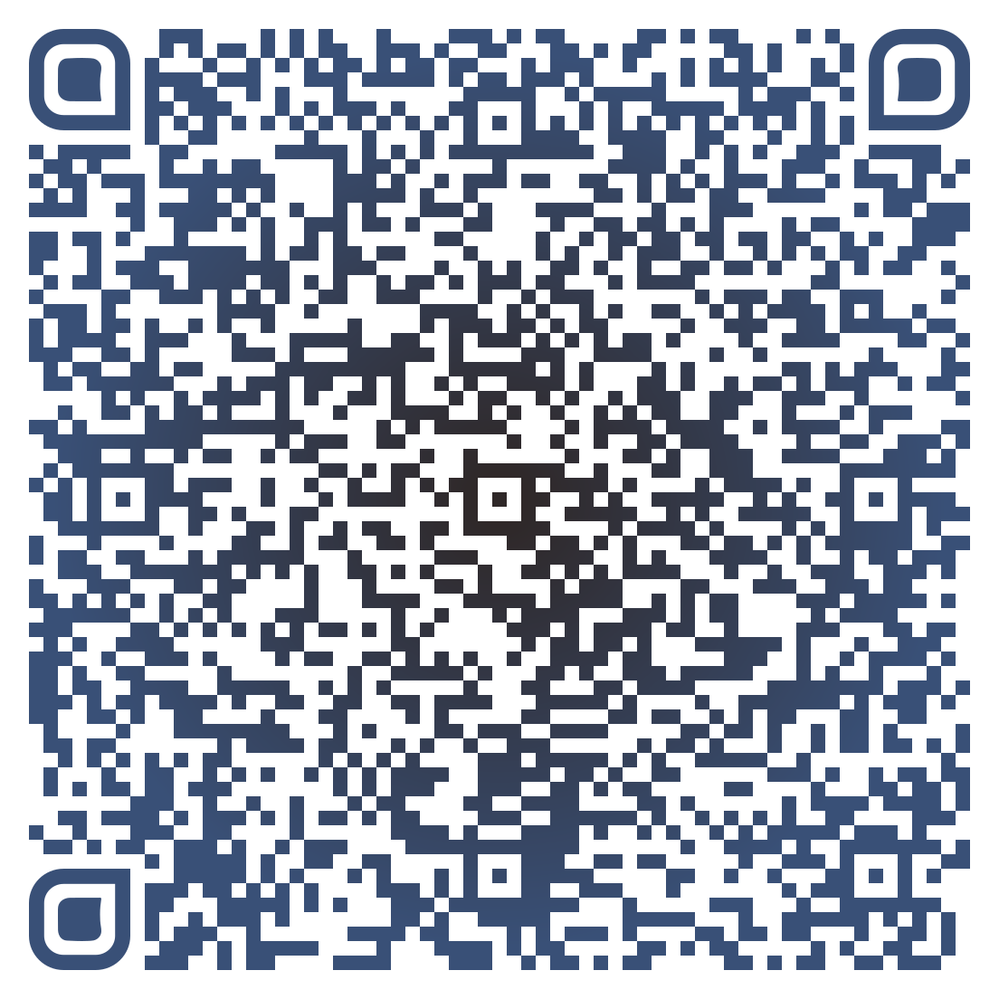
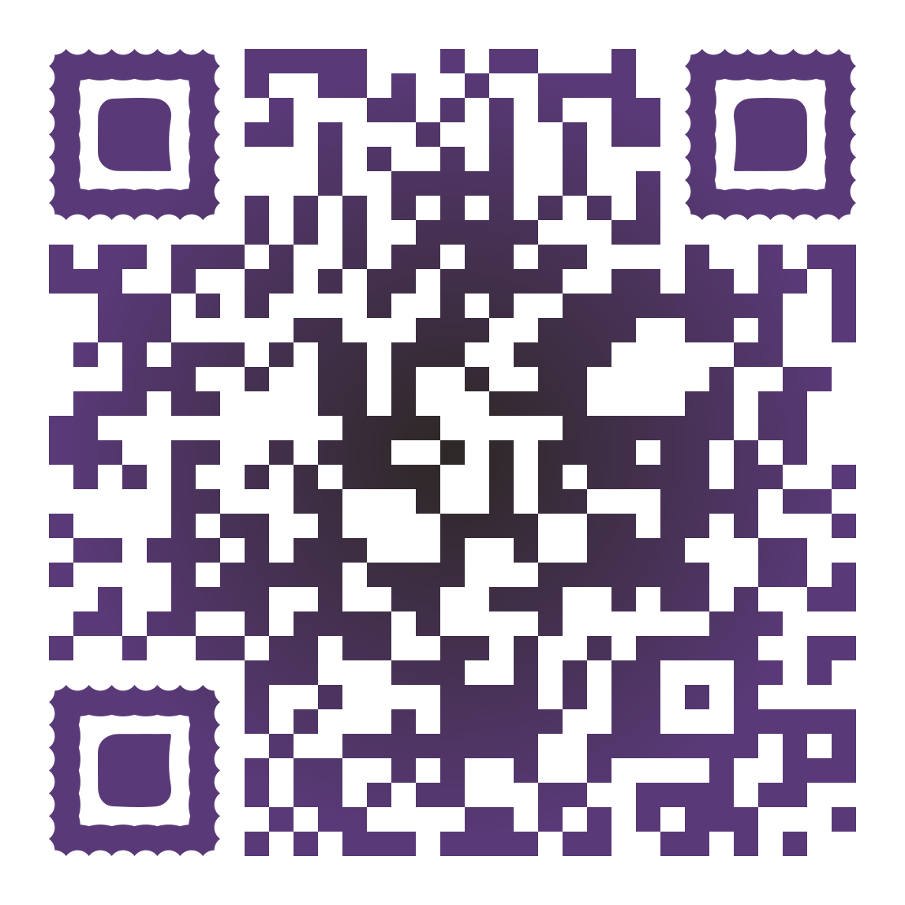


Connect With Us!
Participant Guide
Connect with us on Slido, X, and Instagram
Access Slido & the Livestream from the UIFCW Event Page:
@NOAAEPIC
#UIFCW25
Wi-Fi: UCAR Visitor
No password is required.

Slide 7

Please take the
UIFCW Post Event Survey
Thank you for attending UIFCW 2025!
See you next year!

Slide 8
Thank you for attending UIFCW 2025!
See you next year!
Notes:
Closing slide

