Slide 1
Synergy Between Joint Technology Transfer Initiative and Earth Prediction Innovation Center in Advancing NOAA’s Unified Forecast System
Chandra Kondragunta and Maoyi Huang
Weather Program Office, OAR, NOAA
Center Green Auditorium, Boulder, CO
September 8-12, 2025

Slide 2
Outline
JTTI Mission
EPIC Mission
Current NWS R2O2R cycle
Synergy between JTTI and EPIC
Success stories

Slide 3
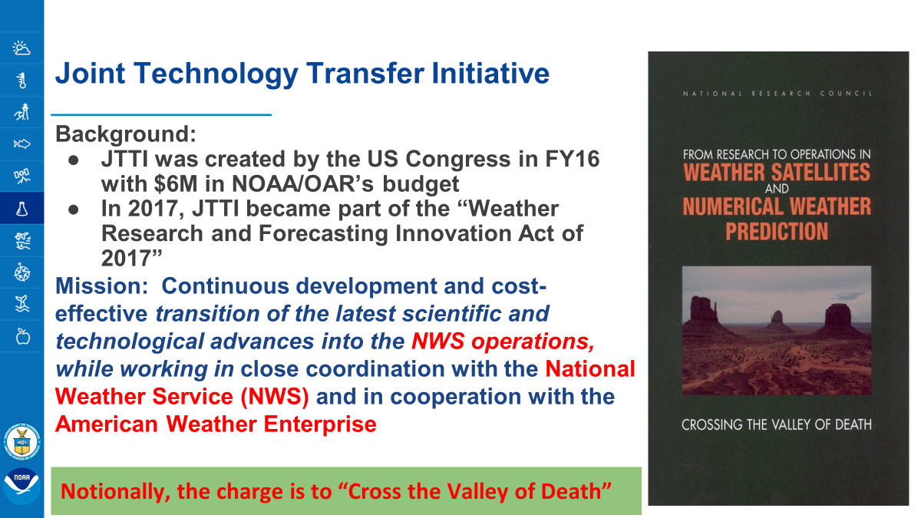

Slide 4
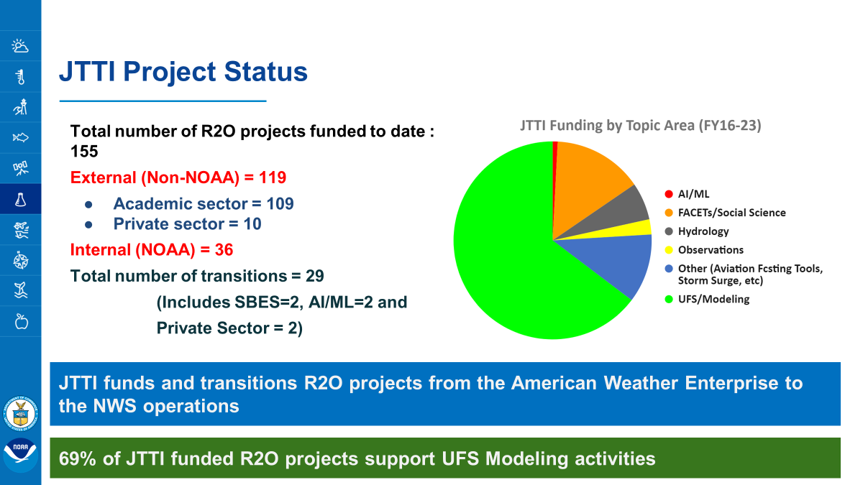

Slide 5

(2024) Bulletin of the American Meteorological Society, 105 (2) https://journals.ametsoc.org/view/journals/bams/103/10/BAMS-D-21-0061.1.xml
PARTNERING WITH THE COMMUNITY FOR THE BENEFIT OF THE NATION
Vision
To enable the most accurate and reliable operational numerical forecast model in the world.
Mission
To be the catalyst for community research and modeling system advances that continually inform and accelerate advances in our nation’s operational forecast modeling systems.
4
Notes:
Based on the congressional mandates and feedback from Community Workshops, an EPIC strategic plan is drafted and approved by the congress in January 2020. In the strategic plan, EPIC’s Vision: is to enable the most accurate and reliable operational numerical forecast model in the world. EPIC’s mission is to be the catalyst for community research and modeling system advances that continually inform and accelerate advances in our nation’s operational forecast modeling systems.
Key Governance Documents::
EPIC Community Workshop Report 2019
A Vision Paper for EPIC (2019)
EPIC Strategic Plan 2021-2025
NOAA Modeling Strategy 2024-2033

Slide 6
Current NWS R2O2R cycle
R2O
R2O
Modeling Framework
Products & Services Framework
Observational
Framework
(DA, Physical & Dynamical Model Development, V&V)
NWS Operations
New Obs. & obs. products
Testing and Evaluation
Testing and Evaluation
Legend
Operational testing of UFS
JTTI-enabled activities
Post Processing Tools
SBES
NWS activities
IDSS
NWS Modeling Operations (UFS)
7
O2R

Slide 7
Synergy between JTTI & EPIC - Looking into the Future
Modeling Framework
Observational
Framework
Products & Services Framework
(DA, Physical & Dynamical Model Development, V&V)
NWS Operations
New Obs. & obs. products
Testing and Evaluation
Post Processing Tools
SBES
AI/ML Model Dev., Testing and Evaluation
Testing and Evaluation
IDSS
Research, Development, and applications inside/outside of NOAA
Legend
Operational testing of UFS
JTTI-enabled activities
EPIC Public Releases
(e.g., EAGLEv2, UFS Global App)
NWS Modeling Operations (UFS)
NWS activities
EPIC Infrastructure
7

Slide 8
Success Stories
UFS Weather: Model and foundation of all UFS Apps initiated via JTTI funding, maintained and supported by EPIC funding
Land DA: JTTI funding established the foundation for component land models, EPIC integrated with JEDI and workflow
SRW App: JTTI supports RRFS development, EPIC integrates to SRW App, maintains the infrastructure, supports releases and provides user support
Unified Workflow: EPIC and partners developed /released the modular toolset, JTTI funds integration to SRW and RRFS
Funding Opportunity: Released a joint Notice of Funding Opportunity (NOFO) in 2023: “Innovations for Community Modeling”

Slide 9
