Slide 1
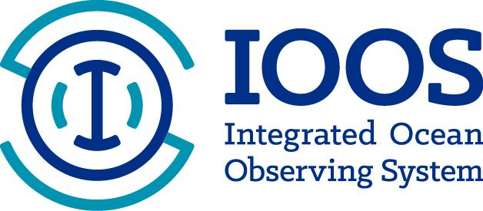
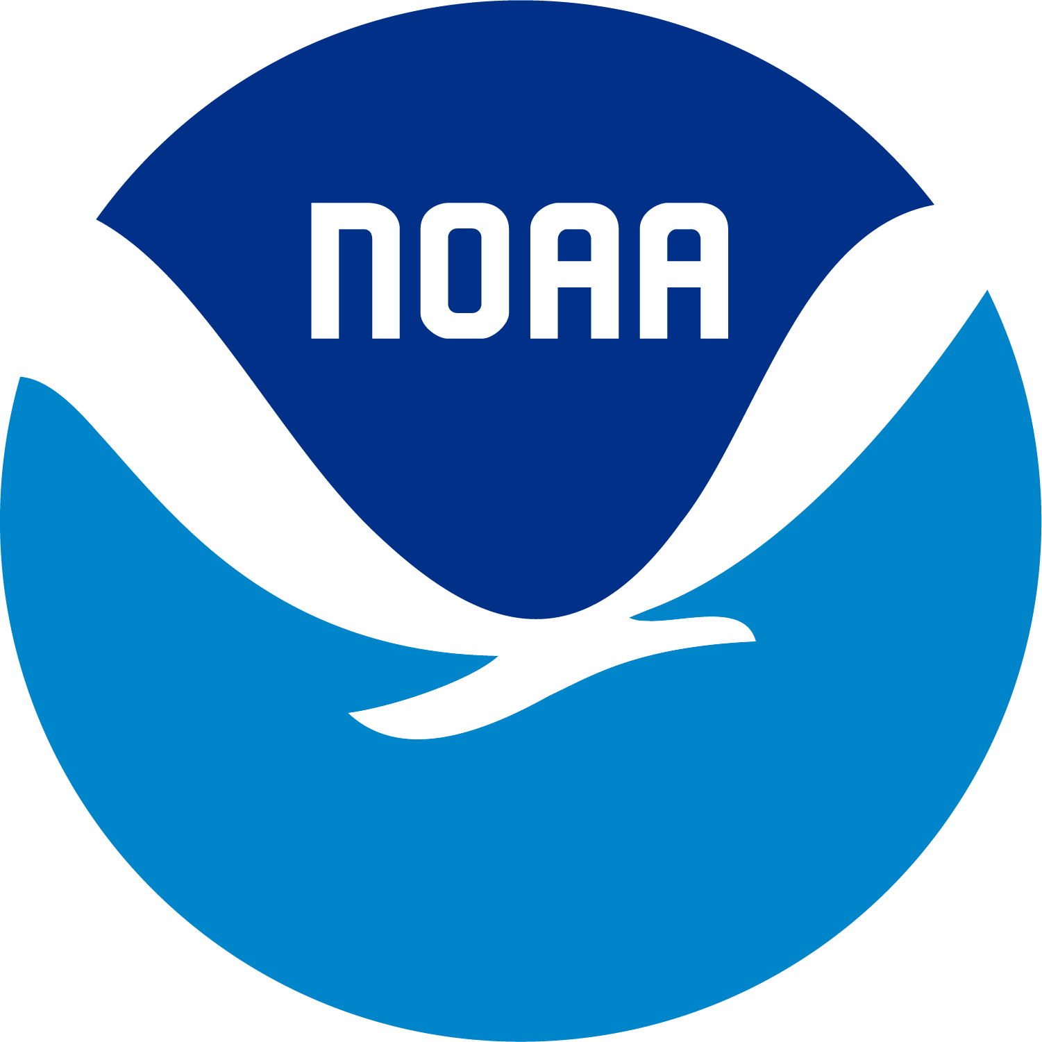

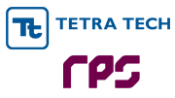
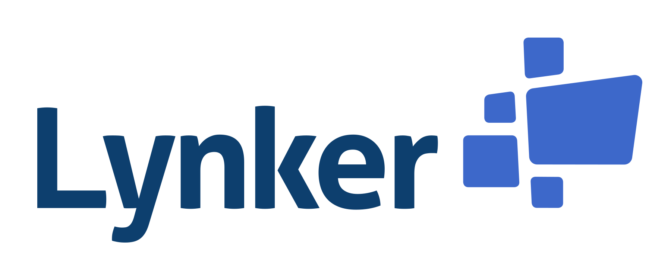
Advancing Community Ocean and Coastal Modeling by Harnessing the Power of the Cloud
Breanna Vanderplow^{1,2}, Michael Lalime^{1,2} Tiffany Vance¹, Katherine Moore Powell³, Patrick Tripp,⁴ Zachary Wills³, Mykel Alvis³, Micah Wengren¹
¹U.S. Integrated Ocean Observing System, ²Integrated Systems Solutions, Inc, ³Lynker, ⁴TetraTech RPS
Center Green Auditorium, Boulder, CO
September 8-12, 2025
Notes:
The Sandbox is a resource to improve models and forecasts through increased efficiency, lower computational costs, and collaboration opportunities. The Sandbox can serve as a platform for NOAA and partners to work together to improve community models, couple models, and advance the UFS.

Slide 2



Limitations of traditional high performance computing
User Terminal
High initial costs
Limited collaboration
login
Interactive Nodes
Time consuming data access
submit job (psub, bsub)
Network File System
Long job queues
Job Scheduler (LSF, MOAB, SLURM)
wait in queue
Limited run times
run the job
Compute Nodes
Limited resources and configuration
Maintenance and failures

Slide 3
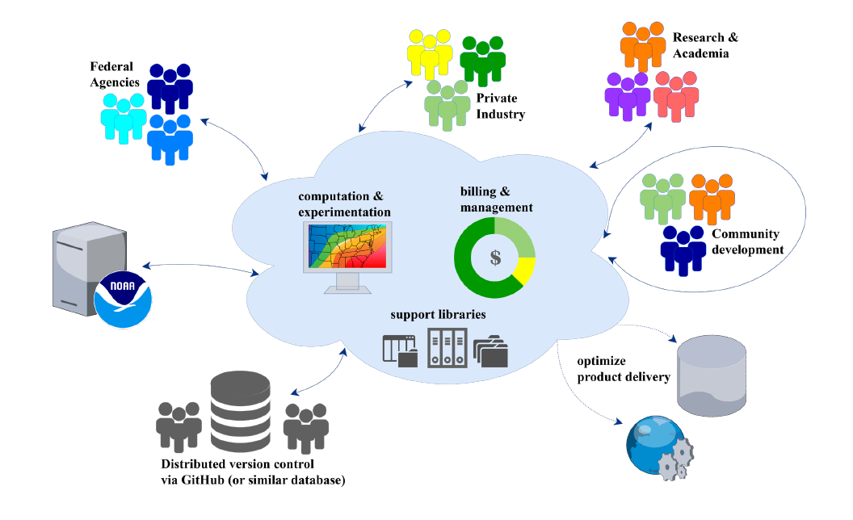
Introducing… The NOS Cloud Sandbox
In progress
Notes:
So how is the sandbox different? The sandbox is an AWS cloud-based platform for high performance computing and collaboration.
It is intended to be an environment where NOAA modelers and their partners can work together in the same space

Slide 4



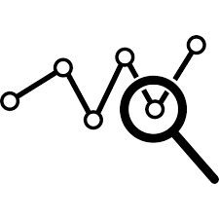
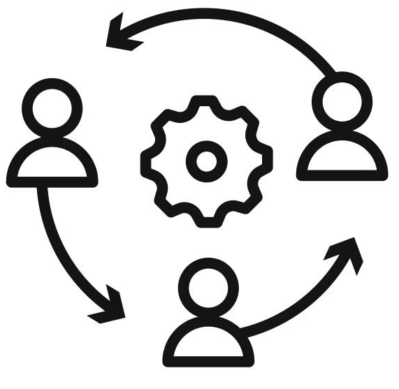
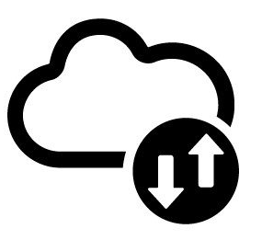
Why should I use the sandbox instead of my own HPC?
Scalable & Flexible
Computing
Immediate Job Execution
Run Without Limits
Enhanced Analysis Tools
Collaborative Development
Improved Data access
Notes:
Immediate Job Execution: Jobs start instantly without waiting for resource availability.
Run Without Limits: No job time limit, allowing continuous runs from start to finish.
Scalable, Flexible Computing: Adaptability to scale resources up or down based on compute needs and configure cluster configuration on demand. Up to 24,000 on-demand HPC vCPUs available!
Enhanced Analysis Tools: Improved flexibility for running Python-based workflows for output analysis and post-processing.
Collaborative Development: Provides a space for partners to work together and streamline code development.
Improved Data Access: Import and process data directly in the cloud without downloading to local machines and easily share data with partners and users.

Slide 5
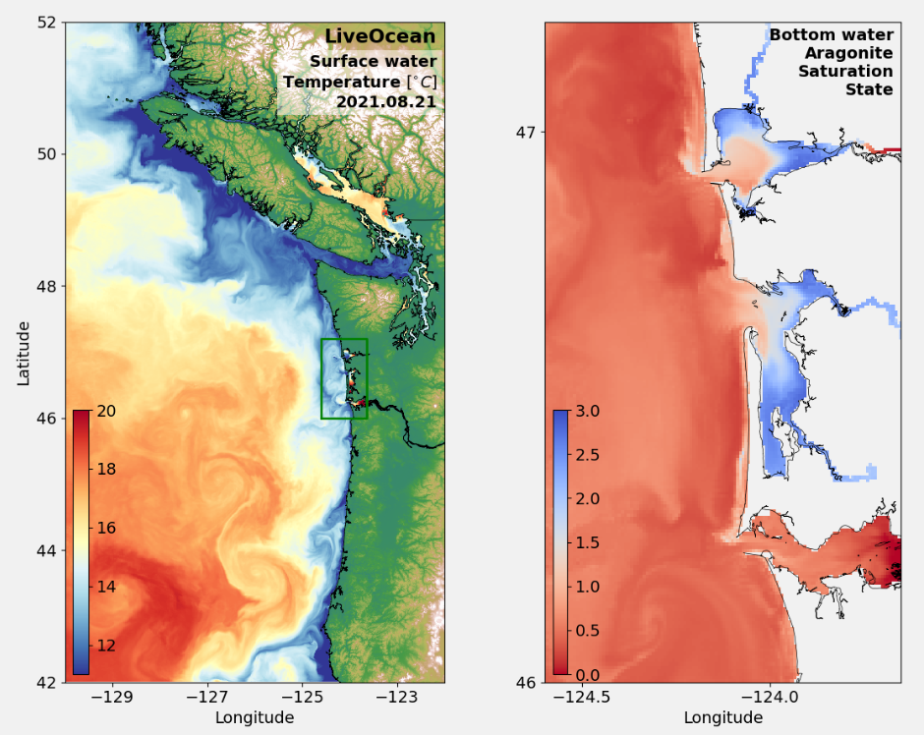
Success Story: LiveOcean
Success Story: LiveOcean
Developed by University of Washington, Dr. Parker MacCready
12 year hindcast
Compute time:
1 yr ~ 10 days
12 yrs ~ 4 months
Data generated:
1 yr ~ 800 GB
12 yrs ~ 100 TB
Once verified, final output will be publicly available to NOAA Open Data Dissemination (NODD)
Notes:
Once it was up and running the first external partner model run in the sandbox was the University of Washington’s LiveOcean model as a proof of platform.

Slide 6
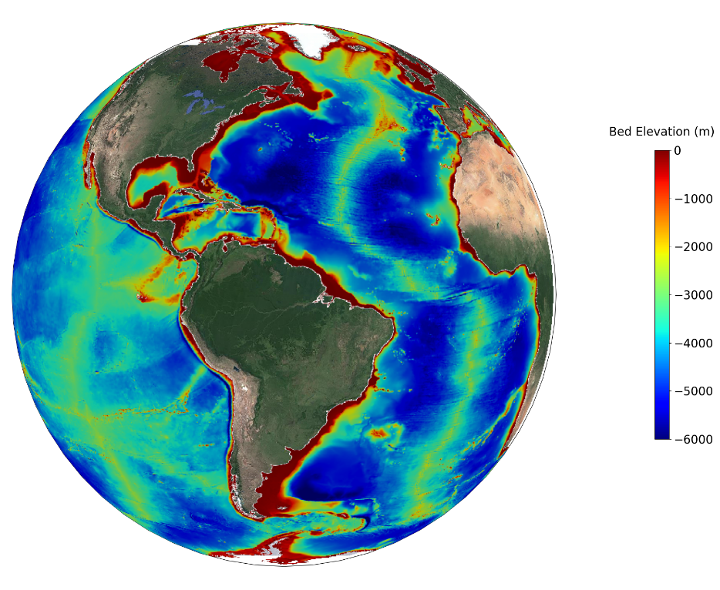
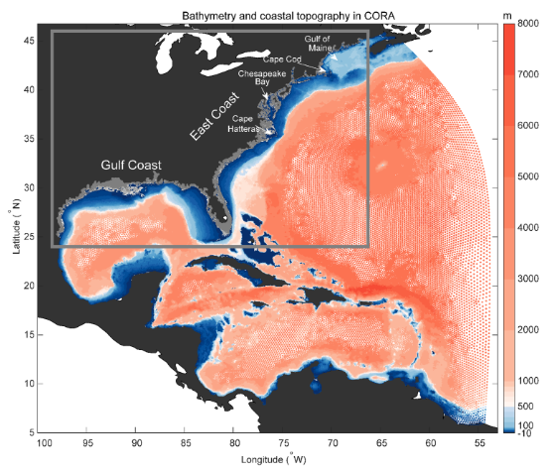
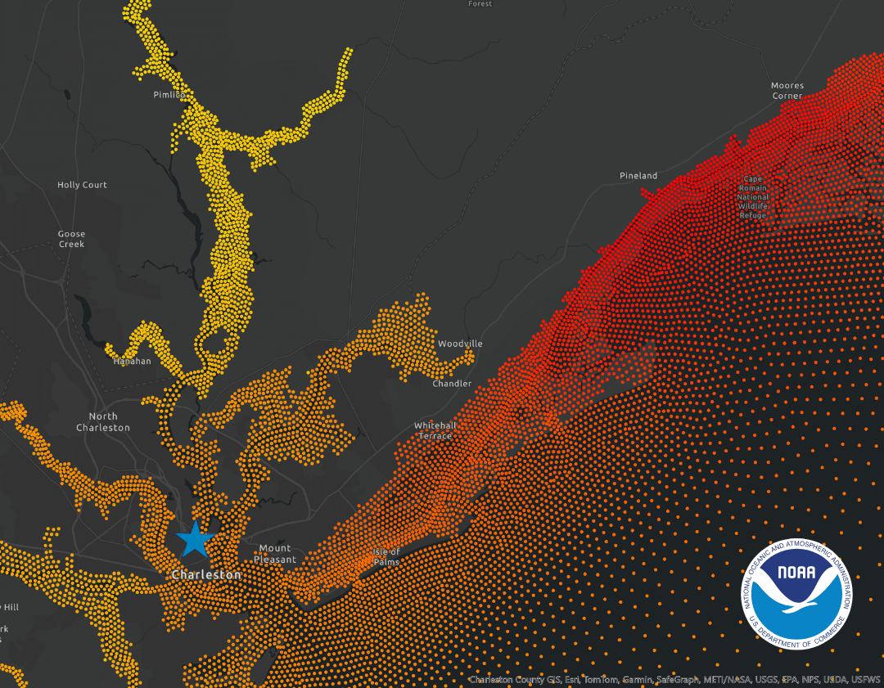
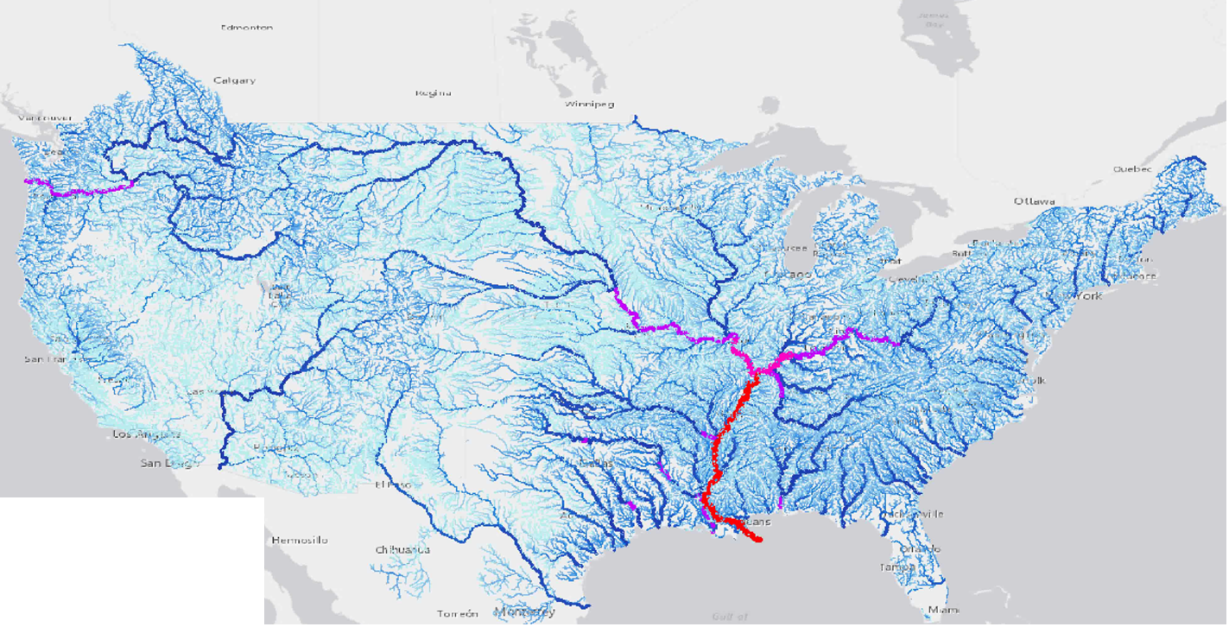
Determining resources and adapting model workflows
STOFS-2D Global (OCS)
Users must determine resources and configuration in the cloud, i.e. instance type and availability - this provides the benefit of testing a variety of configurations
Models have to be adapted for cloud-optimized workflows
CORA (CO-OPS)
National Water Model (OWP)

Slide 7
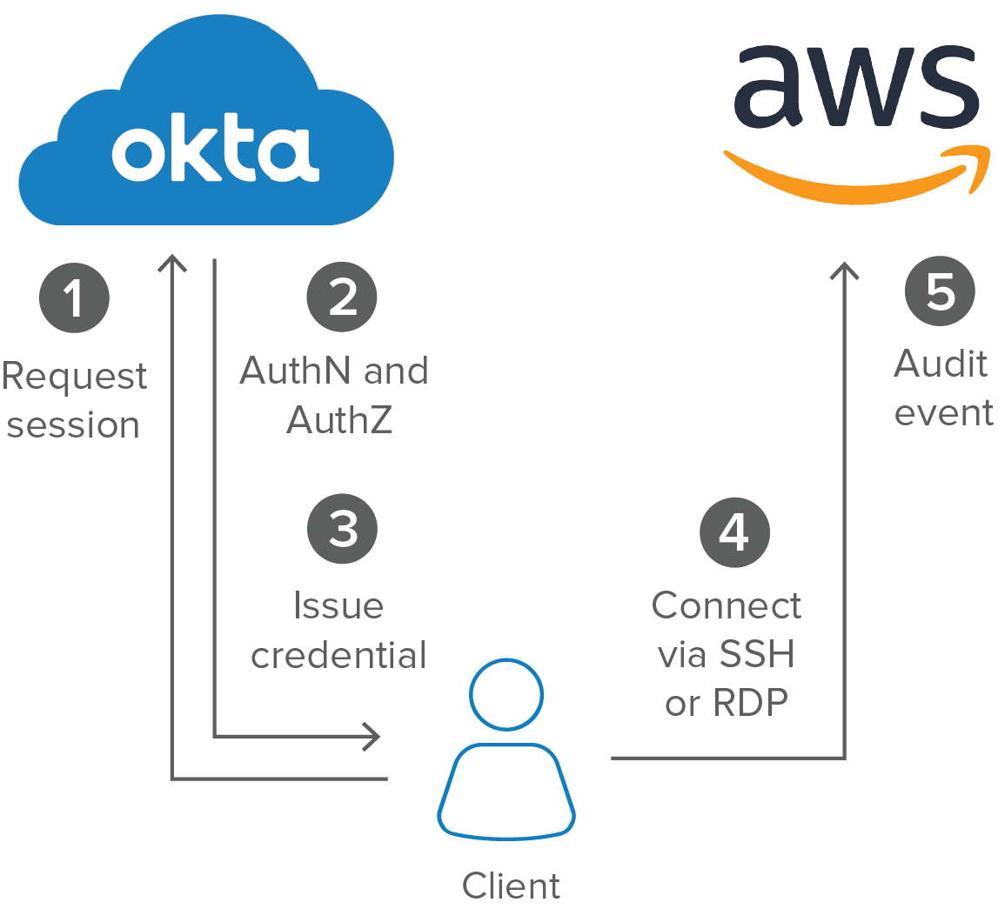

External user access challenging but essential
Okta Authentication allows external users to access NOAA resources on AWS

Slide 8
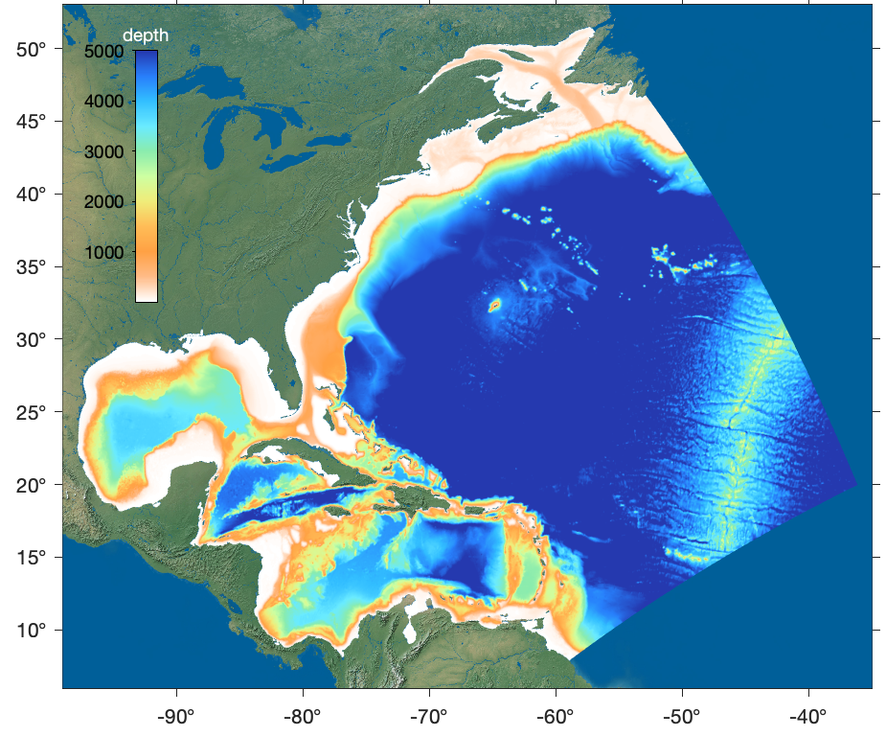
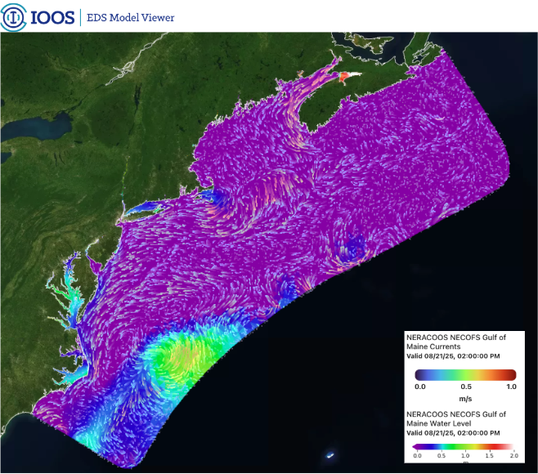
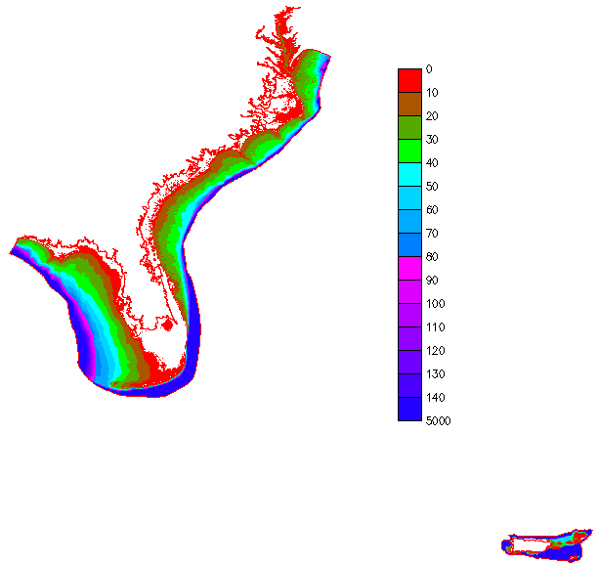
Improving R2O: A comprehensive East Coast Forecast System
NorthEast Coastal Ocean Forecast System (NECOFS)
University of Massachusetts Dartmouth
SouthEast Coastal Ocean Forecast System (SECOFS)
Virginia Institute of Marine Science
East Coast Community Ocean Forecast System (ECCOFS)
Rutgers University
Both coupled with the National Water Model (hydrology)

Slide 9

The path to success
Simplify collaboration via external user access
Offer training and documentation
Continuous engagement
Remain persistent and flexible when roadblocks occur
Get in touch with the Sandbox team at:
ioos.sandbox@noaa.gov
Connect with us on GitHub:
github.com/ioos/cloud-sandbox
Visit our website
Notes:
Cloud computing improves efficiency and overcomes roadblocks of traditional high performance computing, leading to NOS and partners providing better, quicker forecasts to coastal communities.

