Slide 1
Resolution Dependence in the Seasonal Forecast System
Benjamin Cash, Erik Swenson, Chul-Su Shin, Jim Kinter
George Mason University
UIFCW 2025
With grateful acknowledgement of support from NOAA WPO

Slide 2
Academic Research that Benefits NOAA – The Road to R2O
Resolution Dependence in the Seasonal Forecast System
Benjamin Cash, Erik Swenson, Chul-Su Shin, Jim Kinter
George Mason University
UIFCW 2025
With grateful acknowledgement of support from NOAA WPO

Slide 3
Resolution Dependence in the Seasonal Forecast System
Background
  Seasonal Forecast System (SFS) version 1 under development
    UFS-based replacement for the (venerable) CFSv2
  Baseline development runs at C96mx100 (~1 degree)
    Lower than the planned operational resolution (C192mx025)...
    ... but the operational resolution is expensive
Risk
  Model behavior often changes unpredictably with component resolution
    Are the baseline runs telling us what we think they are?
Mitigation
  Run a subset of the baseline experiments at the operational resolution
  Leverage GMU team’s access to non-NOAA HPC resources

Slide 4
Filling in Potholes on the Road to R2O
Simply running the model outside of its ‘comfort’ zone benefits development
  New Platforms and New Configurations equals New Issues
  Examples include...
Internal File Limits
  Extending run length to 6 months encounters unexpected file number limit
  https://github.com/ufs-community/ufs-weather-model/issues/2494
Invalid Sea Ice Initial Conditions
  CICE6 ICs that work for baseline resolution crash model at target resolution
    Traced to spurious sea ice volume and properties
  Eventually requires hacking CICE6 to continue
    Not ideal - new CICE ICs needed to resolve properly
    https://github.com/ufs-community/ufs-weather-model/issues/2562
Not exactly ‘Eureka!’, but still tangible improvements to the model

Slide 5
C192 vs C96: Surface Temperature

Slide 6
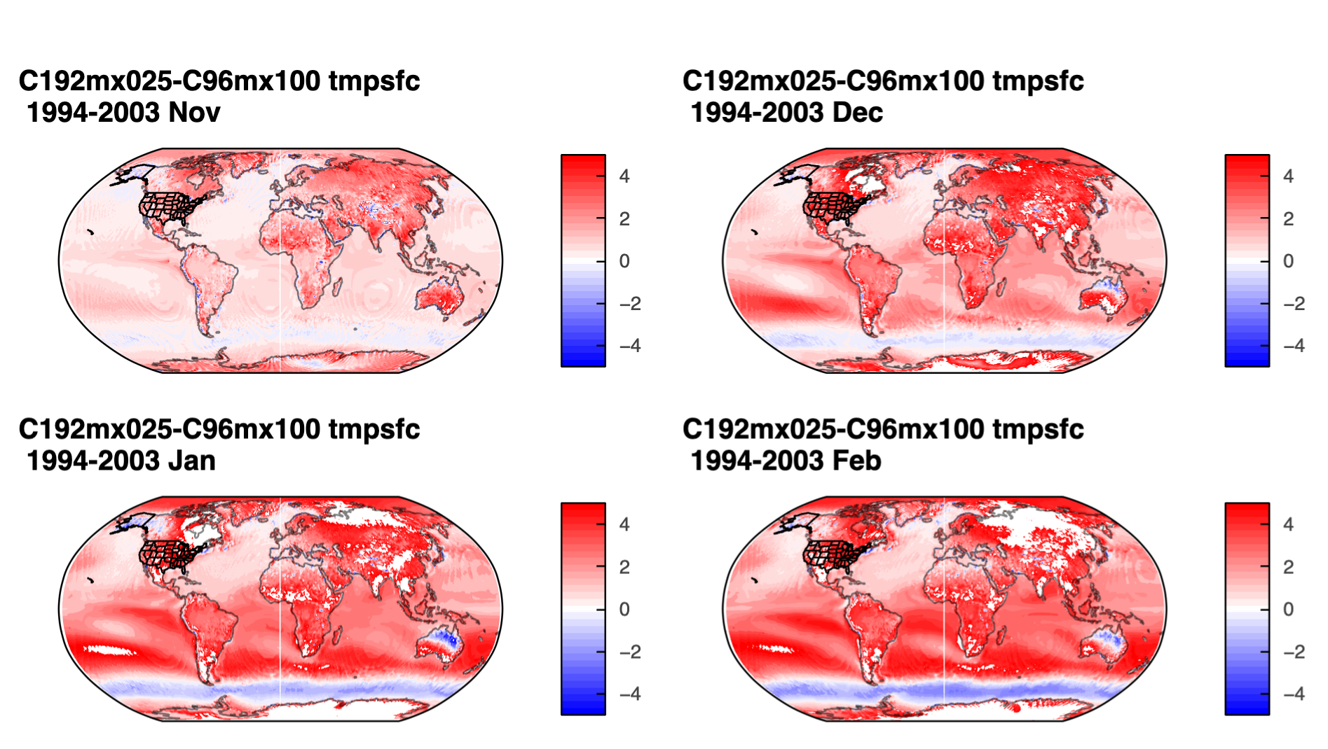
C192 vs C96: Surface Temperature
November 1 Initialization
Dramatic increase in C192 compared to C96 baseline
C96 already had a warm bias
Significant degradation compared to baseline

Slide 7
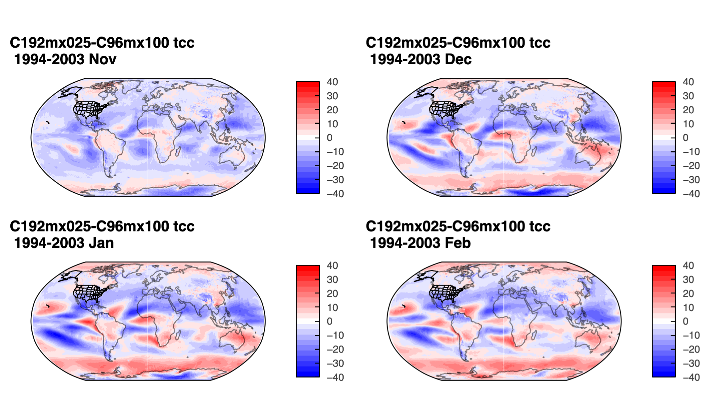
C192 vs C96: Total Cloud Cover
November 1 Initialization
General reduction in C192 relative to C96 baseline
Most pronounced in Nov
Consistent with changes in temperature
Unforeseen sensitivity in cloud parameterizations?

Slide 8
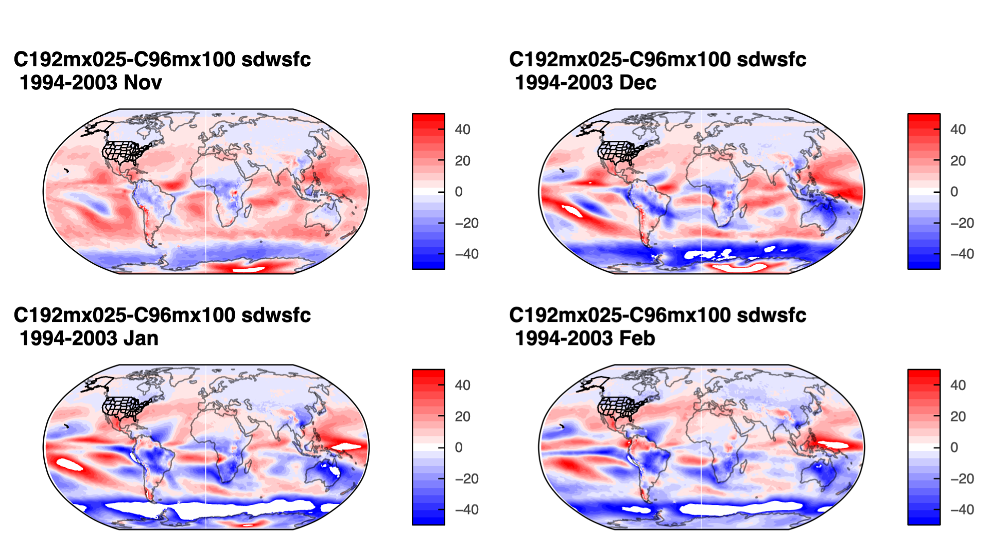
C192 vs C96: Surface Downward Shortwave
November 1 Initialization
Strong initial increase in surface downward shortwave
Consistent with increase in temperatures and decrease in cloudiness
Is there a change in top of the atmosphere (TOA) energy balance?

Slide 9
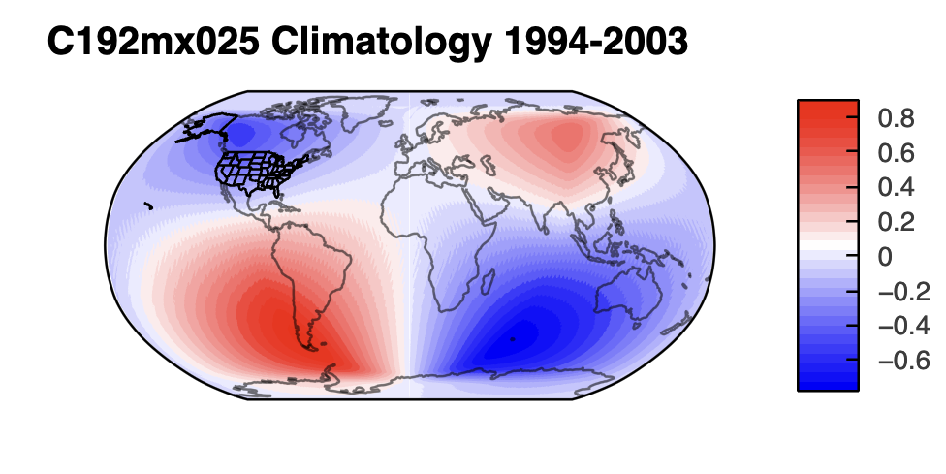
C192mx025 TOA Downward Shortwave
C192mx025 TOA downward shortwave
  Zonally asymmetric component
  Initially just a post-processing sanity check
Magnitudes approaching 1 W/m**2
  Should be near zero
  Distinctive quadrupole pattern
Calculated from daily mean files
  Should not be any residual of solar position
Ok, that’s weird. User error?

Slide 10
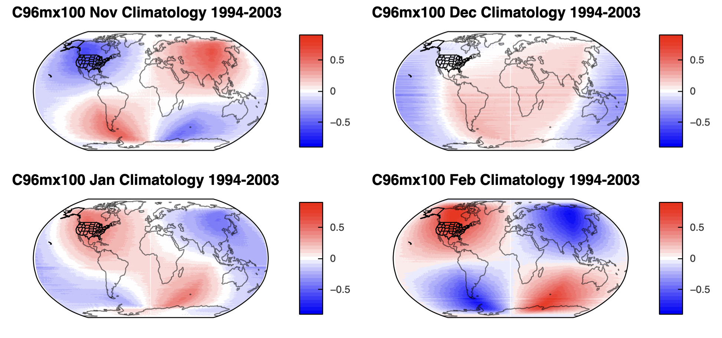
SFS TOA Downward Shortwave
C96mx100 comparison
  Calculated from official baseline runs
  Similar magnitudes as C192mx025
  Pattern and magnitude shifts with month
Pattern appears across multiple versions of SFS, back to at least Prototype-P8
Persistent, previously unidentified issue

Slide 11
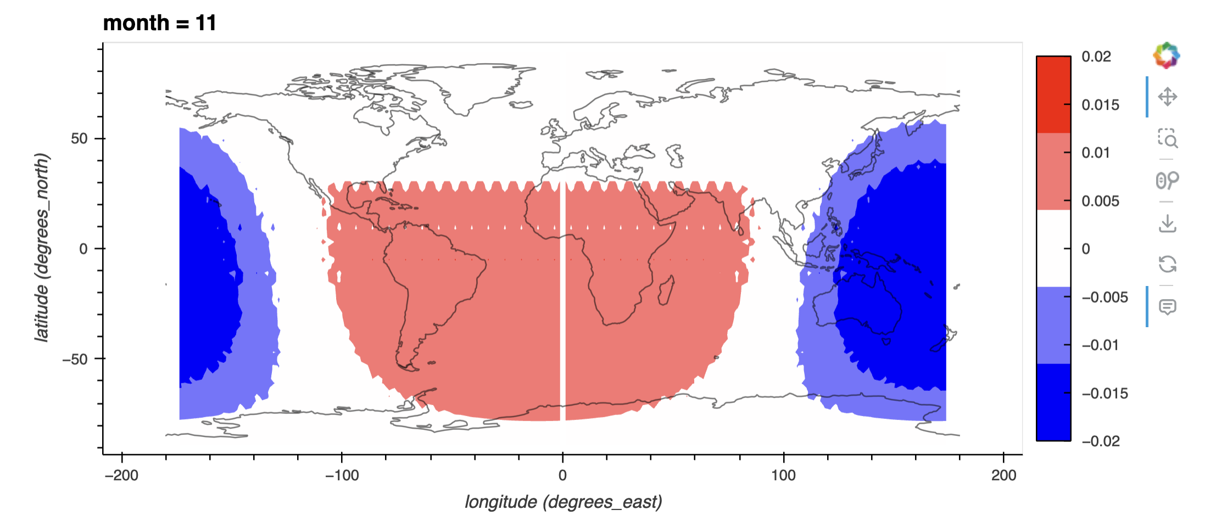
CMIP6 TOA Downward Shortwave: As Expected
NASA GISS, CMIP6 Historical
Magnitude of zonal asymmetry in NASA GISS CMIP6 ~40x less
Explanation still unknown and under investigation
Not something we were looking for!
https://github.com/ufs-community/ufs-weather-model/issues/2785

Slide 12
Academic Research that Benefits NOAA
Benefits to NOAA
  Developing and incorporating new science (R2O)
  Earth System models and their outputs are incredibly complex
    Model errors can be subtle, and do not always reveal themselves in standard diagnostics
    Even when model errors are obvious, their causes may not be
    Academic researchers can help identify and resolve model issues (also R2O!)
  No matter how many people have looked, there will always be more to find

Slide 13
Academic Research that Benefits NOAA
Benefits to NOAA
  Developing and incorporating new science (R2O)
  Earth System models and their outputs are incredibly complex
    Model errors can be subtle, and do not always reveal themselves in standard diagnostics
    Even when model errors are obvious, their causes may not be
    Academic researchers can help identify and resolve model issues (also R2O!)
  No matter how many people have looked, there will always be more to find
New User/Student Parallel Track
  How will working with NOAA models and data benefit you?

Slide 14
Benefits to Academia – One Member’s Perspective
Funding
  NOAA funding typically focuses on improving NOAA models
  Less crowded than some other opportunities
Public (self) service
  Opportunity to improve forecasts and help safeguard lives and property
  Literally in our self-interest to make the models as accurate as possible
Science
  NOAA research models cover a massive range of timescales and phenomena
    There is very likely an application covering your particular area of interest
    Be mindful of developmental stage of code base and potential trade-offs
  Model data is increasingly available
    TOA shortwave analysis could have done without ever touching the code
Increased collaboration benefits both NOAA and Academia

