Slide 1
Rethinking spack-stack support: a containerized approach
Edward Snyder^{1,2}, Mark Potts³, Cameron Book^{1,4}, Ratko Vasic^{1,5}, Natalie Perlin^{1,6}, Rick Grubin^{1,7}
Affiliations: (1) NOAA EPIC, (2) Raytheon, Omaha, NE 68124 USA, (3) Chan Zuckerberg Biohub Network, Arlington, VA USA, (4) Science and Technology Corporation, Hampton, VA 23666, USA, (5) I2X Technologies, Littleton, CO 80120, USA, (6) RedLine Performance Solutions, Gaithersburg, MD 20878, USA, (7) Tomorrow.io, Boston, MA 02210 USA,

Slide 2

Outline
What is spack-stack
Current spack-stack support
  EPIC’s problem
Solutions
  Automating spack-stack builds
  Containerizing spack-stack
Current work / transition plan

Slide 3

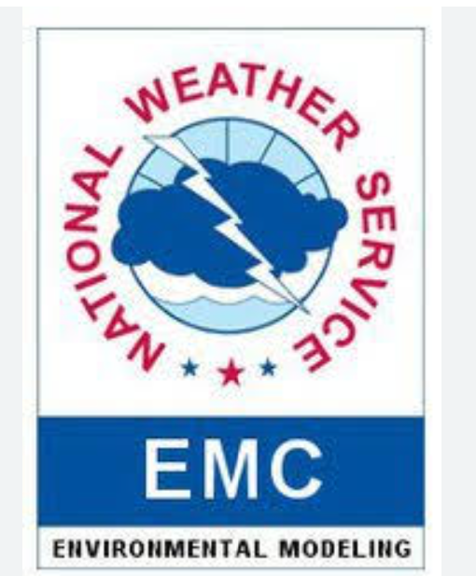


What is spack-stack
A python based package manager forked off of spack
Spack was developed by Lawrence Livermore National Laboratory (LLNL)
Initially developed by Joint Center for Satellite Data Assimilation (JCSDA)
Now supported by
  JCSDA
  National Oceanic and Atmospheric Administration’s (NOAA)
    Environmental Modeling Center (EMC)
    Earth Prediction Innovation Center (EPIC)
  U.S. Naval Research Laboratory (NRL)
Used to build the unified forecast system (UFS) and Joint Effort for Data assimilation Integration (JEDI) models and applications
Notes:
Link: https://spack-stack.readthedocs.io/en/latest/Overview.html
Link: https://spack.io/
It is a one-stop shop for application dependency packages primarily for JEDI and UFS related applications. It is forked from the spack repo, which is a python based package manager developed by LLNL. It creates package module files which you can load that will be needed to build and run your application. Various organizations help support and maintain the spack-stack repo.

Slide 4
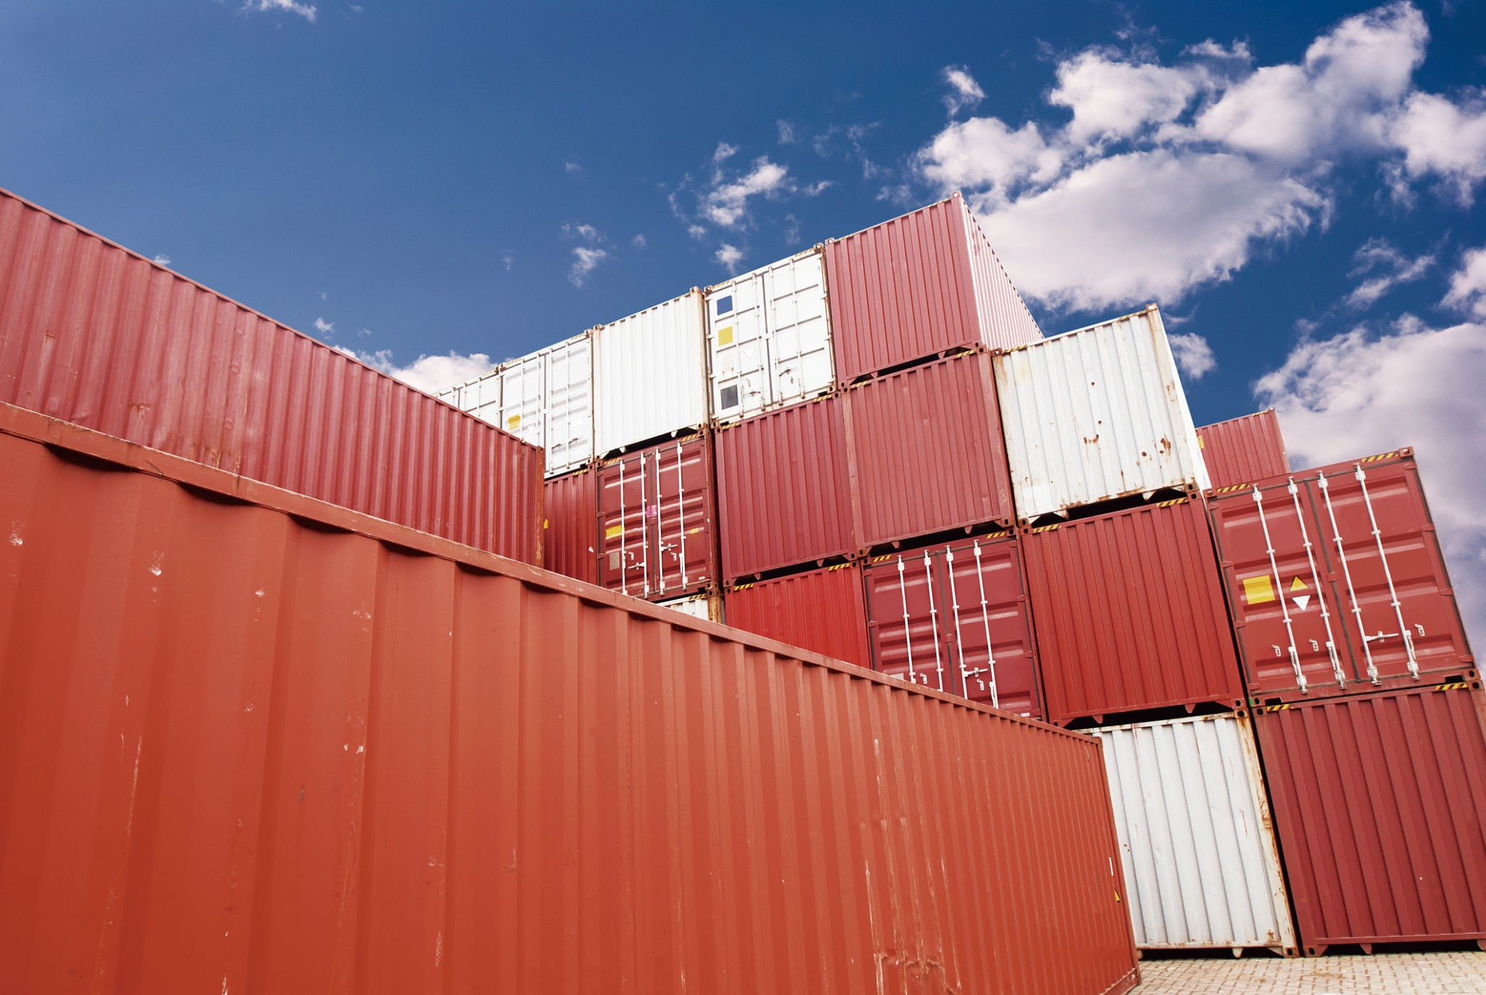
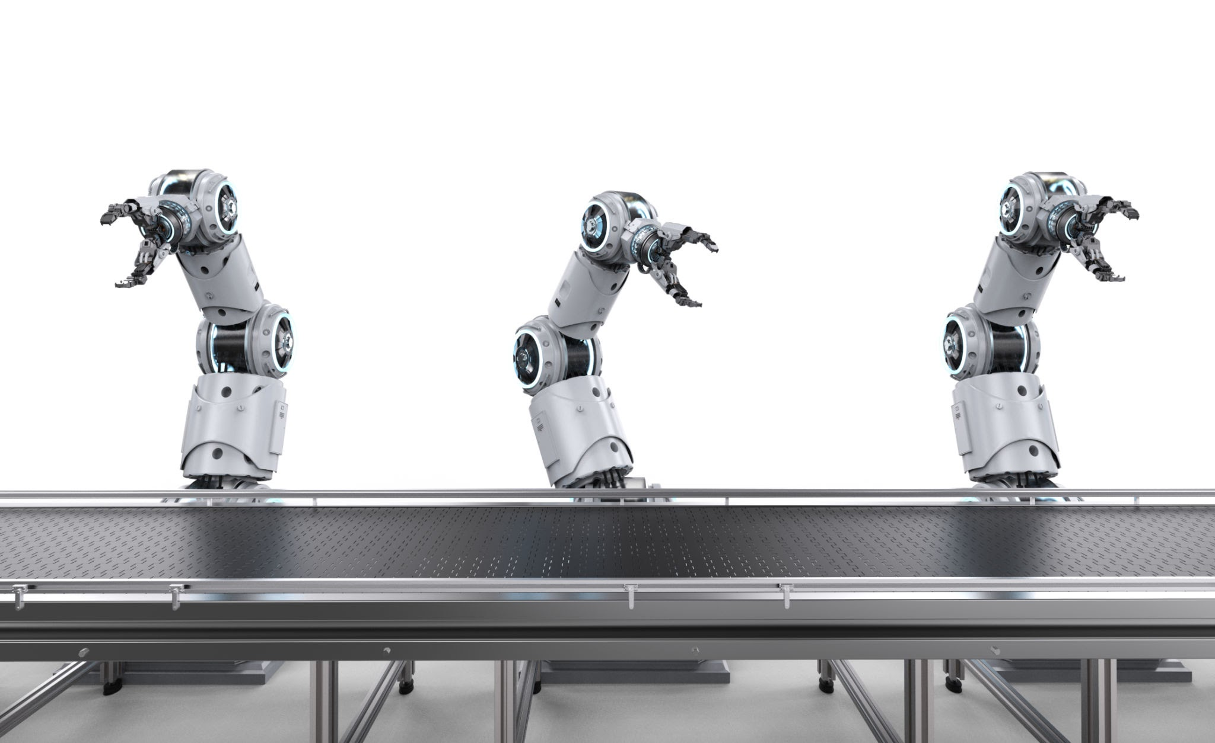
Current spack-stack support
Support is split between JCSDA, EMC, NRL, and EPIC
Maintenance increased for EPIC
  Expansion of Tier-1 platforms
  Shifted responsibilities
To free up developer time to focus on development tasks and reduce platform support, looked into ways to build spack-stack environments by
  Automating
  Containerizing
Notes:
Link: https://spack-stack.readthedocs.io/en/latest/Overview.html
Currently, spack-stack support is split between JCSDA, EMC, NRL, and EPIC. Level of effort to support spack-stack has increased significantly due to expanding T1 support and shift responsibilities internal within NOAA EPIC. To free up developer time, automating and containerizing spack-stack was pursued so developers can focus on development rather deployment and support and to improve portability and consistency.

Slide 5

Automating spack-stack
Use Jenkins to build spack-stack
  Benefits
    Automatically builds spack-stack in background
  Drawbacks
    Cost money
    Jenkins knowledge needed
    Must build spack-stack for all supported platforms
Leverage spack binary cache or mirrors
  Benefits
    Much quicker builds
  Drawbacks
    Support needed for centralized spack cache location
    Must build spack-stack for all supported platforms
Notes:
Spack binary cache or mirrors are pre-built packages and dependencies stored in a tarball. When spack does its concretization process it will account for these prebuilt packages, speeding up the build process and reducing resources significantly in some cases.
The spack binary cache can be stored in a cloud bucket or an OCI registry allowing them to be shared between multiple users. For example, if only a few packages need to be updated, spack binary cache will be used and only the packages needing to be updated will be updated without doing spack add-on environment.

Slide 6
Containerizing spack-stack
Bundles: Intel hpckit Docker image + built spack-stack + container-scripts
Benefits
  Significantly reduce workload. In theory if one container works on one platform, should work on all
Drawbacks
  Intel end-user licence agreement (EULA) issue due to distribution of intellectual property (i.e. compilers)
    Can use if a NOAA affiliated employee
  Risk of non-NOAA affiliated users running it
  Developer training
Intel hpckit +
spack-stack
+
container-
scripts dockerfile
Intel &
spack-stack
Docker image
spack-stack Singularity Image File (SIF)

Slide 7

How does the spack-stack container work?
Copy out the convert-modules.py script from the spack-stack container/SIF
  Copies out the modules files
  Apends ‘APPTAINERENV’ to variables and paths in the lua files
  Creates wrappers scripts for build tools (i.e. cmake, ecbuld, etc.) and binary executables
    singularity exec command
To use, set modulefile to this new spack-stack location, now model will build in the container via wrapper script
make-external script is used to create wrapper scripts for the model executables, so it can run in the container
Was demoed by Mark Potts a few months ago
Notes:
Link: https://github.com/apptainer/apptainer/blob/main/docs/logos/apptainer_v3.png

Slide 8

Current Work / Transition Plan
Submitted EPIC container mitigation and migration plan to EPIC program team and NOAA EMC for review and feedback. If this method is agreed on by all parties, then we will address the feedback and implement the Transition plan:
  Discusses how to use containers that comply with Intel’s EULA
  Mitigation
    Hide repos that can build a docker container with compilers in it
    Rebuild previous release application containers using the two-staged method
  Migration
    Get the UFS WM, SRW App, Land DA, and any other app that uses spack-stack to run with spack-stack container on one platform first (Ursa).
    Repeat the process above for the NOAA RDPHC Tier-1 platforms
    Then onboard the non-NOAA RDHPC Tier-1 platforms (MSU and UCAR)
      Additional discussion needed with system admins
Notes:
Other parties:
UFS SAIC: EMC/Rahul Mahajan
EMC/EIB: EMC/Jacob Carley
UFS WM: EMC/Jun Wang
WPO/Maoyi Huang

Slide 9

Questions
edward.snyder@noaa.gov
Notes:
Generative AI image through Google Slides

