Slide 1
WINGS Transition Session
Emily Faber
WINGS 2023 Cohort
University of Maryland, Baltimore County

Slide 2
Accomplishments
Attended and presented research at numerous conferences and meetings. AGU, AMS, UIFCW, UFS webinar etc.
Learned to work on and run the UFS developer branch
Designed experiments within the developer workflow of the UFS, in collaboration with NOAA scientists, and used the FENGSHA dust emission scheme to analyze the impact of the new SSM on the dust emission processes and AOD.
Published 1 paper, a 2nd is in review, and a 3rd is in preparation.

Slide 3
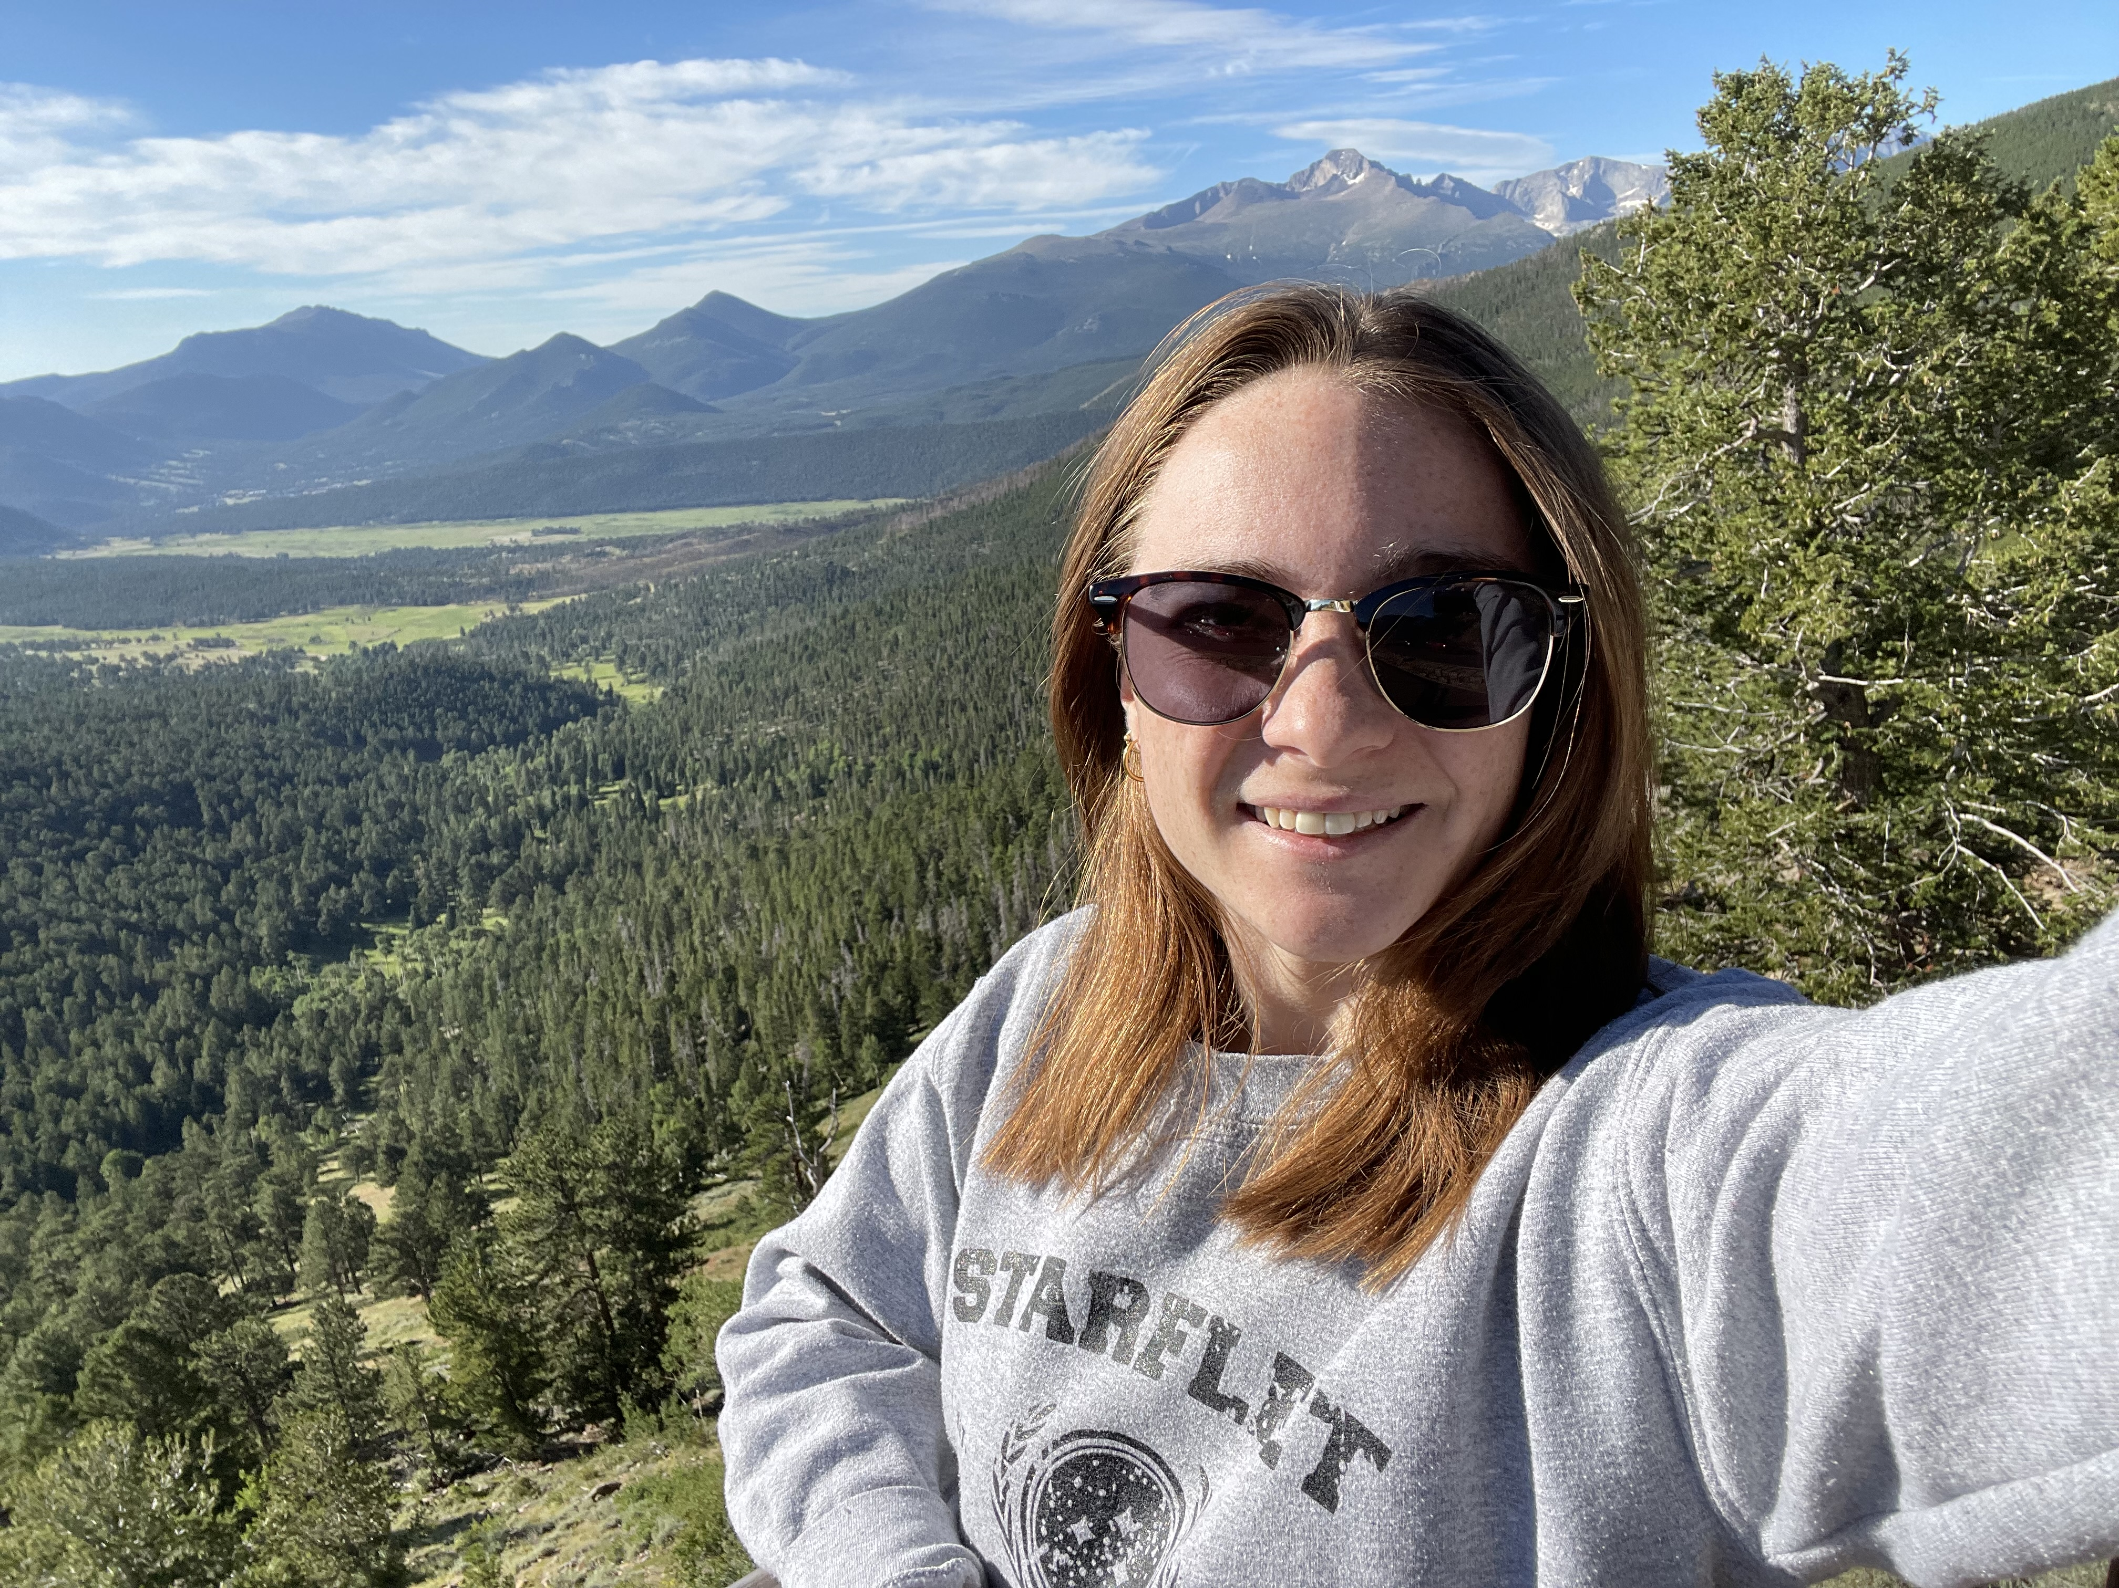
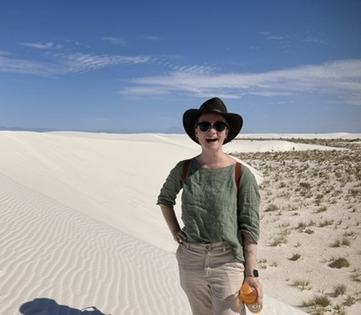
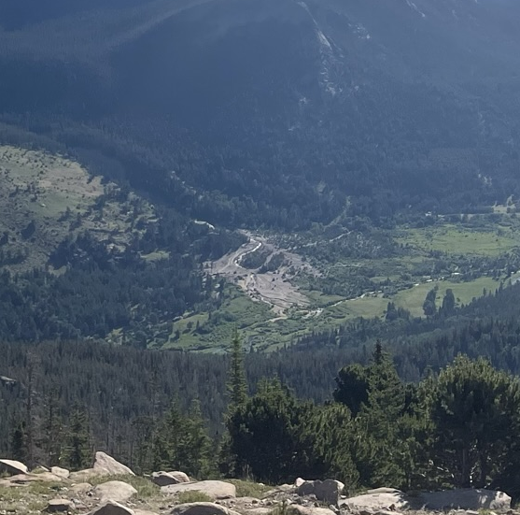
Experiences
Grew as a researcher and as a person
Met outstanding people along the way
Got to travel to present my work at conferences and network with ‘my people’
Got to work with people and resources I never would have had without the WINGS ‘flight crew’. (THANK YOU)
Future Plans: I’m planning to transition to a postdoctoral research position where I will grow as a modeler and expand my Earth system modeling skillset.

