Slide 1

Benefitting NOAA by Improving the Exploitation of Obs in EnsDA Academic Research that Benefits NOAA
Man-Yau (Joseph) Chan
Atmospheric Science Program
Department of Geography
The Ohio State University

Slide 2
Motivation: EnsDA research improves NOAA's forecast system, thus benefiting Stakeholders.
Obs Simulator (aka, "Obs Operator")
Obs Data
Run Short Ens Fcst
Assimilate obs data into model ensemble
Launch NWP
EnsDA

Slide 3
Outline Relevant Research in Joseph's Group
Understanding and mitigating damaging artifacts resulting from assimilating all-sky geostationary satellite IR radiances via an EnKF. Assumption of normal forecast distributions causes performance-damaging low-humidity clouds. Disabling cloud updates fixes that. Chan (2025; accepted), QJRMS
A novel "obs of opportunity" from astrophysics: muon fluxes Proof-of-concept tests are positive. Luszczak and Chan (submitted), Physical Review D.
A potential cost-efficient way to increase ensemble sizes Reasonably realistic NAVGEM virtual members have been produced using less than 10 cents per 100 virtual members. EnsDA tests underway.
Other: How do forecast distributions evolve over time? 1000-member study. Chan et al (submitted), GRL

Slide 4
Outline Relevant Research in Joseph's Group
Understanding and mitigating damaging artifacts resulting from assimilating all-sky geostationary satellite IR radiances via an EnKF. Assumption of normal forecast distributions causes performance-damaging low-humidity clouds. Disabling cloud updates fixes that. Chan (2025; accepted), QJRMS
A novel "obs of opportunity" from astrophysics: muon fluxes Proof-of-concept tests are positive. Luszczak and Chan (submitted), Physical Review D.
A potential cost-efficient way to increase ensemble sizes Reasonably realistic NAVGEM virtual members have been produced using less than 10 cents per 100 virtual members. EnsDA tests underway.
Other: How do forecast distributions evolve over time? 1000-member study. Chan et al (submitted), GRL

Slide 5
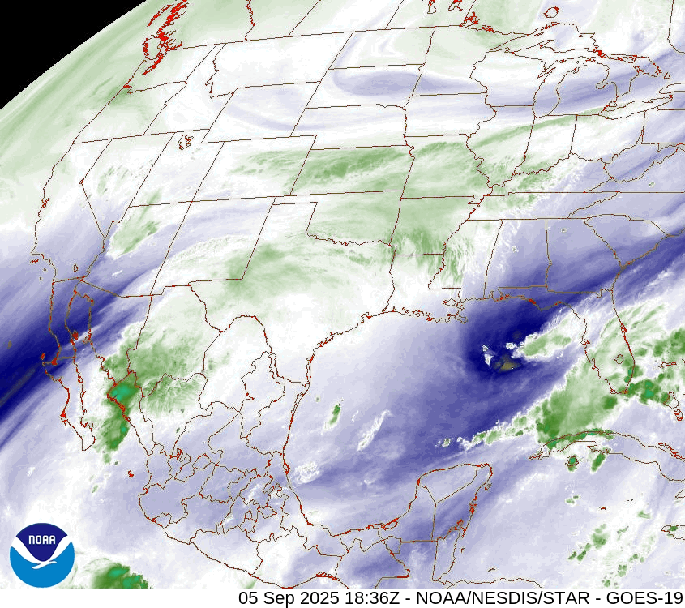
Background: Assimilation of all-sky GeoIR radiances tends to improve convective/mesoscale DA outcomes
Geostationary satellite IR radiances (GeoIR) are frequently available at high resolution.
Thus, much research on GeoIR DA to improve mesoscale NWP. Typically use water vapor channel BTs.
Common finding: EnKF-based IR DA improves analyses & forecasts of convective systems.
Animation loop of GOES-East ABI channel 8 BTs. Credit: NOAA NESDIS

Slide 6
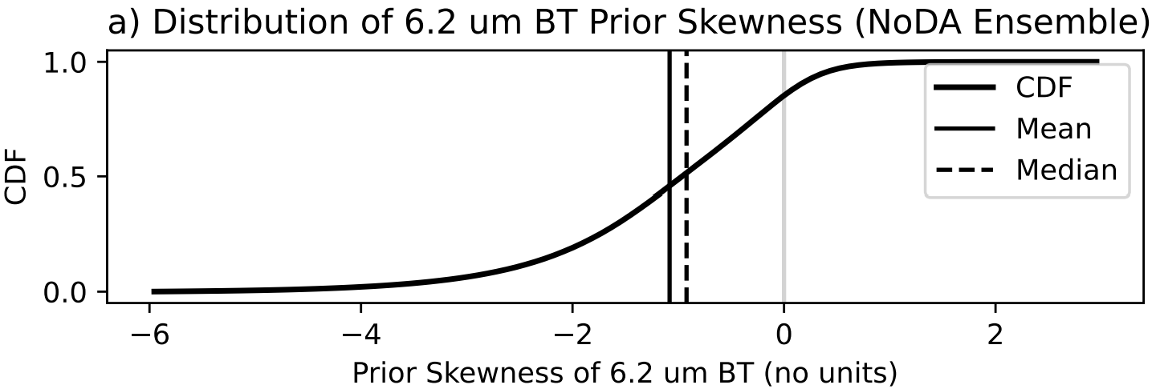
Challenge: EnKFs assume normally-distributed forecast ensemble statistics! This assumption is violated.
GeoIR (6.2um BTs) priors are negatively skewed (i.e., non-Gaussian)!
GeoIR is strongly affected by moist convection, which has non-Gaussian multivariate forecast statistics too!
Recall: normal distributions have zero skew.
Chan (2025, accepted), QJRMS

Slide 7
Challenge: EnKFs assume normally-distributed forecast ensemble statistics! This assumption is violated.
GeoIR (6.2um BTs) priors are negatively skewed (i.e., non-Gaussian)!
GeoIR is strongly affected by moist convection, which has non-Gaussian multivariate forecast statistics too!
Questions raised:
What practical issues manifest due to this violation?
Can we mitigate those issues when using EnKF?
Recall: normal distributions have zero skew.
Chan (2025, accepted), QJRMS

Slide 8
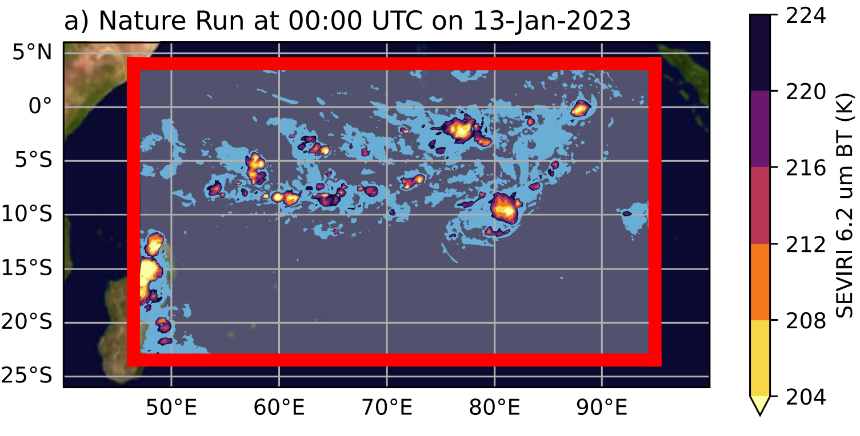
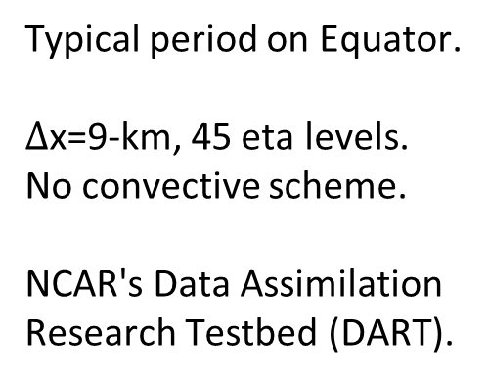
EnKF-based All-sky GeoIR DA produces unphysical low-humidity clouds
Testing: 3-day WRF perfect model experiments
Typical period on Equator.
$Δ$x=9-km, 45 eta levels.
No convective scheme.
NCAR's Data Assimilation Research Testbed (DART).
Chan (2025, accepted), QJRMS

Slide 9
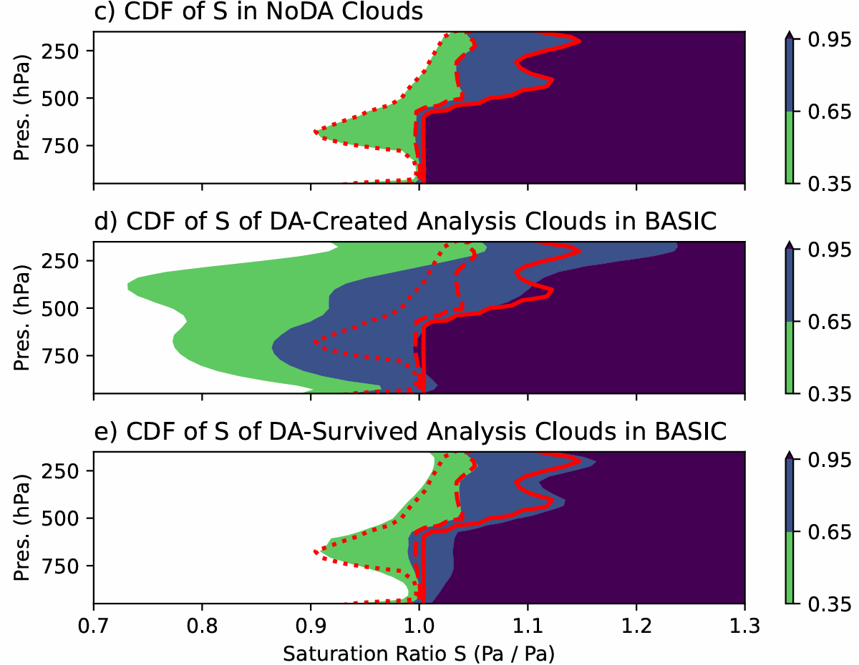
EnKF-based All-sky GeoIR DA produces unphysical low-humidity clouds
Results from 3-day WRF perfect model experiments
Humidity of Clouds before DA
DA-created clouds have unphysically low water vapor saturation ratios!
Humidity of DA-created Clouds
Chan (2025, accepted), QJRMS

Slide 10
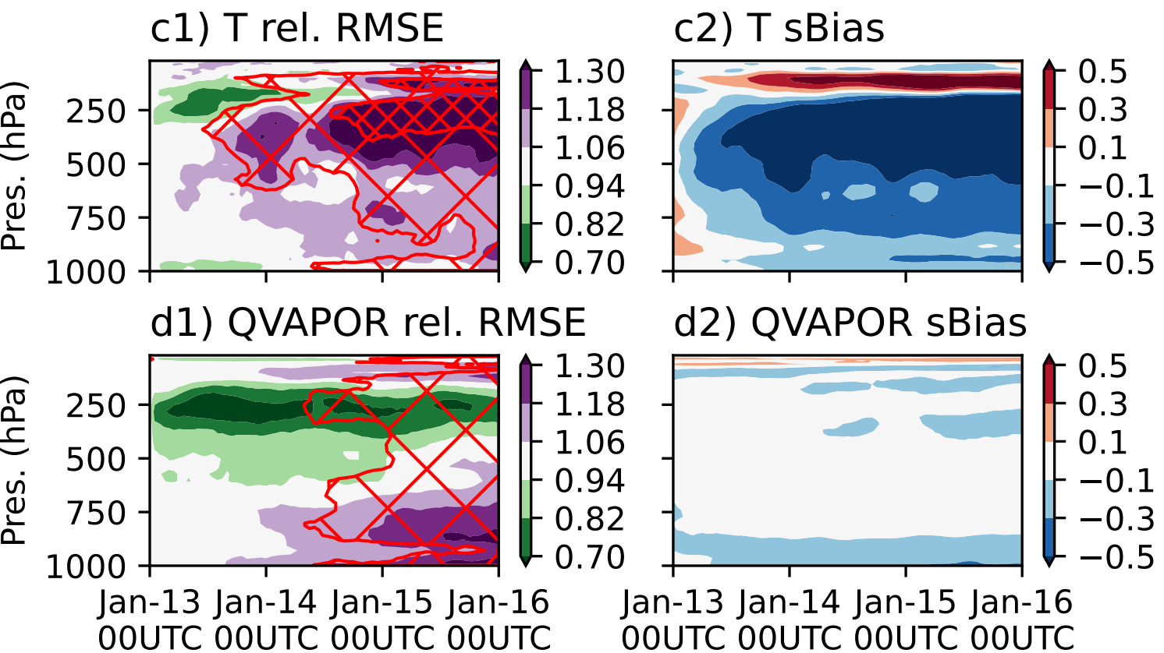

EnKF-based All-sky GeoIR DA produces unphysical low-humidity clouds
Results from 3-day WRF perfect model experiments
Normalized $θ$ Biases*
Red: GeoIR EnKF causes overly warm temperatures in prior ensemble.
Blue: GeoIR EnKF caused overly cold temperatures in prior ensemble
Chan (2025, accepted), QJRMS

Slide 11
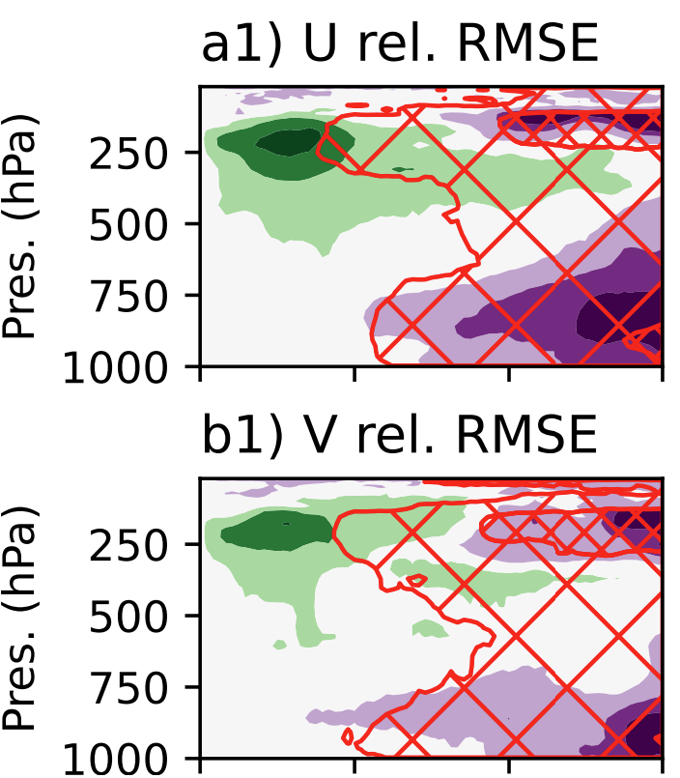
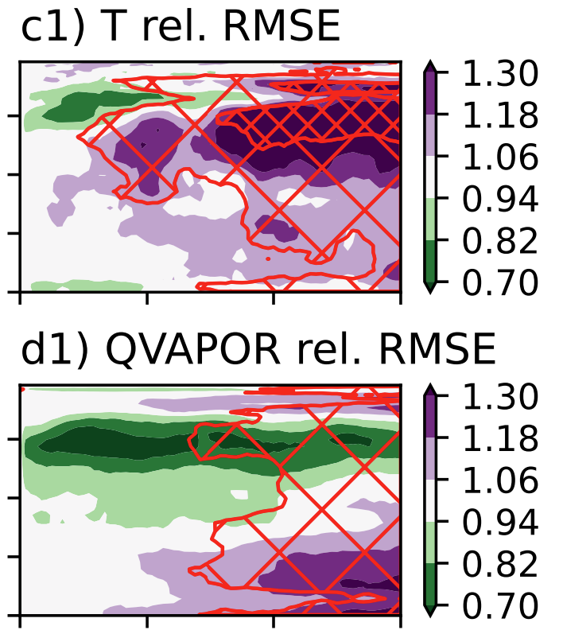
EnKF-based All-sky GeoIR DA produces unphysical low-humidity clouds
Results from 3-day WRF perfect model experiments
Unphysical low-humidity clouds introduced wrecked DA performance
Purple: GeoIR EnKF increased RMSE relative to NoDA
Green: GeoIR EnKF reduced RMSE relative to NoDA
Chan (2025, accepted), QJRMS

Slide 12
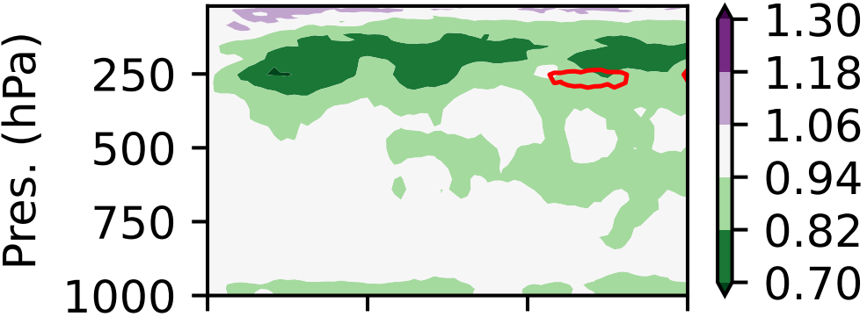
EnKF-based All-sky GeoIR DA produces unphysical low-humidity clouds
Results from 3-day WRF perfect model experiments
T rel. RMSE
Disabling cloud updates stabilizes all-sky GeoIR DA performance
With cloud update enabled
Purple: GeoIR EnKF increased RMSE relative to NoDA
Green: GeoIR EnKF reduced RMSE relative to NoDA
With cloud update disabled
Chan (2025, accepted), QJRMS

Slide 13
EnKF-based All-sky GeoIR DA produces unphysical low-humidity clouds
Results from 3-day WRF expt with hourly all-sky GeoIR DA
Other important finding: Performance-degrading interactions between observation quality control and non-Gaussian forecast statistics. Mitigatable.
Chan, M-Y. (2025, accepted): Improving Convection-Permitting All-Sky Infrared Radiance Ensemble Data Assimilation through Mitigating Deleterious Non-Gaussian Artefacts. Quarterly Journal of the Royal Meteorological Society.

Slide 14
Outline Relevant Research in Joseph's Group
Understanding and mitigating damaging artifacts resulting from assimilating all-sky geostationary satellite IR radiances via an EnKF. Assumption of normal forecast distributions causes performance-damaging low-humidity clouds. Disabling cloud updates fixes that. Chan (2025; accepted), QJRMS
A novel "obs of opportunity" from astrophysics: muon fluxes Proof-of-concept tests are positive. Luszczak and Chan (submitted), Physical Review D.
A potential cost-efficient way to increase ensemble sizes Reasonably realistic NAVGEM virtual members have been produced using less than 10 cents per 100 virtual members. EnsDA tests underway.
Other: How do forecast distributions evolve over time? 1000-member study. Chan et al (submitted), GRL

Slide 15
Outline Relevant Research in Joseph's Group
Understanding and mitigating damaging artifacts resulting from assimilating all-sky geostationary satellite IR radiances via an EnKF. Assumption of normal forecast distributions causes performance-damaging low-humidity clouds. Disabling cloud updates fixes that. Chan (2025; accepted), QJRMS
A novel "obs of opportunity" from astrophysics: muon fluxes Proof-of-concept tests are positive. Luszczak and Chan (submitted), Physical Review D.
A potential cost-efficient way to increase ensemble sizes Reasonably realistic NAVGEM virtual members have been produced using less than 10 cents per 100 virtual members. EnsDA tests underway.
Other: How do forecast distributions evolve over time? 1000-member study. Chan et al (submitted), GRL

Slide 16
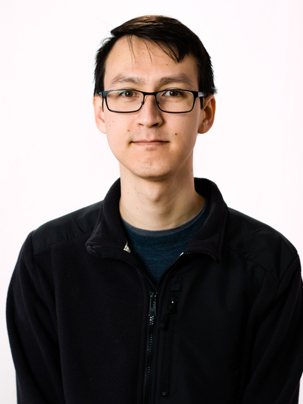
An Obs of Opportunity: Astrophysical Muon Fluxes
Collaboration with William Luszczak from Ohio State's Department of Astronomy
luszczak.1@osu.edu
Luszczak and Chan (submitted; Physical Review D)

Slide 17
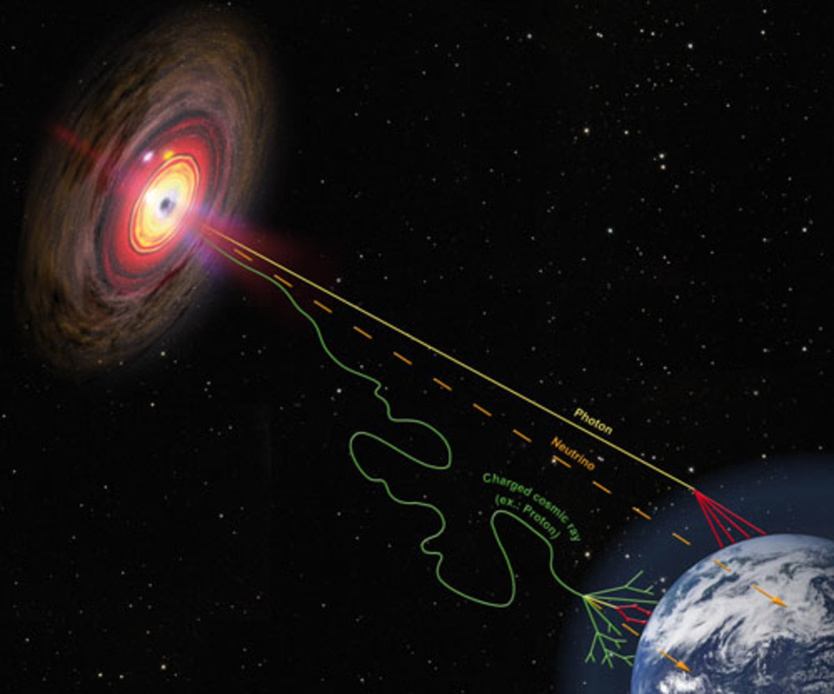
An Obs of Opportunity: Astrophysical Muon Fluxes
Cosmic ray particles originate from space, hit molecules in the atmosphere and set off showers of muons (a lepton).
Image credit: Helmholtz Alliance for Astroparticle Physics (https://www.hap-astroparticle.org/img/cosmic-rays_web-thumbnail.jpg)

Slide 18
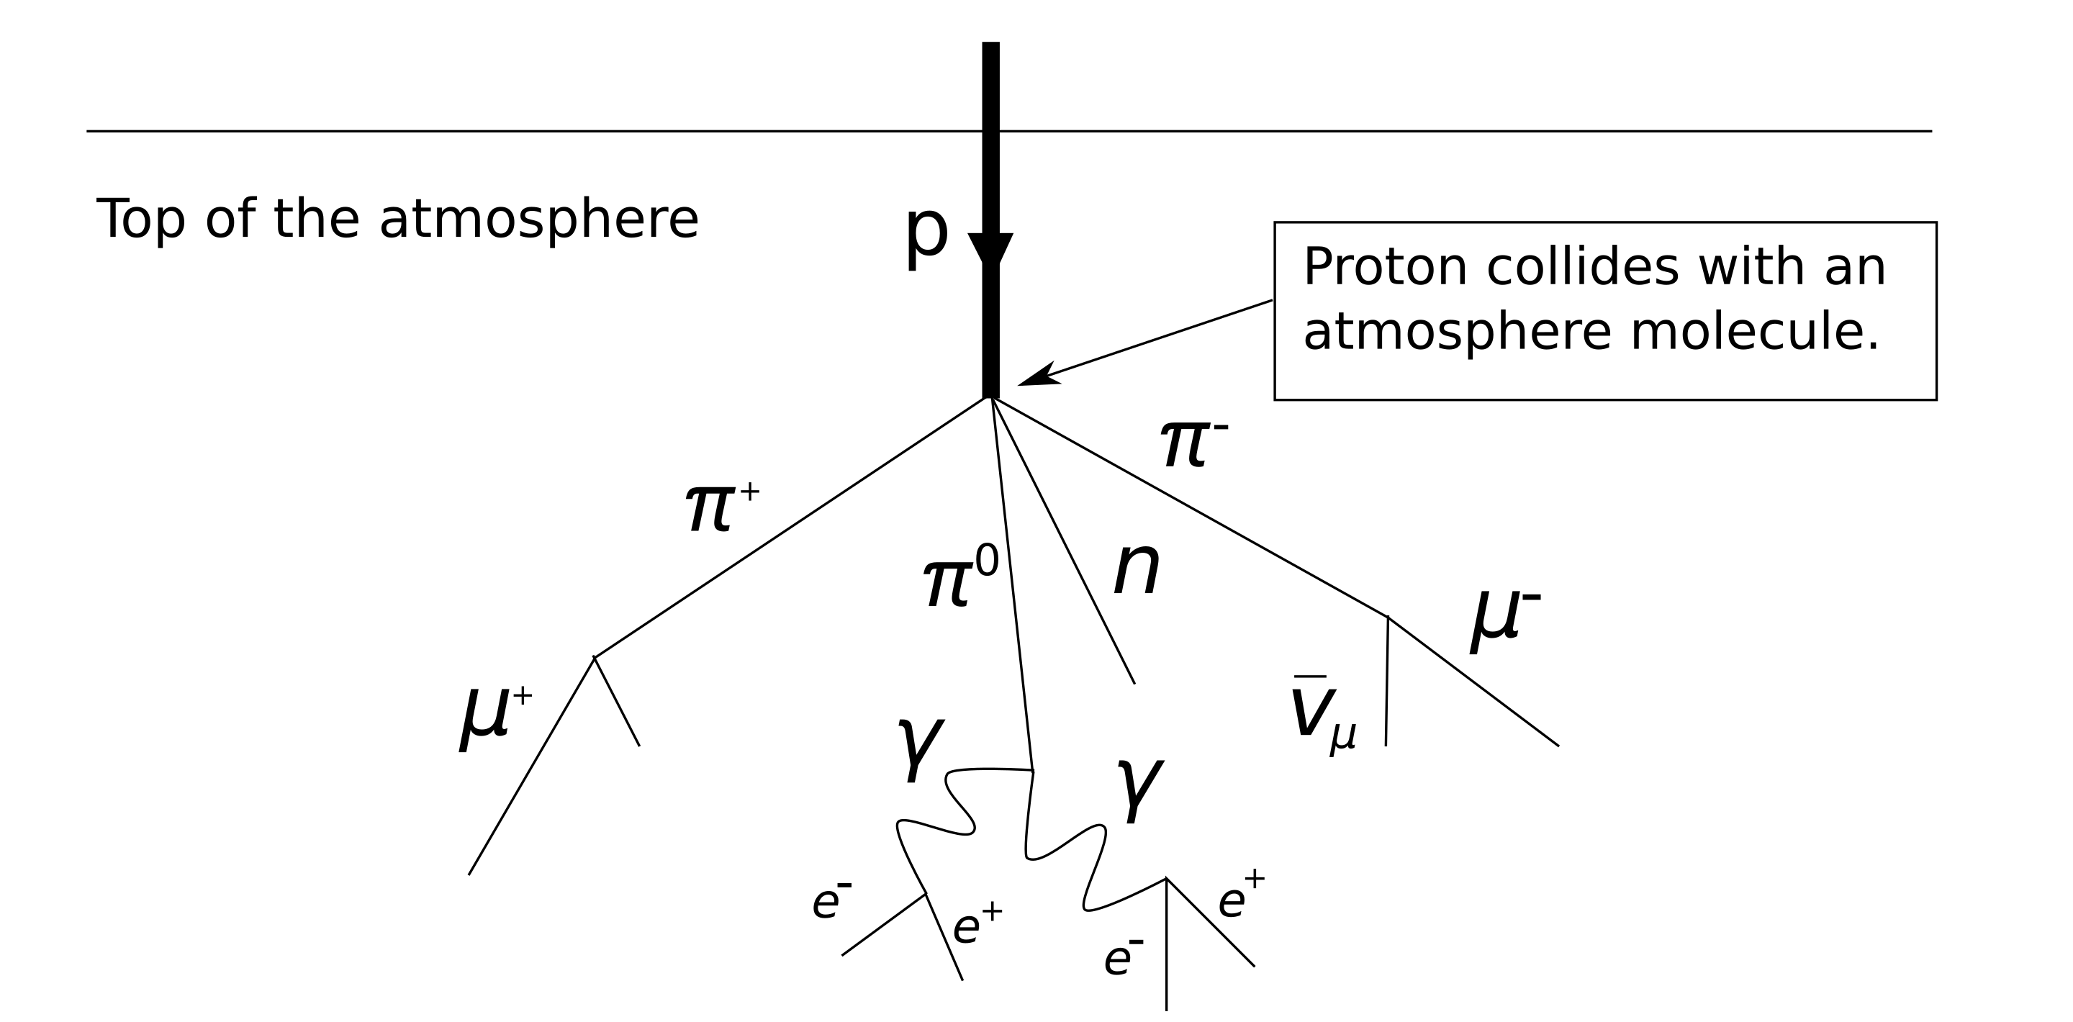
An Obs of Opportunity: Astrophysical Muon Fluxes
Image credit: SyntaxError55 at the English Wikipedia, CC BY-SA 3.0, https://commons.wikimedia.org/w/index.php?curid=13361920

Slide 19
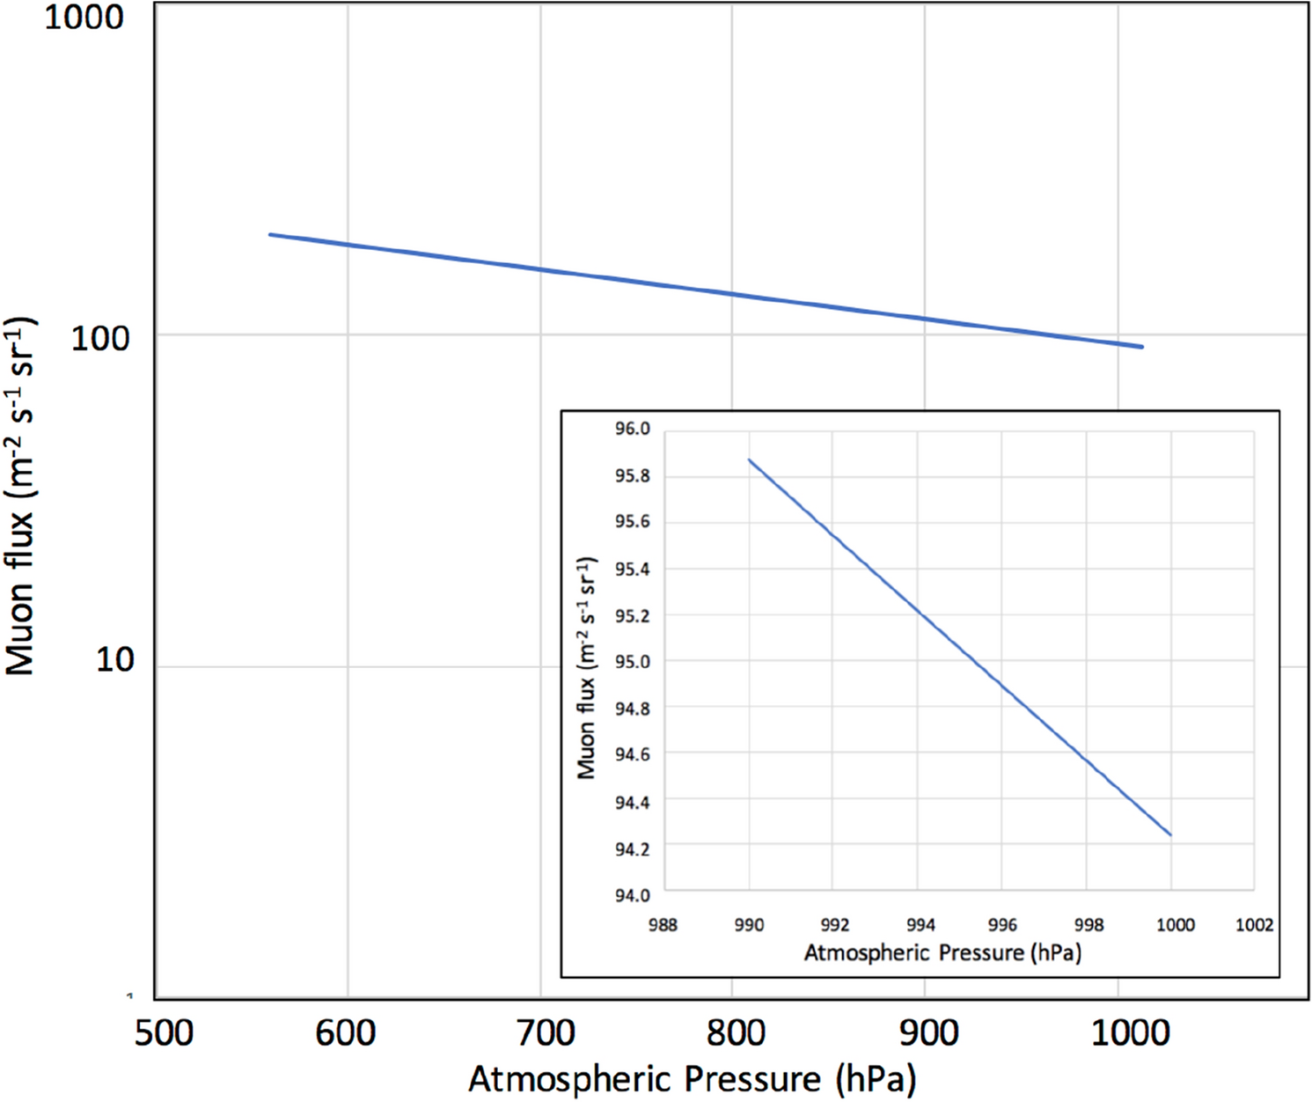
An Obs of Opportunity: Astrophysical Muon Fluxes
Higher air density is associated with smaller muon fluxes
Thus, muon flux has info about thermodynamic properties!
Image credit: Figure 1 of Tanaka, H.K.M., Gluyas, J., Holma, M. et al. Atmospheric muography for imaging and monitoring tropic cyclones. Sci Rep 12, 16710 (2022).

Slide 20
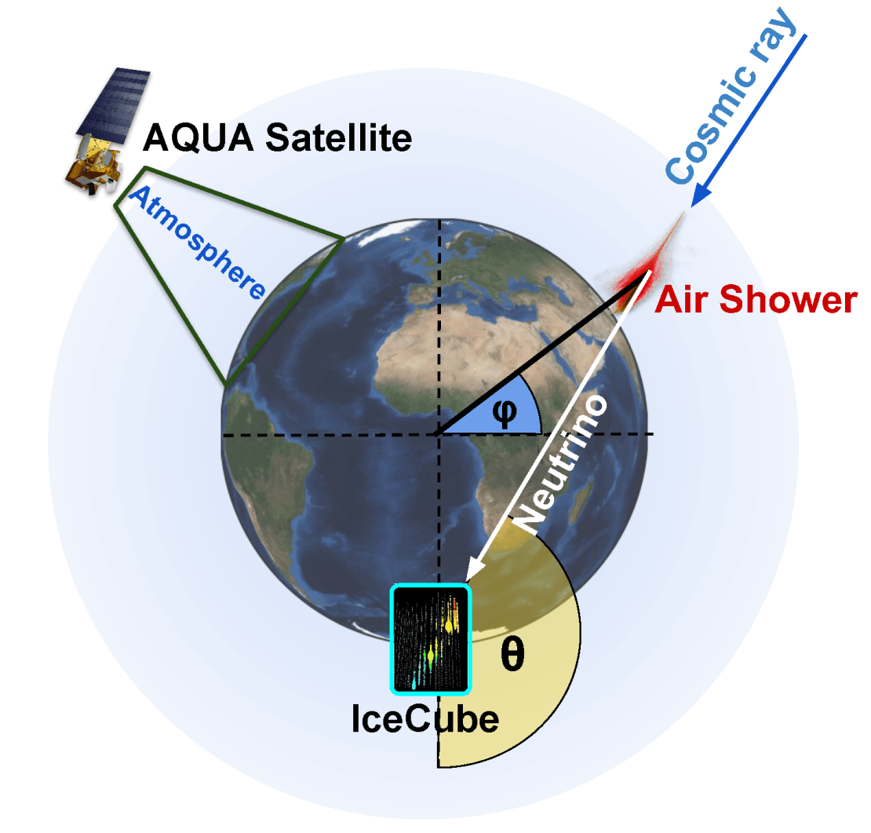
An Obs of Opportunity: Astrophysical Muon Fluxes
Astrophysicists studying neutrinos often (unintentionally) measure muons fluxes too in their neutrino detectors.
Neutrino detectors can be at opportune locations (e.g., IceCube in South Pole)
Muon detectors (portable and much cheaper) are sometimes assembled in college astronomy lab courses by students.
Hypothesis: DA can leverage this data
Credit: IceCube Collaboration

Slide 21
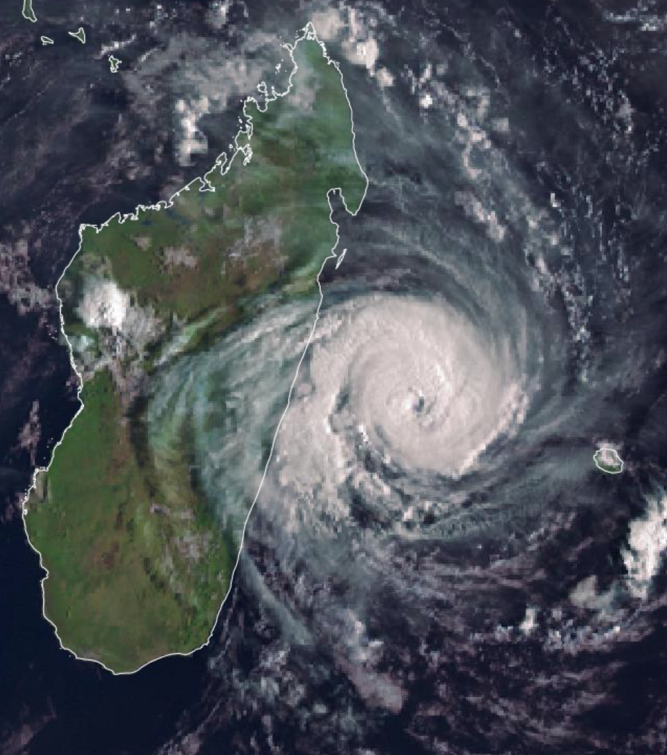
An Obs of Opportunity: Astrophysical Muon Fluxes
Test: Day-long perfect model WRF experiments
Case: Tropical Cyclone Freddy (2023). $1.53 billion USD of damages and 1,434 fatalities.
Proof-of-concept virtual reality experiments with hourly muon flux obs in Indian Ocean
WRF Setup: 9-km grid spacing, Thompson microphysics, no cumulus scheme. DA Setup: NCAR DART, EAKF, hourly DA.
Image credit: EUMETSAT
Madagascar
TC Freddy

Slide 22
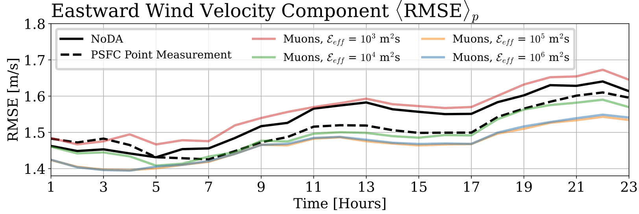
An Obs of Opportunity: Astrophysical Muon Fluxes
Test: Day-long perfect model WRF experiments
Similar outcomes for V and T. Neutral outcome for QVAPOR.

Slide 23
An Obs of Opportunity: Astrophysical Muon Fluxes
Test: Day-long perfect model WRF experiments
Assimilation of muon flux obs improved analysis ensembles.
Impact of muon flux improves with better instrument precision

Slide 24
Outline Relevant Research in Joseph's Group
Understanding and mitigating damaging artifacts resulting from assimilating all-sky geostationary satellite IR radiances via an EnKF. Assumption of normal forecast distributions causes performance-damaging low-humidity clouds. Disabling cloud updates fixes that. Chan (2025; accepted), QJRMS
A novel "obs of opportunity" from astrophysics: muon fluxes Proof-of-concept tests are positive. Luszczak and Chan (submitted), Physical Review D.
A potential cost-efficient way to increase ensemble sizes Reasonably realistic NAVGEM virtual members have been produced using less than 10 cents per 100 virtual members. EnsDA tests underway.
Other: How do forecast distributions evolve over time? 1000-member study. Chan et al (submitted), GRL

Slide 25
Outline Relevant Research in Joseph's Group
Understanding and mitigating damaging artifacts resulting from assimilating all-sky geostationary satellite IR radiances via an EnKF. Assumption of normal forecast distributions causes performance-damaging low-humidity clouds. Disabling cloud updates fixes that. Chan (2025; accepted), QJRMS
A novel "obs of opportunity" from astrophysics: muon fluxes Proof-of-concept tests are positive. Luszczak and Chan (submitted), Physical Review D.
A potential cost-efficient way to increase ensemble sizes Reasonably realistic NAVGEM virtual members have been produced using less than 10 cents per 100 virtual members. EnsDA tests underway.
Other: How do forecast distributions evolve over time? 1000-member study. Chan et al (submitted), GRL

Slide 26



Large NWP Ensembles via Cost-Effective Local PESE-GC* *Probit-space Ensemble Size Expansion for Gaussian Copulas
Goal: Improve forecast statistics used in EnsDA via increasing ensemble size using minimal computational resources.
Collab with NRL: Elizabeth Satterfield, Juli Rubin, and Edward Hyer
My students: Guan Xin, Horeb, Samuel Hurd and Max Albrecht
Young Investigator Program N00014-25-1-2023

Slide 27
Large NWP Ensembles via Cost-Effective Local PESE-GC* *Probit-space Ensemble Size Expansion for Gaussian Copulas
Obs Simulator (aka, "Obs Operator")
Run Short Ens Fcst
Assimilate obs data into model ensemble
Regular Ensemble
Virtual Ensemble

Slide 28
Large NWP Ensembles via Cost-Effective Local PESE-GC* *Probit-space Ensemble Size Expansion for Gaussian Copulas
Obs Simulator (aka, "Obs Operator")
Create virtual members
Run Short Ens Fcst
Assimilate obs data into model ensemble
Remove virtual members
Regular Ensemble
Virtual Ensemble

Slide 29
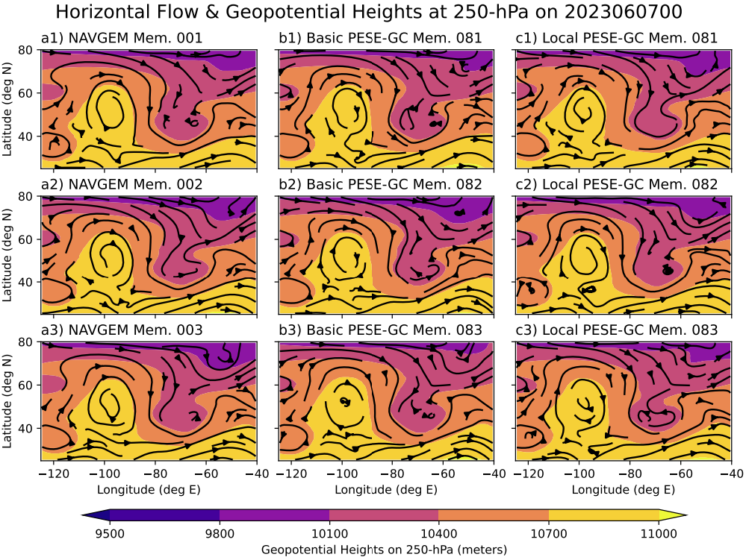
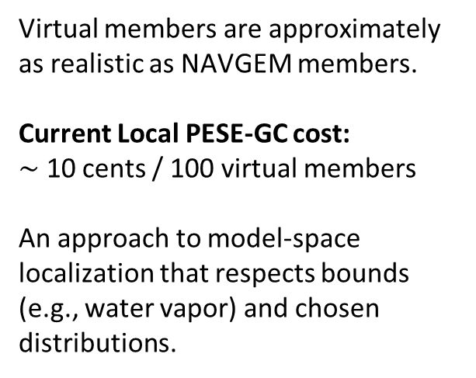
Large NWP Ensembles via Cost-Effective Local PESE-GC* *Probit-space Ensemble Size Expansion for Gaussian Copulas
Demo with NAVGEM Ensemble Data
Virtual members are approximately as realistic as NAVGEM members.
Current Local PESE-GC cost:
$\sim$ 10 cents / 100 virtual members
An approach to model-space localization that respects bounds (e.g., water vapor) and chosen distributions.
NAVGEM
Not Localized
Localized
NAVGEM
Not Localized
Localized
NAVGEM
Not Localized
Localized
9.5
9.8
10.1
10.4
10.7
11.0
250mb Geopotential Heights (km)

Slide 30
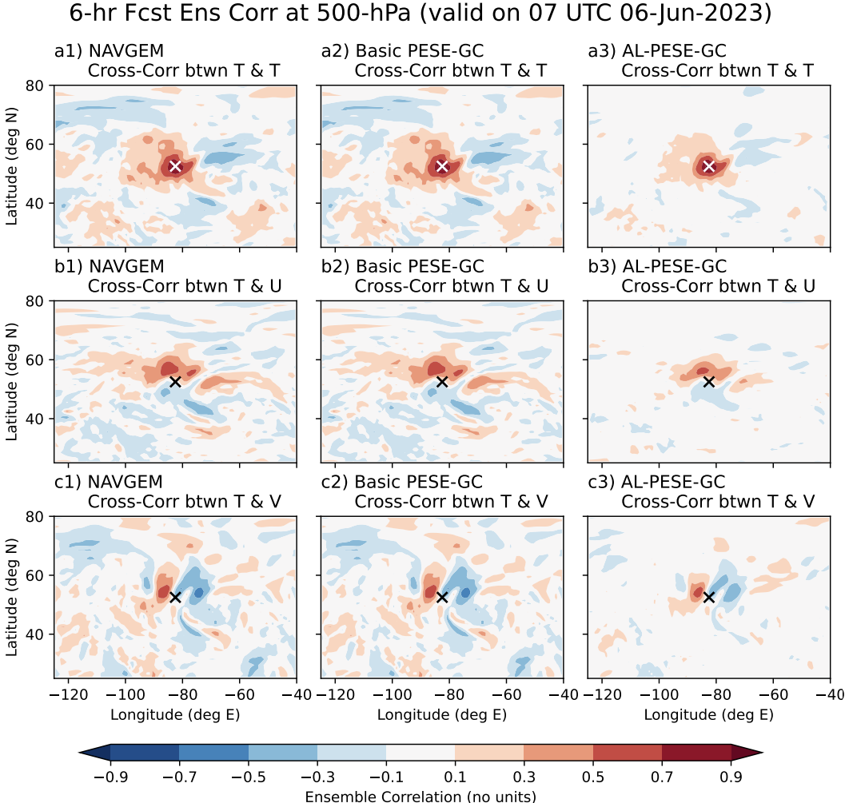

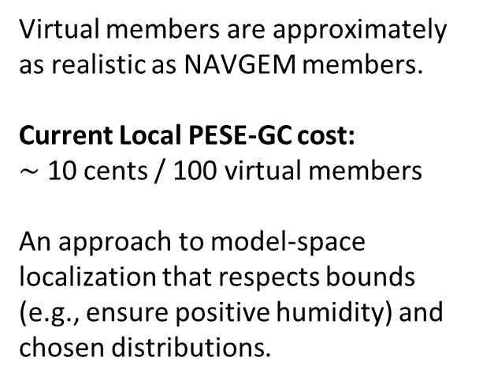



Large NWP Ensembles via Cost-Effective Local PESE-GC* *Probit-space Ensemble Size Expansion for Gaussian Copulas
Demo with NAVGEM Ensemble Data
$$Corr\left(T,T\right)$$
$$Corr\left(T,T\right)$$
Virtual members are approximately as realistic as NAVGEM members.
Current Local PESE-GC cost:
$\sim$ 10 cents / 100 virtual members
An approach to model-space localization that respects bounds (e.g., ensure positive humidity) and chosen distributions.
+0.9
+0.7
+0.5
Original
Expanded
+0.3
+0.1
$$Corr\left(T,U\right)$$
$$Corr\left(T,U\right)$$
-0.1
-0.3
-0.5
Original
Expanded
-0.7
-0.9

Slide 31
Outline Relevant Research in Joseph's Group
Understanding and mitigating damaging artifacts resulting from assimilating all-sky geostationary satellite IR radiances via an EnKF. Assumption of normal forecast distributions causes performance-damaging low-humidity clouds. Disabling cloud updates fixes that. Chan (2025; accepted), QJRMS
A novel "obs of opportunity" from astrophysics: muon fluxes Proof-of-concept tests are positive. Luszczak and Chan (submitted), Physical Review D.
A potential cost-efficient way to increase ensemble sizes Reasonably realistic NAVGEM virtual members have been produced using less than 10 cents per 100 virtual members. EnsDA tests underway.
Other: How do forecast distributions evolve over time? 1000-member study. Chan, Chipilski, Schwartz, Ridgway, Albrecht, Saurav (submitted), GRL

Slide 32
Motivation: EnsDA research improves NOAA's forecast system, thus benefiting Stakeholders.
Obs Simulator (aka, "Obs Operator")
Obs Data
Run Short Ens Fcst
Assimilate obs data into model ensemble
Launch NWP
EnsDA

Slide 33
Fin.
Thank you for your attention!
Happy to take questions & comments.

Slide 34
Summary Academic Research @ OSU that Benefits NOAA
Understanding and mitigating damaging artifacts resulting from assimilating all-sky geostationary satellite IR radiances via an EnKF. Assumption of normal forecast distributions causes performance-damaging low-humidity clouds. Disabling cloud updates fixes that. Chan (2025; accepted), QJRMS
A novel "obs of opportunity" from astrophysics: muon fluxes Proof-of-concept tests are positive. Luszczak and Chan (submitted), Physical Review D.
A potential cost-efficient way to increase ensemble sizes Reasonably realistic NAVGEM virtual members have been produced using less than 10 cents per 100 virtual members. EnsDA tests underway.
Other: How do forecast distributions evolve over time? 1000-member study. Chan, Chipilski, Schwartz, Ridgway, Albrecht, Saurav (submitted), GRL

Slide 35
Extra Slides

Slide 36
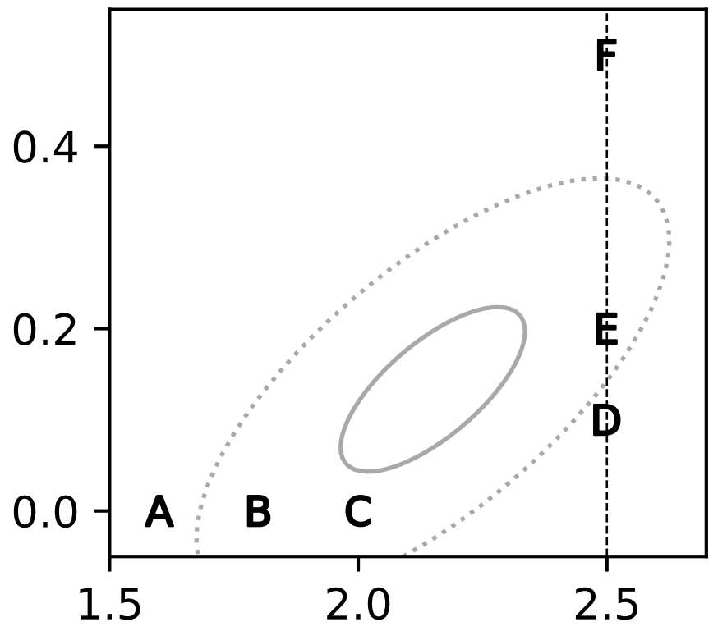
EnKF-based All-sky GeoIR DA produces unphysical low-humidity clouds
An Illustrative Thought Experiment
Ensemble b4 EnsDA
Forecast members' setup:
Low-humidity cloudless members (A, B & C)
High-humidity cloudy members (D, E & F)
Fitting Gaussian PDF to members assigns strong probability to unphysical regime.
Unphysical regime
Gaussian forecast PDF
Cloud Mixing Ratio (g/kg)
Chan (2025, accepted), QJRMS
Specific Humidity (g/kg)

Slide 37
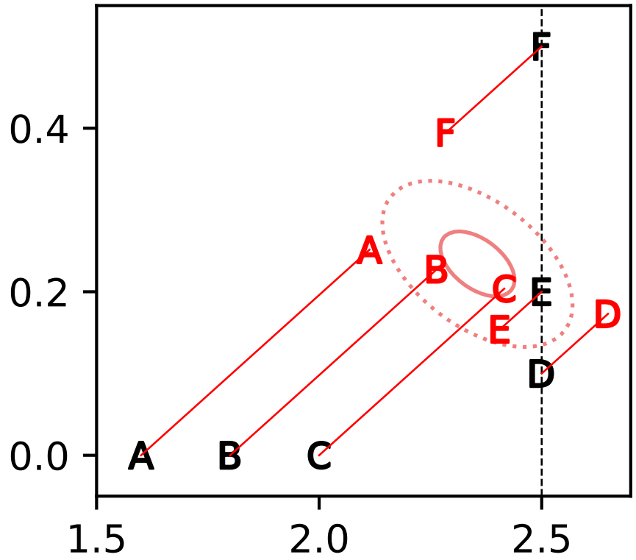
EnKF-based All-sky GeoIR DA produces unphysical low-humidity clouds
An Illustrative Thought Experiment
Ensemble b4 EnsDA
Assimilating an observation turns cloudless members into cloudy members.
However, strong prior probability in unphysical regime causes these newly cloudy members have unphysically low humidity.
Prediction: strong low temperature biases may manifest in multi-day DA!
Unphysical regime
Gaussian forecast PDF
Cloud Mixing Ratio (g/kg)
Specific Humidity (g/kg)

Slide 38
Large NWP Ensembles via Cost-Effective Local PESE-GC* *Probit-space Ensemble Size Expansion for Gaussian Copulas
Main Essence:
Local PESE-GC combines an existing NWP ensemble with the user's knowledge of 1D forecast distributions and forecast correlation lengths to generate virtual members.
Potential uses: EnsDA (offline tests ongoing) and postprocessing (potentially)

