Slide 1
Implementing Machine Learning to Resolve Troposphere-Stratosphere Coupling and Teleconnections in S2S Forecasts
Elena M. Fernández¹
Advisors:
Andrea Lopez Lang^{1,2}, Zheng Wu¹, and Mark Olsen³
¹ University at Albany, SUNY
² University of Wisconsin-Madison
³ NOAA Weather Program Office
WINGS Fellowship Transition Session
September 12, 2025

Slide 2
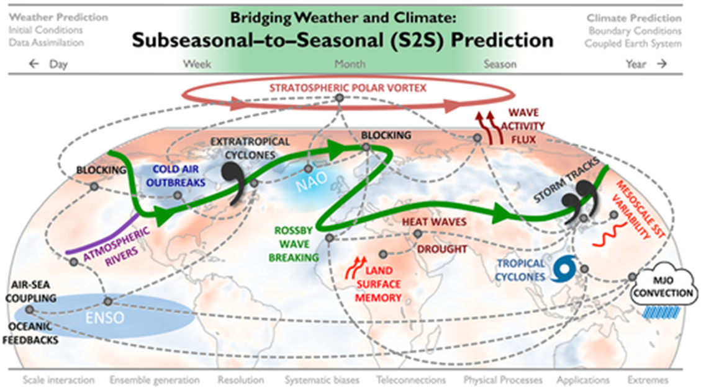
Subseasonal Forecasts: Sources of Predictability and Windows of Opportunity
There is some intrinsic predictable skill provided by the teleconnections between atmospheric states, systems and patterns.
→ These are the “windows of opportunity.”
→ They can extend the predictability beyond the medium-range.
Anomalous stratospheric conditions can modulate the tropospheric flow/create preferential patterns that assist in informing predictions.
From the Special Collection on S2S Prediction in JGR-Atm and GRL

Slide 3
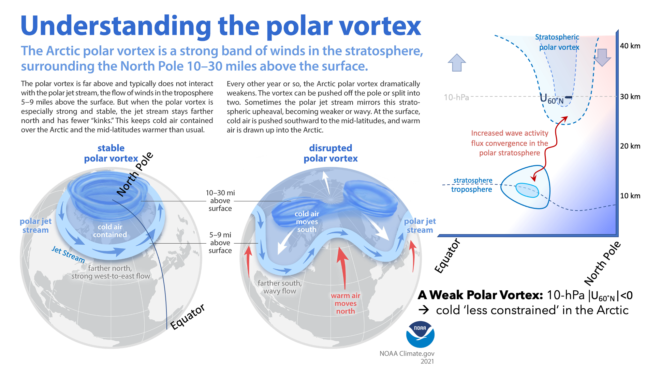
https://www.climate.gov/news-features/understanding-climate/understanding-arctic-polar-vortex
→ Interested in understanding the downward wintertime interactions between the stratospheric polar vortex and surface conditions.

Slide 4
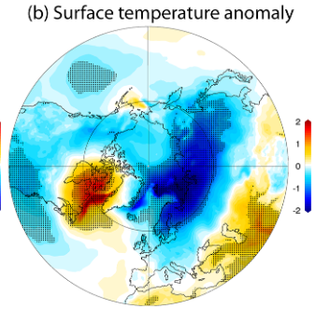
Using Features from the Stratosphere to Forecast Tropospheric Extremes
→ It’s established that changes to the strength and location of the stratospheric polar vortex serve as a known source of predictability into the troposphere.
→ Past research shows that specific conditions of the stratospheric polar vortex can produce enhanced forecast skill for NH temperature extremes (Butler et al. 2017).
I am interested in evaluating this relationship further by establishing which stratospheric polar vortex behaviors lead to window of opportunity forecasts for tropospheric temperature extremes in the NH.

Slide 5
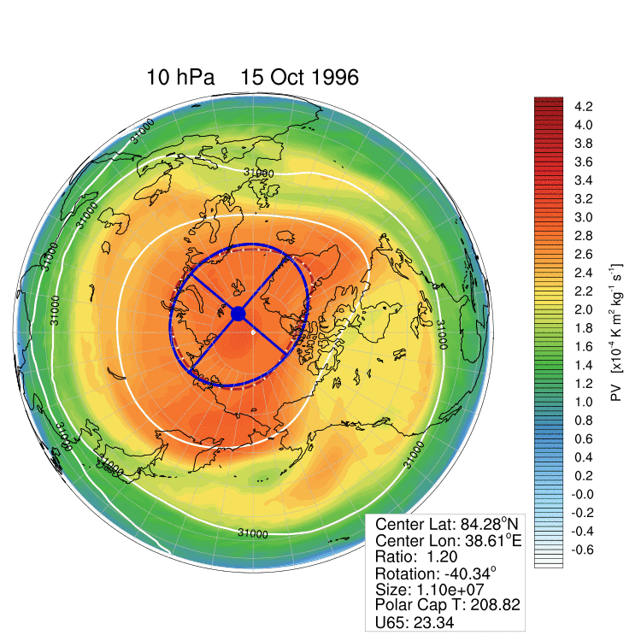
Metrics for Diagnosing Vortex Characteristics:
Non-Zonal Quantities
My work defines geometries describing the non-zonal location/shape and behavior of the vortex and uses them as diagnostics ( ellipse metrics)
At the 10-hPa level, use a best-fit ellipse method on the 30-km contour of geopotential height to define the vortex:
→ Center latitude, longitude
→ Vortex ratio (length/width)
→ Vortex area or size (km2)
→ Vortex angle, measured between of the long axis with respect to 0˚

Slide 6
Proposed Research Questions
Do these proposed stratospheric ellipse diagnostics identify any potential windows-of-opportunity in forecasting tropospheric phenomena on the S2S timescale?
Do the proposed stratospheric ellipse diagnostics inform S2S predictions through identified forecasts-of-opportunity?
Can we improve physics-based and AI model skill on the S2S timescale by integrating these stratospheric moment diagnostics?
I will approach these questions using various ML model architectures, each tailored to the task of the problem.
Q1 compares a set of random forest and LSTM models tasked in classifying temperature anomalies. Each model architecture uses different stratospheric features as their input and their skill in identifying windows of opportunity is compared.
Q2 will adapt the best performing architecture from Q1, leverage stratospheric windows of opportunity, and make temperature forecasts for different regions of the NH.
Q3 will attempt to recreate Q2 results using model data from sources like the UFS or GraphCast, etc.

