Slide 1
Debrief: Findings, Recommendations and Closing Statements
Session Chair: Maoyi Huang
Speakers:
Keven Blackman, Kevin Garrett, Rowin Smith, Shuxia Zhang

Slide 2

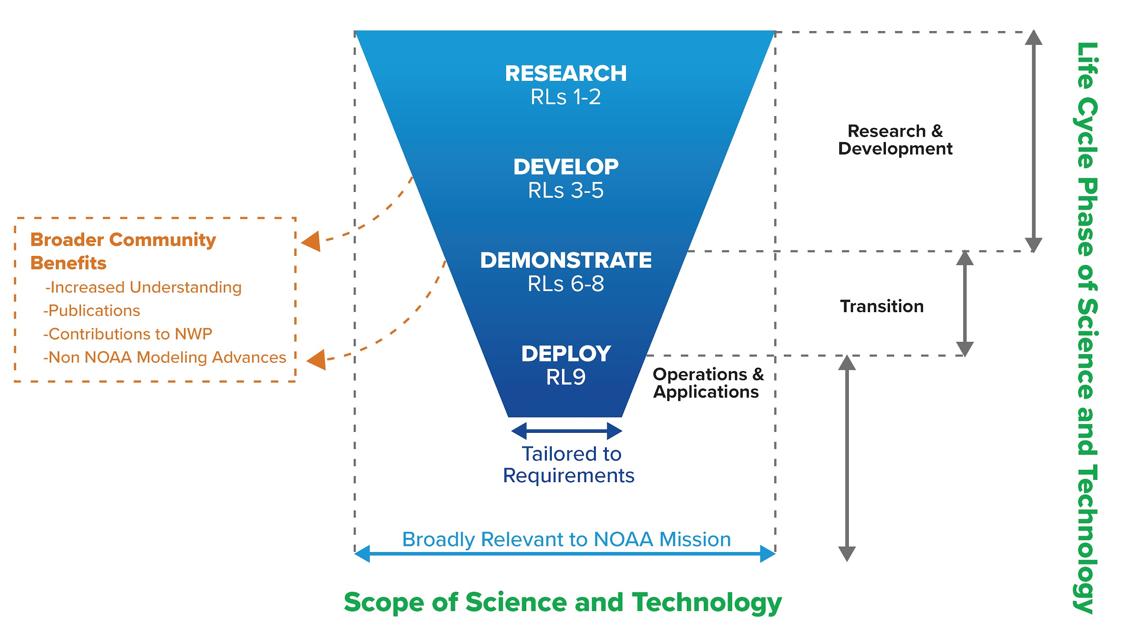

Desired EPIC Outcomes
1
Community: Nurture a representative and unifying modeling community
2
Infrastructure: Develop a publicly accessible end-to-end testing and development environment for the Unified Forecast System
3
Innovation: Bring innovations to improve UFS forecast skill and computation performance
15
Notes:
EPIC program has extended the strategic plan to a strategic implementation plan. We will demonstrate the success of the EPIC by delivering three high-level outcomes with detailed milestones. The three outcomes are
Community: Nurture a representative and inclusive modeling community
Infrastructure: Develop a publicly accessible end-to-end testing and development environment for the Unified Forecast System
Innovation: Bring innovations to improve UFS forecast skill and computation performance via a public facing EPIC Dashboard

Slide 3
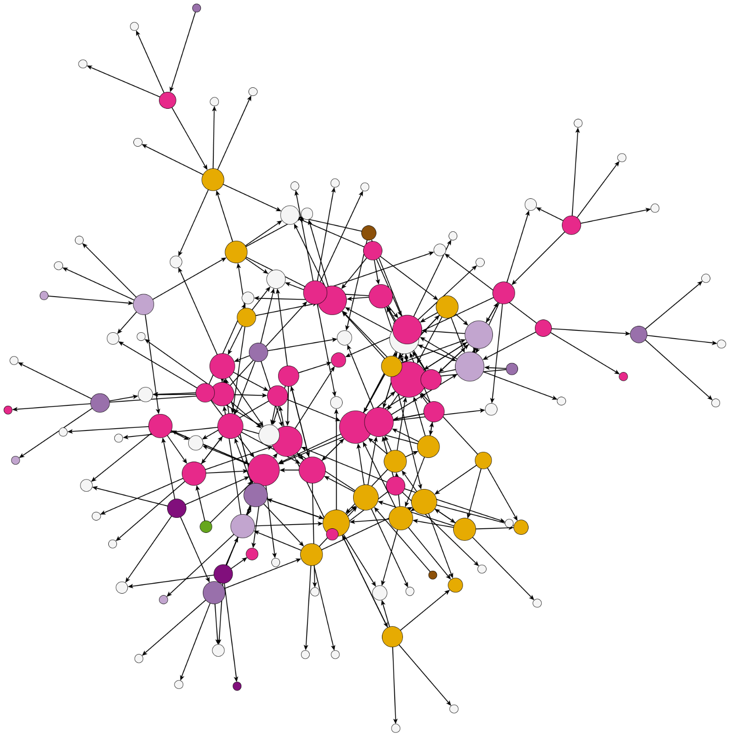
The Very First Peek of the UFS Community
Engagement Strategy
Observation
Goal
Homogeneity in our network
Involve more stakeholder groups
EXPAND
Code users and non-users in our network
Bridge between users and non-users
CONNECT
Different Kinds of Working Relationships
Increase knowledge transfer
STRENGTHEN
Courtesy: Hannah Love and Alison Gregory

Slide 4
Exciting Progress Made in Community Infrastructure
Containerization of UFS for research and for application;
Growing co-development of models and applications across the community
  Recognition of shifting to a DevSecOps paradigm across all sectors
Explosion of AI tools and the need to realign our workforce - challenges and opportunities
  How do we seek balance between physical and driven science and technology?

Slide 5
Innovations are Emerging
Community Fire Behavior Model + highly portal UFS SRWApp enabled private-industry applications for Fire Emergency Management;
Commercial Weather Observations, needs for
  Establishing evaluation platforms and pathway to operations
  Redefining Public-Private relationship
Innovation in Earth system modeling Curriculum?

Slide 6
Accessibility as a Priority
Reaching students and academia is a necessary condition for having a modeling community
Accessibility is currently a major barrier to UFS involvement in academia
Future development must include accessibility by outside users as a primary goal

