Slide 1
NOAA/GSL Model Development and Forecasting Activities Using MPAS
Clark Evans, Curtis R. Alexander, Ligia R. Bernardet, Terra T. Ladwig, Ming Hu, David C. Dowell, and Trevor I. Alcott
UIFCW 2025, Boulder, Colorado
11 September 2025

Slide 2
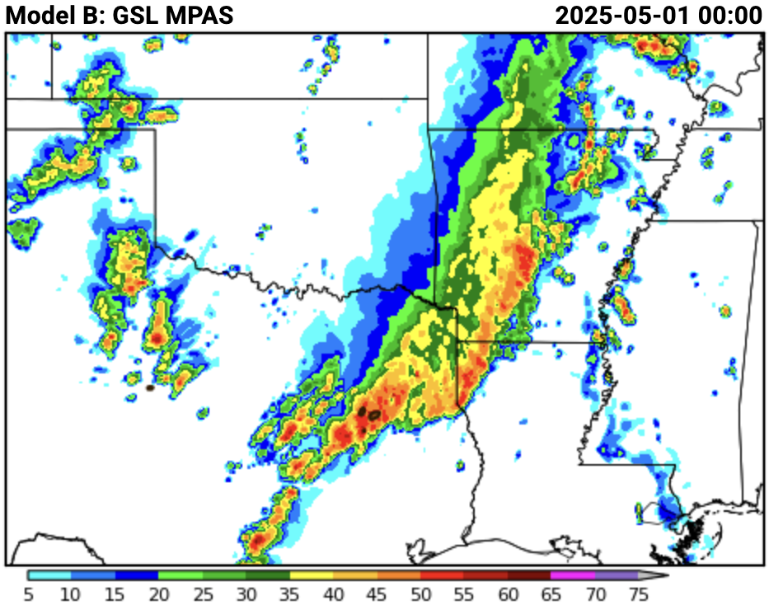

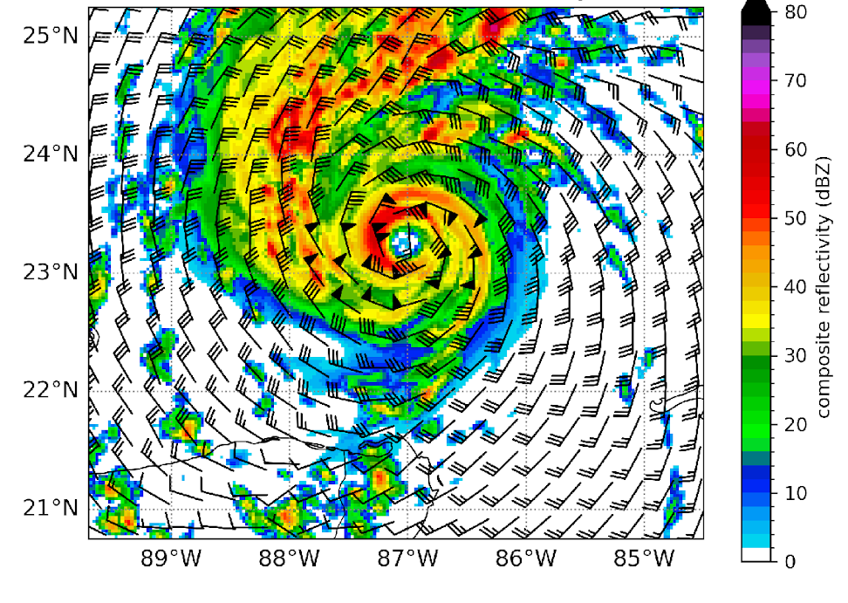
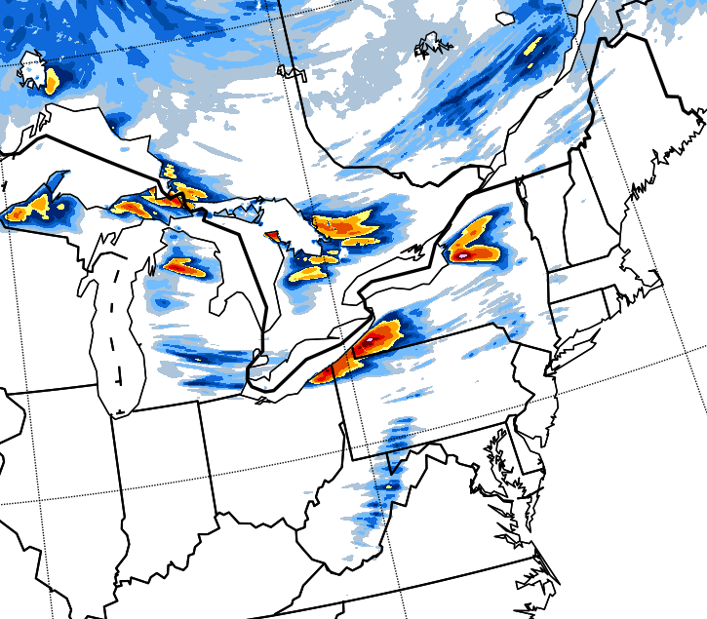
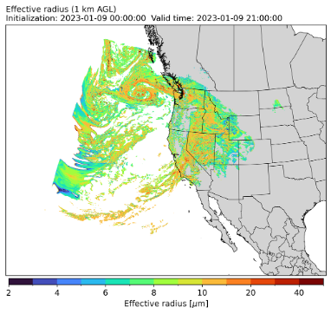
Next-Generation Operational Forecast System Development
Joint Effort for Data-Assimilation Integration
NOAA Testbed Evaluations
Advanced Physics Parameterizations
Real-Time Regional & Global Forecasts
Purpose-Built Forecast Systems

Slide 3
Regional MPAS-Based RRFS Prototypes/Development Systems
GSL is currently running three real-time, cold-start 3-km regional CONUS forecasts, all with MPAS v8.3.0 + physics advances developed at GSL:
MPAS_RRFSA (baseline): 8x daily to 84 h (0000, 0600, 1200, and 1800 UTC) or 24 h (0300, 0900, 1500, and 2100 UTC); atmosphere, surface, and aerosols are initialized from RRFS-A/v1
MPAS_physics_dev1 (physics/dynamics testing): 8x daily to 48 h (0000, 0600, 1200, and 1800 UTC) or 18 h (0300, 0900, 1500, and 2100 UTC); matches MPAS_RRFSA except for single changes
MPAS_physics_dev2 (physics/dynamics testing): 4x daily to 24 h (0000, 0600, 1200, and 1800 UTC); matches MPAS_RRFSA except for single changes
Notes:
Emphasize cold-start – we have no DA entering into any of these forecasts, so we’re entirely reliant on the RRFS-A/v1 DA system for initial conditions, and we do not initialize radar fields from RRFS-A/v1.

Slide 4
Physics Parameterizations for MPAS-Based RRFS Prototypes
Component | Parameterization | Notes
Land-Surface | RUC/NoahMP | Reverted RUC LSM 2-m diagnostics to HRRR-like flux formulation. Working to develop an initial NoahMP-based prototype.
Surface Layer | MYNN | Work underway to integrate MYNN surface-layer code in NoahMP. Otherwise, no major recent changes.
Turbulence + Shallow Cumulus | MYNN-EDMF | Now a level-2.7 (total turbulent energy) scheme with an effective static stability option. Extensive tuning through the 3rd WFIP.
Deep Convection | N/A | Extended real-time testing in 2024 indicated no forecast impact at Δx = 3 km from using a deep convection parameterization.
Gravity-Wave Drag | Unified Gravity Wave Physics | Available in both the ufs-community/MPAS-Model fork and the authoritative NSF NCAR-maintained MPAS-Model repo.
Radiation | RRTMG | Currently using the NSF NCAR-maintained version of RRTMG. Possible update or switch to RRTMGP in the UFS, but testing needed.
Microphysics | Thompson-Eidhammer Microphysics Parameterization for Operations | New machine-learning diagnostic for cloud droplet number concentrations for PBL clouds. New freezing rain & hail diagnostics.

Slide 5
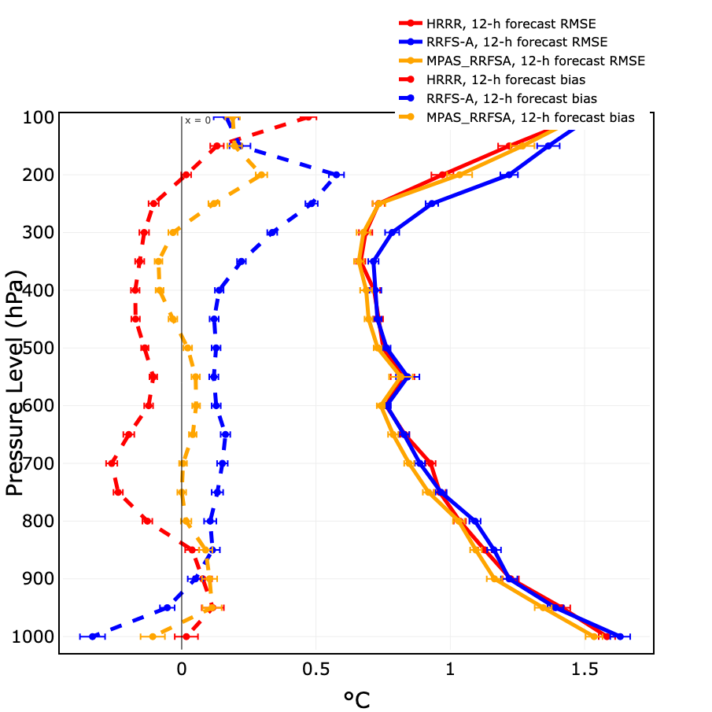
Upper-Air Verification – Temperature
HRRRv4
RRFS-A
MPAS-RRFSA
Period: 16 April – 16 August 2025
12-h forecasts
RMSE
Bias
Note the substantial improvement in both RMSE and bias.

Slide 6
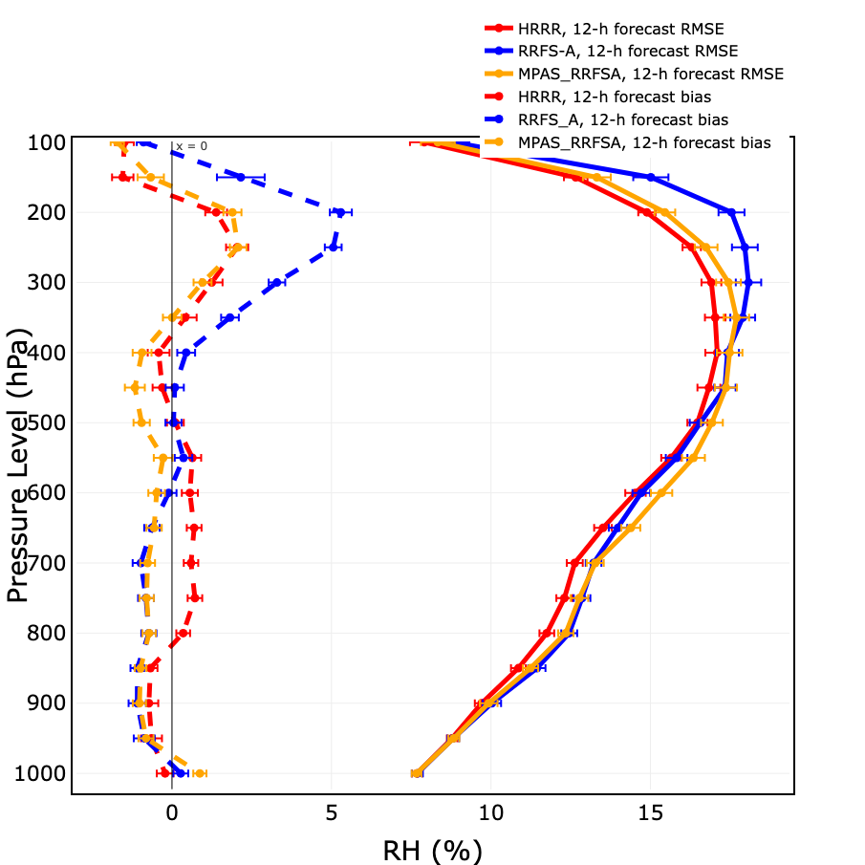
Upper-Air Verification – Relative Humidity (corrected for T)
HRRRv4
RRFS-A
MPAS-RRFSA
Period: 16 April – 16 August 2025
12-h forecasts
RMSE
Bias
The MPAS_RRFSA (and RRFS-A, below ~600 hPa) are dry biased, even more than shown here as the underlying rawinsondes are themselves dry-biased in cloud layers.
Notes:
Research in the NWS and at GSL that has identified rawinsonde moisture biases, particularly with the GRAW sensors used across most of the United States (outside of coastal regions and the Southern Plains). These sensors use a capped moisture sensor that inadequately represents saturated layers and is insufficiently responsive in the presence of sharp moisture gradients.

Slide 7
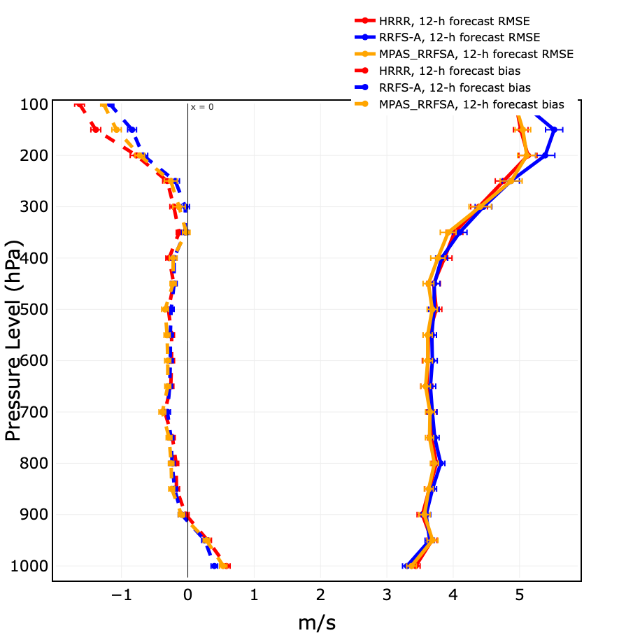
Upper-Air Verification – Wind Speed
HRRRv4
RRFS-A
MPAS-RRFSA
Period: 16 April – 16 August 2025
12-h forecasts
RMSE
Bias

Slide 8
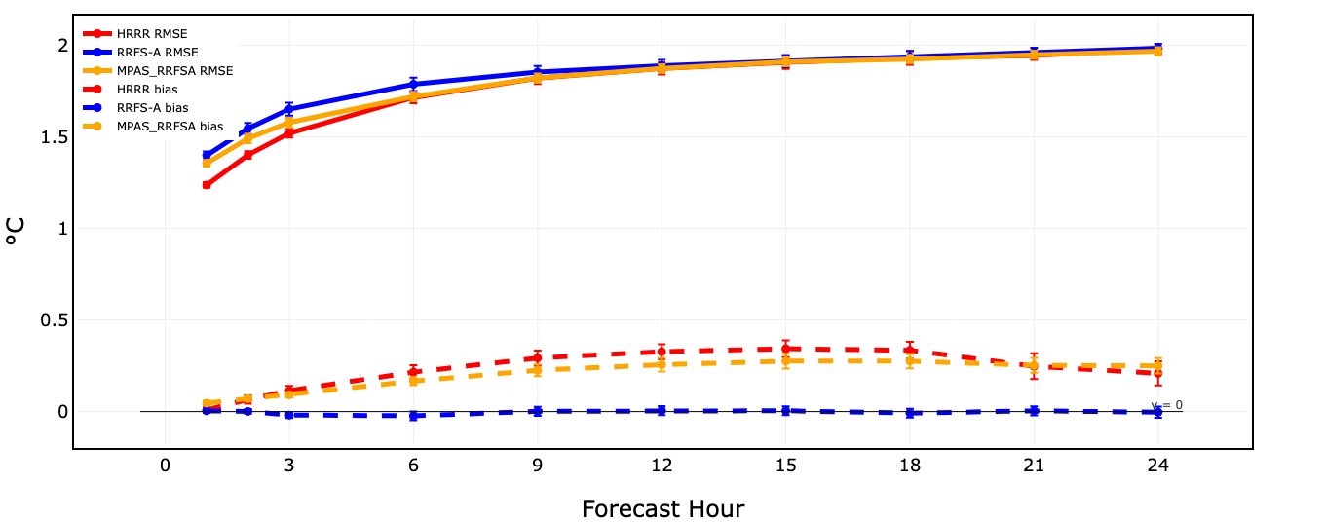
Surface Verification – 2-m Temperature
Note that RRFS-A uses a different 2-m diagnostic computation method.
HRRRv4 RRFS-A MPAS-RRFSA
Period: 16 April – 16 August 2025
0-24 h forecasts
RMSE
Bias
Notes:
Note the significant change in diagnostics between HRRR/MPAS-RRFSA and RRFS-A – the former two use a flux-diagnostic method for T/Td whereas the latter uses an interpolation-diagnostic method. The two are not very different with respect to temperature.

Slide 9
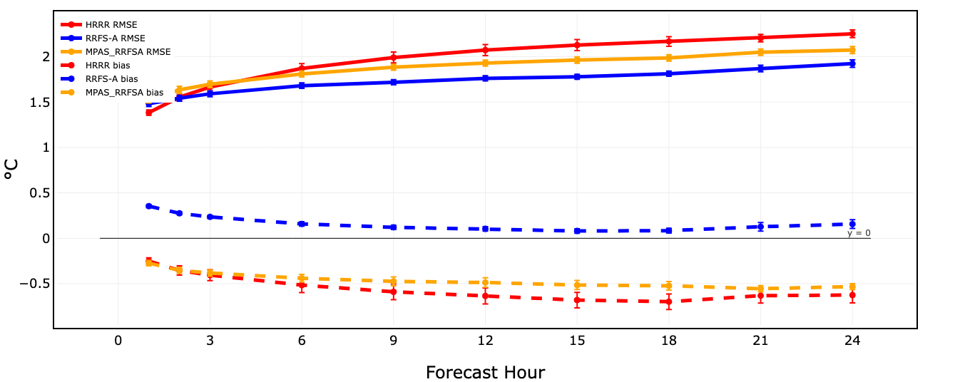
Surface Verification – 2-m Dewpoint
Note that RRFS-A uses a different 2-m diagnostic computation method. It is far too moist in the western US in the warm season.
HRRRv4 RRFS-A MPAS-RRFSA
Period: 16 April – 16 August 2025
0-24 h forecasts
RMSE
Bias
Notes:
Note the significant change in diagnostics between HRRR/MPAS-RRFSA and RRFS-A – the former two use a flux-diagnostic method for T/Td whereas the latter uses an interpolation-diagnostic method. The latter tends to result in substantially higher 2-m Td, masking the model’s overall dryness (and affecting the DA – the obs end up lower than the model first-guess, so the DA dries it out, even as that’s not warranted apart from this diagnostic). The flux method is believed to be more realistic.

Slide 10
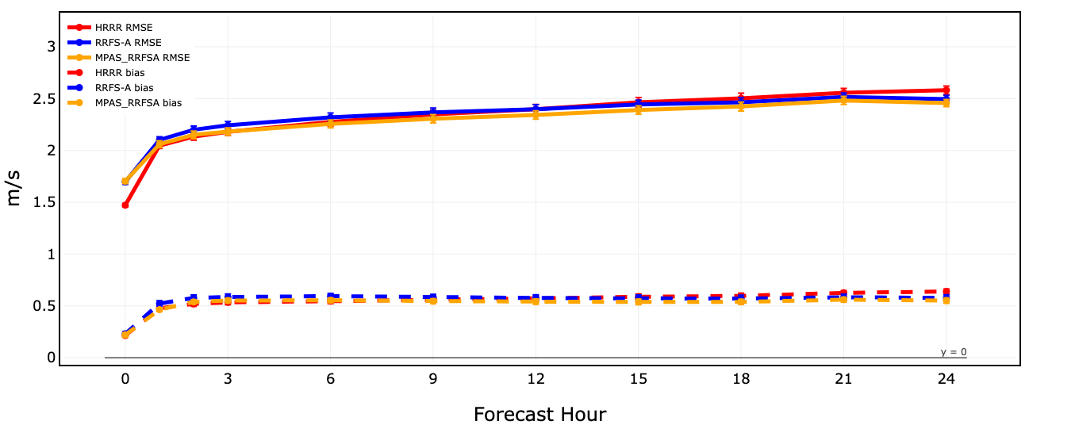
Surface Verification – 10-m Wind Speed
HRRRv4 RRFS-A MPAS-RRFSA
Period: 16 April – 16 August 2025
0-24 h forecasts
RMSE
Bias
Notes:
Extensive testing, evaluation, and development tied to WFIP3 have resulted in substantial positive impacts to near-surface winds in the MPAS_RRFSA forecasts.

Slide 11
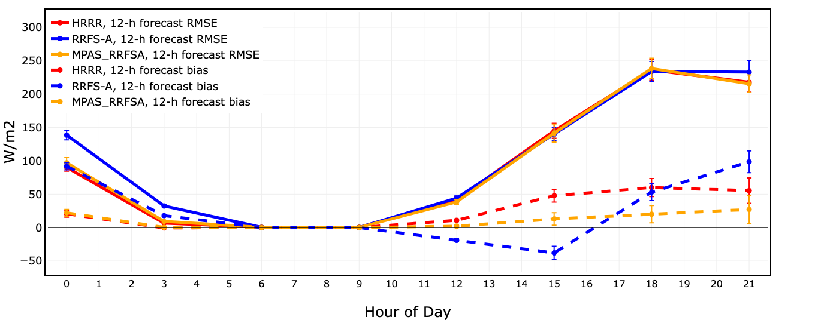
Shortwave Radiation Verification
RRFS-A appears to have a ~30-min radiation time lag that affects its shortwave radiation representation.
Period: 16 April – 16 August 2025
12-h forecasts
HRRRv4 RRFS-A MPAS-RRFSA
RMSE
Bias
Notes:
The MPAS_RRFSA dry bias may partially influence the positive SWdown biases seen here.

Slide 12
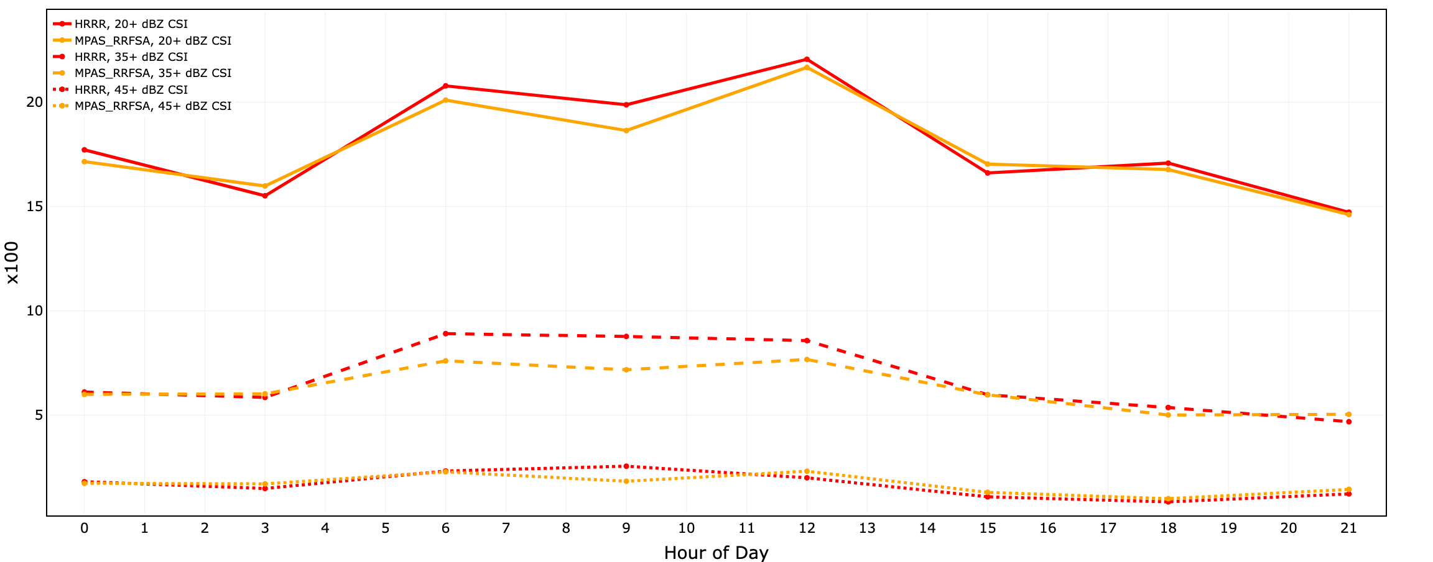
Composite Reflectivity Verification
Primary MPAS_RRFSA shortcoming vs. HRRRv4 (apart from cold-start with no DA) is with the persistence of convection through the overnight hours.
(UTC)
HRRRv4 MPAS-RRFSA
Period: 16 April – 16 August 2025
12-h forecasts
20+ dBZ
35+ dBZ
45+ dBZ
Notes:
Note that 2025 RRFS-A data are not available in our radar or precipitation verification applications, so these results focus on HRRRv4 vs. RRFS-A. As years of development and field evaluations have noted, however, high reflectivity cores and extreme precipitation amounts are known as weaknesses for RRFS-A, preventing it from replacing HRRR in the operational modeling suite, so HRRRv4 is a better evaluation for MPAS_RRFSA anyway.

Slide 13
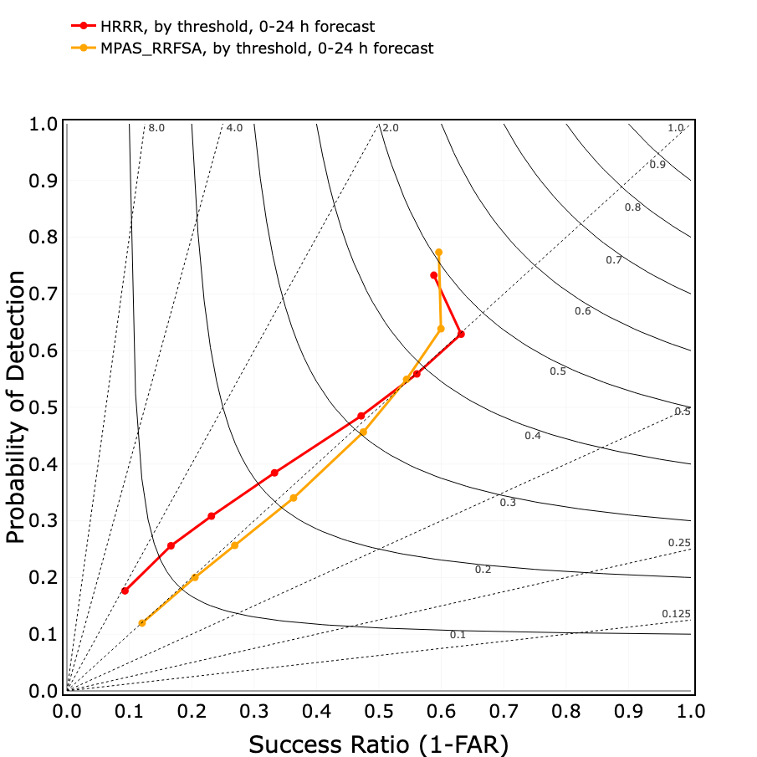
Precipitation Verification
HRRRv4
MPAS-RRFSA
0.01”
Period: 16 April – 16 August 2025
0-24 h forecasts
0.10”
0.25”
0.50”
1.00”
1.50”
MPAS_RRFSA has higher skill at the lightest accumulation threshold and comparable skill at 1”+ thresholds, with slightly degraded skill for 0.1-0.5” thresholds.
2.00”
3.00”
Notes:
Again, no DA!

Slide 14
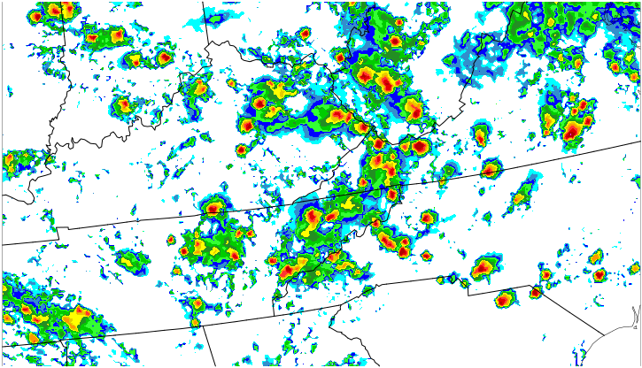
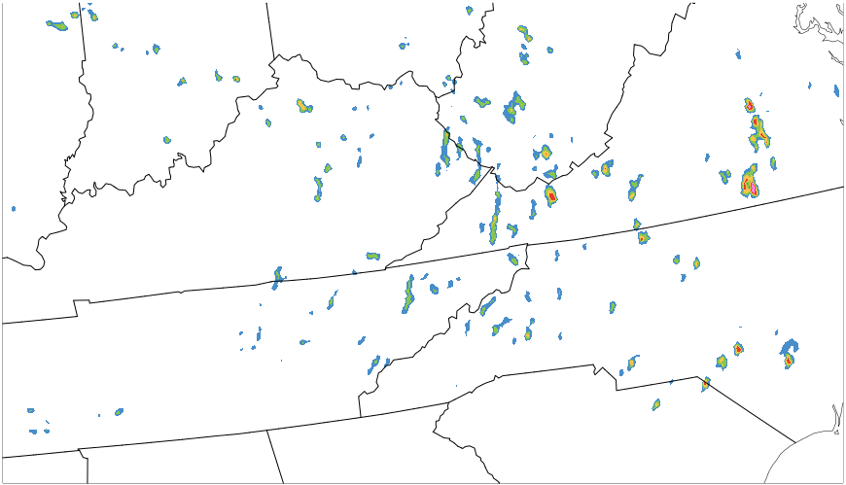
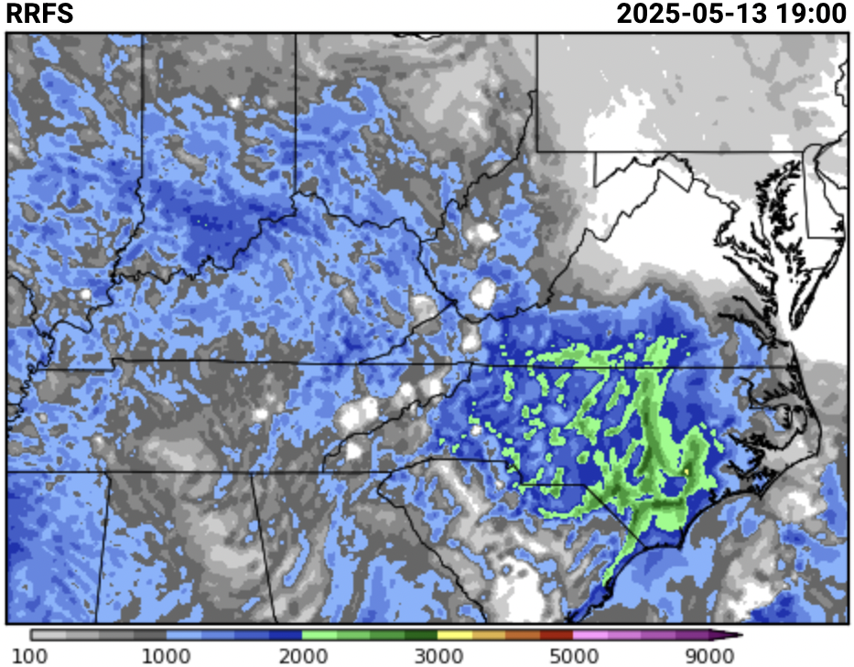
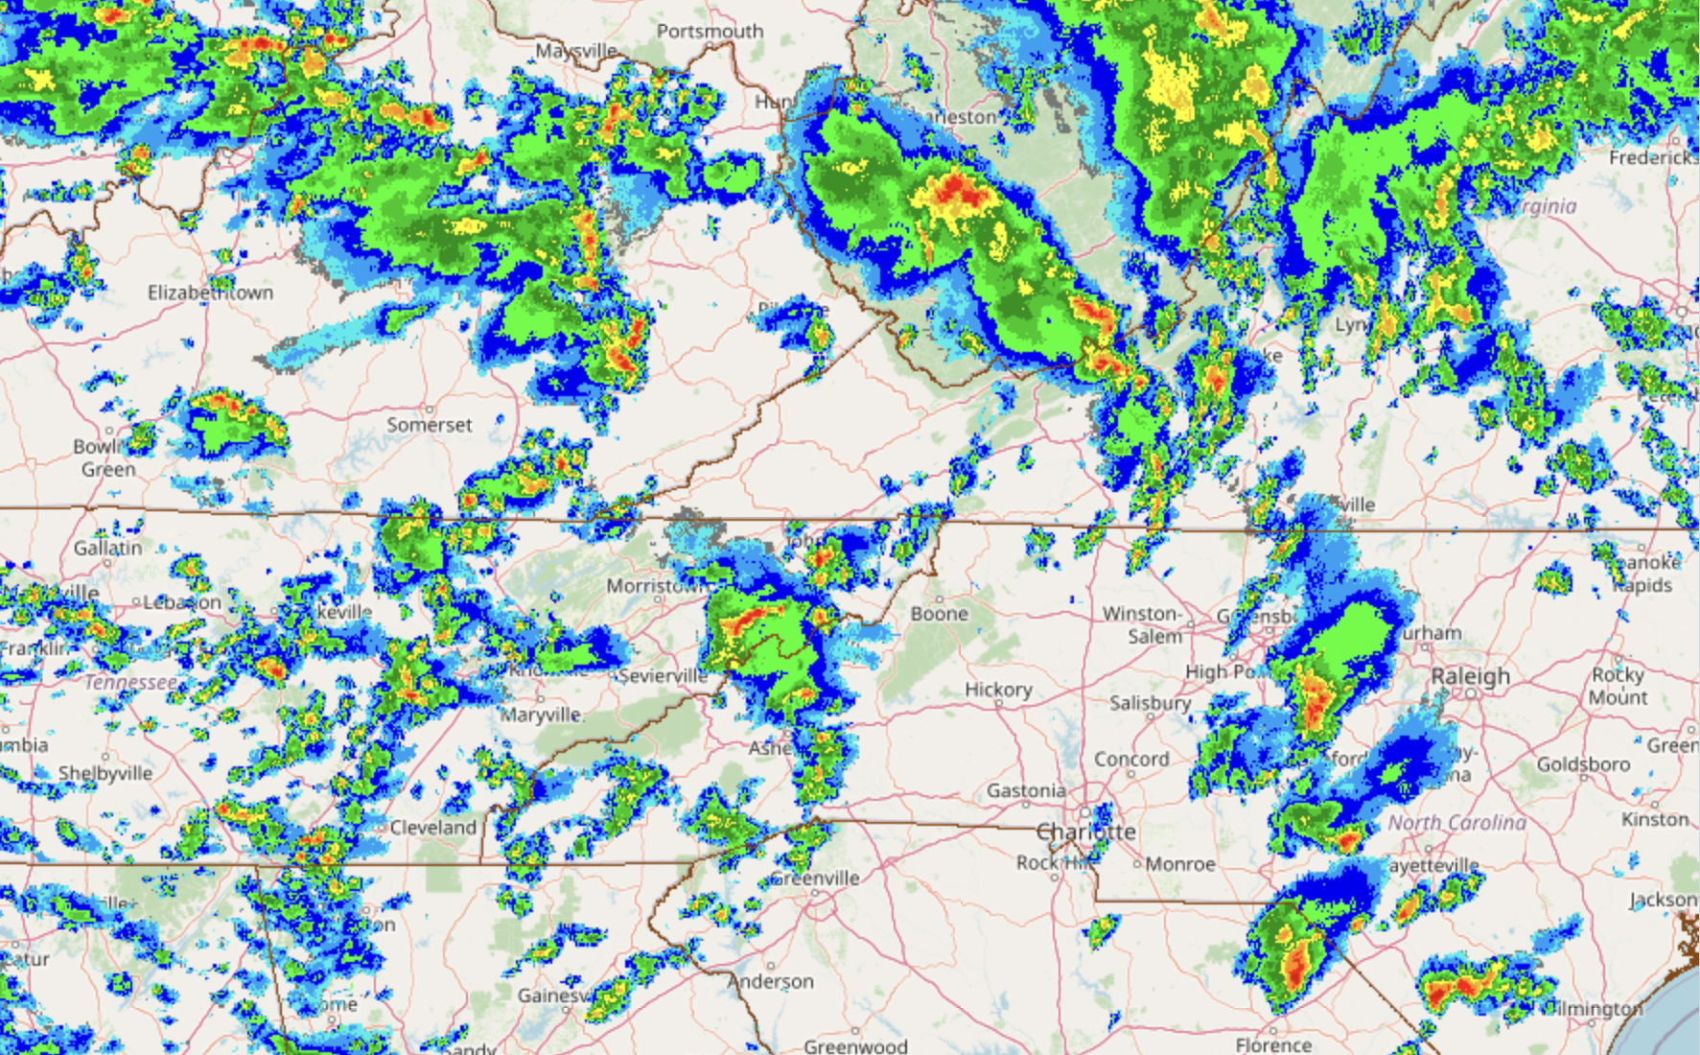
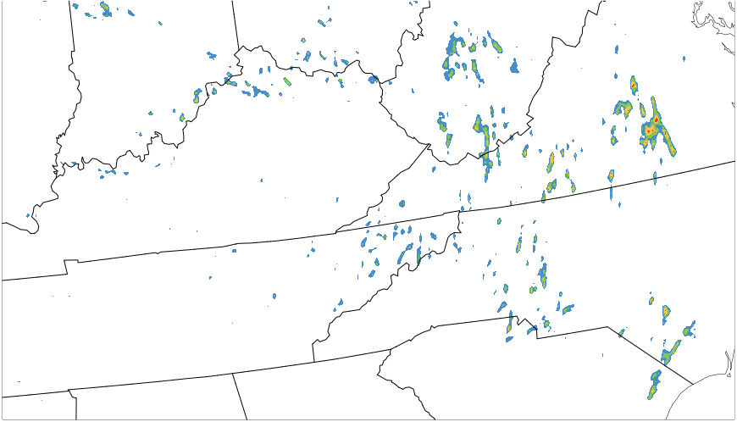
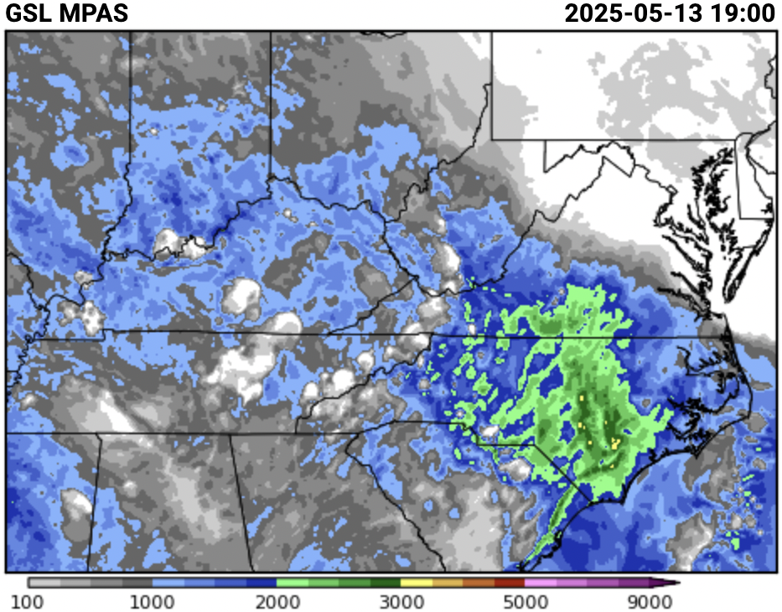
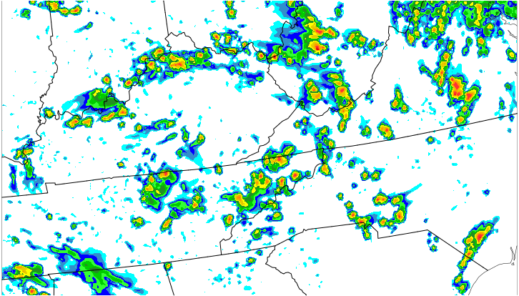
MPAS_RRFSA vs. RRFSv1 Comparison
composite reflectivity 20Z
max vertical velocity 19-21Z
surface-based CAPE
RRFS (FV3)
RRFS (FV3)
obs (MRMS)
MPAS
m s⁻¹
MPAS
Notes:
A major advantage of MPAS vs. the FV3-based RRFS v1 prototype is its convective representation. Here’s a representative example from this year’s Spring Forecasting Experiment, on May 13th, with scattered convection in association with a slow-moving upper-level low over the southeast United States. Whereas the RRFS depicts many small-scale intense convective cells (middle and right panels) in this moderately unstable environment (left panels), MPAS depicts more-realistic convective structures. R&D is ongoing to improve the representation of more-intense convective cores, including their reflectivity and updrafts, with promising results in real-time parallel tests.

Slide 15
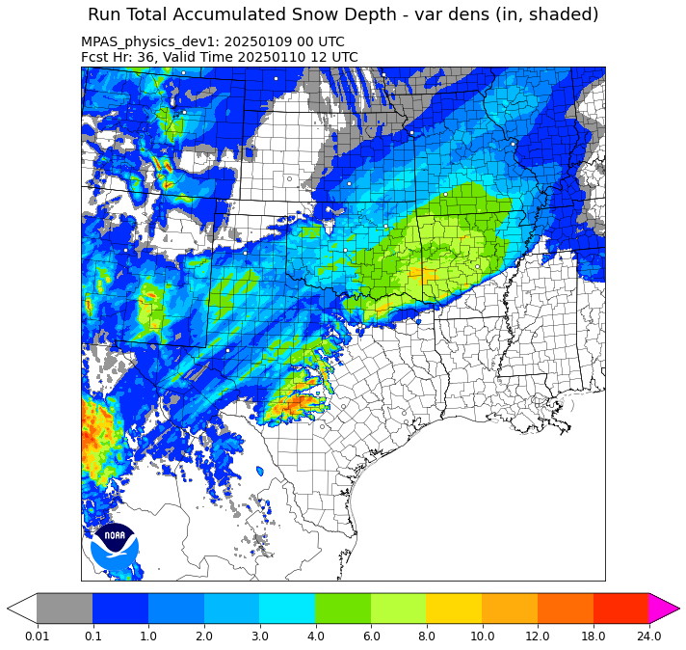
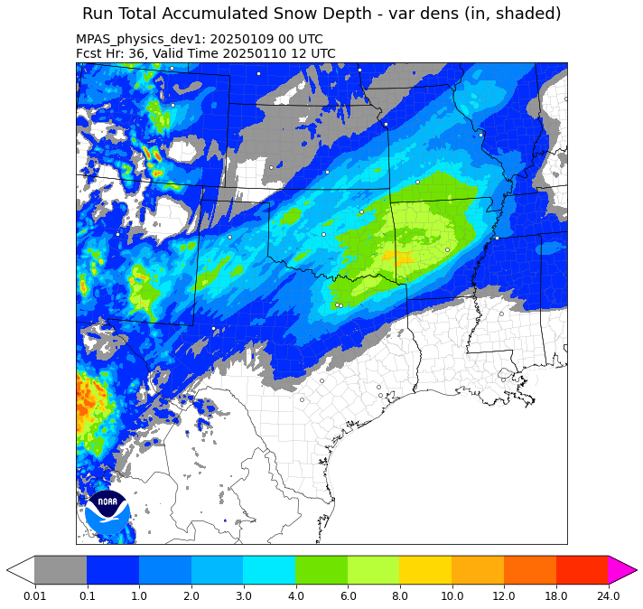
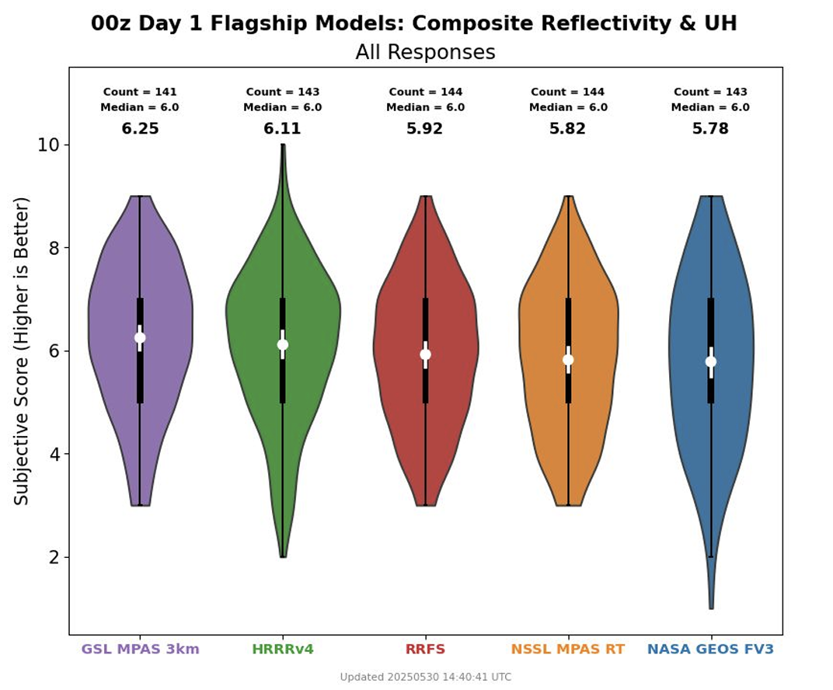
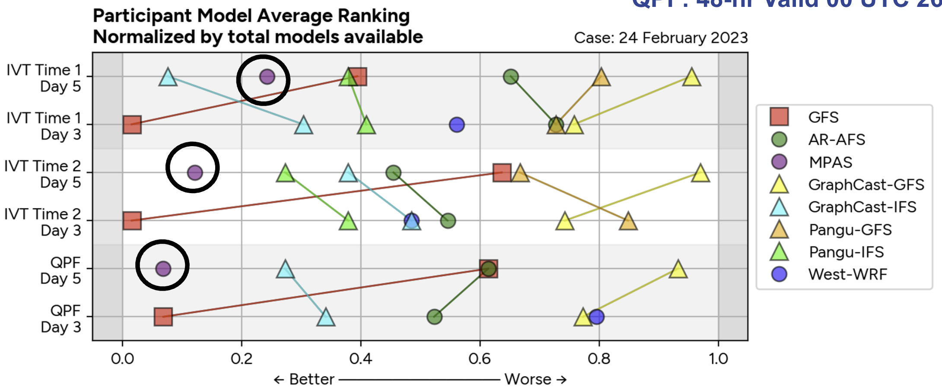
Testbed Evaluations
2024-25 WPC Winter Weather Experiment
GSL MPAS
0-36 h forecast
accumulated
snow depth
2025 HWT Spring Forecasting Experiment
before bug fix
after bug fix
2025 WPC Precipitation Experiment for Atmospheric Rivers
Routine testbed evaluations help us identify bugs and understand model system performance, helping to make forecasts better.
Notes:
The SFE example: the Deterministic Flagships evaluation has taken place each year since 2016. Through 2024, the HRRR – versions 2 through 4 – received the top rating in each year. This is the first year in which it has been bested. (This held for day 2 as well!)
The WWE example: erroneous accumulations of winter precipitation were noticed in GSL MPAS forecasts during week 1; a bug in the LSM driver was found during week 2 and fixed for the remainder of the experiment.
The PEAR example: MPAS forecasts of two atmospheric river events were routinely rated the at or near the highest by forecast participants across forecast elements (IVT, QPF) and lead times.

Slide 16
Regional JEDI-Focused MPAS Forecast Systems
GSL is also currently running three real-time regional CONUS MPAS + JEDI forecast systems:
MPAS_dev3 (cycling and reproducibility tests): 3-km; twice daily at 0000/1200 UTC to 12 h, with hourly cycling between 0100-1100 UTC and 1300-2300 UTC.
MPAS_dev4 (JEDI 3DVar/3dEnVar tests): matches dev3, except with DA of selected observations in the hourly cycling periods (using the GEFS forecasts for 3DEnVar).
MPAS_conus12km (JEDI 3DEnVar tests): matches dev4, except at 12 km and using a 30-member ensemble (initialized from GEFS 30-h forecasts twice daily) for hourly DA with 3DEnVar.
The breadth of observation types assimilated with JEDI continues to grow and currently includes surface, rawinsonde, aircraft, radar, and some satellite observations. Other system aspects (cloud analysis, soil adjustment) are also actively being developed.

Slide 17
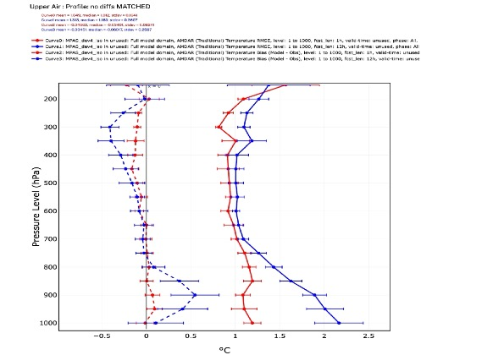
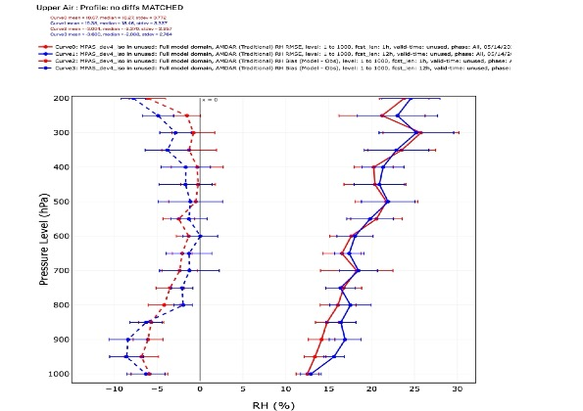
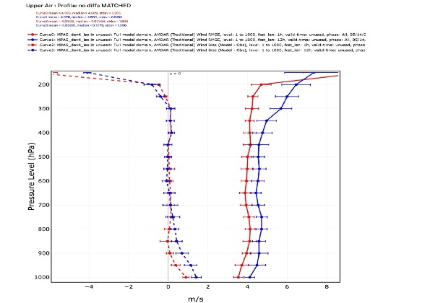
Positive Impact from MPAS-JEDI 3DEnVar of Aircraft Observations
Temperature (°C)
Relative Humidity (%)
Wind Speed (m s⁻¹)
With hourly DA
Cycling only, no DA
RMSE
Bias
Period: 14 May – 1 June
12-h forecasts

Slide 18
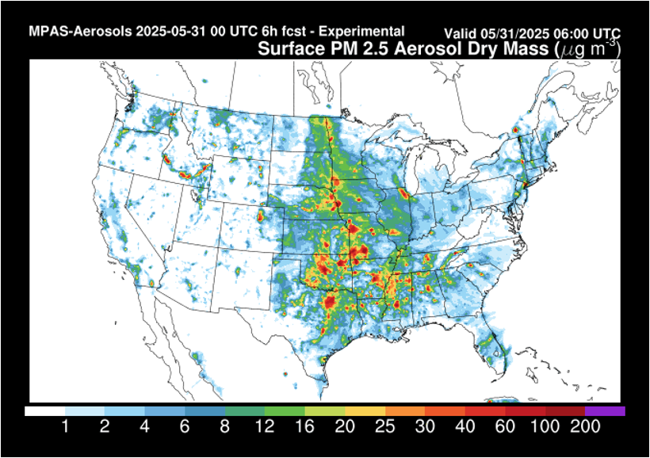
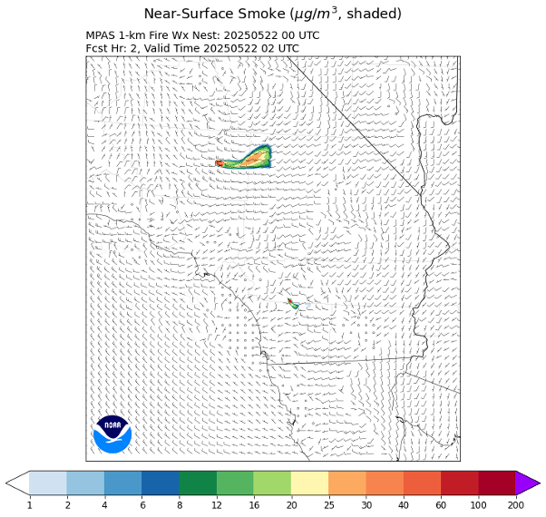
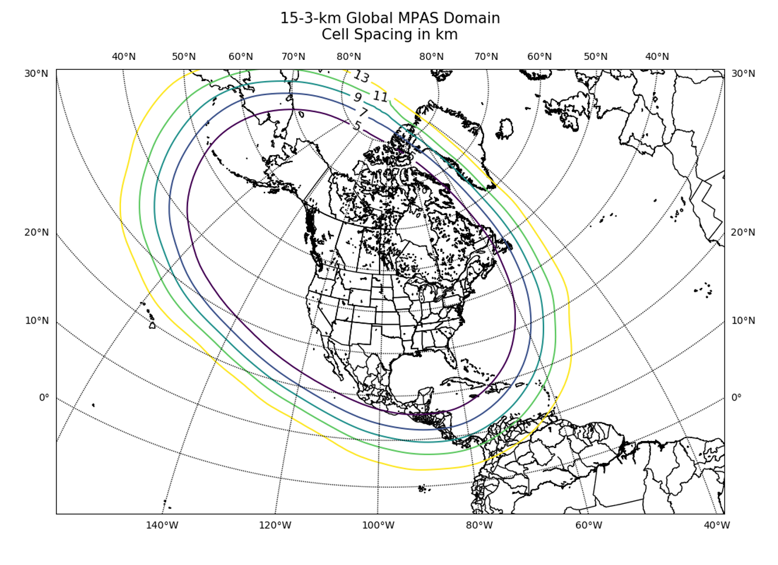
Other MPAS Applications
MPAS-Aerosols: smoke/dust/pollen+ forecasts; MPAS-Smoke/Dust is coming soon
Tropical Cyclones: real-time forecasts as part of NOAA’s HFIP in 2024 and 2025
1-km Regional: western US with RAVE emissions for fire weather; also 1.25-km eastern US
Global Forecasts: including uniform- and variable-resolution prototypes
Notes:
Variable-resolution prototypes for both North America and the Atlantic basin, intended to facilitate scale-aware physics testing/development and potentially inform unification of regional and global forecast systems.

Slide 19
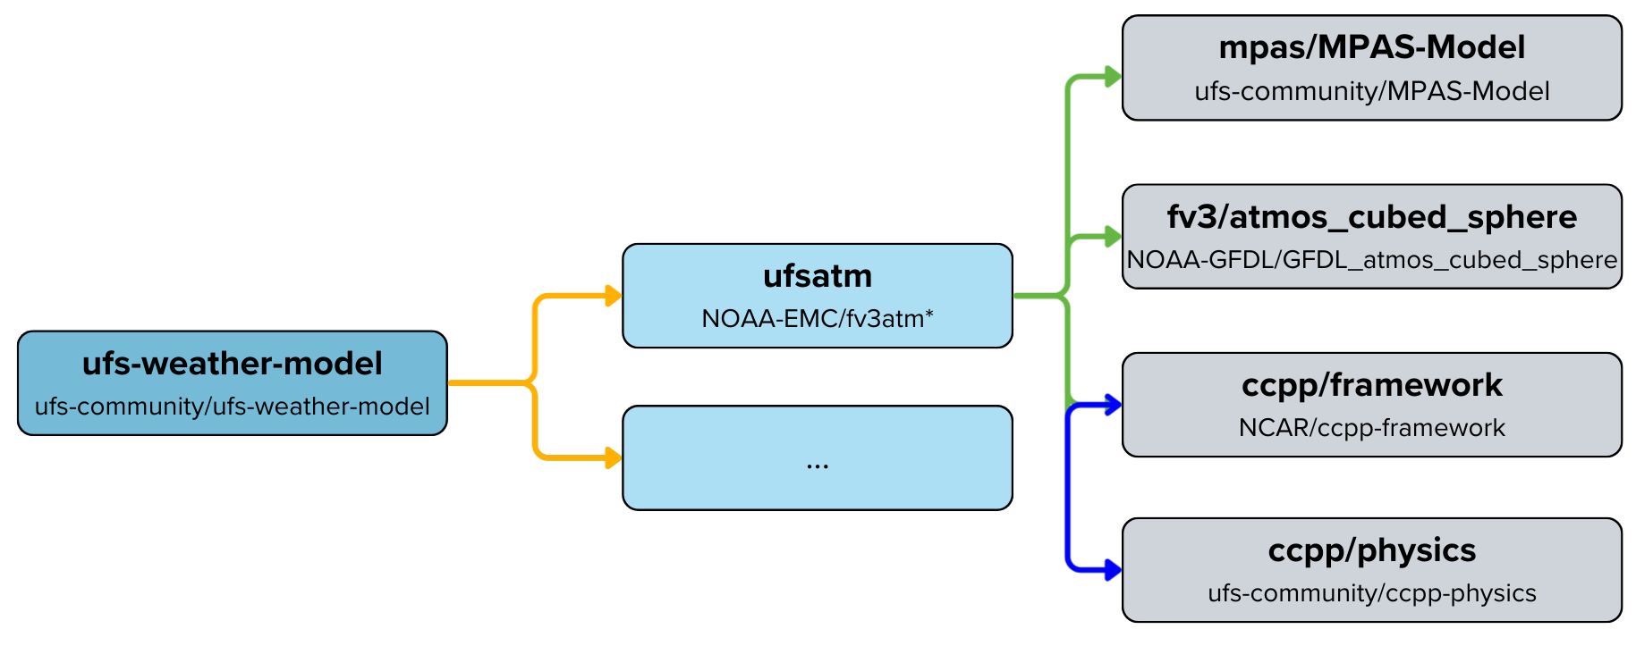
Integrating the MPAS Dynamical Core in the UFS
The UFS Atmosphere component has been generalized to accommodate multiple dynamical cores.
An initial MPAS-based atmospheric driver has been created for the UFS.
All CCPP physics parameterizations have been refactored to return tendencies rather than update the model state (needed due to differing physics-dynamics coupling for MPAS).
NUOPC/ESMF infrastructure has been created for MPAS-based UFS Weather Model forecasts.
Traditional coupling layer
ESMF coupling layer
Image courtesy Dustin Swales (NOAA/OAR/GSL).
Notes:
FV3-based UFS: Dycore is called, then physics, the tendencies from which update the state.
Standalone MPAS: Physics are called except microphysics; dycore is called with microphysics/coupling tendencies from previous timestep (and dribbled during RK3 substeps); previous microphysics tendency is removed and microphysics is called; state is updated.

Slide 20
Where do we go from here?
A top priority across NOAA for improving RRFS is the transition to MPAS.
The transition from RRFSv1 to a full MPAS+JEDI–based RRFS is likely to occur in multiple stages.
At GSL, work continues on multiple fronts toward these goals:
Advanced physics coupling and continued scale-aware physics development
Stochastic physics (SPP, SKEB, SPPT, SHUM) implementation, testing, and evaluation
Further JEDI development toward the fully cycled North America analysis system
Integration, testing, and evaluation of the MPAS dynamical core in the UFS
Scoping of optimal MPAS dynamics, numerics, and filtering options
Potential integration of Unified Workflow Tools into parts of the RRFS workflow
Thank you!
Contact: clark.evans@noaa.gov
Notes:
Advanced physics coupling: improvements to microphysics-radiation-aerosol representation; NoahMP + MYNN surface layer, prognostic cloud scheme using MYNN-EDMF turbulence to diagnose partial clouds consistent with TEMPO microphysics

