Slide 1
A Discussion on Sustaining SRW/CAM Development Agility
While Advancing UFS Capabilities
Moderated by Curtis Alexanderª
Jacob Carley^{b}, Kate Fossell^{c}, Christiane Jablonowski^{d}, Matthew Pyle^{b}, Louis Wicker^{e}
ªNOAA/Global Systems Laboratory (GSL), Boulder, CO
^{b}NOAA/Environmental Modeling Center (EMC), College Park, MD
^{c}NSF National Center for Atmospheric Research (NCAR), Boulder, CO
^{d}University of Michigan (UM), Ann Arbor, MI
^{e}NOAA/Natioonal Severe Storms Laboratory (NSSL), Norman, OK
Center Green Auditorium, Boulder, CO
September 11, 2025

Slide 2

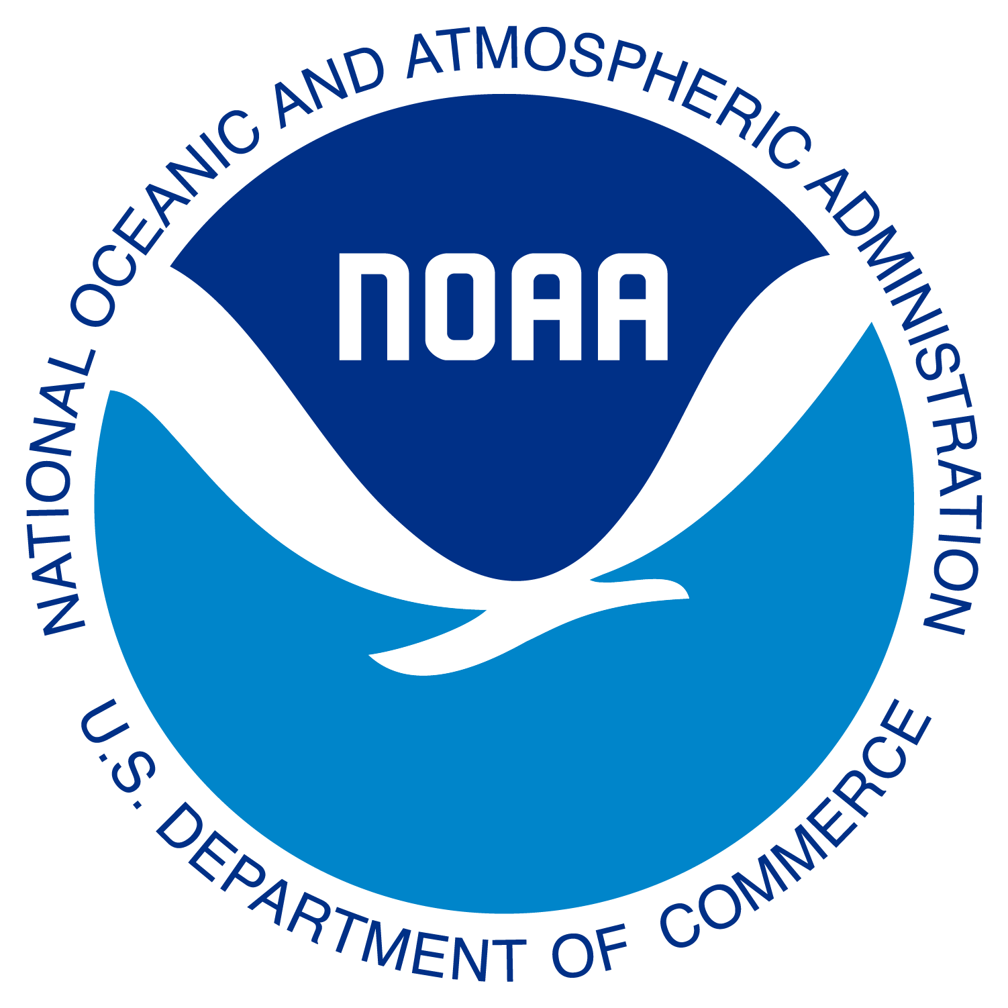
Current Challenges to Agile R20 in the UFS
| National Oceanic and Atmospheric Administration | U.S. Department of Commerce

Slide 3
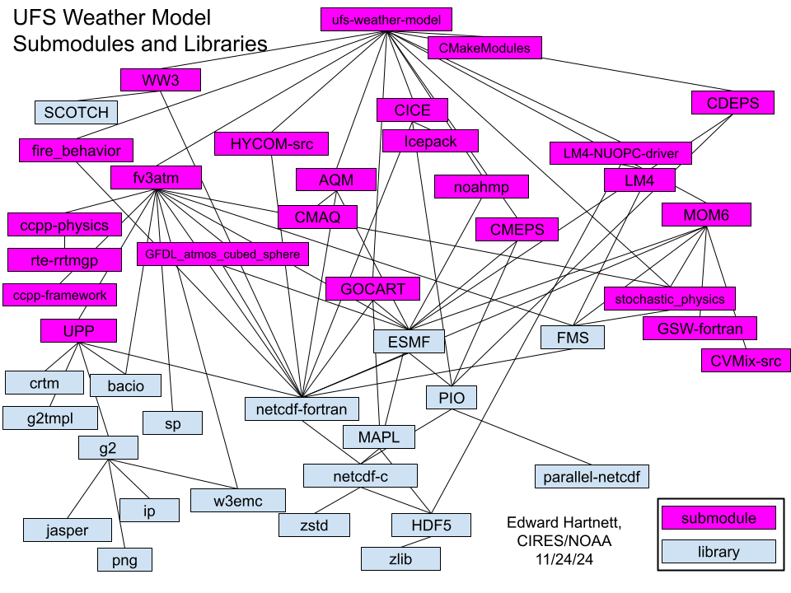
UFS Software Stack is VERY deep…and a highly coupled code base…
HPC Resource Challenges
RDHPCS: every system is setup differently
RDHPCS: containers only supported on three systems
Cloud support - support only on AWS (e.g., Azure?)
Simple issues are problematic (e.g., old Intel versions)!
Min support for non-NOAA (e.g., university or NSF) systems
Outcome: Need to first get access to the “right” resources, but even then it can be hard to get started!
R&D User Challenges
Large number of packages needed to get running
Submodules: Come from external orgs, different resources, different priorities, (e.g., documentation?)
Development often requires altering more than just “your” code (e.g., downstream dependencies)
How to TEST this system using CI? With what resources?
UFS PR requests: Do we have the proper resources?
Outcome: New capabilities are never transferred back into ops?

Slide 4
Some ideas…
Improving R20 User Tools?
Standardize build tools and a single set of external libs that internal and external users have access to!
Those tools need to run everywhere, all RDHPCS, all major cloud vendors, all Linux-based HPC
New tools enabling users to isolate processes and test ideas!
Example: Hierarchical Testing Framework for the Unified Forecast System (UFS, DTC and EPIC)
Prioritize Software Designs that Reduce Complexity for Users
Create standalone pieces that can combine to create coupled earth-system prediction capabilities
Reduce technical debt: Build applications that have minimal software requirements - stop adding more frameworks!
Opportunity: MPAS builds and runs using either UFS infrastructure or in stand-alone!
Balancing the complexity needed for operational systems in R2O cycle when:
There are limited resources with NOAA to support our internal HPC, much less external HPC configurations for R20.
Mounting technical debt overwhelms user’s ability to quickly start and innovate.
Resources for testing components and for CI/CD are extremely limited.
Unclear organizational governance
An agile R20 environment facilitates CI/CD for UFS developers by removing barriers from build to pull request!

Slide 5

Transforming the Development and Implementation Lifecycle
Bringing agility, reliability, and efficiency to implementations
| National Oceanic and Atmospheric Administration | U.S. Department of Commerce

Slide 6
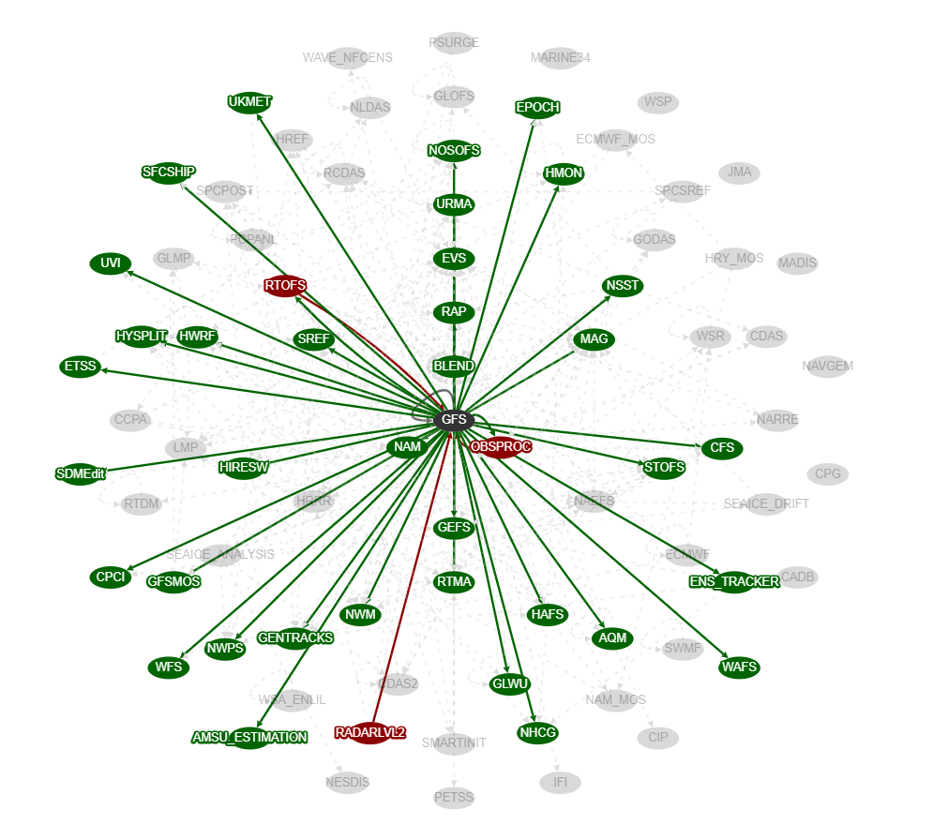
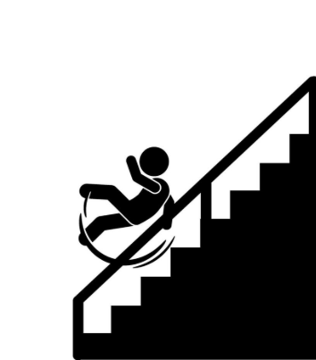

The Current Dev and Ops Lifecycle is Slow, Risky, and Outdated
Requirements
Design
Development
Testing
Deployment
Maintenance
Current State
Problem
Impact
Production suite is increasingly complex with numerous interdependencies.
Upgrades planned on anticipated scientific innovations. Progress is not linear & delays inevitable.
~2-4 years between major upgrades. High risk, burnout, and delays. Unable to keep pace with progress.

Slide 7
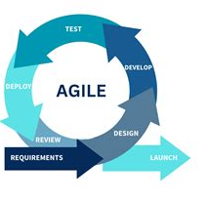
An Agile Approach
Decouple the scientific innovation timeline from the release timeline.
Bring Development and Operations closer together
Upgrades are composed of what is ready now, packaged, tested, and implemented over the course of months.
Reduces implementation risks, delivers science (value) more quickly, yielding better mission results.

Slide 8
Supplemental

Slide 9
Supporting the Foundation: Invest in Tools & Culture
From “Project Deadlines” to “Continuous Flow”
Version Source Control
Promote “Ready and deployable code”
Monitoring and Observability
Treat ToolChain as a Product
PM tools; e.g. Jira, Confluence for tracking work in sprints, Kanban, Scrum
Enterprise GitLab
CI/CD tools e.g. GitLab CI for testing and deploying
Embed Continuous Scalability and Optimization
Dedicated “DevOps” team responsible for managing, maintaining, and improving the toolchain
Invest in Talent and Technology:
Talent without the right tools will be frustrated, and tools without skilled talent will go unused.

Slide 10
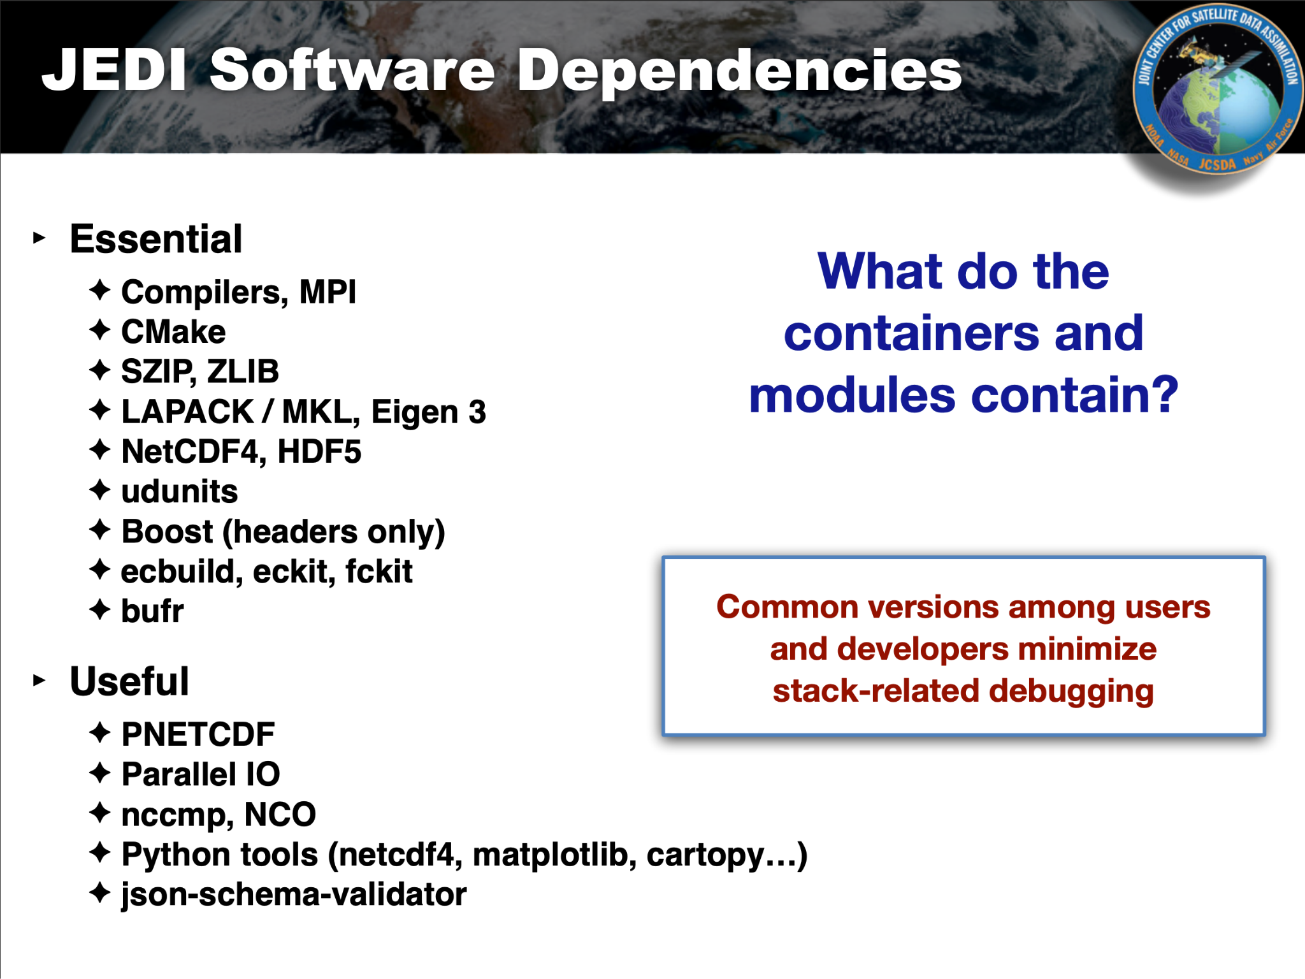
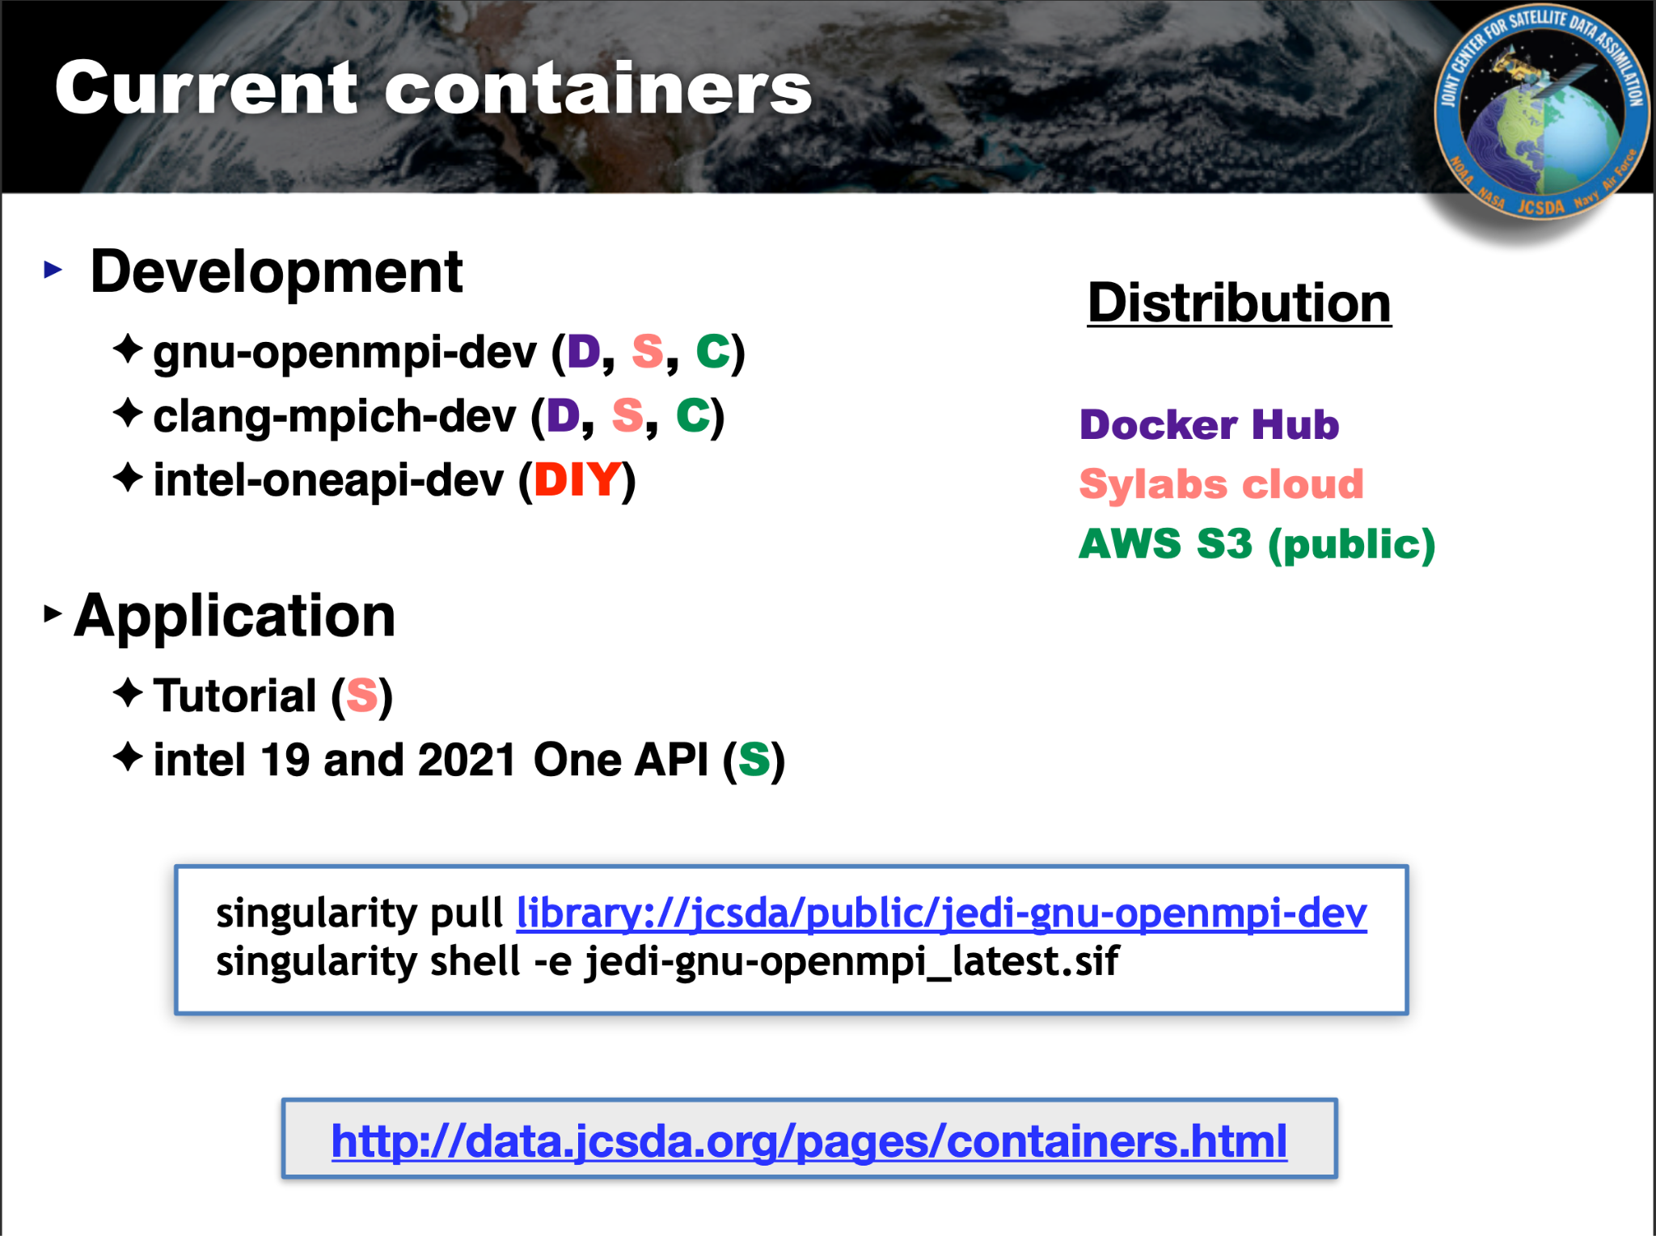
Our software stacks are very deep!
UFS SRW App - Where can it run?
RDHPCS
4 machines (Hera, Orion, Gaea, Hercules)
RDHPC Containers supported on
(Jet, Hera)
Other HPC (Derecho)
Partial support for other sys.
Cloud - only on AWS
JEDI - What does it need to run?
NOAA RDHPCS systems + NCAR
On AWS
Containers (Docker, Singularity, Vagrant)
Compilers:
Self-built stack requires
Intel 2019 or 2021 (3 years old!)
Spack (version changes yearly, nightmare!)
Workflow
Rocoto (Sys Adm install!)
ecFlow
Bash?

Slide 11
Some examples
NCAR MPAS Build Requirements
NCAR DART Build Requirements
compatible C and Fortran compiler
GNU, Intel, nvhpc, pgi, ftn, lvm, nag
Unix make
netCDF installation (PIO is no longer required)
MPI installation such as MPICH or OpenMPI
a Fortran90 compiler,
the netCDF libraries built with the F90 interface,
perl (just about any version),
an environment that understands csh, tcsh, sh, and ksh
the long-lived Unix build tool make

