Slide 1
Research to Operations (R2O) facets and how to engage in R2O to advance the UFS
Moderator: Andrea Ray - NOAA/OAR/PSL
Speakers: Kevin Garrett - Modeling Program Director, NOAA/NWS/STI
Jordan Dale - Testbeds Program Manager, NOAA/OAR/WPO
Andrea Ray - Transitions Lead and Hydromet Testbed Coordinator, NOAA/OAR/PSL, former Chair Testbeds and Proving Grounds Coordinating Committee
Center Green Auditorium, Boulder, CO
September 11, 2025
9:15 - 10:15 AM MT

Slide 2
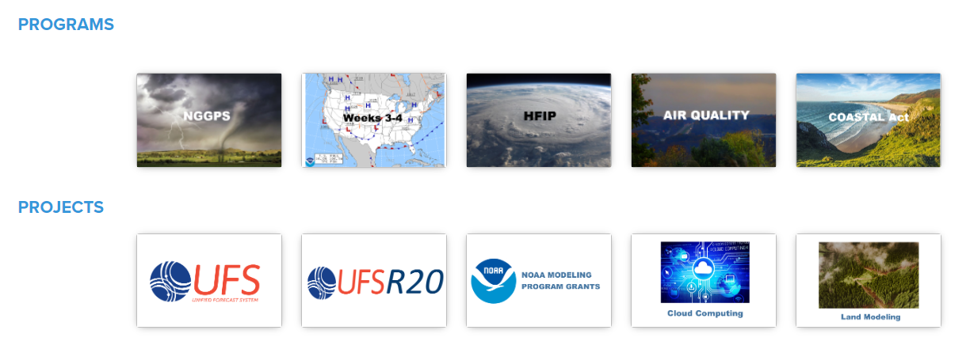
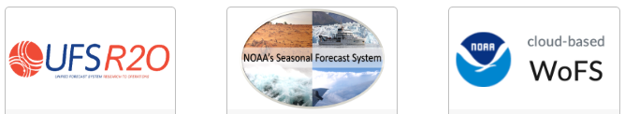
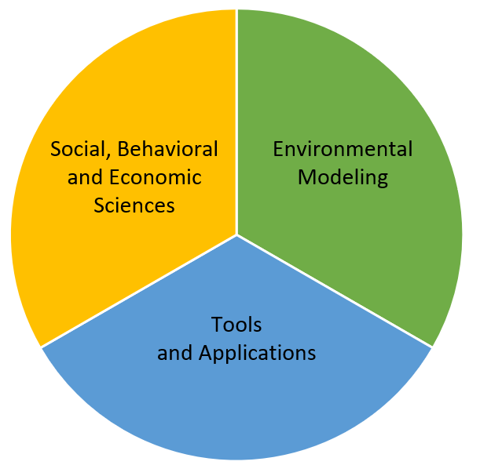
NWS OFFICE OF SCIENCE AND TECHNOLOGY INTEGRATION
STI Modeling Division
NWS/STI 10-year Vision
“Transform the NWS Mission through the Innovative Application of Science and Technology”
“Advance NWS integrated operational environmental modeling through open science to support accurate, reliable, and actionable analysis and forecast information”
NWS Modeling Programs and Project

Slide 3
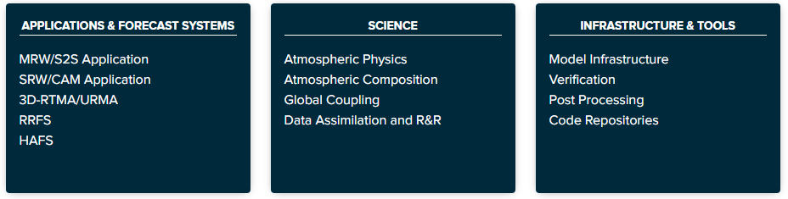
WHAT IS THE UFS-R2O PROJECT?
Transition the NWS modeling suite to Unified Forecast System applications, components, and infrastructure (integrated, fully-coupled Earth system model)
Partnerships with UFS community members and Earth Prediction Innovation Center (EPIC)
Focus on high readiness-level capabilities
Managed by NWS/Office of Science and Technology Integration and OAR/Weather Program Office
Now in Year 6
UFS

Slide 4
UFS-R2O PROJECT STRUCTURE
Project Lead
Tallapragada (EMC)
Project Engineer
Francis (OSTI)
NWS/OSTI and OAR/WPO
Garrett (OSTI), Huang (WPO), and Kondragunta (WPO)
Atmospheric Composition
Baker (ARL), Yang (EMC)
Marine Components
Meixner (EMC),
Hallberg (GFDL)
Physics and Dynamics
Yang (EMC), Bengtsson (PSL)
Data Assimilation, Reanalysis & Reforecast
Holdaway (EMC), Frolov (PSL)
Modeling Infrastructure
Bernadet (GSL), Carley (EMC)
Verification & Validation and Post- Processing
Levit (EMC), Harrold (DTC & NCAR)
MRW/S2S Integrated Application Team
Yang (EMC), Stan (GMU)
Application Teams
SRW/CAM Integrated Application Team
Alexander (GSL), Carley (EMC)
Cross-Cutting Teams
Hurricane Integrated Application Team
Gopalakrishnan (AOML), Zhang (EMC)

Slide 5
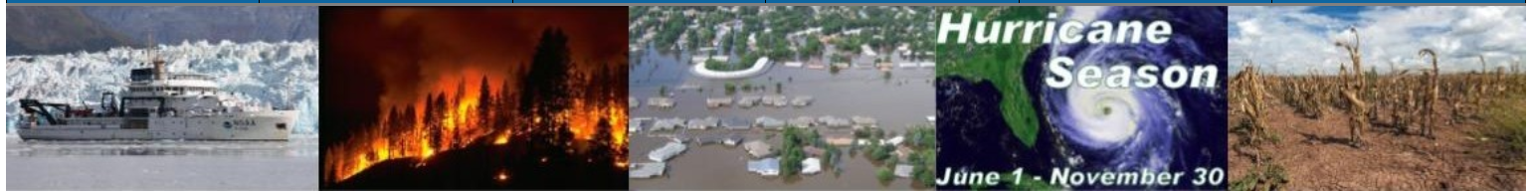
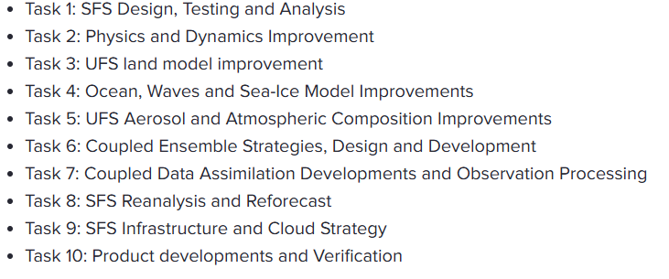
SEASONAL FORECAST SYSTEM PROJECT
Project Leads
Barton (EMC), Pegion (PSL)
NWS/OSTI and OAR/WPO
Xue (OSTI), Olsen (WPO)

Slide 6
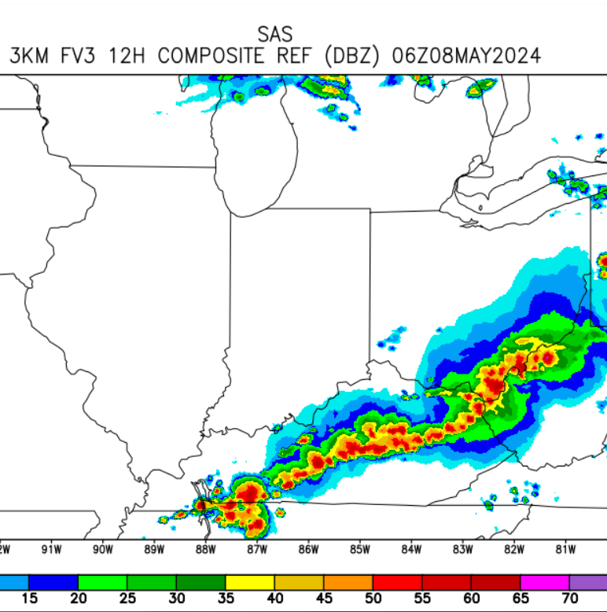
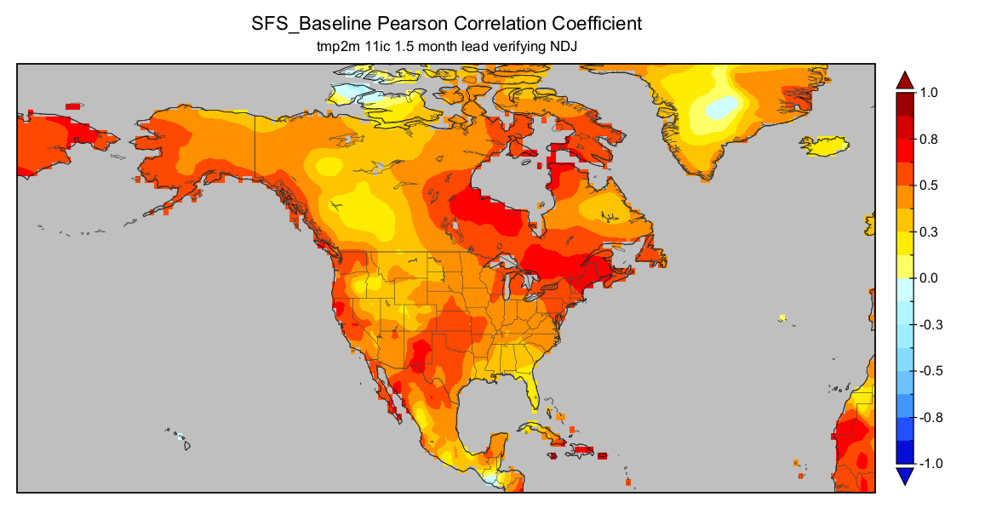
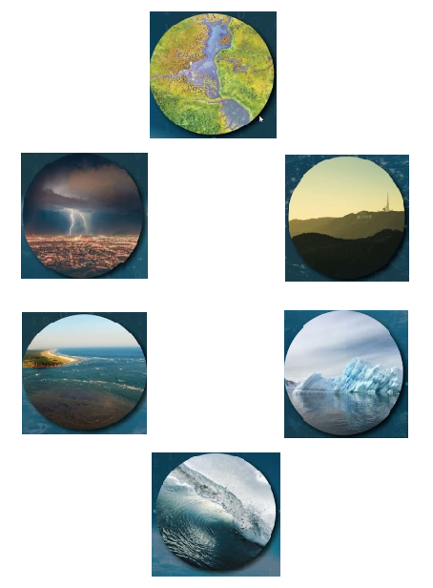
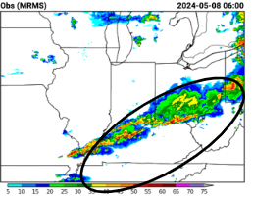
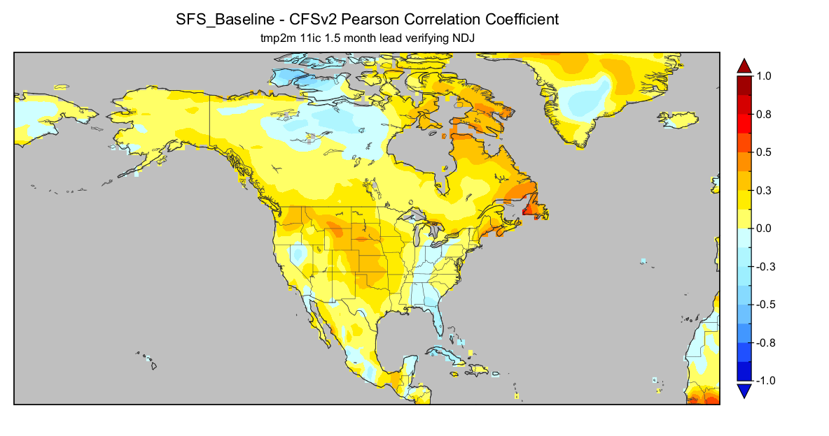
R2O OF UFS-BASED APPLICATIONS
GFS17/GEFSv13
RRFSv1
SFSv1
Noah-MP
FV3
SFS
GOCART
MOM6
CICE6
SFS-CFSv2
WW3
UFS-R2O supported project.
Multiple elements from JTTI/HSUP
Guided by implementation plans
Testbed engagement critical
STI and WPO S2S program supported project
Guided by SFS Development Plan and new Implementation Plan
UFS-R2O supported project.
Multiple elements from JTTI/other programs
Guided by implementation plans
Development and implementation plans define priorities and requirements, and inform UFS community opportunities

Slide 7
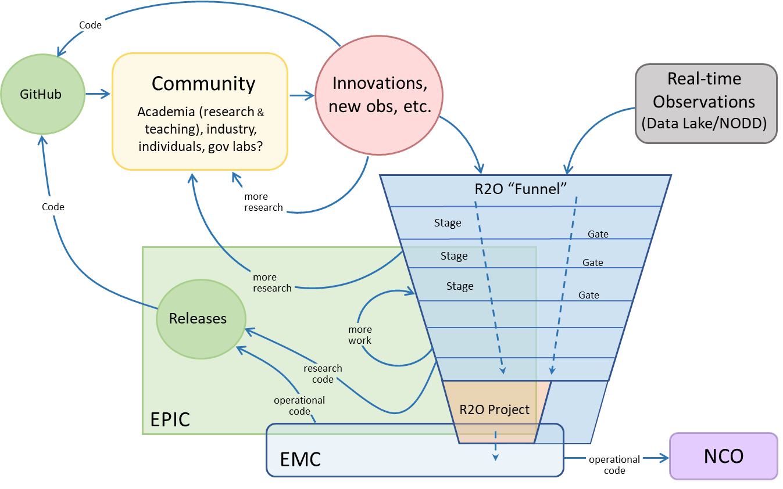
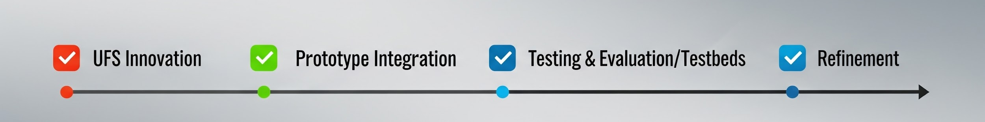
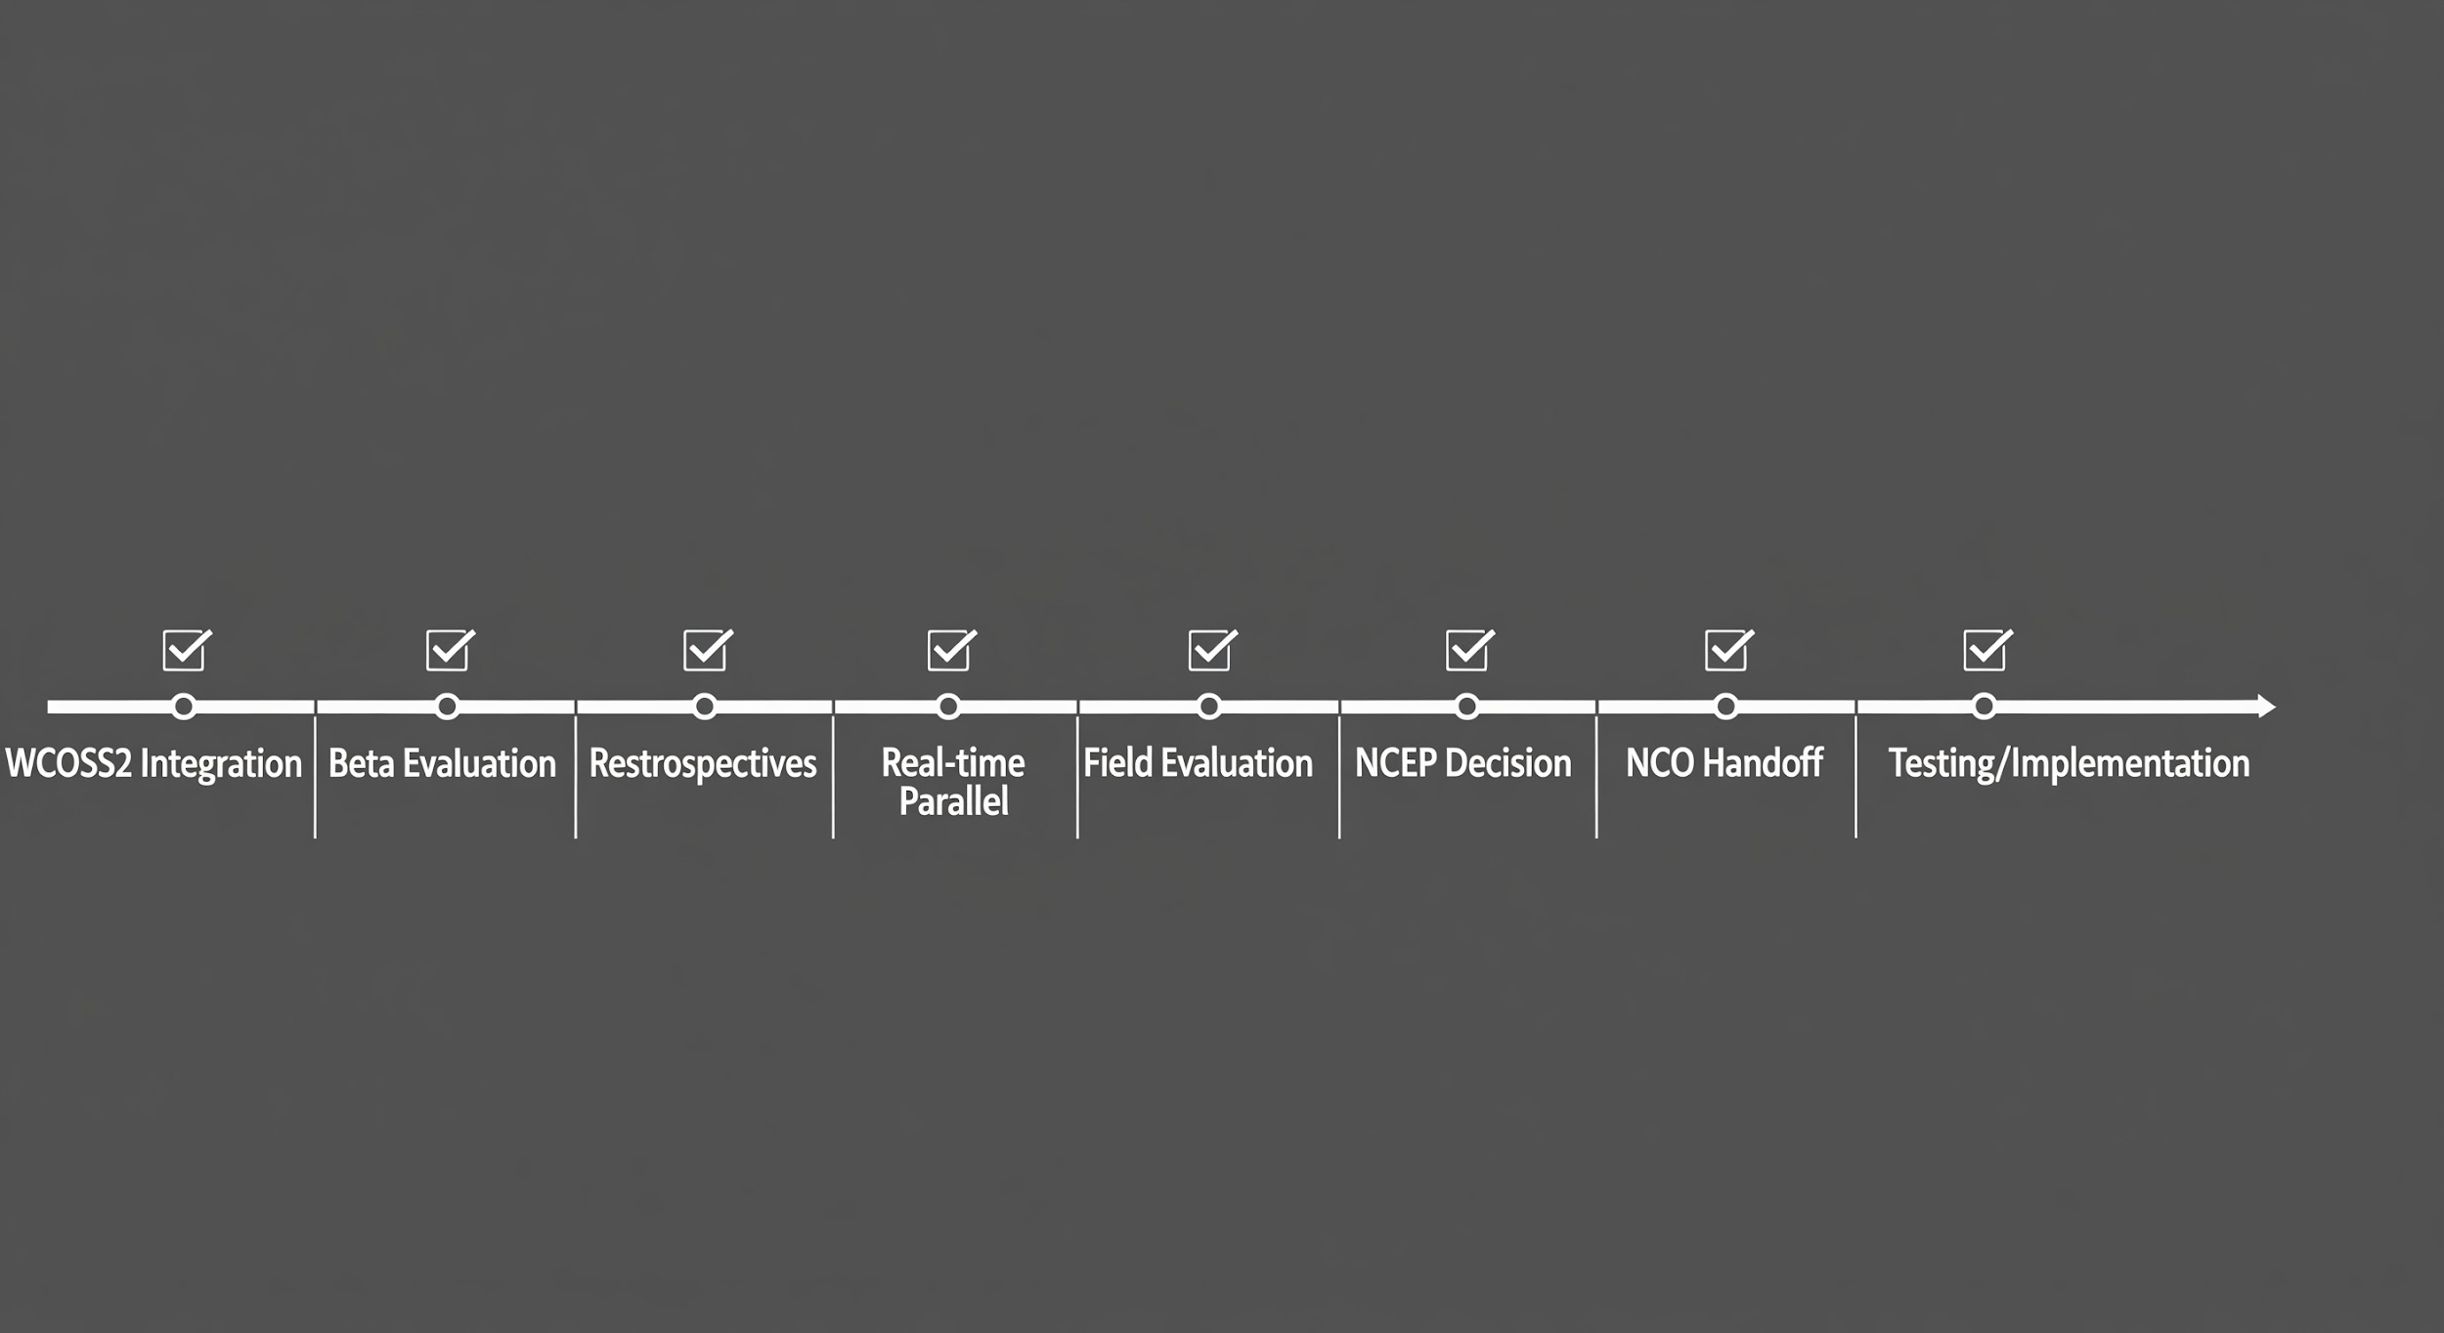
R2O PROCESS
Community Innovation
Gap between UFS community innovation and WCOSS2 integration
Requires NOAA resources
Multiple parallel efforts
Parallel changes to infrastructure, workflow
Testing & Evaluation resource intensive (beyond SCM)
New paradigm with
CI/CD?
Addressing limitations of the UFS-R2O project
NCEP Transition

Slide 8
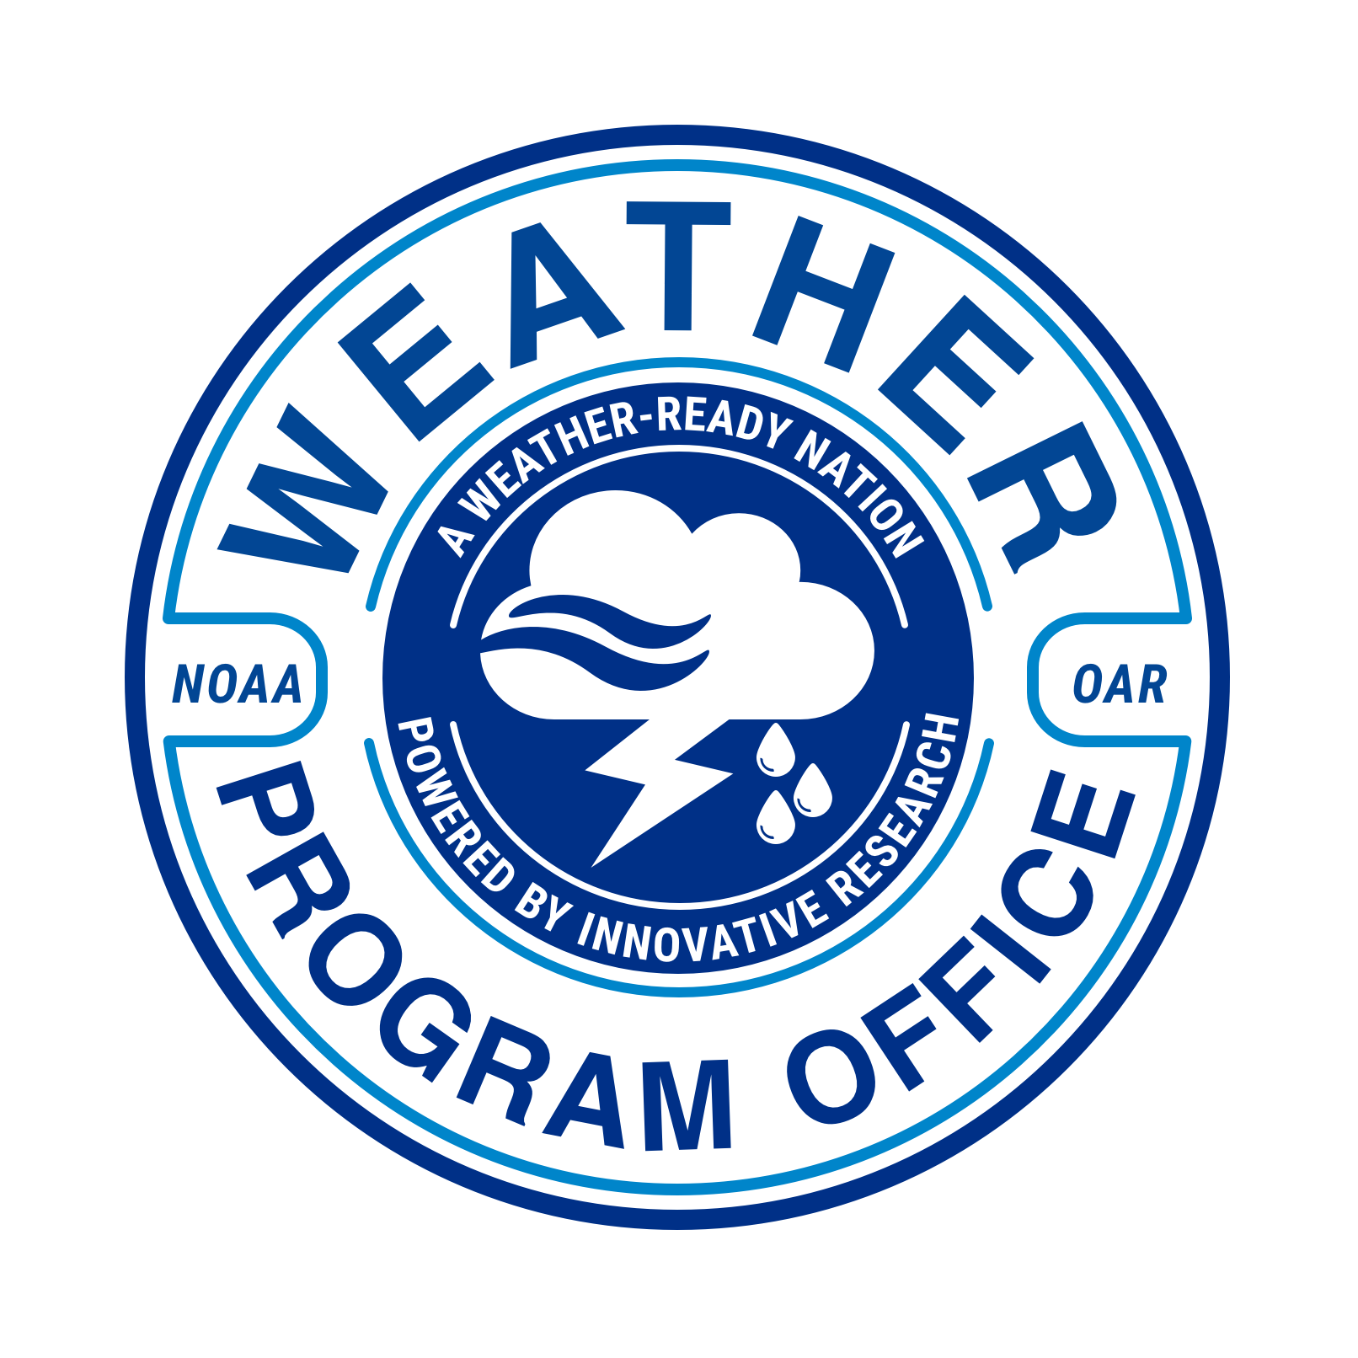
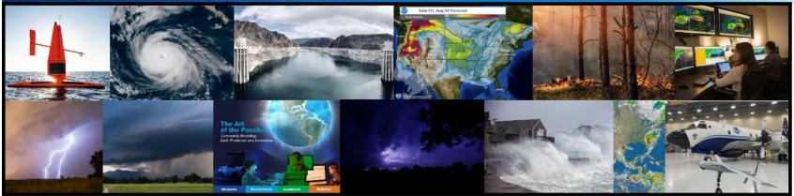
WHAT DOES WPO DO?
WE FUND RESEARCH TO IMPROVE FORECASTS
WPO SCIENCE DIVISIONS
Observations and Research Support
Observations
Supplemental Appropriations
Research Transitions
The Weather Program Office (WPO) is within the Office of Oceanic and Atmospheric Research
(OAR, also known as NOAA Research).
Our aim is to integrate world class weather research into operational forecasts for the public, support new weather applications across the Weather Enterprise, and continually improve our understanding of weather phenomena.
Earth System Research and Modeling
Subseasonal to Seasonal Research (S2S)
Earth Prediction Innovation Center (EPIC)
Air Quality & Fire Weather
Synoptic Weather
Science, Technology, and Society
Social Science Program
Joint Technology Transfer Initiative (JTTI)
Testbeds
VORTEX-USA

Slide 9

WPO AND THE WEATHER ENTERPRISE
Industry, Academia & Other Agencies
At the intersection of the Weather Enterprise, WPO works to facilitate a strong and growing weather research network throughout NOAA, while fostering collaborations with other Federal and non-Federal agencies, institutions, academia, and the private sector.
WPO funds research that supports partnerships between NOAA and the Weather Enterprise*.
NOAA Research
National Weather Service
*Comprised of academia, public sector, industry, and non-profit sectors
Weather R&D

Slide 10
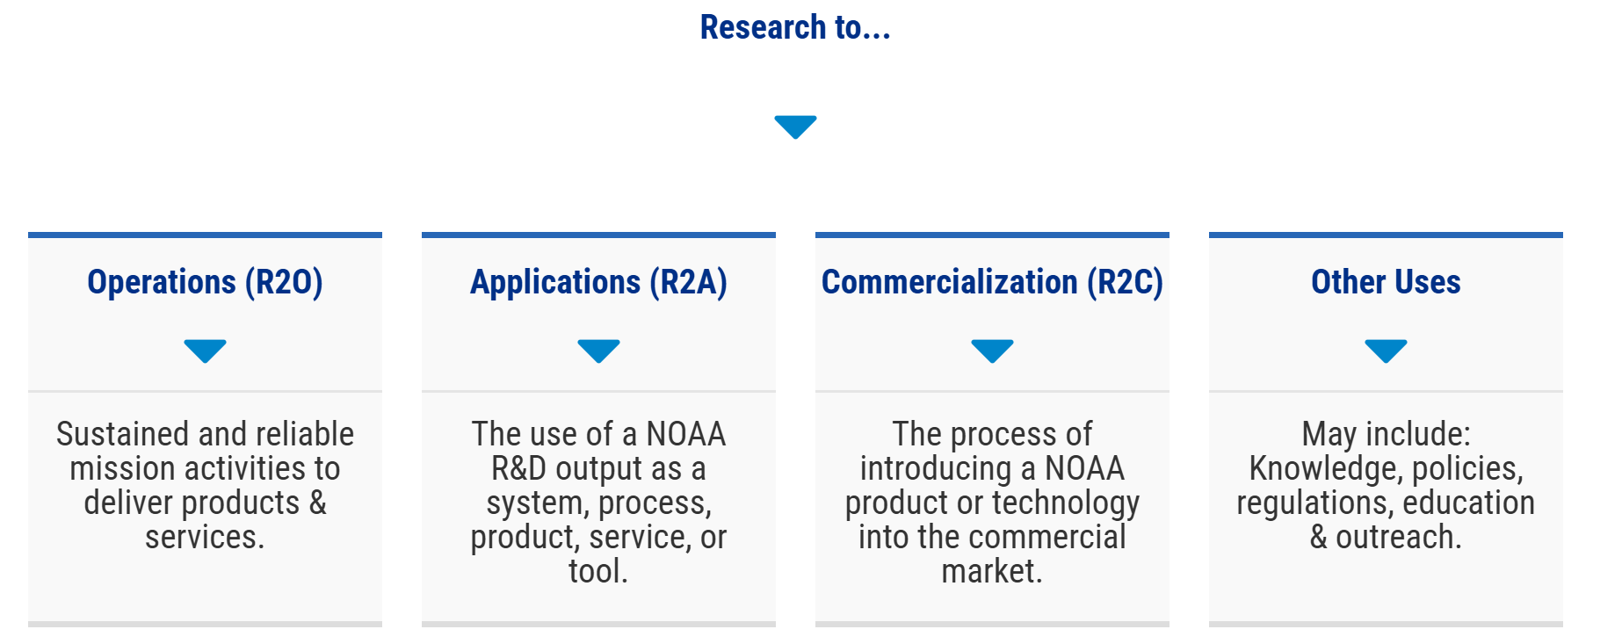
WPO’s VALUE PROPOSITION: RESEARCH TRANSITION TYPES
WPO works to ensure research outputs are useful, usable, and eventually put into practice. Engaging potential end users ahead of writing a proposal for funding can enhance the relevance and feasibility of proposed research. Partnering with end users can provide particularly valuable insights.

Slide 11

HOW CAN YOU MAKE YOUR RESEARCH MORE USEFUL TO PRACTITIONERS?
Coordination between researchers & practitioners: Partnering with potential end users EARLY ensures that research outputs are not only theoretically sound, but also practically applicable and beneficial to practitioners. This early engagement helps ensure research outputs are useful, usable, and eventually put into practice.

Slide 12
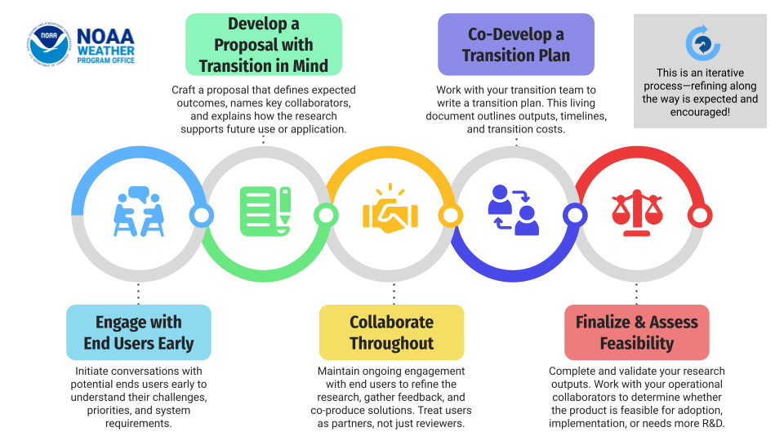
WPO’s END TO END RESEARCH TRANSITIONS STRATEGY

Slide 13
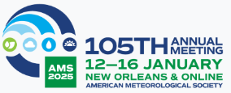
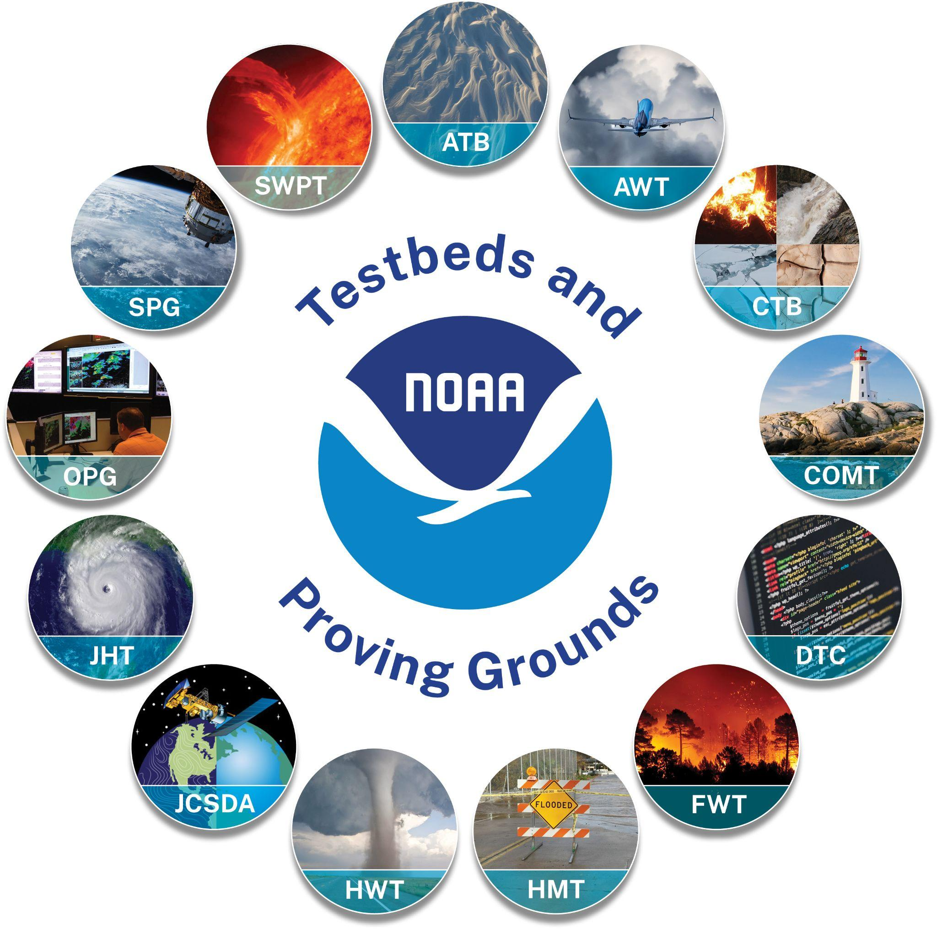
NOAA Testbeds & Proving Grounds:
Advancing probabilistic hazards forecasting for decision support
James Nelson, Chair, TBPG Coordinating Committee (NWS WPC)
Patrick Marsh, Vice-Chair (NWS SPC)
Andrea Ray, Past Chair
(OAR/PSL & HMT)
Arctic Testbed (TB) & Proving Ground (PG),
Aviation Weather TB, Climate TB, Coastal & Ocean Modeling TB, Developmental Testbed Center, Enterprise PG, Fire Weather TB, Hazardous Weather TB, Hydrometeorology TB, Joint Center for Satellite Data Assimilation, Hurricane & Ocean TB,
Operations PG, Space Weather TBPG
Notes:
Role in Advancing Hazards Forecasting for Decision Support
Hazards work across TBPGs
examples
WSSI - winter program kastman
Probabilistic Hazards HI?? see PHI talk

Slide 14
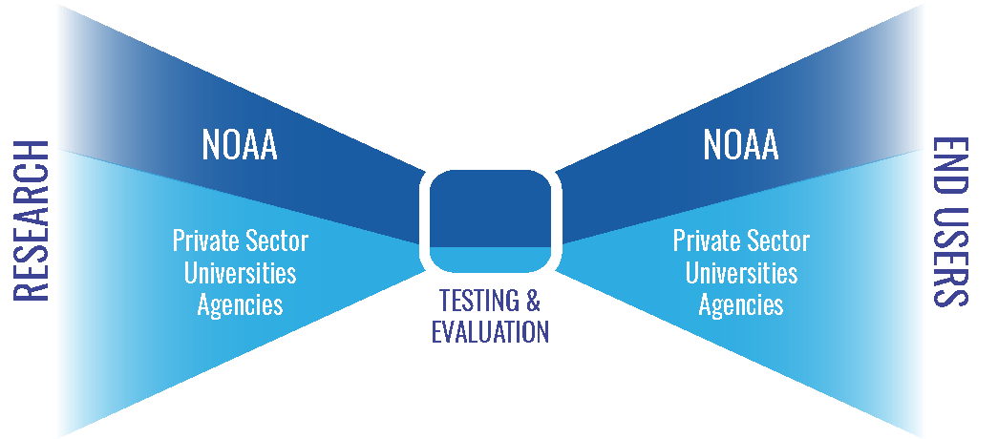

Testbeds & Proving Grounds (TBPGs) sit at a
critical node in NOAA Research to Operations (R2O)
and iteration with research (O2R)
TB & PG terms are used in other contexts, these are:
Multi-project efforts that are ongoing partnerships between research & operations, aimed at improving or creating new operations & operational products in NWS (incl WFOs and National Centers), NOS and NESDIS
TBPG’s facilitate the orderly transition of research capabilities to operational implementation through testing and evaluation (T&E)
They are a major facilitator of R2O, moving through “funnel” – and of O2R, operations informing research
Iteration and collaboration, learn things along the way
“Brings tech stuff to the world” - including post-processed and IDSS-relevant variables from model output including UFS
Online Portal: Charters & links to the 13 NOAA TB & PGs: www.testbeds.noaa.gov
Notes:
After slide from Readiness Levels workshop, May 2020, presentation by Dr. Gary Matlock; graphic from that presentation
NOAA’s mission: science, service, and stewardship
1. To understand and predict changes in climate, weather, oceans and coasts
2. To share that knowledge and information with others
3. To conserve and manage coastal and marine ecosystems

Slide 15
R2O2R in Testbeds: Integral to UFS development
Data assimilation (COMT DA algorithms, DTC*, JCSDA*)
Physics testing (multiple TBs, incl CTB)
Verification - includes how innovations affect IDSS-relevant variables and products
Hurricane and Ocean TB (HOT) , DTC*, HMT, HWT
RRFS testing across mult TBs, incl Aviation Wx, HWT, HMT
RRFS “Mitigation efforts” white paper - result of T&E back to 2017
HMT UFS modifications to alleviate issues (RRFS precip rates)
Diagnostics packages tailored to UFS - DTC*, Climate TB diagnostics for S2S
Develop, demonstrate/evaluate probabilistic products & ProbIDSS based on UFS output - most TBs
Not just, and probably rarely, linear – eval over multiple years, comparison among multiple innovations, iteration with researchers and developers “O2R”
Engage community - forecasters, universities, external to NWS and NOAA
*note: DTC and JCSDA will be discussed in other talks in this session
Notes:
verification, in particular, how do model innovations influence
specifics, see notes: https://docs.google.com/document/d/1xCup_TGgBkKgW5sylvQscpNkQ8Zr_kornS3GBv--q2U/edit
Some activities beyond “testing in a quasi-operational environment”
Identify new techniques, tools, models, observing systems, etc. with potential for improving forecast guidance and products
Software development to prepare for testing
Prepare documentation, assist with training
Engage other TBPGs, EMC, NCEP Central Ops, NOS OCS & COOPS and others as needed for the path for transition to occur
…and their NOAA and external collaborators

Slide 16
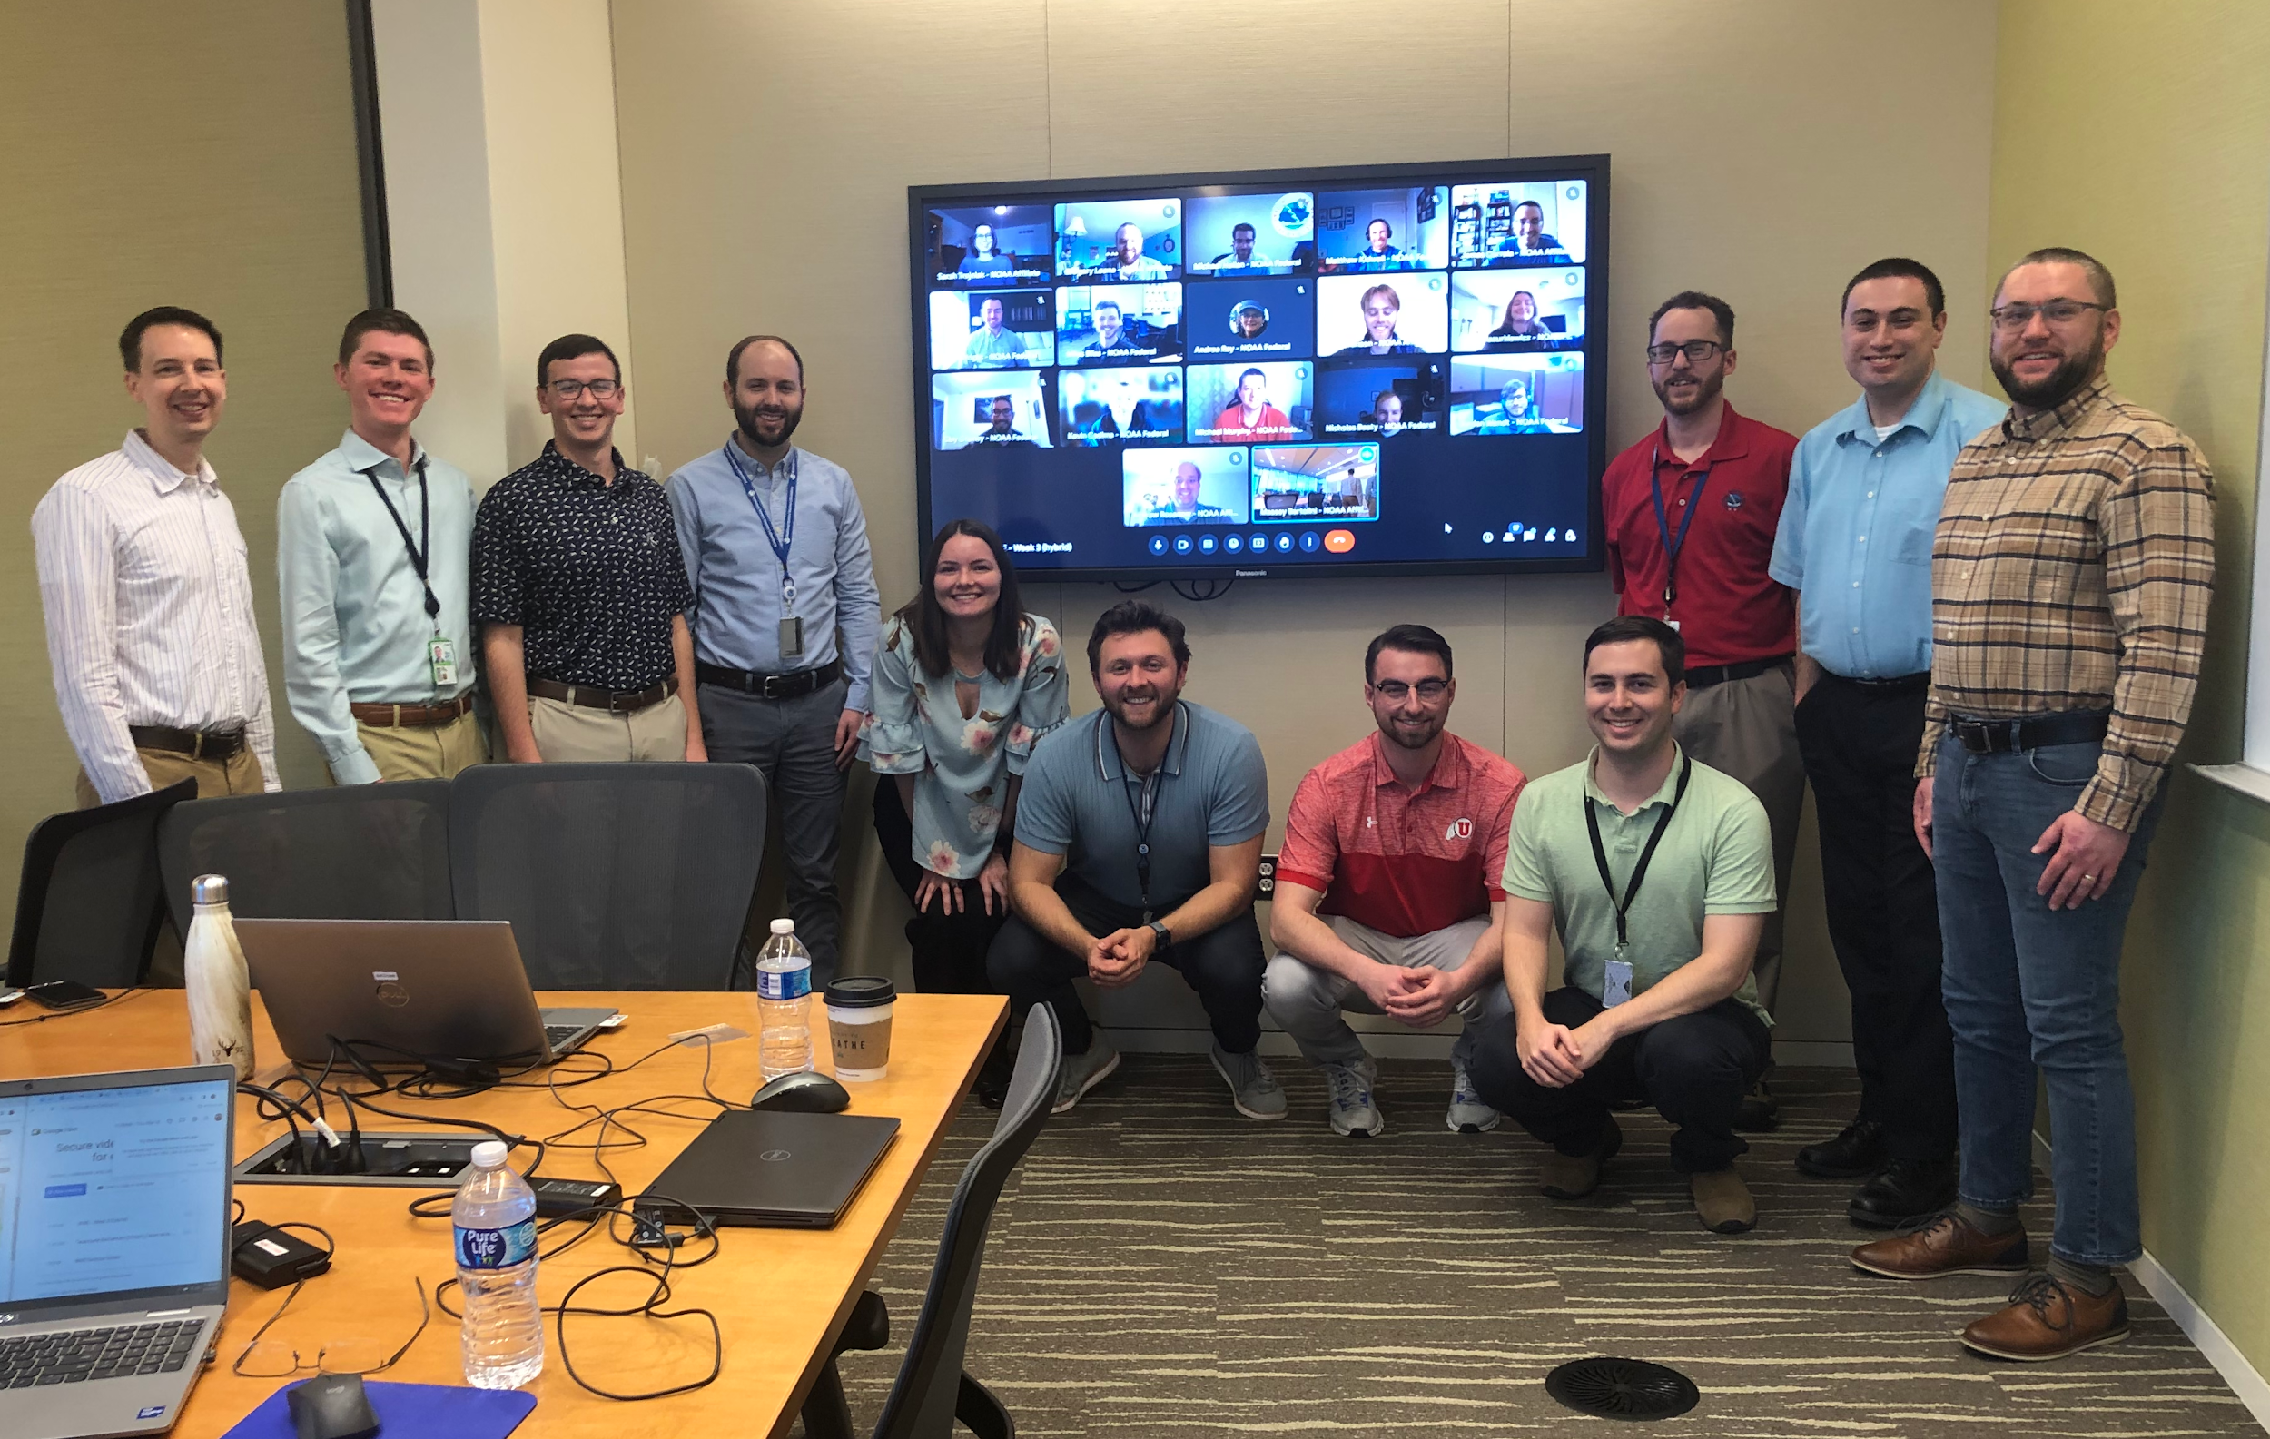
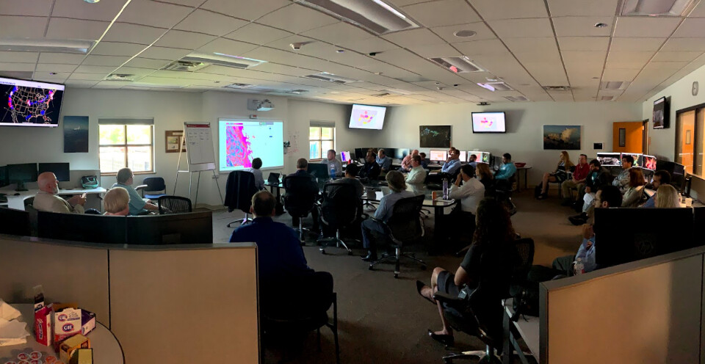
How do TBPGs do this?
Conduct experiments for T&E
HMT: Winter Weather and Flash Flood & Intense Rainfall
HWT: Spring Forecasting, ROC evaluations, PHI
AWT: Weather experiments with airlines
OPG: Evaluations of innovations in a realistic environment mirroring WFOs, before formal deployment and/or extended retrospective tests focused on robust sample sizes & objective verification metrics
Significant collaboration between TBPGs
Forecasters & core partners (e.g., emergency managers, broadcast mets) often involved
Many experiments also have training components
Notes:
https://www.testbeds.noaa.gov/ ; develops new Collaborative Forecast ProcessesMany have or developing social science components Most conduct experiments to test
HMT Winter Weather and Flash Flood & Intense Rainfall Expts
others: Arctic TB & PG > NWS Alaska Region
Coastal & Ocean Modeling TB > NOS coastal forecasting
Operations Proving Ground > WFO’s

Slide 17
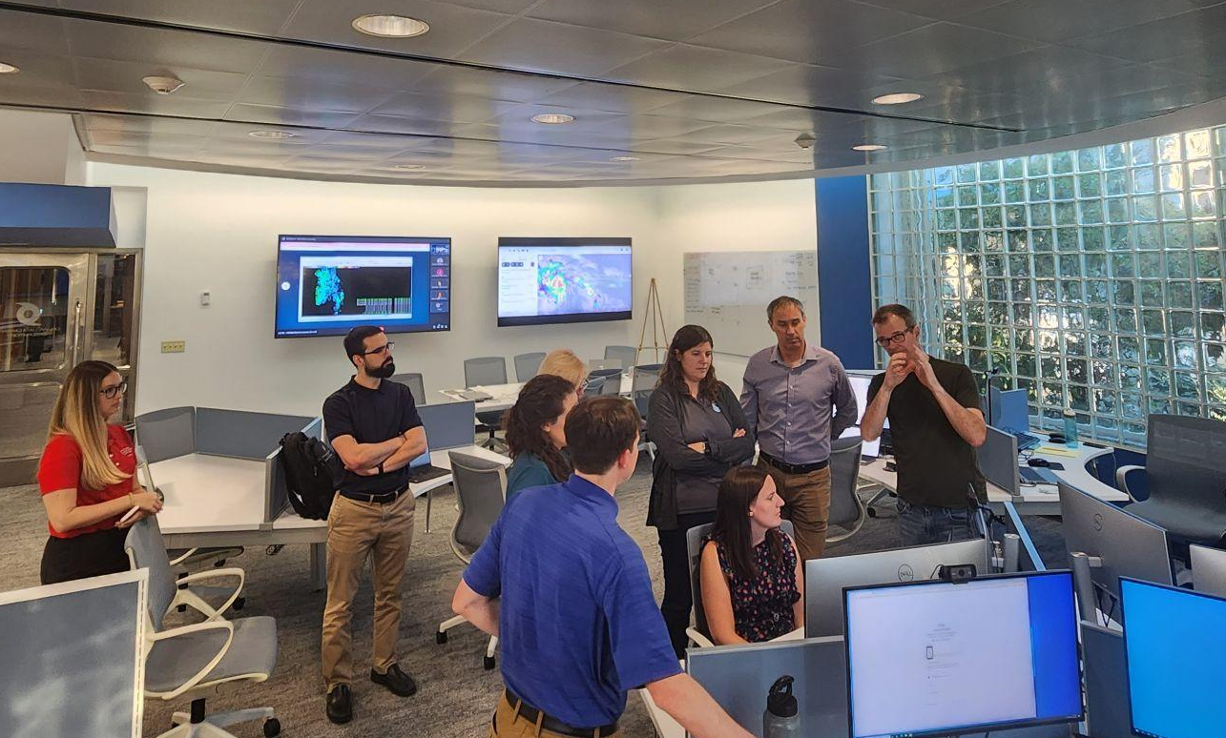
T&E goes beyond quantitative
Often includes forecasters at National and WFO levels -
subjective evaluation of utility
Increasingly, bringing in external end users, e.g. emergency
managers, broadcasters, transportation managers
Focus groups - next slide
Integrating Social, Behavioral and Economic Sciences
results of these inform product development
and qualitative or subjective evaluation methods
For example, feedback from testbed experiments has proven to be an effective strategy for model developers to build into the annual development cycle of next-generation CAM systems. Feedback was systematically collected, assessed and addressed…testbeds brought in diverse stakeholders (i.e., operations, research, and academia) from their respective communities to offer an honest and unbiased perspective on the performance of CAM systems in a real-time, real-world setting - From Carley et al, 2023
Notes:
Thank you Kodi Berry for these findings on benefits; and to Wallace Hoggsett for the photo of HOT
Some findings of HWT on benefits of bringing end users in (from Kodi Berry, HWT)
Realism in testing helps identify, address, & mitigate factors that create the “valley of death” in transitioning R2O (Karstens et al. 2018)
Interaction between NWS forecasters and end users enables the generation of useful, usable, and understandable information (Karstens et al. 2018)
End-user engagement to the level of co-production results in a parallel increase in the use of products developed in those projects (Nygren et al. 2018)

Slide 18
Engaging the Community: over 500 indiv/year
experiments-trainings-workshops-other activities
~100 WFO, CWSU & NCEP forecasters/year, Alaska Aviation Wx Unit (AAWU)
Many universities including NCAR & Coop Institutes
Broadcast meteorologists, Diverse emergency managers
Airlines (Flight Operations, Flight Safety, Dispatch, Meteorology), Pilots Union & Air Traffic Management and Communications Groups
NASA, USAir Force, USNavy, FAA, USForest Service & Nat’l Interagency Fire Ctr
MITRE & other private sector incl space wx providers;
International: UK Met Office, Australian Met Bureau; Space Weather Operations and Scientists from Canada, and the UK
North American Ice Services (US National Ice Center, Canadian Ice Services, and Alaska Sea Ice Program), Alaska Ocean Observing System, Alaska communities & indigenous groups, Alaska Marine Exchange and Skipper's Science (NGO)
Notes:
draft
Coastal and Ocean Modeling TB (COMT)
Developmental Testbed Center (DTC)
Satellite Proving Ground (SPG)
Hydrometeorological TB (HMT)
Climate TB (CTB)
…and their NOAA and external collaborators

Slide 19
Testbed & Proving Ground Challenges
Collective Data Storage
Collective Visualization
Scheduling Fatigue of Meteorologist, Hydrologists, Research Scientists, Partner, etc.
How to emulate a quasi-operational workflow from National to Local
How to get tied into other efforts in order to provide the real world evaluation as TBPGs tie all of it together
How do we integrate the fast pace of AI/ML development into the Testbed and Proving Ground framework

Slide 20
In closing
Most TBPGs already have activities supporting UFS development or UFS-based products & are willing partners, examples
REFS*, GEFS, HAFS, and WoFS Evals (Obj/Subj)
MJO-Teleconnections diagnostics packages tailored for S2S
METplus verification framework
Improving DA algorithms for U.S. West & East coast ocean forecast systems
Enhancements and development of operational products through utilization of new model suites and improved post-processing (e.g. ERO)
Have capabilities that can directly support/benefit UFS
Robust T&E processes already being used for UFS
Access to forecasters and other users who can provide meaningful feedback to UFS development at different stages for different hazard scenarios & IDSS-relevant metrics
Engaged with SBES - both implementing findings and generating SBES science
Probabilistic products are a major focus
Work with us - start talking to us early so we know your schedule for innovations needing T&E, so we can get activities on calendars
*Carley et al,, 2023, https://repository.library.noaa.gov/view/noaa/56514

Slide 21
Panel: Research to Operations (R2O) facets and how to engage in R2O to advance the UFS
Moderator: Andrea Ray - Transitions Lead and Hydromet Testbed Coordinator, NOAA/OAR/PSL, former Chair Testbeds and Proving Grounds Coordinating Committee
Panelists:
Kevin Garrett - Modeling Program Director, NOAA/NWS/STI
Jordan Dale - Testbeds Program Manager, NOAA/OAR/WPO
Chandra Kondragunta - JTTI Program Manager, NOAA/OAR/WPO
Jacob Carley - Chief Engineering and Implementation Branch
NOAA/NWS/NCEP/EMC
Jim Nelson - Chief, Development and Training Branch, NOAA/NWS/NCEP/WPC; Manager, Hydromet Testbed; Chair, Testbed & Proving Ground Coordinating Committee
Kathryn Newman - Science Deputy Director,
Joint Numerical Testbed, NCAR/DTC

