Slide 1
Updates on Rapid Refresh Forecast System Version 1
Matthew E. Pyle*, Curtis R. Alexander, Jacob R. Carley, Terra Ladwig, Shun Liu, Ming Hu
Boulder, CO
September 11, 2025

Slide 2






















The Rapid Refresh Forecast System (RRFS)
Development and evaluation of this system has been a hugely collaborative effort between EMC, NOAA GSL, and ....
WPC

Slide 3
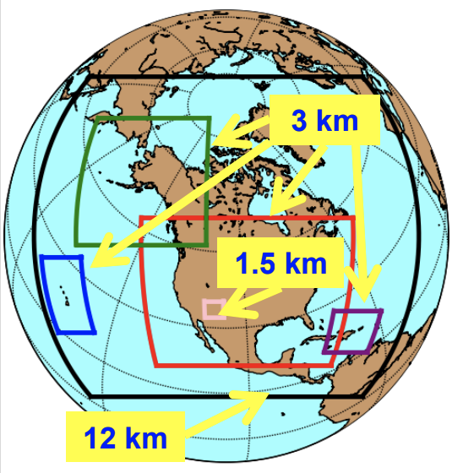
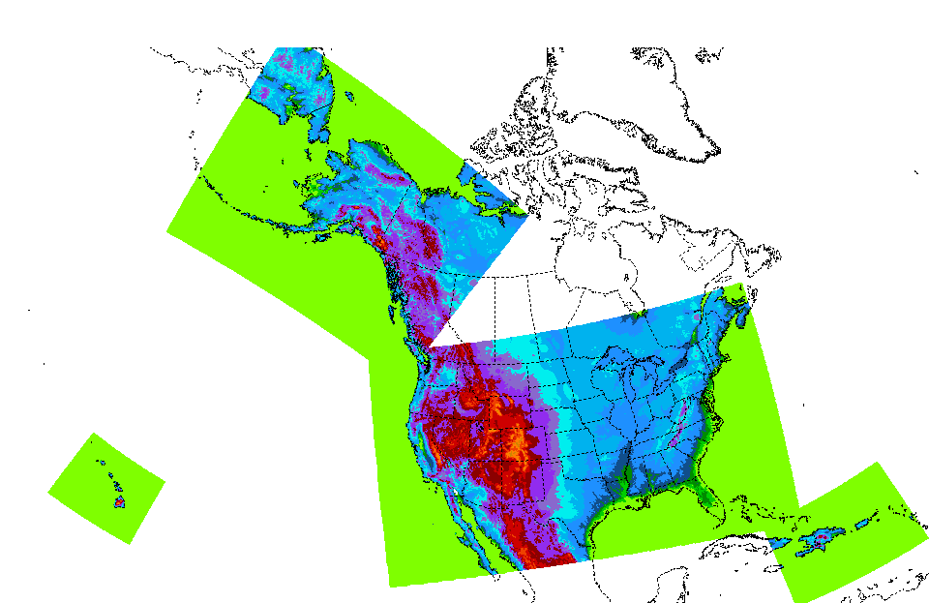
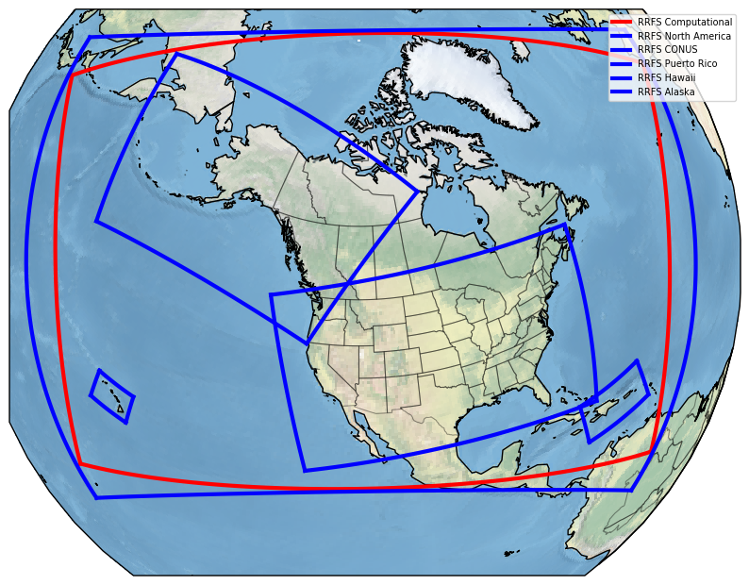
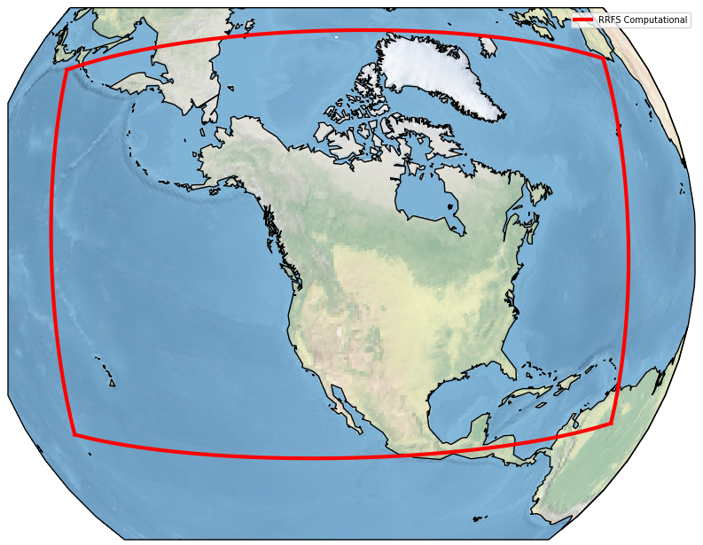
The Rapid Refresh Forecast System (RRFS)
A UFS Application
3 km grid spacing over North America
FV3 dynamical core
Hourly updated
65 vertical layers
Hybrid 3DEnVar assimilation (30 mem)
Deterministic forecasts to 84 h & ensemble forecasts to 60 h for 00/06/12/18Z cycles
Deterministic forecasts only to 18 h, other cycles
Deterministic runs include smoke & dust
Approval given in August to proceed with a v1.0 implementation
NAM +
NAM Nests
HiResW/
HREF
RRFSv1 Compute Domain (red)

Slide 4
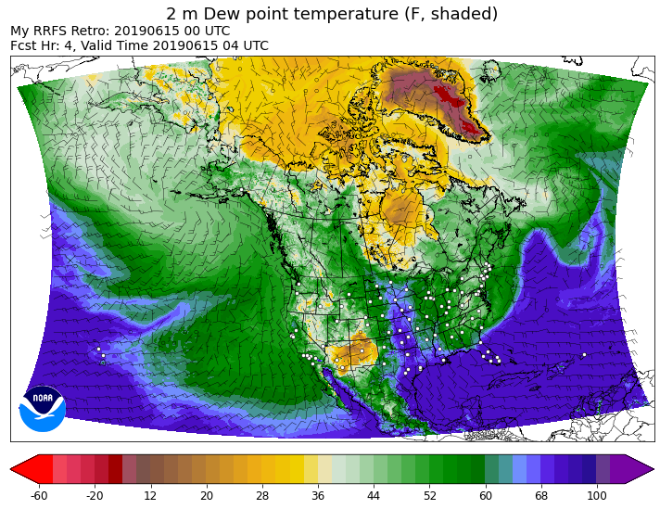
RRFSv1.0 Data Assimilation
GDAS
GDAS
EnKF
00
03
06
09
12
15
18
21
EnVar
00
03
06
Land
09
12
15
18
Land
21
partial cycle
Land
Atmos
Land
Atmos
03
06
15
18
GFS Atmos
GFS Atmos
Two-way interaction between 30 member 3-km DA ensemble [ ] and 3-km deterministic RRFS hybrid 3DEnVar analysis [ ]
Partial cycle spin-up of atmosphere from GFS twice per day (RAP like), land states fully cycled
Large scale information from GDAS ensemble is blended into EnKF system twice per day.
All ensemble members (squares) and deterministic/control runs (circles) are on the 3-km NA grid
Notes:
Complex, hourly cycling, don’t go into details

Slide 5
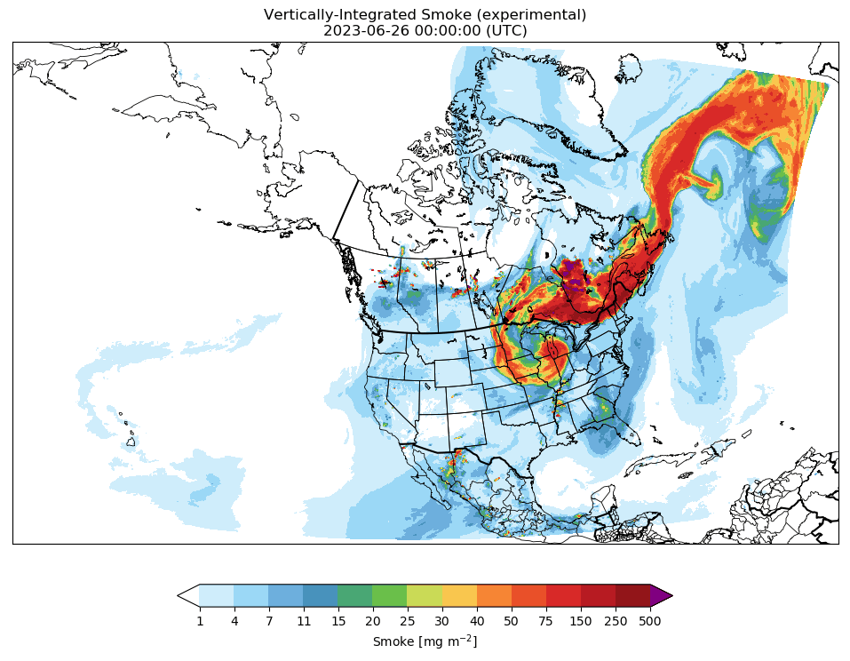
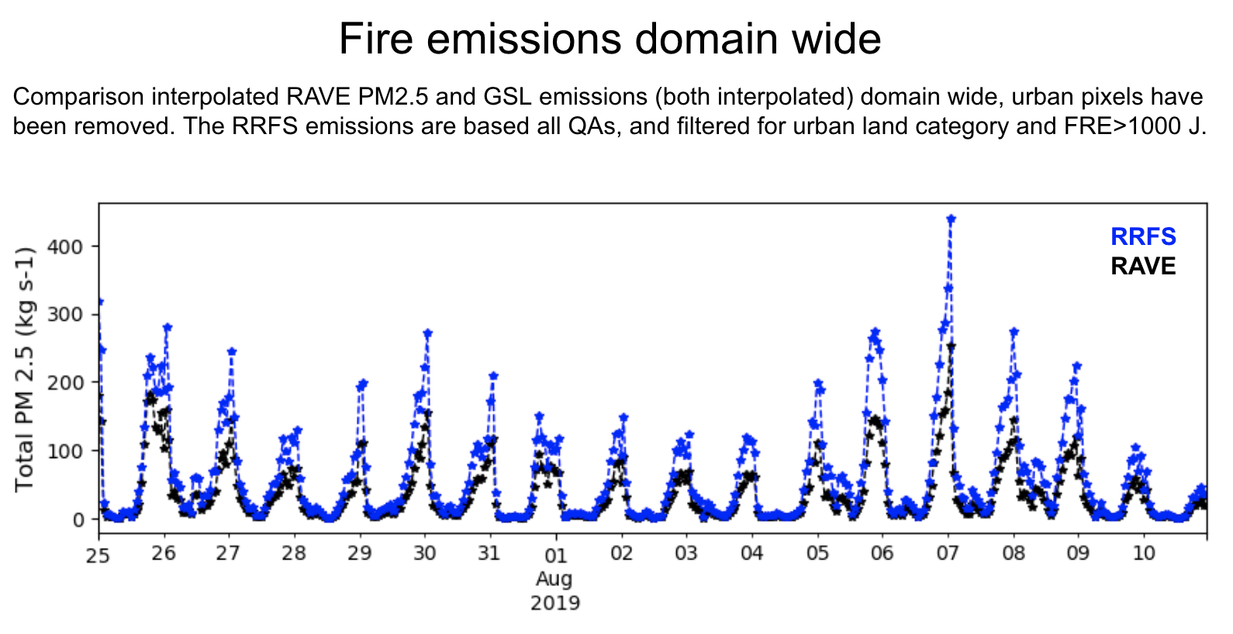

Smoke and Dust
Included in 3-km RRFS over North America
Input data: RAVE Emissions
  Fire Radiative Power → plume rise
  Fire Radiative Energy → estimate emissions
RAVE → Regional Hourly Advanced Baseline Imager (ABI) and Visible Infrared Imaging Radiometer Suite (VIIRS) Emissions
3 km vertically integrated smoke forecast from 26 June 2023 depicting impact from Canadian wildfires
*Thanks to J. Romero-Alvarez (GSL), R. Ahmadov (GSL), B. Baker (ARL), and P. Bhattacharjee (EMC) for material on this slide

Slide 6
REFS (Ensemble forecast) design and membership
60 h forecasts at 00/06/12/18 UTC
 | MP | PBL | sfc | lsm | Cu | IC/LBC
m1 (ctrl) | Thompson | MYNN | MYNN | RUC | saSAS deep | RRFS hybrid/GFS
m2 | Thompson* | TKE-EDMF | GFS | RUC* | G-F dp*+sh | RRFS enkf1/GEFSm1
m3 | Thompson* | MYNN* | MYNN* | RUC* | saSAS deep | RRFS enkf2/GEFSm2
m4 | NSSL# | MYNN* | MYNN* | RUC* | G-F deep | RRFS enkf3/GEFSm3
m5 | NSSL# | TKE-EDMF | GFS | RUC* | G-F dp*+sh | RRFS enkf4/GEFSm4
m6 | NSSL# | MYNN* | MYNN* | RUC* | saSAS deep | RRFS enkf5/GEFSm5
m7 (m1-6h)
m8 (m2-6h)
m9 (m3-6h)
m10 (m4-6h)
m11 (m5-6h)
m12 (m6-6h)
m13 (HRRR) | Thompson | MYNN | MYNN | RUC | None | HRRRDAS / RAP
m14 (m13-6h)
Ensemble spread from:
EnKF ICs
GEFS LBCs
Multi physics
Stochastic (*) and fixed (#) parameter perturbations
Time lagging
Inclusion of HRRR for Alaska & CONUS domains
Thanks to Jili Dong (EMC) for this work

Slide 7
Changes in RRFS system since last year’s UIFCW
Switched to scale-aware SAS deep convection in deterministic RRFS and EnKF systems (August 2024)
saSAS update to reduce excessive 0 h reflectivity (September 2024)
Damping modification to control non-physical “streaks” updated - shifted to stronger damping limited to 400 hPa and above (November 2024)
No real time runs ~12/3/2024 to ~4/2/2025 (retrospective testing + stability fixes + workflow update)

Slide 8
Changes in RRFS system since last year’s UIFCW (post real-time outage)
Ensemble member 3 changes due to stability problems seen in May 2024 REFS retros (April 2025):
  SPP for the G-F deep convection scheme was turned off
  Perturbation of roughness length in the LSM was removed.
RRFS real-time parallel resumed, driven by ecFlow (April 2025)
Lake mask update (August 2025)

Slide 9
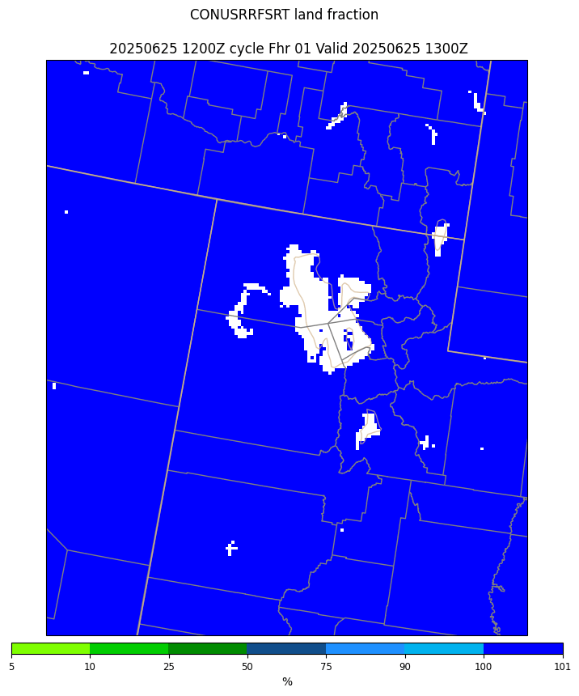
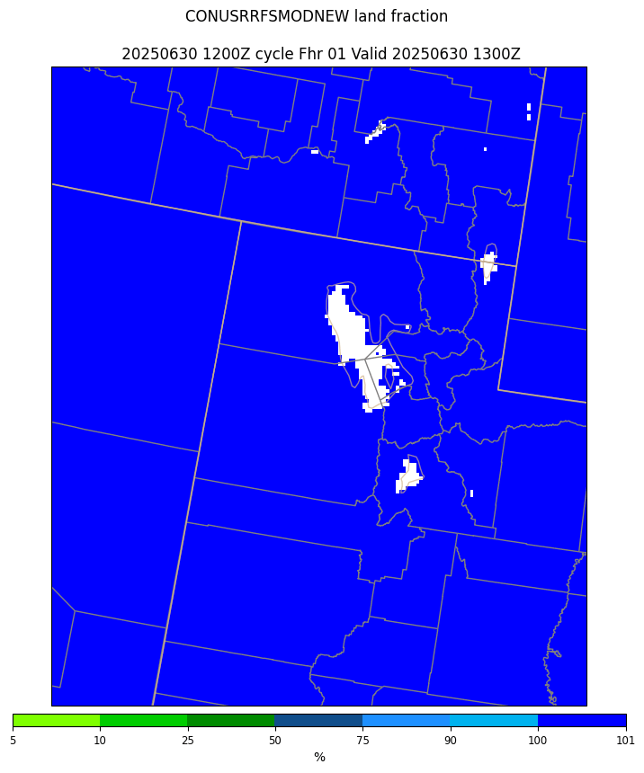
RRFS Field Evaluation and Responses
Received complaints that RRFS lakes were overly large (particularly the Great Salt Lake)
requested that we make them more like the HRRR lakes.
GSL led the effort to update the lake mask. Went into RRFS parallel mid-August
old RRFS lakes
post update lakes

Slide 10
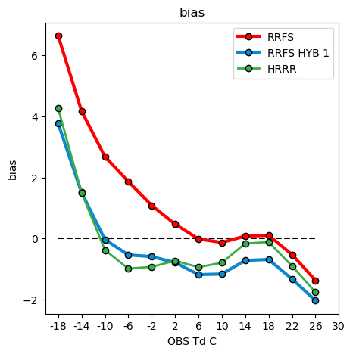
RRFS Field Evaluation and Responses
Numerous complaints about overly moist 2 m Td in western US - most evident in very arid regions
May 12-18 period
00/06/12/18Z cycles
forecast hours 3,6,9,12...48
Courtesy Mike Baldwin/ Nick Nauslar, SPC
HYB1 much drier than RRFS 2 m, and similar to HRRR on the dry end...
...but drier than HRRR (and too dry) for obs Td > 2 C.

Slide 11
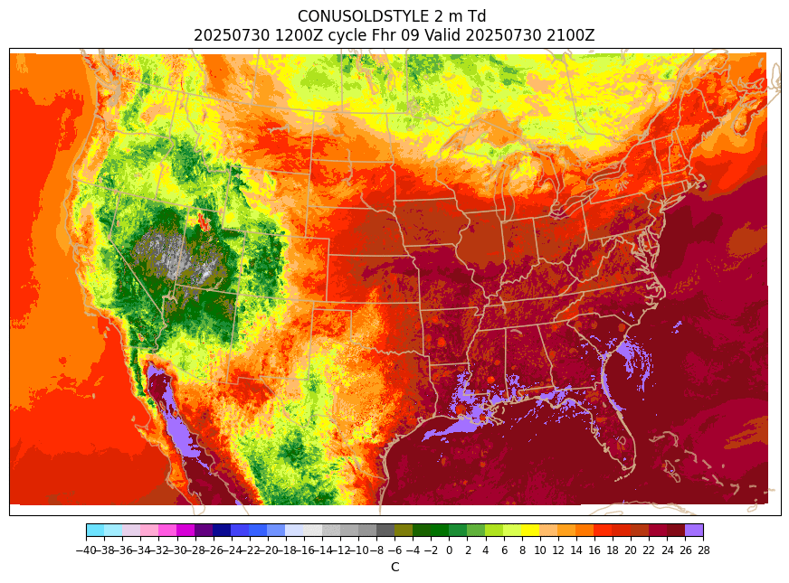
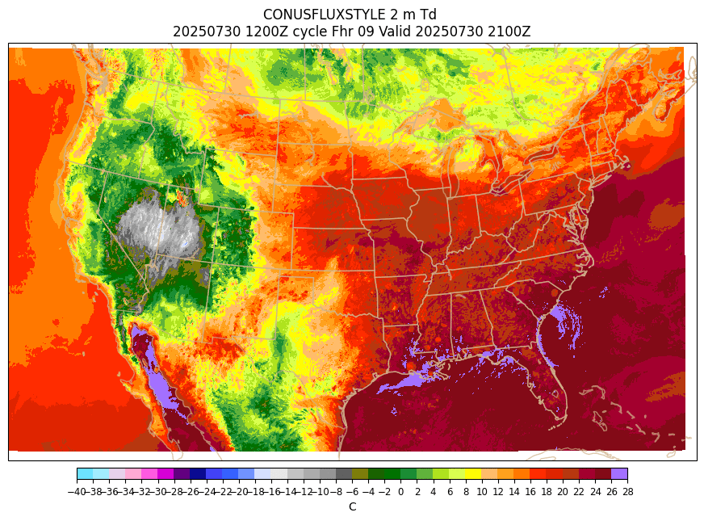
RRFS 2 m Td diagnostic comparison
linear
2 m diagnostic
(current RRFS)
flux-form
2 m diagnostic (future RRFS?)
Much drier (5 to 7+ C) in arid regions out west with the flux form.
2 m fields have a feedback on RRFS soil DA, so couldn’t rush this in as a late v1.0 change

Slide 12
Overview of some other evaluation feedback
Positives:
  RRFS (w/ radar DA) greatly outperformed legacy CAMs without radar DA for certain convective events
  Skill in identifying heavy rainfall events through Day 3
  General happiness with deterministic CAM guidance extending to 84 h and ensemble CAM guidance going to 60 h
Negatives:
  RRFS showed tendency to initiate convection that was too early and/or too intense, especially at long lead times (and in low shear)
  RRFS had a tendency to overpredict QPF during heavy precipitation events
  REFS ensemble products generally show less spread than HREF

Slide 13
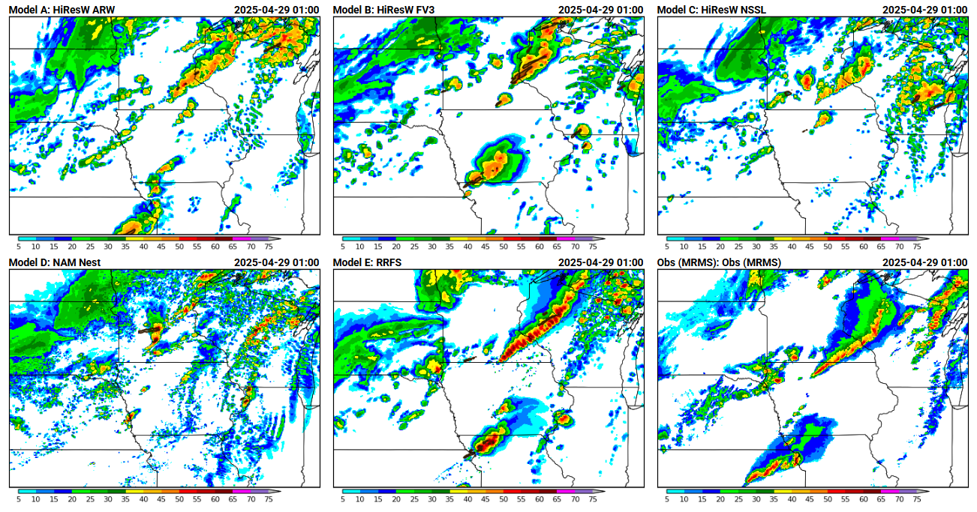
2025 HWT SFE: April 28
ARW
FV3
NSSL
NAMnest
RRFS
Obs
courtesy Andrew Benjamin, based on HWT graphics

Slide 14
Technical challenges for implementing RRFS
Huge data volume
  And much of the data generated needs to be mirrored to the other side of WCOSS (in case this other WCOSS computer needs to become “production”)
  The RRFS EnKF restart files (30 mem) total 3-4 TB/cycle
    With compression can reduce this restart file volume by nearly 70% with minimal data loss - but won’t allow for bit-identical restarts
Large CPU footprint
  A 3 km NA domain with a 30 member DA ensemble creates challenges for testing the full system

Slide 15
RRFS/REFSv1 next steps
Working on getting the v1.0 system into better shape before handing the software off to NCO (currently scheduled for late Oct)
The current implementation target for RRFS v1.0 is ~Feb 2026
Planning to pivot quickly to a v1.1 implementation
  2 m Td improvement + various product requests
  ~6 months after v1.0 implementation?
  Part of a new EMC paradigm to strive for more frequent, incremental upgrades
NAM+Nests
HiResWs
RRFSv1 Compute Domain (red)

Slide 16
Backups

Slide 17
The Rapid Refresh Forecast System (RRFS) is a regional 3 km ensemble and deterministic forecasting system, based on the Unified Forecast System (UFS), and targeting an implementation into NWS operations early in 2026. This talk will summarize the scientific and technical changes made to RRFS over the last year, and share results from runs made with the final scientific configuration. Issues that arose during the RRFS evaluation period will be reviewed, and the remaining steps toward the operational implementation of RRFS will be described.
Progress over last year
  Finalizing saSAS config
  Code freeze
  retros
  evaluation (lakes and 2 m Td)
  approval
Challenges and remaining steps
  Data volume and computational load
  Lingering issues from evaluation (v1.1 update)
  bit-ID restartability

Slide 18
Recent RRFSv1.0 history (2023-)
Long standing complaints from NOAA testbeds and others about overly heavy precipitation, and overly large/intense convective storms.
Grell-Freitas (G-F) convection introduced in August 2023 after exploring other options to improve the QPF bias
Beta evaluation (Jan-Mar 2024) - final tuning based on real-time and retro tests
Initial code freeze in ~Apr 2024
RRFS performs poorly in May 2024 SFE
Became clear that this G-F version would not be approved by the field
Began testing with scale-aware Simplified Arakawa Schubert (saSAS) convection, which went into real-time RRFS parallel mid Aug 2024
Second code freeze late Nov 2024
Final retros run, and RRFS performs fairly well in May 2025 SFE
where things stood as of 2024 UIFCW

Slide 19
RRFSv1 final retrospective runs
Real-time RRFS was shut down in early December 2024 to free computer & human resources to run multiseason retrospective cases
Ran the full cycled DA system over North America, but only generated deterministic forecasts for 00/06/12/18Z cycles (no routine ensemble forecast generation)
Ran three separate ~month long periods:
  July 2023 (summer)
  early Jan to early Feb 2024 (winter)
  May 2024 (spring)
And ultimately ran some limited ensemble forecasts to fulfill stakeholder requests

Slide 20
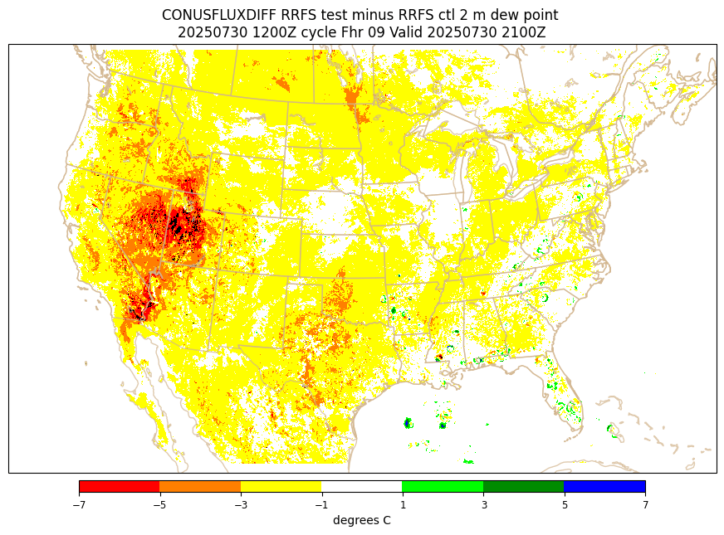
backups
flux - ctl 2 m Td difference
f09 (21Z valid)

Slide 21
RRFSv1.0 CONUS Statistical Summary
Metric | Warm Season | Cool Season
2-m Temperature | Lower RMSE, Improved overall bias | Lower RMSE, Improved overall bias
2-m Dewpoint | Lower RMSE, moist bias: Western US | Lower RMSE, moist bias: Eastern, Central US
Upper Air Temperature | Comparable RMSE and bias throughout troposphere | Lower RMSE, improved biases, especially after F60
Upper Air Specific Humidity | Comparable RMSE and bias throughout troposphere | Comparable RMSE and bias above 850 hPa, higher bias at 1000, 925 hPa
10-m Wind Speed | RMSE, bias comparable to HRRR higher bias than NAM | Comparable RMSE, improved bias over HiResW, higher bias than NAM
Wind Gusts | Lower RMSE, comparable bias, persistent low bias | Lower RMSE, overall bias

Slide 22
RRFSv1.0 CONUS Statistical Summary
Metric | Warm Season | Cool Season
Ceiling | Comparable CSI, Fbias | Comparable CSI, Fbias
Visibility | Higher CSI, Comparable Fbias | Comparable CSI, Lower Fbias
CAPE | Comparable CSI, Fbias | Comparable CSI, Fbias
Composite Reflectivity | Comparable CSI, Fbias | Comparable low threshold CSI, Fbias
QPF | Comparable CSI, Fbias, ETS, FSS | Comparable CSI, Fbias, ETS, FSS
Snow Depth (WEASD) | N/A | Comparable CSI, Fbias, ETS, FSS

Slide 23
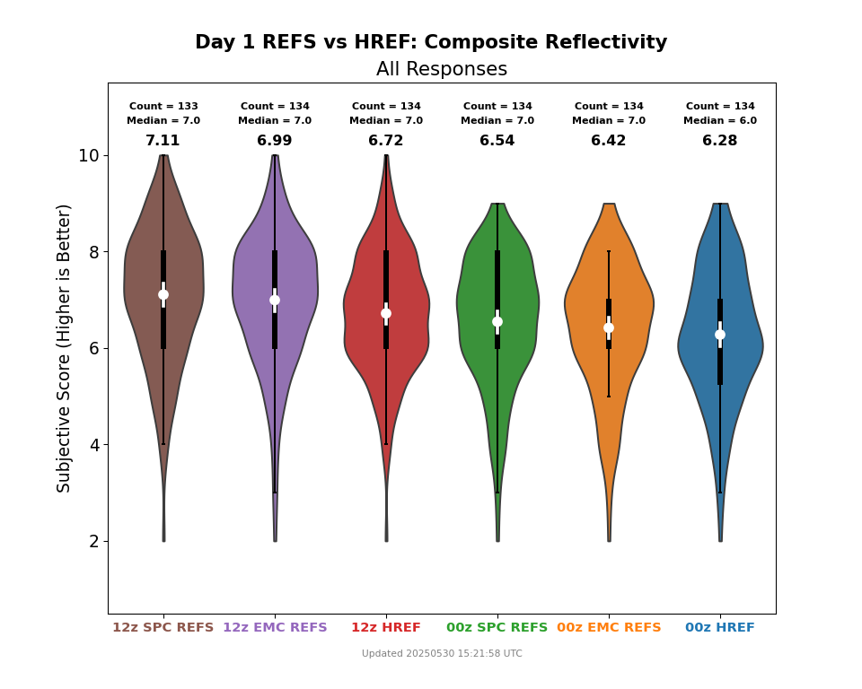
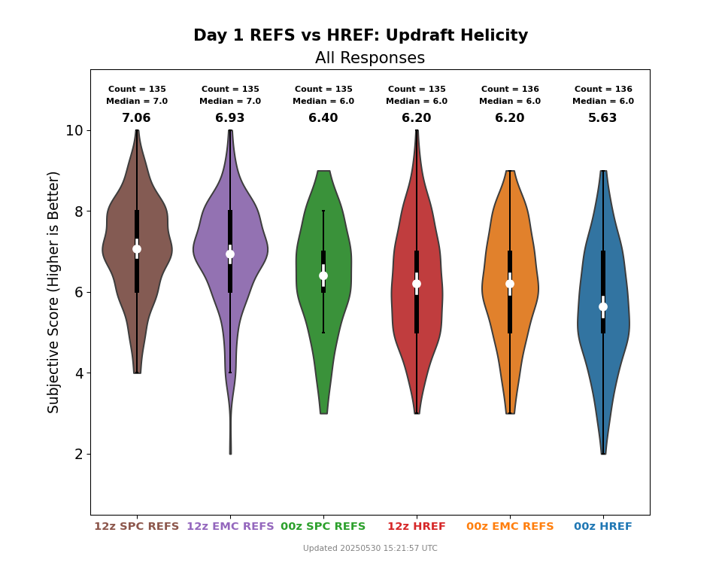
HWT Spring Forecasting Experiment
2025 HWT SFE Subjective Rating Distributions
Day 1 00Z & 12Z REFS vs. HREF
6.99
6.72
6.42
6.28
6.93
6.20
6.20
5.63
12Z
REFS
12Z
HREF
00Z
REFS
00Z
HREF
12Z
REFS
12Z
HREF
00Z
REFS
00Z
HREF
“The REFS performed favorably over five weeks (Apr 28-May 30)
of the HWT SFE compared to the HREF”

