Slide 1
Global Workflow (GW) An End-to-End System for Running the UFS-Weather Model
Priya Pillai
November 28, 2025

Slide 2
What is Global Workflow?
Global-workflow (GW) is an end-to-end system designed to run global configurations of the Unified Forecast System (UFS) Weather Model (WM)
All model components are seamlessly integrated to prepare, analyze, generate, and post-process forecast data, eliminating the need for manual stitching
Ensures consistency between operational forecasts & research experiments
Easily portable for running UFS-WM across diverse computing environments
Model Configurations Currently Supported on Derecho:
Global Forecast System (GFS)
Forecast-only with Atm-only configuration, ATM
Forecast-only with Coupled model (atm-ocean-ice-wave), S2SW

Slide 3
Major Components of GW GFS Configuration
Component | Role | Repository
UFS-WM | Core model used by GW to generate forecasts. Umbrella repo of coupled Earth System Model components | ufs-community/ufs-weather-model
UPP (Unified Post Processor) | Generates useful forecast products from raw model output, interpolated across vertical levels | NOAA-EMC/UPP
UFS UTILS | Utility codes required for NCEP models | ufs-community/UFS_UTILS
GFS UTILS | Utility codes for running GFS config | NOAA-EMC/gfs-utils/
WW3 (WaveWatch III) | Ocean wave model component for coupled atmosphere–ocean–wave simulations | NOAA-EMC/WW3

Slide 4
Getting Started: Resources for GW New Users
Resources | Link
NOAA Environmental Modeling Center (EMC) GW Repo | github.com/NOAA-EMC/global-workflow
GW Documentation | global-workflow.readthedocs.io/en/latest
GW Components | global-workflow.readthedocs.io/en/latest/components.html
Software Requirements | global-workflow.readthedocs.io/en/latest/hpc.html
Running GW on diverse systems | global-workflow.readthedocs.io/en/latest/run.html

Slide 5

Tutorial Outline
In this tutorial, we’ll demonstrate:
Cloning the non-containerized version of GW from the NOAA EMC’s GW GitHub Repository
Building GW on NCAR’s Derecho platform
Exploring the input configuration files
Setting up a GW GFS configuration test case
Finally, triggering the testcase by scheduling a cron job to run it with the ROCOTO Workflow Manager; followed by
A brief description of the model outputs

Slide 6
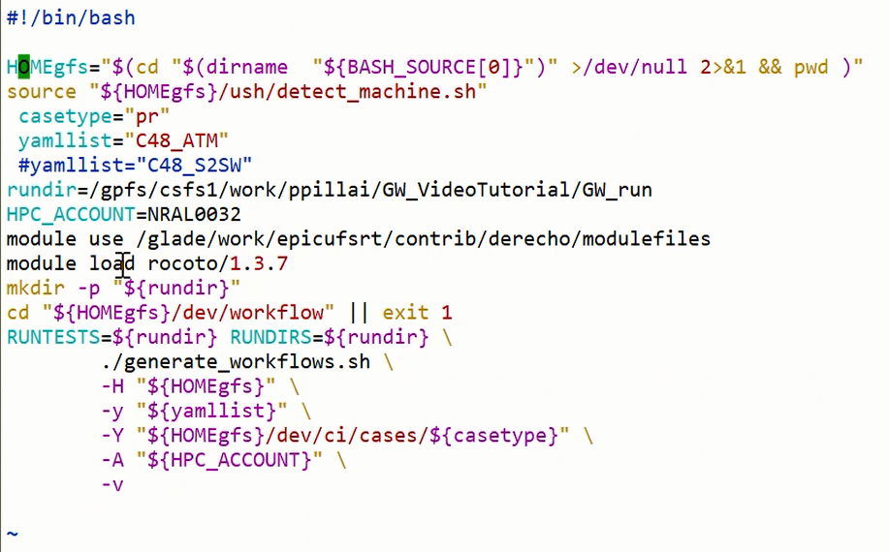
“gen_run_cases.sh” Script for generating a GW GFS C48_ATM Testcase

Slide 7
Generating GFS Configuration C48-ATM Test case
C48‑ATM refers to a specific test configuration of the atmospheric core
“C-48” stands for Cubed‑sphere grid with 48 cells per cube face, giving a ~2º horizontal resolution
“ATM” stands for Atmosphere-only configuration
Update Testcase generation script, “gen-run-testcase.sh” for the following
Casetype=‘pr’
yamllist=“C48-ATM”
rundir=/gpfs/csfs1/work/ppillai/GW_VideoTutorial/GW_run
HPC_ACCOUNT=NRAL0032

Slide 8
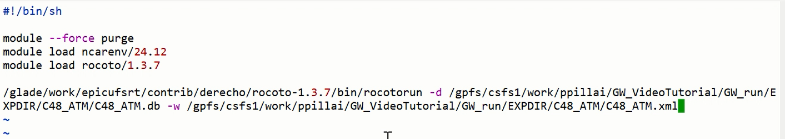
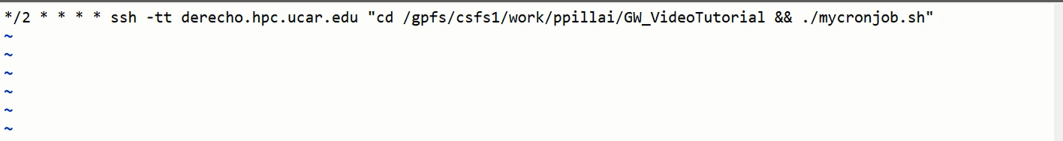
“mygwcronjob.sh” Script to Generate ROCOTO Workflow
Scheduling a Cronjob

Slide 9
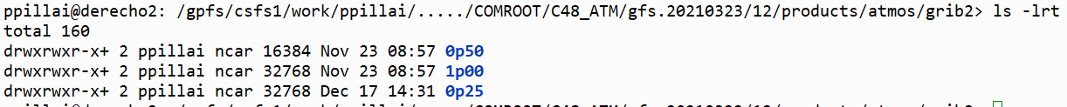
Exploring the GFS-WM C48_ATM Output
Output is located under the following path in the “rundir” specified in “gen_run_cases.sh”: $rundir/COMROOT/C48_ATM/gfs.20210323/12/products/atmos/grib2/
These output directories refer to the horizontal resolution of the model outputs and they contain outputs in GRIdded Binary Edition2 (*.grib2) format
0p25 → 0.25° (~25 km) resolution
0p50 → 0.50° (~50 km) resolution
1p00 → 1.00° (~100 km) resolution

Slide 10
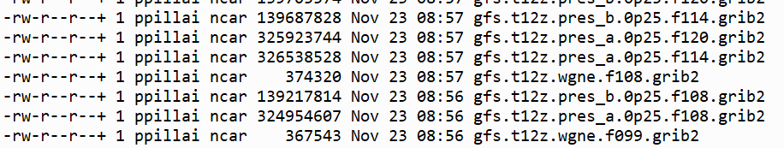
Exploring the GFS-WM C48_ATM Output
For each forecast hour (for example, 108) , there are three files at each horizontal resolution. For example, the 0p25 resolution under, $rundir/COMROOT/C48_ATM/gfs.20210323/12/products/atmos/grib2/0p25/,
gfs.t12z.pres_a.0p25.f108.grib2: GFS forecast of “set a” meteorological variables (winds, temperature, humidity, and geopotential height) at pressure levels set in the model on a 0.25° grid. The “t12z” means the model was initialized at 12 UTC and “f108” indicates the 108th forecast hour. Based on the directory structure (e.g., gfs.20210323/12/), this run corresponds to Mar 23, 2021, 12 UTC, making it the forecast for Mar 27, 2021, 00 UTC (108 hours later).
gfs.t12z.pres_b.0p25.f108.grib2: Same as the above but for “set b” meteorological variables. Forecast variables are spilt into two groups “a” and “b” for easy management
gfs.t12z.wgne.f108.grib2: “wgne” outputs are special diagnostic output set sometimes used for verification

Slide 11
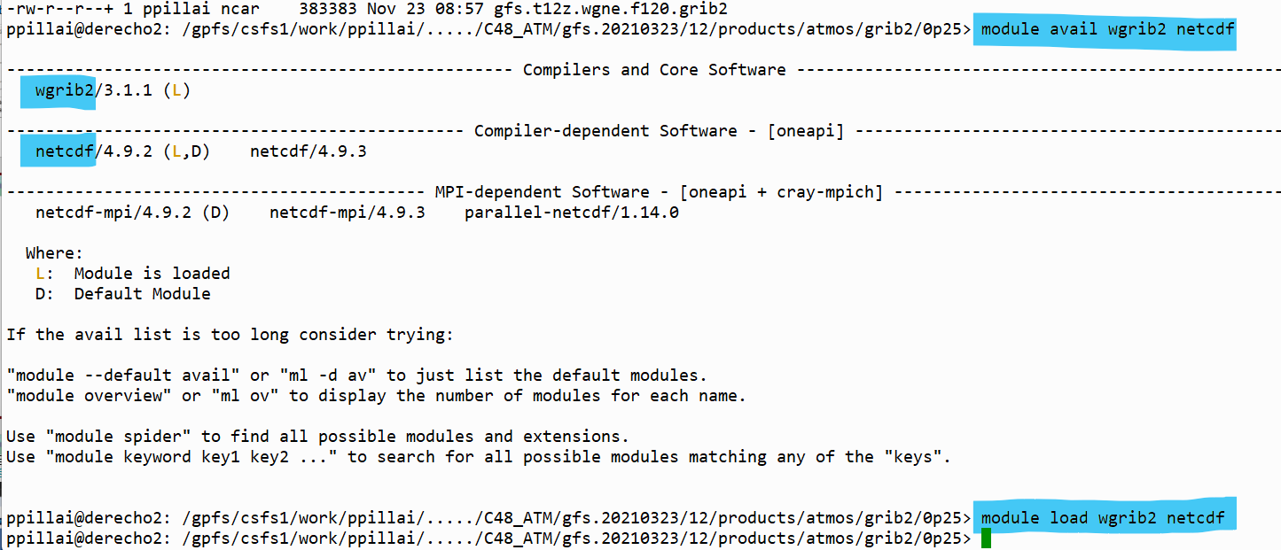
Exploring the GFS-WM C48_ATM Output
On Derecho, load “wgrib2” and “netCDF” modules
“module avail wgrib2 netcdf”
“module load wgrib2 netcdf”

Slide 12
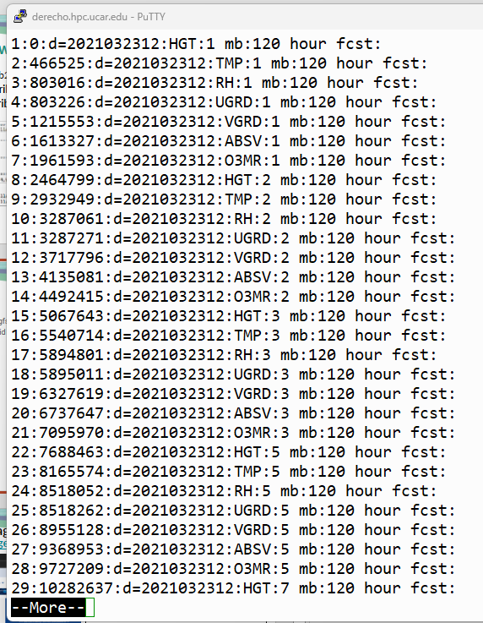
Exploring the GFS-WM C48_ATM Output
On Derecho, under “0p25/” directory, run the following command for a snapshot of grid info, variables, pressure levels, and forecast time etc. “wgrib2 gfs.t12z.pres_b.0p25.f108.grib2 | more”

Slide 13
Exploring the GFS-WM C48_ATM Output
Convert the “grib2” file to “netCDF” for easy exploration with “ncdump” or other netCDF utilities of your choice
On Derecho, under “0p25/” directory, run the following command to create a new netCDF file “gfs.t12z.pres_b.0p25.f108.nc”
“wgrib2 gfs.t12z.pres_b.0p25.f108.grib2 -netcdf gfs.t12z.pres_b.0p25.f108.nc > /dev/null”

Slide 14
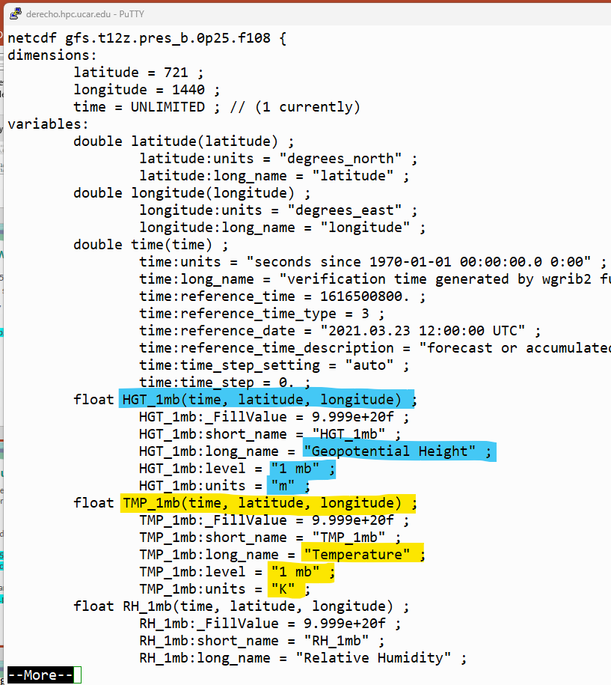
Exploring the GFS-WM C48_ATM Output
To explore the content of the netCDF file, run the following command
“ncdump -h gfs.t12z.pres_b.0p25.f108.nc | more”
This way, explore the output metadata including variable name, pressure level (altitude), unit etc.
For e.g., HGT_1mb is the Geopotential Height at 1mb in meters

Slide 15
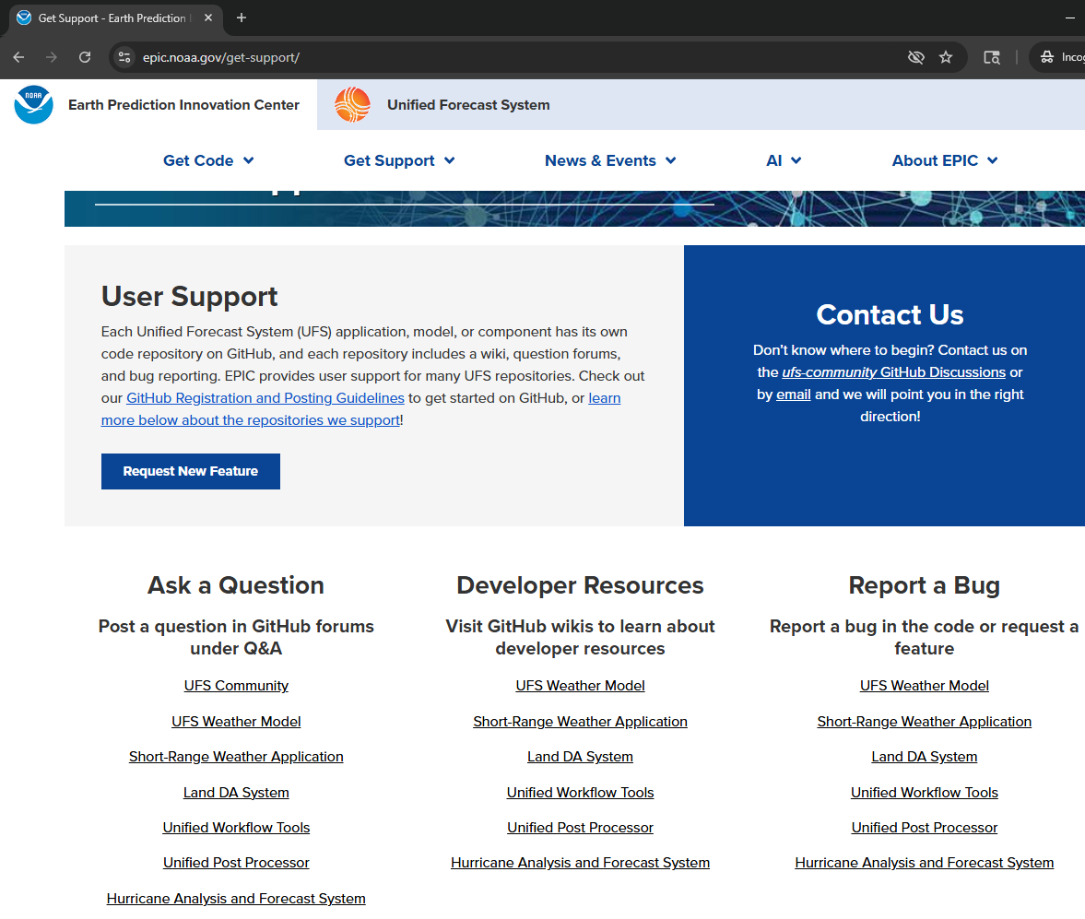
EPIC Get Support page https://epic.noaa.gov/get-support/
For EPIC hosted UFS repos (e.g., UFS Weather Model, Unified Post Processor)
Join the UFS Community Discussion forums linked from the EPIC Get Support page: https://epic.noaa.gov/get-support/
Post your questions related to UFS repos in the Q&A sections of the appropriate forums
Alternatively, email EPIC Support at support.epic@noaa.gov

