Slide 1
Artificial Intelligence in Numerical Weather Modeling Short Course at AMS 2026

Slide 2
Goals for Today
Guide you through a full pipeline to prepare data, train a machine learning weather model, create and verify a forecast
You will get to run everything yourself!

Slide 3
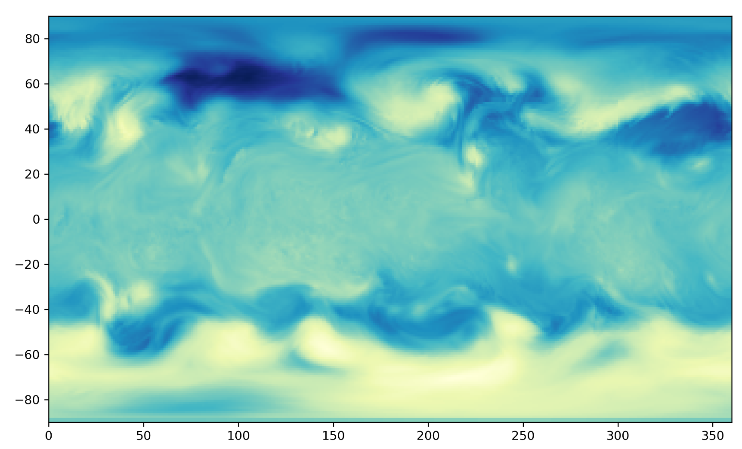
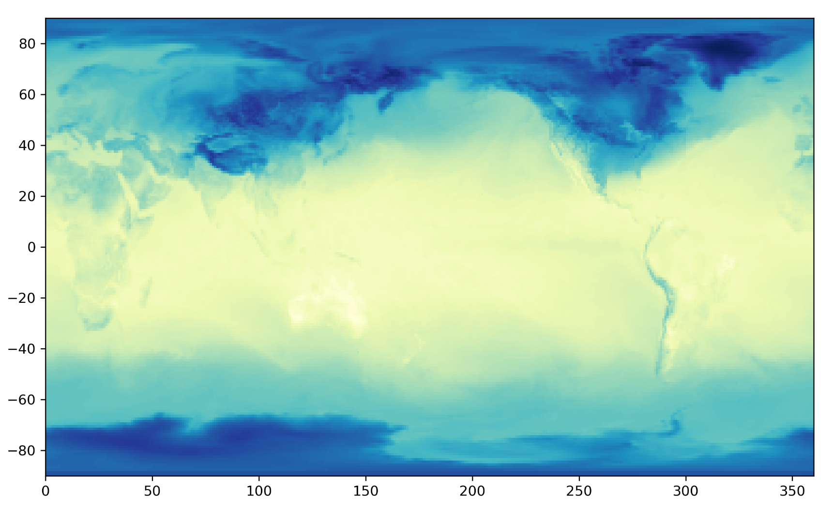
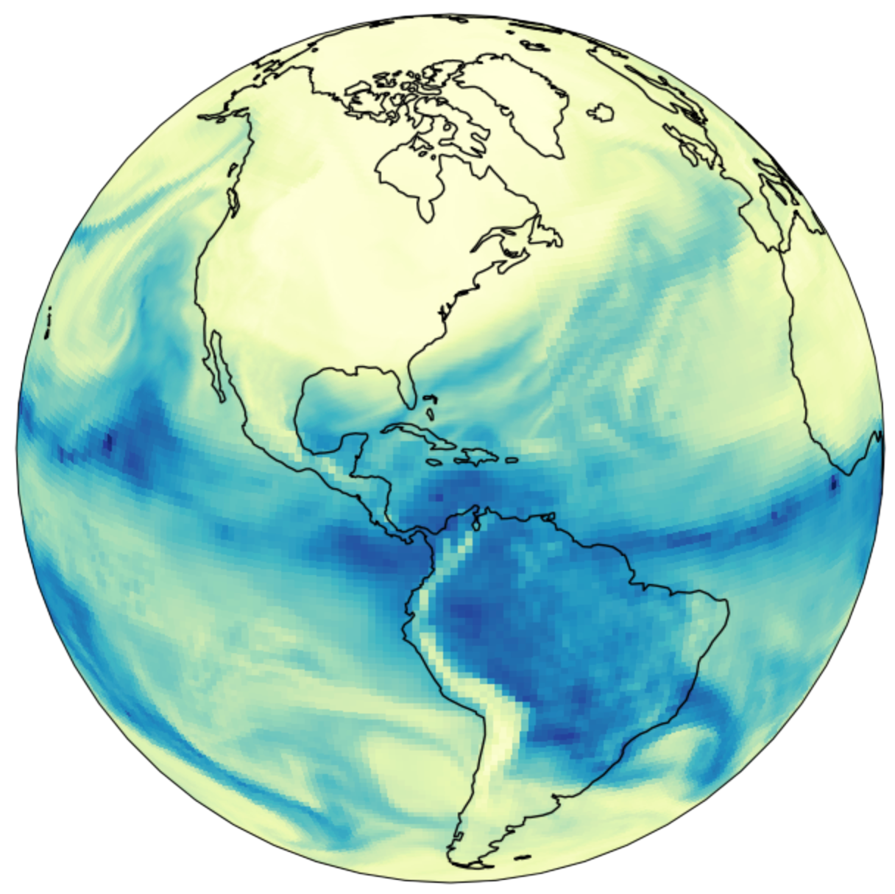
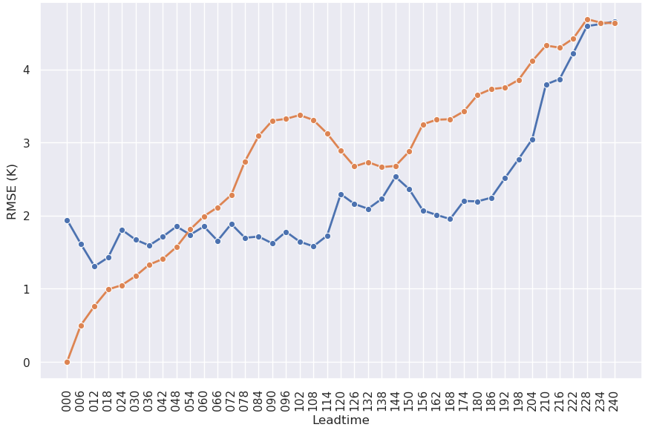

End-to-End Machine Learning Pipeline
ufs2arco
Tool for making NOAA data more accessible for analysis and machine learning
Anemoi-inference
Package within the Anemoi framework for creating forecasts from a model checkpoint
wxvx
Tool for verifying forecasts against various models (GFS/HRRR) or observations
Model Training
Post-processing
Create Conda Environments
DISPLAY RESULTS!
Data Preprocessing
Inference
Verification
Anemoi
Community framework for training graph-based ML weather models using anemoi-core.
eagle-tools
Python functions to make inference output more interpretable and user-friendly
All required packages are easily installable via conda or pip!

Slide 4
Most Importantly…
Acknowledgements
For more in depth information on their work, go see their talks at AMS!
Tim Smith, NOAA PSL
https://ufs2arco.readthedocs.io/ & https://github.com/NOAA-PSL/eagle-tools
European Centre for Medium-Range Weather Forecasts
https://github.com/ecmwf/anemoi-core & https://github.com/ecmwf/anemoi-inference
Paul Madden, NOAA GSL/CIRES
https://github.com/NOAA-GSL/wxvx
ufs2arco
eagle-tools
anemoi
wxvx

Slide 5
Step 1
Data Preprocessing
ML Pipeline Steps
Data Preprocessing
Model Training
Inference
Post-processing
Verification
Most raw data is not ready for training a ML model
  Thousands of netcdf or grib files
  Reshaping, transformations, regridding, etc.
  Handle missing values
  Stored in a way that optimizes model training (e.g. chunks)
  Anemoi requires a very specific data format…
Instead of storing many versions of a large datasets in the cloud, ufs2arco enables users to process data themselves (and do it very quickly!)
Easily installable via conda

Slide 6
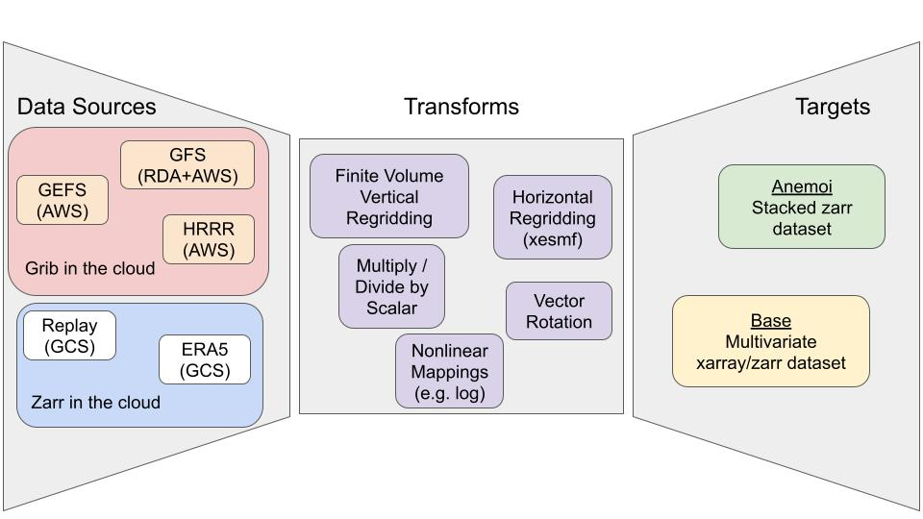
Data Preprocessing with ufs2arco
Source: ufs2arco documentation

Slide 7
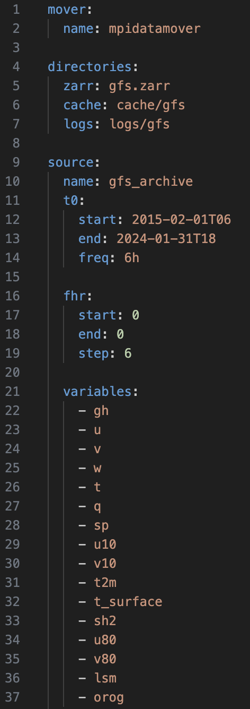
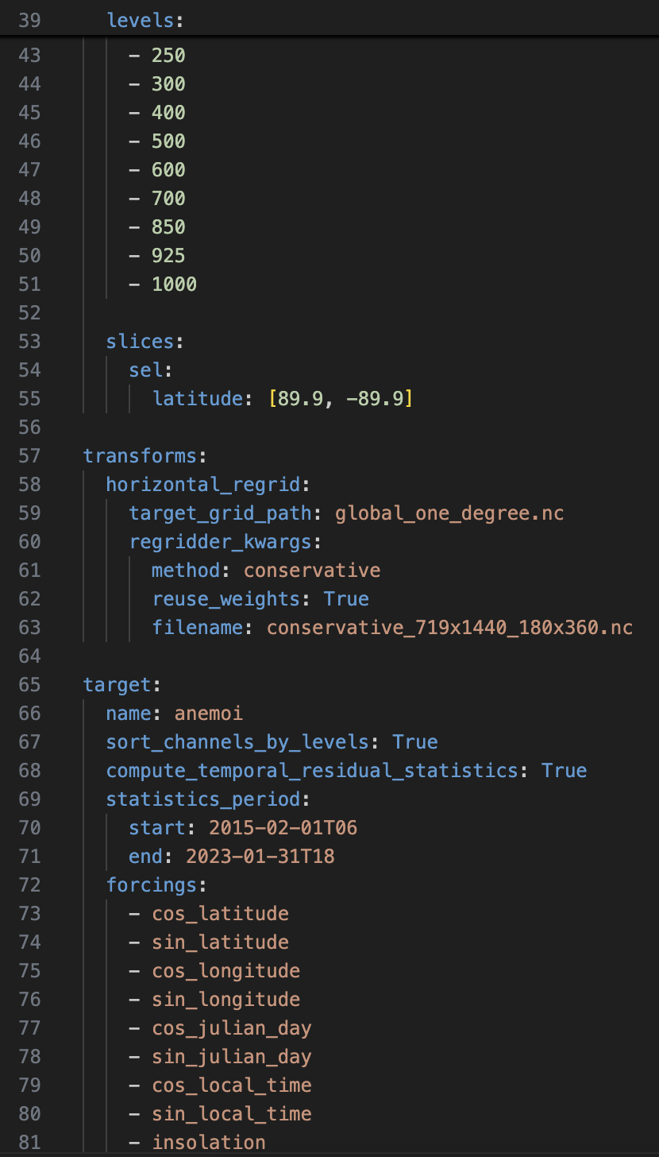
Run with 1 command
> ufs2arco gfs.yaml …..
Example YAML

Slide 8
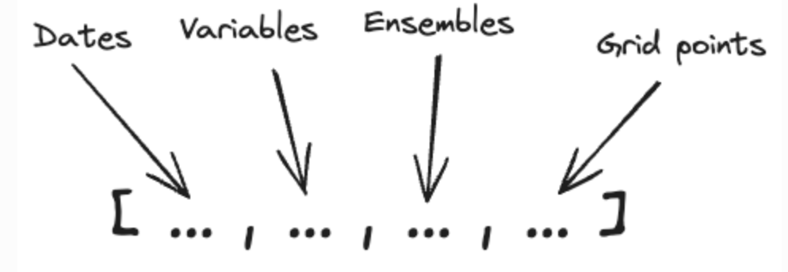
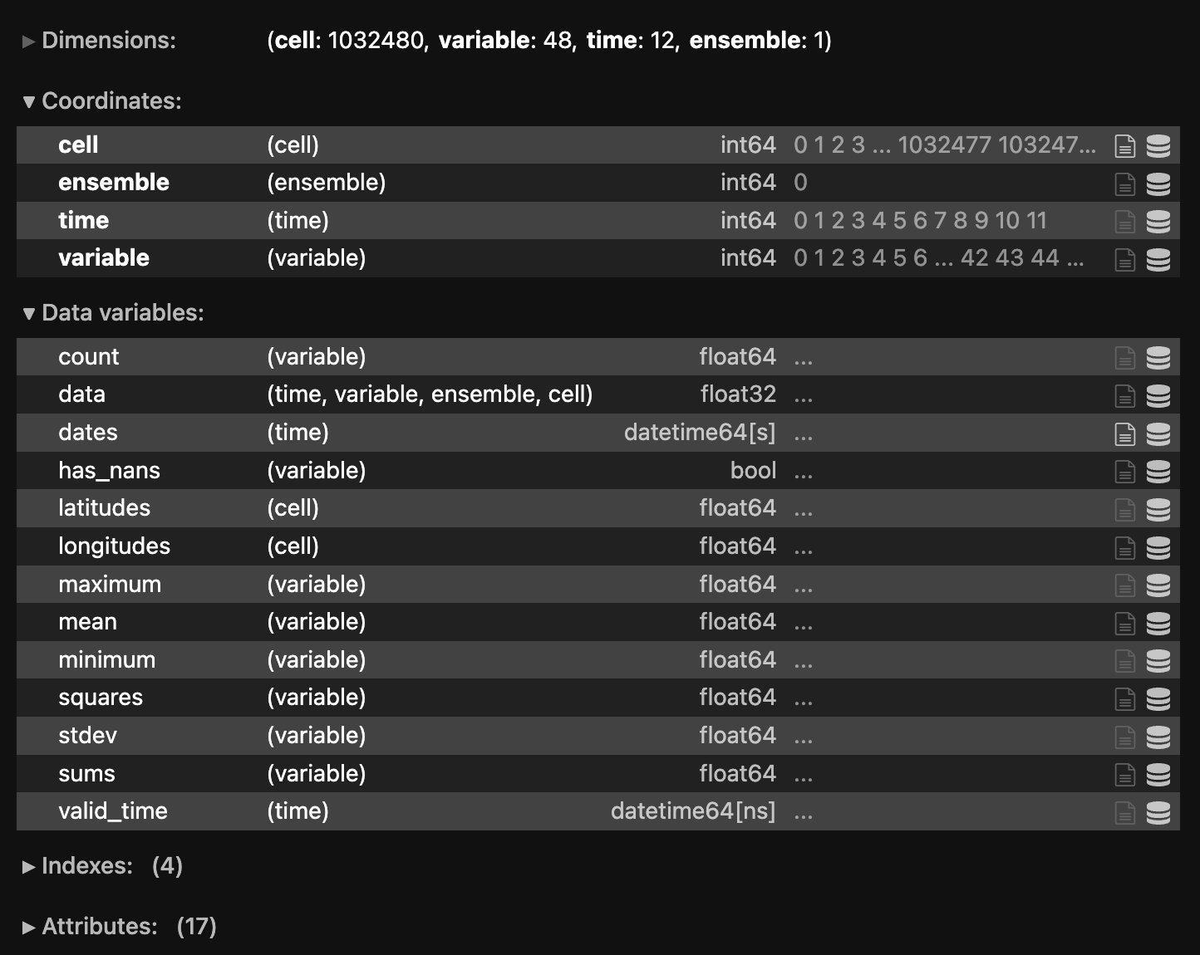
anemoi-dataset Structure
Source: anemoi-datasets documentation
Take note…
Data structure
Statistics
Nan flag
All ensure that training will be successful and efficient

Slide 9

Step 2
Model Training
The Anemoi framework provides modules to train graph-based models
All modules easily installable via pip
ML Pipeline Steps
Data Preprocessing
Model Training
Inference
Post-processing
Verification
Modules used during training
anemoi-graphs
anemoi-training
anemoi-models

Slide 10
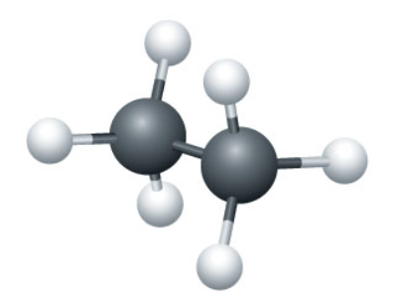
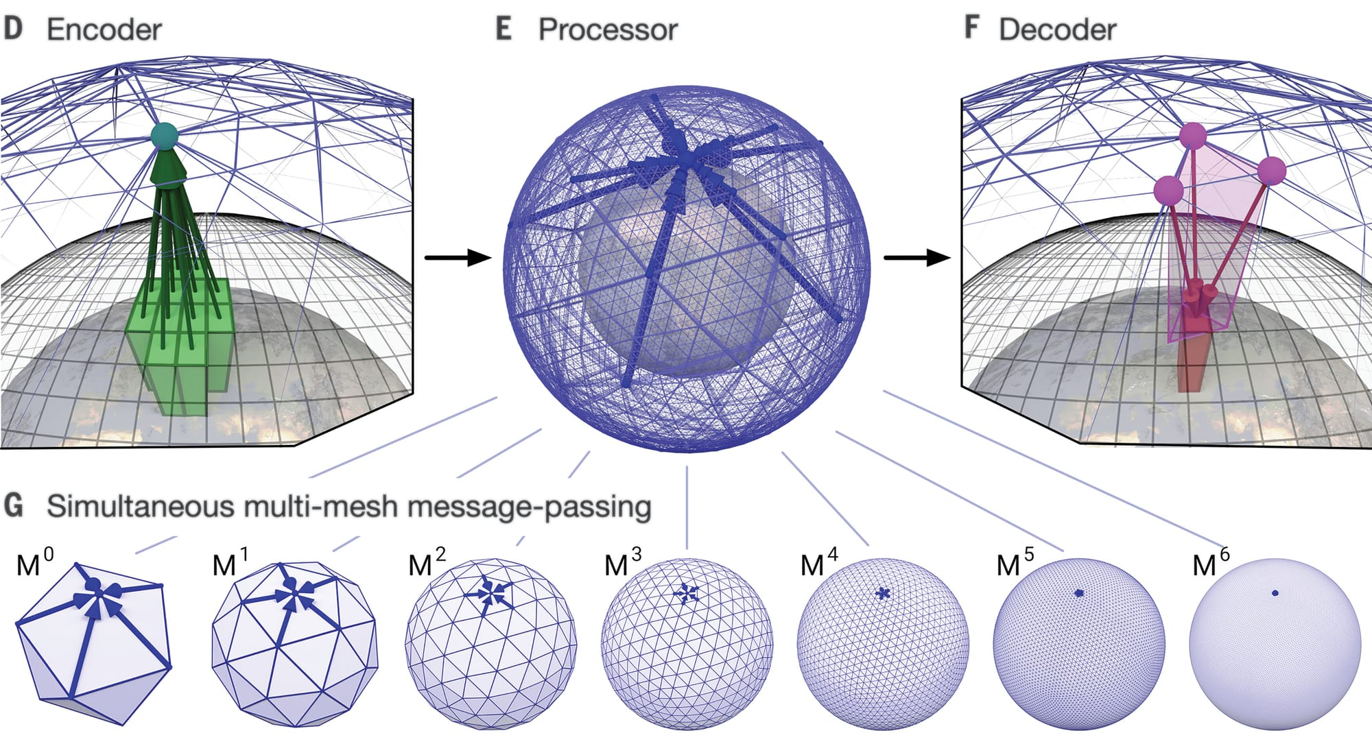
First things first…
What is a “graph-based” machine learning model?!
Think back to organic chemistry and molecules, or picture the human brain…
Encoder-processor-decoder structure
Encoder: maps lat/lon grid to “hidden” nodes in latent space representation, encoding lots of spatial information
Processor: performs message passing in latent space to learn relationships, and how this messaging happens can change depending on various processor types
Decoder: translate this information in the latent space back to the lat/lon grid
Source: Lam et al. 2023

Slide 11
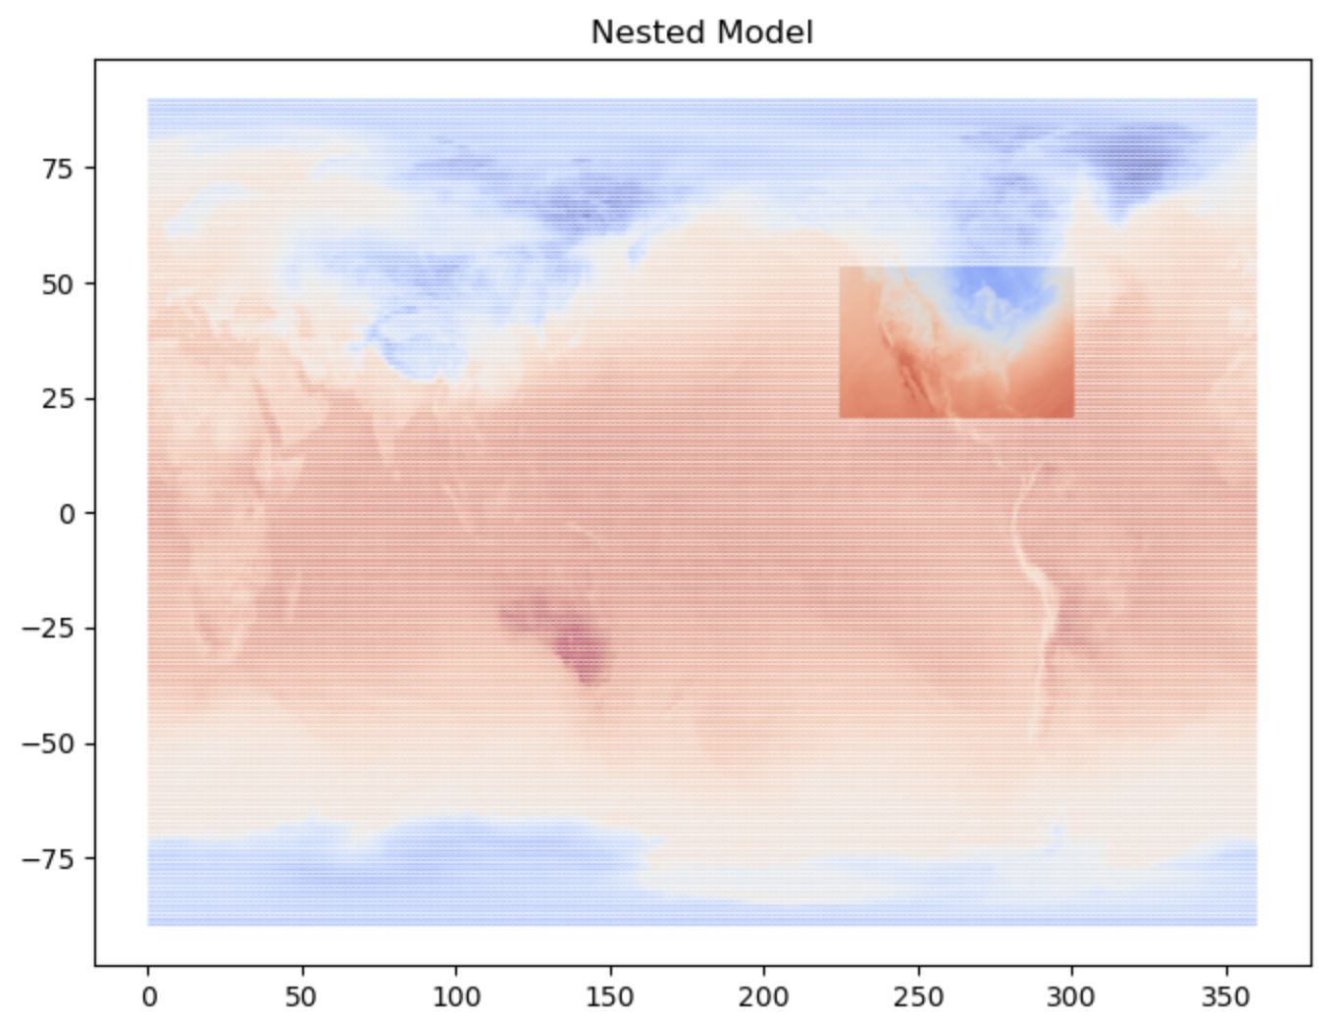
Training & Model Options
Many customizable configurations…
Architectures:
gnn: information from message-passing between neighbors all weighted equally
graph transformer: information from message passing can be weighted differently through an “attention weight”
transformer: sliding window processor where attention is defined within a chosen window
point-wise multilayer perceptron: simple feed forward NN applied at each point
Various configurations:
Global grids
Limited area modeling
Nested grids
Model Tasks:
Deterministic Forecasting
Ensemble Forecasting
Time Interpolation
Diffusion-based Forecasting

Slide 12
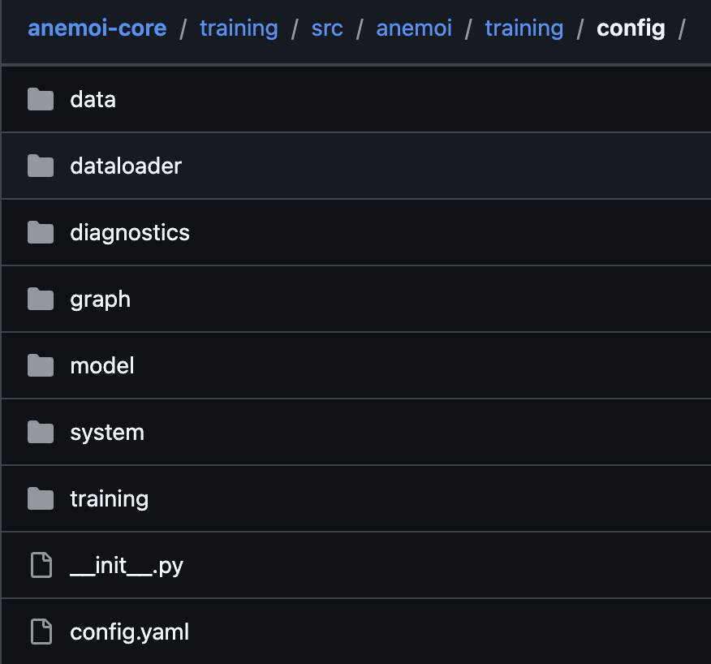
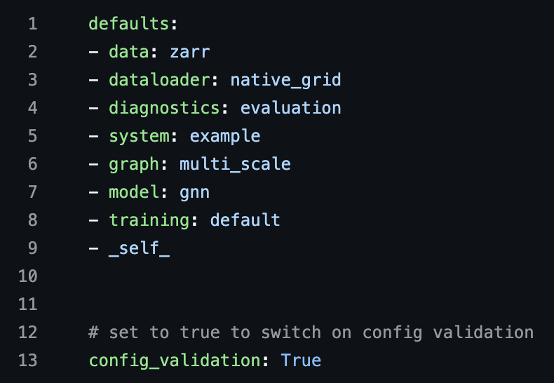
How to Train a Model with Anemoi
After package installations, run > anemoi-training config generate
Then these folders and yamls populate for you
Each folder comes with a few yamls that configure your training set up
Insanely customizable!
  More about each folder on next slide
We will look more at individual yamls when we run through the full demo… to be continued!

Slide 13
Possible Configurations
After you have configured yamls, submit training with:
> anemoi-training train —-config-name=config
Data: define data source, temporal frequency, normalization scheme
Dataloader: define training/validation/test datasets, and loading strategy
Diagnostics: set up plotting, logging, profiling, etc.
Graph: define graph structure (multi scale, hierarchical, limited area…)
Model: gnn, transformer, graph transformer
System: paths to data, slurm configuration, accelerator
Training: default, ensemble, diffusion, LAM, stretched grid
config.yaml = main config!

Slide 14
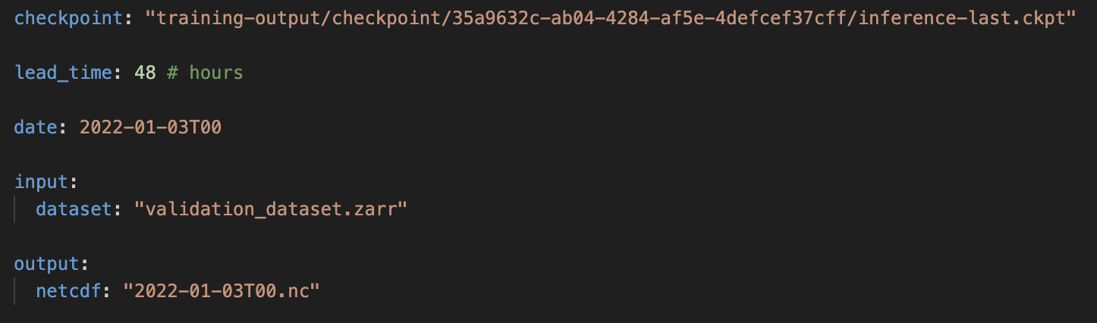
Step 3
Inference
ML Pipeline Steps
Data Preprocessing
Model Training
Inference
Post-processing
Verification
Anemoi-training saves out checkpoints throughout the training run
These checkpoints contain model weights that can be reloaded to create forecasts
> anemoi-inference run inference_config.yaml

Slide 15
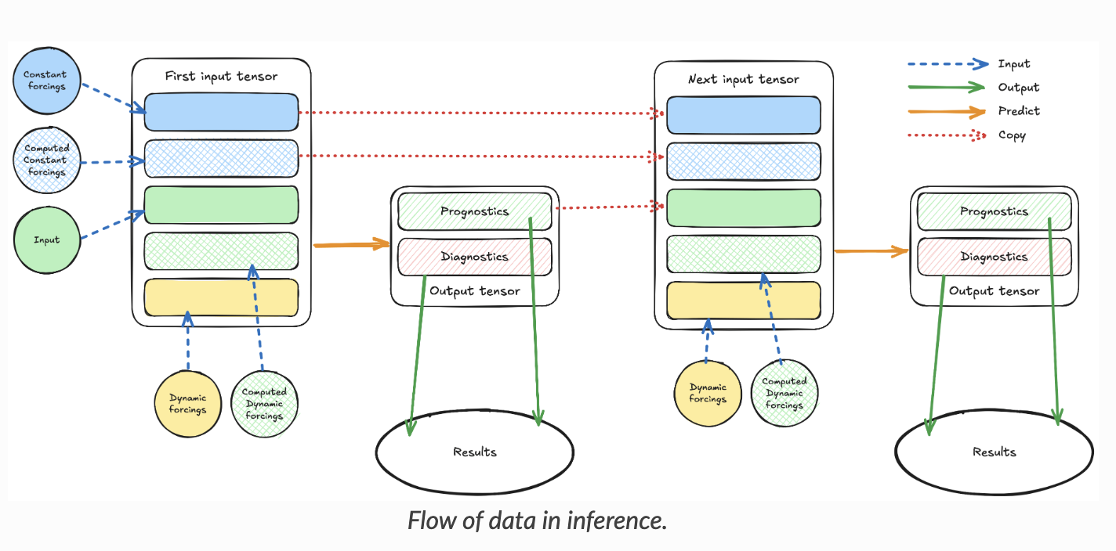
Source: anemoi-inference documentation

Slide 16
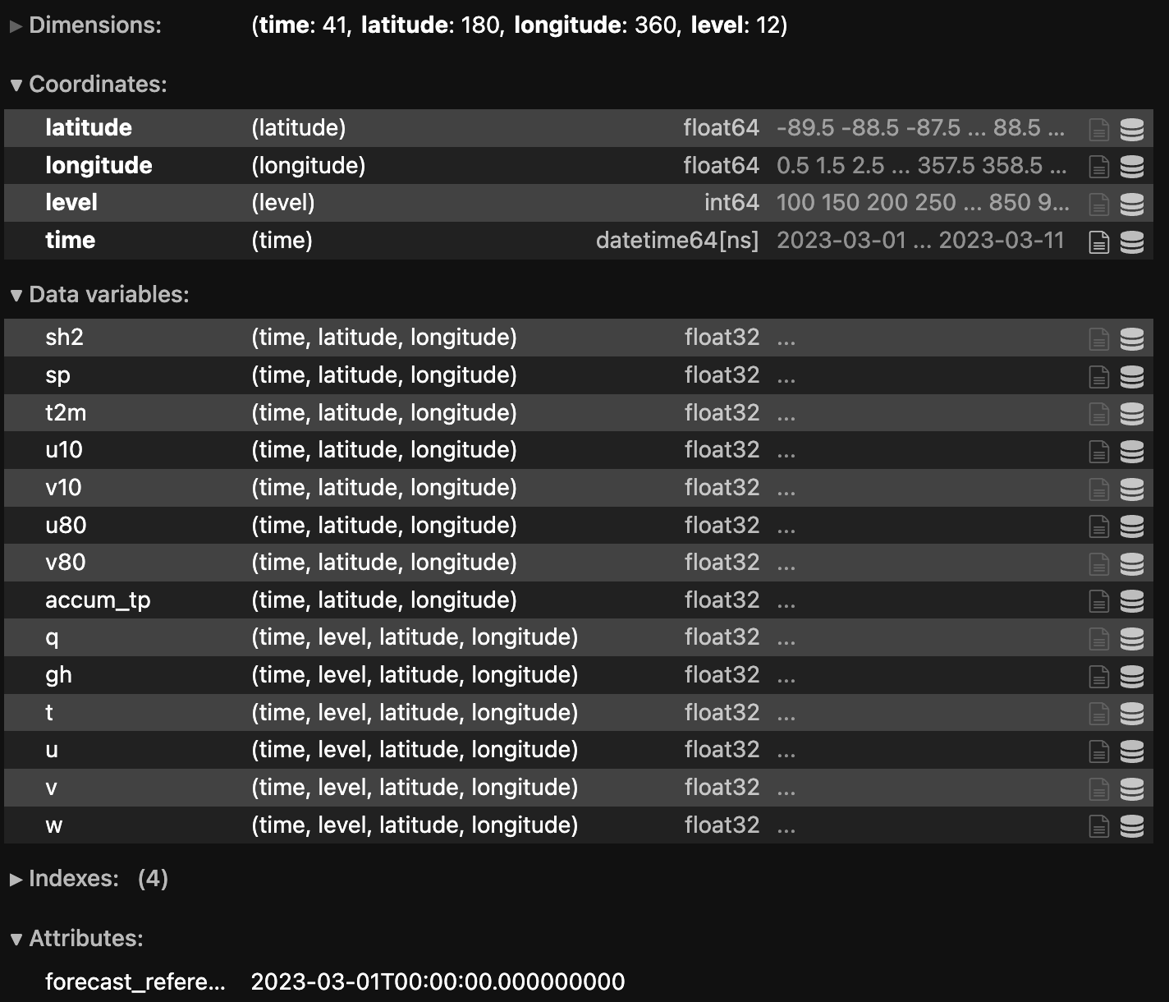
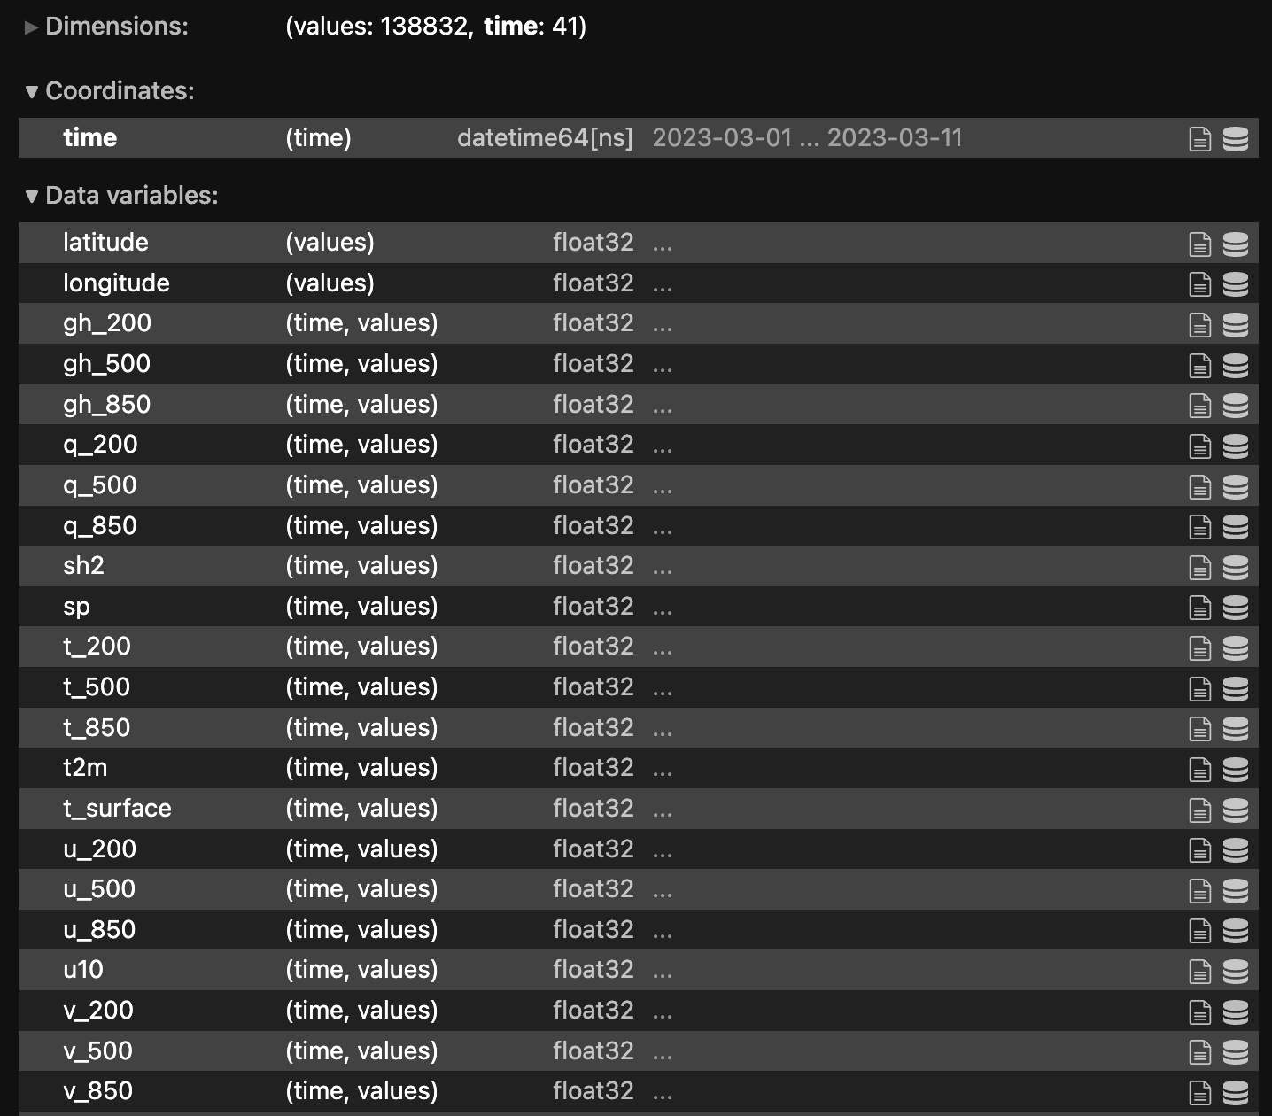
ML Pipeline Steps
Data Preprocessing
Model Training
Inference
Post-processing
Verification
Step 4: Post-processing

Slide 17
Step 5
Verification
wxvx
Python wrapper for MET/METPlus
Configurable via simple yaml changes
  Flexible to number of forecast cycles and forecast lengths
  Flexible to model output, e.g., variables, vertical levels, different coordinate configurations and more
Supports global and regional grid-to-grid and grid-to-obs forecast verification.
ML Pipeline Steps
Data Preprocessing
Model Training
Inference
Post-processing
Verification
GFS
Your Model

Slide 18
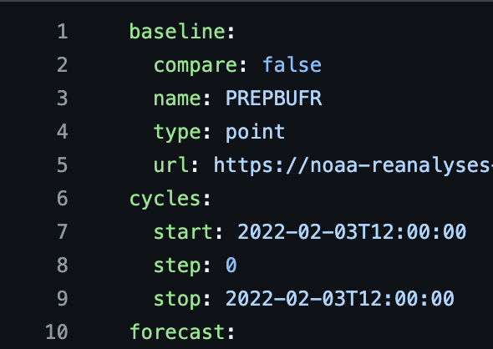
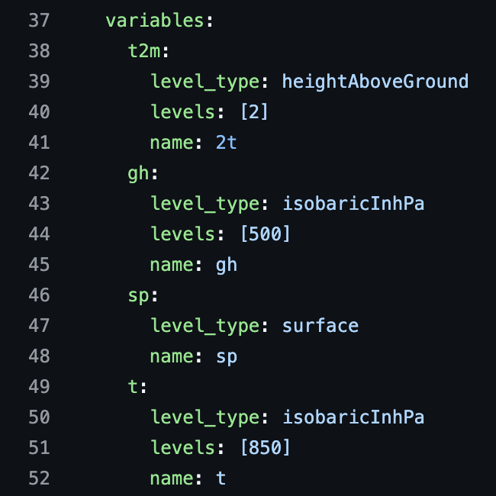
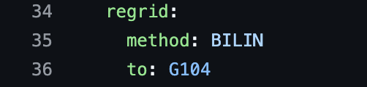
> vim config.yaml
Steps within wxvx:
-t grids
Stage the baseline grids to disk
Stage the forecast grids
-t stats
Produce statistics via MET tools
-t plots
Plot statistics
Calling -t plots automatically invokes -t grids and -t stats, but will not re-do work if those steps were already completed.
> wxvx -c wxvx_config.yaml -t plots

Slide 19
Finally…
We are going to run nested-EAGLE ourselves!
Link will be sent in slack

