Slide 1


EPIC - AMS26 AI EPIC Short Course - Intro
EPIC: Keven Blackman, Mariah Pope, Andrew Justin, Natalie Perlin
Brandon Selbig, Anna Kimball, Aaron Jones

Slide 2

Short Course logistics
Wifi name: amsam2026
Wifi password: amshou2026
Github: NOAA-EPIC/AMS-2026-short-course
Key point: Please don’t go ahead!
Time (EDT) | Content | Presenter
8:30 AM - 8:45 AM | Introduction | Keven Blackman and Mariah Pope (John Ten-Hoeve Additional Remarks)
8:45 AM - 9:00 AM | Google Colab Notebook | Keven Blackman
9:00 AM - 9:30 AM | Project EAGLE and AI overview | Keven Blackman
9:30-9:40 | BREAK
9:40 AM - 11:00 AM | Anemoi Framework | Mariah Pope
11:00-11:10 | BREAK
11:10 AM - 11:50 PM | Inference | Keven Blackman
11:50 PM - 12:00 PM | Closing | Keven and Mariah

Slide 3
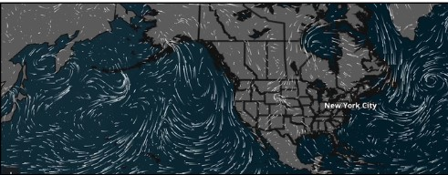
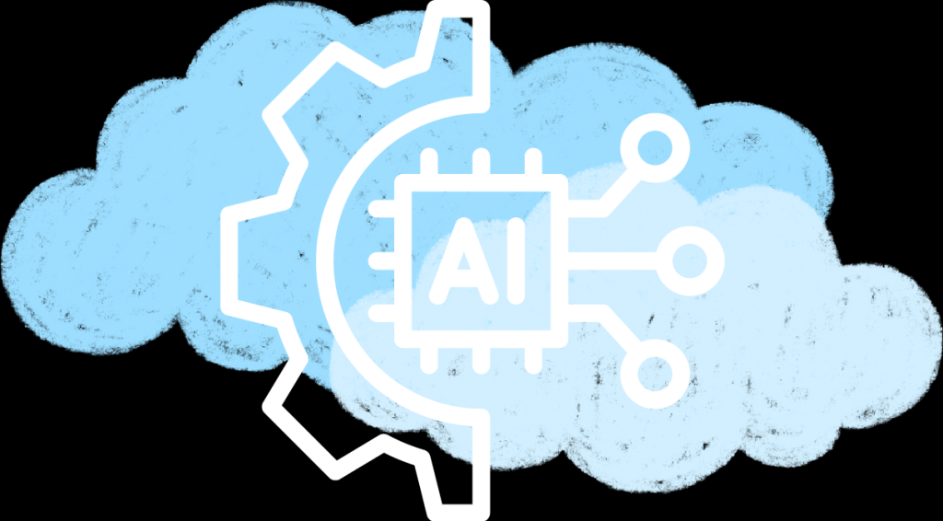
Short Course Overview
Introduction to Project EAGLE: Provide an overview of the objectives and components of Project EAGLE, emphasizing its role in advancing AI-driven global and limited-area weather forecasting and its significance for meteorologists and engineers.
Understanding AI in Weather Forecasting: Explain the fundamentals of Artificial Intelligence (AI) and machine learning in the context of meteorological models, highlighting how AI complements traditional physics-based forecasting systems.
Exploring the Global-EAGLE-Solo and Ensemble Systems: Dive into the technical details of the Global-EAGLE-Solo and Global-EAGLE-Ensemble components, including their initialization processes, data sources, and integration with NOAA’s operational systems.
Hands-On Model Analysis and Visualization: Guide participants through analyzing and interpreting Project EAGLE output, using visualization tools to examine key atmospheric variables and forecast performance metrics.
Future Directions and Collaboration Opportunities: Discuss the ongoing development of Project EAGLE, including advancements in data formats and cloud-native technologies, and highlight opportunities for meteorologists and engineers to contribute to or collaborate on this cutting-edge initiative.

Slide 4
Short Course main points
Data Preprocessing: Explore the methods and tools used to prepare large-scale meteorological datasets, such as NOAA’s Global Data Assimilation System (GDAS) and ERA5 reanalysis data, for use in AI models. Emphasize the importance of data quality, normalization, and feature engineering in ensuring accurate model outputs.
Training AI Models: Walk through the process of training AI models like GraphCast, including techniques for fine-tuning model weights, selecting training targets, and leveraging ensemble datasets. Discuss computational requirements and the role of high-performance computing in model training.
Inference and Forecast Generation: Examine how trained AI models are applied to generate forecasts, focusing on the steps involved in running inference, producing ensemble predictions, and generating 16-day forecasts at high spatial and temporal resolutions.
Verification and Performance Evaluation: Highlight the importance of verifying AI forecast accuracy against trusted NOAA metrics, such as those used in the Global Forecast System (GFS) and Global Ensemble Forecast System (GEFS). Introduce participants to graphical tools and statistical methods for evaluating forecast skill and reliability.
Focus question: How do I incorporate my data? We will try and highlight this through the presentation.

Slide 5
EPIC - AMS26 AI EPIC Short Course - Project Eagle
EPIC: Keven Blackman, Mariah Pope, Andrew Justin, Natalie Perlin

Slide 6
AI world is moving fast
2021
2022
2023
2024
2025
2026
2027
NOAA GFS
GFS16
GFS17
ECMWF (AIFS)
Evaluation of external models
AIFS development starts
AIFSv1
Anemoi released
AIFS-single
Pangu Weather and GraphCast papers
AIFS-ens
NOAA EAGLE
WofSCast
Global-EAGLE
HRRRCast
T2O AIGFS
EAGLE-X
Major upgrade to a legacy NOAA model is taking 5 years.
ECMWF went from evaluation of external models to operational AIFS in 2 years.
NOAA went from grass root efforts to real-time demonstration in about a year.

Slide 7
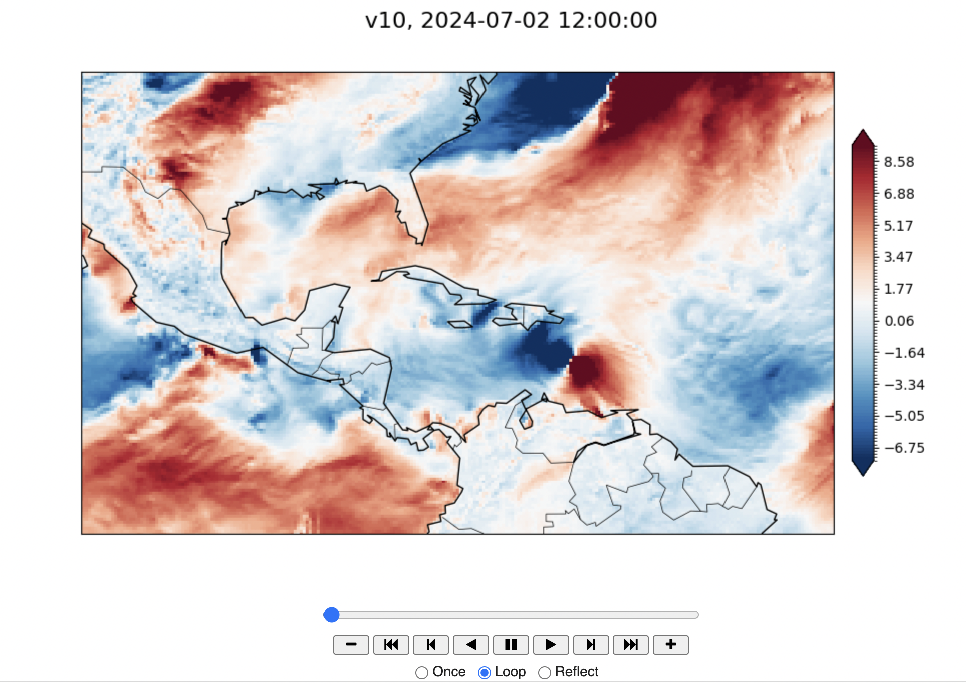
AI - Project Eagle
Rapid AI Integration for Weather Forecasting: Project EAGLE is a NOAA initiative that leverages Artificial Intelligence (AI) to enhance global and limited-area weather ensemble forecasting. It provides a platform for researchers to test and demonstrate AI models against trusted forecast metrics used by NOAA systems like the Global Forecast System (GFS) and the Global Ensemble Forecast System (GEFS).
Key AI Model Demonstrations: The project includes two components: Global-EAGLE-Solo, which focuses on deterministic models initialized from single GFS conditions, and Global-EAGLE-Ensemble, which develops ensemble systems using GEFS initial conditions. Both components utilize Google DeepMind’s GraphCast AI model, fine-tuned with NOAA data, to produce forecasts on a 0.25-degree latitude-longitude grid for up to 16 days.
Data Accessibility and Future Enhancements: Project EAGLE’s output is disseminated via the NOAA Open Data Dissemination Program (NODD) and includes major atmospheric and surface field forecasts. Current outputs are in GRIB2 format, but future versions aim to adopt modern cloud-native storage formats, enhancing accessibility and usability for the broader weather enterprise.

Slide 8
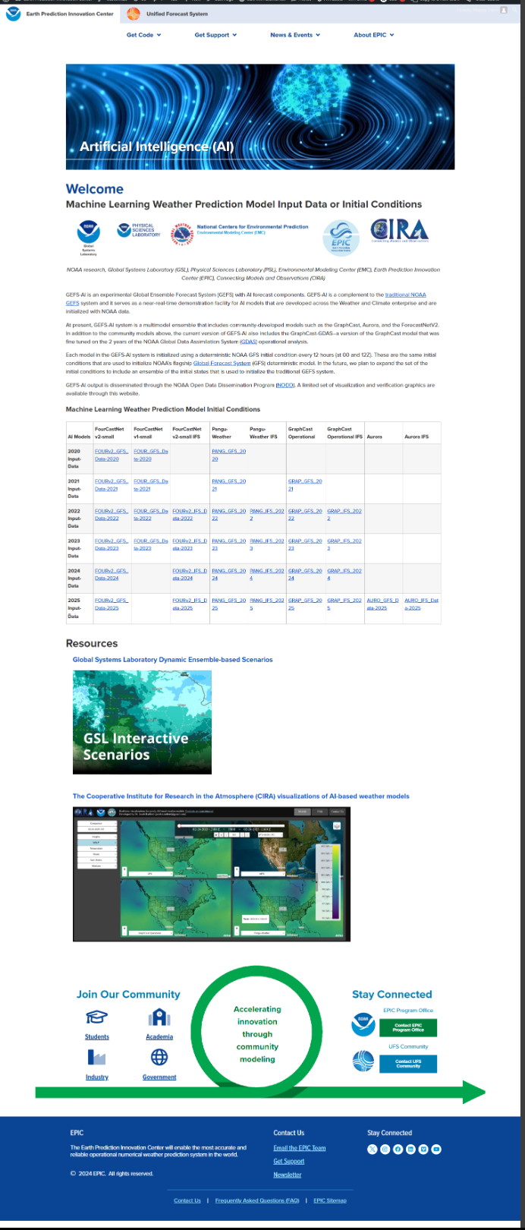
AI Website Updates
Add additional data sets
Rebrand to EAGLE-AI
Add updated notebook links
Update repositories
Update content
More blogs:
Check out the current Eagle-A Blog
Added graphics
https://epic.noaa.gov

Slide 9
How does NOAA stay relevant?
New and robust R2O pipeline
Unified platform for AI forecast
Robust verification pipeline
Drawing on the strength of the community
Separating EAGLE vs operational AIGFS family

Slide 10
EAGLE: a robust pipeline of innovation
Forecast Products
NOAA Dataset A
Project EAGLE Pipeline (Enabled by Anemoi & EPIC)
NOAA Dataset B
Datasets
Training
Models
Inference (Deployment)
External Dataset A
GEFS-AI Config
WOFS-AI Config
Co-Development with End Users (includes Testbed)
Automated Testing, Validation & Evaluation (using MET tools)
HRRR- Config
AR-AI Config
An aspiration to an integrated, open-development program that will:
Produce and release training datasets, models, and verification tools
Co-development of models and products with end-users and NWS partners
Pipeline for innovation across NOAA and wider community that funnels innovations to operations.

Slide 11
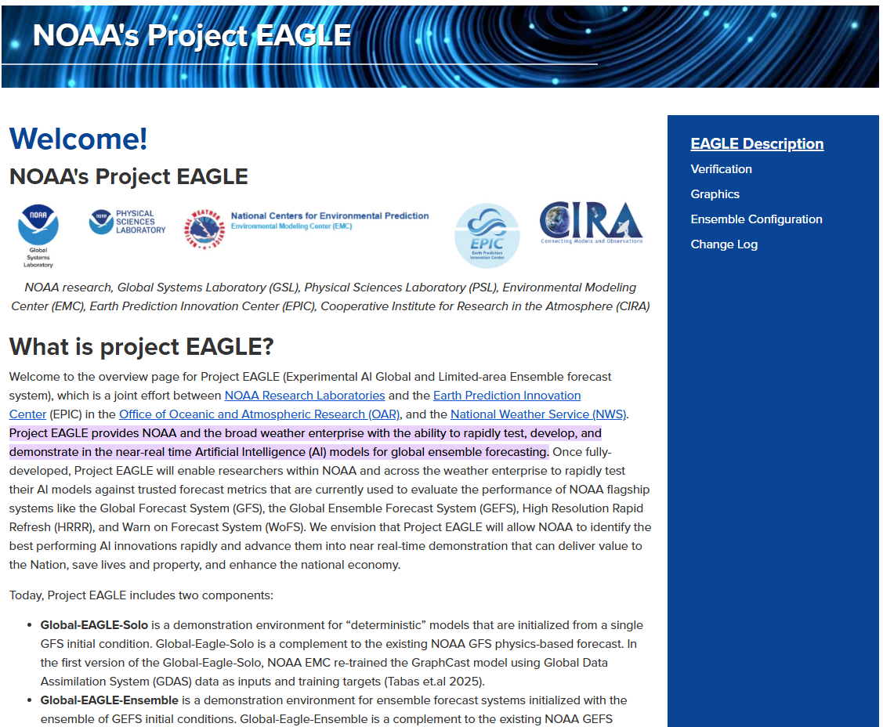
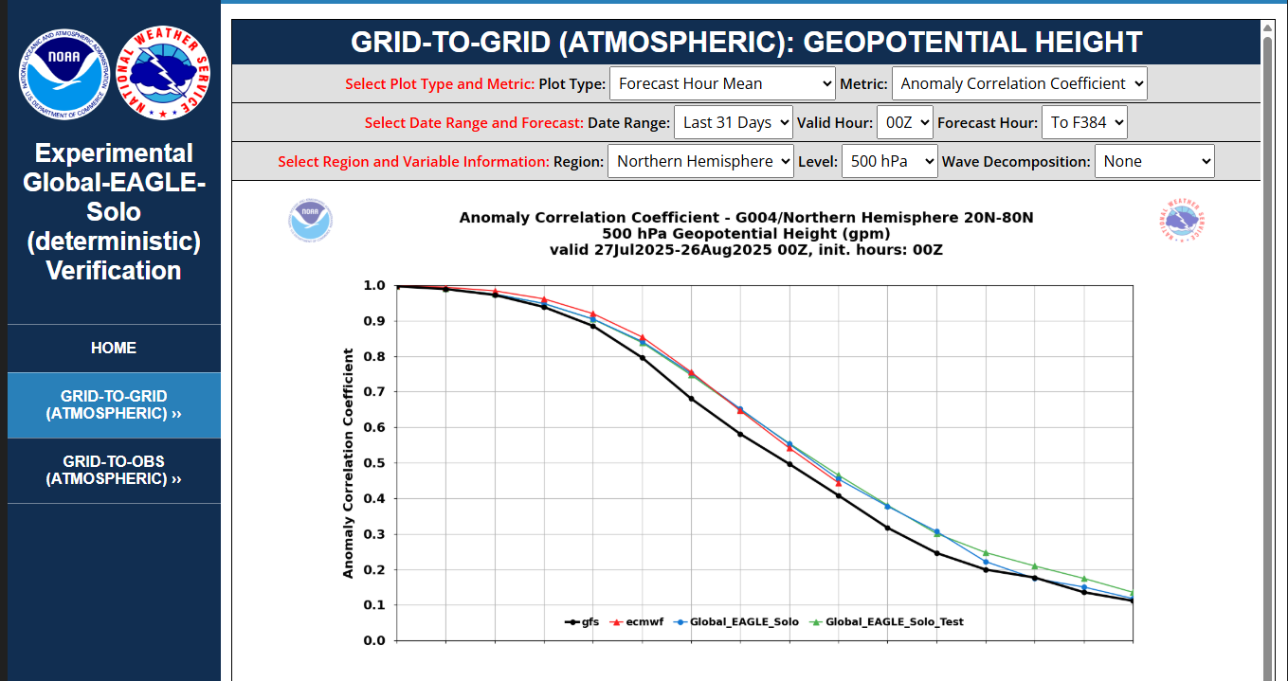
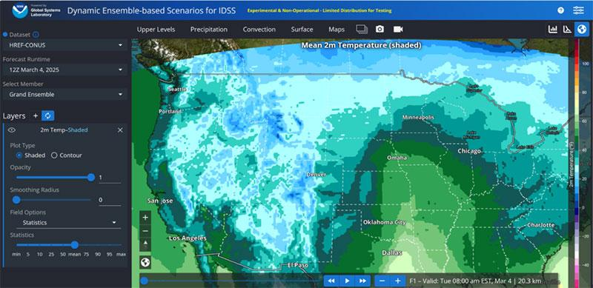
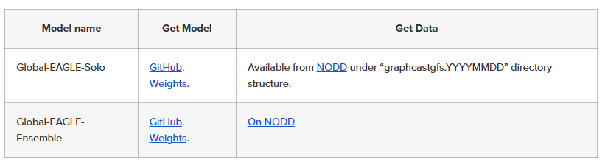
What is EAGLE today
A set of models: Global-EAGLE-Solo and Global-EAGLE-Ensemble.
A monitoring and verification system (using NOAA EMC’s EVS system).
A visualization page (using NOAA GSI DESI).
Model output, code, and weights in open access.

Slide 12
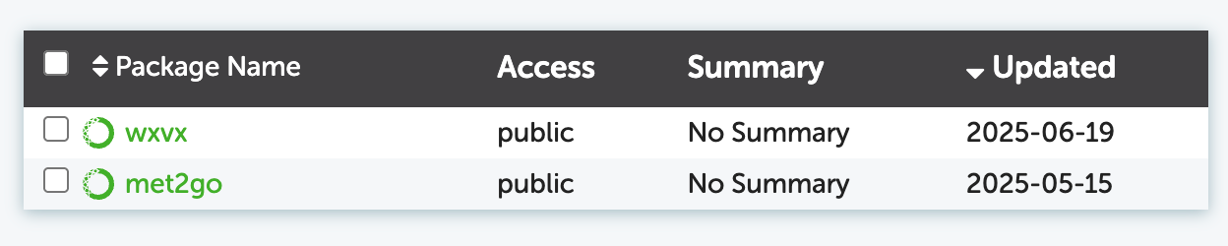
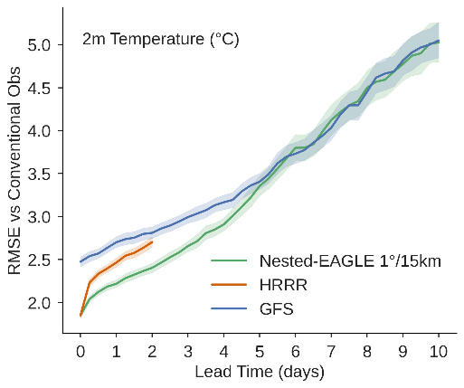
EAGLE: robust verification pipeline
EVS from NOAA EMC
wxvx from GSL/EPIC
For a single cycle, one-variable run, wxvx also:
Extracted 80 netCDF forecast grids
Downloaded 122 GRIB index files
Downloaded 122 GRIB messages
Produced 160 MET .stat files, which could be analyzed, visualized, etc. separately
The workflow task graph can get quite large!
NOAA EMC developed a comprehensive verification system for all NOAA forecast products
Based on the UCAR MET software
EVS software stack wasn’t designed to be portable and used by the community.
EPIC and GSL are packaging verification science from EVS as community python package (wxvx and met2go):
Should allow wider community of AI model developers to use NOAA metrics for verification of AI models.
Includes verification against observations.

Slide 13
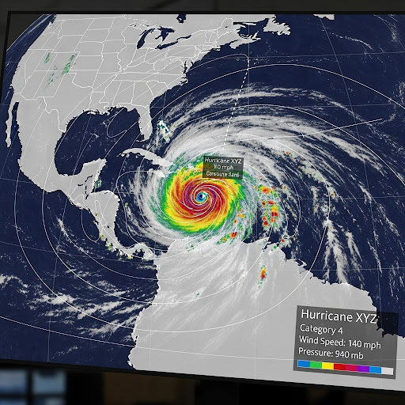
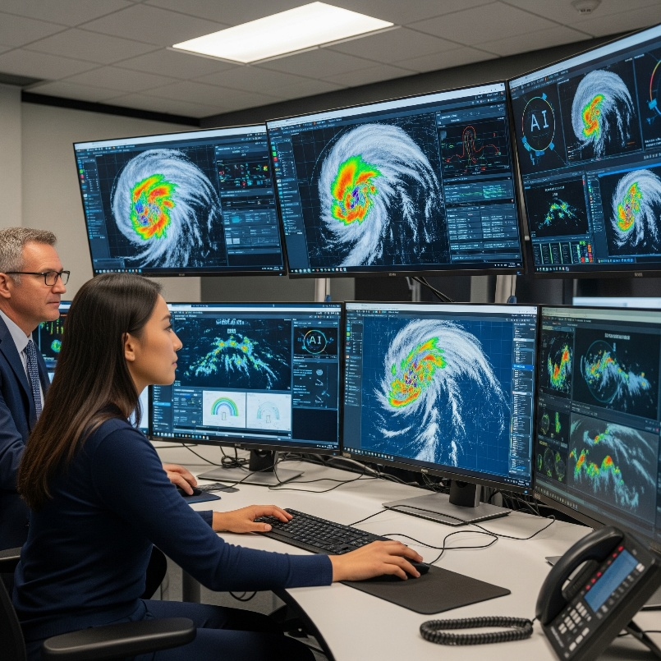
Operational wing of EAGLE
Data - Ensure data quality, presence, and efficient management
Performance - Monitor model performance for accuracy
Reliable and Secure - Guarantee system scalability and reliability
Forecaster Interpretation - Provide comprehensive operational training
Resources - Computational and personnel resources to ensure 24/7 operations
See talk from Jun Wang on transition of EAGLE to AIGFS/AIGEFS/HGEFS

Slide 14
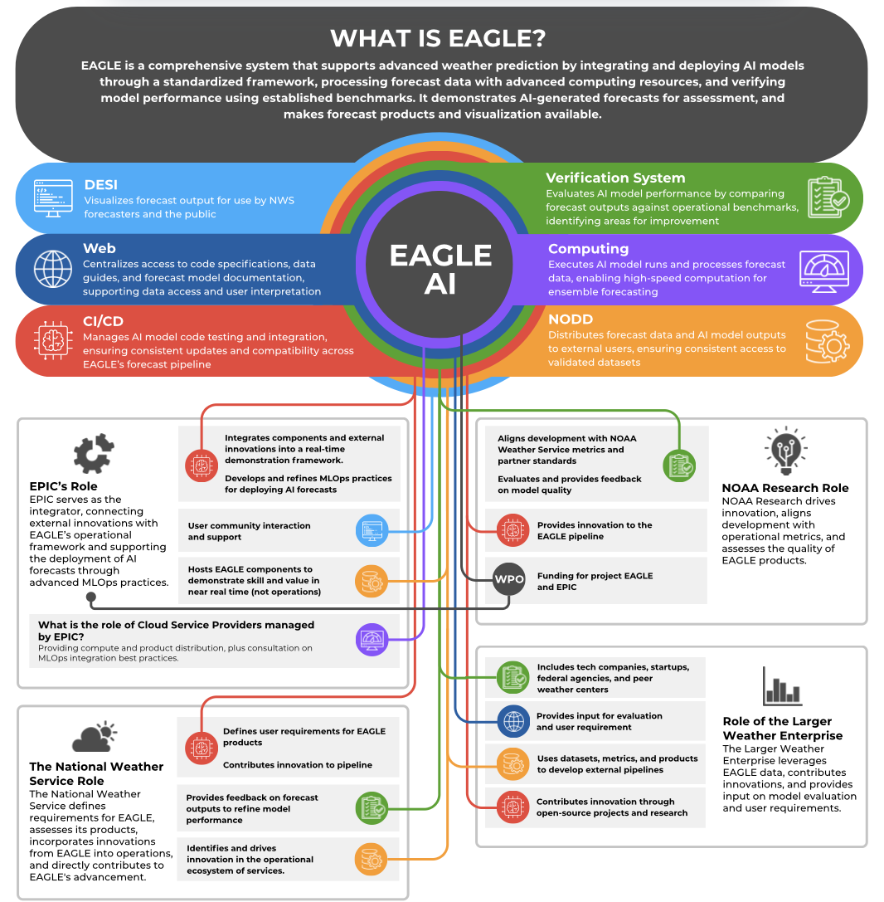
EAGLE community
Project EAGLE is aspiring to deliver the best AI model for the U.S. by leveraging the best in the U.S. weather enterprise.

Slide 15
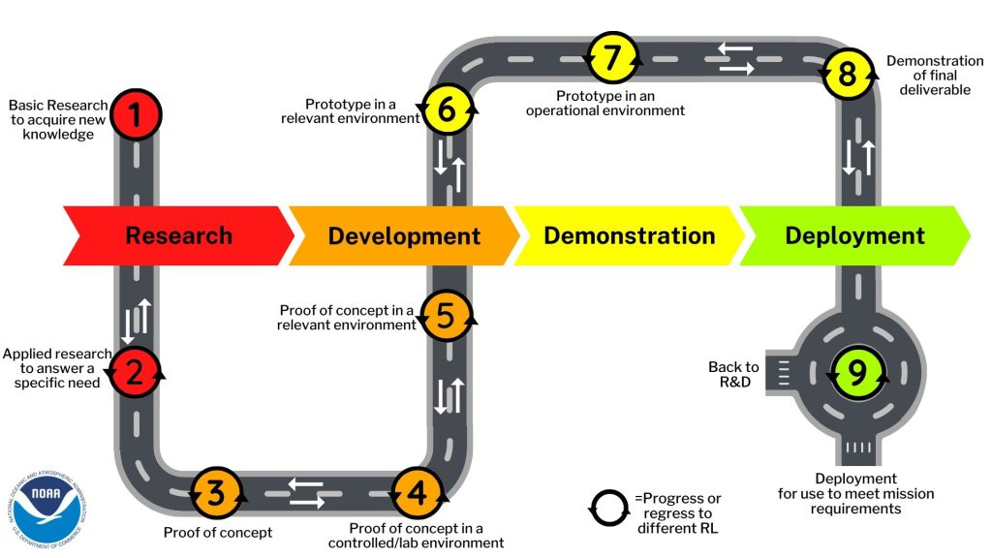
What is next for project EAGLE: map of future products
Application | Current RL
 | SOTA | at NOAA
Atmosphere-only | 9 | 9
Regional atmosphere | 7 | 8
Storm scale | 5 | 8
Nested atmosphere | 5 | 5
Coupled GEFS-like | 3 | 3
Coupled seasonal | 5 | 3
Data assimilation | 4 | 2
???
Operational suite provides good guidance to future EAGLE products.
NOAA is catching up fast to the state of the art.
What would it take for NOAA to lead across the board?

Slide 16
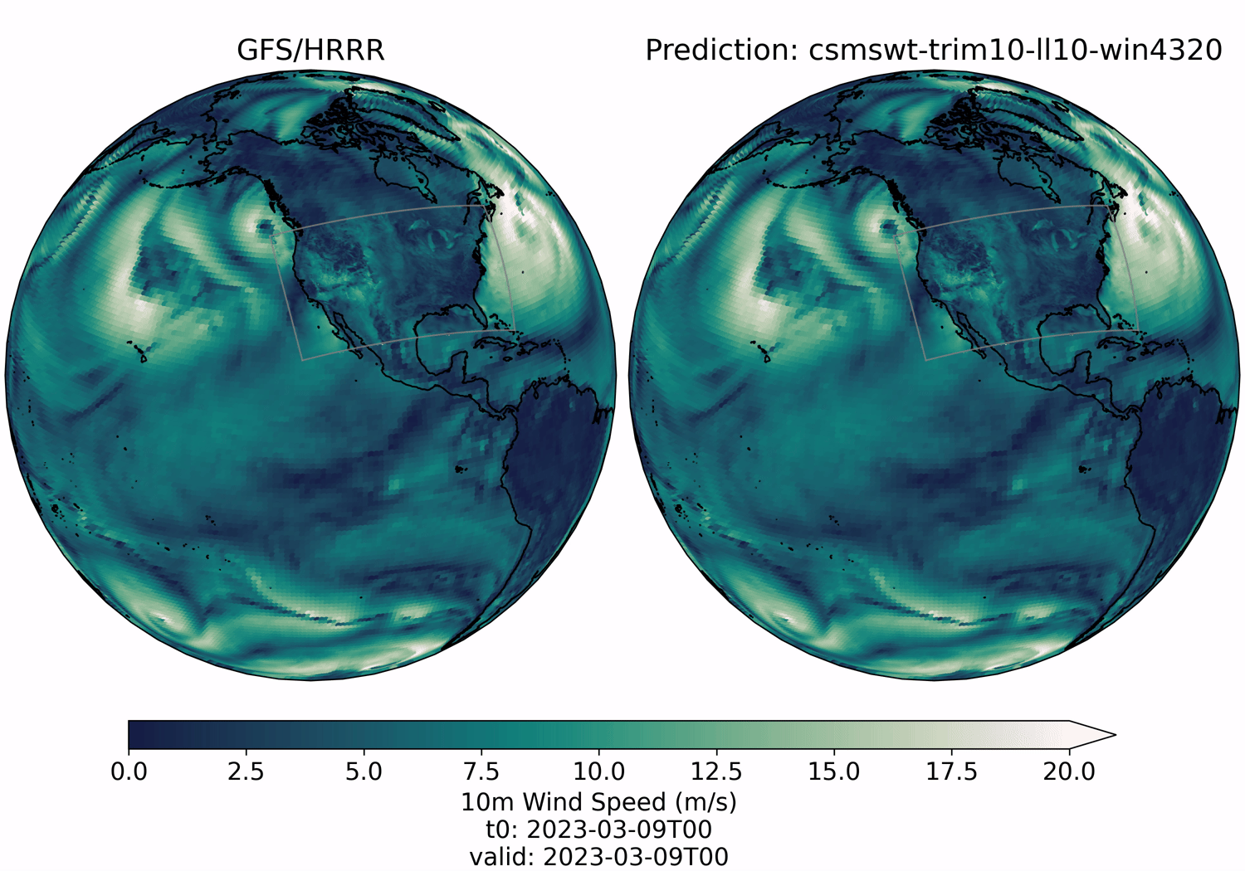
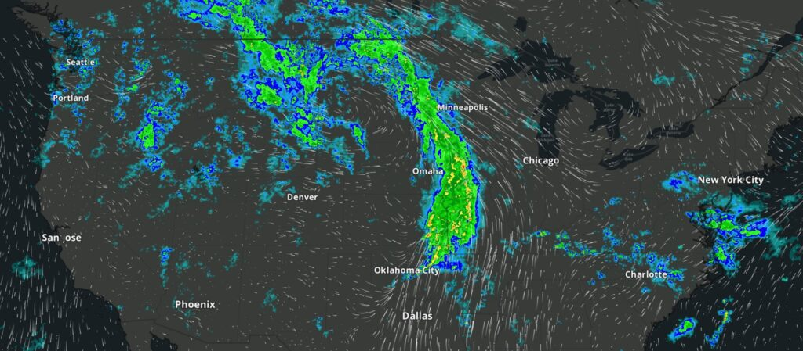
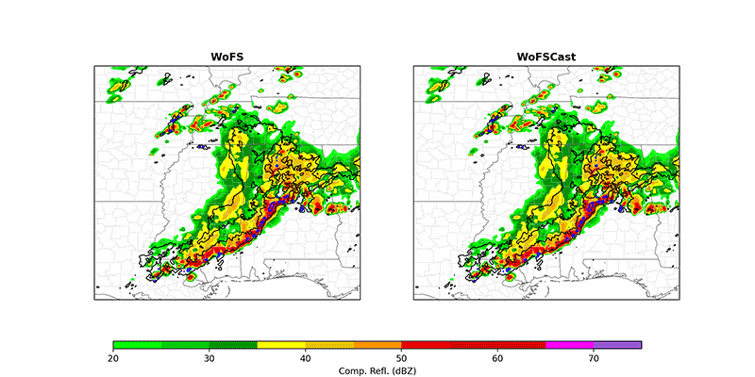
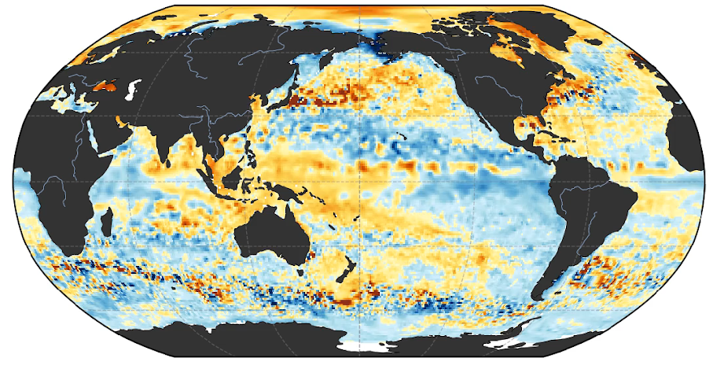
What is next for project EAGLE (6-12 months)
Nested-Eagle: combines the best of HRRR and GFS (talk Tim Smith)
HRRRCast: CONUS-scale ensemble (talk Isidora Iankov)
WOFSCast: storm-scale model (talk Corey Potvin)
3D ocean prediction (talk Niraj Agarwal)

Slide 17
What is next for project EAGLE (12-24 months)
Migrating many of our applications to unified modeling platform (Anemoi):
Release of the verification pipeline for AI models against observations.
Addition of new AI systems:
HRRRCast, WofSCast, Nested-EAGLE, Coupled model?
Developing release strategy
Aiming to frequent upgrades and releases (e.g. continuous deployment)
Driven by science results and verification.
Maintaining parallel experimental versions in addition to the operational version.

Slide 18
EPIC - AMS26 AI EPIC Short Course - Closing
EPIC: Keven Blackman, Mariah Pope, Andrew Justin, Natalie Perlin

Slide 19
Short Course closing points
ERA6 on the Horizon: Scheduled for delivery in late 2026, ERA6 will redefine global weather and climate analysis capabilities.
Increased resolution from ¼ degree to 14 km.
Improved ocean-atmosphere coupling
Cutting-Edge AI Techniques: Leveraging deep learning, neural networks, and ensemble modeling for enhanced prediction accuracy.
Seamless Data Integration: AI-driven frameworks enable the fusion of high-volume, multi-source datasets for comprehensive models.
Future Applications: Transforming weather forecasting, disaster mitigation, and climate resilience strategies globally.

Slide 20
Short Course closing points
Scalable AI Infrastructure: Investment in robust computational resources ensures the scalability of AI modeling efforts to handle growing data complexity and volume.
Real-Time Insights: Advanced AI systems facilitate near real-time analysis and decision-making, empowering faster responses to dynamic environmental changes.
Interdisciplinary Collaboration: Success in AI modeling is driven by collaboration across domains, integrating expertise from data science, meteorology, oceanography, and climate science.
Ethical AI Practices: Adherence to responsible AI principles ensures transparency, fairness, and accountability in modeling outcomes and their applications.
Pushing research to operations!

