Slide 1
The NOAA Anemoi Experience
Scalable and User-Friendly Tools for Training AI Weather Prediction Models
Mariah Pope¹, Timothy A. Smith², Sergey Frolov², Daniel Abdi³, Isidora Jankov³, D. Alex Burrows¹, Anil Kumar¹, Paul Madden³
An EPIC¹, PSL², GSL³, and EMC⁴ collaboration

Slide 2
Overview
Training machine learning models with custom (NOAA) data can be a cumbersome process due to hardware setup, staging data, and efficiently scaling the model. This burden creates a steep learning curve for users that is a barrier to quick scientific iteration and progress.
What if we could create or deploy existing tools to create a
user-friendly and customizable machine learning pipeline?
We present a framework of community tools for developing machine learning weather models that will hopefully enhance collaboration and speed up scientific progress by providing a coherent and scalable end-to-end pipeline.
Notes:
04/01/2025

Slide 3
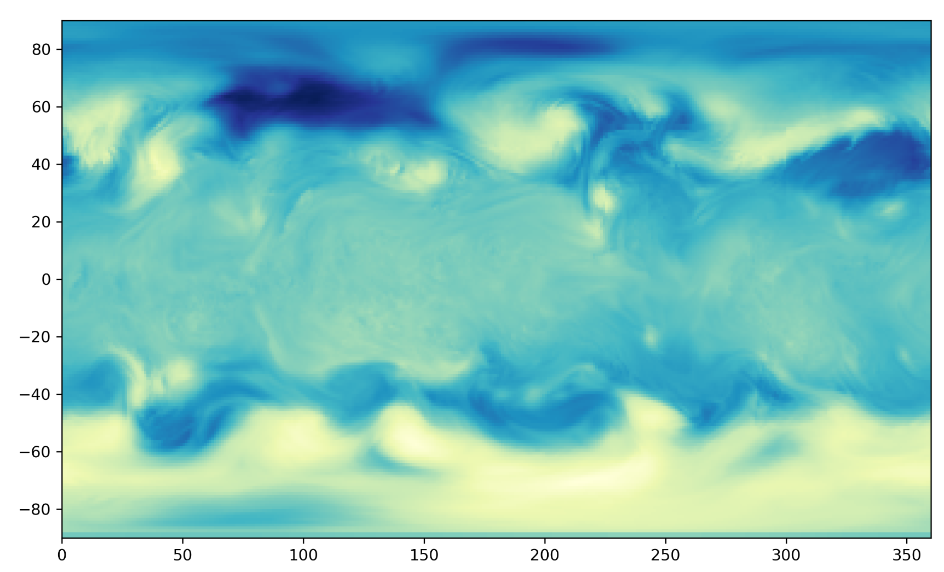
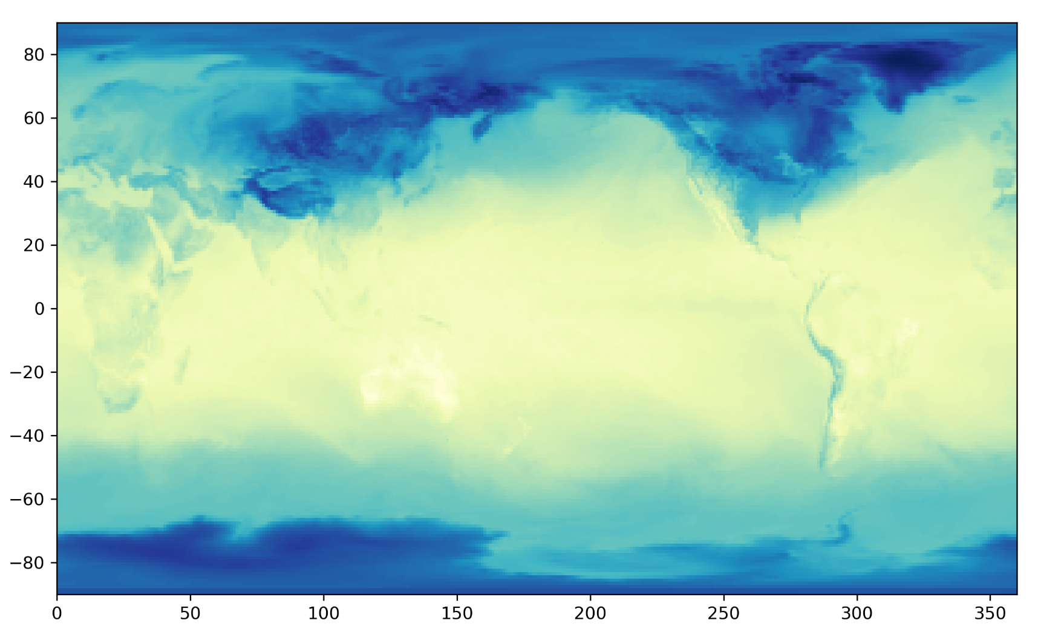
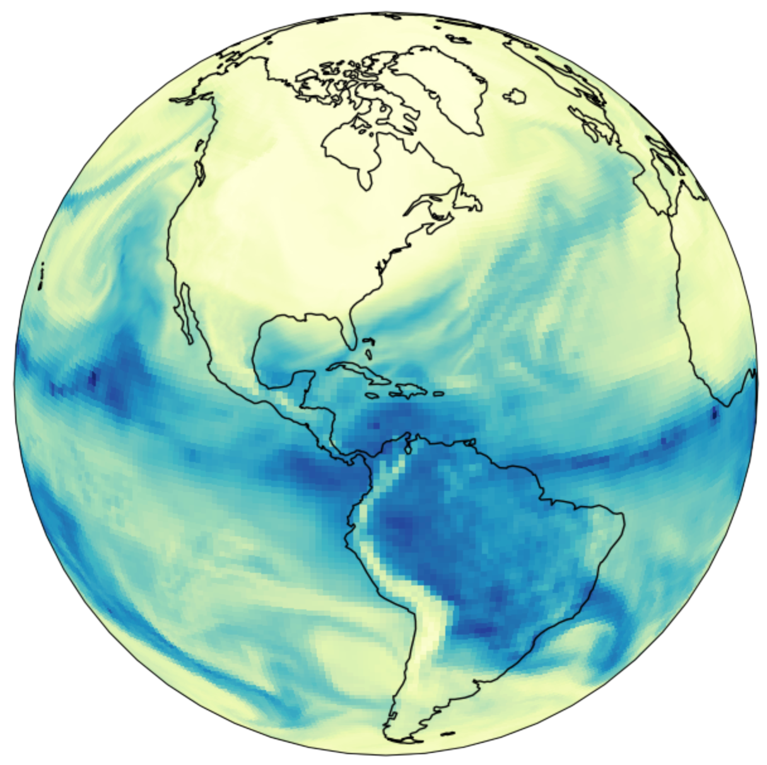
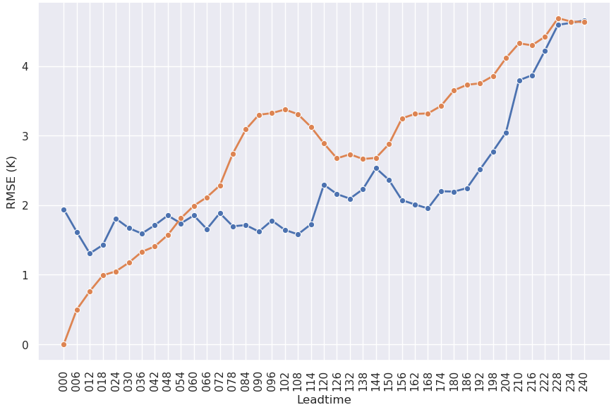

End-to-End Machine Learning Pipeline
ufs2arco
Tool for making NOAA data more accessible for analysis and machine learning
Anemoi-inference
Package within the Anemoi framework for creating forecasts from a model checkpoint
wxvx
Tool for verifying forecasts against various models (GFS/HRRR) or observations
Model Training
Post-processing
Create Conda Environments
DISPLAY RESULTS!
Data Preprocessing
Inference
Verification
Anemoi
Community framework for training graph-based machine learning weather models. We use the anemoi-core modules.
eagle-tools
Python functions to make inference output more interpretable and user-friendly
All required packages are easily installable via conda or pip!
Notes:
Note: remember to say that Anemoi also recently has transformer only options, but that they are mostly graph based.

Slide 4
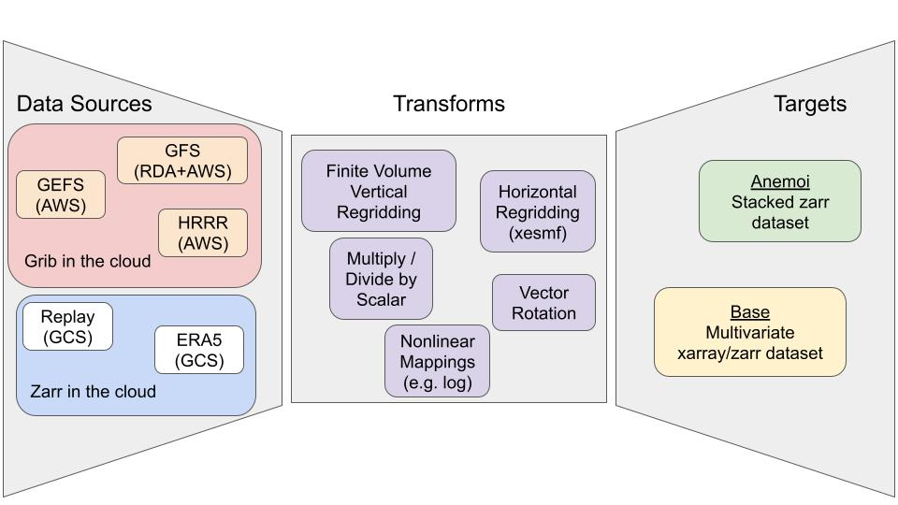
Step 1
Data Preprocessing
Most raw data are not ready for training a machine learning model
Thousands of netcdf or grib files
Reshaping, transformations, regridding, etc.
Handle missing values
Stored in a way that optimizes model training (e.g. chunks)
Anemoi requires a very specific data format and layout
Instead of storing many versions of large datasets in the cloud, ufs2arco enables users to process data themselves (and do it very quickly!)
Source: ufs2arco documentation

Slide 5
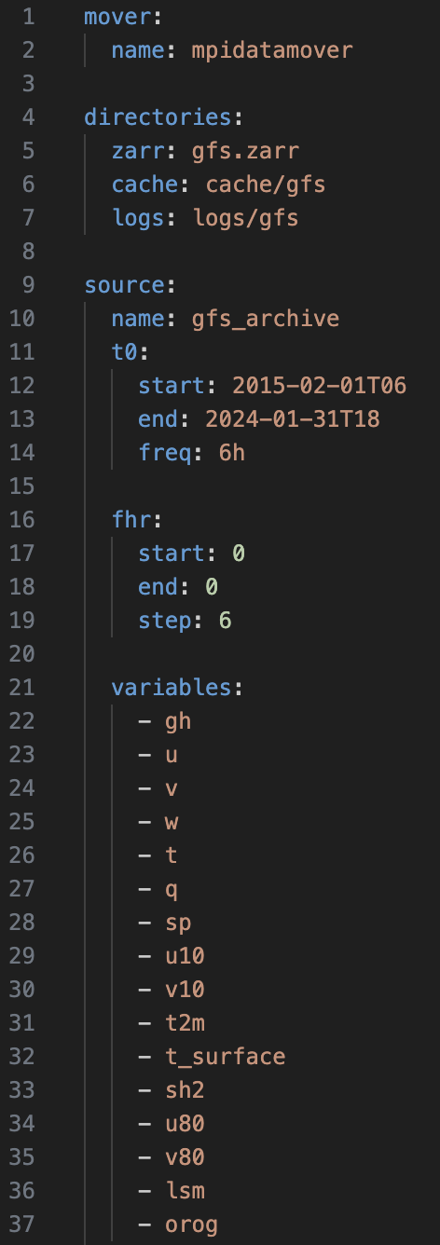
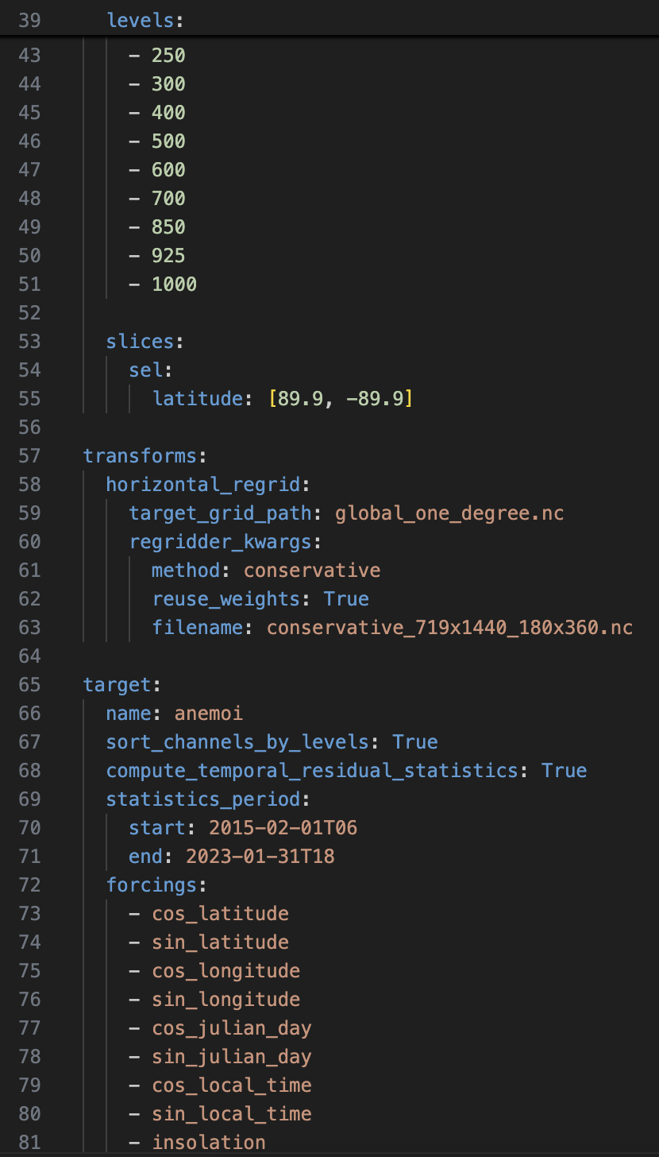
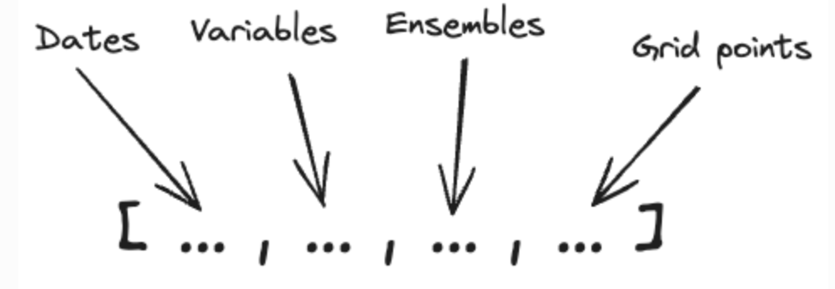
Run with 1 command
> ufs2arco gfs.yaml …..
Source: anemoi-datasets documentation
Example YAML
Important data considerations
Data structure
Statistics
Nan flag
All ensure that training will be successful and efficient

Slide 6
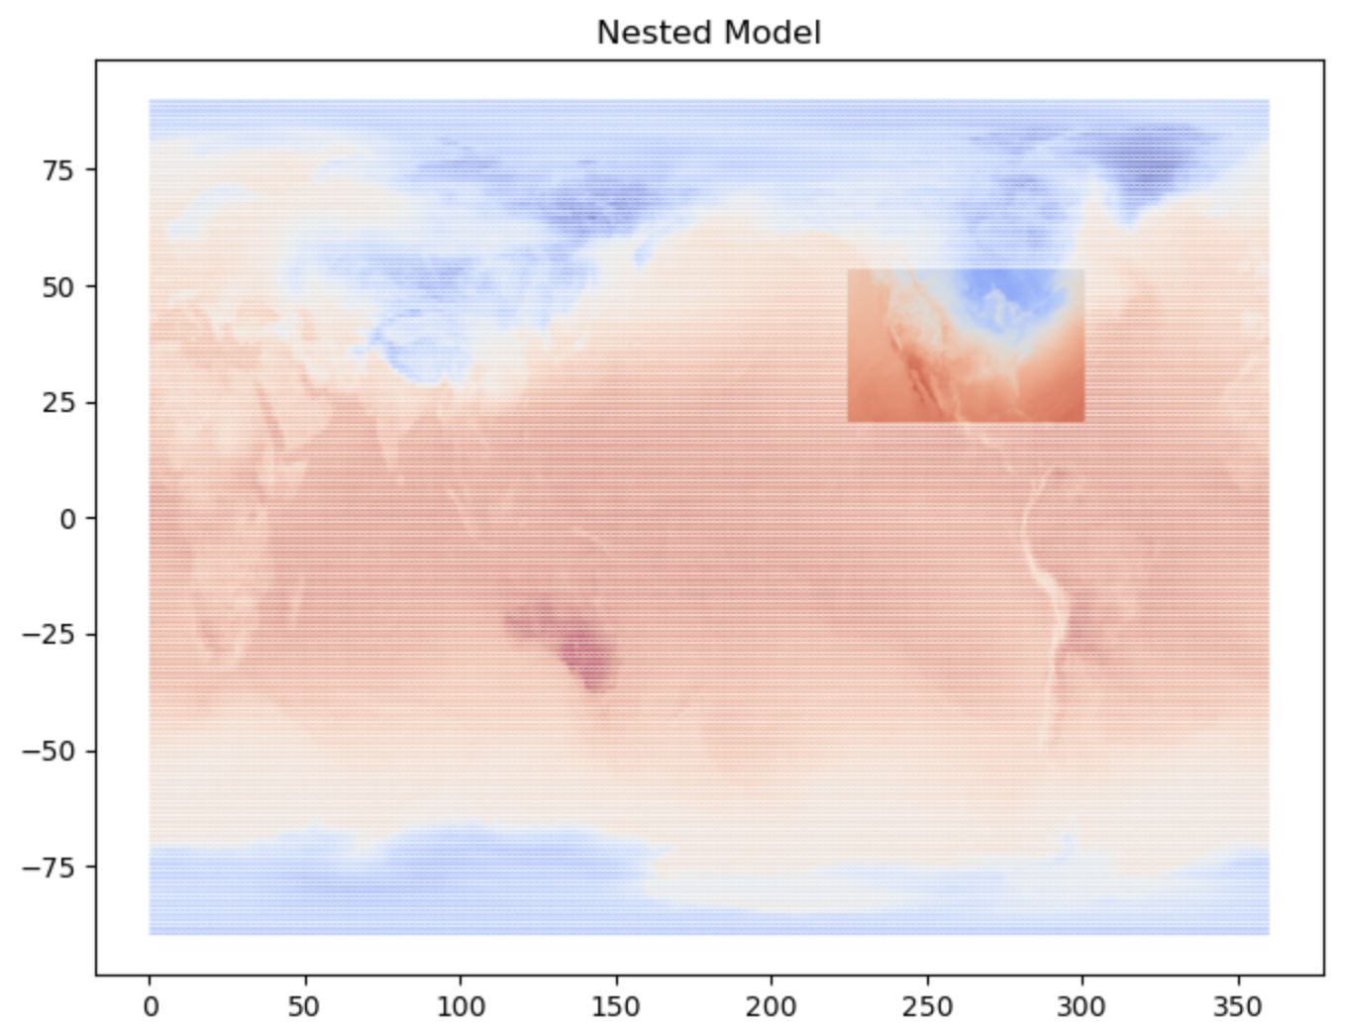
Step 2
Model Training
The Anemoi framework provides modules to train graph-based models
Encoder-processor-decoder structure with many customizable configurations
Architectures:
gnn: information from message-passing between neighbors all weighted equally
graph transformer: information from message passing can be weighted differently through an “attention weight”
transformer: sliding window processor where attention is defined within a chosen window
point-wise multilayer perceptron: simple feed forward NN applied at each point
Various configurations:
Global grids
Limited area modeling
Nested grids
Model Tasks:
Deterministic Forecasting
Ensemble Forecasting
Time Interpolation
Diffusion-based Forecasting

Slide 7
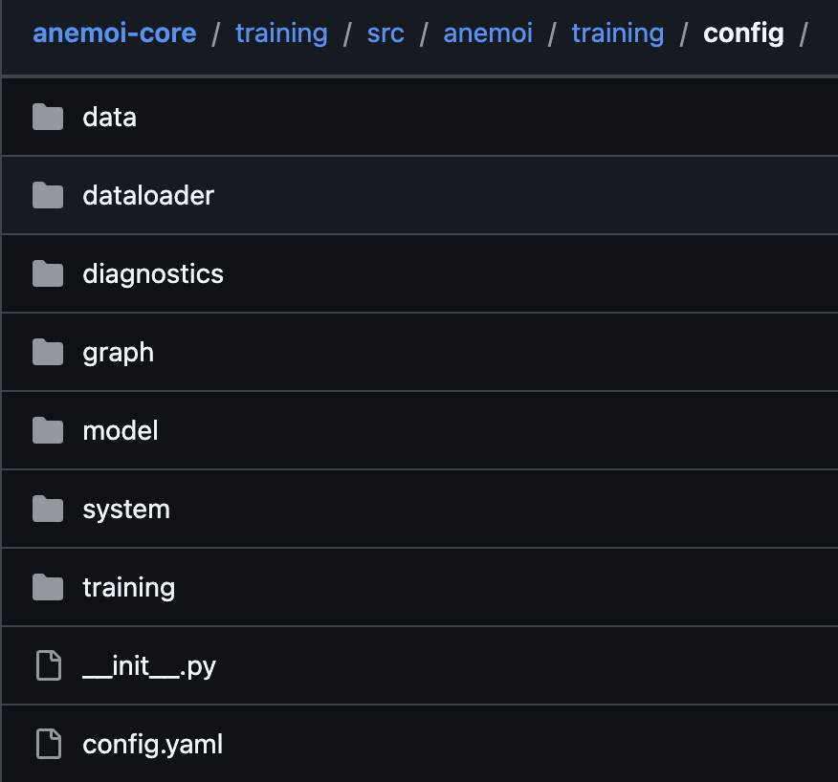
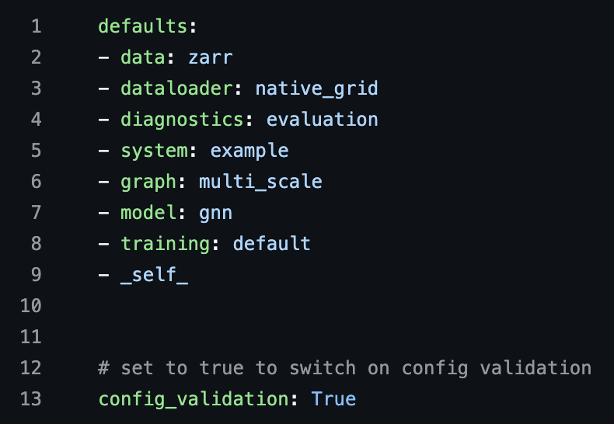
How to Train a Model with Anemoi
> anemoi-training train config.yaml
Yamls populate for you via a generate command
Each folder comes with a few yamls that configure your training set up
Insanely customizable via yaml changes
Packages used during training:
anemoi-graphs
anemoi-training
anemoi-models
Outputs:
Checkpoints
Logging via MLFlow, Weights & Biases, Tensorboard, etc.
Plots (loss, params)

Slide 8
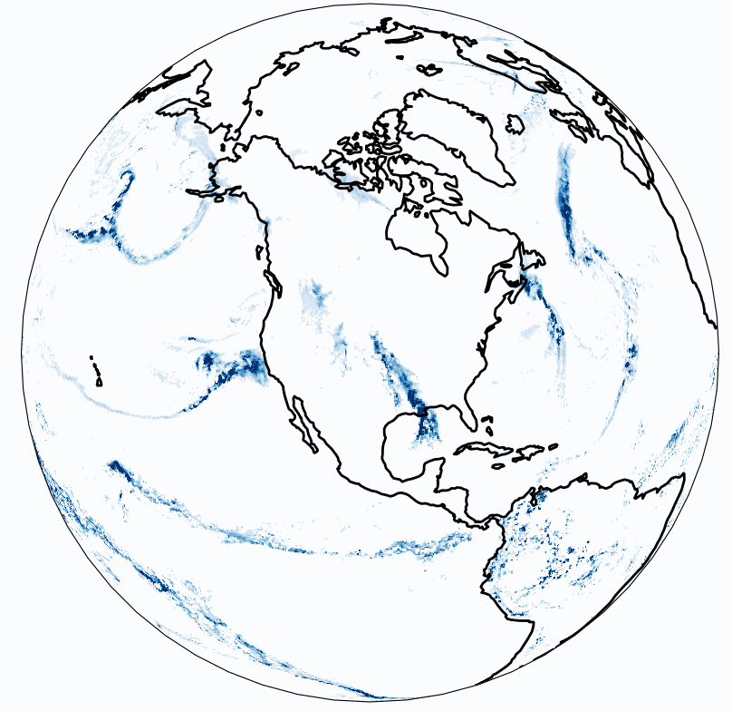
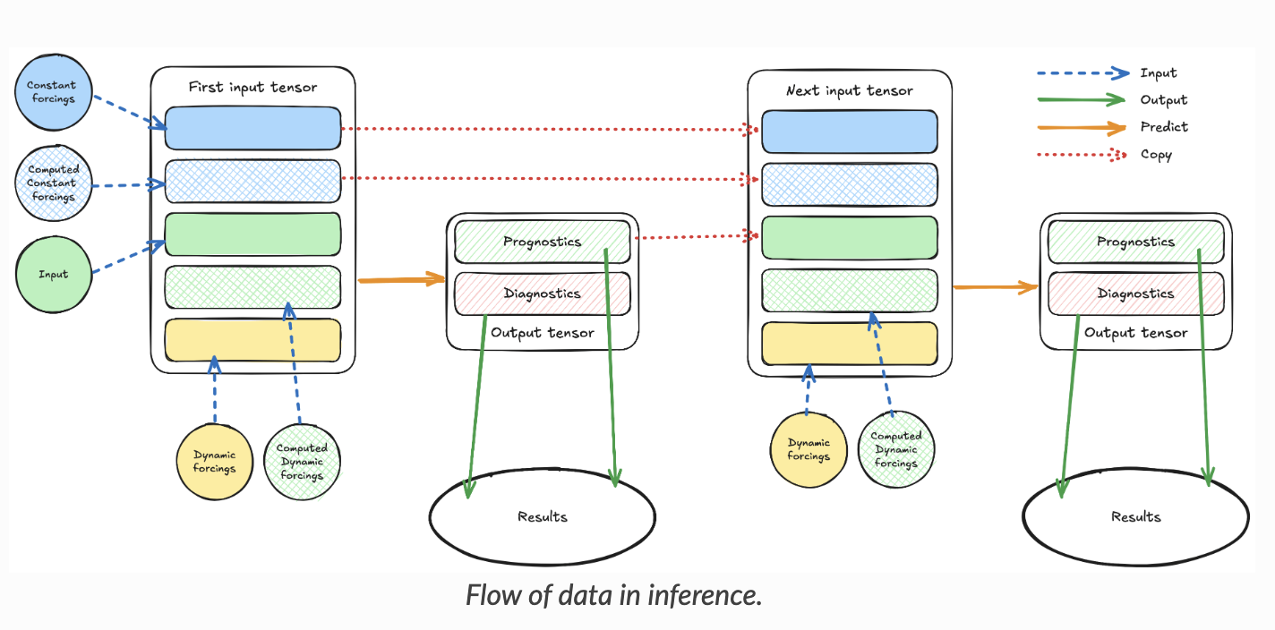
Step 3
Inference
> anemoi-inference run config.yaml
Anemoi-training saves out checkpoints throughout the training run
These checkpoints contain model weights that are reloaded to create forecasts
Source: anemoi-inference documentation

Slide 9
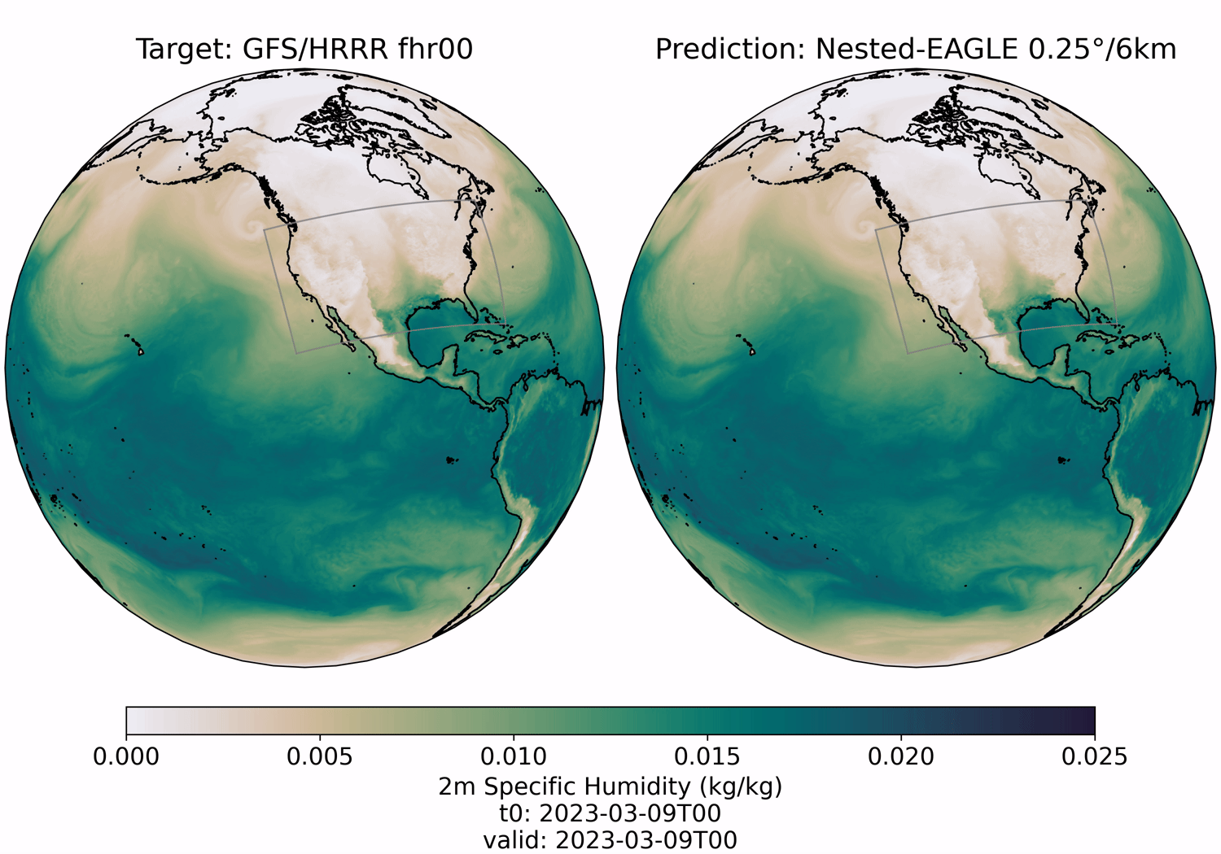
Step 4:
Post-processing and Visualization Tools
eagle-tools
Run inference at scale
Average error metrics
Spatial error
Power spectra
Visualize predictions vs. targets
Post-process inference to work with downstream applications
> eagle-tools movies config.yaml

Slide 10
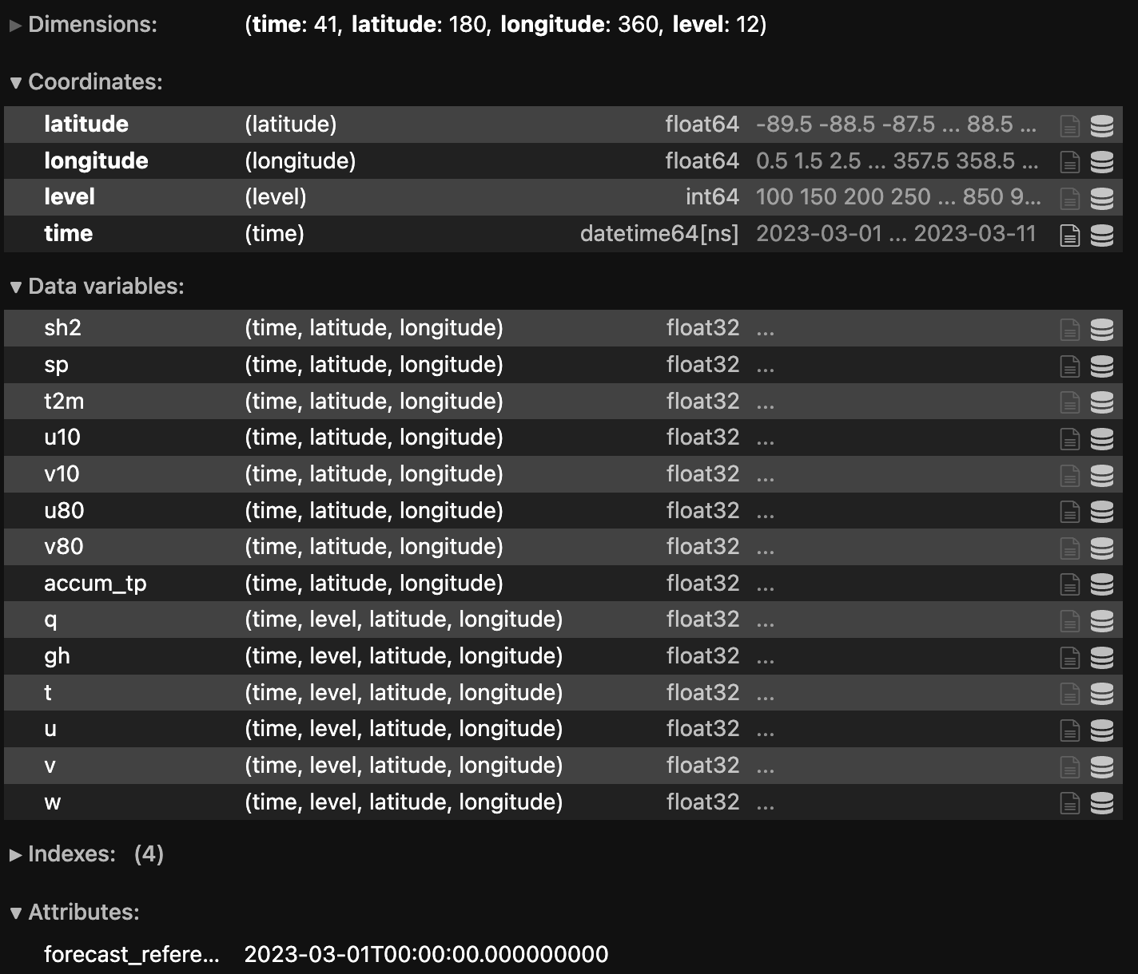
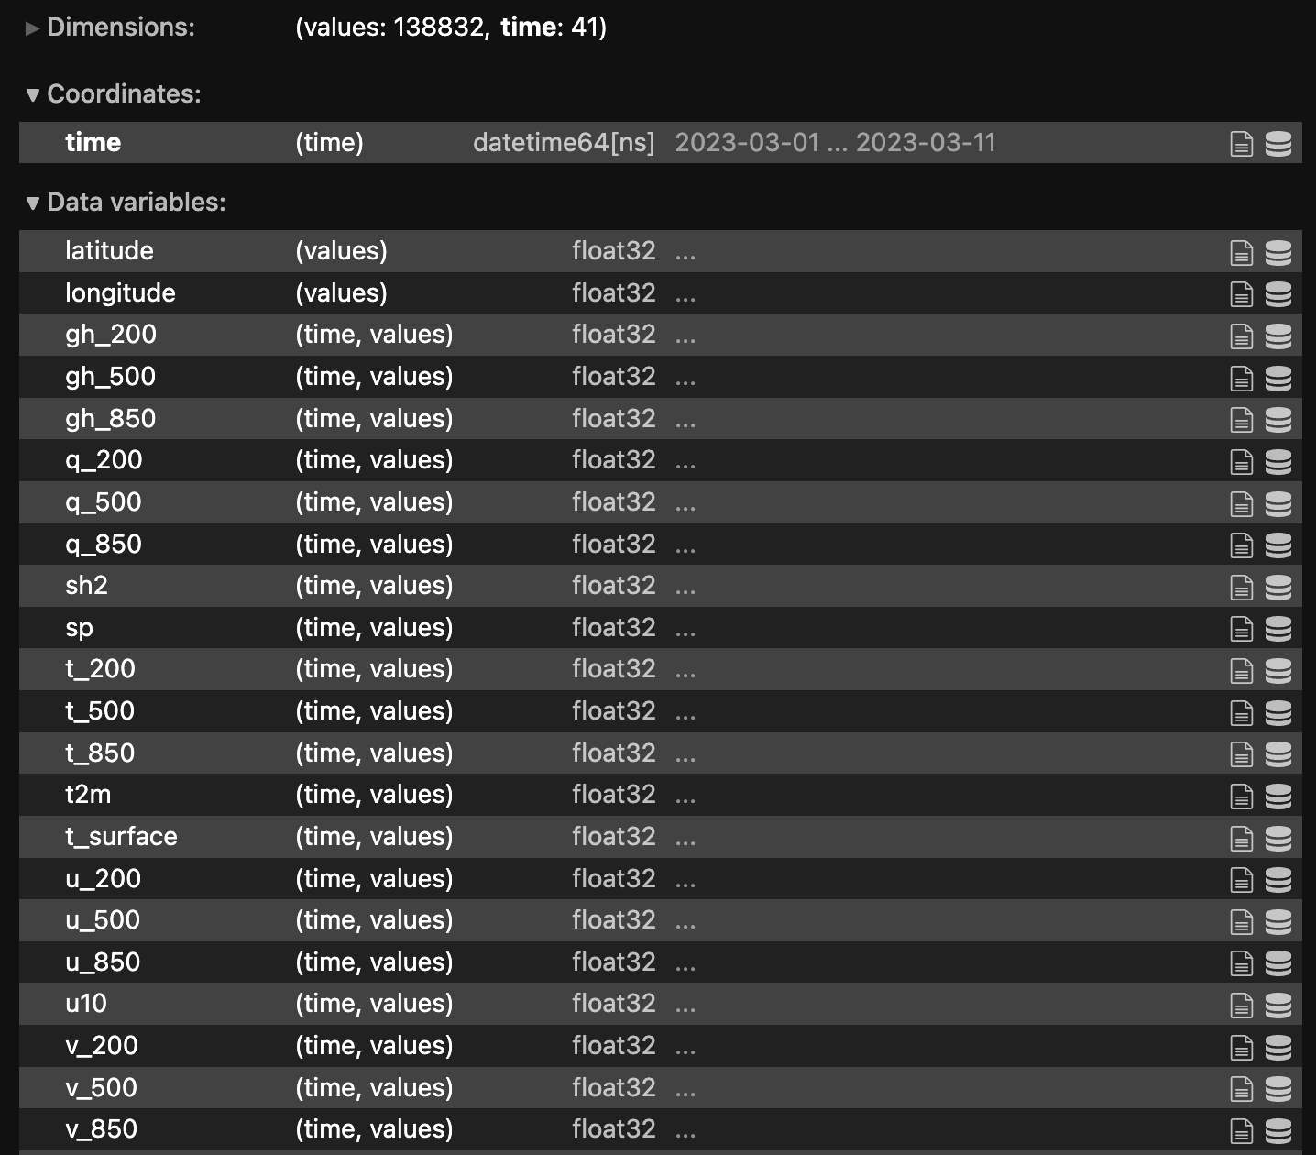
Example of post-processing with eagle-tools:
> eagle-tools prewxvx config.yaml

Slide 11
Step 5
Verification
wxvx
Python wrapper for MET/METPlus
Flexible to number of forecast cycles, forecast lengths, model output, and more!
Supports global and regional grid-to-grid and grid-to-obs forecast verification.
GFS
Your Model
> wxvx -c wxvx_config.yaml -t plots

Slide 12
Concluding Thoughts
From dealing with large datasets to sharding models across GPU’s, machine learning can be a cumbersome process with a steep learning curve.
Our hope is to make machine learning for weather prediction accessible to all by creating and/or deploying user-friendly tools as a coherent pipeline.
The Earth Prediction Innovation Center (EPIC) is planning an official
release of this pipeline this spring!

Slide 13
Most Importantly…
Acknowledgements
For more in depth information on their work, go see their talks at AMS!
Tim Smith, NOAA PSL
https://ufs2arco.readthedocs.io/ & https://github.com/NOAA-PSL/eagle-tools
European Centre for Medium-Range Weather Forecasts
https://github.com/ecmwf/anemoi-core & https://github.com/ecmwf/anemoi-inference
Paul Madden, NOAA GSL/CIRES
https://github.com/NOAA-GSL/wxvx
ufs2arco
eagle-tools
anemoi
wxvx

