Slide 1


Supporting ML Weather Prediction at NOAA: A Flexible Verification Pipeline with wxvx
An EPIC¹, PSL⁴, GSL⁵, and EMC⁶ collaboration
Collaborators: D. Alex Burrows^{1,2}, Anil Kumar^{1,3}, Mariah Pope^{1,3}, Tim Smith⁴, Sergey Frolov⁴, Paul Madden⁵, Isidora Jankov⁵, Jacob Carley⁶, Jun Wang⁶
²
³

Slide 2
Outline
Current State of Machine Learning (ML) Forecast Models
non-NOAA
NOAA
NOAA’s Nested-EAGLE
Pipeline
Verification
Notes:
04/01/2025

Slide 3
Current State of ML Forecast Models: non-NOAA
Model | Developer | Resolution | Architecture | Training Data
GraphCast | Google DeepMind | ~0.25° | Graph Neural Network | ECMWF ERA5
Pangu-Weather | Huawei | ~0.25° | 3D U-Net + Earth-specific | ECMWF ERA5
FourCastNet | NVIDIA/ Universities | ~0.25° | Fourier Neural Operator (FNO) | ECMWF ERA5
FengWu | CMA (China) | 0.125° | Transformer (Swin/ViT) | ECMWF ERA5
Aurora | Microsoft | variable | 3D Swin Transformer | ERA5, CMIP6, IFS, GFS, obs
EAGLE | NOAA | ??? | ??? | ???
What is the state of NOAA ML forecast models?

Slide 4
Current State of ML Forecast Models: NOAA
NOAA’s motivation for ML pipeline
To enable NOAA model development for science and operations in a single ML pipeline (i.e., dev-ops type environment)
Scientific development to include preprocessing, training, forecast, and verification
Operational configuration to include forecast and verification
To produce competitive forecasts
NOAA-EAGLE - Experimental AI Global and Limited-area Ensemble forecast system - https://epic.noaa.gov/ai/eagle-overview/
Current/Future for EAGLE…
Notes:
Global-EAGLE-Solo is a demonstration environment for “deterministic” models that are initialized from a single GFS initial condition. Global-Eagle-Solo is a complement to the existing NOAA GFS physics-based forecast. In the first version of the Global-Eagle-Solo, NOAA EMC re-trained the GraphCast model using Global Data Assimilation System (GDAS) data as inputs and training targets (Tabas et.al 2025).
Global-EAGLE-Ensemble is a demonstration environment for ensemble forecast systems initialized with the ensemble of GEFS initial conditions. Global-Eagle-Ensemble is a complement to the existing NOAA GEFS physics-based ensemble forecast system. The weights for the Global-Eagle-Ensemble members are generated by fine tuning the original GraphCast weights from DeepMind(c) with recent NOAA operational GDAS analyses. The resulting weights are effectively trained on the combination of the European Centre for Medium-Range Weather Forecasts (ECMWF) Reanalysis dataset, version5 (ERA5), European Centre for Medium-Range Weather Forecasts High RESolution (ECMWF HRES), and the NOAA’s Global Data Assimilation System (NOAA GDAS) analysis. Multiple checkpoints were saved to form 31 global ensemble members. The Global-Eagle-Ensemble is driven by the initial conditions of the operational GEFSv12

Slide 5
Current State of ML Forecast Models: NOAA
Global-EAGLE-solo based on Google DeepMind’s GraphCast model
Training: GDAS
Initial Conditions: GFS
Purpose: Complement to GFS physics-based forecasts
Went live 12/17/2025
Global-EAGLE-ensemble based on Google DeepMind’s GraphCast model
Training: ECMWF ERA5, HRES & GDAS
Initial Conditions: GEFS
Purpose: Complement to GEFS physics-based ensemble forecast
Went live 12/17/2025
For more details, see: https://epic.noaa.gov/ai/eagle-overview/
Notes:
Global-EAGLE-Solo is a demonstration environment for “deterministic” models that are initialized from a single GFS initial condition. Global-Eagle-Solo is a complement to the existing NOAA GFS physics-based forecast. In the first version of the Global-Eagle-Solo, NOAA EMC re-trained the GraphCast model using Global Data Assimilation System (GDAS) data as inputs and training targets (Tabas et.al 2025).
Global-EAGLE-Ensemble is a demonstration environment for ensemble forecast systems initialized with the ensemble of GEFS initial conditions. Global-Eagle-Ensemble is a complement to the existing NOAA GEFS physics-based ensemble forecast system. The weights for the Global-Eagle-Ensemble members are generated by fine tuning the original GraphCast weights from DeepMind(c) with recent NOAA operational GDAS analyses. The resulting weights are effectively trained on the combination of the European Centre for Medium-Range Weather Forecasts (ECMWF) Reanalysis dataset, version5 (ERA5), European Centre for Medium-Range Weather Forecasts High RESolution (ECMWF HRES), and the NOAA’s Global Data Assimilation System (NOAA GDAS) analysis. Multiple checkpoints were saved to form 31 global ensemble members. The Global-Eagle-Ensemble is driven by the initial conditions of the operational GEFSv12

Slide 6
Current State of ML Forecast Models: NOAA
Global-EAGLE-solo based on Google DeepMind’s GraphCast model
Training: GDAS
Initial Conditions: GFS
Purpose: Complement to GFS physics-based forecasts
Global-EAGLE-ensemble based on Google DeepMind’s GraphCast model
Training: ECMWF ERA5, HRES & GDAS
Initial Conditions: GEFS
Purpose: Complement to GEFS physics-based ensemble forecast
Next configuration: Nested-EAGLE (global and CONUS nested configuration) based on ECMWF’s Anemoi ML framework
Notes:
Global-EAGLE-Solo is a demonstration environment for “deterministic” models that are initialized from a single GFS initial condition. Global-Eagle-Solo is a complement to the existing NOAA GFS physics-based forecast. In the first version of the Global-Eagle-Solo, NOAA EMC re-trained the GraphCast model using Global Data Assimilation System (GDAS) data as inputs and training targets (Tabas et.al 2025).
Global-EAGLE-Ensemble is a demonstration environment for ensemble forecast systems initialized with the ensemble of GEFS initial conditions. Global-Eagle-Ensemble is a complement to the existing NOAA GEFS physics-based ensemble forecast system. The weights for the Global-Eagle-Ensemble members are generated by fine tuning the original GraphCast weights from DeepMind(c) with recent NOAA operational GDAS analyses. The resulting weights are effectively trained on the combination of the European Centre for Medium-Range Weather Forecasts (ECMWF) Reanalysis dataset, version5 (ERA5), European Centre for Medium-Range Weather Forecasts High RESolution (ECMWF HRES), and the NOAA’s Global Data Assimilation System (NOAA GDAS) analysis. Multiple checkpoints were saved to form 31 global ensemble members. The Global-Eagle-Ensemble is driven by the initial conditions of the operational GEFSv12

Slide 7
Outline
Current State of Machine Learning (ML) Forecast Models
non-NOAA
NOAA
NOAA’s Nested-EAGLE
Pipeline
Verification
Notes:
04/01/2025

Slide 8
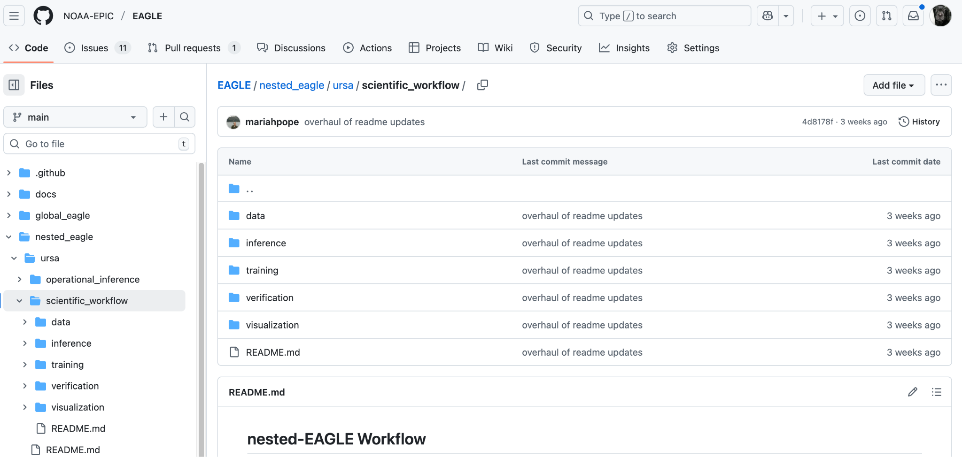
NOAA’s Nested-EAGLE: Pipeline
NOAA Workflow/ Configuration layer
NOAA Preprocessing
NOAA Datasets to Zarr
Repository to house the platform agnostic workflow configs and scientific configs; contains pointers to other pipeline components and scripts to run the entire pipeline. Starting point for nested-EAGLE pipeline
NOAA Verification and Display
ECMWF Anemoi Pipeline
(3)
NOAA-
EAGLE
NOAA-
UFS2ARCO
Training: 1° GFS; 15 km HRRR
(5)
Verification: wxvx/met2go
(1)
(2)
(4)
(6)
Inference
Display at epic.noaa.gov

Slide 9
NOAA’s Nested-EAGLE: Pipeline
NOAA Workflow/ Configuration layer
NOAA Preprocessing
NOAA Datasets to Zarr
“Python package designed to make NOAA forecast, reanalysis, and reforecast datasets” ready for Anemoi training
For nested-EAGLE, converts 1° global GFS and 15-km CONUS HRRR to Zarr format for training
NOAA Verification and Display
ECMWF Anemoi Pipeline
(3)
NOAA-
EAGLE
NOAA-
UFS2ARCO
Training: 1° GFS; 15 km HRRR
(5)
UFS2ARCO schematic for nested-EAGLE:
Verification: wxvx/met2go
(1)
(2)
1° global GFS
GFS.zarr
(4)
(6)
Inference
ufs2arco
Display at epic.noaa.gov
15 km CONUS HRRR
HRRR.zarr

Slide 10
NOAA’s Nested-EAGLE: Pipeline
NOAA Workflow/ Configuration layer
NOAA Preprocessing
NOAA Datasets to Zarr
NOAA Verification and Display
ECMWF Anemoi Pipeline
Training: Uses Zarr files created by UFS2ARCO for Anemoi training: Graph Neural Network, Graph Transformer, Deterministic, Ensemble ⇒ main scientific configurations for NOAA model development
Inference: Run the forecast
(3)
NOAA-
EAGLE
NOAA-
UFS2ARCO
Training: 1° GFS; 15 km HRRR
(5)
Verification: wxvx/met2go
(1)
(2)
(4)
(6)
Inference
Display at epic.noaa.gov

Slide 11
NOAA’s Nested-EAGLE: Pipeline
NOAA Workflow/ Configuration layer
NOAA Preprocessing
NOAA Datasets to Zarr
NOAA Verification and Display
ECMWF Anemoi Pipeline
(3)
NOAA-
EAGLE
NOAA-
UFS2ARCO
Training: 1° GFS; 15 km HRRR
(5)
Verification: wxvx/met2go
(1)
(2)
(4)
(6)
Inference
Display at epic.noaa.gov

Slide 12
NOAA’s Nested-EAGLE: Verification
WXVX…What is it? Why use it?
https://github.com/NOAA-GSL/wxvx “A workflow tool for weather-model verification, leveraging uwtools to drive Model Evaluation Tools (MET)” from DTC
Portable: wxvx is a python wrapper using Conda environments that provides pre-built MET and METplus components for Linux systems
No need for spack or spack-stack type installations
Generates mean error and root-mean squared error statistics for various atmospheric fields, e.g., temperature, winds, height, etc.
Current configuration: grid-to-grid and grid-to-observation statistics
Flexible to model output, e.g., variable naming, different vertical levels, different coordinate configurations, number of forecast cycles, forecast lengths and more

Slide 13
NOAA’s Nested-EAGLE: Verification
Download, install, and activate Miniforge for Miniconda
wget https://github.com/conda-forge/miniforge/releases/download/25.3.0-3/Miniforge3-Linux-x86_64.sh
bash Miniforge3-Linux-x86_64.sh -bfp conda
. conda/etc/profile.d/conda.sh
conda activate
conda create -y -n wxvx -c ufs-community -c paul.madden wxvx
conda activate wxvx
wxvx --version
Obtain package: git clone https://github.com/NOAA-GSL/wxvx.git
Note: The activated virtual environment includes the met2go package, which provides MET and select METplus executables and data files. In particular, grid_stat and point_stat executables
Notes:
Met2go: A conda recipe for MET and select METplus components.

Slide 14
NOAA’s Nested-EAGLE: Verification
wxvx --help
usage: wxvx [-c FILE] [-t TASK] [-d] [-h] [-k] [-l] [-n N] [-s] [-v]
Required arguments:
-c, --config FILE
Configuration file
-t, --task TASK
Task to execute
Optional arguments:
-d, --debug
Log all messages
-k, --check
Check config and exit
-l, --list
List available tasks and exit
-n, --threads N
Number of threads
-s, --show
Show the realized config and exit
wxvx $ wxvx -l
[2025-12-03T15:23:30] INFO Available tasks:
[2025-12-03T15:23:30] INFO grids
[2025-12-03T15:23:30] INFO grids_baseline
[2025-12-03T15:23:30] INFO grids_forecast
[2025-12-03T15:23:30] INFO ncobs
[2025-12-03T15:23:30] INFO obs
[2025-12-03T15:23:30] INFO plots
[2025-12-03T15:23:30] INFO stats
grids, grids_baseline, and grids_forecast prepare gridded forecast for grid_stat calculation
ncobs and obs prepare PrepBufr files for point_stat calculation
stats produces .stat files typical of MET/METPlus
plots generates RMSE and ME plots

Slide 15
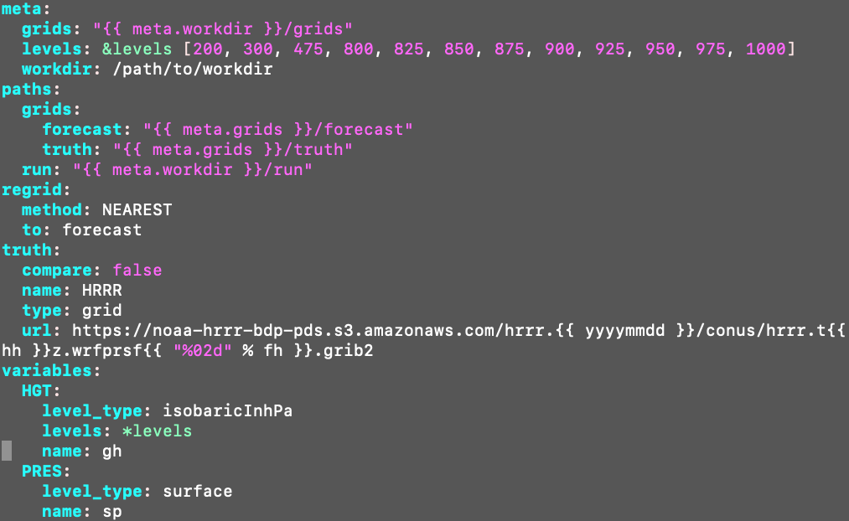
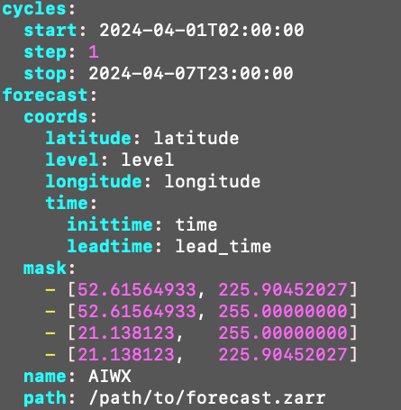
NOAA’s Nested-EAGLE: Verification
wxvx -c gridstat.yaml -t plots
Truth/baseline setup:
Grid-stat Config YAML:
Forecast setup:

Slide 16
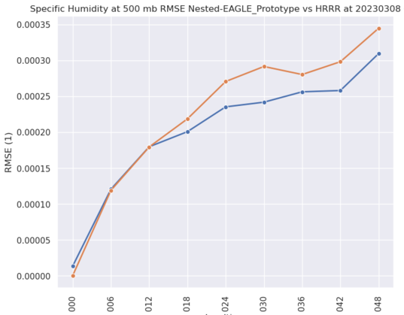
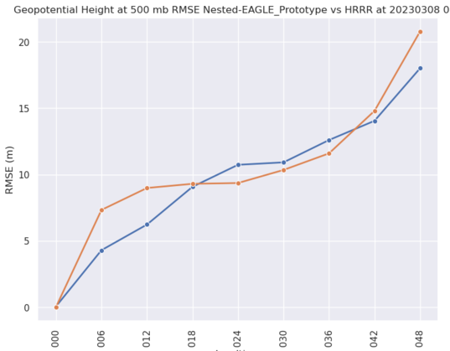
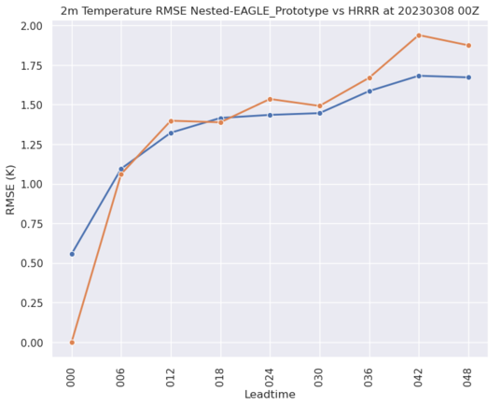
NOAA’s Nested-EAGLE: Verification
500 hPa Spec. Hum.
500 hPa Height
wxvx -c gridstat.yaml -t plots
Truth/baseline setup:
Grid-stat Config YAML:
RMSE (g/kg)
RMSE (m)
Forecast setup:
2 m Temp.
HRRR
nested-EAGLE Prototype
RMSE (K)
Leadtime

Slide 17
Conclusion
Verification with wxvx, current capabilities:
Grid-to-grid and grid-to-observation verification using MET’s grid-stat and point-stat tool
Baseline/truth for grid-stat: GFS and HRRR
Baseline/truth for point-stat: PrepBufr files
Diagnostics: Mean error and Root-mean squared error (RMSE)
wxvx highlights
Flexible to model outputs
Portable to multiple Linux architecture
Future development will re-evaluate the use of a stand-alone version of MET/METPlus that DTC is currently developing for agnostic verification across multiple platforms and systems

Slide 18




Acknowledgements

Slide 19
Backup slides beyond here

Slide 20
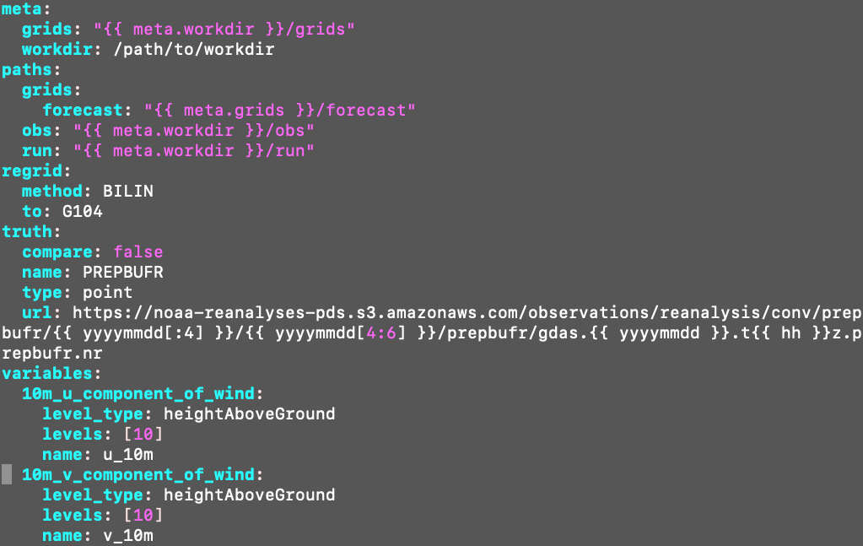
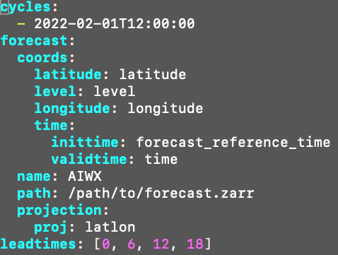
NOAA’s Nested-EAGLE: Verification
Point-stat Config YAML:
Truth/baseline setup:
Forecast setup:

Slide 21
NOAA’s Nested-EAGLE: Pipeline
Pipeline Component | What/Why?
NOAA- EAGLE | To house the platform agnostic workflow configs and scientific configs; contains pointers to other pipeline components and scripts to run the entire pipeline. Starting point for nested-EAGLE pipeline

Slide 22
NOAA’s Nested-EAGLE: Pipeline
Pipeline Component | What/Why?
NOAA- EAGLE | To house the platform agnostic workflow configs and scientific configs; contains pointers to other pipeline components and scripts to run the entire pipeline. Starting point for nested-EAGLE pipeline
UFS2ARCO | “Python package designed to make NOAA forecast, reanalysis, and reforecast datasets more accessible for scientific analysis and machine learning model development” For nested-EAGLE, converts 1° global GFS and 15-km CONUS HRRR to Zarr format for training
UFS2ARCO schematic for nested-EAGLE:
1° global GFS
GFS.zarr
ufs2arco
15 km CONUS HRRR
HRRR.zarr

Slide 23
NOAA’s Nested-EAGLE: Pipeline
Pipeline Component | What/Why?
NOAA- EAGLE | To house the platform agnostic workflow configs and scientific configs; contains pointers to other pipeline components and scripts to run the entire pipeline. Starting point for nested-EAGLE pipeline
UFS2ARCO | “Python package designed to make NOAA forecast, reanalysis, and reforecast datasets more accessible for scientific analysis and machine learning model development” For nested-EAGLE, converts 1° global GFS and 15-km CONUS HRRR to Zarr format for training
Anemoi Training | Uses Zarr files created by UFS2ARCO for Anemoi training: Graph Neural Network, Graph Transformer, Deterministic, Ensemble ⇒ host of the main scientific configurations for NOAA collaboration
Anemoi Inference | Run the forecast

Slide 24
NOAA’s Nested-EAGLE: Pipeline
Pipeline Component | What/Why?
NOAA- EAGLE | To house the platform agnostic workflow configs and scientific configs; contains pointers to other pipeline components and scripts to run the entire pipeline. Starting point for nested-EAGLE pipeline
UFS2ARCO | “Python package designed to make NOAA forecast, reanalysis, and reforecast datasets more accessible for scientific analysis and machine learning model development” For nested-EAGLE, converts 1° global GFS and 15-km CONUS HRRR to Zarr format for training
Anemoi Training | Uses Zarr files created by UFS2ARCO for Anemoi training: Graph Neural Network, Graph Transformer, Deterministic, Ensemble ⇒ host of the main scientific configurations for NOAA collaboration
Anemoi Inference | Run the forecast
WXVX - Verification | “A workflow tool for weather-model verification, leveraging uwtools to drive MET”

