Slide 1
Project EAGLE: An AI‑Driven Weather Modeling Pipeline
Video Tutorial
Josh Kublnick
March 2, 2026
Notes:
Welcome to this Project EAGLE training, an AI-driven weather modeling pipeline video tutorial.
My name is Josh Kublnick, and I am the Scrum Master for the EPIC User Support team.
In this tutorial, I will walk you through how to run each step of the EAGLE pipeline yourself, from preparing training data to training a model, generating a forecast, and verifying the results.

Slide 2
What is Project EAGLE?
Project EAGLE (Experimental AI Global and Limited-area Ensemble) is a joint effort between NOAA Research Laboratories, the Earth Prediction Innovation Center (EPIC), and the National Weather Service (NWS).
Project EAGLE provides NOAA and the broader weather enterprise with a platform to rapidly test, develop, and demonstrate in the near real-time Artificial Intelligence (AI) models for global and limited area ensemble forecasting.
Once fully developed, EAGLE-AI pipeline will allow researchers to evaluate these AI models against the forecast metrics used in NOAA’s flagship systems.

Slide 3
Project EAGLE Components
Global-EAGLE-Solo is a demonstration environment for “deterministic” models initialized from a single Global Forecast System (GFS) Initial Conditions (ICs). It serves as a complement to NOAA’s GFS forecast system.
Global-EAGLE-Ensemble is a demonstration environment for ensemble forecast systems initialized with the ensemble of Global Ensemble Forecast System (GEFS) ICs. It complements NOAA’s GEFS forecast system.

Slide 4
Project EAGLE Resources
Resources | Link
EAGLE Repository | https://github.com/NOAA-EPIC/EAGLE
EAGLE User’s Guide | https://epic-eagle.readthedocs.io/en/latest/
EAGLE Portal | https://epic.noaa.gov/ai/eagle-overview/
EAGLE-AI Tutorial Repository | https://github.com/NOAA-EPIC/AMS-2026-short-course
Notes:
Here are several resources that may be helpful as you explore the Project EAGLE workflow further.
The Project EAGLE GitHub repository contains the core code and supporting materials for the EAGLE framework.
You can also find detailed documentation on the EAGLE ReadTheDocs site, which provides installation instructions, configuration examples, and workflow guidance.
The EPIC website includes an overview page describing the goals and capabilities of Project EAGLE.
For utilities used in this workflow, the eagle-tools repository contains the supporting tools used for postprocessing and workflow tasks.
Finally, the AMS 2026 short course repository contains the notebook and materials used in this tutorial.

Slide 5
EAGLE-AI Tools
ufs2arco (NOAA PSL) - Converts various output into Analysis‑Ready, Cloud‑Optimized (ARCO) training datasets for Project EAGLE’s AI models. anemoi (ECMWF) - A framework used in EAGLE for training AI Weather Models (WMs), providing tools for model configuration, workflow management, and scalable training in Project EAGLE.
wxvx (NOAA GSL/CIRES) - Tool for post‑processing, visualizing, and evaluating forecasts using standardized metrics, plots, and verification workflows.
eagle-tools (NOAA PSL) - Tools for processing and evaluating anemoi based EAGLE ML models.

Slide 6
Tutorial Goals
In this tutorial you will walk through the full Project EAGLE AI workflow and learn how to:
• Prepare training datasets using ufs2arco
EAGLE depends on GFS, GEFS, and HRRR Archives, and Unified Forecast System (UFS) Replay (1994–2024) for historical and real‑time data
• Train a Machine Learning (ML) WM using anemoi-core • Generate forecasts from the trained model using anemoi-inference • Postprocess using eagle-tools and verify using wxvx
You will run each step of the EAGLE pipeline yourself.
Notes:
Today we will walk through the full Project EAGLE AI workflow from start to finish.
You will learn how to prepare training datasets using ufs2arco, train a machine learning weather model using the Anemoi framework, generate a forecast from the trained model, and finally postprocess and verify that forecast using the wxvx verification workflow.
Throughout this tutorial, you will be able to run each step of the pipeline yourself.

Slide 7
Tutorial Workflow
1. Set up your environment
2. Prepare training data
3. Train the AI model
4. Generate a forecast
5. Post‑process the output
6. Verify and evaluate the model

Slide 8
Experiment Requirements
What do I need?
All you need is access to the EAGLE-AI Google Colab notebook linked below! NOAA Replay Reanalysis data for January 1-7, 2022 is provided, and the notebook will produce a 48-hour forecast initialized from 2022-01-05 00Z.
https://colab.research.google.com/github/NOAA-EPIC/AMS-2026-short-course/blob/main/eagle_pipeline_demo.ipynb

Slide 9
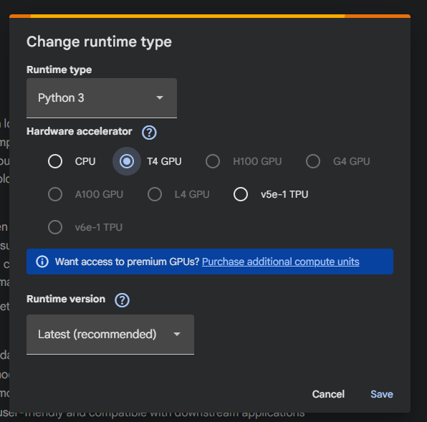
Environment Setup
Runtime Configuration
Select Python 3
Enable GPU (T4 recommended)
Install & Initialize
Install required packages (Anemoi Modules, ufs2arco, and eagle-tools)
Restart session (ignore NumPy warnings)
Clone tutorial repository
Estimated Runtime: ~4 minutes
Notes:
Now we’ll begin with environment setup.
Since we’re using Google Colab for this tutorial, the first step is to configure the runtime environment.
Make sure the runtime is set to Python 3. If a GPU is available, I recommend selecting a T4 accelerator. If a GPU is not available, the notebook can still run on CPU, though training will take longer.
Next, we’ll install the required dependencies, including the Anemoi modules, ufs2arco for data preparation, and eagle-tools for postprocessing.
After the installation completes, you’ll restart the session before continuing.
You may see some NumPy-related warnings or compatibility messages during installation. That is expected behavior for this environment and can safely be ignored.
Now we can clone into the repository, after executing this cell you should see the short-course repository along with sample_data to the left of your screen.
This setup step typically takes about four minutes.

Slide 10
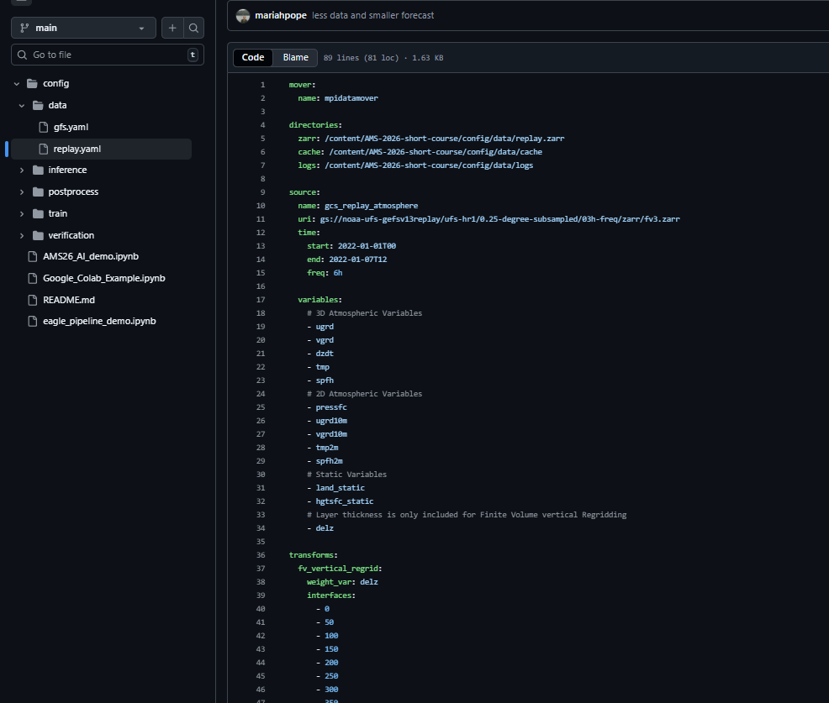
Training Data Preparation
Dataset
NOAA Replay
6-hour data
First week of January 2022
Processing
Core atmospheric and surface variables
Vertical regridding to pressure levels
Output
ML-ready Zarr dataset
Estimated runtime: ~3 minutes
Notes:
Now that the environment is configured and all dependencies are installed, we can move into the data preparation stage.
To understand how this step works, we will begin by examining the replay.yaml configuration file, which defines how the training and validation datasets will be generated using ufs2arco.
At the top of the configuration file, you will notice the mover section, which specifies the mpidatamover. MPI is included because this workflow supports parallel data movement. However, in this demonstration we are generating a relatively small dataset, so MPI parallelization will not be used. For larger production jobs, MPI can significantly accelerate data loading and preprocessing.
Next is the directories section. This defines where the generated outputs will be stored within the Colab environment. The Zarr dataset will be written to the configured Zarr directory, while intermediate cache files and log files will be written to their respective cache and logs directories.
The source section defines where the input data is coming from. In this example, we are pulling data from the NOAA UFS Replay dataset stored in a Google Cloud Storage bucket.
For this demonstration, we are pulling in one week of data, specifically the first week of January 2022, at six hour intervals. This provides a manageable but realistic dataset for training and validation.
Within the source configuration, we also define the variables that will be extracted from the dataset. These include three dimensional atmospheric variables such as wind components, temperature, humidity, and vertical motion. We also include two dimensional surface fields such as surface pressure, ten meter winds, and two meter temperature. Static fields such as land mask and surface height are included to provide geographic context.
The next section defines transforms applied to the data. The Replay dataset is stored on model levels, so we apply a finite volume vertical regridding transformation. This interpolates the data onto standard pressure levels ranging from 0 to 1000 hectopascals. Converting to pressure levels provides a consistent vertical coordinate that is well suited for machine learning applications.
After the transforms, the target section defines how the processed data will be structured for training. In this workflow, the target format is Anemoi. The configuration also specifies how variables should be sorted and how the dataset should be chunked for efficient storage and loading.
You will notice that although the dataset spans January 1 through January 7, the statistics period stops on January 4. The reason for this is to prevent data leakage during training. When computing normalization statistics such as means and standard deviations, we only want to use the training portion of the dataset. By stopping the statistics period on January 4, we ensure that validation data does not influence the training process.
The configuration also includes a set of forcings, which are additional derived inputs such as trigonometric encodings of latitude, longitude, time of day, and seasonal cycles. These help the machine learning model better understand spatial and temporal relationships in the data.
Finally, the configuration includes metadata attributes that describe the dataset source.
Once this step completes, we will have an Anemoi ready dataset stored in Zarr format and prepared for model training.

Slide 11
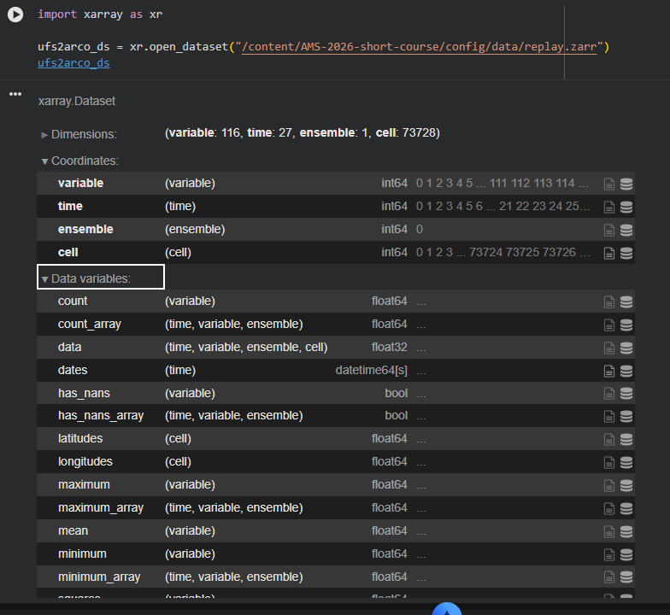
Viewing Dataset
Output Files
replay.zarr — Processed ML-ready dataset
logs/ — Data processing logs and diagnostics
Optional
Run cell 4 to visualize the dataset structure
Notes:
Now that the data preparation step has completed, we can confirm that everything was generated correctly.
On the left side of the screen, you can see that the replay.zarr directory has been created. This is the processed dataset that was just generated and converted into an Anemoi-ready Zarr format.
You’ll also notice the logs directory. This contains detailed information about the data processing step, including status messages and diagnostic output. If you ever need to troubleshoot or better understand what was written during dataset creation, the logs provide that full record.
If you would like to take a closer look at the dataset, feel free to run the cell below to visualize the data and explore what the dataset structure looks like.
At this point, the dataset has been successfully created, and we are ready to move on to model training.

Slide 12
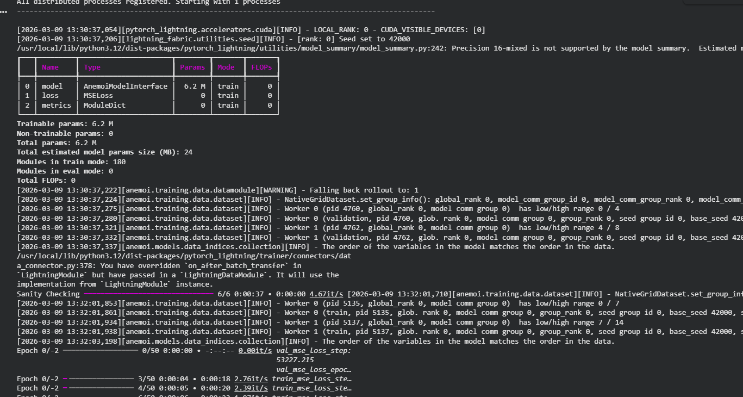
Model Training
Cell 4
Configure environment variables
Cell 5
Navigate to training directory
Cell 6
Launch training process
Configuration file is loaded
Logs displayed in real time
Estimated Runtime: ~4 minutes
Notes:
Now we move into model training.
The first cell sets a few environment variables that ensure the training process runs correctly in this Colab environment.
The second cell changes into the appropriate training directory so the configuration files can be referenced properly.
When we run the third cell, the training process begins. This command reads the main config.yaml file and starts the training workflow.
As training initializes, you will see a number of logging statements printed to the screen. These logs confirm that the configuration has been validated and that training is starting from scratch, which is indicated by ‘starting from checkpoint: false.’
This is important because it means we can also resume training from an existing checkpoint. For example, if a model is partially trained and performance looks promising, you can restart training from a saved checkpoint and continue improving it instead of starting over.
During initialization, the model begins normalizing the data, constructing the graph structure, reporting the number of parameters, and initializing data loaders. You can watch all of this happen in real time through the logs.
While training is initializing, we can also take a look at the main config.yaml file that is driving this run.
At the top, you’ll see that we are loading the dataset directly from the Zarr file created in the previous step.
Next is the model configuration. In this example, we are using a graph transformer architecture with a global deterministic setup.
You will also see the forcings that are included. These provide spatial and temporal context such as latitude, longitude, local time, and insolation.
Further down, the configuration specifies normalization behavior. We define which variables should be normalized to ensure stable training.
In the dataloader section, we configure how batches are loaded into the model. For this example, we are using two workers and specifying the training and validation date ranges. For the purpose of this tutorial, we are ignoring the test dataset.
Finally, diagnostic plots and checkpoints are automatically saved during training, allowing us to monitor progress and evaluate performance.
At this point, training is underway and we can monitor progress directly from the logs

Slide 13
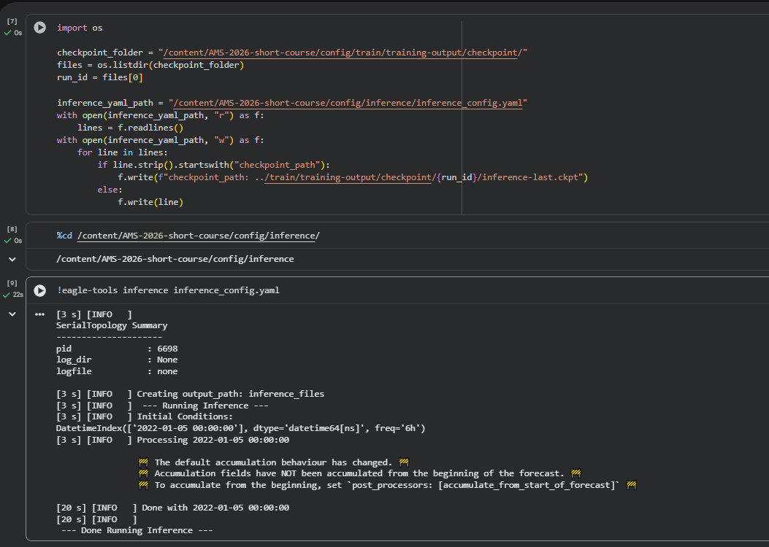
Forecast Generation
Cell 7
Update inference configuration
Link to trained model checkpoint
Cell 8
Navigate to inference directory
Cell 9
Run inference to generate forecast
Use checkpoint from trained model
Runtime: ~20 seconds (longer on CPU)
Notes:
Now that the model has finished training, we can move on to generating a forecast using the trained checkpoint.
The first cell updates the inference configuration so that it points to the checkpoint that was just produced during training. Each training run creates a unique run ID, and this step ensures that inference uses the correct checkpoint from that run.
The next cell simply moves us into the inference directory where the configuration file for inference is located.
Finally, the third cell runs the inference process. This uses the trained model checkpoint to generate a forecast.
For this example, we are generating a 48 hour forecast beginning on January 5th, 2022. Compared to training, inference runs very quickly and typically completes in about twenty seconds when using a GPU, though it may take a bit longer on a CPU

Slide 14
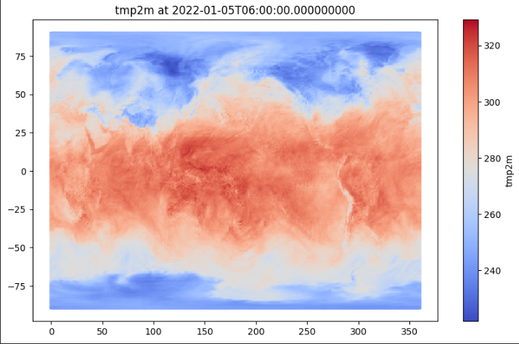
Viewing Inference
Cell 10
Open generated forecast dataset
Cell 11
Select forecast variable and hour
Cell 11
Visualize forecast data
Runtime: ~15 seconds
Notes:
Now that the forecast has been generated, we can take a look at the model output.
In the first cell, we open the forecast dataset that was produced during the inference step. This allows us to inspect the data structure and see the available variables.
Next, we can choose a variable and forecast hour to visualize. In this example, we are plotting two meter temperature, but you can easily change the variable or forecast hour if you would like to explore other outputs.
Finally, the last cell generates a simple visualization of the selected field. This provides a quick way to inspect the forecast and confirm that the model produced reasonable results.
This step runs very quickly and typically takes about ten to fifteen seconds

Slide 15
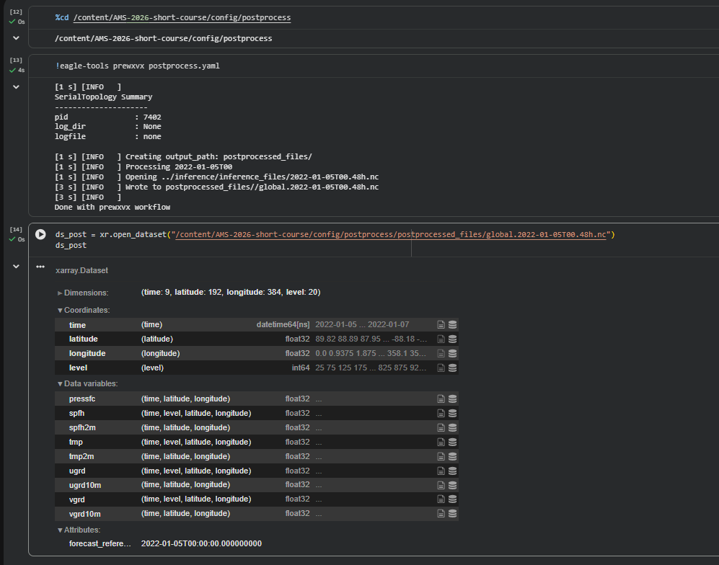
Post Processing
Cell 12
Navigate to postprocessing directory
Cell 13
Run eagle-tools post processing
Cell 14
Open processed forecast dataset
Runtime: ~10 seconds
Notes:
Next we perform a short postprocessing step using eagle-tools.
The first cell moves us into the postprocessing directory where the configuration for this step is located.
The second cell runs the eagle-tools postprocessing command. This step prepares the forecast output so that it can be used by the verification framework. It adjusts the structure of the dataset and adds the required attributes needed for verification.
Once postprocessing is complete, the final cell opens the processed dataset so we can confirm that the output file was created successfully.
This step runs very quickly and typically takes about ten seconds.
At this point we now have a processed forecast dataset that is ready for verification

Slide 16
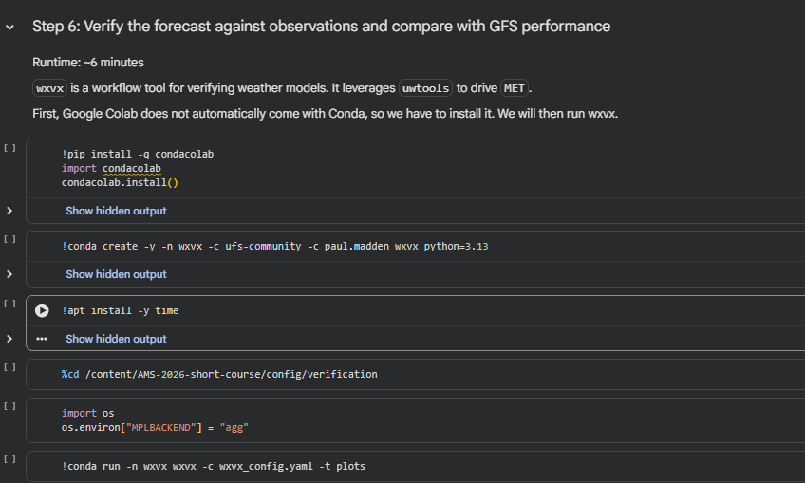
Model Verification
Cell 15
Install Conda in the Colab environment
Cell 16
Create verification environment with wxvx
Cell 17
Navigate to verification directory
Configure plotting backend
Cell 18
Run wxvx verification workflow
Generate verification plots and statistics
Model performance compared with observations and GFS
Runtime: ~6 minutes
Runtime: ~6 minutes
Notes:
Finally, we evaluate the forecast using the wxvx verification workflow.
The wxvx framework is a workflow tool designed for verifying weather model output. It leverages uwtools, which orchestrates the verification process and drives the MET verification toolkit to compute statistics and generate plots.
Since Google Colab does not include Conda by default, the first step installs Conda so we can create the environment needed to run the verification tools.
Next, we create a Conda environment that includes wxvx and its dependencies.
After the environment is ready, we move into the verification directory and configure the plotting backend.
The final cell runs the wxvx verification workflow. This step compares our model forecast against observations and computes verification statistics.
Once the workflow completes, plots are generated showing performance metrics such as RMSE and mean error for variables like two meter temperature. The same statistics are also calculated for the GFS so we can compare our model’s performance against an operational baseline

Slide 17
Next Steps and Exploration
Congratulations!
You have completed the full ufs2arco + anemoi + wxvx pipeline
Feel free to experiment with different configurations and explore how the modules work.
Additional tests with ufs2arco
• Try loading Global Forecast System (GFS) data using gfs.yaml instead of replay.yaml
Additional tests with anemoi-core
• Try using a Graph Neural Network (GNN) model instead of the graph transformer • Update config.yaml to switch model types
(Note: The transformer option requires the flash-attn library, which cannot run on a T4 GPU.)
Notes:
Congratulations. You have now completed the full ufs2arco, anemoi, and wxvx pipeline.
From here, feel free to experiment with different configurations to learn more about how these modules work.
For example, you can try loading Global Forecast System, or GFS, data instead of replay data by replacing the replay configuration with the provided gfs.yaml.
You can also experiment with different model architectures. One option is switching from the graph transformer to a Graph Neural Network, or GNN, by updating the model configuration file.

Slide 18
Acknowledgements
The tools and workflows used in this tutorial were developed by the following contributors and organizations.
ufs2arco and eagle-tools Tim Smith NOAA Physical Sciences Laboratory
Anemoi framework European Centre for Medium Range Weather Forecasts (ECMWF)
wxvx Verification Workflow Paul Madden NOAA Global Systems Laboratory / CIRES
Tutorial Notebook Author Mariah Pope EPIC / Tomorrow.io
Notes:
Before we conclude, we would like to acknowledge the developers and contributors behind the tools used in this tutorial.
The ufs2arco and eagle-tools workflows were developed by Tim Smith at NOAA’s Physical Sciences Laboratory.
The Anemoi framework was developed by the European Centre for Medium-Range Weather Forecasts.
The wxvx verification workflow was developed by Paul Madden at NOAA’s Global Systems Laboratory and CIRES.
And finally, the tutorial notebook used in this demonstration was authored by Mariah Pope from NOAA EPIC.
Thank you for following along with this tutorial.
If you have any questions or feedback, please feel free to email the EPIC team at support.epic@noaa.gov

Slide 19
Questions or Feedback?
Email us at support.epic@noaa.gov
Notes:
Thank you for following along with this tutorial on the Project EAGLE AI pipeline.
We hope this walkthrough helped demonstrate how the workflow moves from data preparation with ufs2arco, to model training with anemoi, and finally verification using wxvx.
If you have any questions or feedback, please feel free to email the EPIC team at support.epic@noaa.gov.
Thank you for your time, and we look forward to seeing how you use these tools in your own workflows.

